Slide 1
Alternative method for Mapping processes in the Ganges river delta
Tess Jarriel
Notes:
1st year grad student in the environmental and water resources engineering program

Slide 2
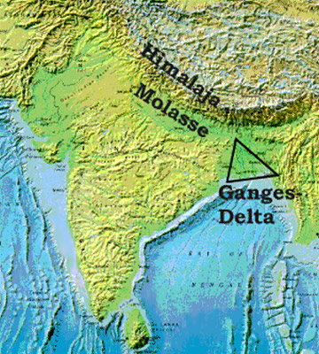
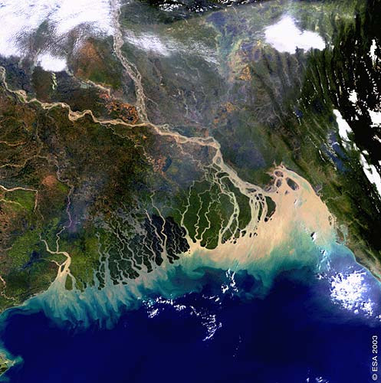
BackgrounD
Study Area: Ganges-Brahmaputra-Jamuna River Delta
Home to 170 million people
100,000 km² area
Preservation importance: livelihoods of inhabitants, ecologic diversity, navigation, productivity
Important to understand morphology characteristics (of channels and islands) to determine how delta will respond to changing forcings and inform policy decisions
Tides
Sea level rise
Decreased sediment inflow from human interference
Tropical cyclone effects
Notes:
Deltas are threatened because they’re low lying and subject to effects of sea level rise, but also because of anthropogenic interference of natural sediment resupply patterns inland (development, embankments, dams)
And how they are distributed through the channel

Slide 3
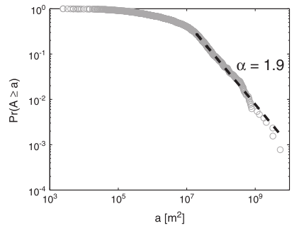
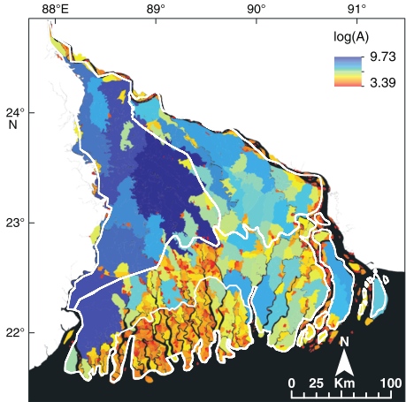
Geomorphic signatures of deltaic processes and vegetation
Main Idea: You can identify key metrics of the delta, analyze their statistical behavior, and explore if breaks can potentially be linked to the processes acting on the delta
ex. Island area
Notes:
My whole project is based around an existing paper titled: the ganges Brahmaputra jamuna case study
Basically looking to highlight scaling breaks in probability distribution function that correspond to breaks in scales of delta processes, vegetation type, and anthropogenic modifications known locations
For instance: a simple example is island area, if you have a shapefile of land with area as parameter, you can create this probability distribution function, can determine break point of data using power law relationship. I’m not going to get into detail of this but if you create a probability frequency distribution, when log=log plot of value vs probability is linear, it displays power law behavior. values below Xmin are statistically separate. Can then go into arcgis and select values with that value above or below Xmin and see where in the delta they are, and what regions they correspond to.
In this case, the smallest islands were mostly in the mangrove forest Sundarbans region, whereas the larger islands were in the inactive region of the delta.

Slide 4
Project objective
Recreate and improve upon analyses in this paper by using:
More recent satellite data
Rivamap channel extraction tool

Slide 5
STEPS:
Obtain data images
Delineate channels from land in Rivamap
Choose metric of land or channel to analyze
Characterize statistically using Power law distribution
Identify break
Visualize in GIS where in delta features in/out of break zone occur
Assess potential linkages between characteristic and morphology
Notes:
I’ll mention here this is a work in progress sort of presentation because this whole project is part of a larger long term research project for my advisor Dr. Passalacqua who wrote the original paper being recreated in this study. would take a very long time to entirely recreate. Took Paola over a year.
(island area, shape factor, nearest-edge distance, etc.)

Slide 6
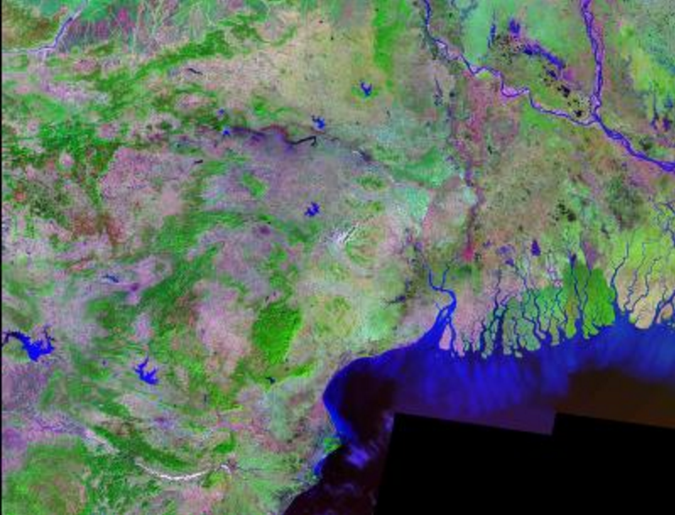
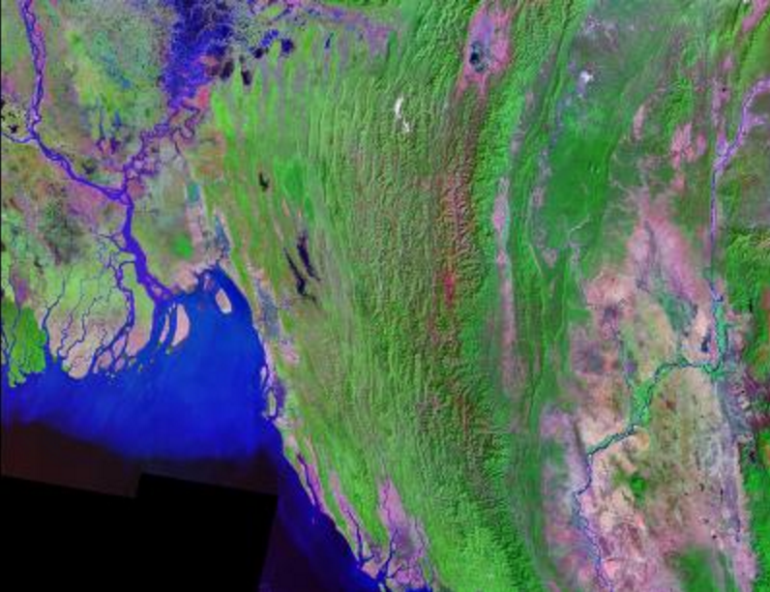
Data Acquisition
Previous study data: “Orthorectified Landsat Thematic Mapper Mosaic”
Source: landcover.org
1987-1993
Band 7, band 4, band 2
N-45-20
N-46-20
Notes:
The two mosaicked tiles are shown here with the study area outlined in red

Slide 7
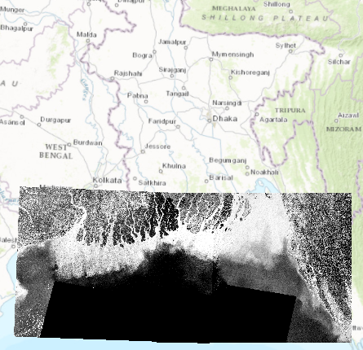
Data Acquisition
Option 1: Enhanced Thematic Mapper (ETM+):
source: USGS Earth Explorer
1999-2001
Same source as original study
Notes:
First thought was to use same source but more recent images from 10 years later
Same two tiles didn’t cover entire area this time
14.25 meter resolution as opposed to 28.5 in 1990 data

Slide 8
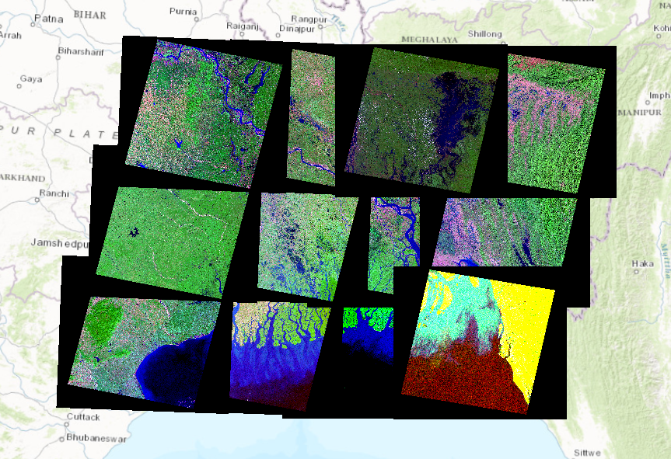
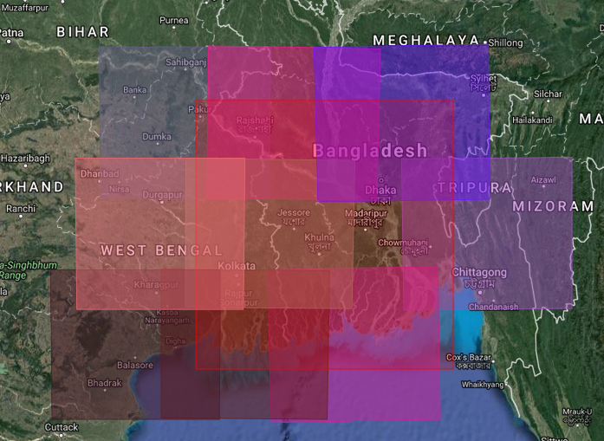
Data acquisition
Option 2: Create own mosaic
source: USGS Earth Explorer
same Landsat as original study
Difficult to accomplish
Notes:
- Different stretch values, symbologies, black borders

Slide 9
Data Acquisition
Sensor | Relevant Band #’s | Wavelength (µm)
Landsat 5 (TM) | 2 | 0.52 – 0.60
 | 4 | 0.76 – 0.90
 | 5 | 1.55 – 1.75
 | 7 | 2.08 – 2.35
Landsat 8 | 3 (green) | 0.53 – 0.59
 | 5 (NIR) | 0.85 – 0.88
 | 6 (SWIR 1) | 1.57 – 1.65
 | 7 (SWIR 2) | 2.11 – 2.29
 | 10 (TIRS 1) | 10.60 – 11.19
 | 11 (TIRS 2) | 11.50 – 12.51
Option 3:Google Earth Engine Code Editor
different Landsat bands than original
Feb 2013
can match bandwidths
Required Bands | Wavelengths (µm)
Green | 0.53 - 0.59
Infrared | 1.57 - 1.65
Notes:
Gives you access to many many data sources, so I decided to choose the most recent landsat data
Worked out well because the bands here in red matched perfectly with the band wavelength requirement for the channel extraction tool
Near infrared, short wave infrared, thermal infrared scanner

Slide 10
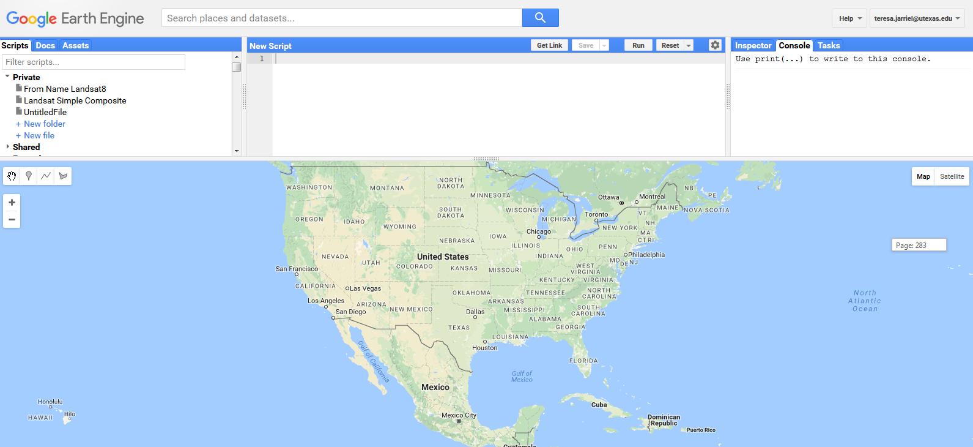
Data acquisition
Google Earth Engine Empty Platform:

Slide 11
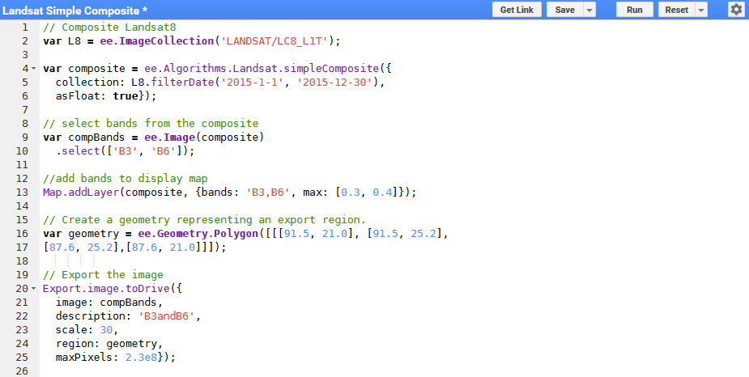
Data Acquisition
Google Earth Engine Code:
Notes:
Wrote some of it myself and modified other parts from scripts I found online to suit my needs
Loads image collection
Collects images from dates you filter
Allows you to select bands you want and composite them into one file
Adds layer to visualize to map
Defines study area you want to extract
Exports to your google drive account

Slide 12
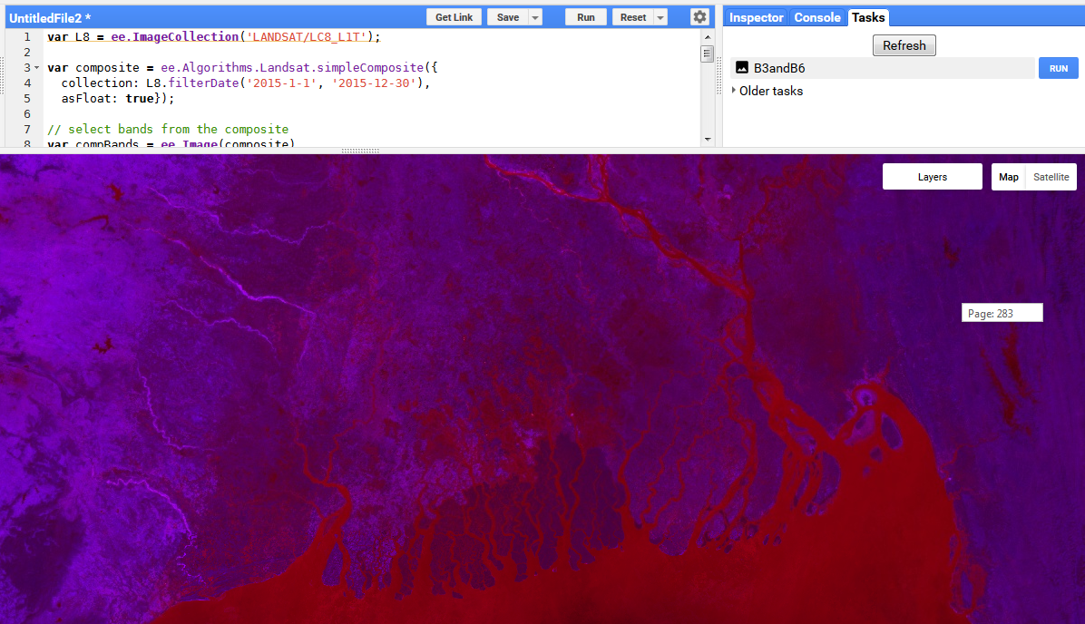
Data acquisition
Google Earth Engine Output:

Slide 13
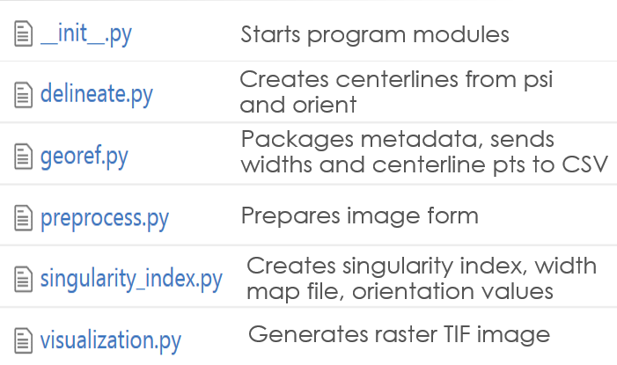
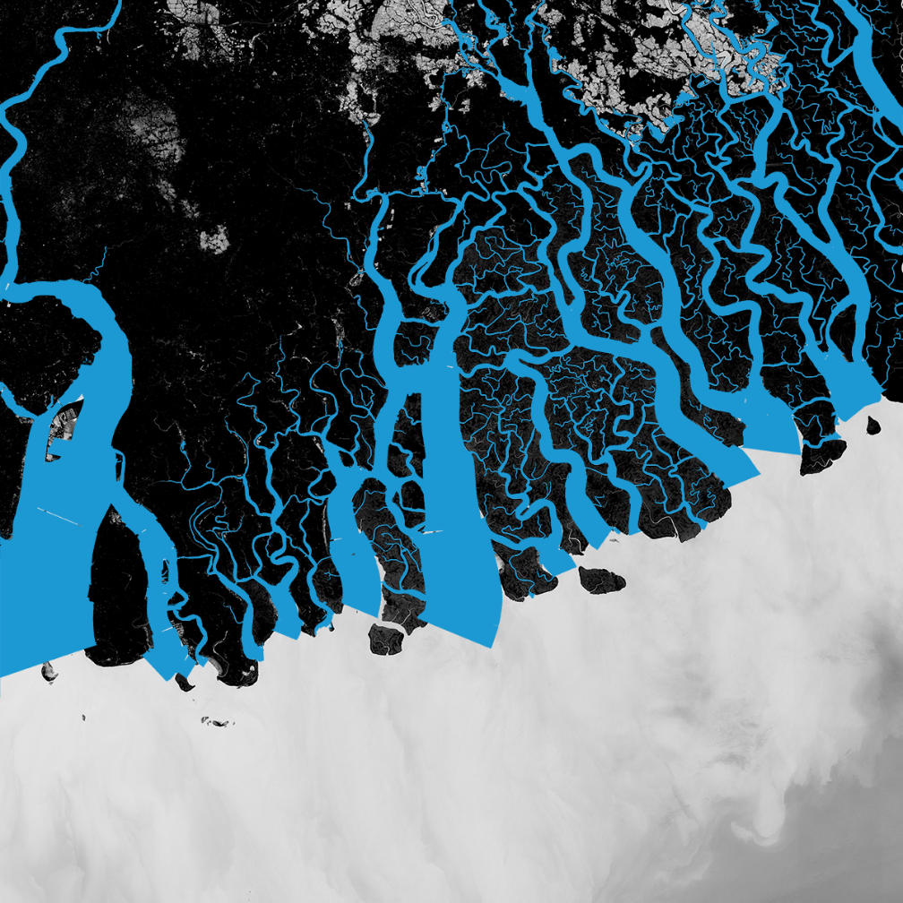
Rivamap python code
Based on multiscale singularity analysis
Value responds strongly to curvilinear structures
Value responds weakly to edges
Input: raster TIFF images (green band, middle infrared band)
Output: TIFF image of channels, CSV file of channel centerline points (longitude and latitude) and associated widths
Notes:
- To get this image had to do a lot of manipulating: basically was written in 2.7 version of python, all the site packages, modules, etc on my computer were python 3.5, had to install new python interpreter and reassign all of the module paths so they could be imported in 2.7

Slide 14
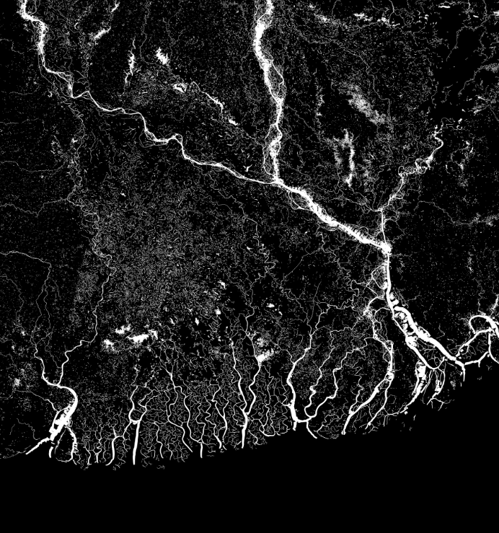
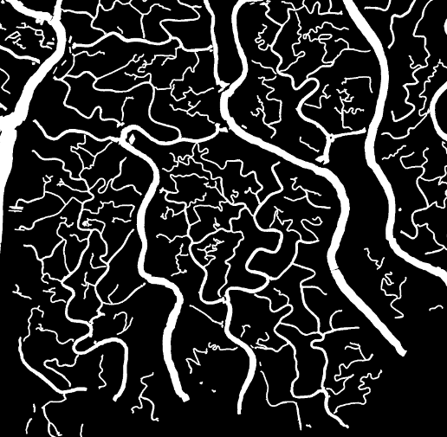
Rivamap python Code
Notes:
Output file from rivamap
Right is zoomed in section. There are errors and things not fully linked but overall is relatively accurate depiction of channels

Slide 15
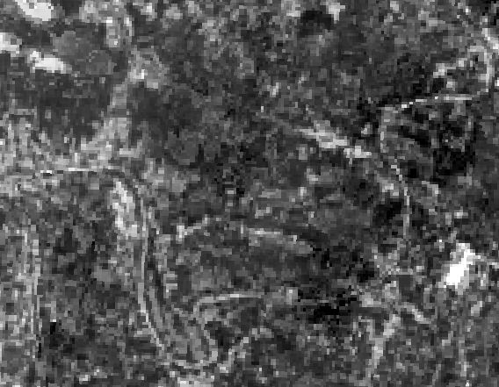
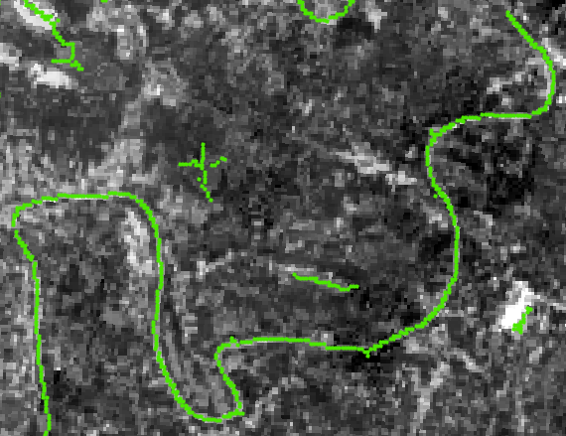
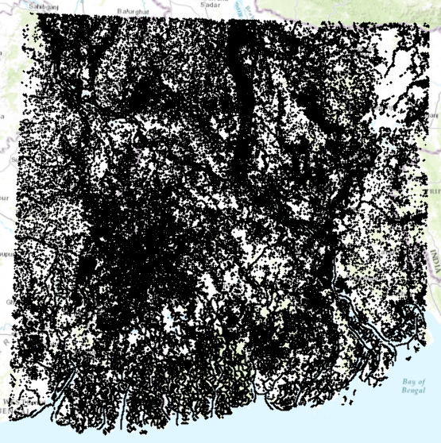
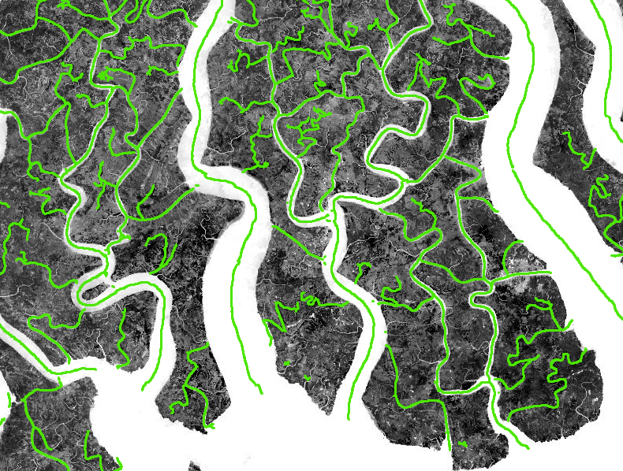
ARCGIS: Points to Shapefile
Notes:
Next step was to load the data into GIS for visualization
Added the CSV width table to map, add x y data, created a layer of points with long and lat and width associated with each as an attribute
I was impressed zooming in at accuracy of more murkey areas

Slide 16
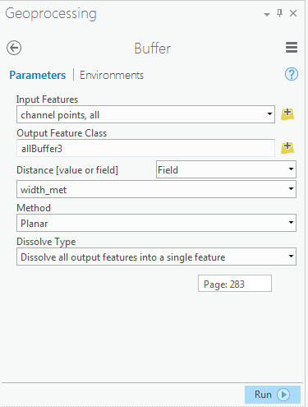
ARCGIS: Points to Shapefile
Ideally would import in raster image and convert to polygon shapefile
Mismatch of raster coordinate system
Came from python code and couldn’t be fixed without altering code
FIX: add buffer around each corresponding to width
Width in pixels → new field, calculate field, width_met = width*30

Slide 17
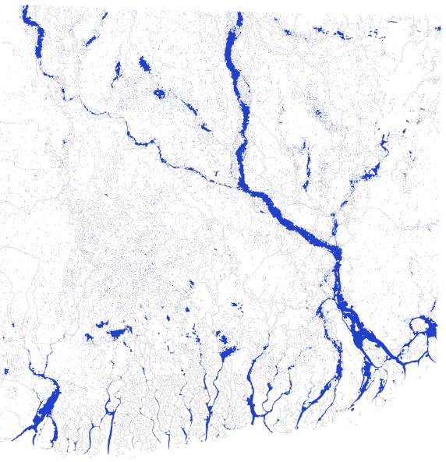
ARCGIS: Points to Shapefile
Notes:
Merged into one feaure and this was the result:
Here was where my analysis hit somewhat of a wall because of some errors in the channel polygon features

Slide 18
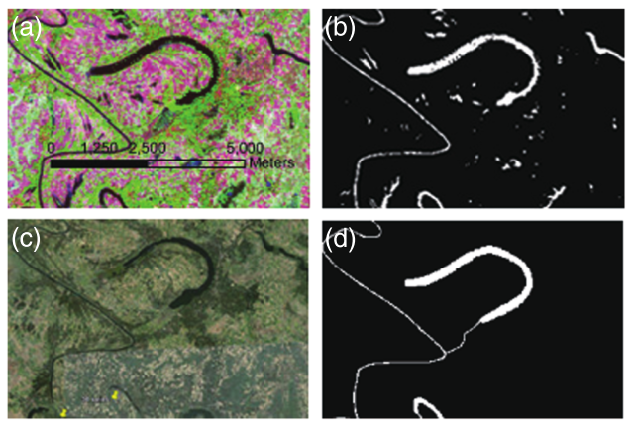
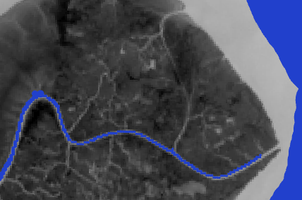
ARCGIS: Points to Shapefile
Error #1: Manual corrections to link some channels required
Notes:
This here was an expected error.
This is an image from the paper showing how manual edits were made to the channel file.
Similarly there are regions like this in my own file that make land areas that should be two separate islands into one island.
I was told this step took months to complete. Without this you can’t do a lot of the detailed island analysis (island area, shape factor, aspect ratio) because it’s all dependent on the complete closure of some islands and channels
The one thing I would have been able to do was assess channel width because it wasn’t dependent on the land area closures (leads me to my second error)

Slide 19
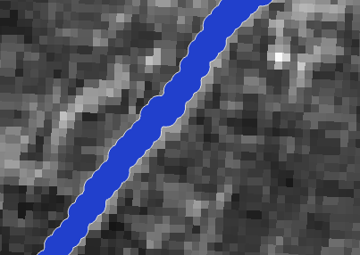
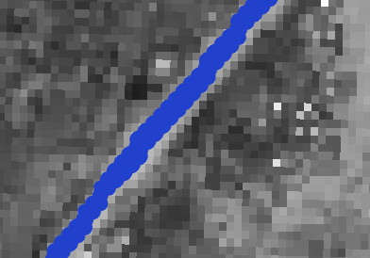
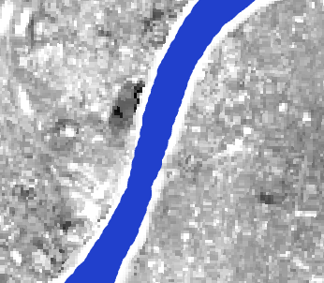
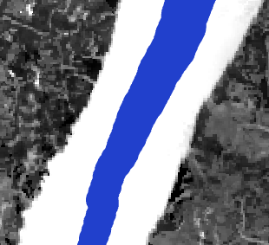
ARCGIS: Points to Shapefile
Error #2: TIFF bands 3 and 6 not projected before python import
TOP
BOTTOM
Notes:
As I was looking at channel buffers I noticed they were getting less and less accurate to the TIF image underneath as you move down delta
Units are dd and 1 dd at the top doesn’t equal 1 dd at bottom
Should have projected TIFF bands 3 and 6 to WGS 1984 UTM Zone 45N before I imported the TIFFs into rivamap

Slide 20
Preliminary Distribution
Notes:
Even though the data was wrong I went ahead and did the frequency distribution to see what it looked like
Created bins to get frequency distribution of different channel widths
Kind of interesting because you can see errors on both ends that reflect the error in channel width projection calcs (take away one of either side and you get a curve looking like you would have expected with power law
But again, this data is not useful and can’t be compared to the previous study

Slide 21
Future work
Re-do Rivamap with correctly projected TIF bands
Connect broken channels manually to get full accurate channel shapefile
Analyze width metric again (and rest of metrics)

Slide 22
Questions?

