Slide 1
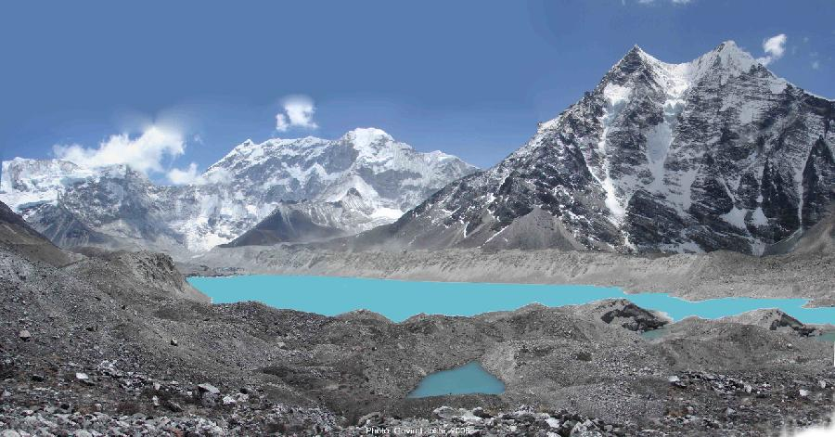
Glacial Lake Outburst Floods in the Nepal Himalaya
Jonathan M. Lala December 1, 2016
CE 394K.3 GIS in Water Resources

Slide 2
Introduction
  Himalaya Region contains more glacial ice and perennial snow than any other region on earth outside the polar regions
  Climate change is causing glaciers to recede, leaving behind lakes held up by unstable terminal moraines
  Natural disasters such as avalanches or debris flow can create a wave that overtops the terminal moraine, creating a glacial lake outburst flood (GLOF)
  Imja Tsho lies above a village of 200 people and is expanding rapidly
  Goal: Model a GLOF of Imja Tsho to recommend risk reduction measures to the Nepali government

Slide 3
Methods: Preprocessing with ArcGIS
  Combine regional 8m DEM with field bathymetric data and online soil and terrain database
  Geoprocessing: Raster Calculator, Focal Statistics, Mosaic to New Raster

Slide 4
Methods: Preprocessing with ArcGIS
  Avalanche will not likely enter Imja Tsho soon: predict expansion of lake (MATLAB Monte Carlo simulations)
  Determine origin of avalanche using critical angle (Raster Calculator)

Slide 5
Methods: Modeling an Avalanche with RAMMS
  Avalanche from SE valley, initial block 50 m deep with a volume of 6.7 million m3
  Result converted to raster, cells within lake area counted at each time step

Slide 6
Methods: Modeling an Avalanche with RAMMS
  Output function of deposition per timestep become input hydrographs for flood model (left: 2035; right: 2045)

Slide 7
Methods: Flood Modeling with BASEMENT
  More preprocessing: expand lake bathymetry to avalanche extents (bedrock DEM)
  Smooth interface: polygon to raster, Set Null, Focal Statistics, Raster Calculator

Slide 8
Methods: Flood Modeling with BASEMENT
  Generation of triangulated irregular network (TIN)
  Smoother calculations than raster DEM, avoid false sinks
  Serves as terrain for BASEMENT

Slide 9
Results
  Neither hydrograph produced a GLOF; larger hydrograph from previous study did
  Flood is confined to the river channel
  Dingboche is safe

Slide 10
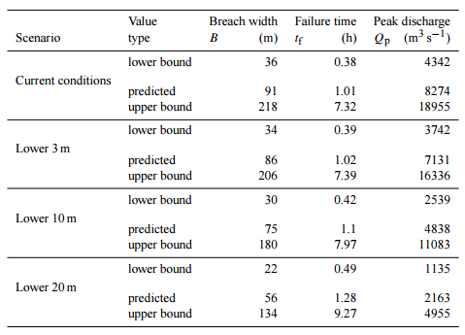
Discussion
  According to BASEMENT model, Dingboche is safe
  Downside: Analysis on effects of a GLOF at Dingboche cannot be made
  Results conflict with previous studies (Somos-Valenzuela et al. 2015)
  Field data will be gathered in April/May 2017
Source: Somos-Valenzuela et al. (2015)

Slide 11
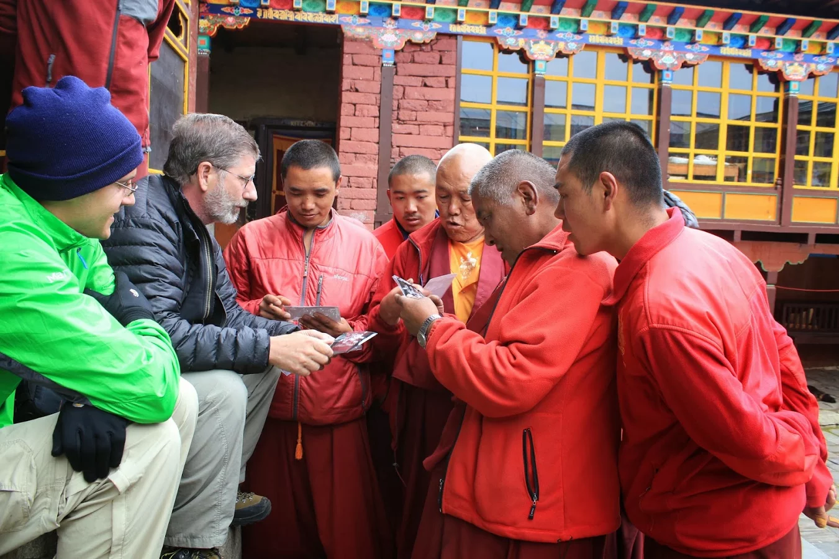
Conclusion
  Useful demonstration of uses and limits of GIS
          Use of various information, geoprocessing tools
          Incorporation into other software
          Field data better when GIS data is limited
  Conflicts with previous studies (dam breaching)
  Overall conclusion: Dingboche is safe, but this data may change!

Slide 12
References
Benn, D; Bolch, T; Hands, K; Gully, J; Luckman, A; Nicholson, L; Quincey, D; Thompson, S; Toumi, R; and Wiseman, S; 2012: Response of debris-covered glaciers in the Mount Everest region to recent warming and implications for outburst flood hazards. Earth-Science Reviews, Vol. 114
ICIMOD, 2011: Glacial Lakes and Glacial Lake Outburst Floods in Nepal. International Centre for Integrated Mountain Development, Kathmandu, Nepal
Rana, B; Shrestha, A; Reynolds, J; Aryal, R; Pokhrel, A; and Budhathoki, K; 2000: Hazard assessment of the Tsho Rolpa Glacier Lake and ongoing remediation measures. Journal of Nepal Geological Society, Vol. 22
Rounce, D. R; McKinney, D. C; Lala, J. M; Byers, A. C; and Wilson, C. S; 2016: A new remote hazard and risk assessment framework for glacial lakes in the Nepal Himalaya, Hydrology and Earth System Sciences, Vol. 20.
Somos-Valenzuela, M. A; McKinney, D. C; Byers, A. C; Rounce, D. R; Portocarrero, C; and Lamsal, D; 2015: Assessing downstream flood impacts due to a potential GLOF from Imja Tsho in Nepal, Hydrology and Earth System Sciences, Vol. 19, Issue 3.
Somos-Valenzuela, M. A; Chisolm, R. E; Rivas, D. S; Portocarrero, C; and McKinney, D. C; 2016: Modeling a glacial lake outburst flood process chain: the case of Lake Palcacocha and Huaraz, Peru. Hydrology and Earth System Sciences, Vol. 20.

