Slide 1
Water Scarcity in the United States
By: Eddie Tiernan

Slide 2
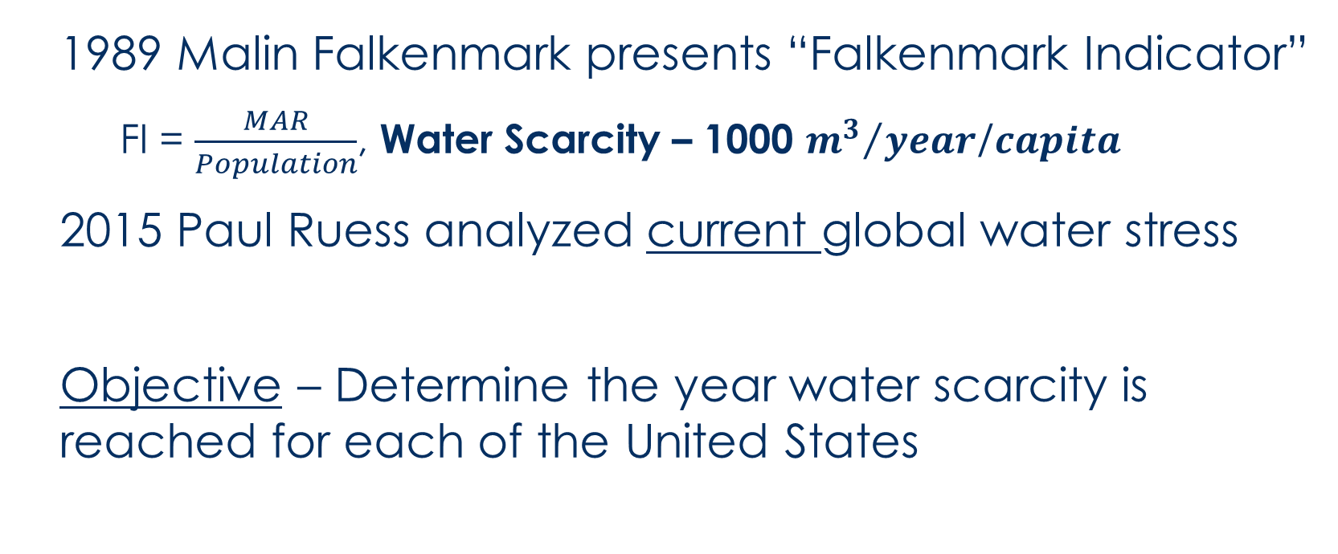
Inspiration and introduction
1989 Malin Falkenmark presents “Falkenmark Indicator”
  FI = $\frac{MAR}{Population}$, Water Scarcity – 1000 ${m^{3}}/{year}$/$capita$
2015 Paul Ruess analyzed current global water stress
Objective – Determine the year water scarcity is reached for each of the United States

Slide 3
Time dependent FI
Land Cover(t)
(Curve Number)
Mean Annual Runoff
Falkenmark
Indicator
Precipitation (t)
Population(t)

Slide 4
Time dependent FI
Land Cover(t)
(Curve Number)
Mean Annual Runoff
Falkenmark
Indicator
Precipitation (t)
Population(t)
1

Slide 5
Time dependent FI
Land Cover(t)
(Curve Number)
Mean Annual Runoff
Falkenmark
Indicator
Precipitation (t)
2
Population(t)
1

Slide 6
Time dependent FI
Land Cover(t)
(Curve Number)
Mean Annual Runoff
3
Falkenmark
Indicator
Precipitation (t)
2
Population(t)
1

Slide 7
Population(t)

Slide 8
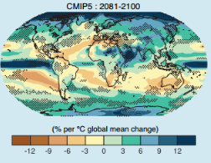

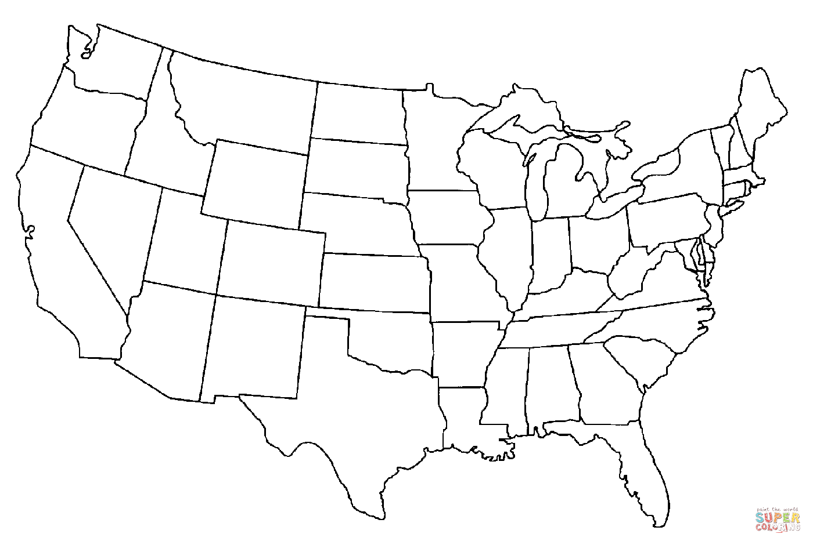
Precipitation(t)

Slide 9
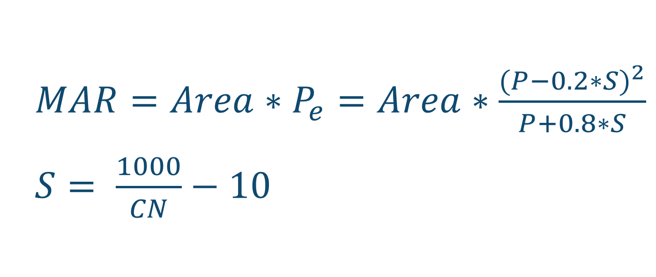
Land Cover(t) – SCS Curve Number
${MAR=Area∗P}_{e}=Area∗\frac{{(P−0.2∗S)}^{2}}{P+0.8∗S}$
$S= \frac{1000}{CN}−10$

Slide 10
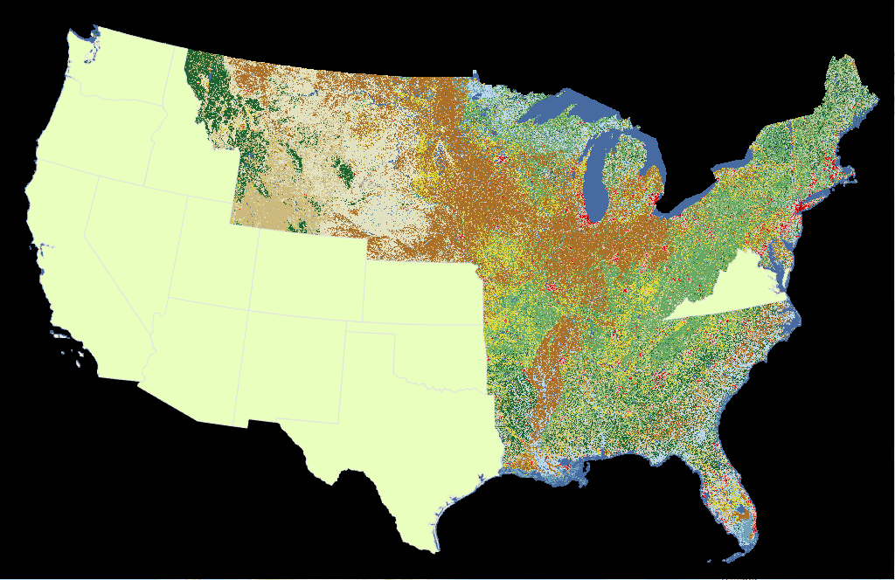
Land Cover(t) – NLCD 2001, 06, 11
WA
OR
ID
NV
UT
CA
CO
KS
VA
AZ
NM
OK
TX

Slide 11
Curve Number

Slide 12
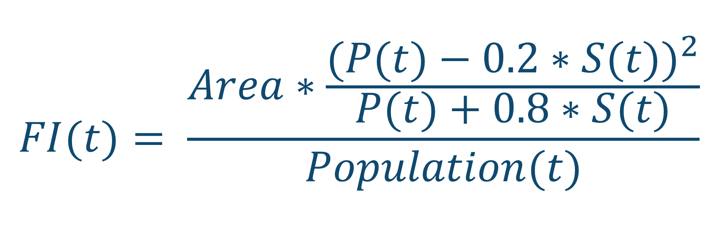
$$FI(t)= \frac{Area∗\frac{{(P(t)−0.2∗S(t))}^{2}}{P(t)+0.8∗S(t)}}{Population(t)}$$

Slide 13
Years to water scarcity

Slide 14
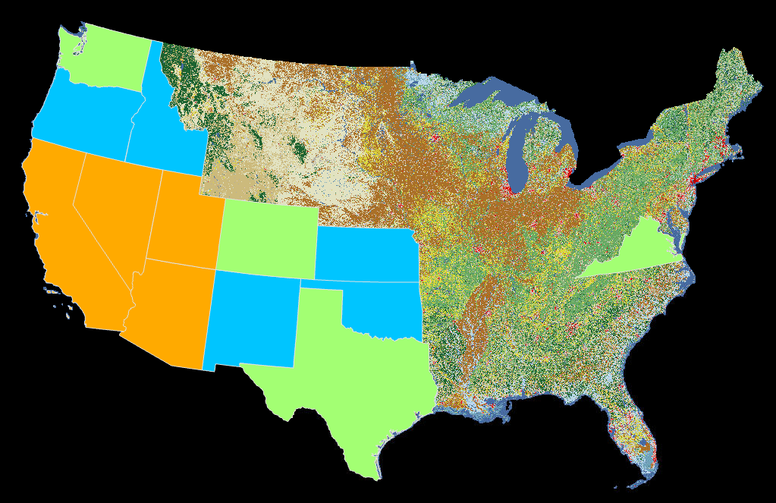
Threat of Water scarcity
WA
OR
ID
NV
UT
CO
CA
KS
VA
AZ
NM
OK
TX

Slide 15
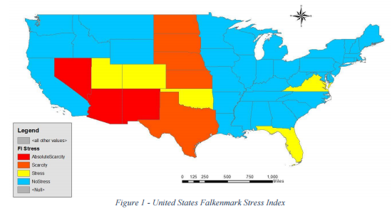
Threat of Water scarcity – Comparison To Paul Ruess

Slide 16
References
Ruess, P. (2015). Mapping of Water Stress Indicators. CE 394K Term Paper.
Posa, R. (2015). Development and Land Use Change in the Central Potomac River Watershed. CE 394K Term Paper.
Mackun, P., Wilson, S. (2011). Population Distribution and Change: 2000 to 2010. US Census Bureau.
Falkenmark, M. (1989). The massive water scarcity now threatening Africa: why isn't it being addressed? Ambio, 112-118.
Kirtman, B., Power S., Adedoyin J.A., Boer G.J., et al. (2013). Near-term Climate Change: Projections and Predictability. In: Climate Change 2013: The Physical Science Basis. Contribution of Working Group I to the Fifth Assessment Report of the Intergovernmental Panel on Climate Change. Cambridge University Press, Cambridge, United Kingdom and New York, NY, USA.
Mays, L. (2011). Water Resources Engineering. Hoboken, NJ: John Wiley & Sons.
National Land Cover Data. Obtained from www.usgs.gov
U.S. Census Data. Obtained from www.census.gov
Proposal of the President (2015). Adoption of the Paris Agreement. Framework Convention on Climate Change. United Nations.
Average Annual Precipitation by State. Current Results: Weather and Science Facts. Obtained from https://www.curren0tresults.com/Weather/US/average-annual-state-precipitation.php

