Slide 1

Groundwater Flow Near Lake Nebagamon, WI
Andrew Austin-Petersen
facebook.com/negabamonlakeassociation

Slide 2

Overview
Lake Nebagamon
ArcGIS Groundwater Tools
Progress
Issues
Goals

Slide 3
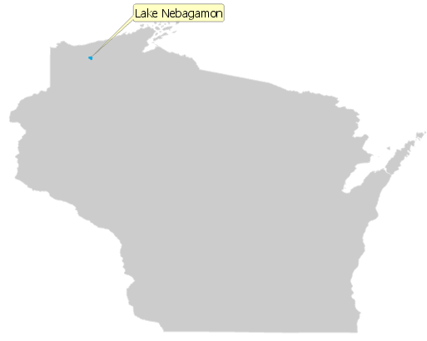
What? Why? Where?
What is a “Nebgamon”?
  Chippewa phrase meaning "place to hunt deer by fire on the water.“ https://en.wikipedia.org/wiki/Lake_Nebagamon,_Wisconsin
Why Lake Nebagamon?
  Family Cabin
Where?
  Northern Wisconsin!

Slide 4
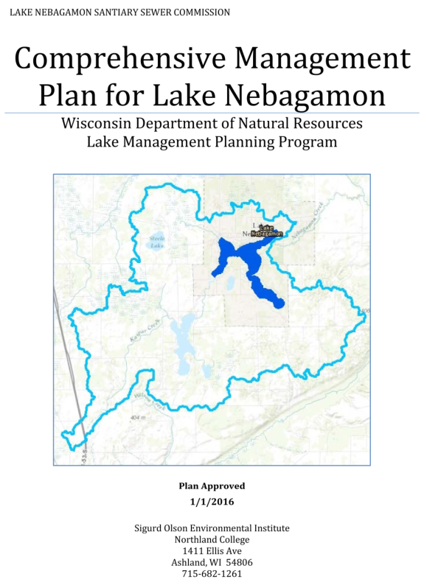
Water Quality Concerns
Currently “relatively healthy”
Majority of homes are on septic
  Seepage contributes to phosphate accumulation
Potential for increased cabin density
Optimal areas for extending sewage system?

Slide 5
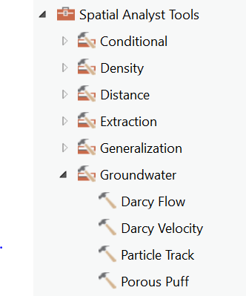
ArcGIS Pro Groundwater Tools

Slide 6
ArcGIS Pro Groundwater Tools
Assumptions
  Steady State Flow
  Vertically Mixed
  Two dimensional model

Slide 7
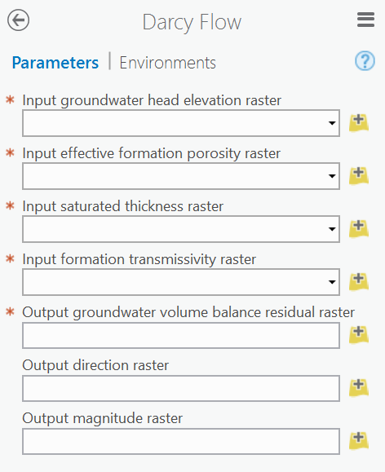
ArcGIS Pro Groundwater Tools

Slide 8
ArcGIS Pro Groundwater Tools
Interpolated from well data or from model

Slide 9
ArcGIS Pro Groundwater Tools
Interpolated from well data or from model
Physical constant
  gSSURGO Valu Tables

Slide 10
ArcGIS Pro Groundwater Tools
Interpolated from well data or from model
Physical constant
  gSSURGO Valu Tables
Measured or modeled

Slide 11
ArcGIS Pro Groundwater Tools
Interpolated from well data or from model
Physical constant
  gSSURGO Valu Tables
Measured or modeled
Hydraulic Conductivity * Saturated Thickness
  gSSURGO Valu Tables

Slide 12
ArcGIS Pro Groundwater Tools
Groundwater Volume Balance Residual
  Net flow into or out of a cell
  Indicative of the internal consistency of the raster data
  Ideally all cells are zero

Slide 13
ArcGIS Pro Groundwater Tools

Slide 14
ArcGIS Pro Groundwater Tools
Groundwater Volume Balance Residual
  Net flow into or out of a cell
  Indicative of the internal consistency of the raster data
  Ideally all cells are zero
Groundwater Flow Direction

Slide 15
ArcGIS Pro Groundwater Tools

Slide 16
ArcGIS Pro Groundwater Tools
Groundwater Volume Balance Residual
  Net flow into or out of a cell
  Indicative of the internal consistency of the raster data
  Ideally all cells are zero
Groundwater Flow Direction
Groundwater Flow Magnitude

Slide 17
ArcGIS Pro Groundwater Tools

Slide 18
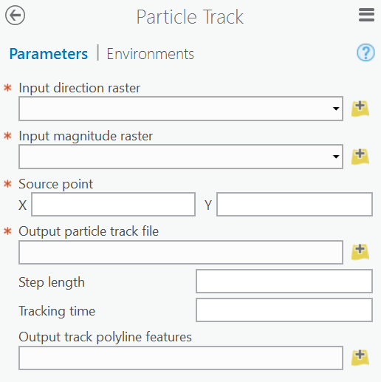
ArcGIS Pro Groundwater Tools

Slide 19
ArcGIS Pro Groundwater Tools
From Darcy Flow

Slide 20
ArcGIS Pro Groundwater Tools
From Darcy Flow
Entered Manually
  Why isn’t this a drop down?

Slide 21
ArcGIS Pro Groundwater Tools
From Darcy Flow
Entered Manually
  Why isn’t this a drop down?
ASCII File

Slide 22
ArcGIS Pro Groundwater Tools
From Darcy Flow
Entered Manually
  Why isn’t this a drop down?
ASCII File
Default is one-half cell size

Slide 23
ArcGIS Pro Groundwater Tools
From Darcy Flow
Entered Manually
  Why isn’t this a drop down?
ASCII File
Default is one-half cell size
Default is infinity

Slide 24
ArcGIS Pro Groundwater Tools
From Darcy Flow
Entered Manually
  Why isn’t this a drop down?
ASCII File
Default is one-half cell size
Default is infinity
Optional polyline feature

Slide 25
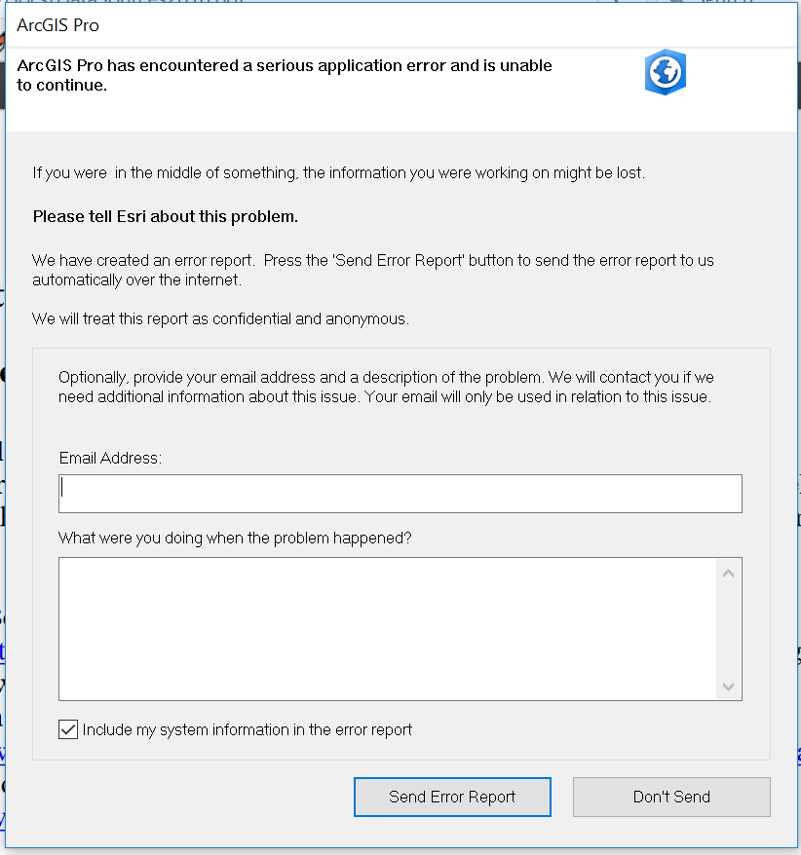

Slide 26
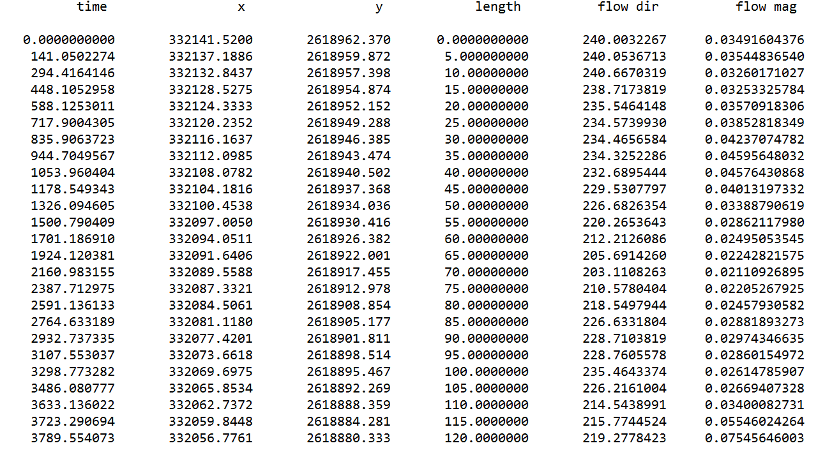
ArcGIS Pro Groundwater Tools
From Darcy Flow
Entered Manually
  Why isn’t this a drop down?
ASCII File

Slide 27
ArcGIS Pro Groundwater Tools
From Darcy Flow
Entered Manually
  Why isn’t this a drop down?
ASCII File
Default is one-half cell size
Default is infinity
Optional polyline feature

Slide 28
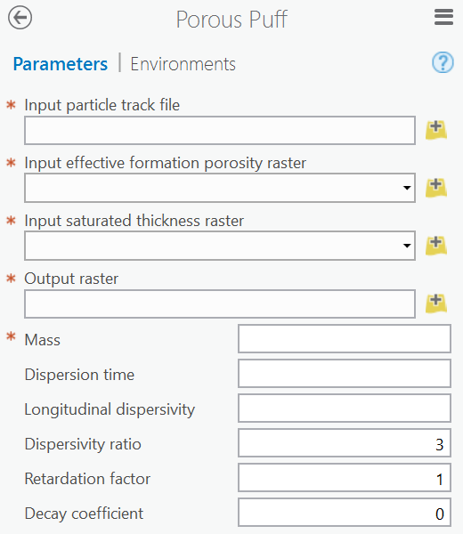
ArcGIS Pro Groundwater Tools

Slide 29
ArcGIS Pro Groundwater Tools
Particle Track ASCII File

Slide 30
ArcGIS Pro Groundwater Tools
Particle Track ASCII File
Input Rasters for Darcy Flow

Slide 31
ArcGIS Pro Groundwater Tools
Particle Track ASCII File
Input Rasters for Darcy Flow
Pollutant Specific Parameters

Slide 32
ArcGIS Pro Groundwater Tools

Slide 33
Next Steps
Generate Particle Path & Porous Puff for each address point near lake
  Utilize automation or Python?
Explore options for modeling
  Generate lower residual in head/transmissivity rasters
Combine and analyze porous puff rasters

Slide 34
Questions?

