Slide 1
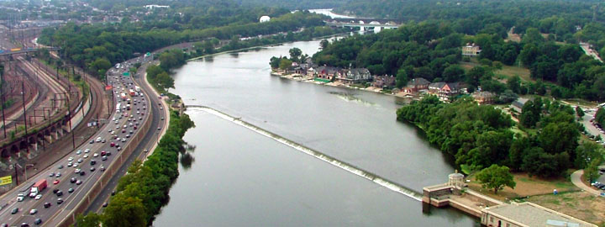
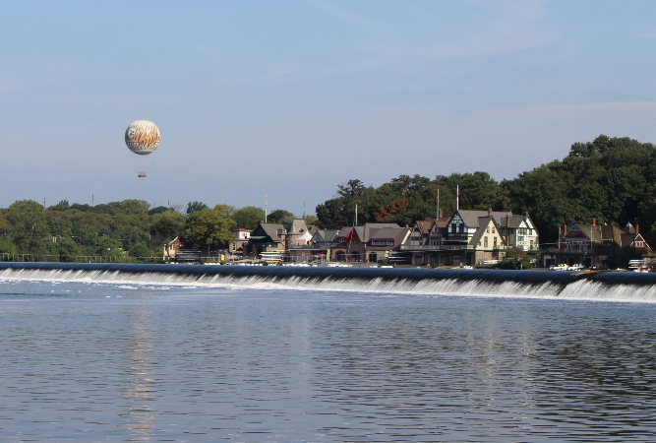
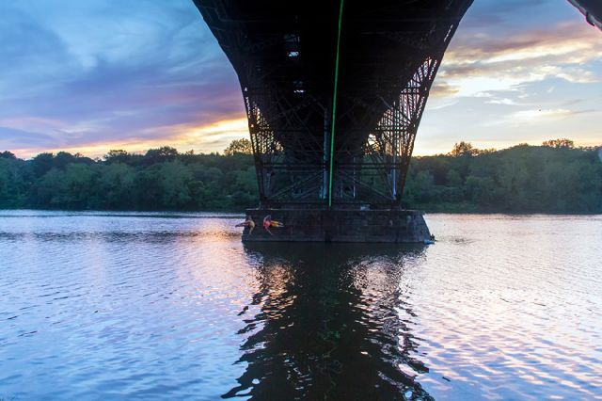
Floods in the Lower Schuylkill River at Philadelphia
CE 394K Project
Kexin Lai

Slide 2
Some Facts
Area
-drains approximately 2,000 square miles
Stream Miles
-approximately 130 linear miles
Population
-approximately 1.5 million residents
Counties / Municipalities
-Encompasses areas of 11 counties
Notes:
The basin includes large parts of Schuylkill, Berks, Montgomery, Chester, and Philadelphia counties and smaller parts of Carbon, Lehigh, Lebanon, Lancaster, Bucks, and Delaware counties.

Slide 3
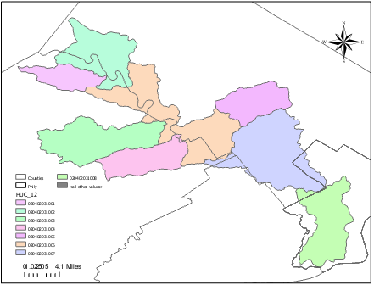
Study Area
—Hydrologic Unit
Code(HUC_10):
0204020310
—8 HUC_12
Lower Schuylkill River Watershed
Notes:
Part of Philly’s watershed and part of schuylkill river watershed

Slide 4
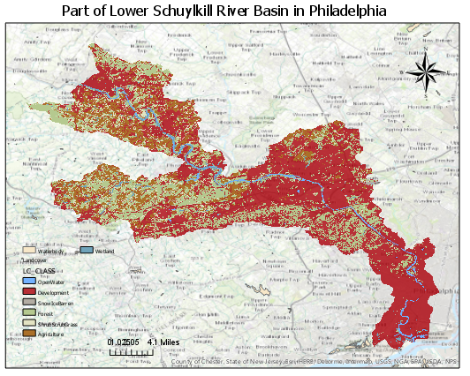
Landcover
Lower Schuylkill River Watershed’s Landcover
Notes:
1st landcover map the majoraty of the are is in red color represents the development
Then create pie chart for the result of percentage of diff class. Half of total is Develop in red.
The area is developed

Slide 5
Urbanization and Flood
Urbanization increases peak discharges and decreases lag times
  Increases the amount of people at risk to flooding
The larger the storm, and the larger the impact of urban
  Loss of lives and property
  Loss of livelihoods
  Mass migration
  Etc.
Notes:
Urbanization creates areas that are impermeable to precipitation and leads to increased runoff
Water drainage systems deliver precipitation to rivers much more quickly than the groundwater system

Slide 6
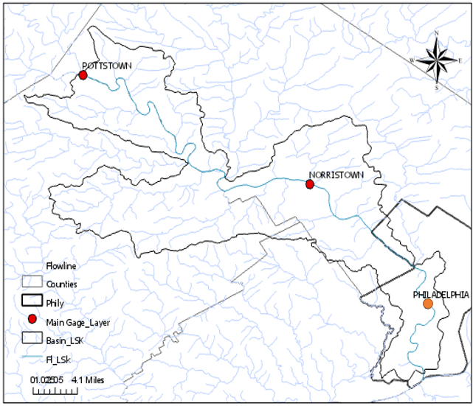
The Gages in the Watershed
Gage Name | DASqMile | MAFlow
POTTSTOWN | 1,147 | 18.79191
PHILADELPHIA | 1,893 | 67.3487
NORRISTOWN | 1,760 | 45.91014
Gages Locate on the Flowline
Notes:
For detecting locate the gage

Slide 7
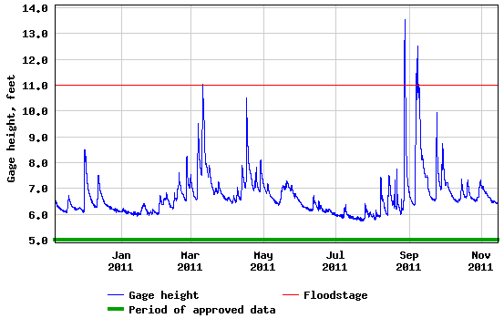
Gage Height of Schuykill River at Philadelphia, PA
Notes:
Action stage-10 ft, at 10.4 ft Kelly Drive floods/closes between North Ferry Road and Falls Bridge; Flood stage-11 ft, Kelly Drive is flooded and closed between Hunting Park Avenue and Falls Bridge; Flat Rock area is flooded; Moderate flood stage-13 ft, Main Street in Manayunk is closed from Ridge Avenue to Leverington Street; Major flood stage-15.5 ft.
inundation of buildings usually begins at this stage. Roads are likely to be closed and some areas cut off. Some evacuations may be necessary.

Slide 8
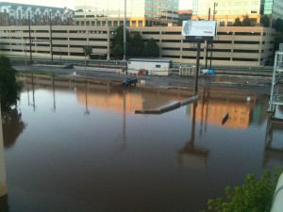
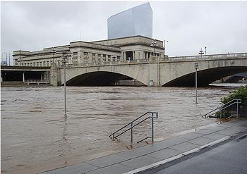
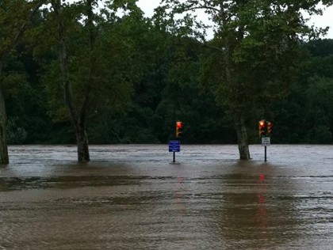
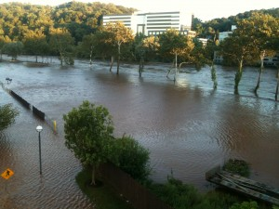
Notes:
It’s bc there’s a Hurricane called Irene bringing heavy rains and flooding from 26-28 August 2011.
Following with another tropical storm (TS) Lee 09/08/2011.
Cite:http://philadelphia.cbslocal.com/2011/08/28/schuylkill-river-flooding-reaches-near-record-highs/
http://www.exploitationvm.com/schuylkill-river-flooding/
http://ens-newswire.com/2011/08/30/hurricane-irene-pummels-eastern-seaboard-claims-10-lives/

Slide 9
Flood Risk
“100-year Flood”
  Recurrence interval(T) =(n+1)/m
    Example
  The probability (P) of an flood with recurrence interval T is
    P=1/T
Discharge | Magnitude | Recurrence Interval (years)
4452 | 1 | (1+39)/1=40.00
…… | …… | ……
1014 | 39 | (1+39)/39=1.03
Notes:
“100-year Flood”-flood frequency distribution
n number of years on record;
m is the number of recorded occurrences of the event being considered
forecast the future probability of a flood of a given discharge.

Slide 10
Two Figures
Notes:
As the increasingly development…climate change might bring more extreme storms here.and the urbanization might change the frequency of flood here. So I assess the flood risk in two time period.
The distribution range from.
For the 1st one the 100 yr flood,
2nd----around 6800 cfs
Which shows the frequency of the larger flood increase recently.
So if they site the discharge at 5000(6800)cfs, they would have a 1 percent chance any given year of the plant being flooded.
What is really meant by this term is a flood with recurrence interval of 100 years - one that has a 1% chance of occurring in any given year.

Slide 11
Further study
Precipitation data
Analyze the connection between gage height and discharge
Suggestion for preventing flood
……

Slide 12
Reference
Baer, E. M. (n.d.). Floods and Flooding. Retrieved November 14, 2016, from http://serc.carleton.edu/quantskills/methods/quantlit/floods.html
USGS Current Conditions for USGS 01472000 Schuylkill River at Pottstown, PA. (n.d.). Retrieved November 14, 2016, from http://waterdata.usgs.gov/nwis/uv?01472000
USGS Current Conditions for USGS 01471510 Schuylkill River at Reading, PA. (n.d.). Retrieved November 14, 2016, from http://waterdata.usgs.gov/usa/nwis/uv?01471510
USGS Current Conditions for USGS 01473500 Schuylkill River at Norristown, PA. (n.d.). Retrieved November 14, 2016, from http://waterdata.usgs.gov/usa/nwis/uv?01473500
USGS Current Conditions for USGS 01474500 Schuylkill River at Philadelphia, PA. (n.d.). Retrieved November 14, 2016, from http://waterdata.usgs.gov/usa/nwis/uv?01474500
Alexakis et al., 2014; Bronstert et al., 2002; Greenough et al., 2001; Ouellet et al., 2012; Wheater et al., 2009
Your Watershed. (n.d.). Retrieved November 14, 2016, from http://phillywatersheds.org/your_watershed
USGS Surface Water data for Pennsylvania: USGS Annual Statistics. (n.d.). Retrieved November 15, 2016, from http://waterdata.usgs.gov/pa/nwis/water

Slide 13

Questions

