Slide 1

Hurricane Matthew Flood Analysis in Neuse River Basin, North Carolina
Washingtonpost.com
Anna Merryman
CE394K.3 Term Project

Slide 2
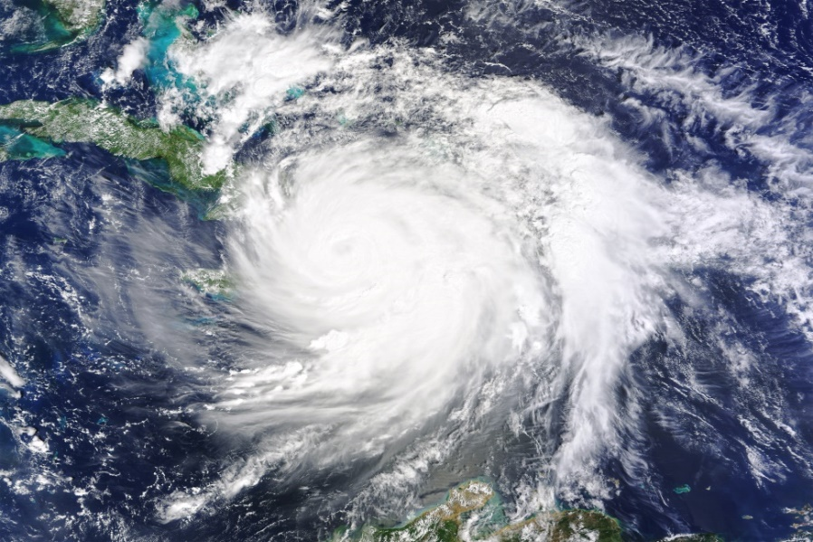
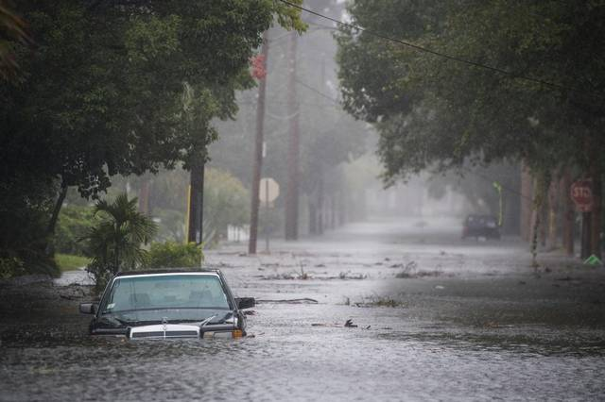
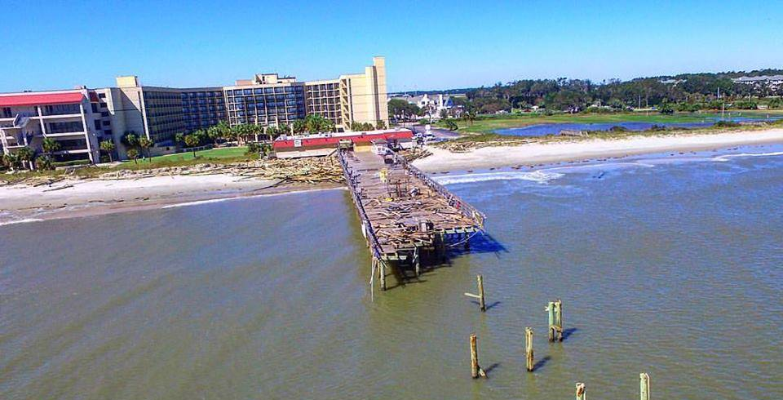
Hurricane Matthew
Category 5 Hurricane
~1600 Deaths
  49 in US, 28 in NC
  Most due to flooding days after event – Lumber, Neuse, Tar River
Inland communities hardest hit
  100 yr flood event in many areas
  Surpassed 1999 Hurricane Floyd
$1.5 Billion in damages
nasa.gov
miamiherald.com

Slide 3
Matthew in North Carolina
2:00 PM EDT
October 9, 2016
8:00 PM EDT
October 8, 2016
2:00 PM EDT
October 10, 2016
Path of Matthew along NC coast – data from NOAA National Hurricane Center
Downgraded to tropical cyclone, max winds < 75 mph
Officials warned flooding risk more dangerous than winds

Slide 4
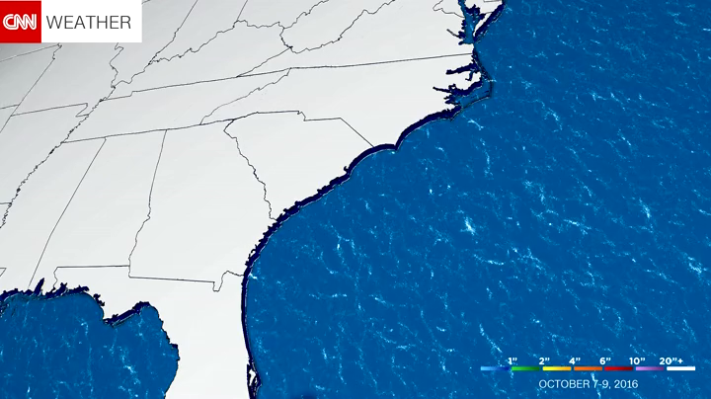
Dangerous Precipitation

Slide 5
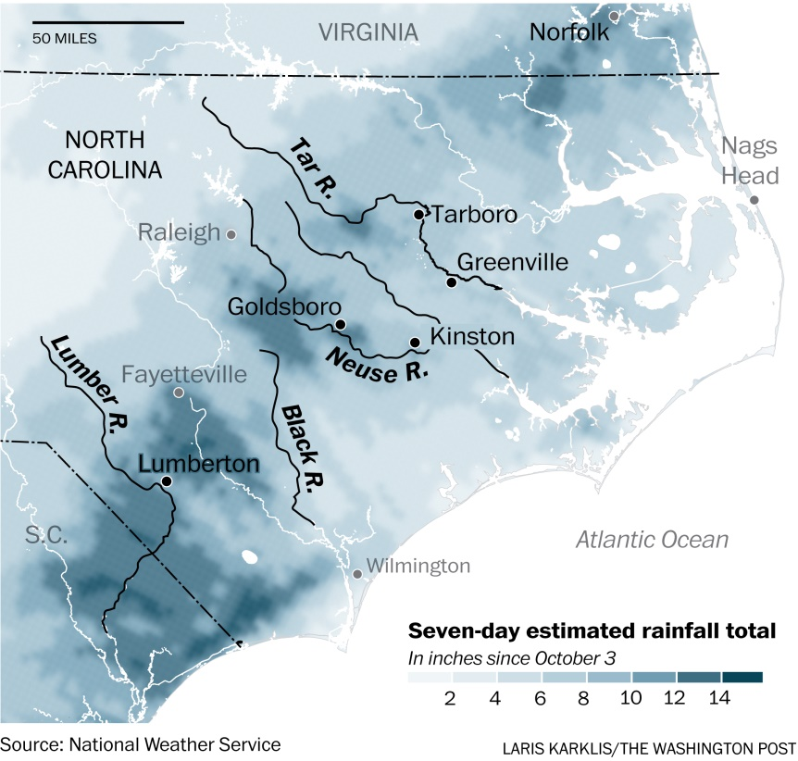
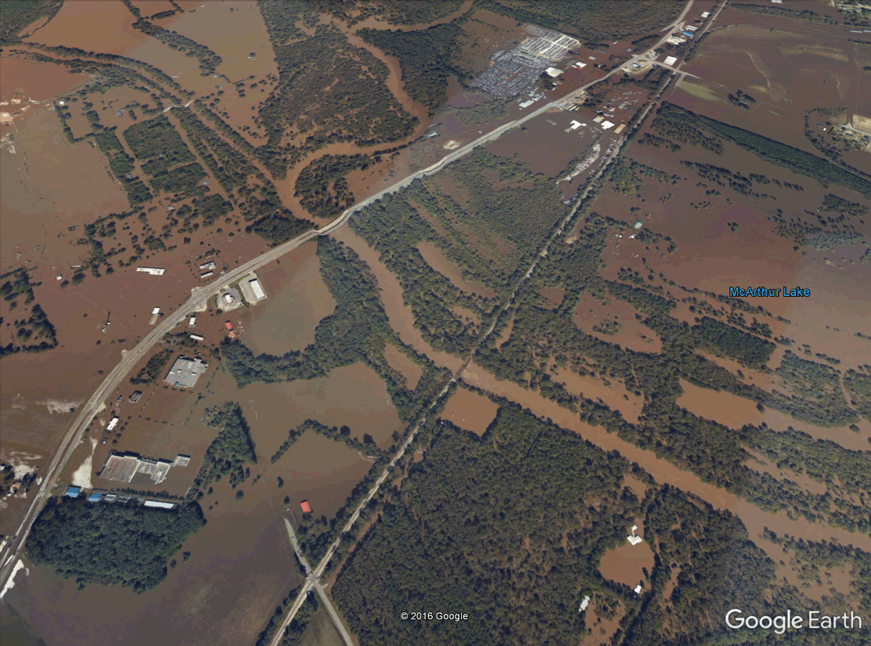
Flooding
Severity of flooding linked to soil saturation
“Much of eastern North Carolina saw 15 to 20 inches of rain during September, which is 200% to 300% above normal. The rainfall left the ground saturated and river levels also well above normal.” –CNN
Neuse River

Slide 6
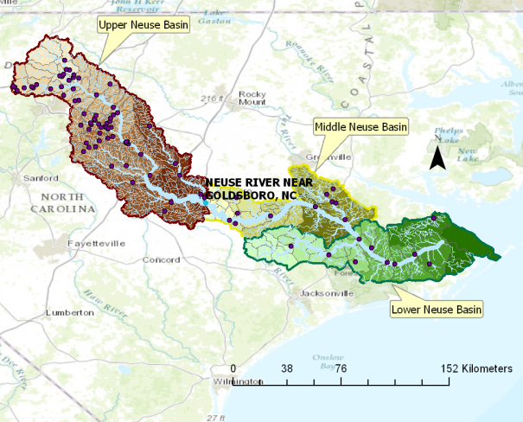
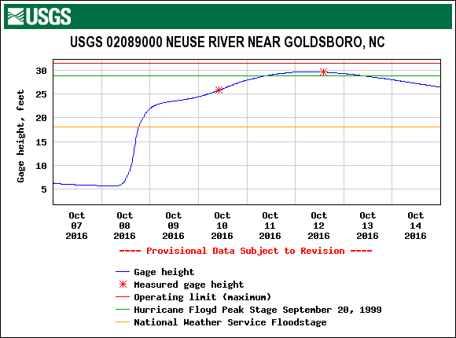
Study Gage
Outline of entire Neuse River Basin – NHD
Record height recorded at USGS 02089000 – Neuse River near Goldsboro
Location of interest, entire Upper Neuse Basin drains to this point

Slide 7
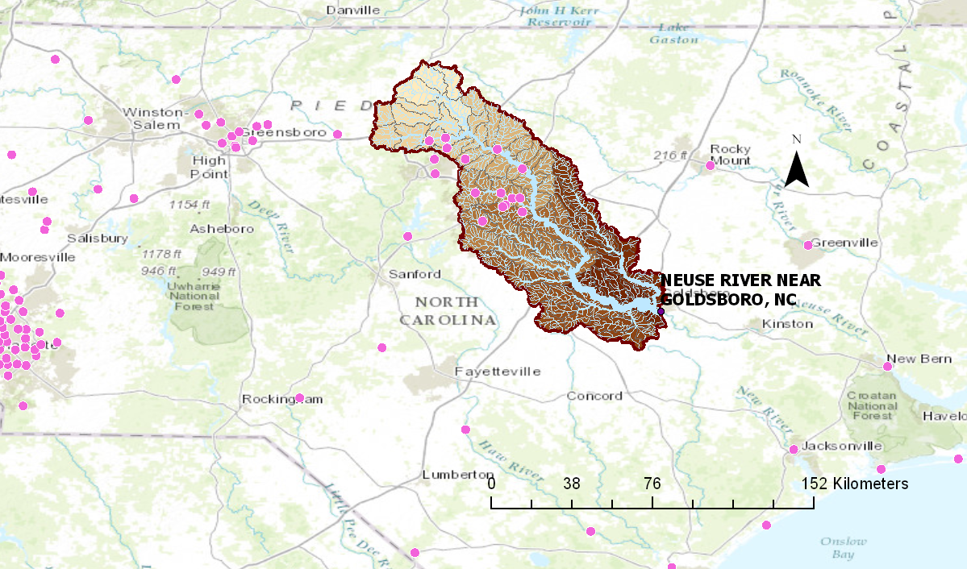
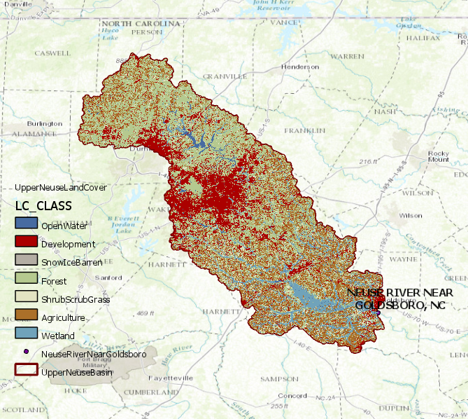
Limitation of Interpolation
Interpolation of precipitation data from gages difficult
  Few precipitation gages in area
  Interpolation may be poor using either spline or Theissen
Need to incorporate available water storage of soil data

Slide 8
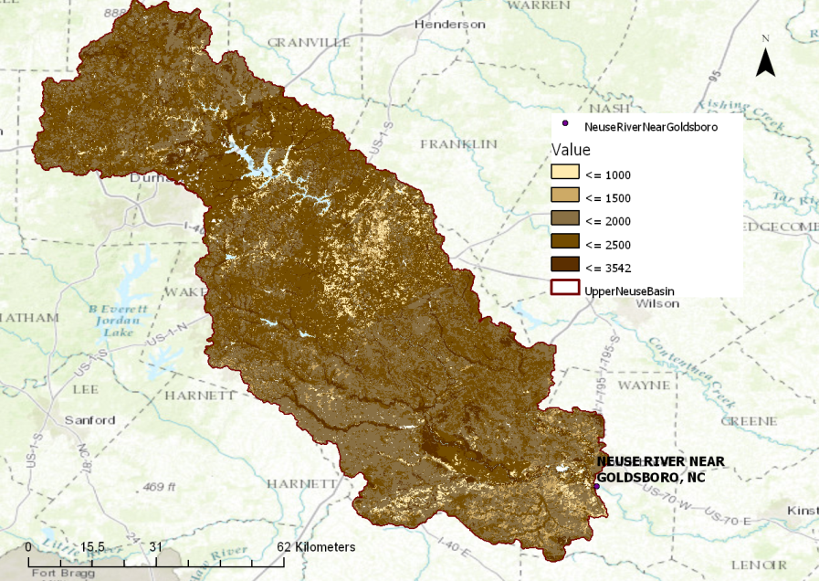
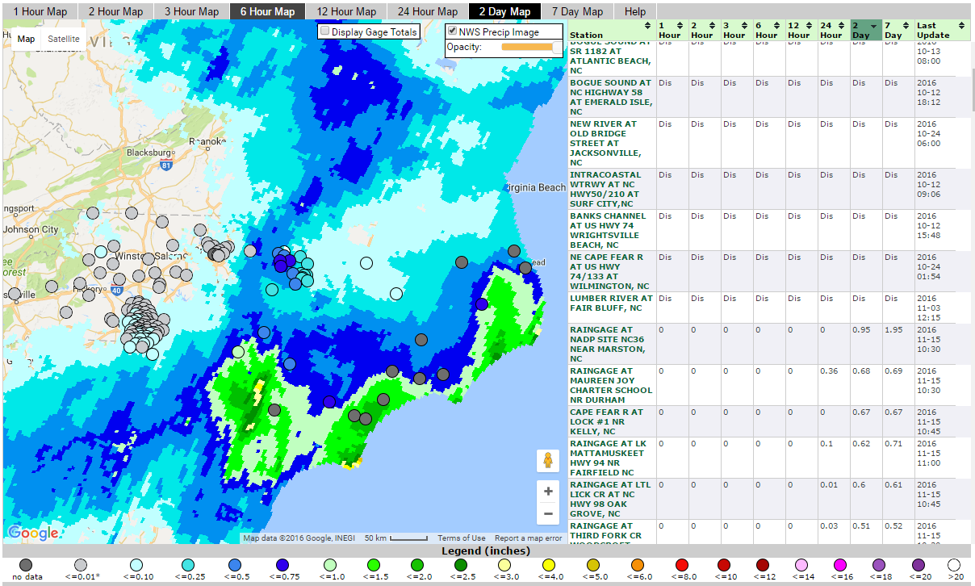
Datasets
SSURGO soil data
  AWS up to 150 cm in depth
NWS/South Atlantic Water Science Center hourly precipitation data
  From combination of radar and real time precipitation gage readings
  Hydrologic Rainfall Analysis Project (HRAP) grid system

Slide 9
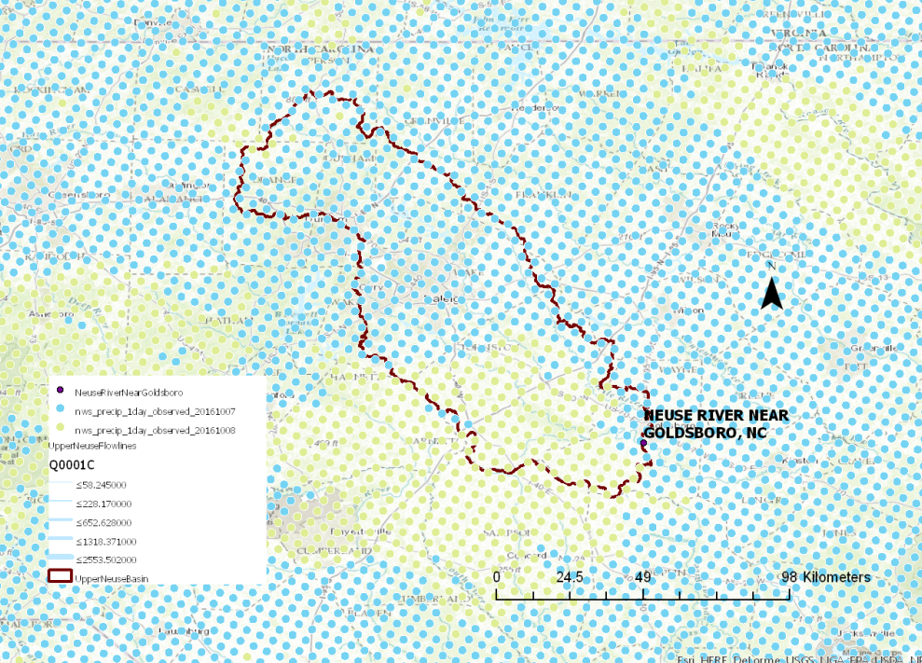
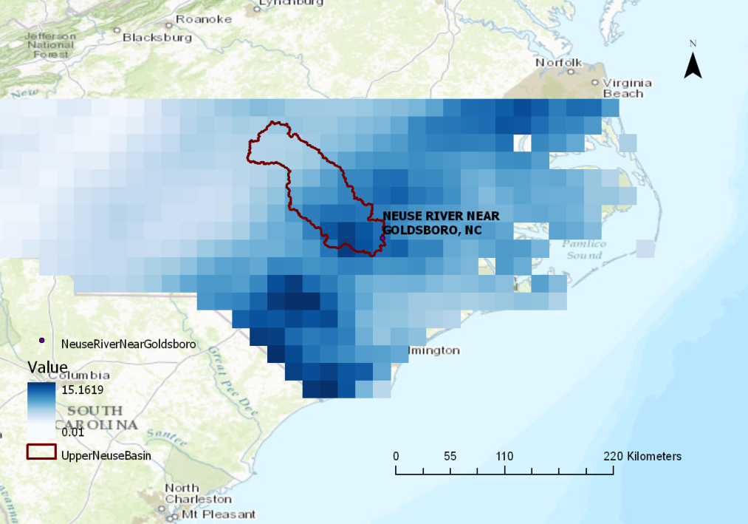
Using Precipitation Data
Individual daily precipitation point shapefiles
Collected for 6 days before major flooding events in Goldsboro
Soil storage subtracted from precipitation to get flood water precipitation height

Slide 10
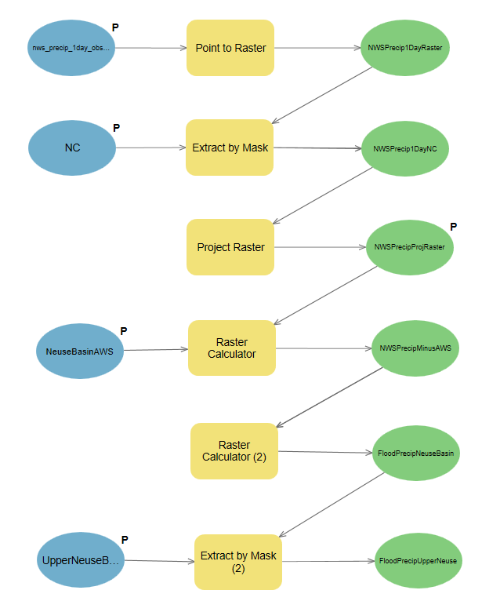
ModelBuilder

Slide 11
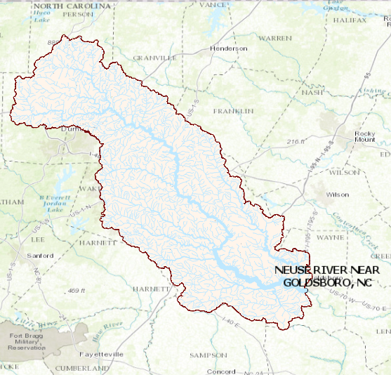
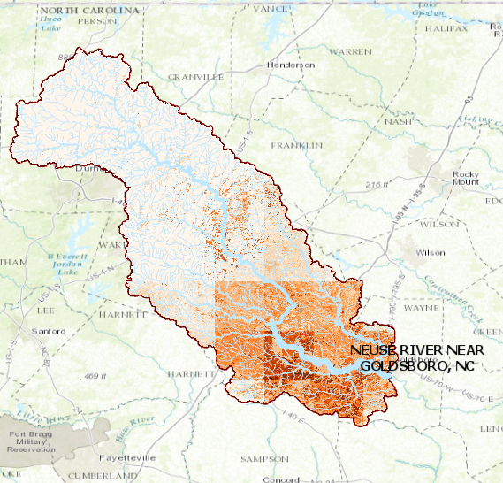
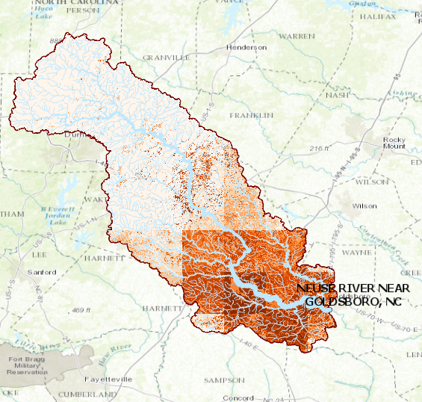
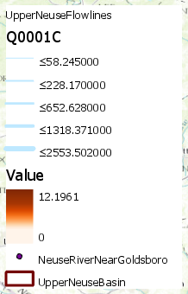
Results of flood precipitation height
October 8, 2016→ October 9, 2016 →October 10, 2016

Slide 12
Next Steps
Compare runoff of flood precipitation volume to increase in flow at Neuse River near Goldsboro gage
Compare method to DEM+precipitation interpolation method as used in Ex. 4 and 5
Analyze advantages and disadvantages of each method, how to choose method

Slide 13
Questions

