Slide 1
Effects of persistent drought on Lake Mead and the Las Vegas Valley
Shari Schwartzer

Slide 2
Agenda
Background
Drought Information
Stream Delineation
Bathymetry
Calculations
Future Work

Slide 3
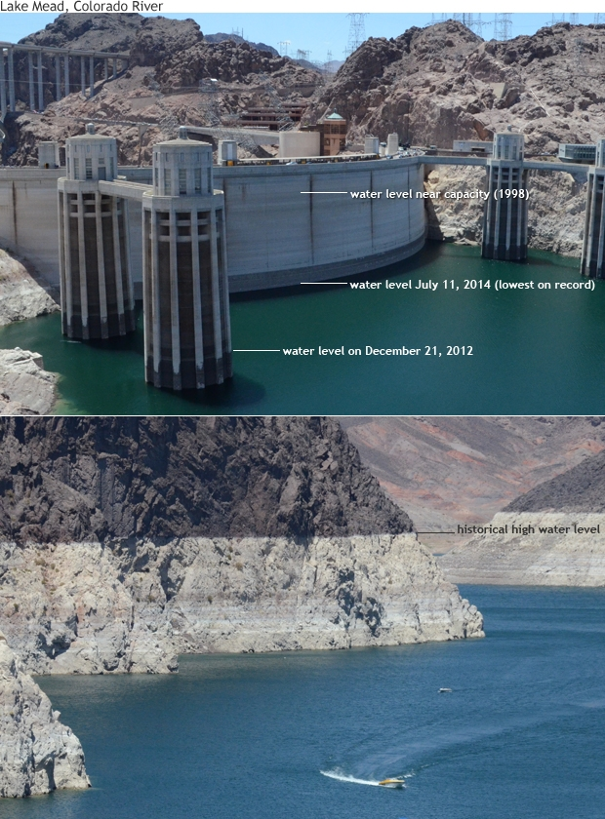
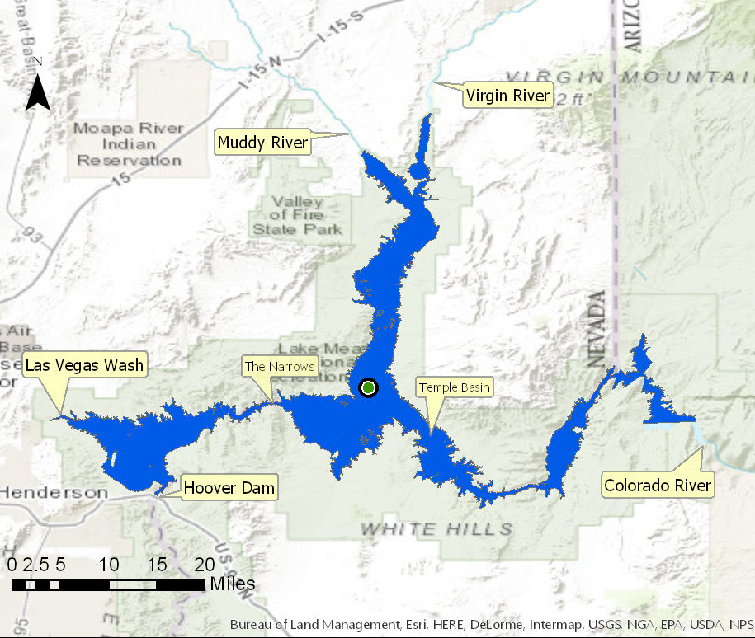
Lake Mead
Largest reservoir in US
Formed by Hoover Dam
Supplies water to NV, AZ, CA
Currently at 37% capacity
Notes:
Lake Mead is the largest reservoir in the United States with a capacity of 28,945,000 acre-feet. It is formed by the Hoover Dam and contributes to the water supply of Nevada, Arizona, and California. As of September 21, 2016 the water level was 1074 ft above sea level which means the reservoir is only 37% full. No other area depends more on Lake Mead than Las Vegas due to a lack of alternative freshwater sources. More than 90% of the freshwater used by Las Vegas is from Lake Mead.
Lake Mead on the Colorado River is one of the most intensely used reservoirs in the western United States, providing recreational watercraft activities and domestic drinking, industrial, and irrigation water for over 22 million users. The quality of this water must be maintained to guarantee a reliable and safe resource for its many uses. Inflow into Lake Mead primarily is from the Colorado River; however, about 3 percent of the inflow is from tributaries on the northern side of the Lake and from Las Vegas Wash on the northwest side of the Lake.
Las Vegas Wash transports treated municipal wastewater effluent, stormwater and urban runoff, and shallow ground-water seepage from the Las Vegas urban area to Las Vegas Bay of Boulder Basin in Lake Mead. Water in Lake Mead eventually evaporates, flows through Hoover Dam, or is intercepted by pump intakes for the municipal water treatment plant at Saddle Island. Efforts are currently underway to improve the quality of water in Las Vegas Wash before it discharges to Lake Mead. Additionally, the Las Vegas Wash Coordination Committee, a multi-agency panel chaired by the Southern Nevada Water Authority, is working to stabilize the Las Vegas Wash Channel, establish wetlands along Las Vegas Wash, perform environmental monitoring, and promote public awareness by disseminating timely monitoring results.

Slide 4
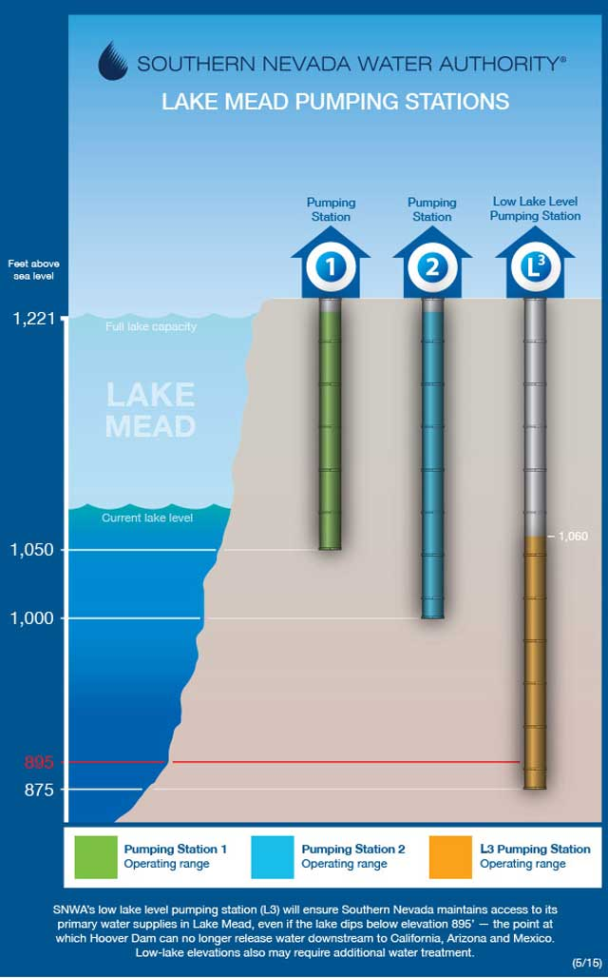
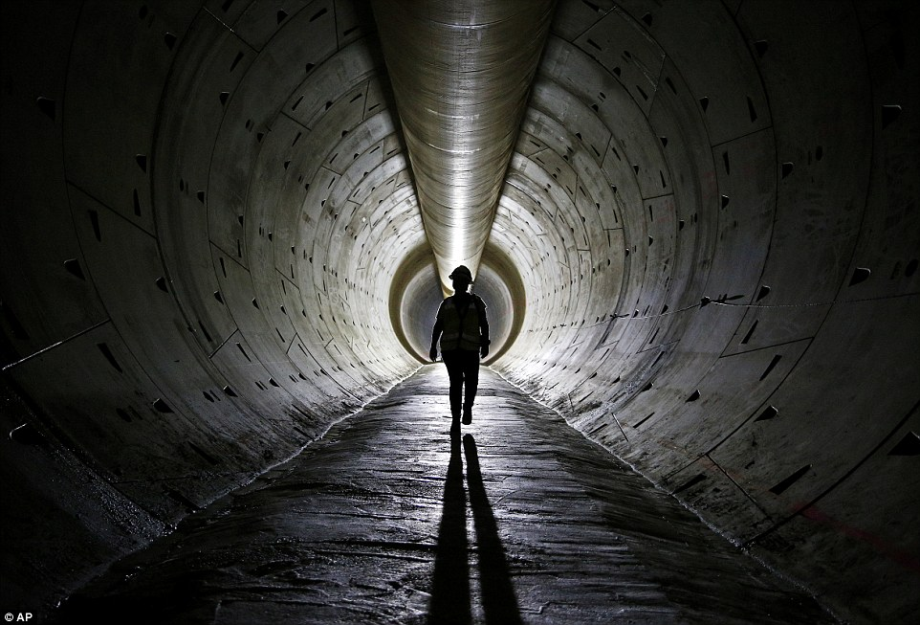
Third Straw
$817M
6 years
Uncapped September 2015
Notes:
Third intake: In order to address unprecedented drought conditions and provide long-term protection of Southern Nevada's primary water storage reservoir—Lake Mead— the Southern Nevada Water Authority constructed a third drinking water intake capable of drawing upon Colorado River water at lake elevations below 1,000 feet (above sea level).
Originally I wanted to know how this third intake would affect the lake level. If it would lower it and cause more of those bathtub rings shown on the previous slide. However after further research I found that Las Vegas essentially removes the same amount of water with this third intake so flow does not increase. The level of the lake is just too low for that same amount of water to be take from intake 1&2. The lowering of lake mead thus is caused by upstream flow decrease and drought.

Slide 5
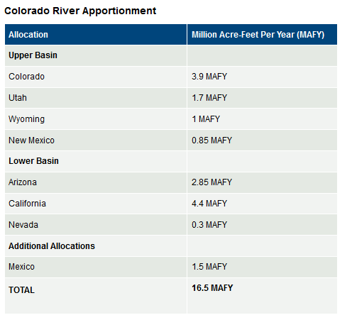
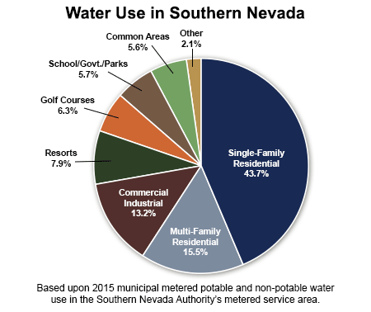
Water Use
Notes:
Las Vegas had about 126,000 residents when it began drawing water from Lake Mead in 1971. It now has 2 million residents and 40 million tourists a year.
Originally I wanted to know how this third intake would affect the lake level. If it would lower it and cause more of those bathtub rings shown on the previous slide. However after further research I found that Las Vegas essentially removes the same amount of water with this third intake so flow does not increase. The level of the lake is just too low for that same amount of water to be take from intake 1&2. The lowering of lake mead thus is caused by upstream flow decrease and drought.
https://www.snwa.com/ws/river.html

Slide 6
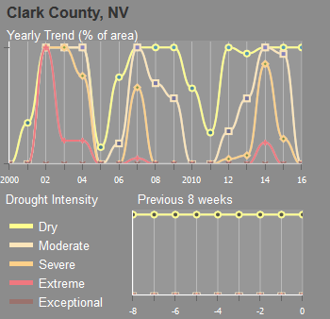
Drought in Las Vegas Valley
Notes:
You can see currently we are in a low drought classified as dry period. However 2014 saw extreme drought conditions. This shows how the drought intensity have changed in the last 16 years, bu one thing remains the samewith the exception of 2005 and 2011 Clark County has consistently been in a drought.

Slide 7
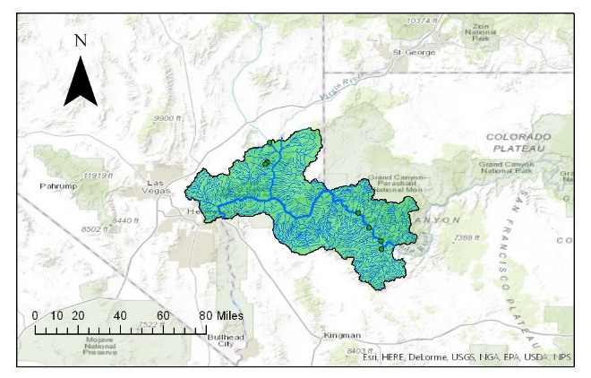
Stream Delineation
Notes:
Using gauge points and elevation I was able to get the stream network. The large stream in the middle is the Colorado River

Slide 8
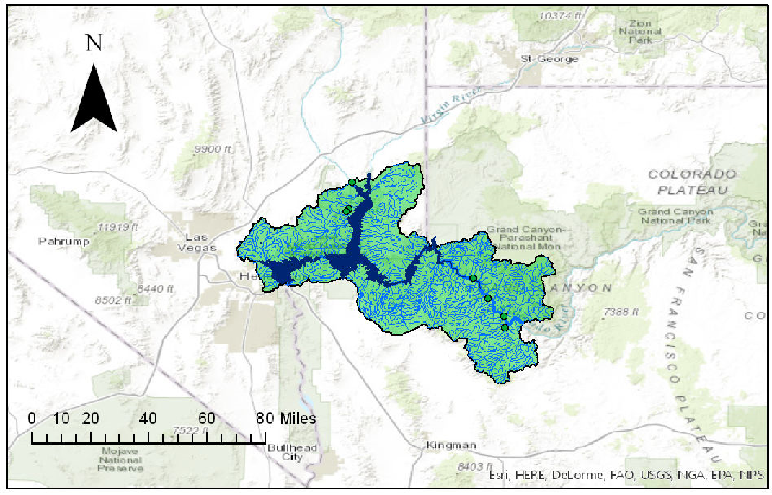
Stream Delineation
Notes:
Then I looked into how Lake Mead was filled by the stream network

Slide 9

Stream Delineation

Slide 10
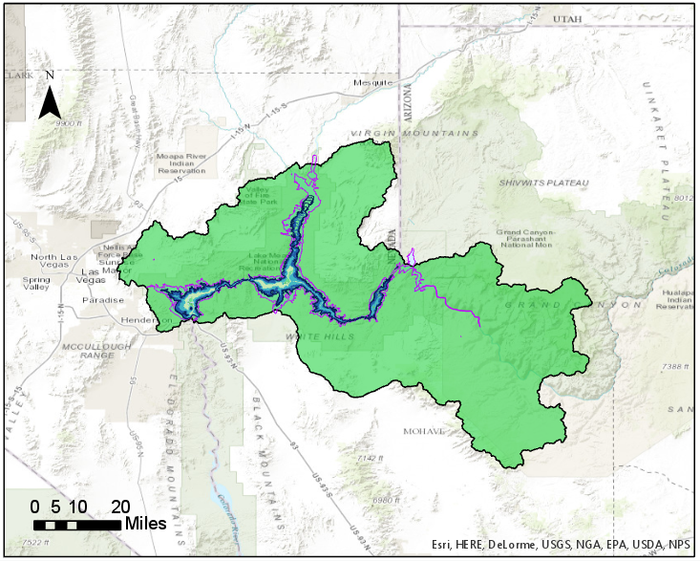
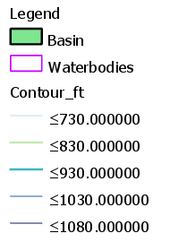
Bathymetry

Slide 11
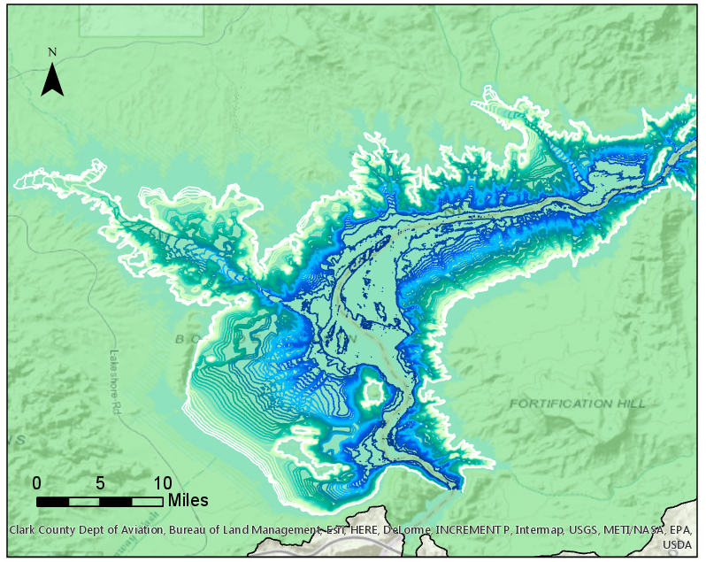
Bathymetry – Boulder Basin
Notes:
The left portion is the Las Vegas Bay, Major area is the boulder basin. Hoover Dam to the bottom center

Slide 12
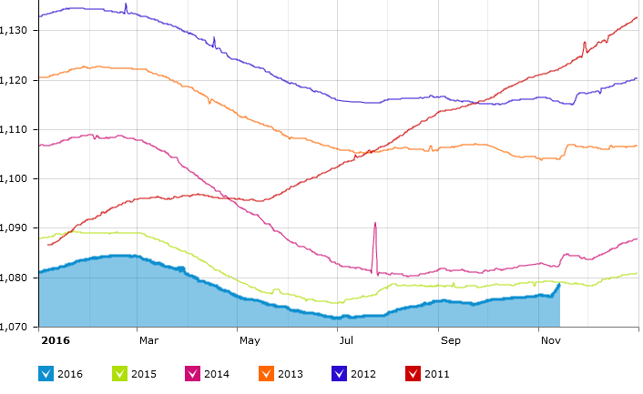
Lake Mead Depth
YEAR
2011
2012
2013
2014
2015
2016
Notes:
Adapted from Lakelines.org

Slide 13
Lake Mead Level Calculations
 | 2009 Given | Calculated | Units | % Dif
Surface Area | 637.05 | 611.828 | m² | -4%
Volume | 3583.4 | 2690.0 | m³ | -25%
Max depth | 162 | 144.27 | m | -11%
Watershed Area | 433,000 | 427944 | km² | -1%
Mean Inflow | 13.4 |  | km³/yr
Hydraulic Residence Time | 2.6 |  | years
Watershed Area to Lake Surface Area Ratio | 680 | 699 |  | 3%
Notes:
From the elevation I determined the following values. The majority of which are much less than what was calculated by the SNWA/ I think this is due to my shoreline being significantly smaller. Part of my future work will to also get the mean depth.
I think this is from 2012.

Slide 14
Future Work
  Compare bathymetry from different years
    Utilize 3D Analyst tools
    Calculate mean, max depths, volume changes
  Factors for volume changes i.e. evaporation, population growth
  Calculate volume-area-elevation function

Slide 15
References
Clark County (US Census – Population data)
  http://www.clarkcountynv.gov/gis/services/Pages/FreeGISData.aspx
USGS – Stream flow, water level, river reach
  http://nevada.usgs.gov/lmqw/
Bureau of Reclamation -Lake levels form the lower Colorado river operations
  http://www.usbr.gov/lc/riverops.html
NOAA – precipitation data
  http://www.cpc.ncep.noaa.gov/products/GIS/GIS_DATA/USDM_Products/precip/index.php
North American Land Data Assimilation System (NLDAS) monitor -precipitation, runoff, evaporation, and snow melt)
  http://www.emc.ncep.noaa.gov/mmb/nldas/
Southern Nevada Water Authority (SNWA)

Slide 16
Thank you
QUESTIONS?

