Slide 1
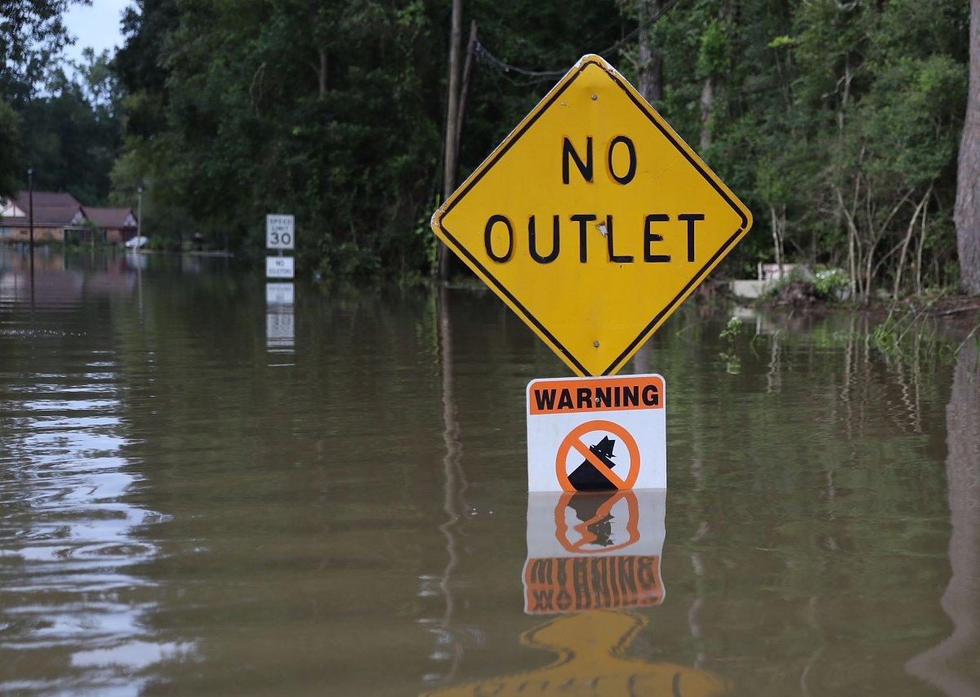
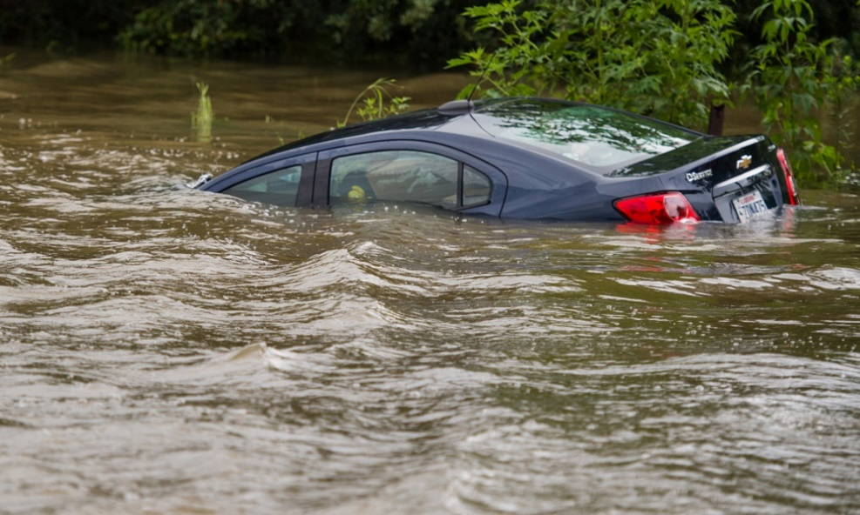
Flooding in the Amite River Basin (August 12- August 22, 2016)
Raedle, Joe. Signs in Flood. [Photograph]. Retrieved from http://wgno.com/2016/08/17/206724/
Clause, Scott. Flooding in Youngsvile. [Photograph]. Retrieved from http://gridironnow.com/baton-rouge-flooding-louisiana-floods
trey Stewart – The University of Texas – 14Sep16

Slide 2
Research Goal
To report on the August 2016 flooding in Louisiana by looking at the following data:
Precipitation (NWS and USGS)
River Stage (USGS)
Elevation (USGS)
High Water Marks (USGS)

Slide 3
Flood Details
Historic amount of precipitation in south Louisiana
Over 2 feet in some locations
Most occurred within 2-day period (August 12-13)
1000 year event
Stage records recorded in 8 Louisiana rivers
One Amite river gauge beat record by 6 feet!
13 Deaths reported

Slide 4
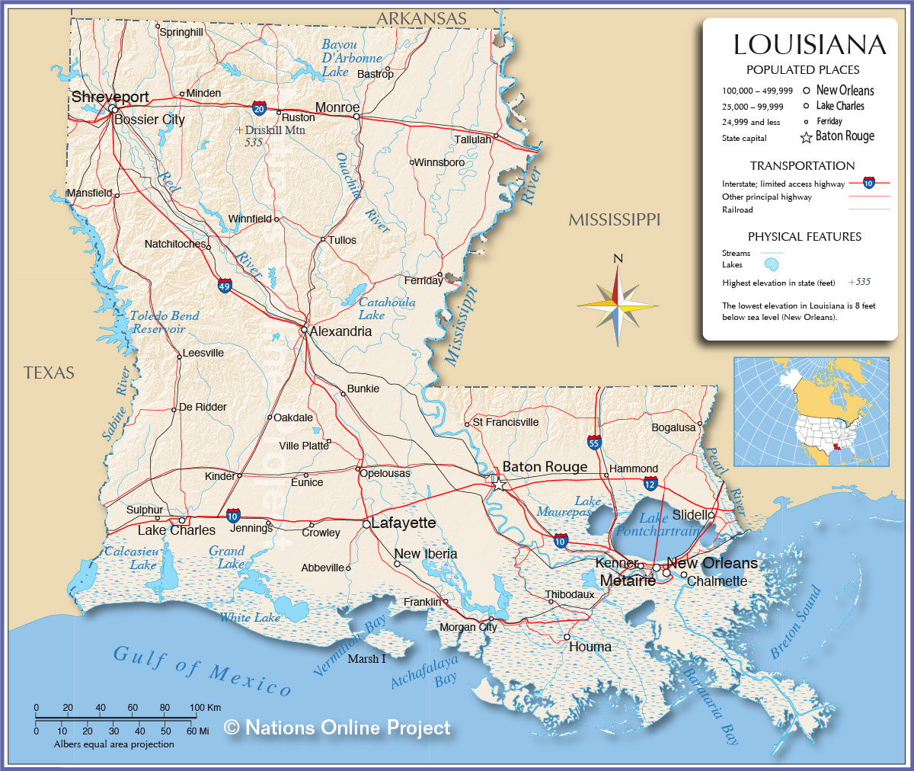
Watershed Location
Amite Watershed Flowlines
Nations Online Project. Map of Louisiana. [Photograph]. Retrieved from http://www.nationsonline.org/oneworld/map/USA/louisiana_map.htm

Slide 5
Watershed Location
Comite River
East Baton Rouge
Amite River
Amite River
Amite Watershed Flowlines
Nations Online Project. Map of Louisiana. [Photograph]. Retrieved from http://www.nationsonline.org/oneworld/map/USA/louisiana_map.htm

Slide 6
South Louisiana is Flat!
Comite River
East Baton Rouge
Amite River
Amite River
Amite Watershed Flowlines
Nations Online Project. Map of Louisiana. [Photograph]. Retrieved from http://www.nationsonline.org/oneworld/map/USA/louisiana_map.htm

Slide 7
Precipitation Mapping
Amite Watershed precipitation 8/12-8/13 (in inches) generated using Empirical Bayesian Kriging Method with precipitation station data
Louisiana precipitation according to NWS August 9-August 16

Slide 8
Precipitation Mapping
My Hometown
Amite Watershed precipitation 8/12-8/13 (in inches) generated using Empirical Bayesian Kriging Method with precipitation station data
Louisiana precipitation according to NWS August 9-August 16

Slide 9
Quantifying Precipitation
South Louisiana:
7.1 trillion gallons of water
3x more than Hurricane Katrina
Amite River Basin:
Average of 14 inches of precipitation
0.5 trillion gallons of water
Thiessen polygons for precipitation stations

Slide 10
Contour Affects Flooding Behavior
Flooding downstream lagged precipitation
Amite and Comite Junction
Amite and Comite Junction
Date | River Stage (feet)
8/11/2016 | 16.85^{P}
8/12/2016 | 28.54^{P}
8/13/2016 | 42.36^{P}
8/14/2016 | 45.60^{P}
8/15/2016 | 42.27^{P}
8/16/2016 | 36.77^{P}
8/17/2016 | 30.18^{P}
8/18/2016 | 26.69^{P}
8/19/2016 | 24.33^{P}
8/20/2016 | 20.47^{P}
8/21/2016 | 18.30^{P}
8/22/2016 | 17.24^{P}
Baton Rouge
Main Rainfall Occurred
Amite Watershed Contour Plot – Lines indicate 10 m height difference

Slide 11
Contour Affects Flooding Behavior
Backwater flooding occurred south of Baton Rouge
Amite and Comite Junction
Amite and Comite Junction
Tributary Stage
Date | River Stage (feet)
8/11/2016 | 16.85^{P}
8/12/2016 | 28.54^{P}
8/13/2016 | 42.36^{P}
8/14/2016 | 45.60^{P}
8/15/2016 | 42.27^{P}
8/16/2016 | 36.77^{P}
8/17/2016 | 30.18^{P}
8/18/2016 | 26.69^{P}
8/19/2016 | 24.33^{P}
8/20/2016 | 20.47^{P}
8/21/2016 | 18.30^{P}
8/22/2016 | 17.24^{P}
Date | River Stage (feet)
8/11/2016 | 1.11
8/12/2016 | 3.15
8/13/2016 | 7.82
8/14/2016 | 14.46
8/15/2016 | 16.56
8/16/2016 | 15.55
8/17/2016 | 13.42
8/18/2016 | 11.00
8/19/2016 | 8.69
8/20/2016 | 6.97
8/21/2016 | 5.69
8/22/2016 | 4.60
Baton Rouge
Main Rainfall Occurred
Tributary
Amite Watershed Contour Plot – Lines indicate 10 m height difference

Slide 12
High Water Mark Locations
High water marks indicate locations with >5 feet of flooding
Notice lots of flooding where Comite and Amite Rivers join
Comite River
Amite River
Amite River
Amite Watershed High Water Marks and Flowlines

Slide 13
High Water Mark Locations
At least 110,000 homes damaged across South Louisiana
Much flooding occurred outside FEMA’s “high-risk” zone
Most homes are not covered by flood insurance
Amite Watershed High Water Marks and Land Cover

Slide 14
High Water Mark Locations
Flooding on I-10 and I-12 made them unusable from August 12th-16th
I-10 West of Baton Rouge remained closed until August 18th
I-12
I-10
Baton Rouge
Interstate Flooding

Slide 15
Final Thoughts and Next Steps
Conclusions:
Historic rainfall event requiring many days for water to drain
Damaged homes and loss of life
Buy flood insurance!
Next Steps
Map HAND for watershed to compare modeled flood inundation depth with HWM data
Determine total precipitation volume upstream from Comite and Amite River junction
Look at Amite River slope and the velocity of the stage peak

Slide 16
Acknowledgements
University of Texas
Dr. David Maidment
Paul Ruess
Louisiana State University
Dr. Clint Wilson

Slide 17
Questions?
References:
Ball, J. (2016, September 23). Louisiana Flood of 2016 made worse by growth-focused policies. Retrieved from NOLA.com: http://www.nola.com/news/baton-rouge/index.ssf/2016/09/louisiana_flood_of_2016_develo.html
Barney, A. (2016, August 24). Review of Historic Flooding in Louisiana. Retrieved from WeatherWorks: http://www.weatherworksinc.com/Louisiana-Floods-2016-Historic
Moscona, M. (2016, August 16). Historic flooding has brought Baton Rouge to its knees . Retrieved from gridironnow.com: http://gridironnow.com/baton-rouge-flooding-louisiana-floods
Samenow, J. (2016, August 19). No-name storm dumped three times as much rain in Louisiana as Hurricane Katrina. Retrieved from The Washington Post: https://www.washingtonpost.com/news/capital-weather-gang/wp/2016/08/19/no-name-storm-dumped-three-times-as-much-rain-in-louisiana-as-hurricane-katrina/
Unknown. (2016, August 22). Death toll rises to 13 in historic flood. Retrieved from wwltv.com: http://www.wwltv.com/news/death-toll-rises-to-13-in-historic-flood/298408105
Unknown. (2016, August 17). Historic flood death toll climbs to 12 after body found in Livingston Parish. Retrieved from wgno.com: http://wgno.com/2016/08/17/206724/
Unknown. (2016, August 14). Louisiana Flooding: 4 Dead, 20,000 Rescued, 10,000 in Shelters, Drivers Still Stranded on Interstate. Retrieved from Weather.com: https://weather.com/news/weather/news/gulf-coast-flooding-latest-news-rescues-motorists-interstate
Wells, C. K. (2016, August 18). I-10 reopens in Lafayette after historic flooding. Retrieved from Nola.com: http://www.nola.com/traffic/index.ssf/2016/08/i10_reopens_lafayette_flooding.html
Wells, C. K. (2016, August 16). Louisiana flooding: Interstate 12 reopens, parts of I-10 still closed. Retrieved from Nola.com: http://www.nola.com/traffic/index.ssf/2016/08/i12_open_i10_closed_flood.html

