Slide 1
Surface Mining & Water Quality
Janice Zhuang

Slide 2
Surface Mining
Mine Drainage
(Wikipedia)
(EPA)
Notes:
General: https://www.epa.gov/sc-mining/basic-information-about-surface-coal-mining-appalachia
Aerial: https://www.washingtonpost.com/opinions/the-dirty-effects-of-mountaintop-removal-mining/2014/10/21/851c4236-58a2-11e4-bd61-346aee66ba29_story.html
mine drainage: https://en.wikipedia.org/wiki/Acid_mine_drainage
Surface mining – mountaintop removal & valley fill
Mine drainage = yellow/orange, highly acidic

Slide 3
Objective
Relationship between surface mining and stream water quality?
  Specific conductivity
    uS/cm or umho/cm
Upper Levisa Subbasin

Slide 4
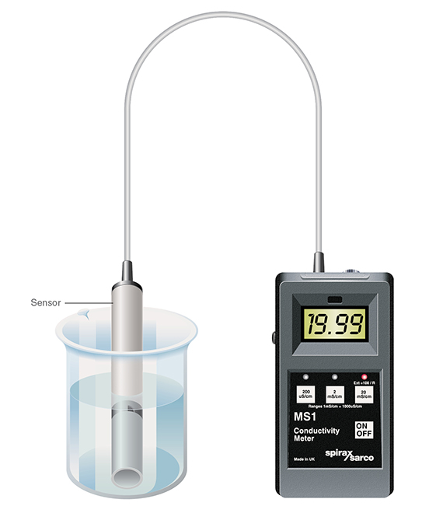

Specific Conductivity
Indicator of pollution
  Presence of dissolved solids (e.g. sulfate)
Sensor measures resistance
  Conductance = $\frac{\text{1}}{\text{resistance}}$
  “mho” ← ohm
2011 EPA guidance:
  300 uS/cm = negative impact
  500 uS/cm = mine violating permit
(Spirax Sarco Ltd.)
Notes:
Specific conductivity:
+ how well water conducts electrical current @ room temp, 25 degrees C (if water not at 25 deg, value converted)
+ conductivity increases with increasing amount and mobility of ions
= indirect measure of presence of dissolved solids such as nitrate, sulfate, phosphate, sodium, magnesium, calcium, iron, etc
= indicator of water pollution
+ easily obtained: sensor measures resistance
+ Conductance = 1 / resistance
+ units can be “mho,” which is “ohm” (for electrical currents) spelled backwards HAHA
+ water naturally conductive from ions released from rock & soil & in groundwater
+ increases in SC from acid mine drainage, ag runoff, road runoff
+ drainage from mine sites can contain higher concentrations of metals, minerals, sediment, etc
+ 2011, EPA issued guidance concluding 300 uS/cm – neg impact on aq life; 500 uS/cm – mine violates WQL standards on permits
+ This is a disputed measure of water quality by mining industry because natural waters have some conductivity
http://www.spiraxsarco.com/resources/pages/steam-engineering-tutorials/the-boiler-house/controlling-tds-in-the-boiler-water.aspx

Slide 5
Upper Levisa Subbasin
Data sources
  NLCD
  Living Atlas
Notes:
NLCD = national land cover database
Mostly forested, some more agriculture on the kentucky side (northwest)

Slide 6
Mining in Upper Levisa
Active Mines
USGS Energy Data Finder
+
Abandoned Mines
Virginia DMME
+
Kentucky MMIS
Notes:
Virginia Department of Mines, Minerals, and Energy (DMME) & Kentucky Mine Mapping Information System (MMIS)

Slide 7


Water Monitoring in Upper Levisa
Gages
STORET
&

Slide 8
Stream Delineation
Delineated from NED (30m) and NHD Plus V2
Notes:
+ Getting the pour point right…
NED = national elevation dataset
NHD = national hydrography dataset

Slide 9
Water Quality in Upper Levisa
Specific conductivity, 2010 - present

Slide 10
Spatial Interpolation
Natural Neighbor interpolation

Slide 11
Spatial Interpolation - Conductivity
Specific conductivity, 2000 - 2010
Notes:
There’s also agriculture in the northwest portion so runoff from that could contribute to increase conductivity

Slide 12
Spatial Interpolation - Conductivity
Specific conductivity, 2010 - present
Notes:
There’s also agriculture in the northwest portion so runoff from that could contribute to increase conductivity

Slide 13
Impaired Streams
Total = 143.5 mi
Impaired = 99.9 mi (red)

Slide 14
Impaired Streams
Impaired by Characteristic
Mining = 50.8 mi
Sediment = 55.2 mi
Conductivity = 57.6 mi
(EPA, 2012)
Notes:
EPA WQL Assessment report 2012 for Ky Upper Levisa

Slide 15
Future Investigation
Further data interpretation
Other stream health indicators
  Sediment (TSS)
  Benthic, if sufficient data
Surface drinking water sources

