Slide 1
Water Usage & Drought in Austin
Meghan Bock
November 17, 2016

Slide 2
Overview
Historical drought and precipitation trends in Austin
Impact of Drought on Residential Water Usage
Analysis of Austin Water Usage Data
Time Elapse of Drought Conditions & Water Usage
Average GPCD for January, 2012-2014
Average GPCD for July, 2012-2014
Further Analysis

Slide 3
Historical Drought & Precipitation Trends
History of severe, long-lasting periods of drought
August 2008 to April 2009: 37 weeks straight of extreme/exceptional drought
April 2011 to January 2012: 41 weeks straight of extreme/exceptional drought
Notes:
2008/2009 drought lasted over a year (68 weeks at nearly 100% D2+
After 2008/2009 drought, Austin remained out of drought conditions for nearly an entire year
2011 drought picked up in late March 2011
Didn’t let up until November 2013, but continued to persist under abnormally dry conditions until January 2015

Slide 4
Impact of Drought on Residential Water Usage
Residential water use patterns tend to reflect increased consumption during periods of reduced rainfall
These patterns are often the result of increased rates of outdoor irrigation
Rate at which water consumption fluctuates varies in response to reduced rainfall
Notes:
Opposite behavior during periods of increased rainfall
Must also consider average temperatures

Slide 5
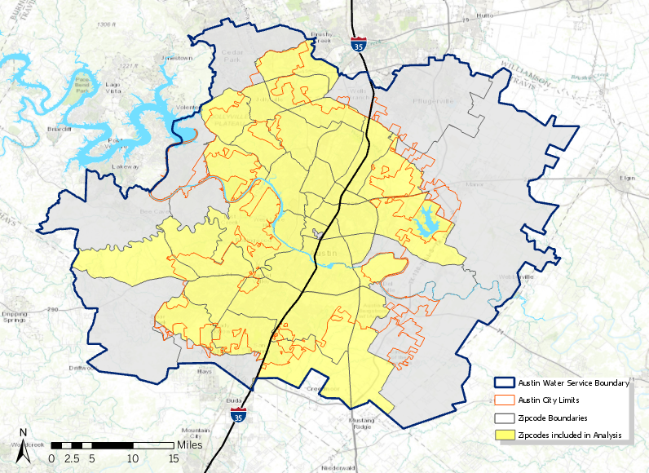
Analysis of Austin Water Usage Data
Based on monthly water consumption data for the residential sector (single family & multi-family) by zip code
Determined average gallons per capita per day using population data from the US Census Bureau
Some zip codes excluded from analysis
Notes:
Opposite behavior during periods of increased rainfall

Slide 6
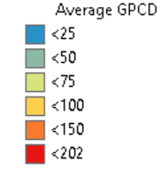
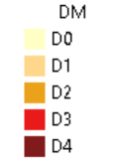
Time Elapse of Drought Conditions & Water Usage (January 2012 through December 2014)
Notes:
Opposite behavior during periods of increased rainfall

Slide 7
Average GPCD for January, 2012-2014
Over the 3-year period, average water consumption was higher in 2013, which saw greater rainfall, but usage decreased in response to drought-like conditions in 2014
Since this for January, likely less outdoor irrigation demands
5-year Rainfall Average
Notes:
Opposite behavior during periods of increased rainfall

Slide 8
Average GPCD for July, 2012-2014
Over the 3-year period, average water consumption was higher in 2012 despite moderate rainfall and continued to decrease as precipitation levels stayed above average
What other factors could be influencing residential water usage?
Notes:
Opposite behavior during periods of increased rainfall

Slide 9
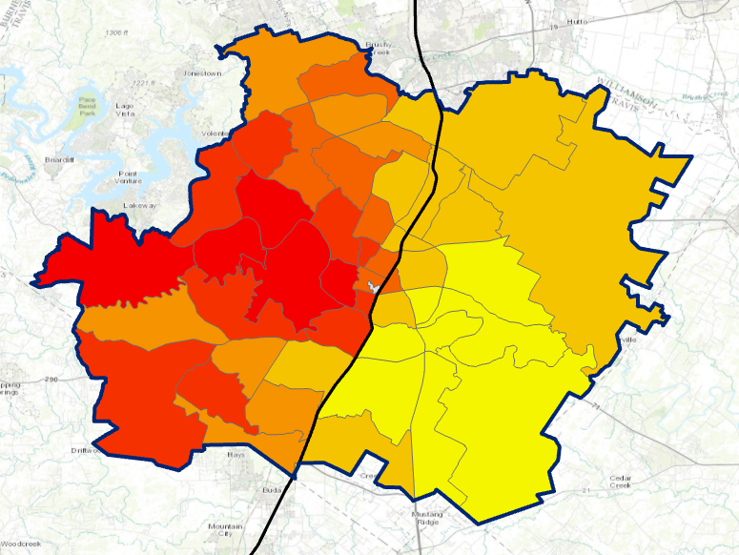
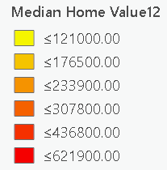
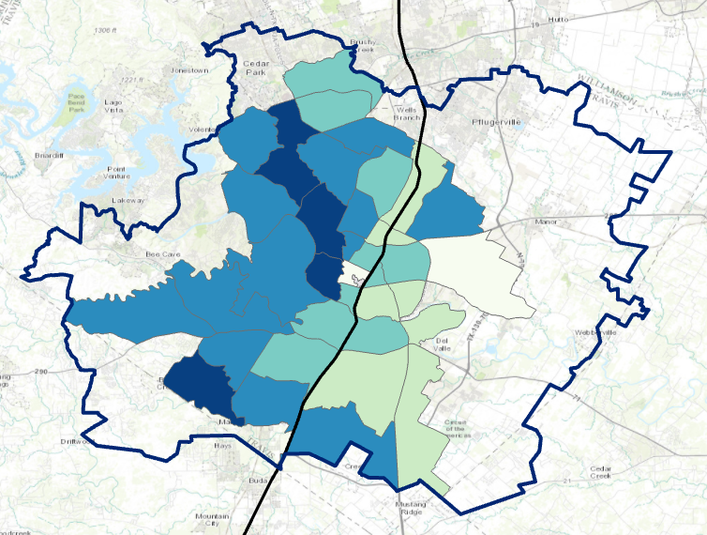
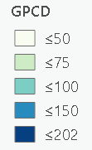
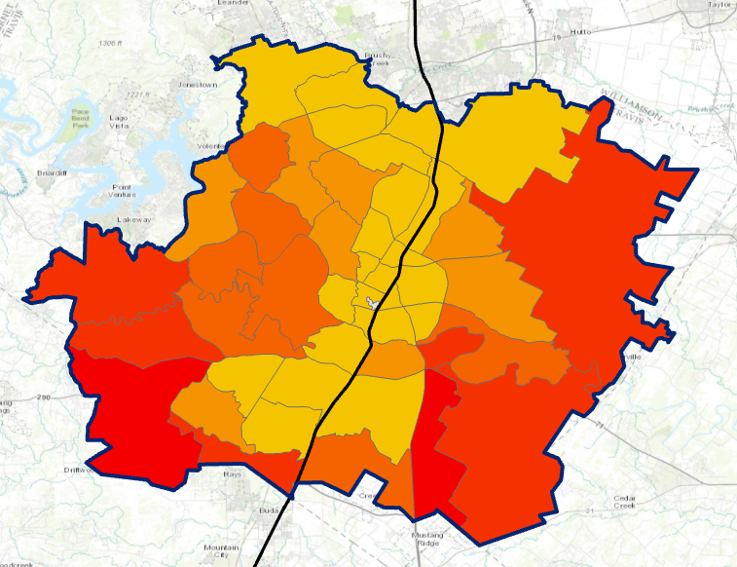
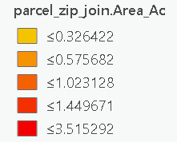
Further Analysis
Median Home Value (2012)
Evaluate other factors that could be contributing to residential water use patterns, including median home value and average lot size
Average GPCD (November 2012)
Average Lot Size
Notes:
Opposite behavior during periods of increased rainfall

