Slide 1
Channel Conditions in the Onion Creek Watershed
Lukas Godbout
CE394K
Fall 2016

Slide 2
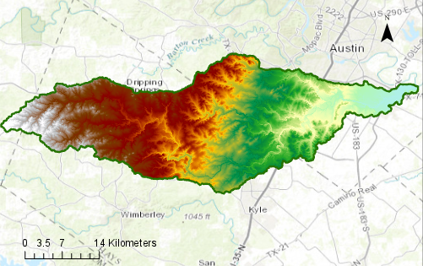
Study Area: Onion Creek

Slide 3
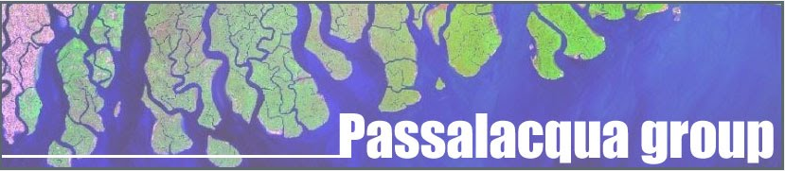
GeoNet: Geomorphic Feature Extraction
Integrating LiDAR elevation data into channel extraction
Nonlinear filtering to enhance high gradient areas
Cost minimization for feature extraction

Slide 4
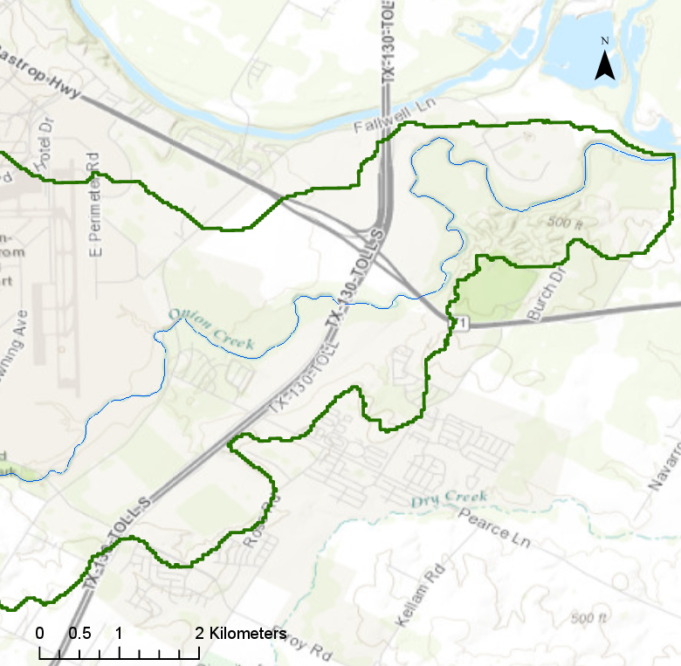
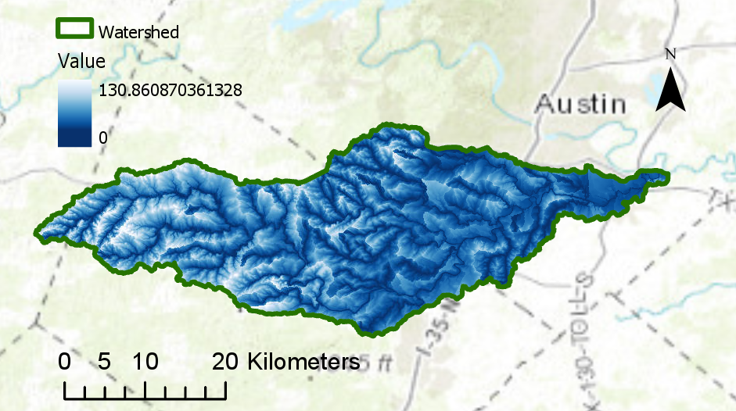
Existing Data
NED 10m DEM
USGS NHD Plus Flowlines
HAND

Slide 5
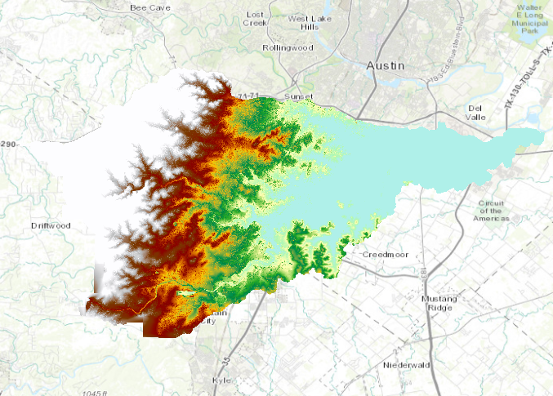
Method: Channel Extraction using GeoNet
Dataset: CAPCOG 10ft DEM
Clipped to Onion Creek watershed
GeoNet 2.2 in MATLAB

Slide 6
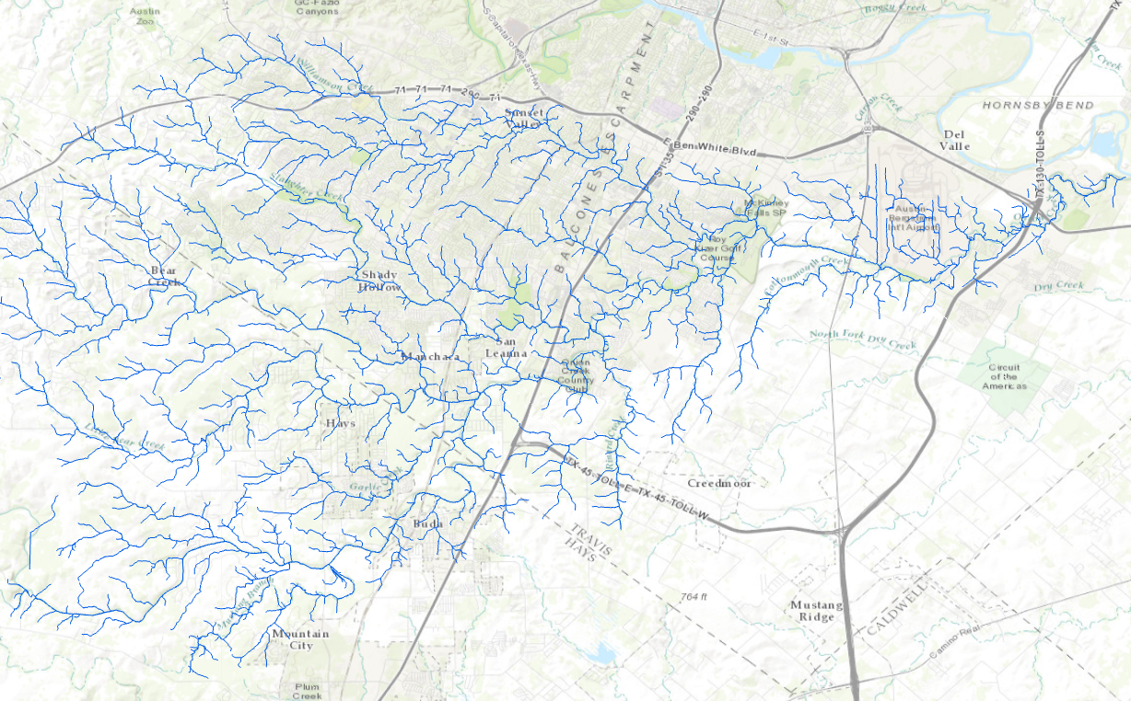
Results: Drainage Network

Slide 7
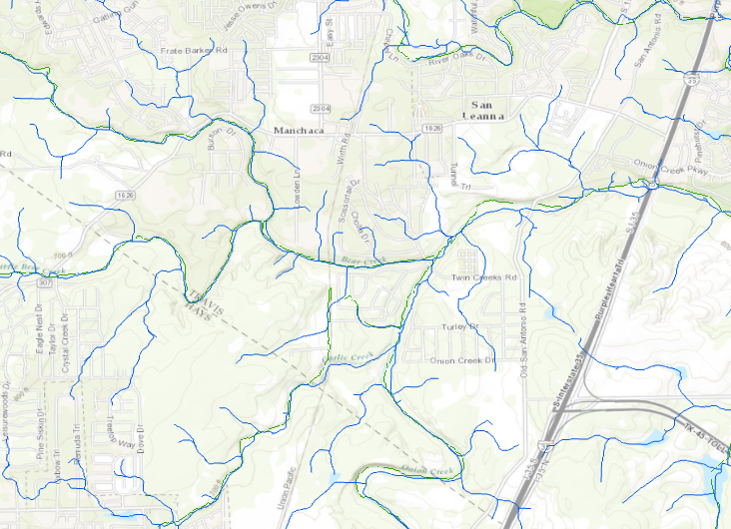
Channel Comparison: GeoNet and NHD Plus
GeoNet
NHD Plus

Slide 8
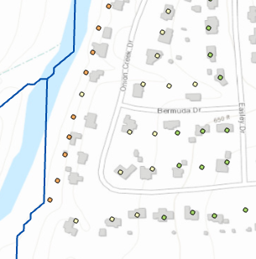
Additional Analysis
Calculating HAND for the study area
Calculating depth of inundation at address points
Comparing HAND and depth of inundation from NHD Plus and GeoNet

Slide 9
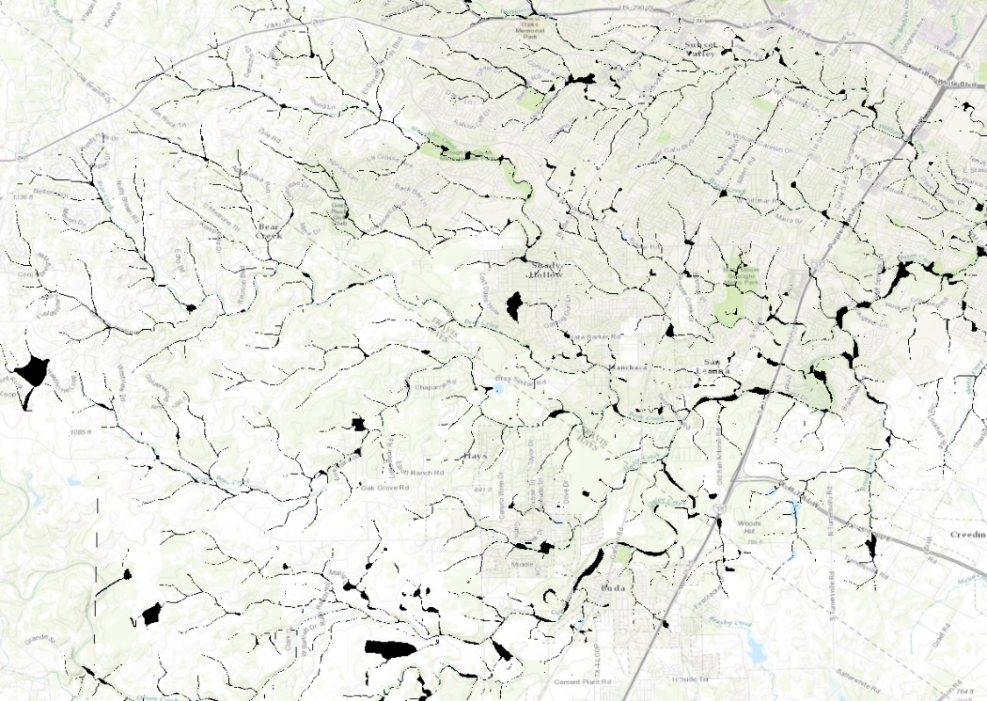
Further Research
GeoNet in Flat Areas
GeoNet in Urban Areas
Quantifying Improvements
3D Representation of Channel Flow

Slide 10
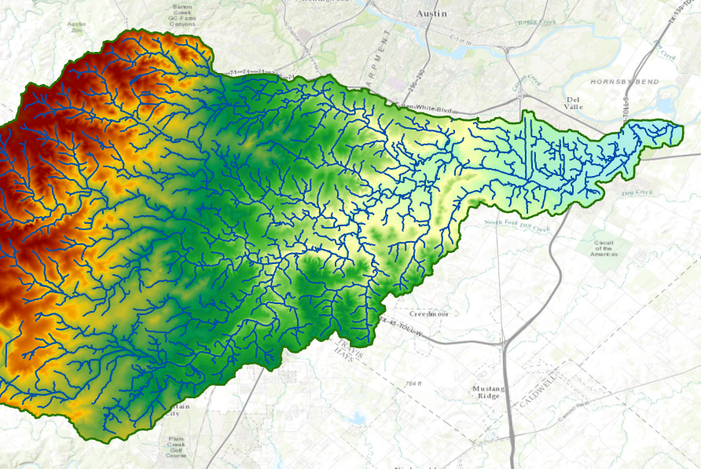
Questions

