Slide 1
Save Our Springs, Save Our City:
Development policy impacts on Floodplain increase
Brian C. Jackson

Slide 2
Content:
Welcome to Austin:
Watersheds and Public Policy: Waller Creek Example
Austin Growth
Save our Springs the fight to protect Barton Springs
National Land Cover Data and Analysis
FloodPlain Growth

Slide 3
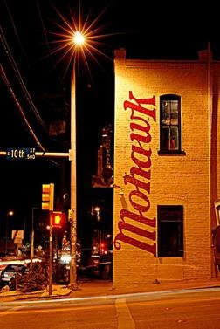
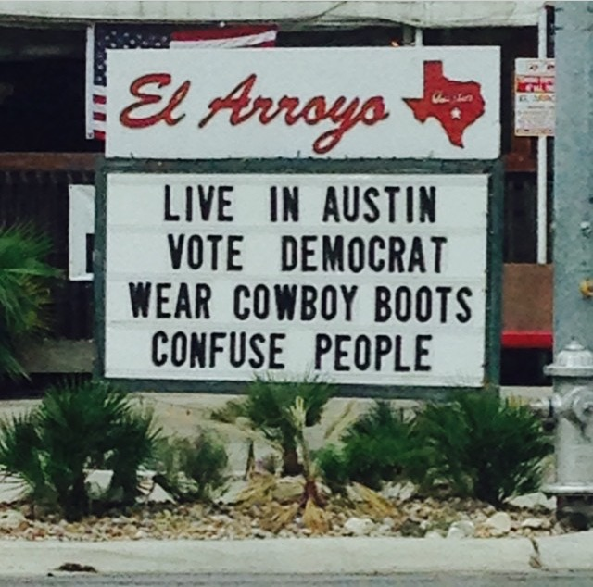
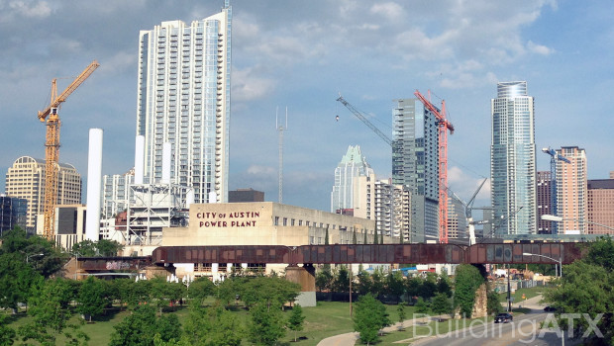
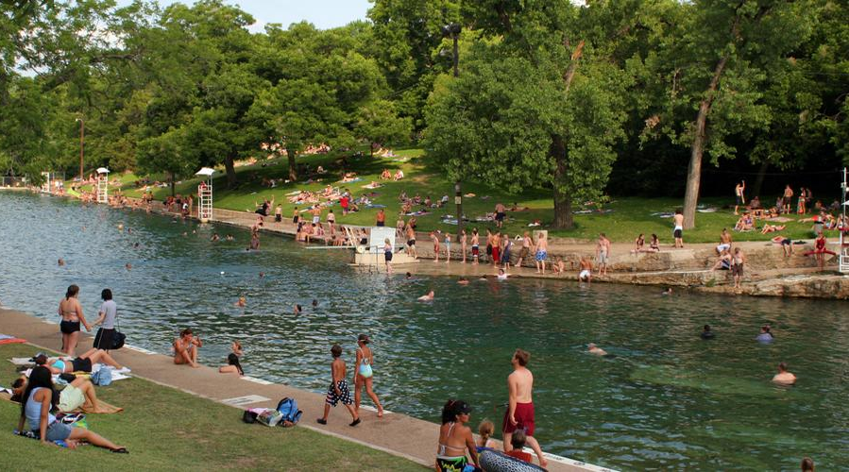
Welcome to Austin
What do you think of when you think of Austin?

Slide 4
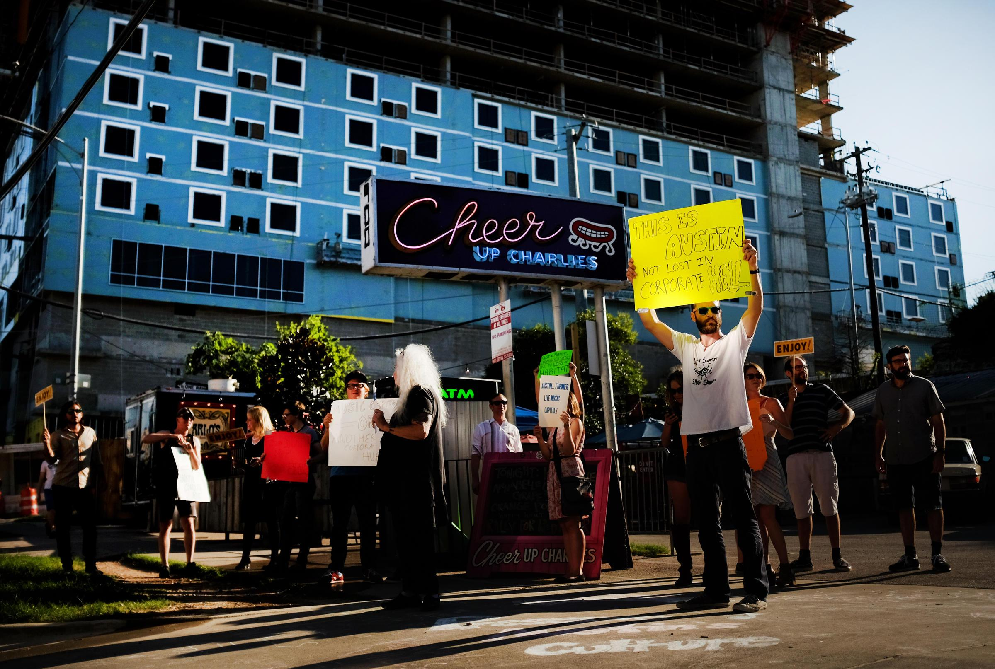
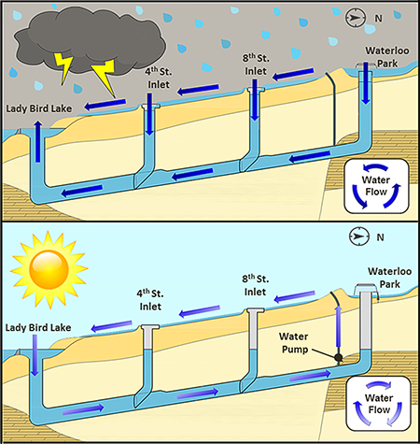
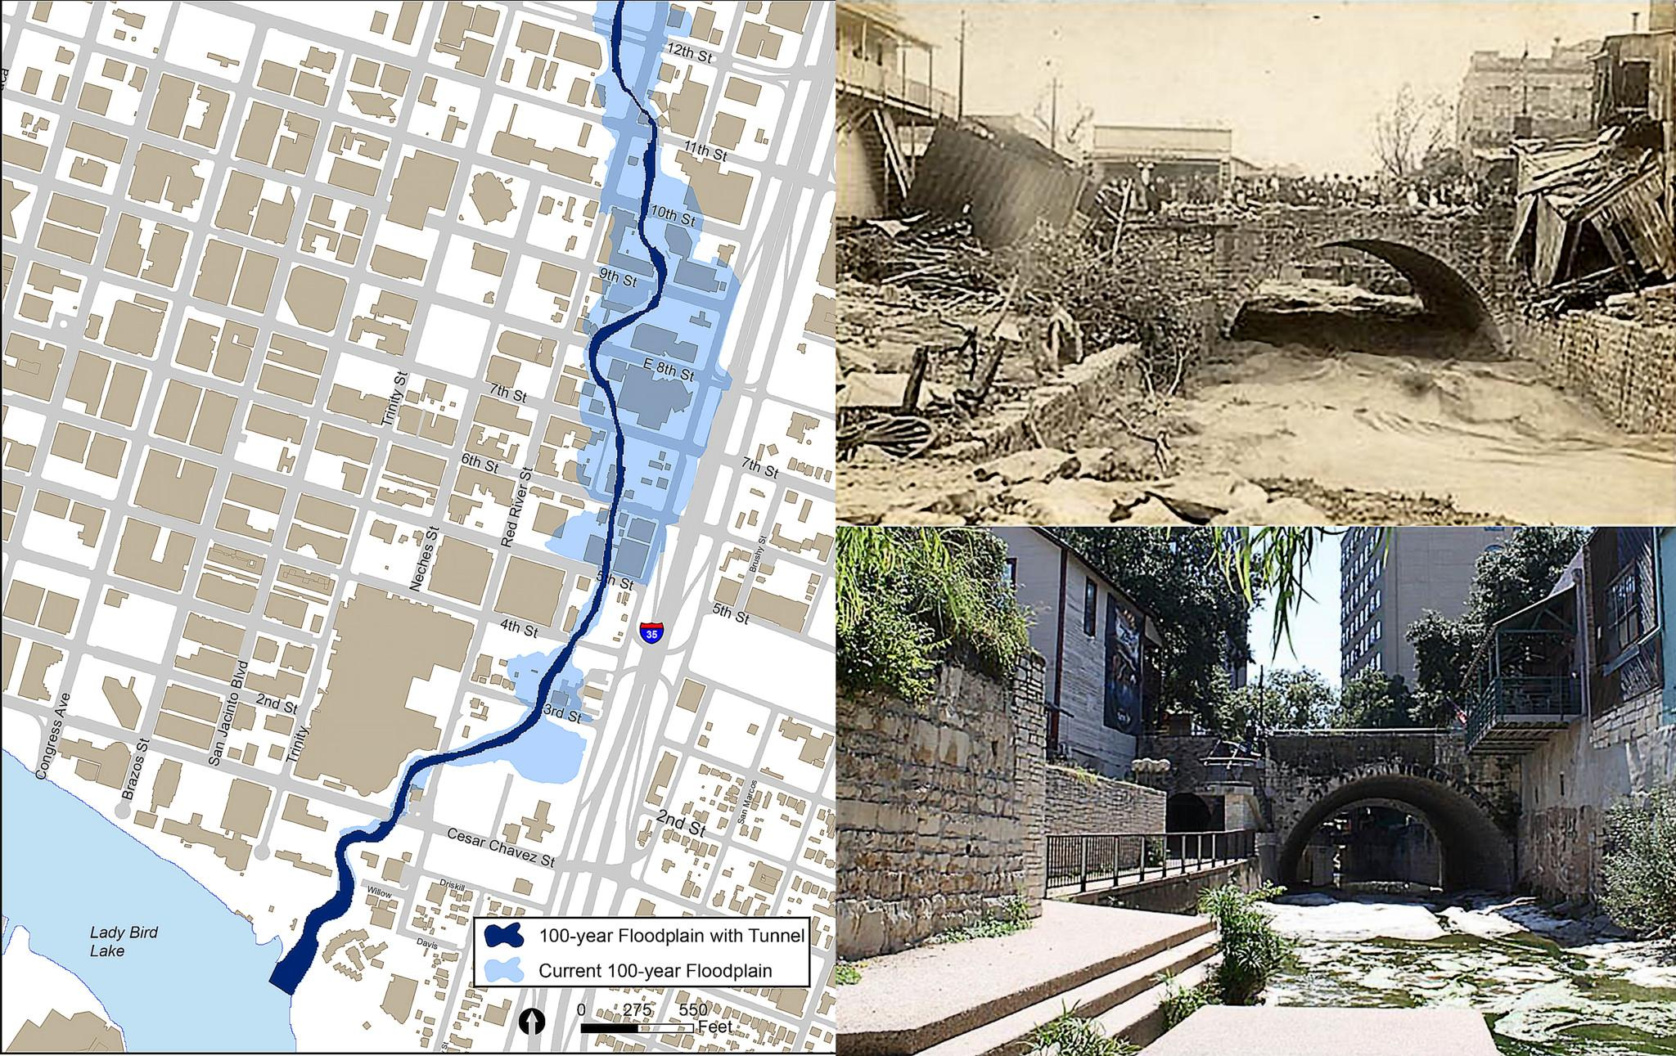
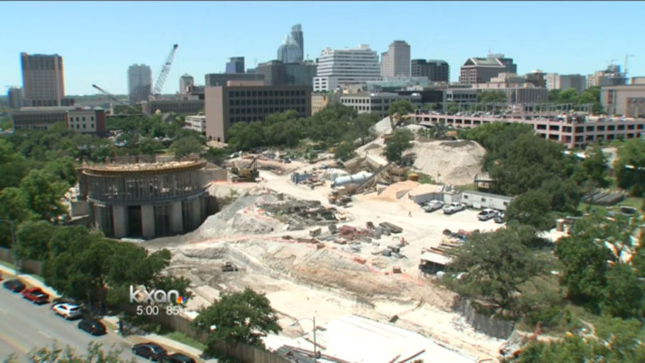
Waller Creek Flood Abatement Tunnel
Pitchfork music magazine writes “Holy Mountain, part of the Red River Cultural District closed when lease expired in October 2015 due to rent increases of nearly 50%. The club next door, Red 7, is currently in the midst of fighting the doubling of their rent as well.
The Red River district has been a vital part of Austin music history for decades. Now developments, rising rents, and an influx of residential properties near these venues are pushing them out.

Slide 5
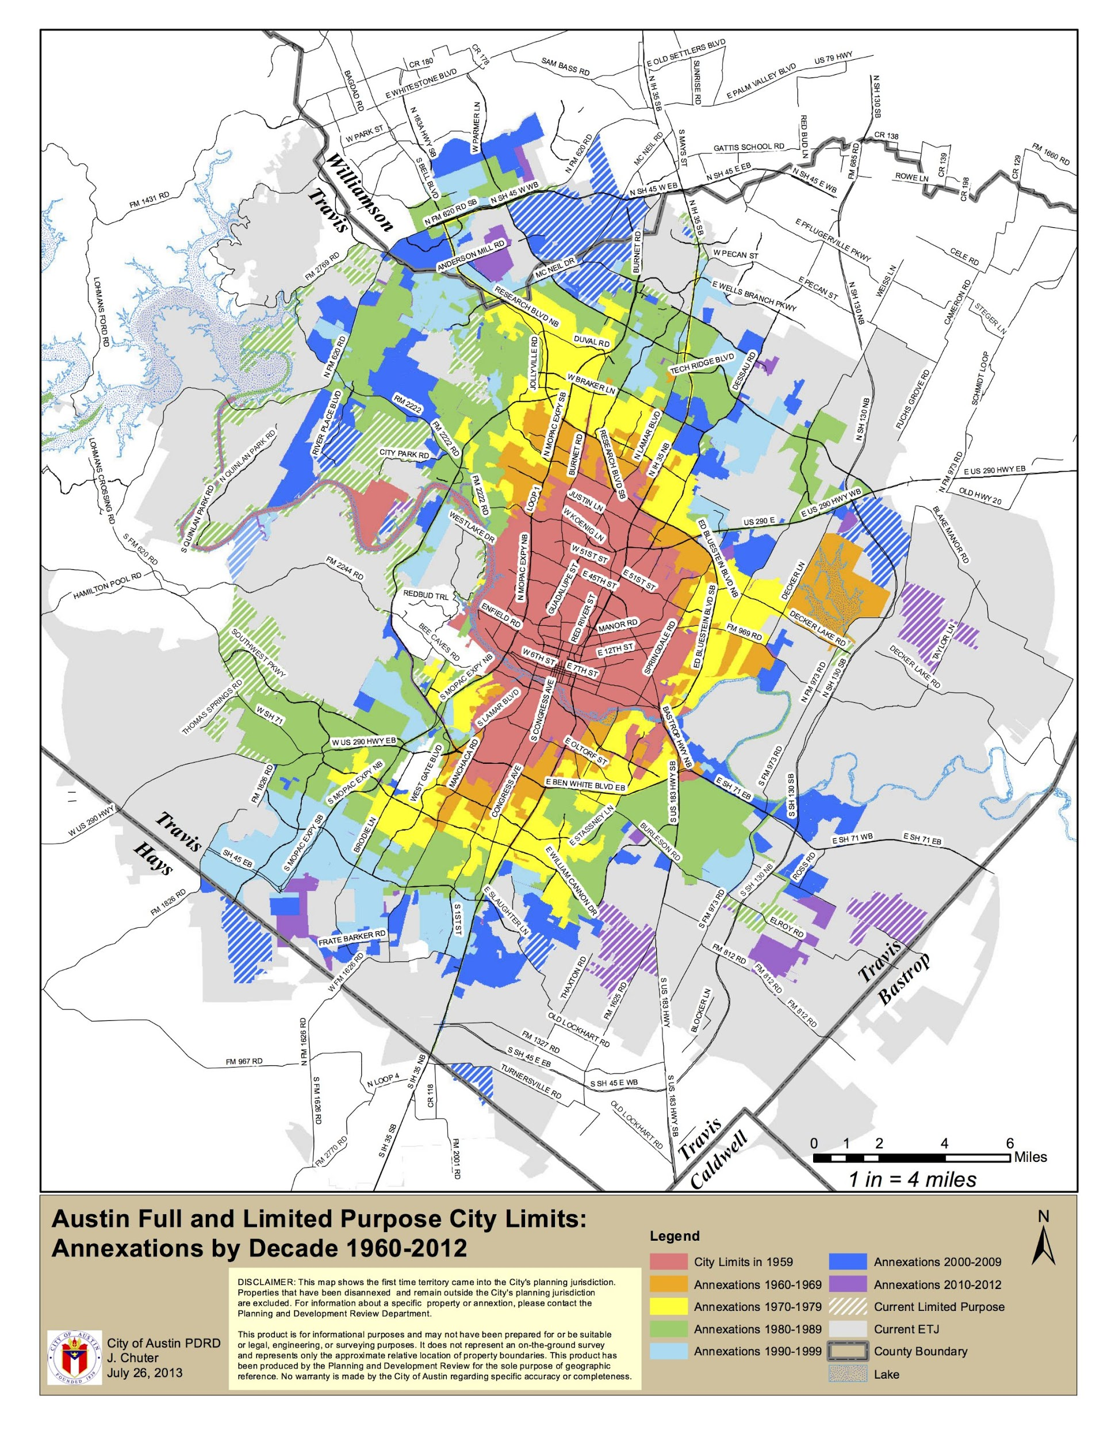
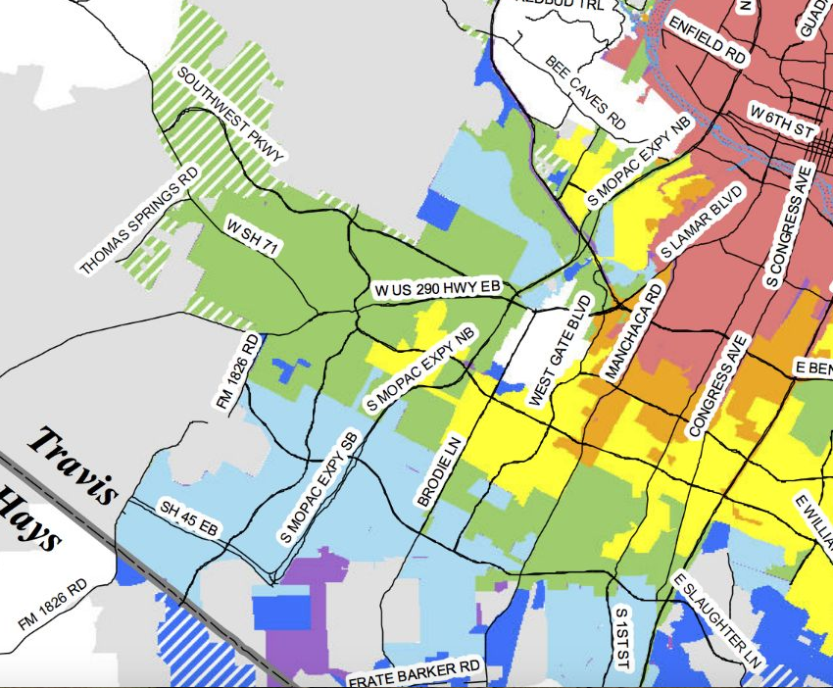
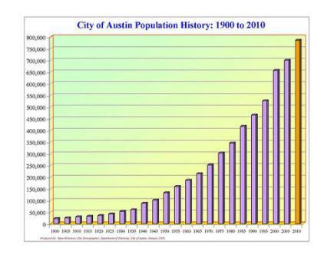
Development and Growth
Austin has been growing rapidly for decades, both population and size.
Development and impervious cover has impacted the water quality in Austin
Image Credits: City of Austin Demographer’s Office, Planning and Zoning Department.

Slide 6
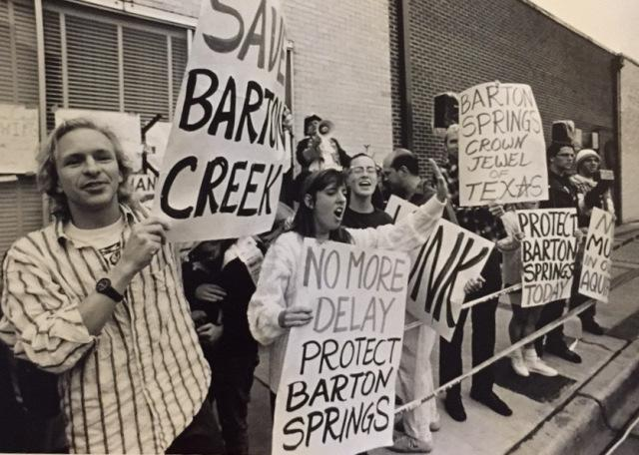
Development History in Austin
Barton Springs Pool
Circle C Ranch
Mopac Expansion
The Barton Creek PUD
Photo Credits Clockwise: Austin American Statesmen, Save Our Springs Alliance, City of Austin

Slide 7
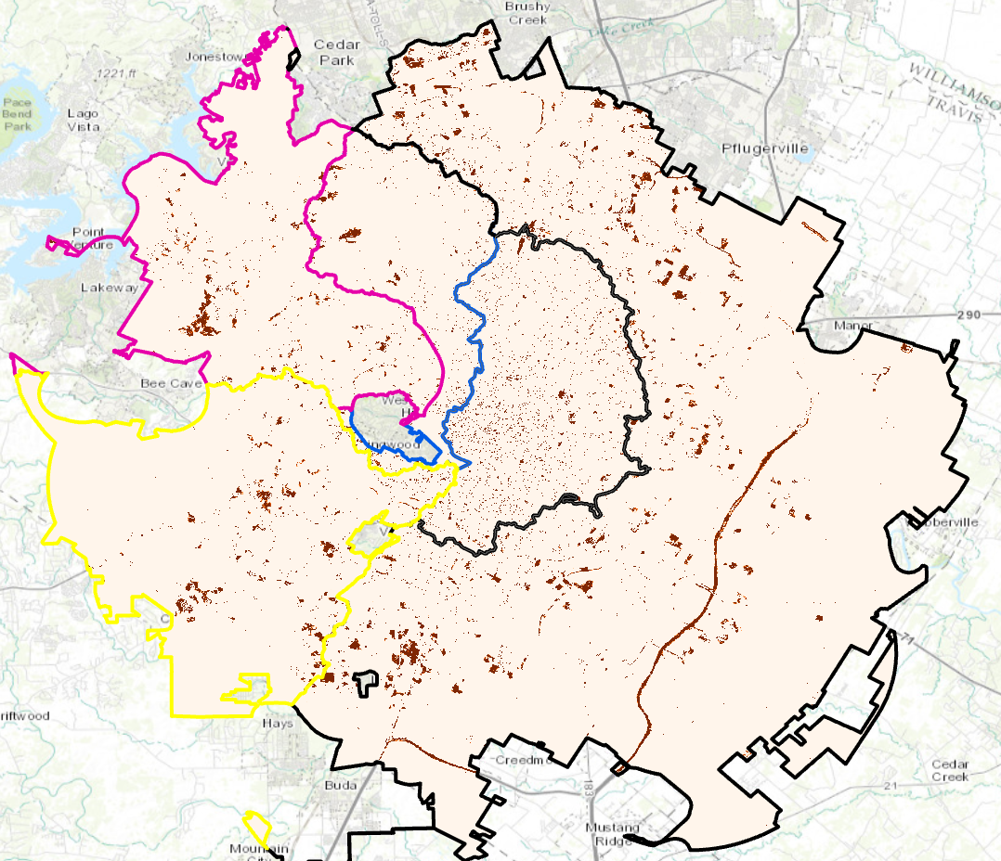
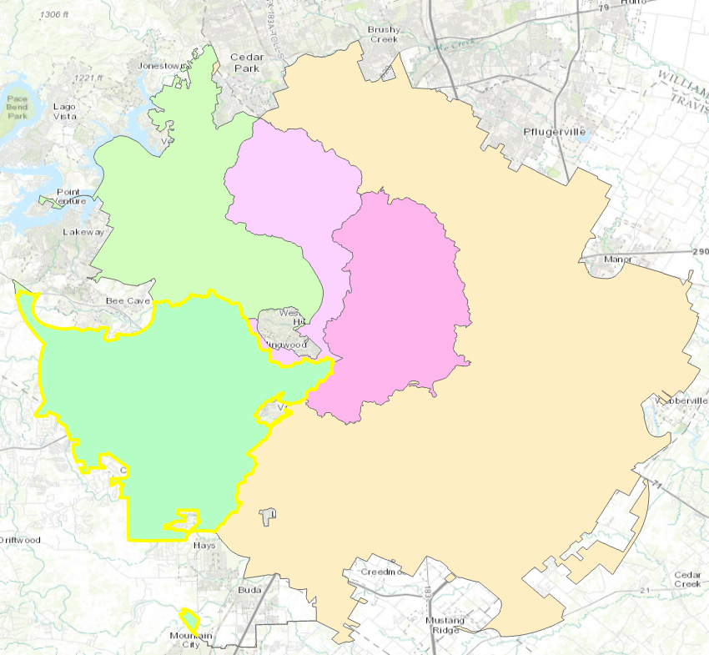
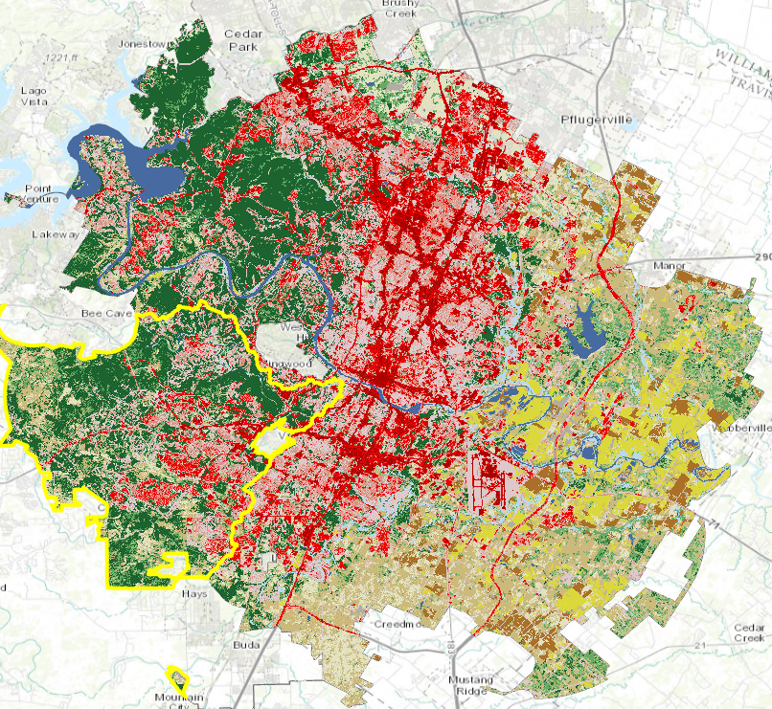
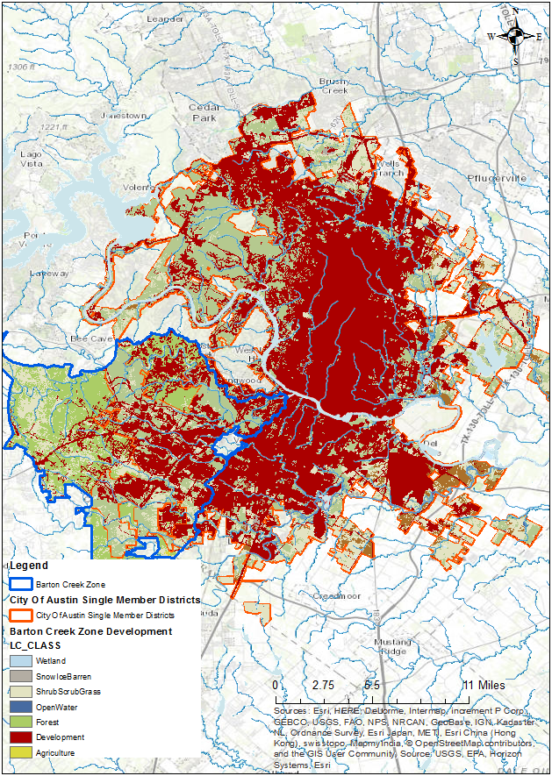
Development in different parts of the City
Watershed Ordinance Zones
2006
2011
Change 2006-2011

Slide 8
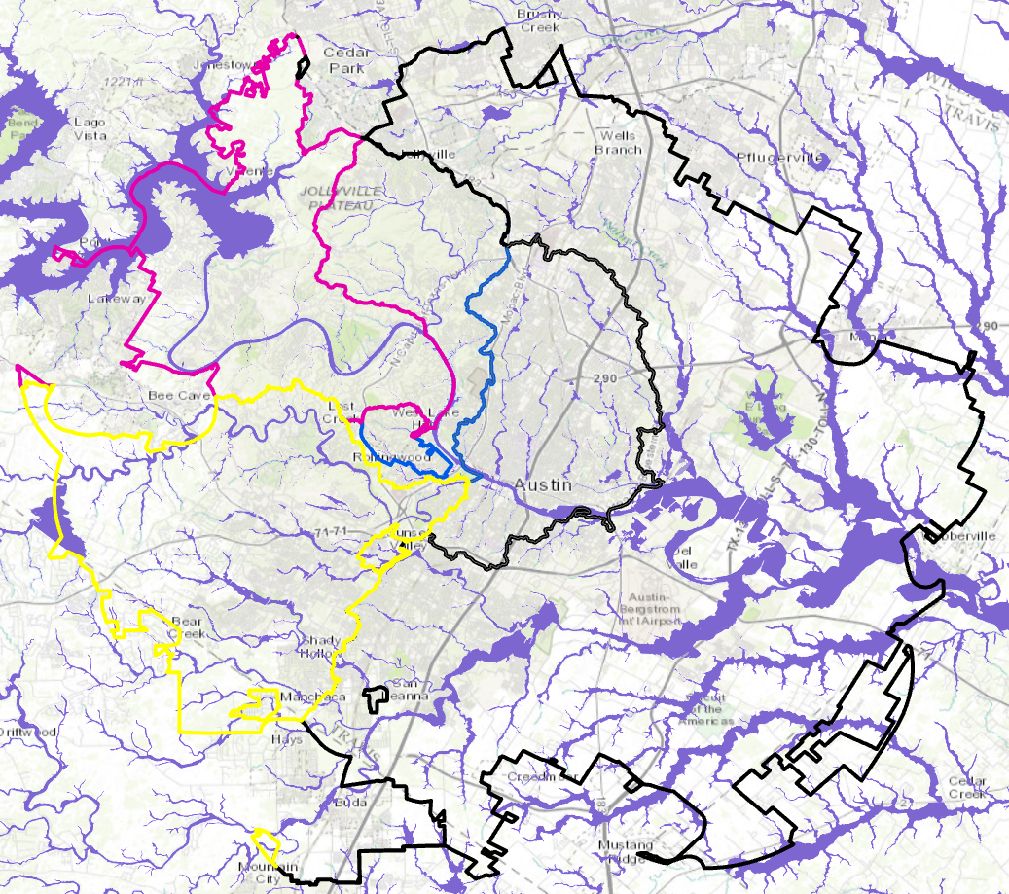
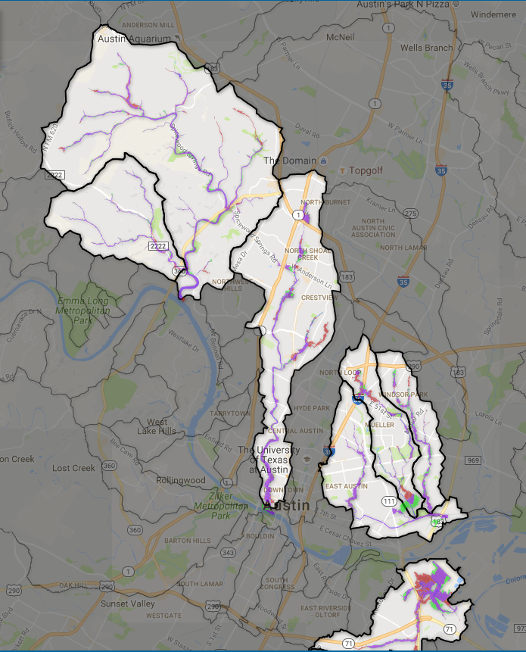
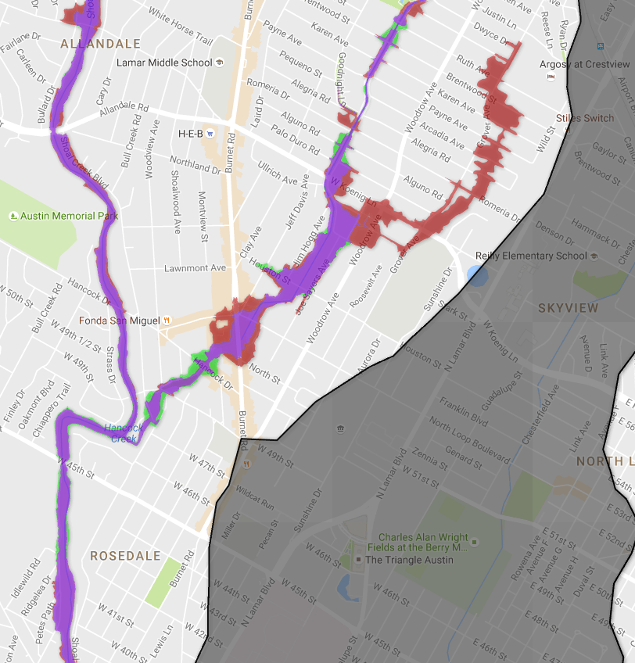
Floodplains
100yr FEMA Floodplain
Austin Watershed Floodplain Changes
Only Selected Watersheds

Slide 9
Questions: Thoughts?
Thank You

