Slide 1
Regulation and Development in the Edwards Aquifer Zone
Abby M. Pfeiffer
November 17, 2016

Slide 2
Agenda
Edwards Aquifer Overview
Regulatory Background
Land Cover Changes
Population Growth
Discharge and Recharge Data
Water Efficiency Measures
Questions

Slide 3
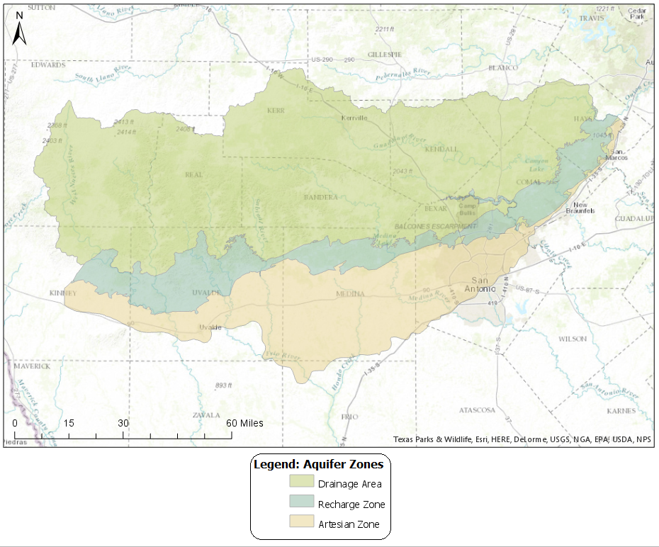
The Edwards Aquifer
Naturally recharging karst aquifer
Very important regional water resource
In San Antonio and surrounding towns, it provides water for
  Agricultural irrigation
  Industrial use
  Municipal drinking supply for >2 million people
Contributing (Drainage) Zone
  Runoff and streams collect to flow into aquifer
Recharge Zone
  Where the aquifer outcrop is at the surface
Artesian Zone
  Areas where natural spring flow discharge occurs

Slide 4
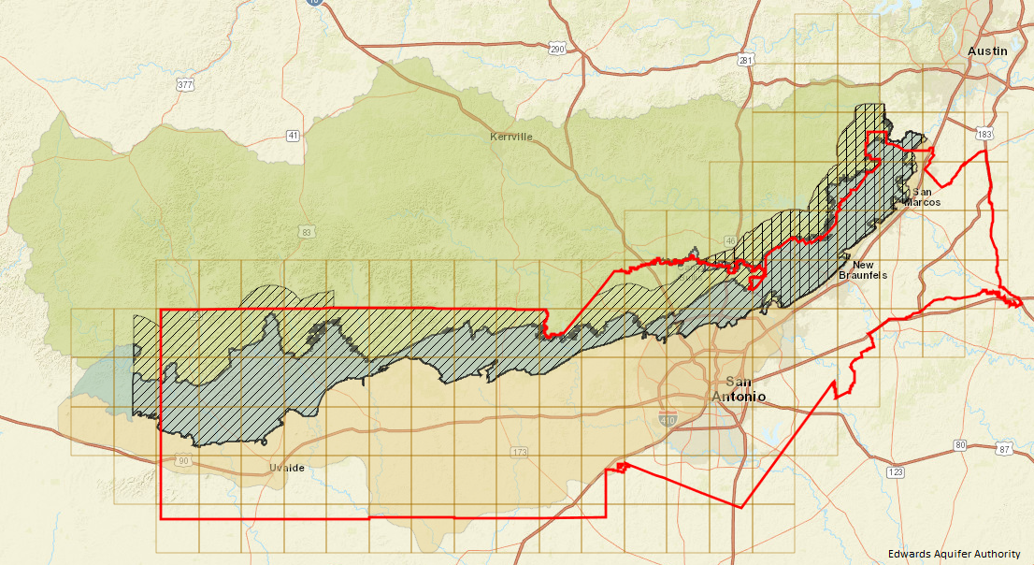
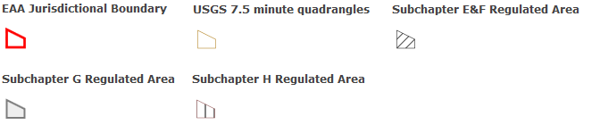
Edwards Aquifer Regulation
1959: Edwards Underground Water District, worked to create maps and assist with licensing
1970s: Texas Water Quality Board started to study issues regarding recharge & contamination
1993: Edwards Aquifer Authority established as regulatory body, crosses county jurisdictions
TCEQ requires special permits to construct in the recharge zone
Legislative Regulations:
  Subchapter E: Spill Reporting
  Subchapter F: Regulated Substances Registration, Storage, and Planning
  Subchapter G: Above and Underground Storage Tank
  Subchapter H: Prohibitions on Coal Tar

Slide 5
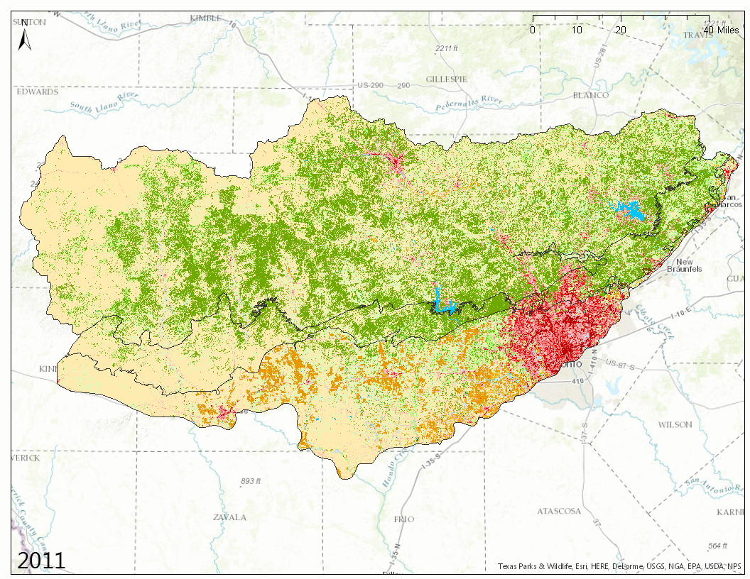
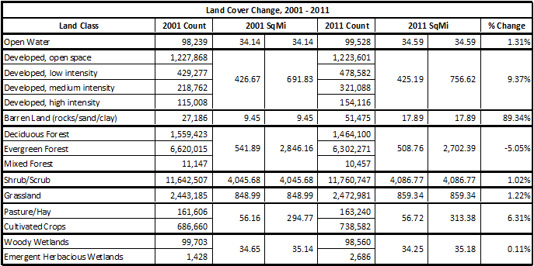

Land cover Changes
9.4% increase in developed land cover 2001-2011
Further steps:
  Compare with 1992 NCLD
  Do analysis of just area over recharge zone

Slide 6
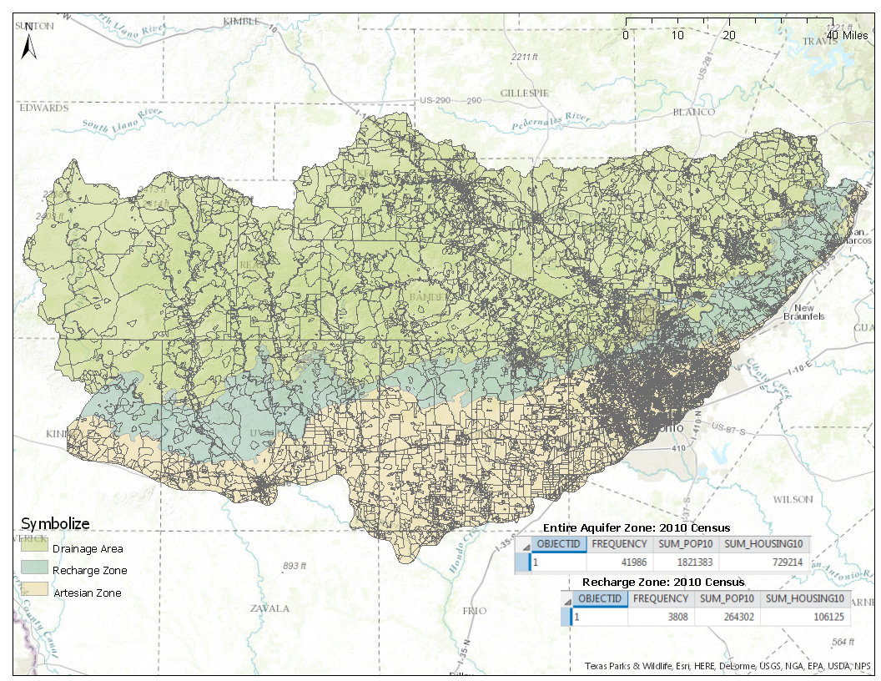
Population Growth
San Antonio has seen very substantial population growth recently
Bexar County Population:
  1980: 988,800
  1990: 1,185,394
  2000: 1,392,931
  2010: 1,714,773
  2015 (ACS est.): 1,897,753
Further Steps:
  Get mapped census data for 1990 and 2000

Slide 7
Discharge and Recharge
Notes:
350K wells, 230K natural springs

Slide 8
Water Efficiency under SAWS
San Antonio Water System (SAWS) is the main municipal user of the Aquifer
Between 1985 and 2010, the residential population using the Aquifer rose 55.6% while the number of acre feet used annually rose only 15.4%
Per person usage has fallen from 225 gallons per person per day in 1982 to only 140 in 2012
Proactive in educating about and incentivizing water conservatoin
  Free low flow toilets: 19 year program giving away over 250,000 toilets
  Annual seasonal water restrictions
  Major conservation PR campaign reaching >100,000 citizens per year in schools and at city events
  Native landscape and irrigation incentives
  Tiered water rate structure

Slide 9
Questions?

