Slide 1
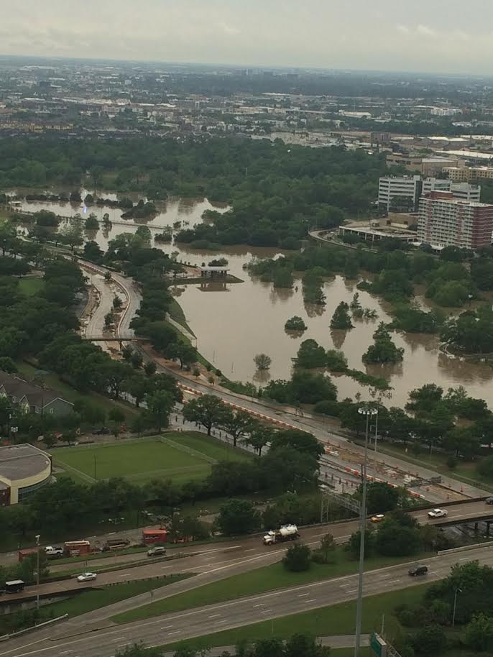
Severe Flooding in Houston
Amy Shoebotham
Notes:
My Dad took this April 18, 2016

Slide 2
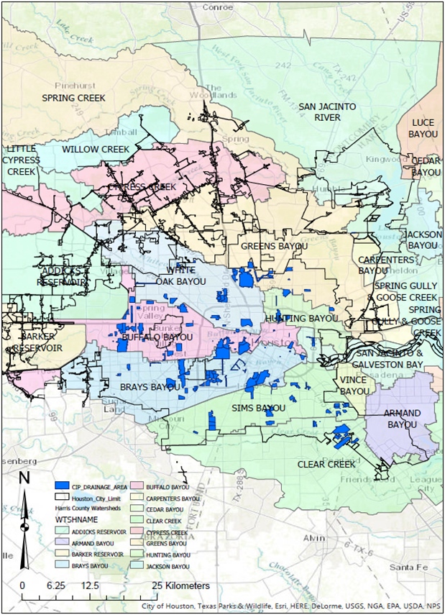
Notes:
CIP (Capital Improvement Plan) Drainage Areas-where city is planning to immediately work on drainage
I would like to see if the City is doing enough in the short-term to mitigate flooding

Slide 3
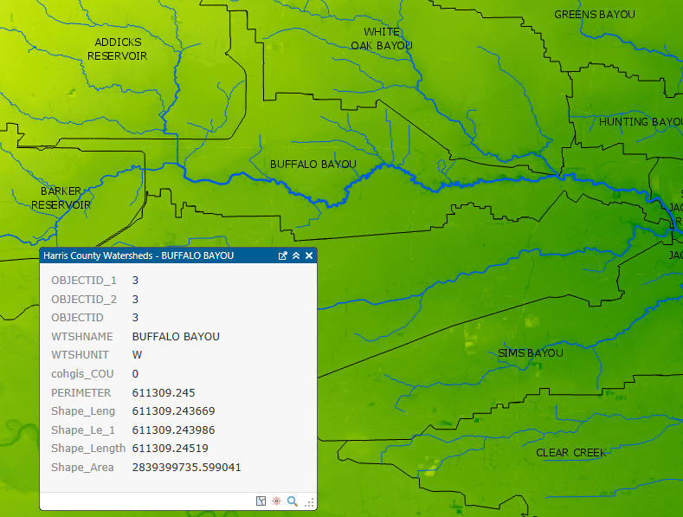
Buffalo Bayou Watershed
Notes:
Very severe flood Memorial Day weekend 2015 and April 2016

Slide 4


Buffalo Bayou Restoration Efforts
me
June 2015: Cleaning up from the Memorial Day flood
October 2015: Opening of new Buffalo Bayou park
Notes:
Major cleanup and rebuilding efforts
Grand opening on new park was on October 3, 2015
I went to a cleanup with AWWA-it rained and we used trash bags as ponchos-I clearly wasn’t into my poncho anymore and didn’t like being in the rain

Slide 5
Analysis
Explore DEM to find lowest elevations in watershed, and compare to the CIP Drainage Plan for the City of Houston
Delineate Buffalo Bayou watershed
Next steps
  Narrow down goal
  Look at other factors such as land cover
  Use Model Builder for more in-depth analysis
Notes:
-make more specific than “look at flooding of Buffalo Bayou”

Slide 6
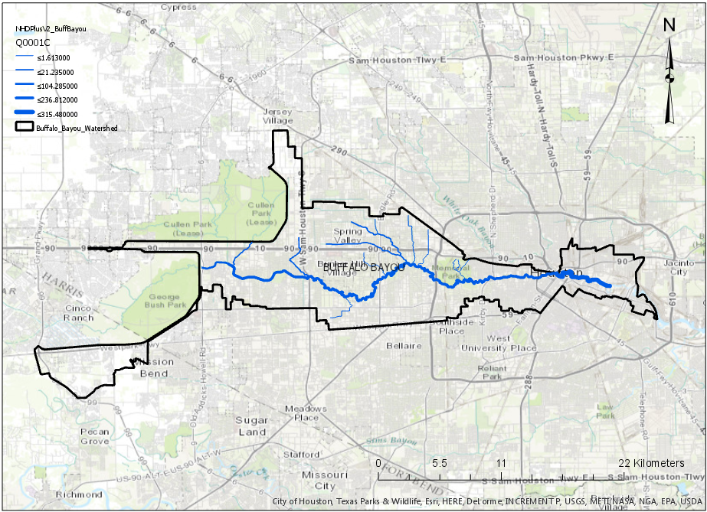
Notes:
Made Buffalo Bayou watershed its own feature class, and made Buffalo Bayou watershed’s streams their own feature class using Extract Landscape Source Data
Mostly main stream! But in very populated and developed area, goes through downtown
Star is where my family lives/where I’m from

Slide 7
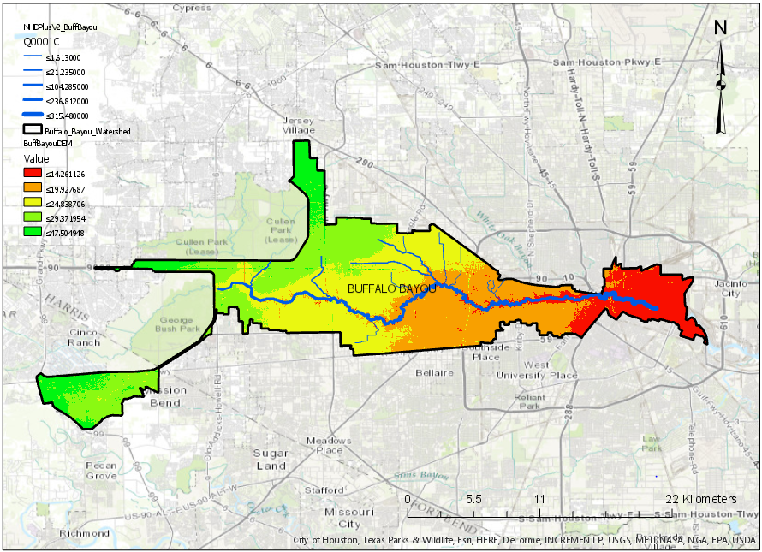
Notes:
-Extract by Mask to make DEM Raster of only Buffalo Bayou Watershed—symbology of just this watershed makes it easier to see elevation differences than DEM of all Houston-Galveston that I found from USGS

Slide 8
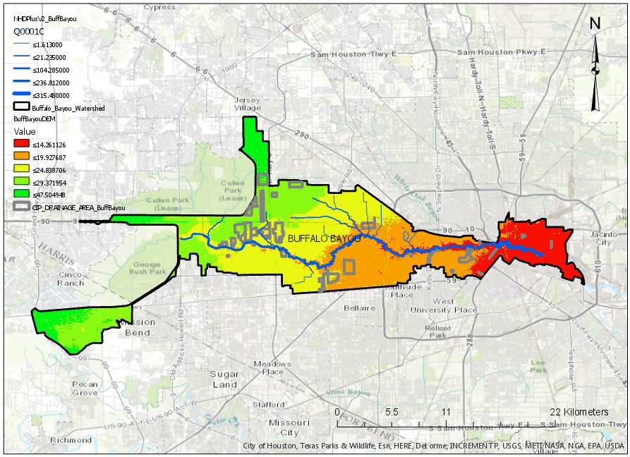
Notes:
Did not have the expected correlation between digital elevation model and CIP
CIP seems to be mostly focused on highly populated residential areas rather than the lowest elevation—makes sense in terms of financial damages of homes, etc.
A bit more towards bayou

Slide 9
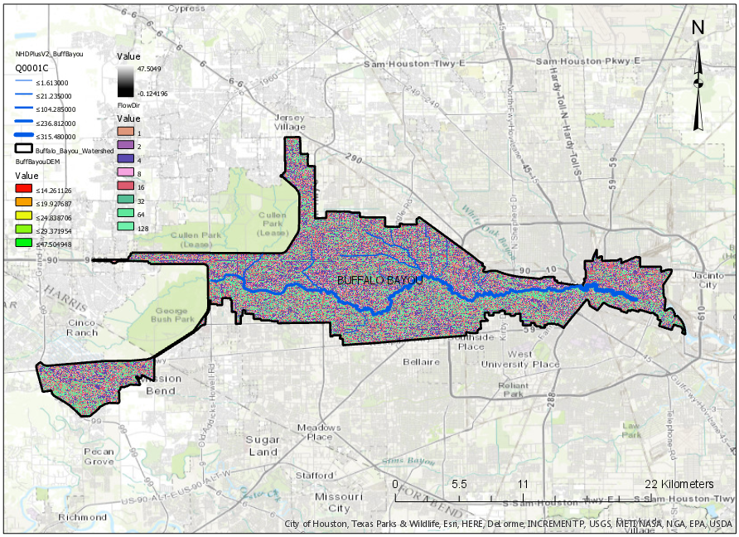
Notes:
Flow direction and flow accumulation—Houston is so flat that it doesn’t have much of a pattern

Slide 10
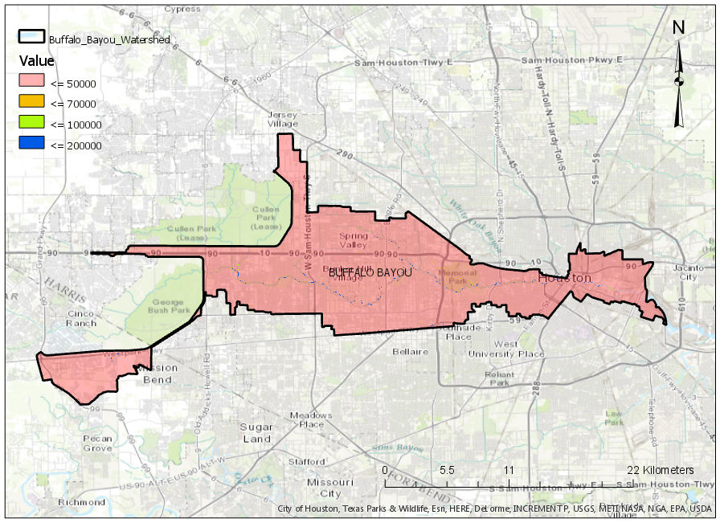
Notes:
Flow accumulation drops off very abruptly-guessing it is because of man-made bayou

Slide 11
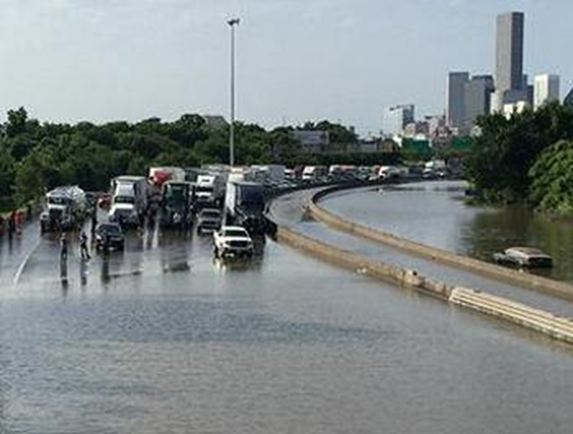
References and Data Sources
ftp://rockyftp.cr.usgs.gov/vdelivery/Datasets/Staged/Hydrography/NHD/State/HighResolution/GDB/
http://cohgis.mycity.opendata.arcgis.com/
http://365thingsinhouston.com/2015/09/27/celebrate-grand-opening-newly-transformed-buffalo-bayou-park/
http://www.tawwa.org/members/group_content_view.asp?group=108292&id=398834
http://ens-newswire.com/2015/05/26/extreme-weather-proves-deadly-in-texas-oklahoma/

