Slide 1
Height Above Nearest Drainage in Houston and Galveston
Jeff Zheng
GIS Water Resources

Slide 2
HAND - Houston

Slide 4
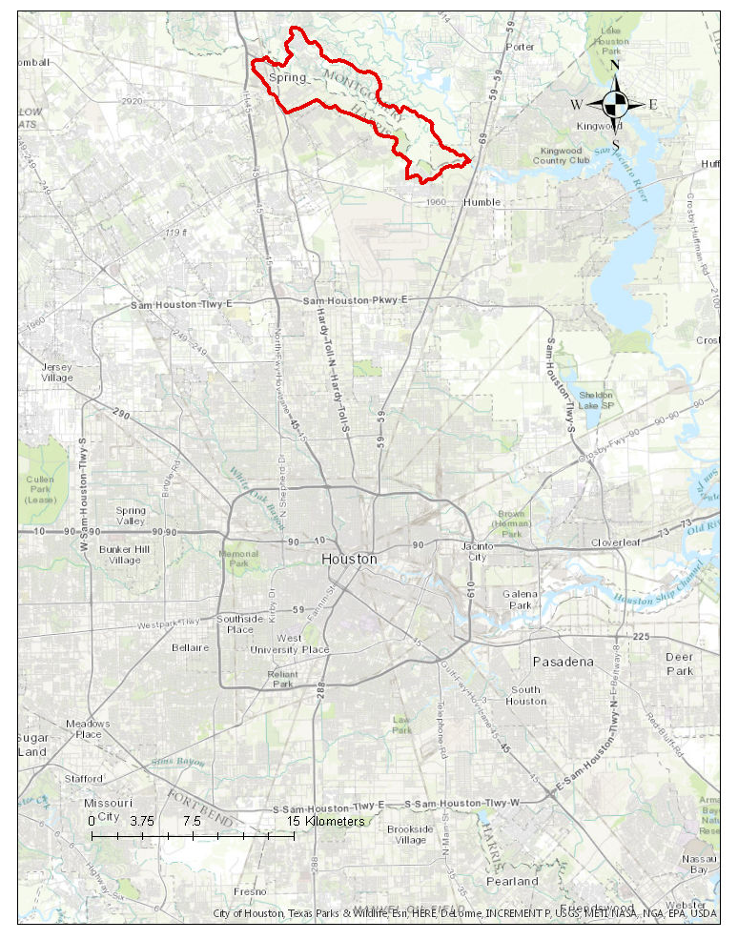

Slide 5
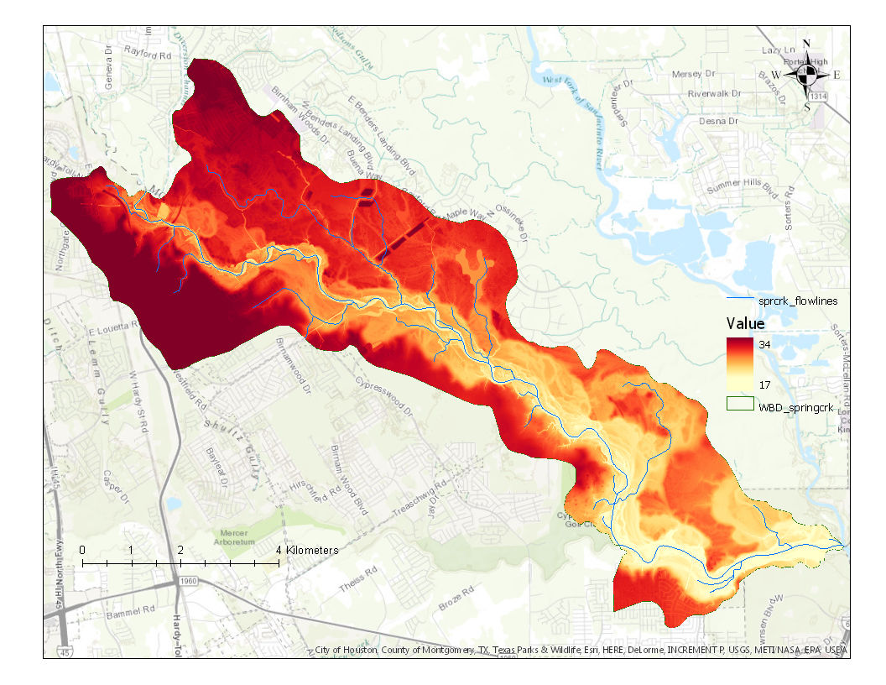

Slide 7
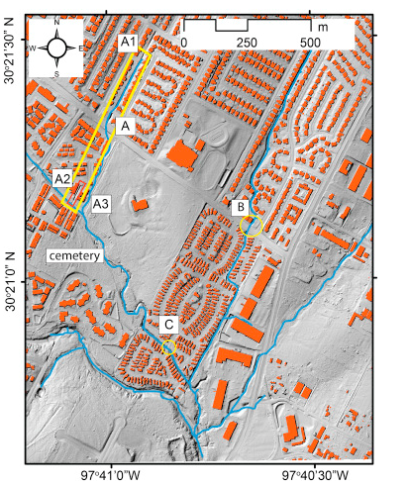
GeoNet
Open access computational tool
Can be applied to different types of terrain:
Natural areas/catchments
Relatively flat topography and some artificial features
Urban areas

Slide 8
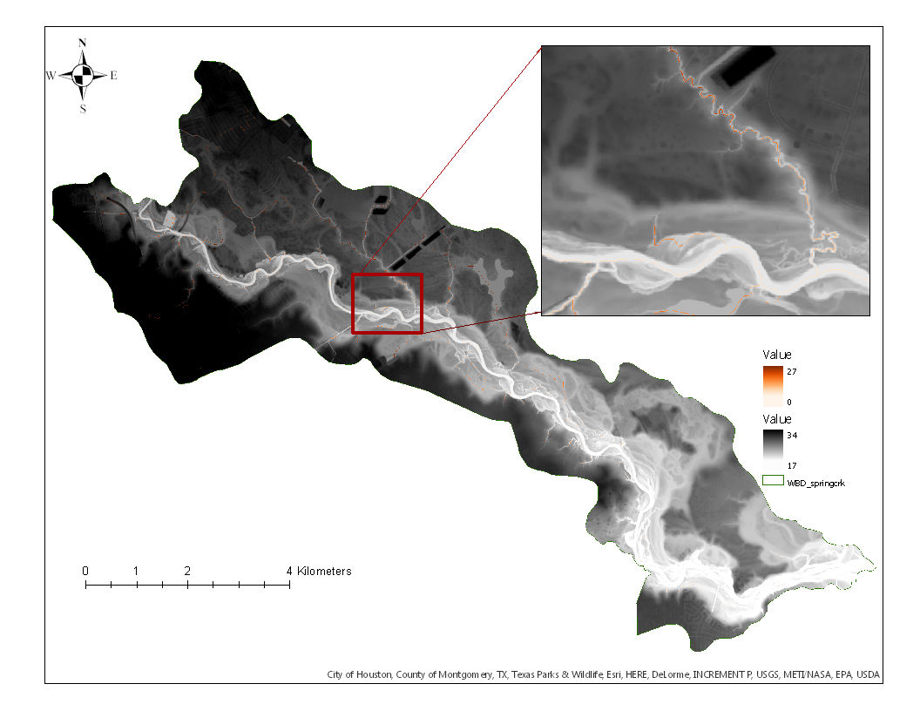

Slide 9
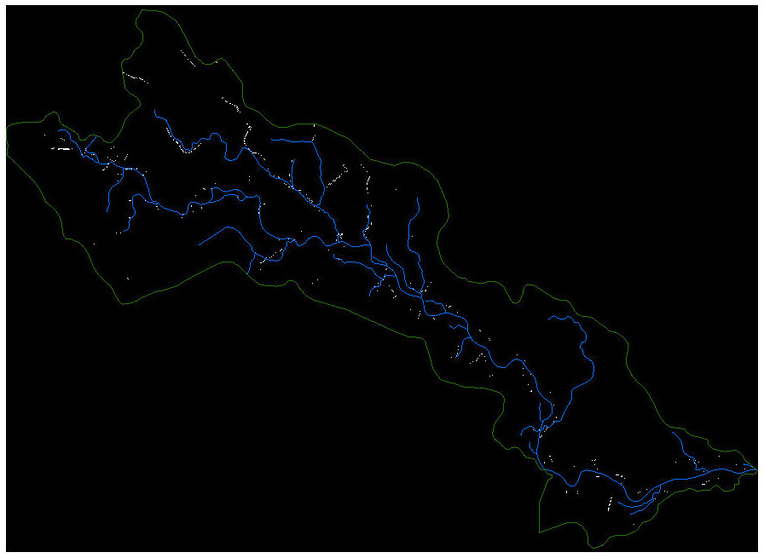

Slide 10
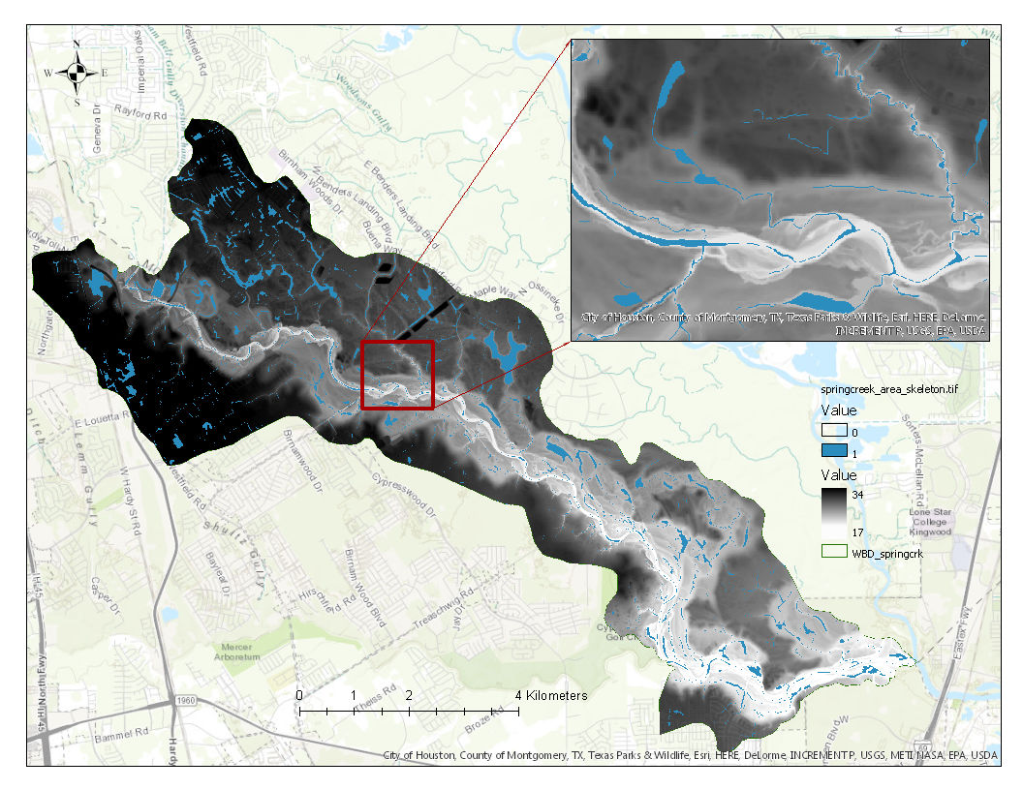

Slide 12
Project Challenges
Large datasets (~60 GB – Houston area)
First time experience (so lack of)
Need to analyze data at much smaller scales
Administrative access in general
Downloading/installing software
Access to licensed commercial software
Mapping toolbox (MATLAB)
Learning curve
Become some-what competent with MATLAB and Python

Slide 13
Next Steps
Produce drainage networks for several more small scale catchments (in shape file)
Overlay with the 3-meter DEM and compare with NHD-Plus flowlines
Create HAND raster files for the small scale catchments
Compare with original HAND (containing 3-meter NED and high resolution flowlines)
Look into the Modified HAND (based on stream order)
Developed by McGehee, Li, and Poston at the National Water Center (Summer Institute)
Analyze non-uniform inundation while also account for backwater effects

Slide 14
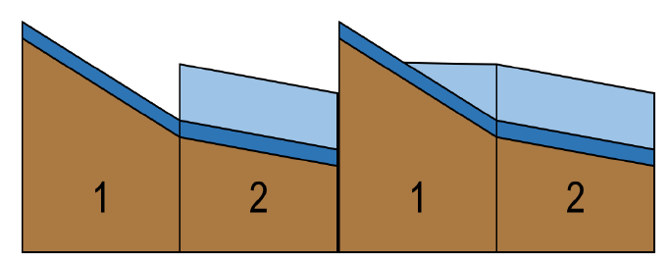
Modified HAND

Slide 15
References
Sangireddy, H.*, C.P. Stark, A. Kladzyk*, Passalacqua, P. (2016). GeoNet: An open source software for the automatic and objective extraction of channel heads, channel network, and channel morphology from high resolution topography data, Environmental Modeling and Software, 83, 58-73, doi:10.1016/j.envsoft.2016.04.026.

Slide 16
HAPPY THURSDAY!

