Slide 1
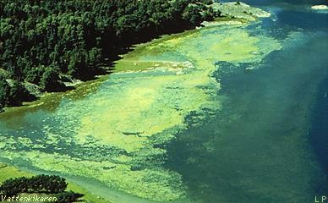
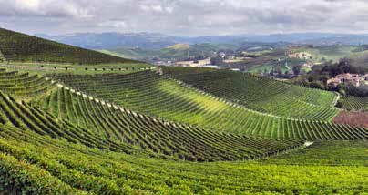
Nitrogen Transport Estimates in the San Antonio River Basin
Term Project for GIS in Water Resources
Seungwon Chung
2016-11-22
Source: https://www.lakeforest.edu, UNEP (2014)

Slide 2
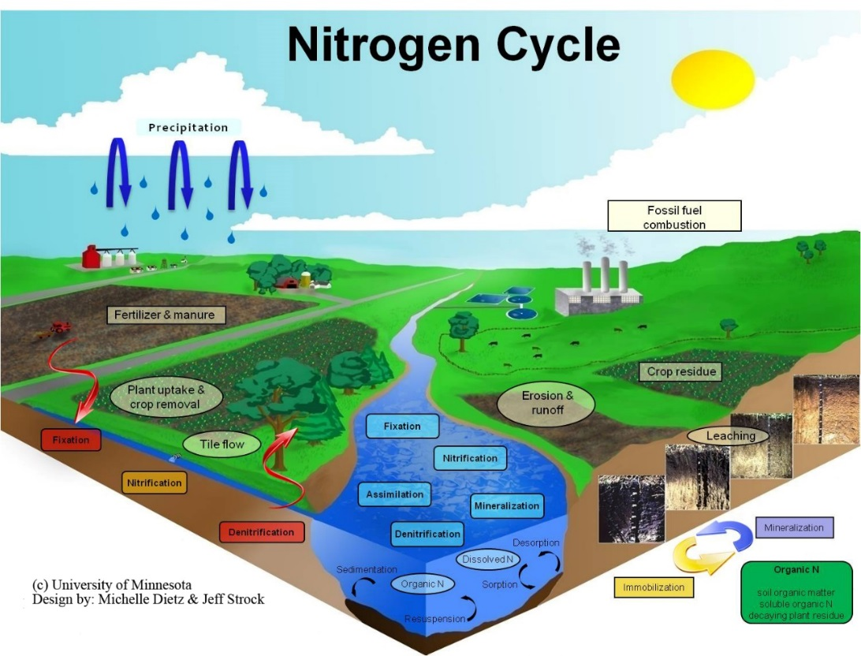
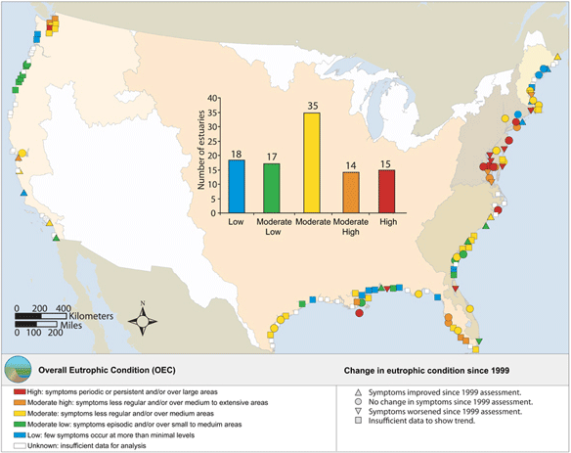
How Does Landscape Nitrogen Dynamics Affect Coastal Water Quality?

Slide 3
Objectives
Nitrogen Transport Modeling
1. Investigate anthropogenic nitrogen input data
2. Simulate nitrogen transport under the impacts of terrestrial nitrogen inputs, dynamics and transports
3. Understand the relationship between nitrogen inputs, transports and processes

Slide 4
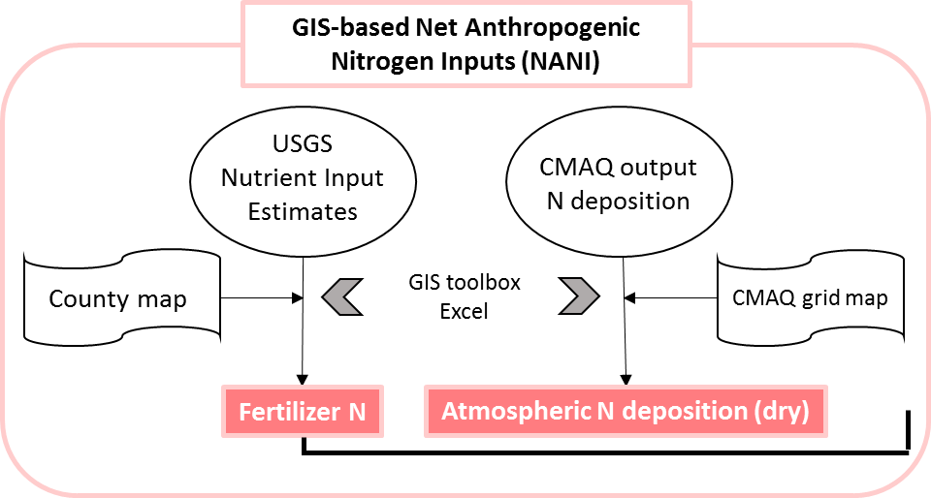
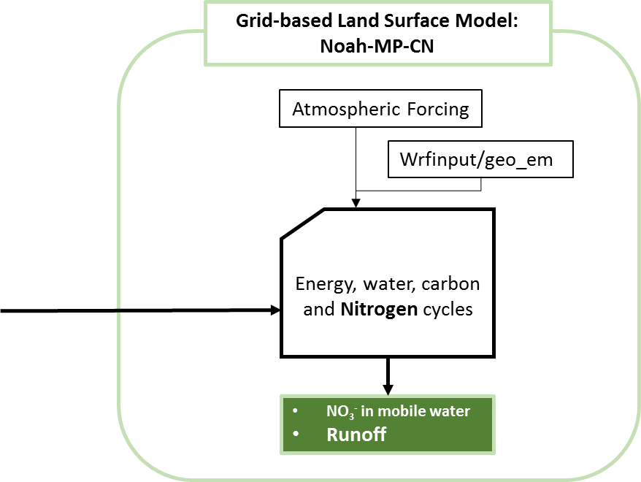
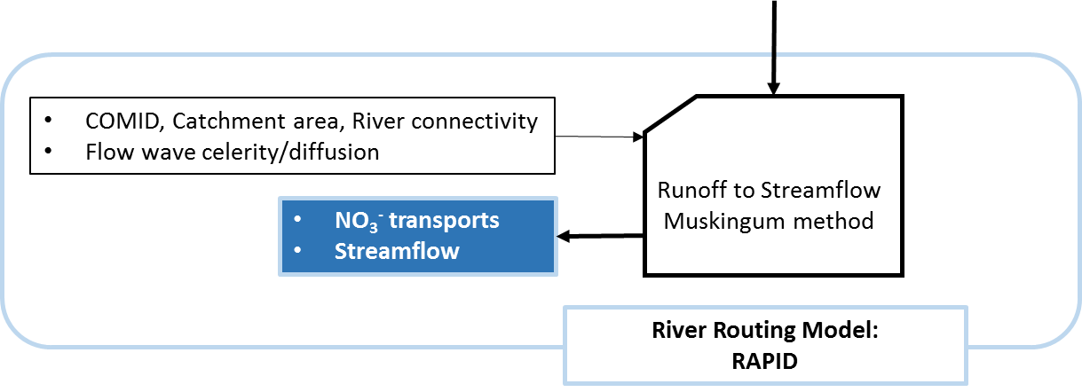
Processing Steps

Slide 5
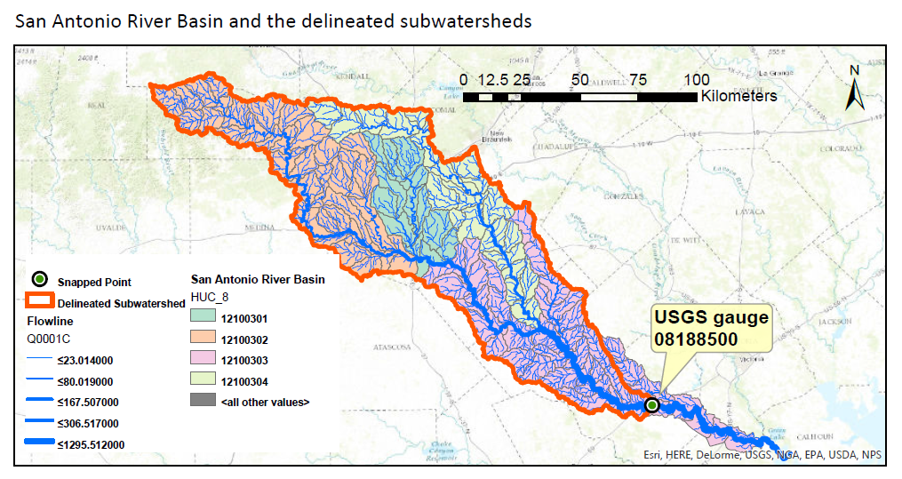
Study Region

Slide 6
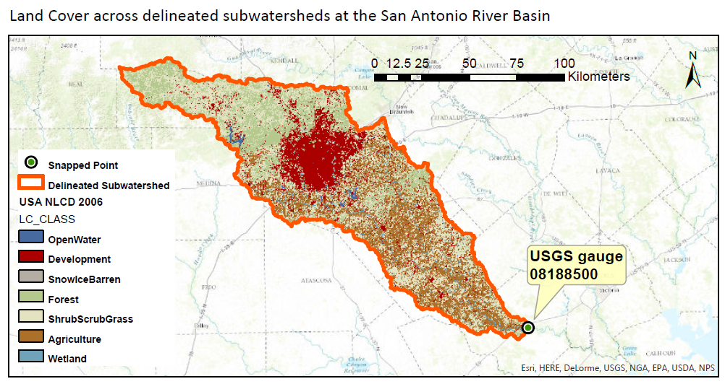
Land Cover in the San Antonio River Basin

Slide 7
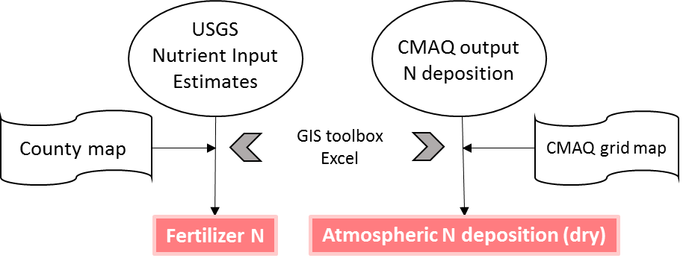
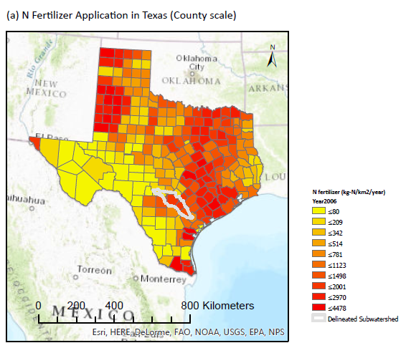
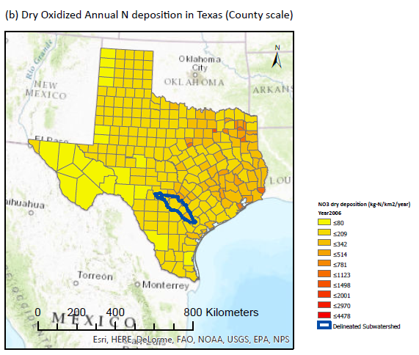
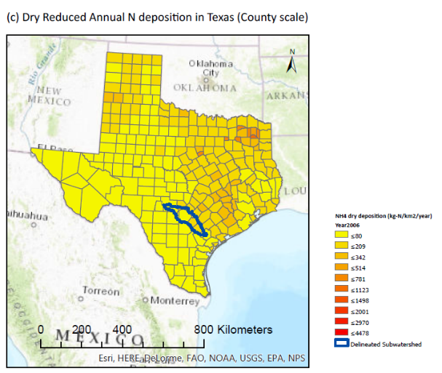
Net Anthropogenic Nitrogen Inputs (NANI)
- Generate input data (feature)

Slide 8
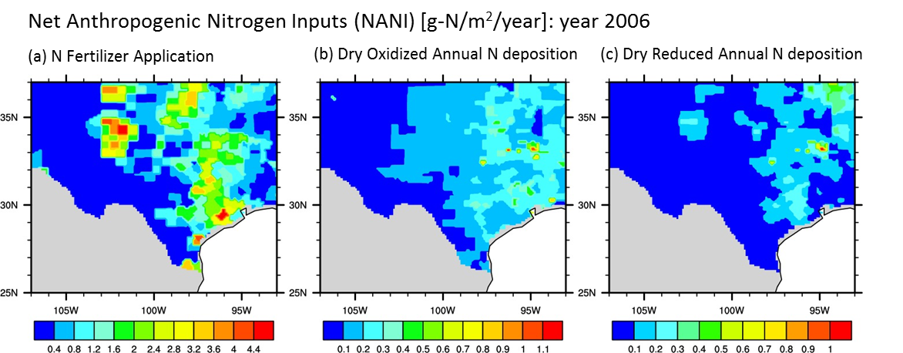
Net Anthropogenic Nitrogen Inputs (NANI)
- Convert to land surface model input file (raster)
Grid-based Land Surface Model: Noah-MP-CN
Atmospheric Forcing
Mineralization
Decomposition
Immobilization
Nitrification
Volatilization
Atmospheric deposition
Denitrification
Fertilizer application
Leaching
Uptake
Fixation
Leaf N retranslocation
Wrfinput/geo_em
Energy, water, carbon and Nitrogen cycles
NO₃⁻
Runoff

Slide 9
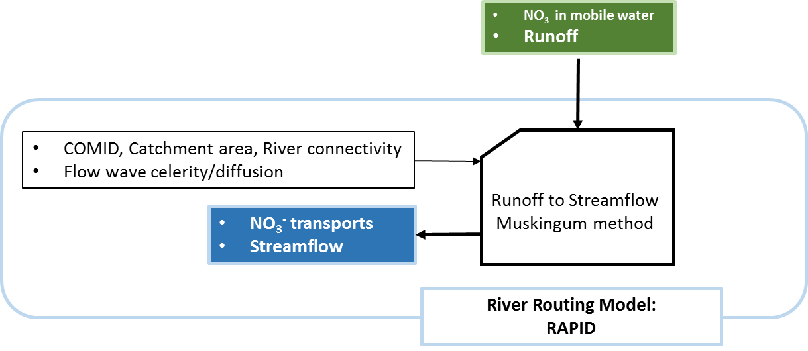
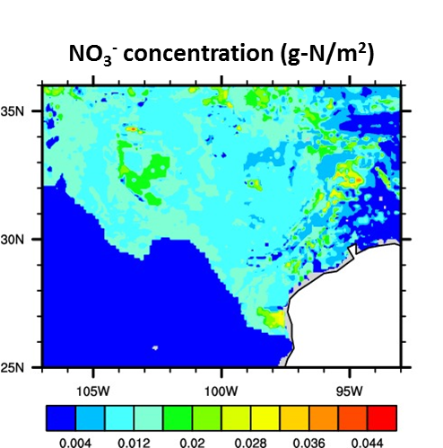
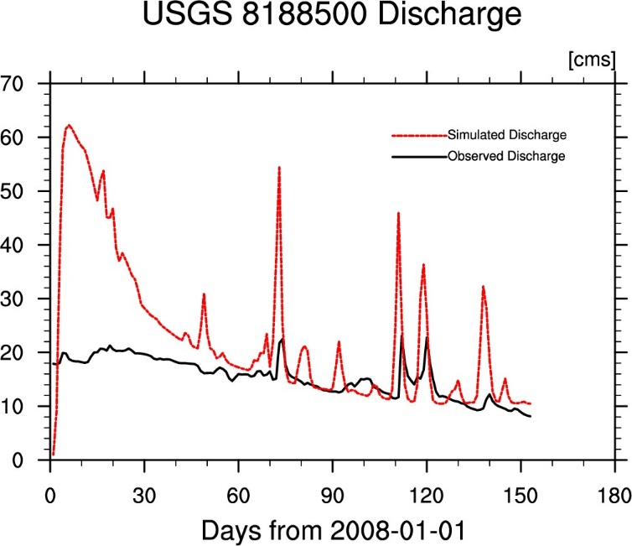
Land Surface Model and River Routing Model
- Simulate NO₃-, Runoff, Streamflow

Slide 10
Future Work
NO₃⁻ in mobile water
Runoff
COMID, Catchment area, River connectivity
Flow wave celerity/diffusion
USGS gage stations
Runoff to Streamflow
Muskingum method
NO₃⁻ concentration (mg/L)
Discharge (cfs)
NO₃⁻ transports
Streamflow
River Routing Model:
RAPID
Nutrient Transport
  Stored or lagged from previous day
In stream nutrient process
  Oxidation
  Uptake by algae
(Originally from SWAT)

Slide 11
Thank you for your attention
Any question?

