Slide 1
Flood Risk Areas in El Paso County, Texas
By William Delgado

Slide 2
El Paso Average Annual Rainfall - 8.71 inches
Notes:
Source for El Paso Average Annual Rainfall: http://www.weather.gov/epz/elpaso_monthly_precip

Slide 3
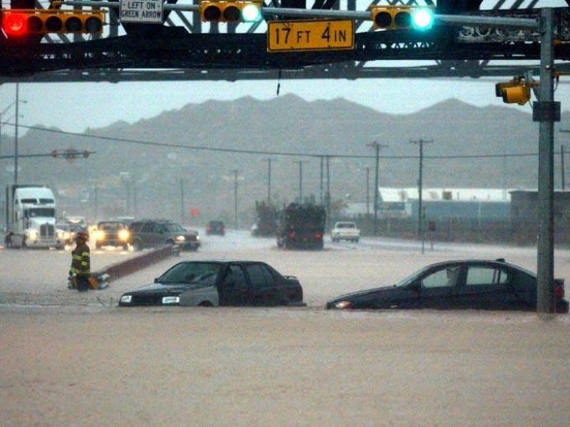
2006 Flood
A year’s worth of rain fell in 2 days
Notes:
Image Source of man and boy: http://usatoday30.usatoday.com/weather/stormcenter/2006-08-06-ElPaso-floods_x.htm
Image Source of cars: http://www.elpasotimes.com/picture-gallery/archives/2016/07/28/archive-photos-flood-of-2006/87687140/
Source for rainfall figures: http://www.epwu.org/stormwater/stormwater_faq.html

Slide 4
Elevation Range: 1141 – 1616 meters
Key Topographic Features: Franklin Mountains (long red patch)
Rio Grande Depression (long dark green patch)
Notes:
DEM Source: http://earthexplorer.usgs.gov/

Slide 5
A areas
1% annual chance of flood
26% chance of flood over 30 year mortgage
AE areas
Base floodplain
D areas
Possible but undetermined flood risk areas
Notes:
Source of Flood Risk Areas: http://snmapmod.snco.us/fmm/document/fema-flood-zone-definitions.pdf

Slide 6
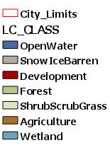
Notes:
Source for 1992 NLCD Dataset: https://tnris.org/data-catalog/entry/national-land-cover-database-1992/
Source for 2001 NLCD Dataset: http://www.mrlc.gov/nlcd01_data.php

Slide 7
Notes:
Source 2006 NLCD Dataset: http://www.mrlc.gov/nlcd06_data.php
Source for 2011 NLCD Dataset: http://www.mrlc.gov/nlcd11_data.php

Slide 8
Notes:
Source for Median Income by Census Block Group: 2010 US Census Data obtained for my final project in Prof. Miguel Pavon’s Spring 2016 Intro to GIS for Public Affairs Class

Slide 9
Remaining Objectives
Explain FEMA flood zone criteria
Verify legend of NLCD datasets
Verify block group income field
Find population living in flood risk areas

Slide 10
Questions?

Slide 11
References
http://www.weather.gov/epz/elpaso_monthly_precip
http://usatoday30.usatoday.com/weather/stormcenter/2006-08-06-ElPaso-floods_x.htm
http://www.elpasotimes.com/picture-gallery/archives/2016/07/28/archive-photos-flood-of-2006/87687140/
http://www.epwu.org/stormwater/stormwater_faq.html
http://earthexplorer.usgs.gov/
http://snmapmod.snco.us/fmm/document/fema-flood-zone-definitions.pdf
http://www.mrlc.gov/nlcd06_data.php
https://tnris.org/data-catalog/entry/national-land-cover-database-1992/
http://www.mrlc.gov/nlcd01_data.php
http://www.mrlc.gov/nlcd11_data.php
2010 US Census Data obtained for my final project in Prof. Miguel Pavon’s Spring 2016 Intro to GIS for Public Affairs Class

