Slide 1
Watersheds and Flow Impacts on the Mission-Aransas Estuary
Sarah Douglas
GIS in Water Resources
Fall 2016

Slide 2
Purpose
Explore the relationship between river discharge and nutrient input to an estuarine system
Compare water quality and nutrient parameters in the Mission-Aransas Estuary over periods of drought to periods of drought recovery
Determine potential impact of land usage in the watersheds draining to the estuary

Slide 3
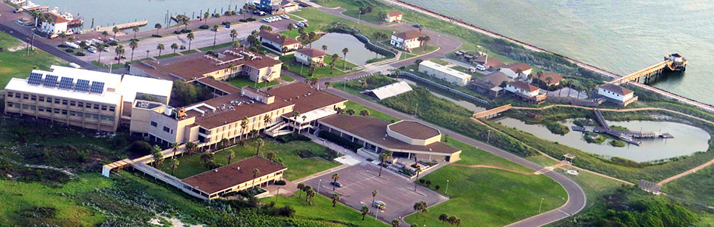
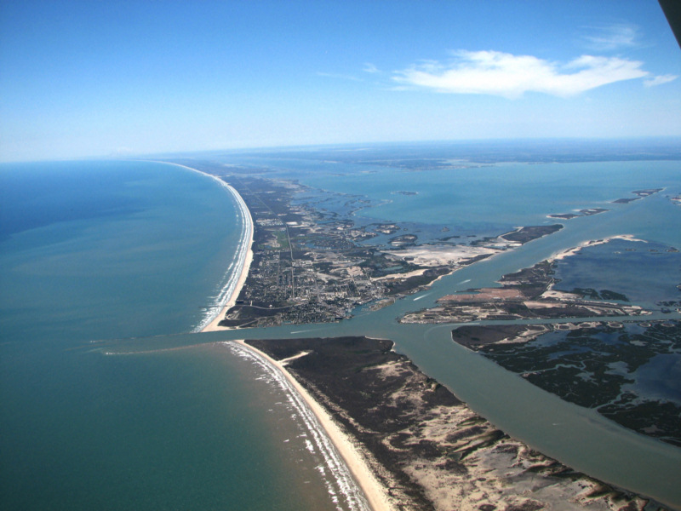
UT Marine Science Institute and the NERR

Slide 4
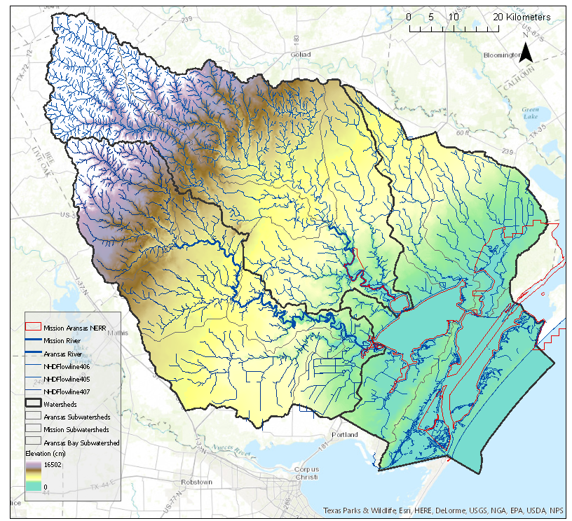
Notes:
Elevation

Slide 5
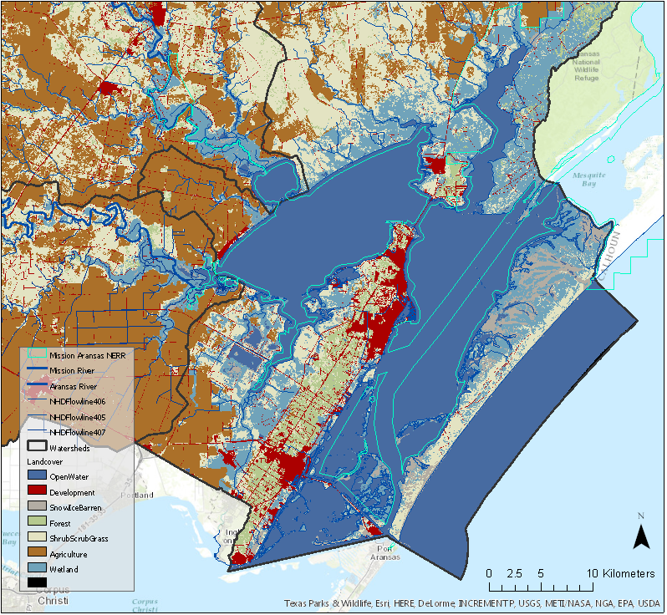

Slide 6
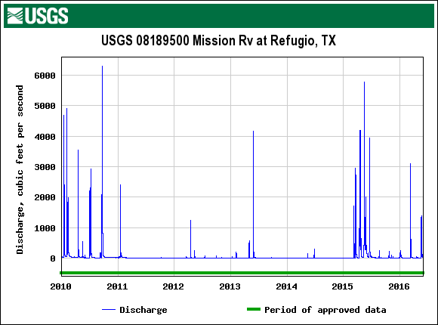
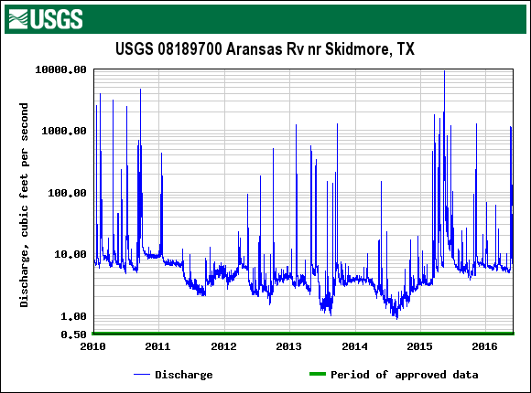
Freshwater input to the estuary is extremely variable

Slide 7
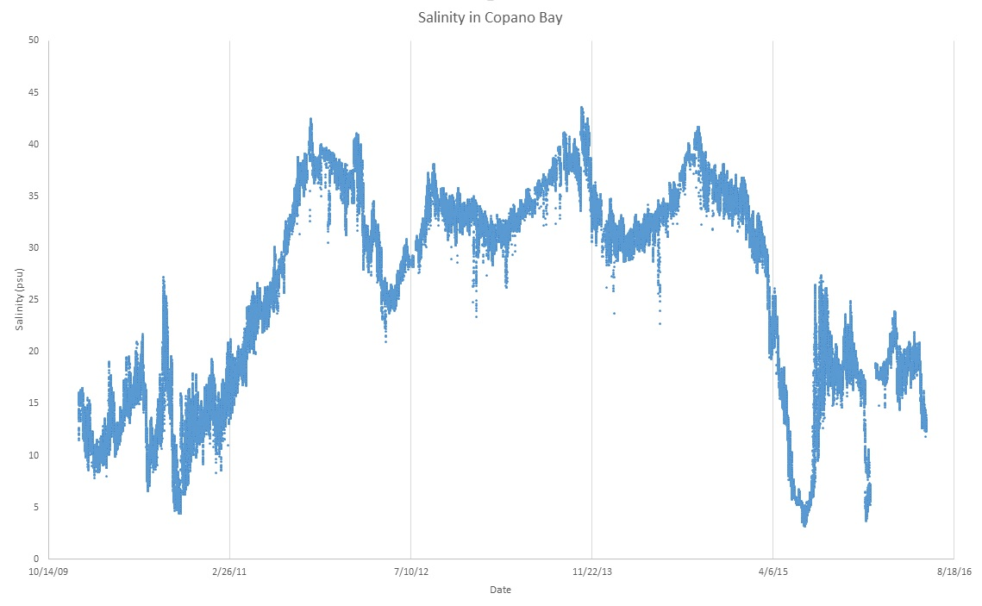

Slide 8
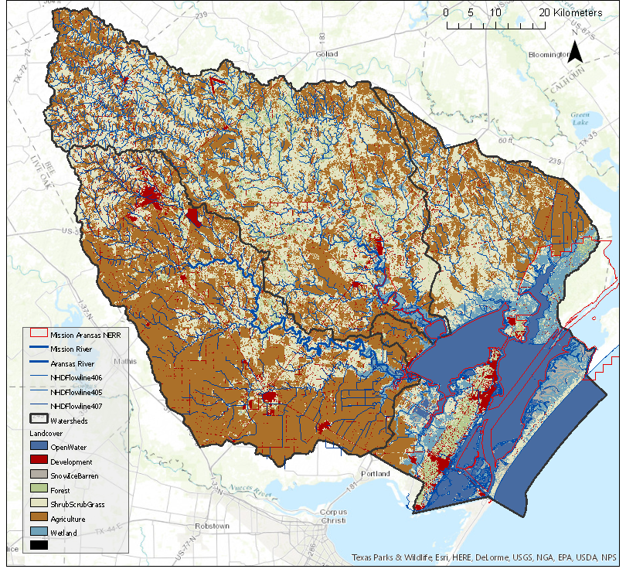

Slide 9
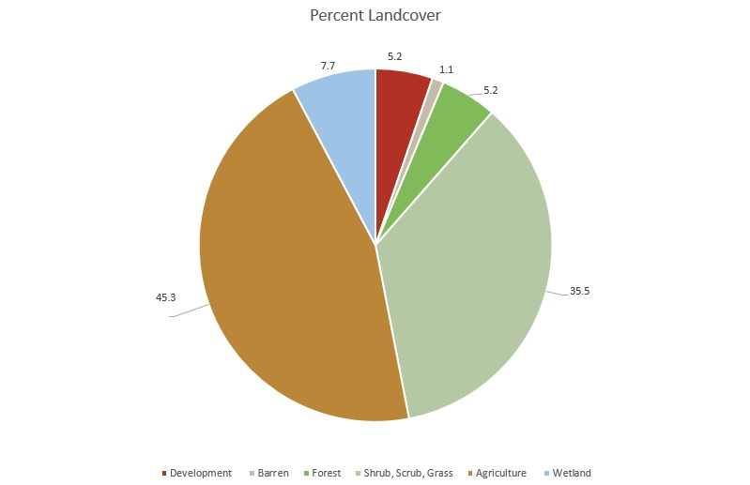

Slide 14
Conclusions
Fertilizing nutrients from agriculture appear to be transported from the watershed to the estuary by the Mission and Aransas rivers
Freshwater input (or lack thereof) controls the salinity of the back bays over tidal exchange

Slide 15
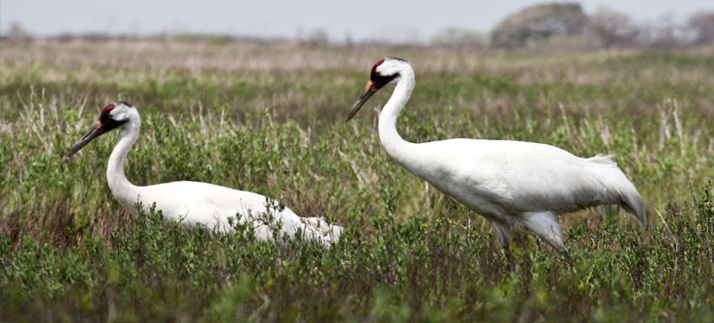
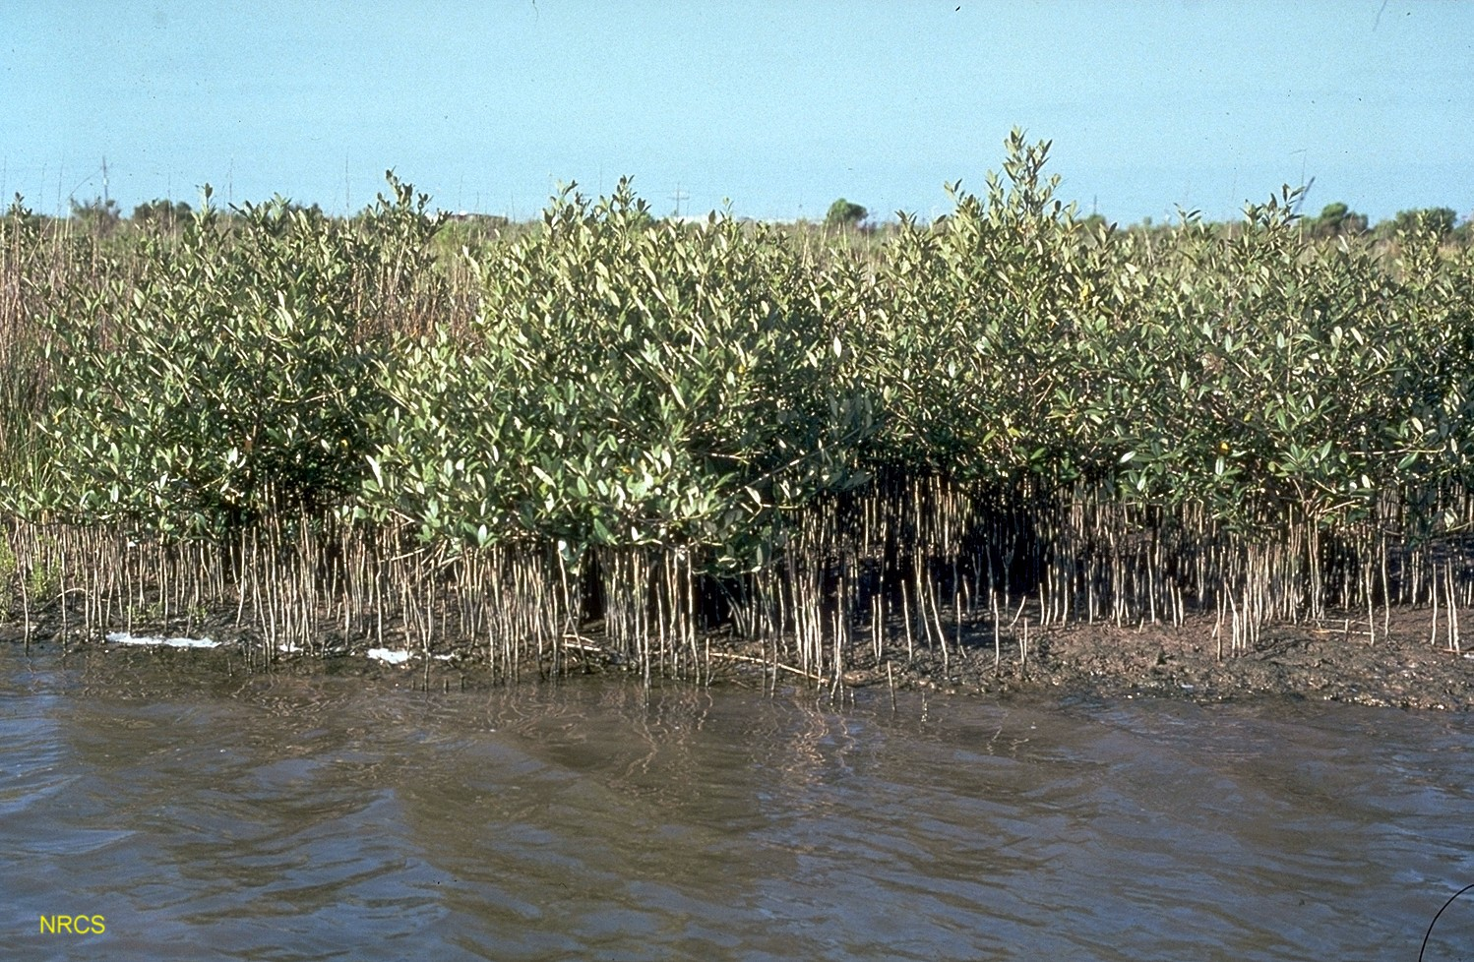
Long-term Impacts
• Loss of critical salt marshes
• Mangrove encroachment

Slide 16

Questions?
Aransas Bay

