Slide 1

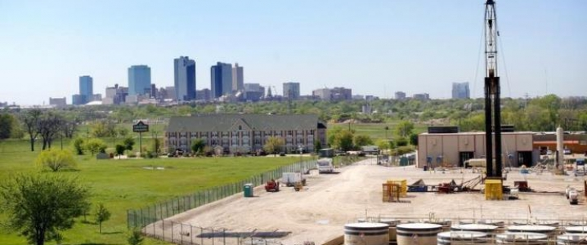
Underground Representation and Imaging of
Barnett Shale
Source: http://oilprice.com/Energy/Crude-Oil/Game-May-Not-Be-Over-For-Barnett-Shale.html
Weili Lin
Environment and Water Resources Engineering
11/22/2016
Notes:
Joel

Slide 2
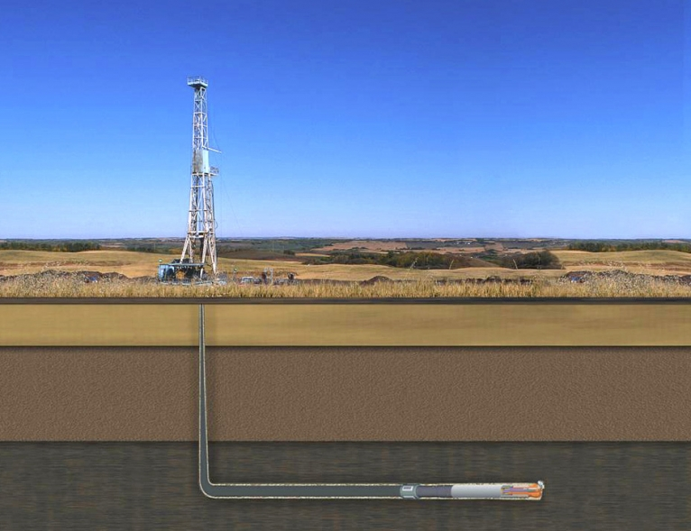
Contents
Background
Objectives and Scope
Methods and Results
Outlook
Source: http://energy.gov/articles/producing-natural-gas-shale

Slide 3
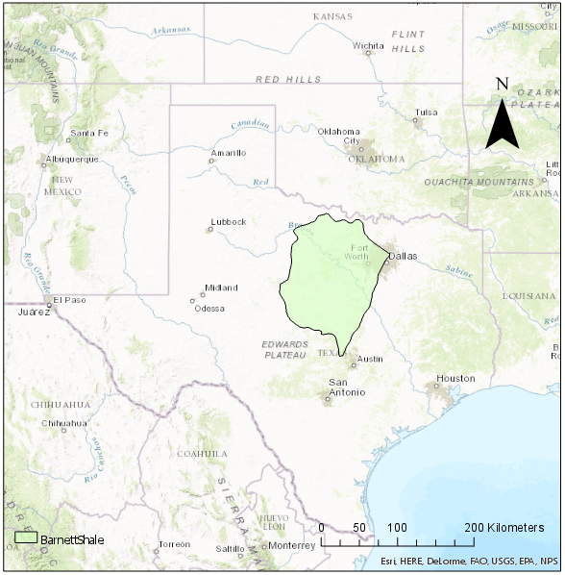
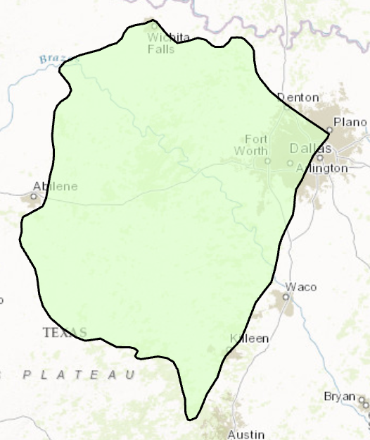
Background

Slide 4
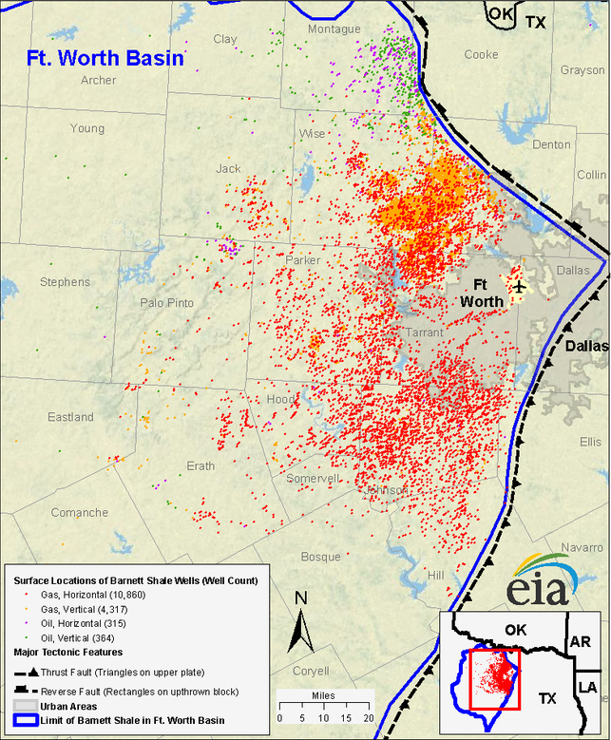
Over 15,000 oil and gas wells drilled and hydraulic fractured in Barnett Shale by 2007.
Hydraulic fracturing uses chemicals that potentially contaminate water resource.
Barnett Shale gas play depth 6500 to 8000 feet.
Leak of hydraulic fracturing well casing will result in ground water contamination.
Source: Annual Energy Outlook 2016, EIA
Source: US Energy Information Administration http://www.eia.gov/oil_gas/rpd/shaleusa1_letter.pdf

Slide 5
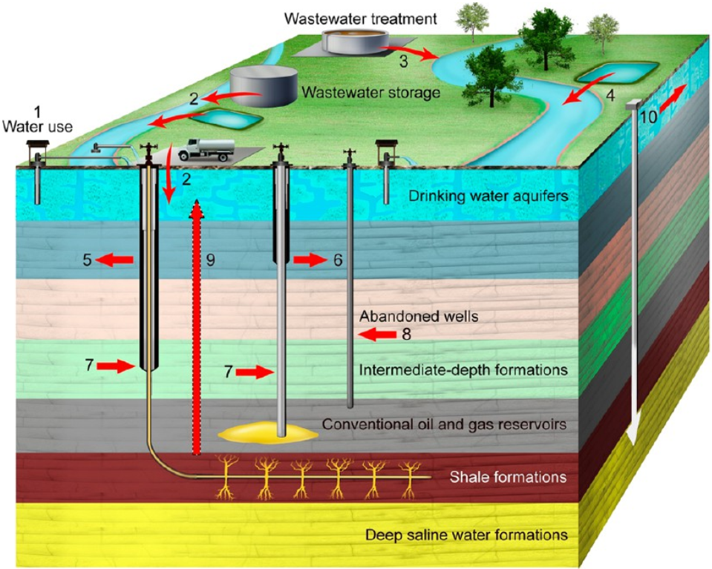
Over 15,000 oil and gas wells drilled and hydraulic fractured in Barnett Shale by 2007.
Hydraulic fracturing uses chemicals that potentially contaminate water resource.
Barnett Shale gas play depth 6500 to 8000 feet.
Leak of hydraulic fracturing well casing will result in ground water contamination.
Source:Vengosh, Avner, et al. "A critical review of the risks to water resources from unconventional shale gas development and hydraulic fracturing in the United States.

Slide 6
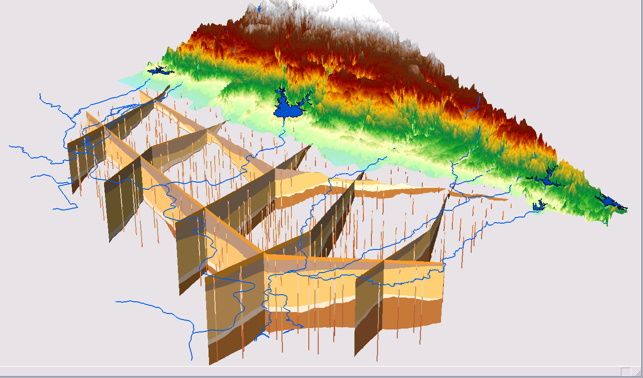
Objectives
Hydrostratigraphy: Geosection
Represent the underground formations, especially aquifers
Represent the wells in the Barnett Shale
Source: http://www.archydrogw.com/Arc_Hydro_Groundwater_Data_Model.
ArcGIS Tools
Arc Hydro Groundwater (provided by Aquaveo and ESRI)

Slide 7
Geology of Barnett Shale
Barnett Shale Outline
From Railroad Commission of Texas
Other Source may have different shape
Land Surface Elevation
USGS NED30
Generally west – higher
east – lower
Maximum elevation 731 meter
Minimum elevation 71 meter

Slide 8
TexasCounty
Barnett Shale Intersects with 46 counties
Landcover
National Land Cover Database 2011
Value | Classification | Area Percent (%)
21 | Developed, Open Space | 5.8243
41 | Deciduous Forest | 7.3300
42 | Evergreen Forest | 7.2187
52 | Shrub/Scrub | 22.8370
71 | Grassland/Herbaceous | 41.7871
82 | Cultivated Crops | 5.7391
 | Total Area | 69281.6769
*Low contribution not included

Slide 9
Aquifers maps and Aquifer features
Polygon shape files from Texas Water Development Board (TWDB)
9 major aquifers (TX)
  3 intercept with Barnett
21 minor aquifers (TX)
  3 intercept with Barnett
Filled: Outcrop
Line-Shaded: Subcrop
Notes:
The most basic features commonly used to represent groundwater systems are aquifers and wells. (page 23)
Artesian Aquifer - Aquifer in which ground water is confined under pressure that is significantly greater than atmospheric pressure. Synonym: Confined Aquifer. See also Unconfined Aquifer.
Aquifer - A geologic formation, group of formations, or part of a formation that contains sufficient saturated permeable material to yield significant quantities of water to springs and wells.
Ground water - In the broadest sense, all subsurface water; more commonly that part of the subsurface water in the saturated zone.

Slide 10
Well Database and well features
Groundwater Database From TWDB
TWDB: Texas Water Development Board
WellMain table contains spatial references.
WellMain
StateWellNum
County
AquiferID
AqCode
LatitudeDD
LongitudeDD
LandElev
WellDepth
WellType
…
Notes:
Wells are designed for many reasons: to produce water from aquifers, to monitor water levels and quality, and to inject (discharge) solutions into the subsurface.
WellType: Observation, Oil&Gas, Withdrawal of Water, WasteDisposal, etc.

Slide 11
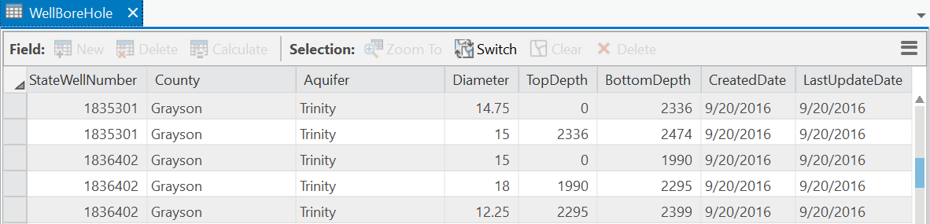
Well Database and well features
WellMain table serves as the central table, and is linked with additional tables describing all sorts of information.
WellBoreHole
StateWellNum
County
Aquifer
Diameter
TopDepth
BottomDepth
…
WellMain
WaterLevel
StateWellNum
County
AquiferID
AqCode
LatitudeDD
LongitudeDD
LandElev
WellDepth
WellType
…
StateWellNum
County
DepthFromLSD
LandElevation
WaterElevation
…
WaterQuality
StateWellNum
County
Aquifer
ParameterCode
…
Notes:
Groundwater databases commonly have a central table that describes the location of wells and their properties. The central table is usually linked with additional tables describing information on the well construction, measurements of water levels and water quality taken at the wells, and descriptions of the formation material observed along boreholes.

Slide 12
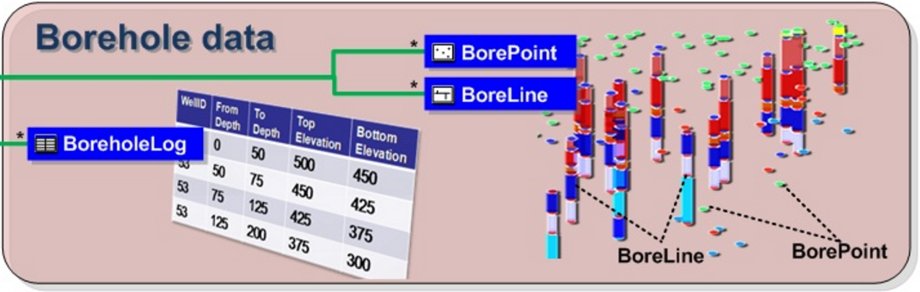
Well Database and well features
WellMain
WellBoreHole
Drilling Logs
StateWellNum
County
AquiferID
AqCode
LatitudeDD
LongitudeDD
LandElev
WellDepth
WellType
…
StateWellNum
County
Aquifer
Diameter
TopDepth
BottomDepth
…
Eg. Strata Observed
BoreholeLog
StateWellNumber
RefElev
FromDepth
ToDepth
TopElev
BottomElev
…
AbsElev
Depth
550
0
Depth
540
10
0
530
10
520
30
490
50
Notes:
In the previous slide we represent each wellpoint as a point in a 2-D graph, but actually each well is a 3-D object, including the depth of the well. And most of the underground data is actually data from the wells we drill.
Material Text Description of strata observed along a borehole. Usually documented in drilling logs and later classified into geologic/hydrogeologic units.

Slide 13
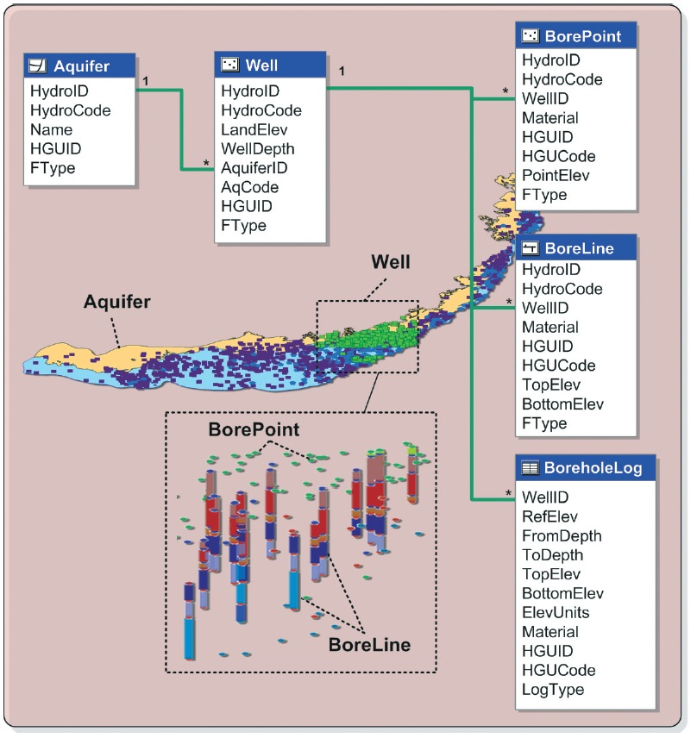
Arc Hydro framework
Unique Identifiers:
  Aquifer: HydroID
  Well: HydroID
The obtainment of BoreholeLog table and the subsequent boreline building can be carried out by Arc Hydro Groundwater Tools.
Source: http://www.archydrogw.com/images/c/c2/Archydrogw_wellsandboreholes.JPG

Slide 14
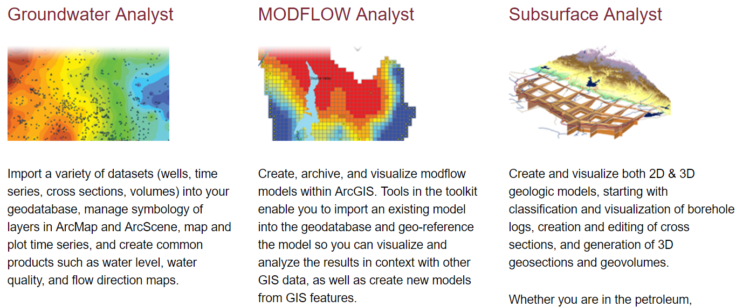
Arc Hydro Groundwater Overview
http://www.aquaveo.com/software/ahgw-archydro-groundwater-introduction

Slide 15
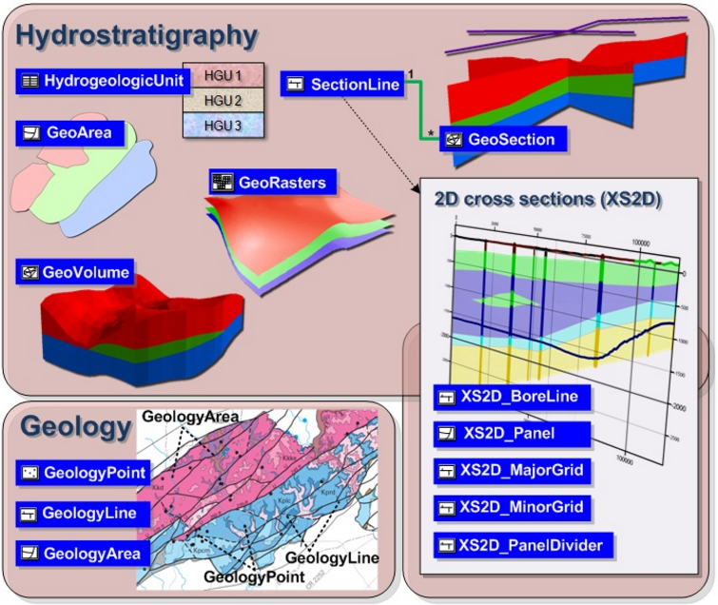
Project Objectives
http://www.archydrogw.com/images/9/9c/Archydrogw_overview.JPG

Slide 16
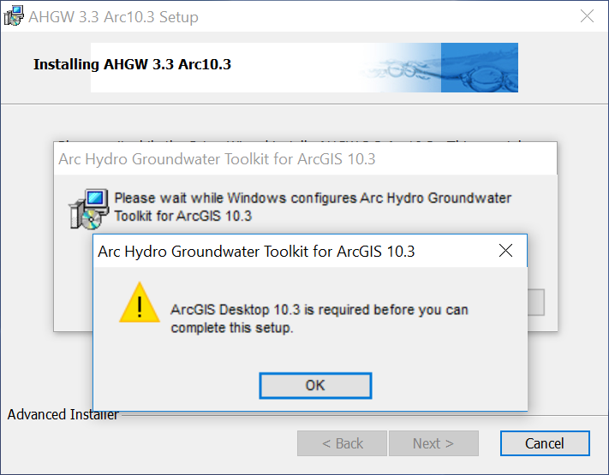
Arc Hydro Groundwater - Oohs

Slide 17
Challenges and Outlook
Challenges:
  Software requirements.
  Scarcity of well data.
Outlook:
  Borelines Building
  Hydrostratigraphy Construction
  3D Representation of Cross Sections

Slide 18
Acknowledgements:
Dr. David Maidment
Dr. Timothy Whiteaker
Thank you!
Weili Lin
11/22/2016

