Slide 1
2006 Flood in El Paso TX

Slide 2
Overview
Background
Progress
Future Work

Slide 3
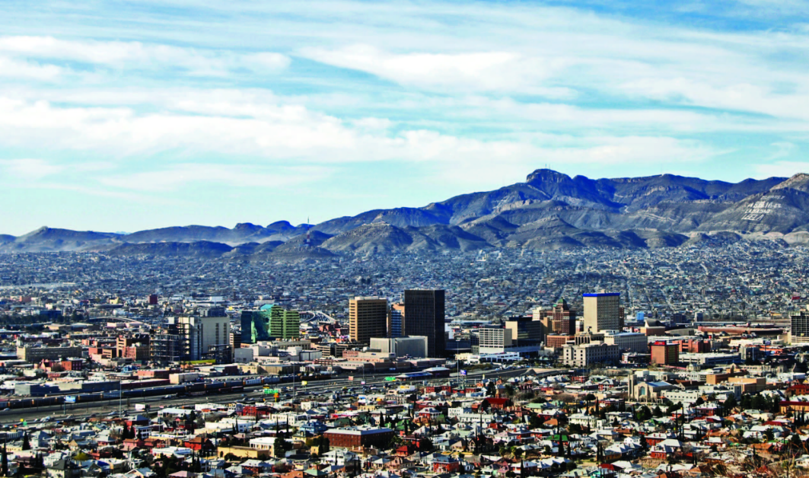
El Paso
Population
  674,433
  El Paso, Texas lies within the tip of the Chihuahuan desert
  Area
  256.3 mi²
Annual precipitation
  9 inches

Slide 4
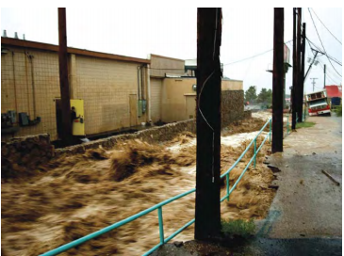
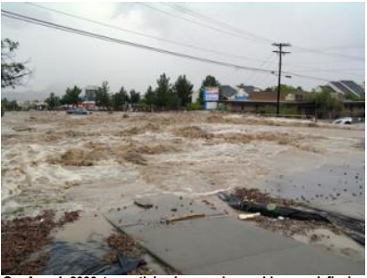
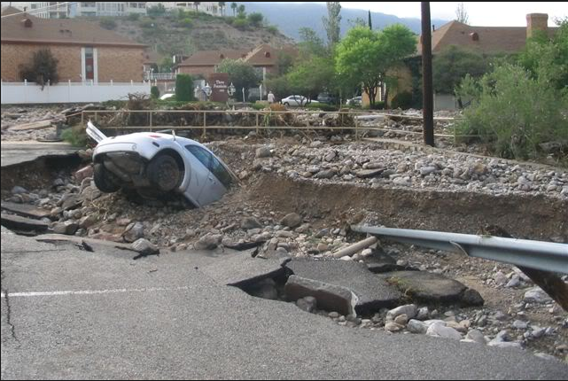
Flood
July – September 2006
  6.6 – 10 inches of rain within a week
  Wettest 3 months on record
  Caused severe localized and widespread flooding
  Damage to infrastructure
  Homes
  Businesses
  Estimate cost $200-300 million
  Flash flood warning
  Current data did not provide useful flash-flood hazard assessments

Slide 5
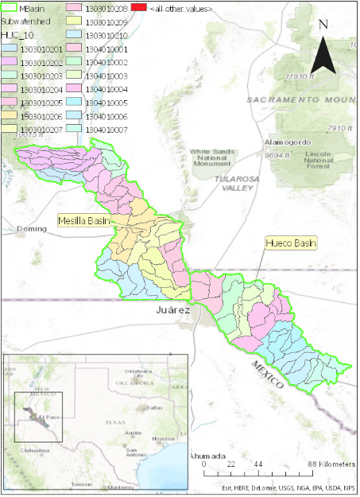
Paso Del Norte Subwatershed
Information
  17 HUC 10
  Extends 340 miles along Rio Grande
  Irrigates 200,000 acres of farmland
  Impacted by needs of 2 million people
Basin
  Mesilla
  Hueco

Slide 6
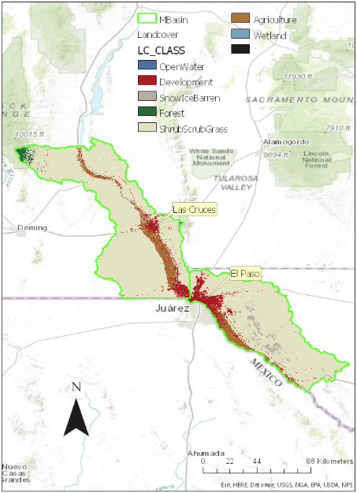
Landcover

Slide 7
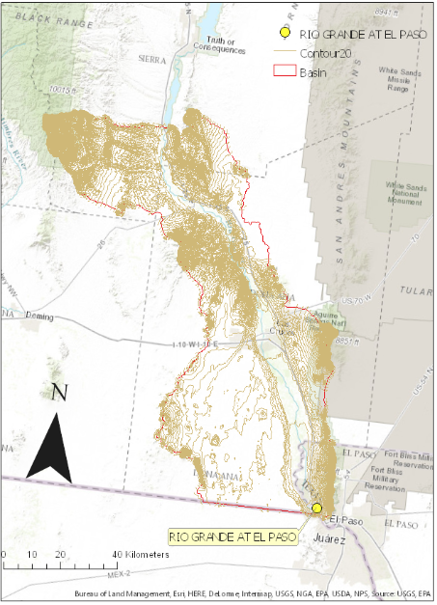
Study Gage
USGS lacks gages in the region
  Rio Grande at El Paso
El Paso is built around the Franklin Mountains
  Significant effects on run off
  Causes variations in storm impacts from one location to another

Slide 8
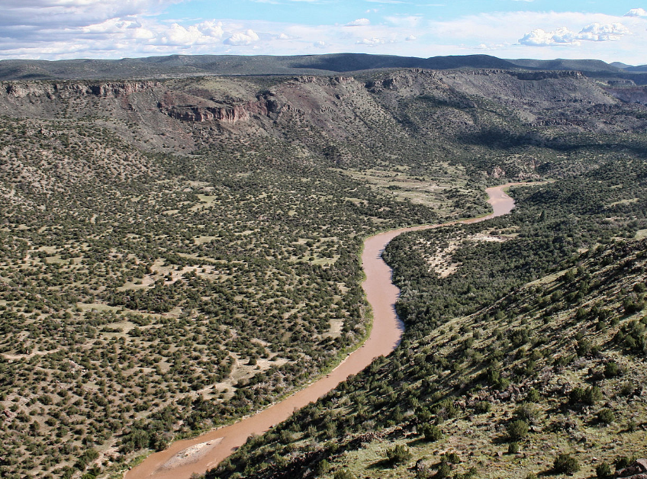
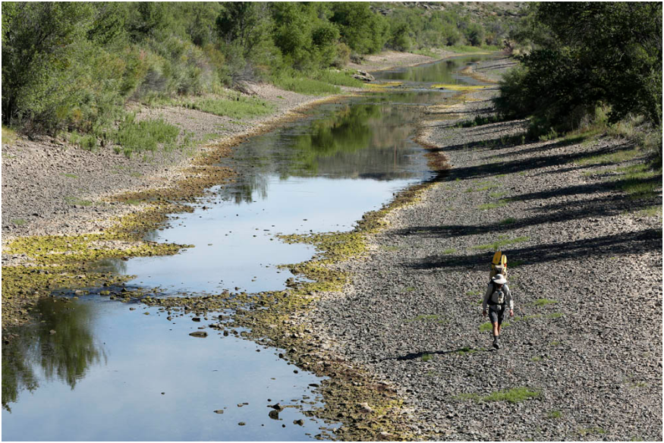
Rio Grande flow
1916 damming of the Rio Grande at Elephant Butte Reservoir
  Altered river flows
  Eliminated springtime flood pulses
  Straightened and channelized to deliver water more efficiently
  Reduction from 945 cfs to 178 cfs (82%)

Slide 9
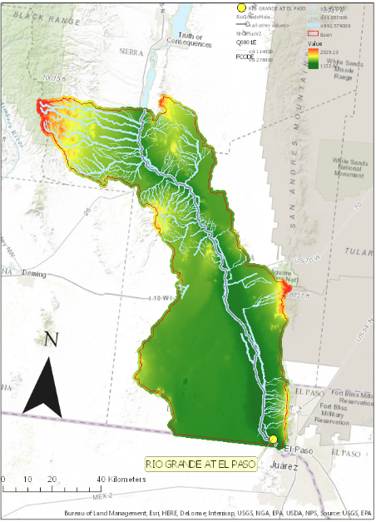
Streams delineation
Rio Grande
  Length: 173 km
Streams
  Total length: 1810 km

Slide 10
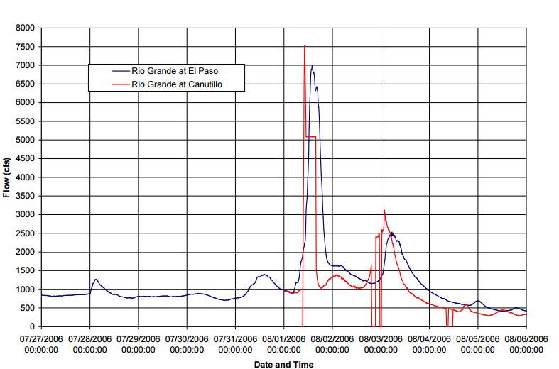
Peak Flow
Significant discharge
  1-3 August

Slide 11
Conclusions
  Very little data was gathered because of the lack of rain gages, stage recorders, and stream gages in the watershed
  Weather stations are needed in strategic places to provide accurate measurements and appropriate warning
  Orographic effects may not have been properly considered in developing urban planning in El Paso, causing the flash-flood risk in some neighborhoods to be underassessed
  Future Work
  Add Precipitation Gage Data
  Compare precipitation data to elevation
Station | Agency | Data Fequency
El Paso AP | NOAA | Hourly
Rio Grande at El Paso | IBWC | Hourly
Rio Grande at Canutillo | EPCWID#1 | Hourly
Ysleta | NOAA | Hourly
El Paso #2 | NOAA | Hourly
La Tuna 1 S | NOAA | Hourly

Slide 12
Questions?
References
Thomas E. Gill and Timothy W. Collins, 2010. Southwest Hydrology.
Federal Emergency Management Agency, 2007. Flood Frequency Determination El Paso County and Incorporated Communities, Texas.
USGS Current conditions for USGS 08364000 Rio Grande at El Paso. http://nwis.waterdata.usgs.gov/tx/nwis/monthly/?search_site_no=08364000&amp;agency_cd=USGS&amp;referred_module=sw&amp;format=sites_selection_links

