Slide 1
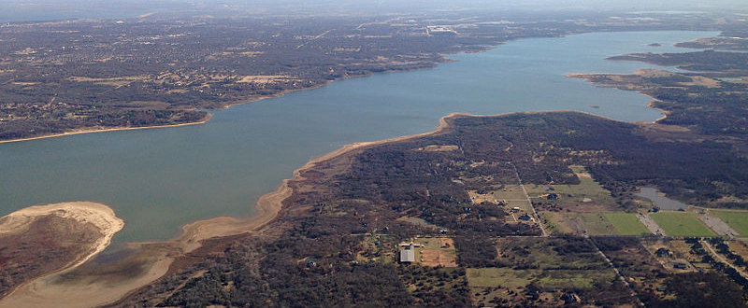
Grapevine Lake Modeling & Watershed Characteristics
Nash Mock

Slide 2
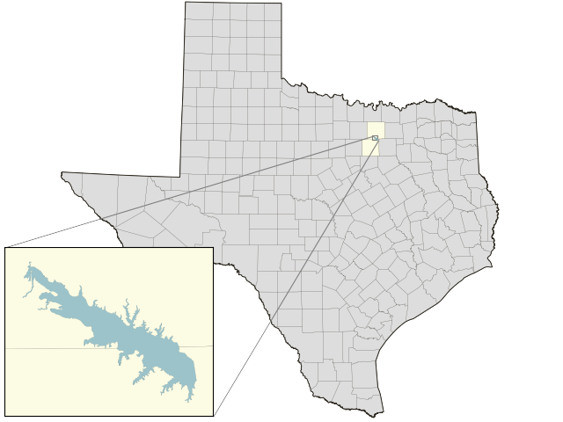
Location & Background
Located between Tarrant and Denton counties in North Texas
Constructed following the Rivers & Harbors Act of 1945
Built 1948-1952 by the Army Corps of Engineers
Dallas/Fort Worth Metroplex flood control, water storage & recreational waters

Slide 3
Digital Elevation Model and NHDPlus Streams
Elevation Range: 170-395 ft.
Watershed Area: 1799 km²
Lake Surface Area: 29.47 km²
Medium Resolution Reaches Draining to Grapevine Lake: 604
Total Reach Length: 1326 km

Slide 4
Denton Creek
Largest GNIS stream draining to Grapevine Lake
Stream Length: 147 km
Discharge from dam joins the Elm Fork of Trinity River

Slide 5
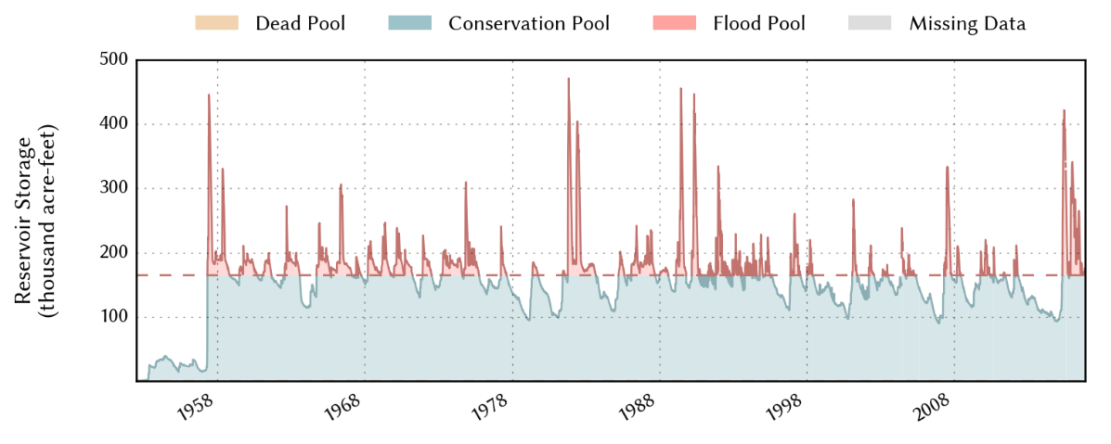
Reservoir Storage Timeline
Dead Pool | Conservation Pool | Flood Pool/ Emergency Spillway | Max Design Elevation | Top of Dam
475 ft. | 535 ft. | 560 ft. | 581.9 ft. | 588 ft.

Slide 6
2006-2016 Summer Drought History
Yellow: Abnormally Dry
Light Orange: Moderate Drought
Orange: Severe Drought
Dark Orange: Extreme Drought
Red: Exceptional Drought
2012-2014 corresponds to extended conservation pool period

Slide 7
Watershed Flow Direction
Majority of flow east towards dam (purple)
Flow around dam directed north (light blue)
Anomalous around lake boundaries

Slide 8
Watershed Land Slope
Land Slope Range: 0-71%
DEM indicates Grapevine Lake is nearly flat
Anomalous around lake boundaries

Slide 9
Watershed Flow Accumulation
Flow accumulates along northern boundary of lake
Appears to jump from watershed above dam location
Anomalous around lake boundaries

Slide 10
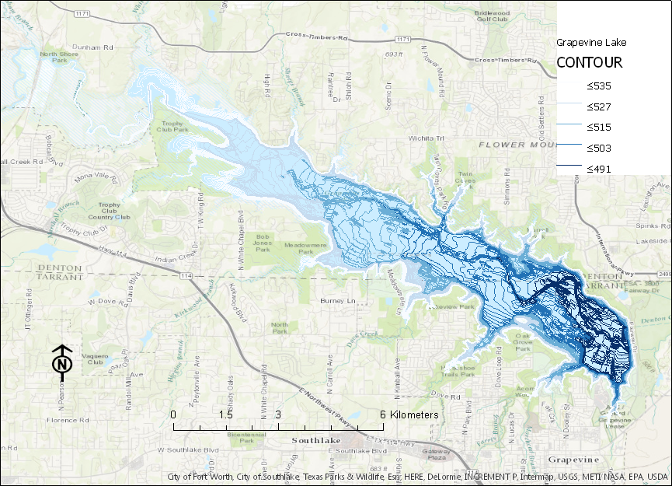
Grapevine Lake Contours
Lake Depth: 70 ft.
Contours from Texas Water Development Board 2011 lake survey
1, 2, 5, and 10 ft. contours up to conservation pool elevation

Slide 11
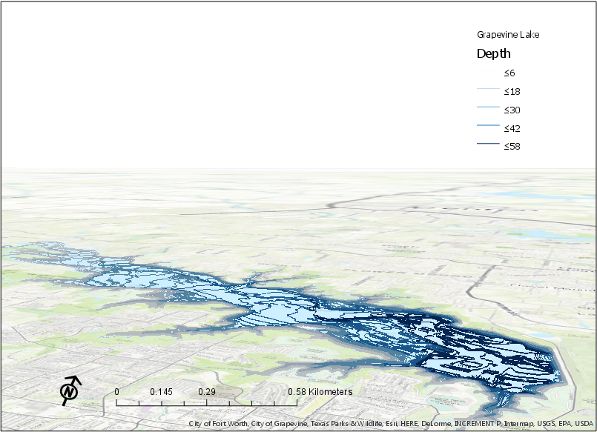
Grapevine Lake Bathymetric Model
Used 2 ft. contours to assist rendering
Local scene view since earth’s curvature insignificant
Extruded contours down from conservation pool elevation
Scale and north direction not well represented in 3D

Slide 12
Remaining Work
Perform a HAND analysis on the Grapevine Lake watershed.
Further improve bathymetric model by extruding polygons between contour polylines.

Slide 13
Questions?

