Slide 1
LEED Buildings and their effects on permeability
Kelsey Abel
11/29/2016

Slide 2
Outline
Conclusions
Introduction to LEED Building
Motivation: to be green or not to be green
Methodology
Data
Results & Discussion
Conclusions

Slide 3
Conclusions
LEED building trends:
  All cities studied exhibited exponential growth in the number of LEED projects
  New construction dwarfed retrofitting
Development is Development
  No appreciable “benefit” WRT permeability or land cover
  Landscaping points ineffective in mitigating impact building

Slide 4
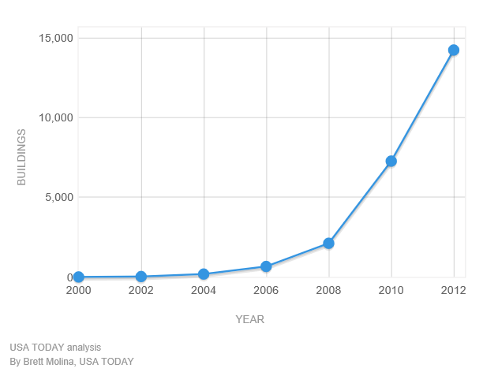
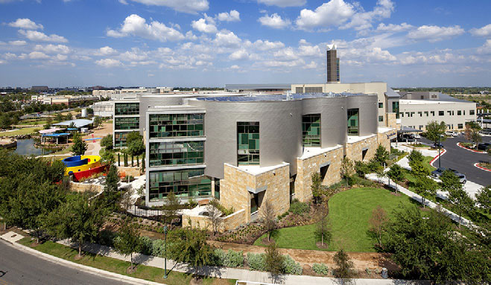
LEED Building Basics
Leadership in Energy and Environmental Design
Point System rating levels:
  Platinum (>80), Gold(60-79), Silver(50-59), Certified(40-49) ^{[1]}
82,000 commercial projects and growing ^{[2]}
WSP Parsons Brinkerhoff
Notes:
graph from: http://www.usatoday.com/story/news/nation/2012/10/24/green-building-leed-certification/1650517/
Dell children’s hospital photo: http://www.sustainablecitiescollective.com/sites/sustainablecitiescollective.com/files/imagepicker/566036/Photo-courtsey-of-McConnell-Photography_1.jpg

Slide 5

To be green or to not be green
Buildings advertised as “low impact”
Debate in the true “green”-ness of LEED buildings
  No follow-up on completed constructions
  No assurance of demonstrated efficient ^{[3]}
Landscaping guidelines
Are LEED buildings truly low impact to their immediate environment?
Notes:
Sustainable Site points: points you get for exterior. Maximum of 22? points, must have a minimum of 6 points in this category. Good flow chart and break down at http://blueberrypdx.com/leed-point-flow-charts.htm

Slide 6
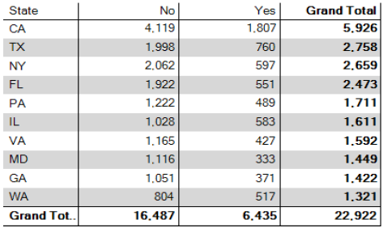
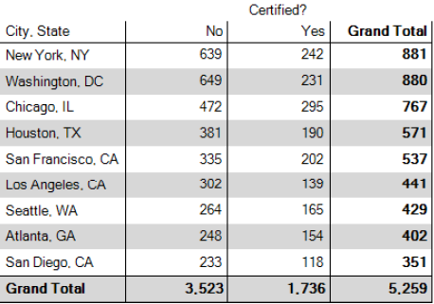
Finding this out (Methodology)
Top 10 cities and States by number of LEED certified projects
Studied 6 cities in Texas and California
Mapped all current LEED certified buildings
  Green Building Information Gateway (GBIG)
  Date of completed construction noted
USGBC
Notes:
I chose texas because we have paid a lot of attention to water conservation and natural landscaping over the past few years, but are generally considered “conservative” while California may lead us in policy and should in theory see better effects from LEED buildings

Slide 7
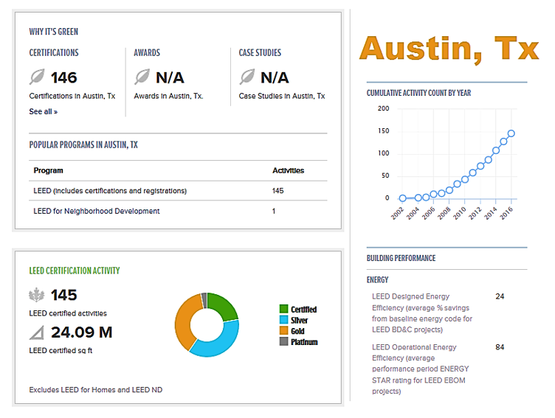
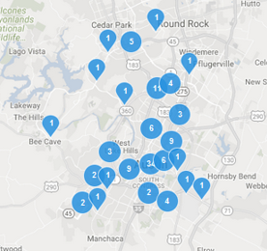
Data Collection

Slide 8
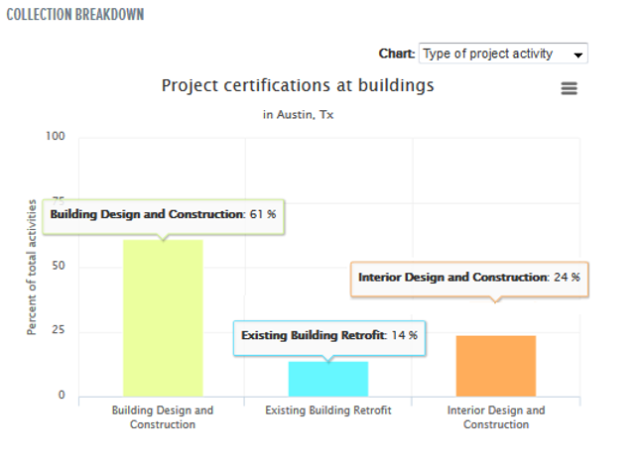

Slide 9
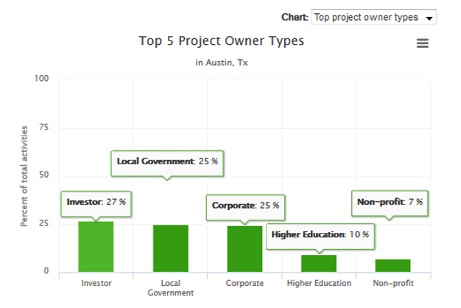

Slide 10
Summary Stats, all cities
Units: percentage
City | Investor | Local Gov | Corporate | Higher Education | Non-Profit | Federal Gov
Austin | 27 | 25 | 25 | 10 | 7 | -
Houston | 36 | 11 | 28 | 8* | - | 5
Dallas | 25 | 29 | 26 | 5* | 7 | -
San Diego | 20 | 9 | 21 | 21 | - | 10
San Francisco | 27 | 10 | 39 | 6 | 7 | -
Los Angeles | 21 | 22 | 20 | 22 | 4 | -

Slide 11
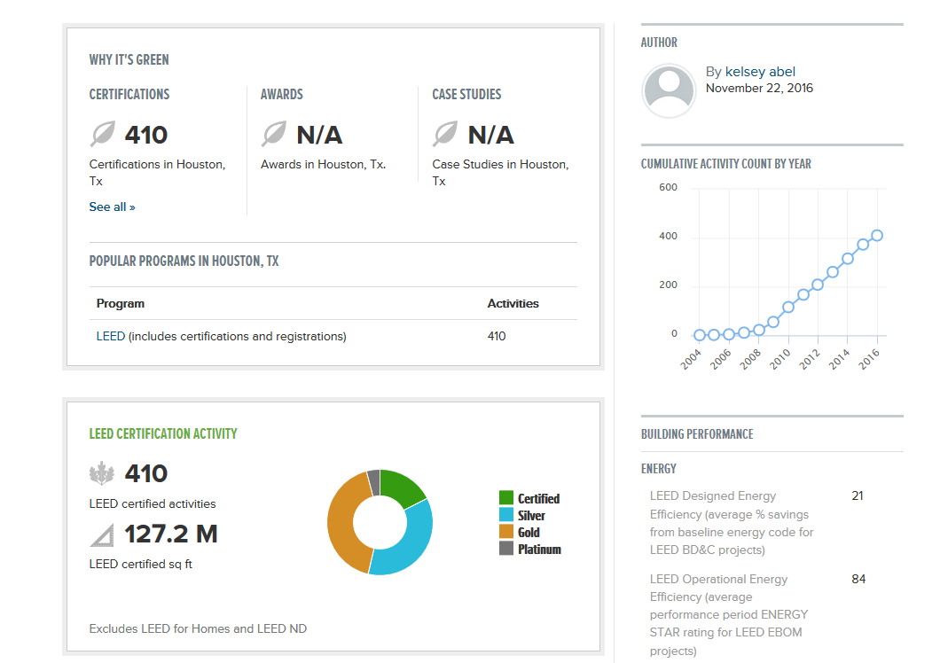
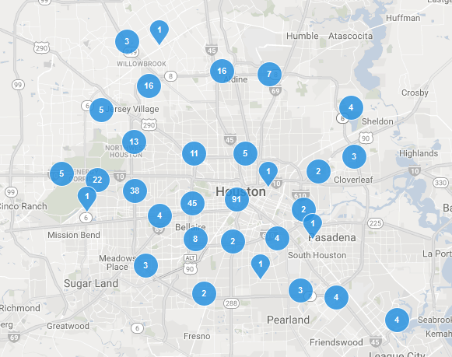
Houston, Tx

Slide 12
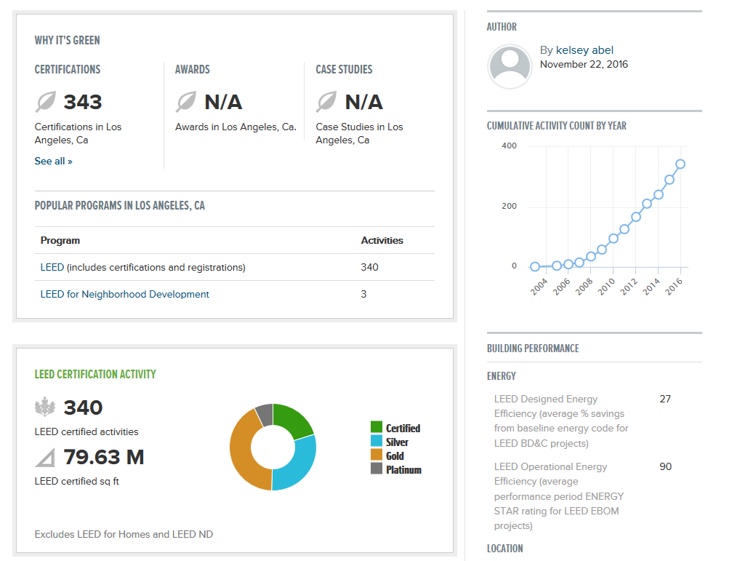
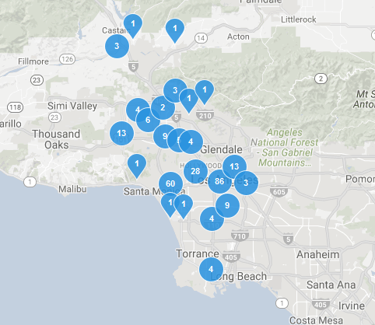
Los Angeles, Ca

Slide 13
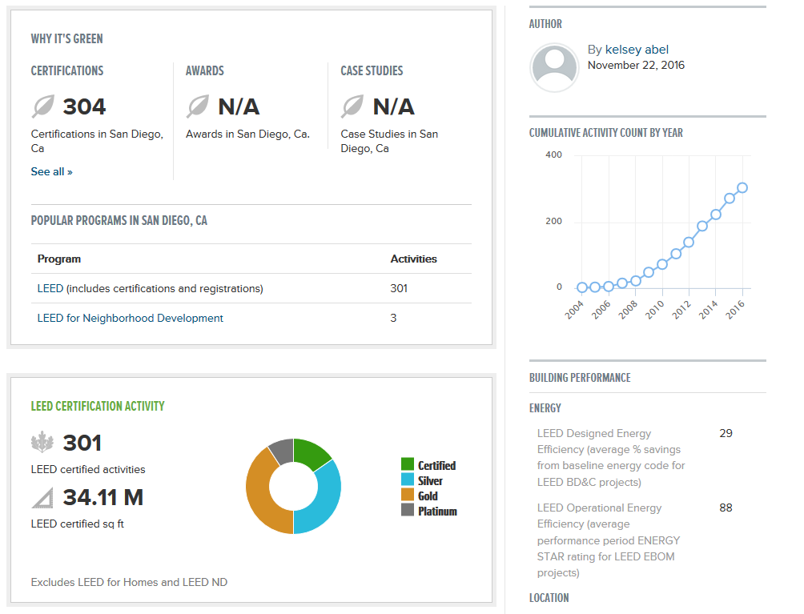
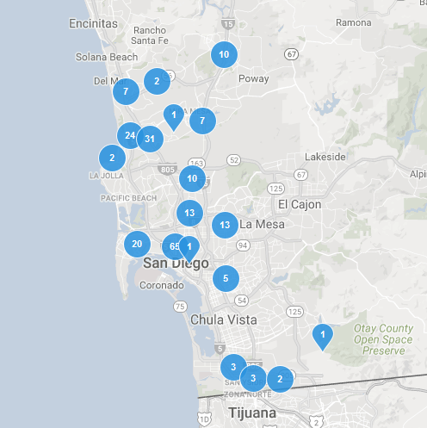
San Diego, Ca

Slide 14
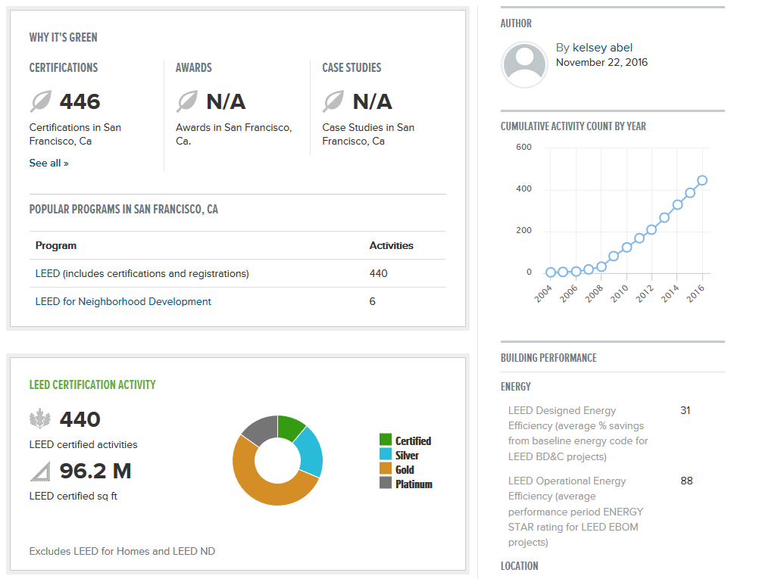
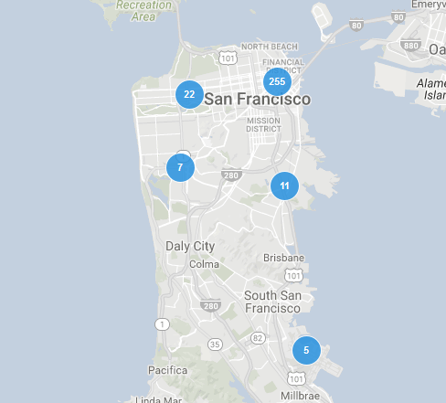
San Francisco, Ca

Slide 15
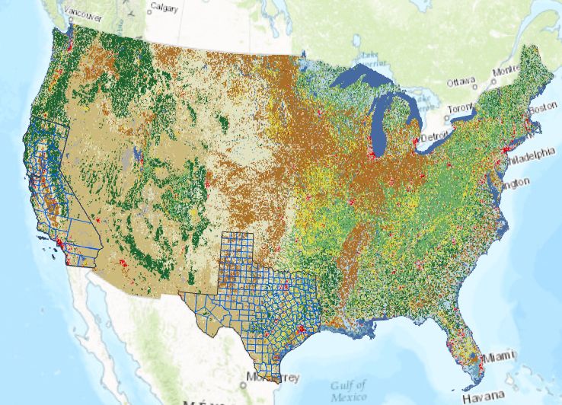
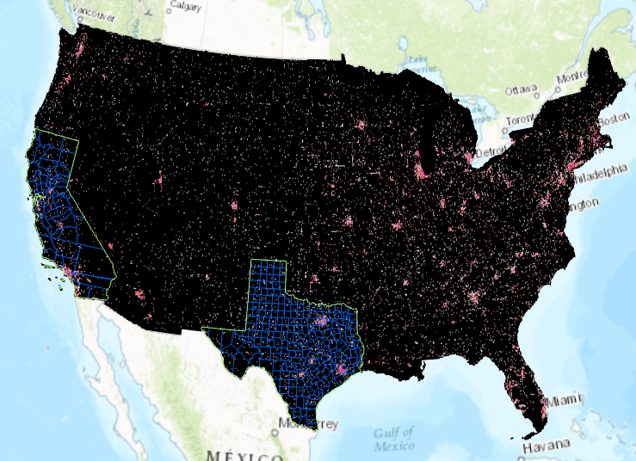
GIS Data
NLCD for 1992, 2001, 2006, 2011
Compared placement of LEED buildings with NLCD and Permeability

Slide 16
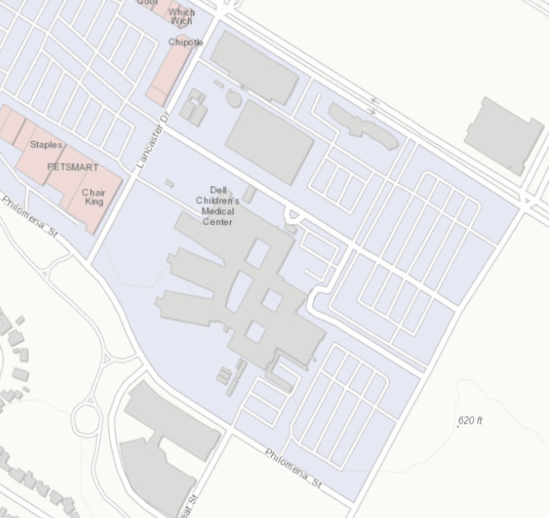
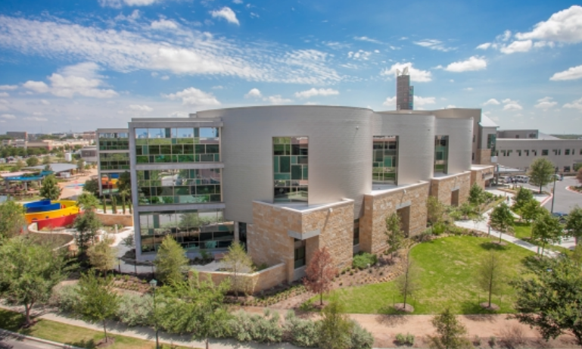

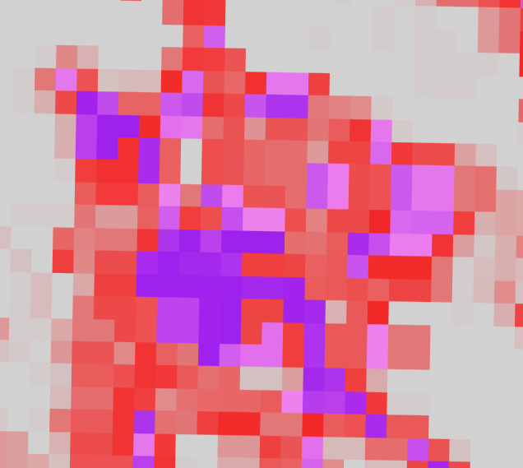

Characteristic Results
Dell Children’s Hospital»
WSP Parsons Brinkerhoff
2001
2006
2011

Slide 17
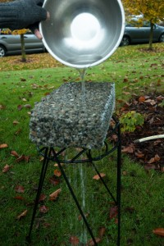
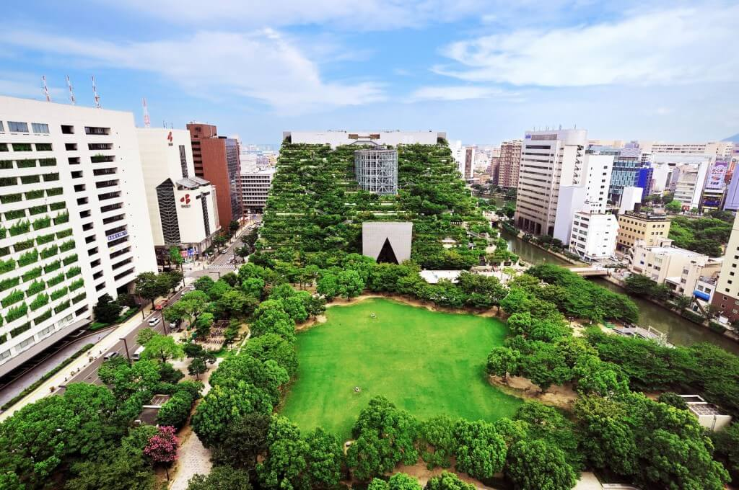
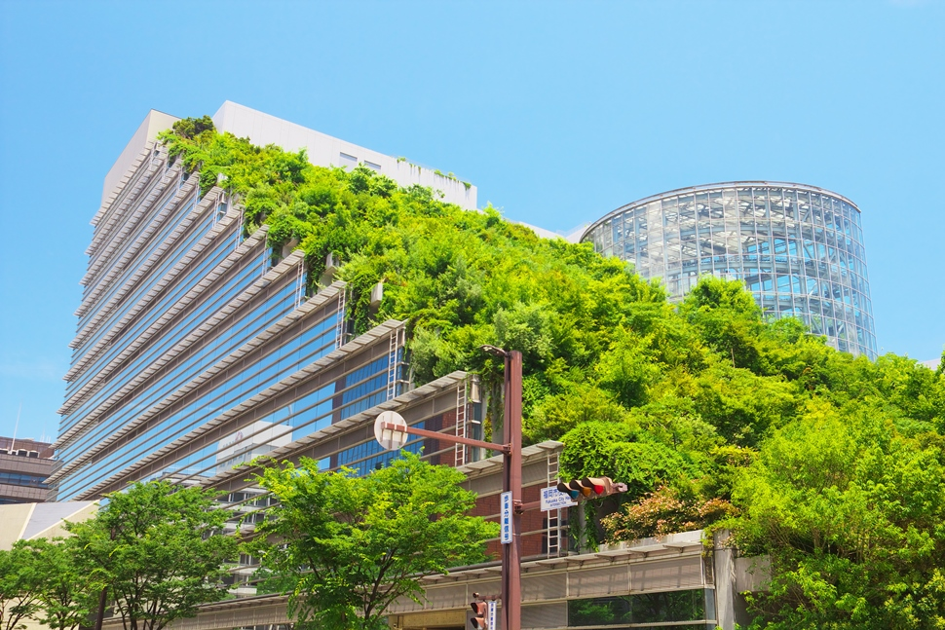
Conclusions & Discussion
Green Building Alliance
Development is development
  Independent of new construction or retrofitting
  Impact on run off and recharge
Building footprint > landscaping footprint
LEED and “Pointless Points”
LEED building trends:
  All cities studied exhibited exponential growth in the number of LEED projects
  New construction dwarfed retrofitting
Possible Problems
Skygardens
JLL
Notes:
Pavement: https://www.go-gba.org/resources/green-building-methods/permeable-pavements/

Slide 18
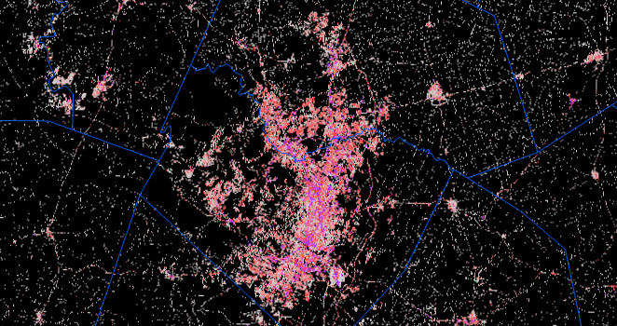
Questions?

Slide 19
Sources and References:
[1] Dell children’s medical center of central Texas. (2015, November 5). Retrieved November 29, 2016, from http://www.wsp-pb.com/en/WSP-USA/What-we-do-USA/Projects/Dell-Childrens-Medical-Center-of-Central-Texas/
[2] USGBC. (2016, July 1). USGBC Statistics. Retrieved November 29, 2016, from http://www.usgbc.org/articles/usgbc-statistics
[3] USATODAY (2013, June 13). In U.S. Building industry, is it too easy to be green? Retrieved from http://www.usatoday.com/story/news/nation/2012/10/24/green-building-leed-certification/1650517/
[4] USGBC. (2012). Top 10 U.S. Cities and States Ranked By Total Number of LEED Projects. Retrieved from http://www.usgbc.org/Docs/Archive/General/Docs7744.pdf

Slide 20
Image Citations
Slide 4:
  USATODAY (2013, June 13). In U.S. Building industry, is it too easy to be green? Retrieved from http://www.usatoday.com/story/news/nation/2012/10/24/green-building-leed-certification/1650517/
  WSP Parsons Brinkerhoff. Dell Children’s Medical Center of Central Texas. Retrieved November 29, 2016, from http://www.wsp-pb.com/en/WSP-USA/What-we-do-USA/Projects/Dell-Childrens-Medical-Center-of-Central-Texas/
Slide 5:
  Retrieved November 29, 2016, from https://s-media-cache-ak0.pinimg.com/originals/92/c8/5b/92c85b38a1453f8657c2d6cc137d17a6.png
Slide 6:
  USGBC. (2012). Top 10 U.S. Cities and States Ranked By Total Number of LEED Projects. Retrieved from http://www.usgbc.org/Docs/Archive/General/Docs7744.pdf
Slide 7-11:
  I used gbig.org for information
Slide 14:
  WSP Parsons Brinkerhoff. Dell Children’s Medical Center of Central Texas. Retrieved November 29, 2016, from http://www.wsp-pb.com/en/WSP-USA/What-we-do-USA/Projects/Dell-Childrens-Medical-Center-of-Central-Texas/
Slide 15:
  Green Building Alliance. (2016). Permeable pavement. Retrieved November 29, 2016, from https://www.go-gba.org/resources/green-building-methods/permeable-pavements/
  Skygardens. Retrieved November 29, 2016, from http://www.greenroofs.com/blog/wp-content/uploads/2011/08/ACROSFukuokaShowcase.gif
  JLL. (2016). Japan sharpens its green building focus. Retrieved November 29, 2016, from http://www.jllrealviews.com/places/japan-sharpens-its-green-building-focus/

