Slide 1

Offshore petroleum platforms and dissolved oxygen in the northern Gulf of Mexico
Derek G. Bolser
Geographic Information Systems in Water Resources
November 29th, 2016

Slide 2
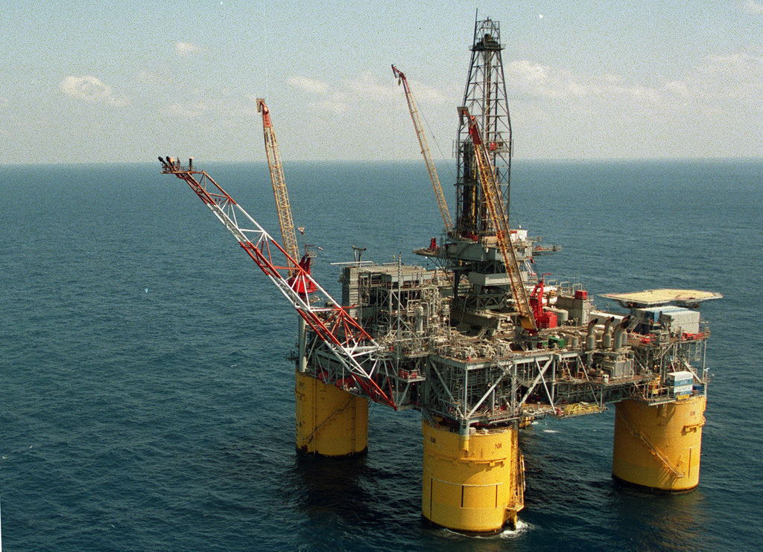
Overview
Background
Objectives
Data
Methods
Results
Significance
Rig Fusion

Slide 3
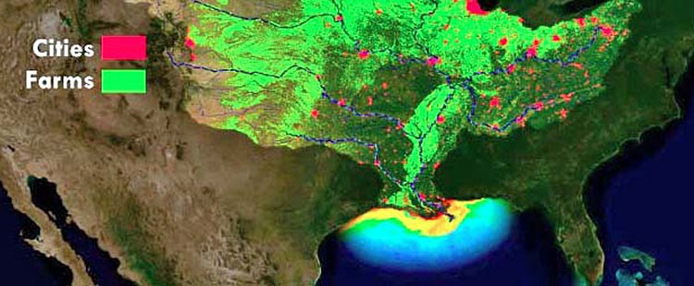
Background
Transient hypoxic zones are known to exist in the northern Gulf of Mexico
  These phenomena are well studied, and are caused by excess nutrient input
  Most marine organisms cannot survive in hypoxic zones
Population Education
Notes:
Hypoxia is defined as dissolved o2 less than 2 mg/L. Does not occur in the winter, are most intense in the summer. This is something that we already know, but what we don’t know is how hypoxic zones and offshore drilling rigs interact

Slide 4
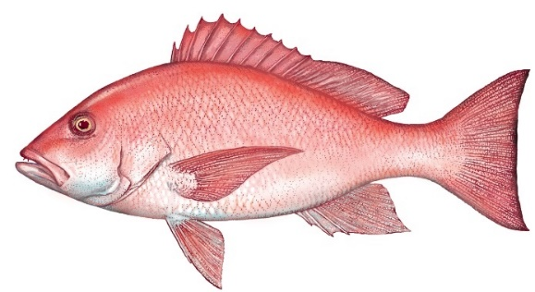
Background
FL dept. of ag.
Offshore petroleum platforms are important habitat for many marine organisms
  68% of age 2 red snapper in the Gulf reside on these platforms (Gallaway et al. 2009)
  Offshore petroleum platforms are temporary structures by legal definition
Notes:
About 200 are being removed by explosive severance every year. For Red snapper, explosive severance was estimated to kill 71% of fish present (Gitshlag et al. 2003). My thesis work will aim to improve this estimate, as well as provide estimates for other species. Knowledge of how which and how many platforms fall within hypoxic zones could: improve severace planning to reduce ecological impacts, be foundational for research studying hypoxia impacts on drilling rigs, be informative for fishermen planning their next fishing trip.

Slide 5
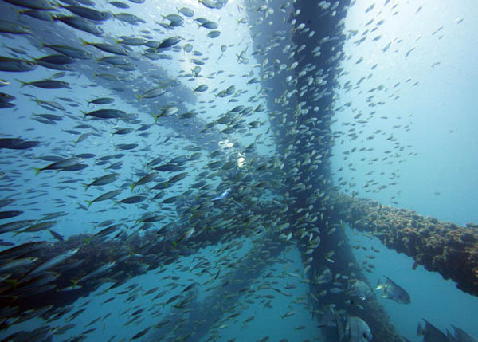
Objectives
Proof-of-concept study to quantify how many platforms fall within hypoxic zones.
  If a sufficient number are found, a similar map with real-time data may be used to inform explosive severance decisions
Quantify total hypoxic area within range of data.
Erich Schlegel
Notes:
My thesis work will quantify impacts of explosive severance. Whenever you want to identify a problem, you also want to propose a solution. Minimizing ecological impacts

Slide 6
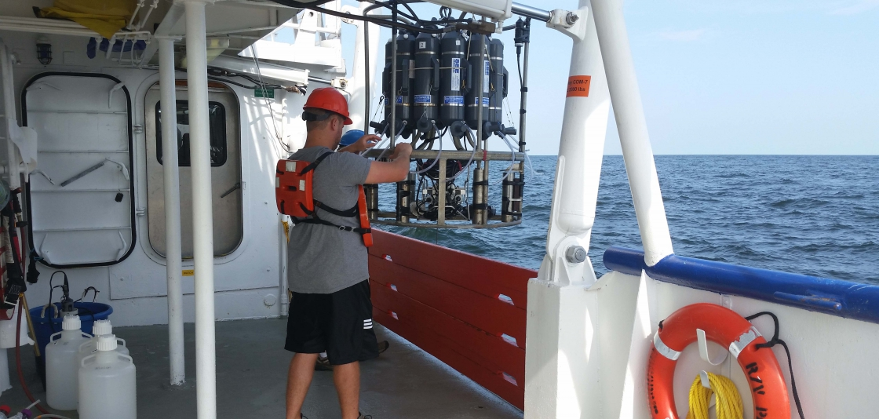
Data
Hypoxia data from USGS and NOAA
  Measurements have been taken with CTD devices every June & July since 2001
Platform location data from the BSEE
  There are 7225 platforms in the Gulf
USGS
Notes:
Bureau of safety and environmental enforcement. #s as of oct 2016. Since 2001 with this sampling protocol, but studied since 1985

Slide 7
Methods
Somewhat similar to the flood inundation mapping we did in exercise 5
  Spatial join tool was very useful—thanks, Dr. Maidment!
Data had to be transformed back and forth between points and rasters several times.
Exercise 5- Onion Creek
2013 northern Gulf

Slide 8
2013 results- platforms
Class | Number of platforms
Hypoxic (0-2 mg/L O2) | 460
Near-hypoxic (2-5 mg/L O2) | 612
Not hypoxic (5+ mg/L O2) | 311

Slide 9
2013 results- dissolved oxygen
Class | Area (km^2)
Hypoxic (0-2 mg/L O2) | 7,082.2924
Near-hypoxic (2-5 mg/L O2) | 11,883.069
Not hypoxic (5+ mg/L O2) | 2,424.9211

Slide 10
2015 results- platforms
Class | Number of platforms
Hypoxic (0-2 mg/L O2) | 93
Near-hypoxic (2-5 mg/L O2) | 1,309
Not hypoxic (5+ mg/L O2) | 139

Slide 11
2015 results- dissolved oxygen
Class | Area (km^2)
Hypoxic (0-2 mg/L O2) | 1,351.2498
Near-hypoxic (2-5 mg/L O2) | 19,782.8712
Not hypoxic (5+ mg/L O2) | 2,442.7895

Slide 12
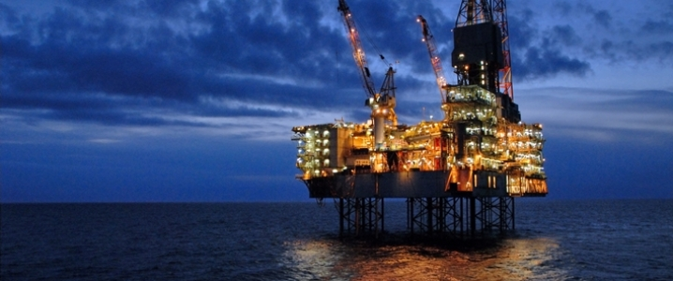
Significance
There may be a sufficient number of platforms in hypoxic areas to meet demolition demands in some locations
This process undertaken with real-time data could be used to better plan explosive severance, or at least accurately quantify impacts
Oil price

Slide 13
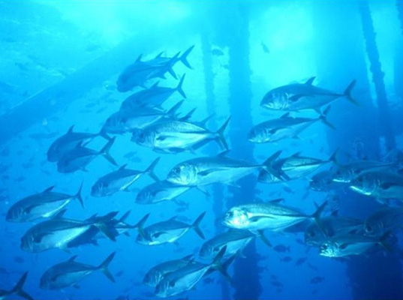
Acknowledgements
Thank you Dr. Maidment and Paul Ruess!
InHabitat

Slide 14
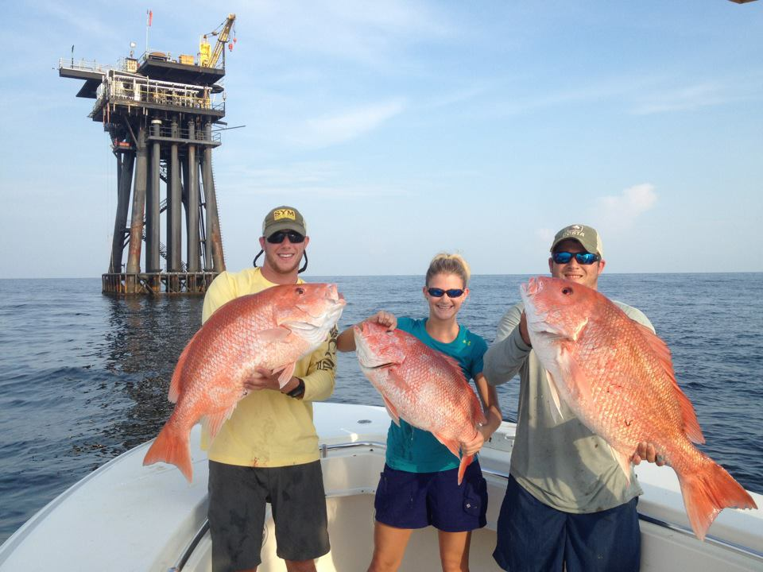
Questions?
Home run charters
Reference: Gallaway, B. J., S. T. Szedlmayer, and W. J. Gazey. 2009. "A life history review for red snapper in the Gulf of Mexico with an evaluation of the importance of offshore petroleum platforms and other artificial reefs." Reviews in Fisheries Science 17.1: 48-67.

