Slide 1
Applying GIS to Determine Suitability for Viticulture in Washington State
By: Mark Gockowski

Slide 2
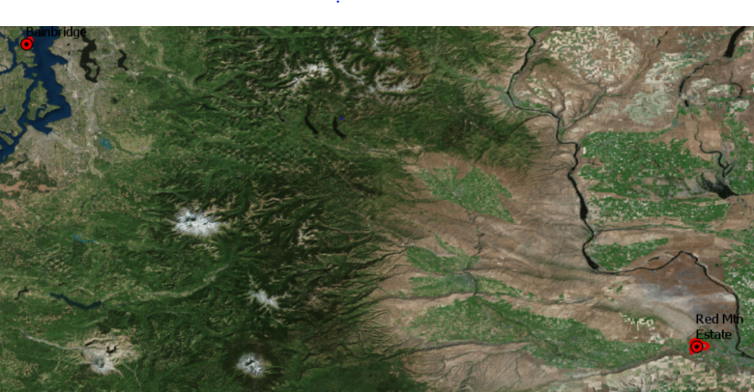
The Vineyards
1. Bainbridge Vineyards
2. Red Mountain Estate Vineyards
Notes:
Bainbridge Vineyards:
Located on Bainbridge Island, WA (Puget Sound)
7 acres of farmland, producing 1,200 cases/yr of wine
Main varietals = Pinot Noir, Muller-Thurgau, and Pinot Gris
Red Mountain Estate Vineyards:
Yakima Valley, WA
32.45 acres planted area
Growing predominantly cabernet sauvignon, cabernet franc, and merlot

Slide 3
Agenda
Data Collection
  Topography Considerations
  Climate Considerations
  Soil Considerations
Suitability Analysis
Further Work

Slide 4
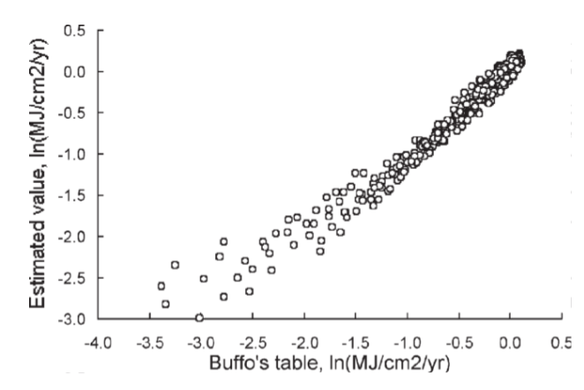
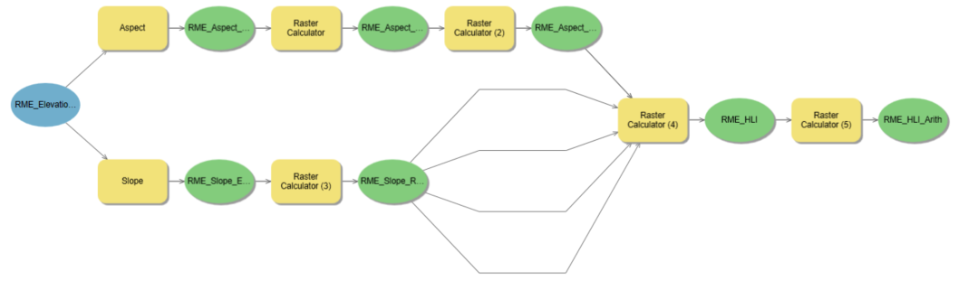
Topography Considerations
Heat Load Index:
Approximation of solar radiation based on slope, aspect, and latitude
Does not account for cloud cover, difference in atmospheric coefficient, and shading
Notes:
The first category I examined was topography. In addition to a few other variables, I (with the help of Sara Goeking) looked at the Heat Load Index
HLI = equation for annual direct incident solar radiation and heat load
Function of latitude, slope, and aspect, and can be derived in GIS from elevation data
Steeper slopes = increased HLI, Southwestern aspect = increased HLI, lower latitudes = increased HLI
I used model builder to convert my NED30m data into HLI as follows

Slide 5
Topography Considerations
Summary:
Category | Bainbridge Average | Red Mountain Estate Average
Slope (% drop) | 10.12 | 3.84
Aspect (degrees) | 270.5 (W) | 234.11 (SW)
Elevation (meters) | 74.39 | 216.05
Heat Load Index | 0.736 | 0.714
Notes:
In addition to HLI, I looked at the following topographical parameters: slope, aspect, and elevation, all of which you will notice are involved in the calculation of heat load index.
Slope is important for surface and internal water drainage. Slopes in excess of 15% are not recommended b/c of risk of soil erosion, equipment roll over.
Aspect is important because it affects the total heat balance of a vineyard. Studies by Johnstone, et al have shown that minimum temps on northerly slopes were 1-2.5 degrees cooler than on corresponding southerly slopes.
Elevation is largely negligible with respect to this project, as both sites are at relatively low elevation.
Heat load index, as mentioned before, tell us a lot about how the topography affects the incident solar energy at the vineyards. Noting that the model does not adjust for cloud cover, atmospheric differences, and shading, the values predicted for both vineyards is almost identical.

Slide 6
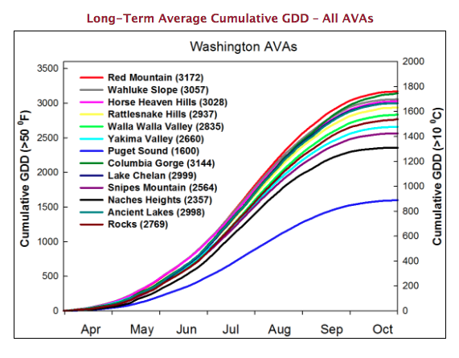
Climate Considerations
Summary:
Category | Bainbridge Average | Red Mountain Estate Average
Frost-Free Period (days) | 184.8 | 172.57
Growing-Degree Days | 1600 | 3172
Annual Precipitation (inches) | 41.19 | 8.73
Notes:
Length of frost-free period is one of the most important metrics in determining whether grapes will ripen or not.
Determined as number of days between last winter frost and first fall frost
A minimum of 160 frost-free days is recommended for most vineyards (Read) although some varietals may ripes with a season as short as 150 days
Growing-degree days:
Defined as the sum of (average daily temp – 50 degrees F) for all days from April 1 – Oct 31
Used to quantify heat available for grapevine development, assumes that for all practical purposes, photosynthesis and respiration cease below 50F
Average precipitation:
Obviously precipitation is important for growing any crop, however, precipitation brings cloud cover and moderates temperature
The precipitation in Bainbridge is 5x that of RME, which explains why despite a higher HLI and more frost free days, Bainbridge has substantially fewer growing degree days than does RME

Slide 7
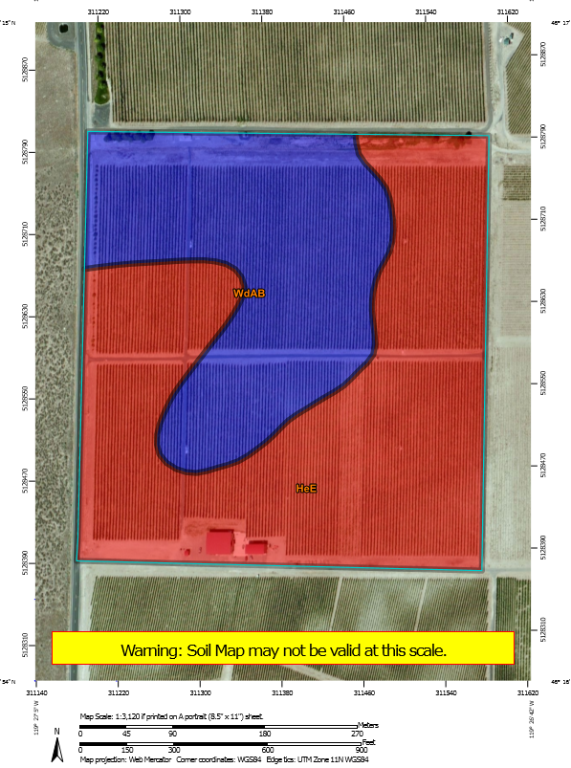
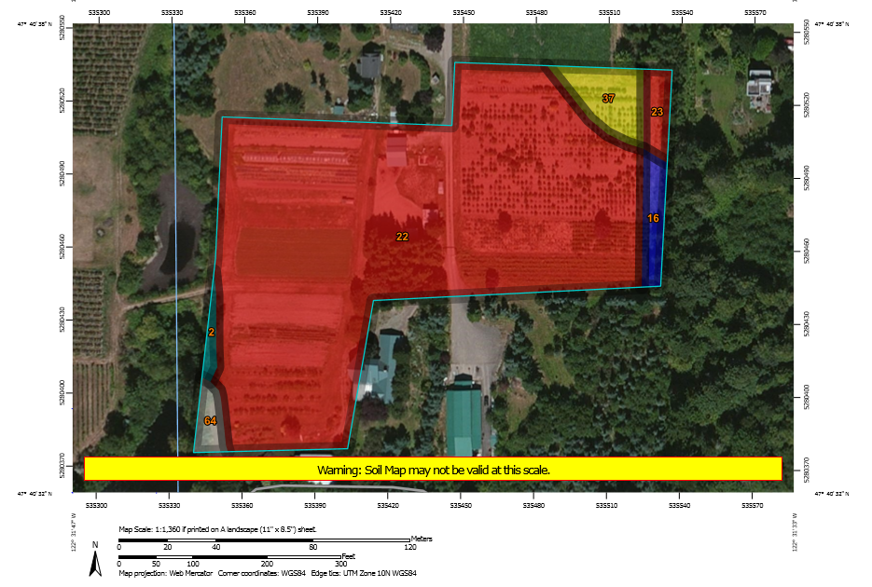
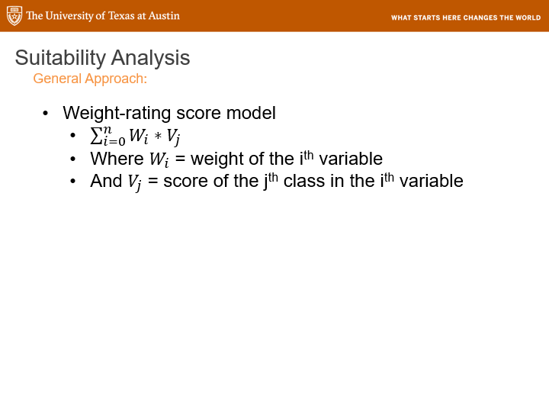
Soil Considerations
Summary:
Category | Bainbridge Average | Red Mountain Estate Average
Soil Drainage | 5 (Moderately well- drained) | 6.62 (Somewhat excessively drained)
Soil pH | 5.5 | 7.45
Soil Organic Matter (%) | 7.72 | 0.92
Notes:
Soil influences grapevine productivity and wine quality. There are infinitely many factors that can be considered with respect to soil, but some compromises need to be made so that the selection process does not become too biased toward soil considerations
Used the NRCS (Natural Resources Conservation Service) Web Soil Survey to examine soil pH, drainage, and organic matter
Soil drainage is the most important soil trait
Waterlogged soils increase root rot, fungus, and pathogens
Also forces deeper root systems, which increases drought resistance
Organic matter contributes porosity, structure, nutrients, and moisture holding ability
Organic matter greater than 5% can be counter productive since excessive N can lead to supra-optimal vine growth
Low organic matter valvues can be amended with compost, manure, etc
pH
Acidic to neutral soils are best (5.5-7), but grapes can tolerate a wide range

Slide 8
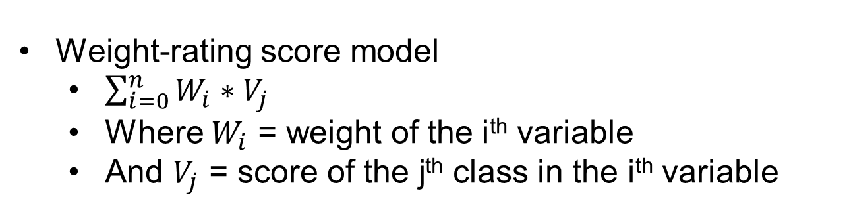
Suitability Analysis
General Approach:
Weight-rating score model
  $\sum_{i=0}^{n}{W_{i}}∗V_{j}$
  Where $W_{i}$ = weight of the i^{th} variable
  And $V_{j}$ = score of the j^{th} class in the i^{th} variable

Slide 9
Suitability Analysis
General Approach:
Variable | W_{scale} | W_{normalized}
Slope | 6 | 9.83%
Aspect | 5 | 8.2%
Heat Load Index | 7 | 11.47%
Frost Free Period | 9 | 14.75%
Growing Degree Days | 8 | 13.11%
Annual Precipitation | 8 | 13.11%
Soil Drainage | 10 | 16.4%
Soil pH | 4 | 6.55%
Soil Organic Matter | 4 | 6.55%
SUM | 61 | 100%

Slide 10
Suitability Analysis
Results:
Variable | Bainbridge Value | Bainbridge Score | RME Value | RME Score
Slope | 10.12 | 8 | 3.84 | 5
Aspect | 270.5 (W) | 5 | 234.11 (SW) | 7
Heat Load Index | 0.736 | 7 | 0.714 | 7
Frost Free Period | 184.8 | 10 | 172.57 | 8
Growing Degree Days | 1600 | 1 | 3172 | 7
Annual Precipitation | 41.19 | 2 | 8.57 | 9
Soil Drainage | 5 | 10 | 6.62 | 8
Soil pH | 5.5 | 10 | 7.45 | 10
Soil Organic Matter | 7.72 | 0 | 0.92 | 5

Slide 11
Suitability Analysis
Results:
Bainbridge Total Score: 6.1636
RME Total Score: 7.4413

Slide 12
Further Work
Improvements to weight rating score model
  Define a specific set of weights and values for each parameter specific to each grape varietal
  Automate a GIS function to determine “ideal grape varietal” for a given GIS polygon
  Include additional parameters to the model to better capture terroir
  Improve the output from the model from a simple score from 0-10 to a predicted average percent yield, etc.
  Many more!

Slide 13
Questions?

