Slide 1
Texas Reservoir Storage
Michael Link

Slide 3
Objective
Initial: Project time till Texas took regulatory action based off of California
California enacted restrictions when reservoirs were higher
Western Texas had already put into place minor water restrictions
Final: Provide visual representation of changes in water storage capacity across the state of Texas

Slide 4
Notes:
As Shown in exercises there is a longitudinal correlation for evaporation. In addition there is a trend in precipitation.

Slide 5
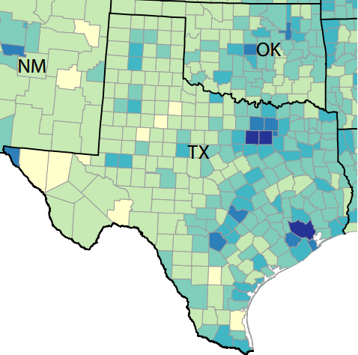
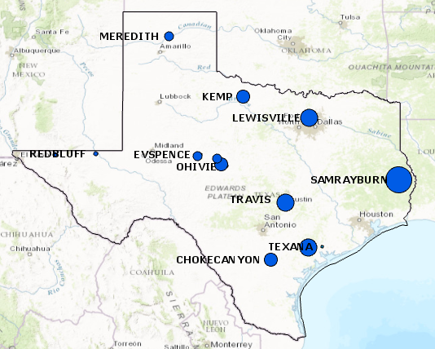
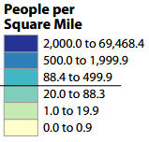
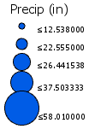
Population Centers and Precipitation
Population Density | Average Precipitation (2000-2015)
Notes:
Interestingly enough there is a strong correlation between Average Precipitation and population density

Slide 6
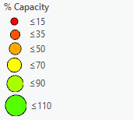
Percent Capacity 2001-2015
Notes:
Green is at or above 90% capacity. Western reservoirs stay constantly below 70 % and Easter reservoirs fluctuate between 70-110%. Learn more about flood pool etc.

Slide 7
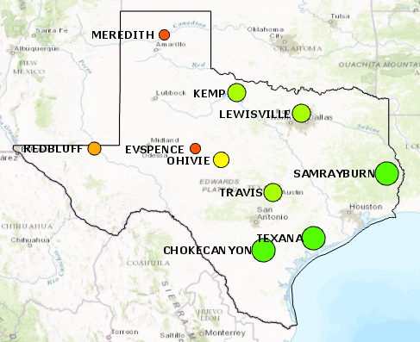
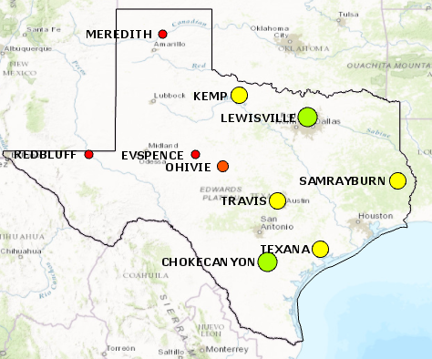
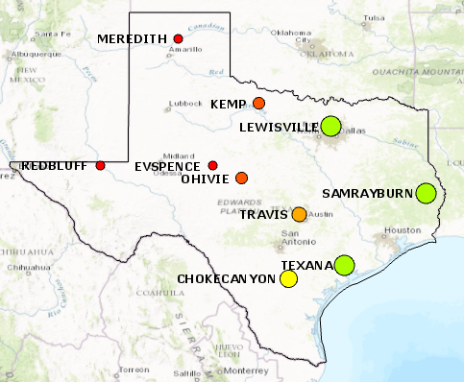
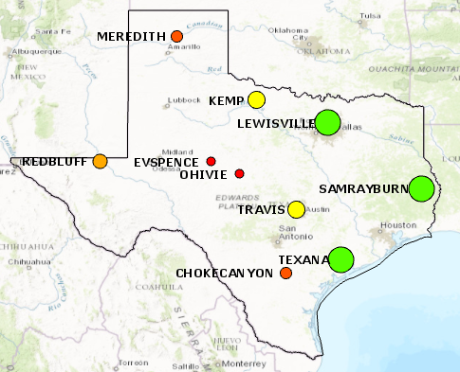
2005 | 2011
2012 | 2015
Notes:
Here are some snapshots of capacity over time. 2011-2012 was the worst drought.

Slide 8
Projection Till Zero Percent Capacity
Reservoir | R^2 | Years Till
O.H. Ivie | 0.52 | 23
E.V. Spence | 0.48 | 20
Meredith | 0.71 | 21
Travis | 0.67 | 23

Slide 9
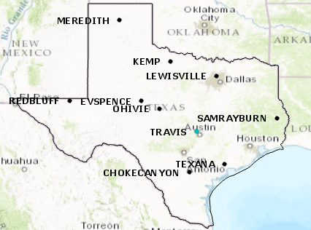
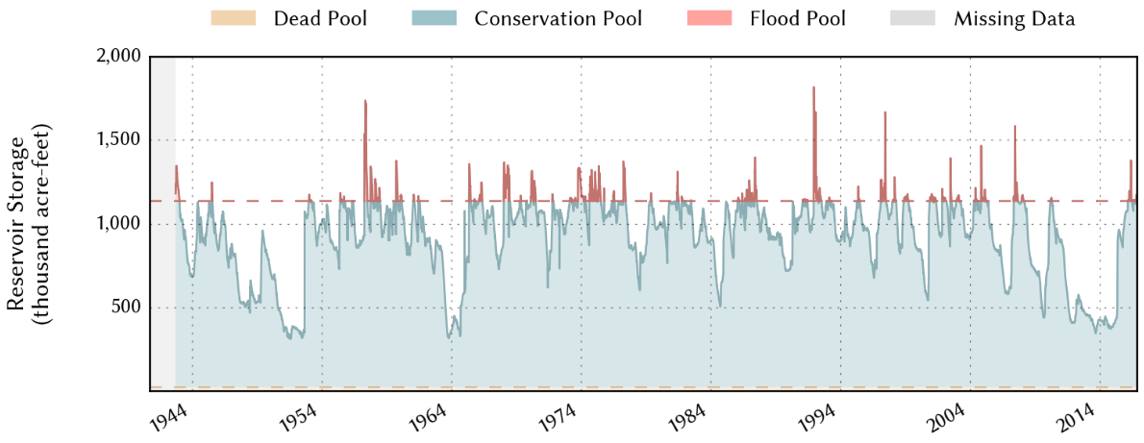
Lake Travis (23 years)
Provides water for Austin TX

Slide 10
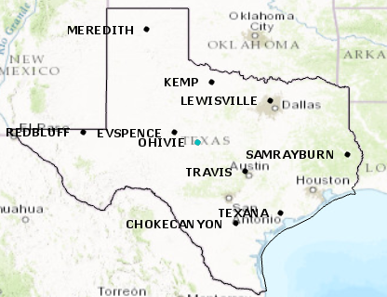
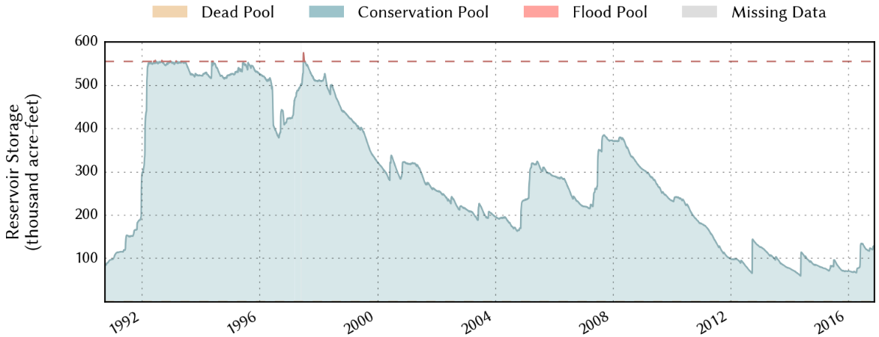
O.H. Ivie (23 years)
Supports Cities of Abilene, San Angelo, Odessa, ...
O.H. Ivie consistently below 50% capacity

Slide 11
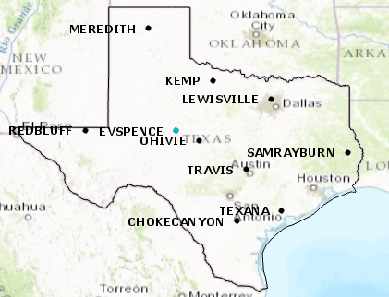
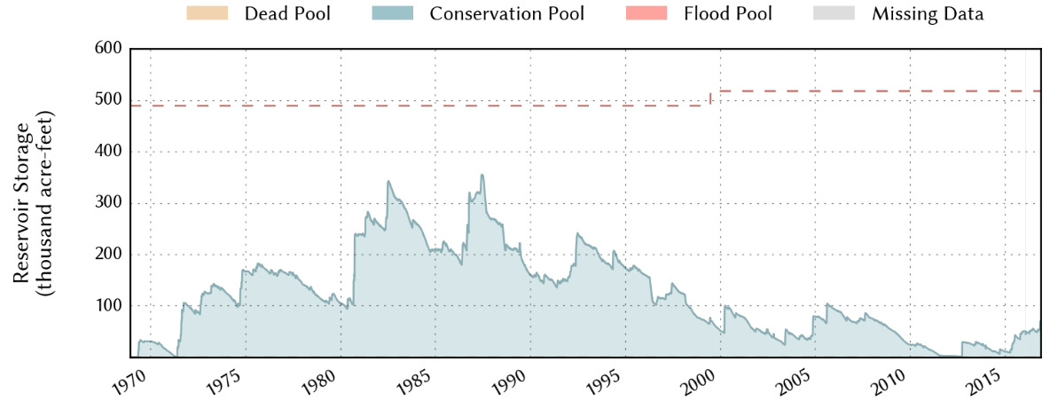
E.V. Spence (20 years)
Supports San Angelo, Big Spring, ...
E.V. Spence below 20% capacity from 2000-2015

Slide 12
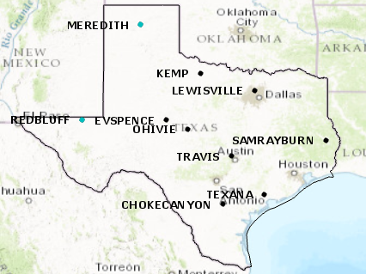
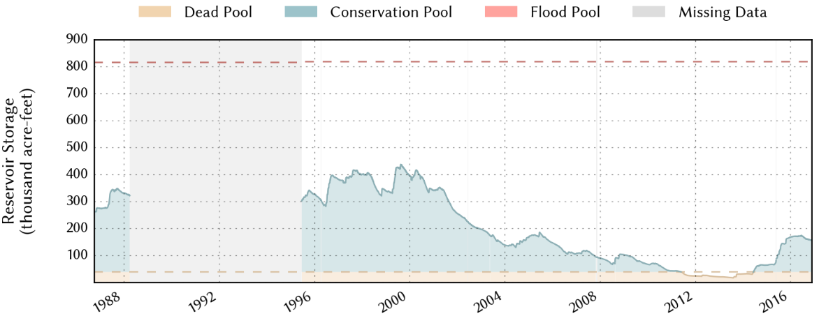
Lake Meredith (21 years)
Provides Water for Lubbock and Amarillo TX
Average 21 percent Capacity since 2000

Slide 13
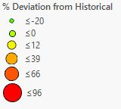
Percent Historical Deviation 2000-2015
Notes:
Historical averages for each reservoir was found from initial reservoir construction to the year 2000. In this animation I try to show the percentage deviation from historical water storage or in other words what is normal. Lake OH Ivie, EV Spence, and Lake Meredith are frequently in the range of 40-96% deviation.

Slide 14
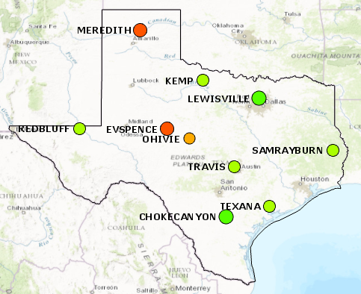
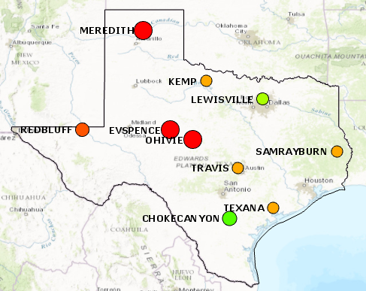
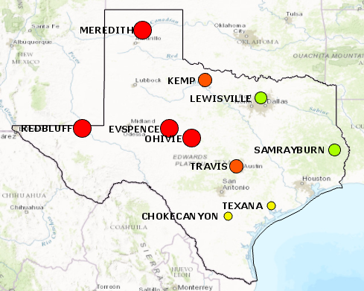
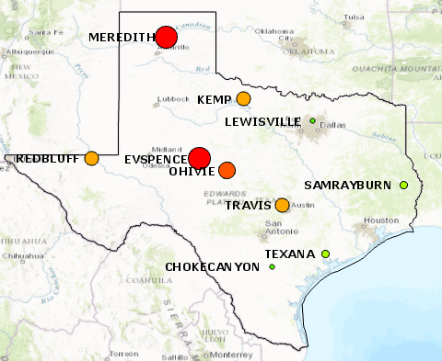
2005 | 2011
2012 | Averaged Deviation (2000-2015)
Notes:
Here are the snapshots for percent deviation. Reservoirs on the western side of the state were severely hit by the drought. The bottom right image shows the average deviation over the course of the 15 year period of study. I will next examine OH Ivie, EV Spence, Lake Meredith, and lake Travis to show historical trends.

Slide 15
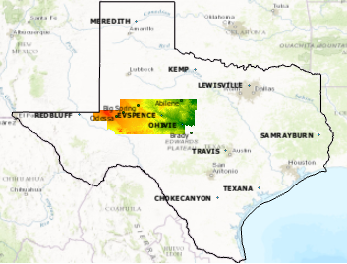

Slide 16
Slide from Dr. Maidment’s Texas Drought Planning Presentation

Slide 17
Case Study: San Angelo
Population ~ 100,000
Water Sources – EV Spence, OH Ivie, ..
Previous Contingency Plan
1 portable toilet per two houses
5 gallons of water per person per day
1.2 million dollars per day
Mayor Alvin New (2009-2013)

Slide 18
San Angelo
Hickory Aquifer Project
Acquired water rights in 1970’s
62 miles southeast near Brady TX
120 million for infrastructure (2009)
43 million for land purchase (Nov 2016)
9 MGD capacity (12 MGD for city)
Radioactive Materials

Slide 19
Conclusions
Eastern Texas reservoir levels are not concerning
Western Texas cities should continue to evaluate water resource options
Potential Solutions
Cradle to cradle
Groundwater infrastructure

Slide 20
References
City of Abilene: Water Production. (n.d.). Retrieved November 20, 2016, from http://abilenetx.com/city-hall/departments/water-utilities/water-production
Water Resources. (n.d.). Retrieved November 20, 2016, from http://www.cosatx.us/departments-services/water-utilities/water-resources
Utilities. (n.d.). Retrieved November 20, 2016, from http://amarillo.gov/?page_id=210
City of Lubbock - Water Department - Home. (n.d.). Retrieved November 20, 2016, from https://www.mylubbock.us/departmental-websites/departments/water-department/home
Division, P. (n.d.). Density Using Land Area. Retrieved November 20, 2016, from http://www.census.gov/population/www/censusdata/density.html

Slide 21
Questions?

Slide 22
Projection Till Zero Percent Capacity
Reservoir | R^2 | Years Till
O.H. Ivie | 0.52 | 23
E.V. Spence | 0.48 | 20
Choke Canyon | 0.29 | 11
Kemp | 0.35 | 19
Lewisville | 0.01 | 319
Meredith | 0.71 | 21
RedBluff | 0.05 | -23
Sam Rayburn | 0.12 | 134
Texana | 0.20 | 97
Travis | 0.67 | 23

