Slide 1
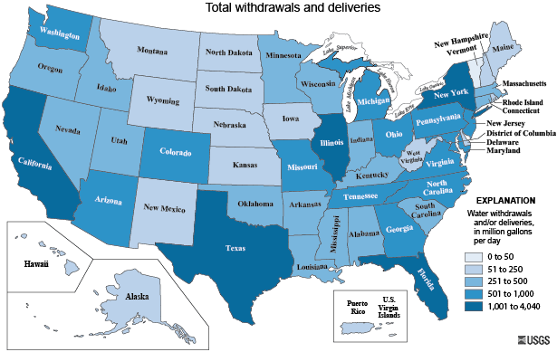
Water Rates in the United States
November 29, 2016
Rachel Turner
University of Texas at Austin
GIS in Water Resources

Slide 2
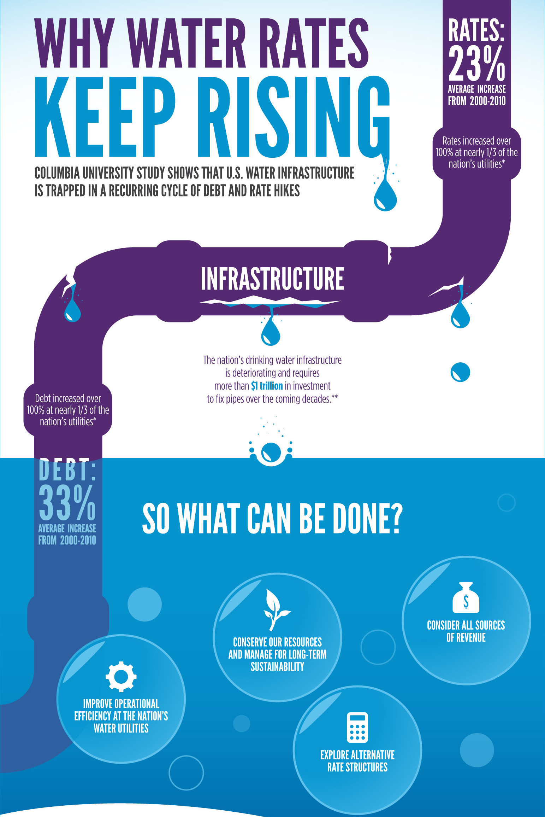
What factors affect water rates?
Water Source/Availability
Water Usage
Climate
Population
Rate Structure
Existing Infrastructure
New Regulations
Notes:
Driving factors behind the variability in water rates – I want to do an exploratory analysis
Rates have increased 23% from 2000-2010
Population shift to some water scarce areas and aging infrastructure
ASCE estimates that over $1 trillion dollars is needed to fix water infrastructure and billions of gallons of water lost daily from leaky pipes
So some factors affecting water rates are the type of water source used and the availability of it, amount of water used, climate such as precipitation drought tendency and temp, population/utility size, type of rate structure, condition of existing infrastructure, new more stringent regulations on water quality

Slide 3
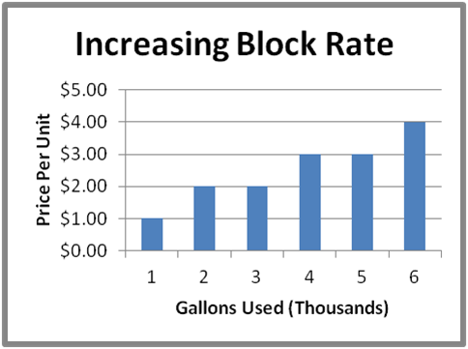
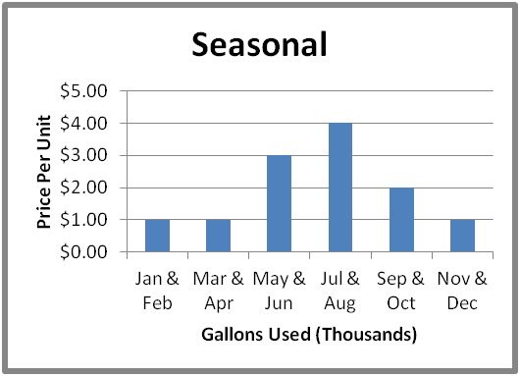
Rate Structures
Rate is constant
Rate increases as
usage increases
Goal: Promote conservation
Rates vary seasonally
Goal: Promote conservation during peak periods
Notes:
Increasing block rate most common – so I’ll show a quick example of determining the rate

Slide 4
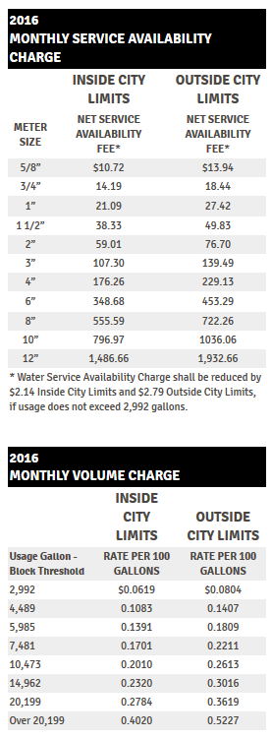
Rate Calculation Example
Rate = Fixed + Volume Charge
Fixed:
5/8” Meter Size $10.72
Volume (assume 7,500 gal/month usage):
0 – 2,992 gallons 29.92 x $0.0619 = $1.85
2,992 – 4,489 14.97 x $0.1083 = $1.62
4,489 – 5,985 14.96 x $0.1391 = $2.08
5,985 – 7,481 14.96 x $0.1701 = $2.54
7,481 – 7,500 0.19 x $0.2010 = $0.04
$8.13
Fees $15.10
TOTAL: $33.95
Notes:
Only focusing on single family housing

Slide 5
GIS Mapping
Actual Water Usage (gal/month)
Water Cost ($)
at Fixed Usage (7,500 gal/month)
Water Cost at Fixed Usage ($)
Water Cost at Actual Usage ($)
Notes:
Discuss data collection – rate
Usage taken from the USGS 2010 water use survey

Slide 6
Average Annual Precipitation (inches)
Notes:
Reiterate that dots are rate

Slide 7
Drought Intensity
Notes:
As you can see there is more clear of a correlation like in CA, NM and parts of TX vs the Eastern US

Slide 8
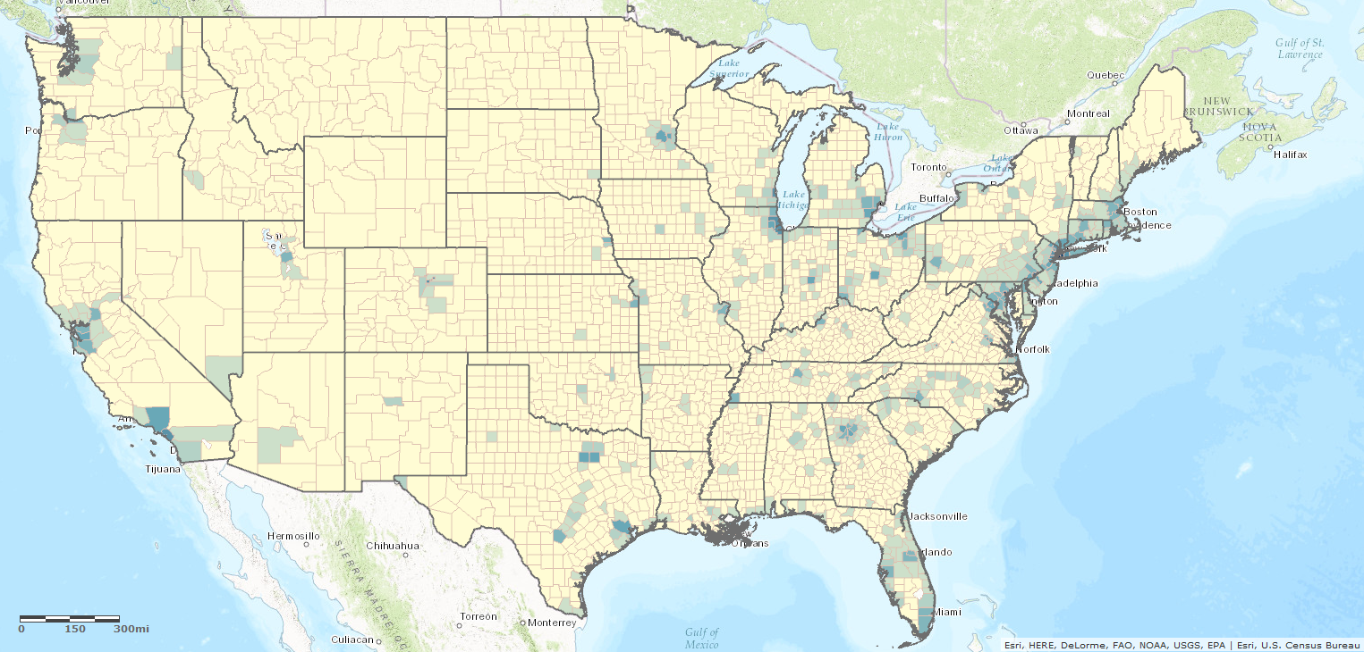
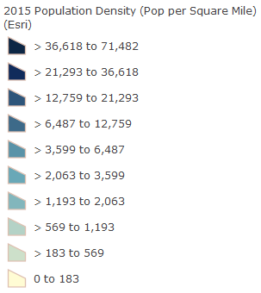
Primary Water Source
Population Density
Average Annual Temperature
Notes:
I did an analysis on these factors as well in excel and they had weak correlations to water rate.

Slide 9
Results & Conclusions
No strong correlations can be made directly between individual factors and water rates with the current data
Water rates are very complex with driving factors that vary widely from city to city
Notes:
From my research, even studies done with more locations sampled and more factors come up with a similar result of weak direct correlations
I do think it could be interesting if this could be expanded upon for more locations with more varying utility sizes and collect data on utilities operating costs which is a more direct correlated variable

Slide 10
References
Prism Climate Group, Oregon State University. <http://prism.oregonstate.edu/normals/>
U.S. Drought Monitor, The National Drought Mitigation Center. <http://droughtmonitor.unl.edu/MapsAndData/GISData.aspx>
America’s Water: An Exploratory Analysis of Municipal Water Survey Data. Rahill, Bianca. <http://growingblue.com/wp-content/uploads/2013/10/Aquanauts_Study_Data.pdf>
Why Water Rates are Likely to Increase, Columbia University. <http://growingblue.com/case-studies/why-water-rates-are-likely-to-increase/>
Water Sense, US EPA. <https://www3.epa.gov/watersense/our_water/understanding_your_bill.html>

Slide 11
Thank You! Any Questions?

