Slide 1

Drainage in Los Angeles: Ballona Creek
Alice Wang
GIS CE 394K | Fall 2016
Environmental and Water Resources Engineering

Slide 2
Objectives
Tell a story of water movement within a highly urbanized environment
Utilize ArcGIS Pro to illustrate water drainage in highly urbanized watershed

Slide 3
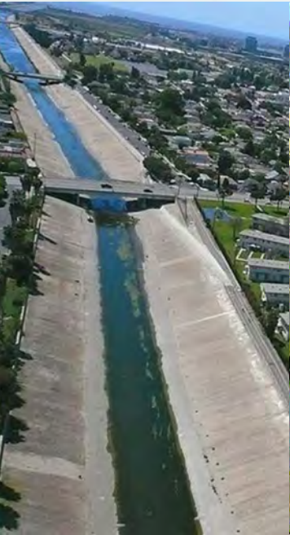
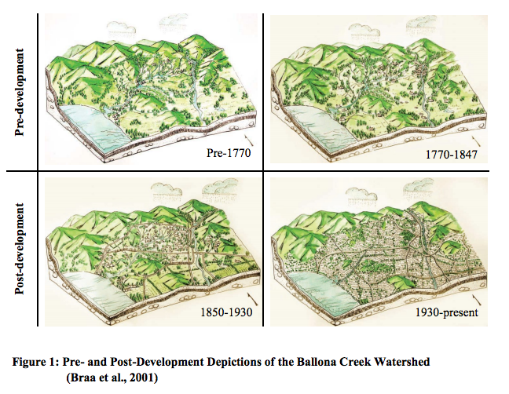
Ballona Creek Beginnings

Slide 4
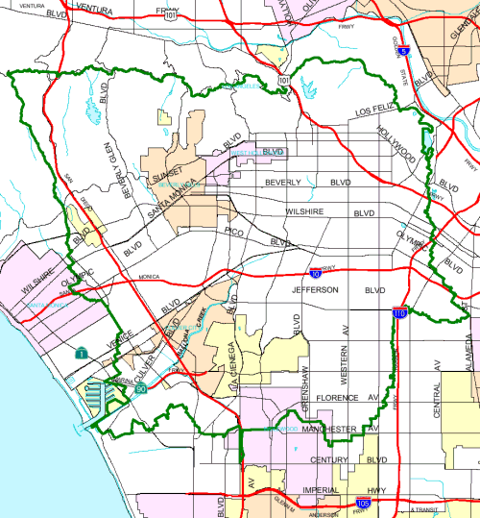

Ballona Creek Background
Greater Los Angeles Basin of Southern California
Approximately
130 square miles
Main open channel:
~8.8 miles
Santa
Monica
Bay
http://ladpw.org/wmd/watershed/bc/map.cfm

Slide 5
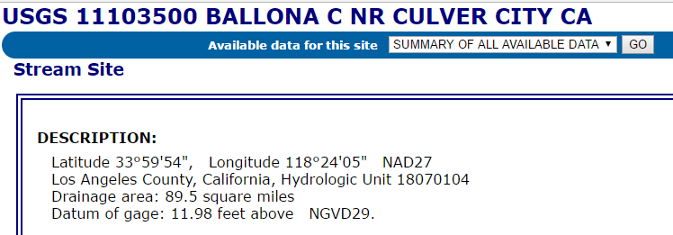
Data Sources
Los Angeles County GIS Data Portal
  Los Angeles county storm drain system
  Flow Direction Arrows
USGS
  Stream Gage
  Discharge History
ArcGIS Server
  Elevation
  Flow Direction
  Land Cover

Slide 6
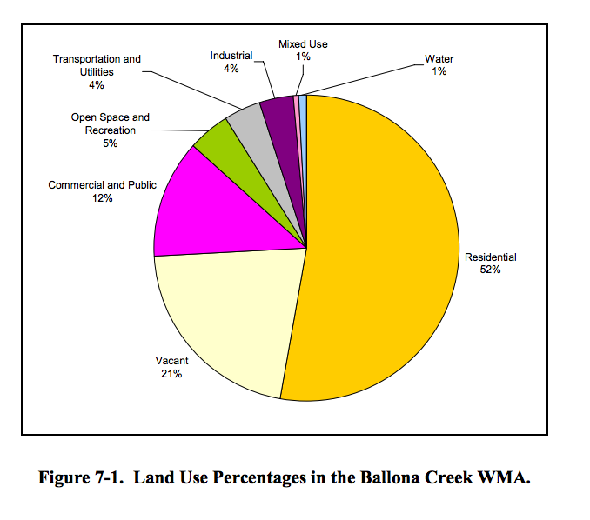
ArcGIS Pro Results: Landcover
~80% Development
~49% impervious

Slide 7
ArcGIS Pro Results:
Flowlines
Few natural channels remain
in Santa Monica Mountains
and Baldwin Hills (not shown)

Slide 8
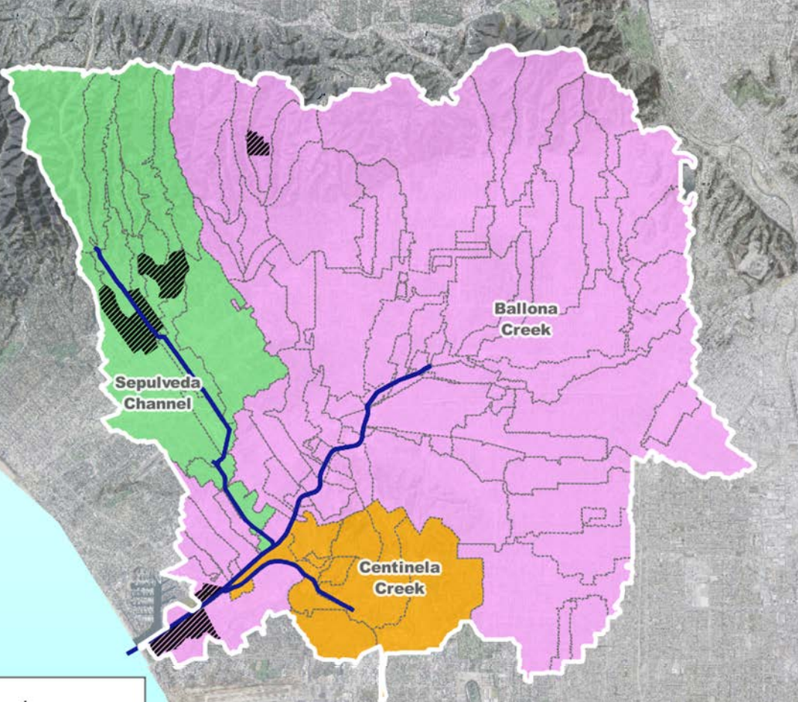
Some major channelized tributaries
not shown in arcGIS

Slide 9
ArcGIS Pro Results:
Storm Drain System
Reduced interception
Increased imperviousness
Faster conveyance systems

Slide 10
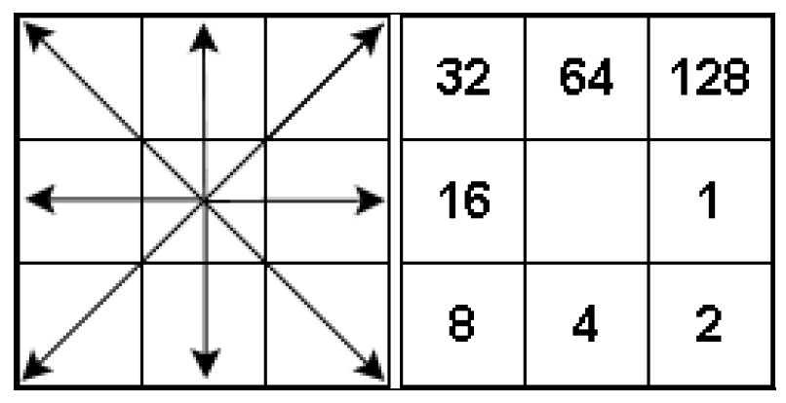
ArcGIS Pro Results:
Elevation and Flow Direction

Slide 11
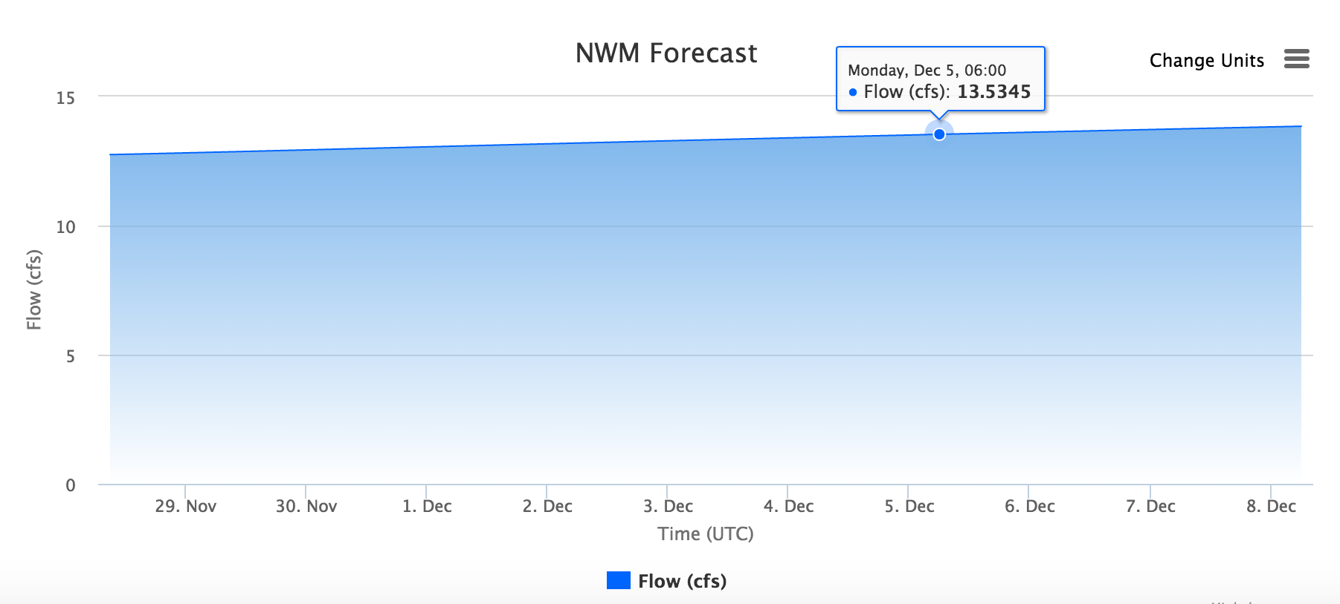
National Water Model Forecast

Slide 12
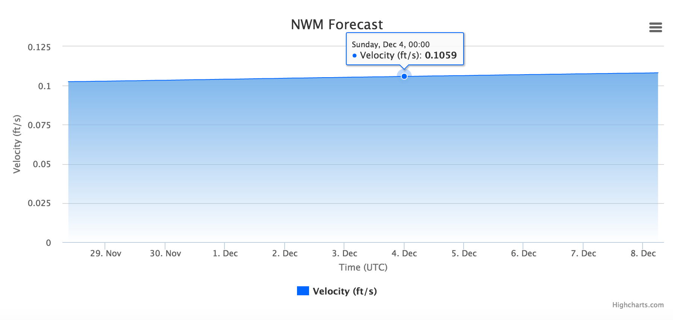
National Water Model Forecast

Slide 13
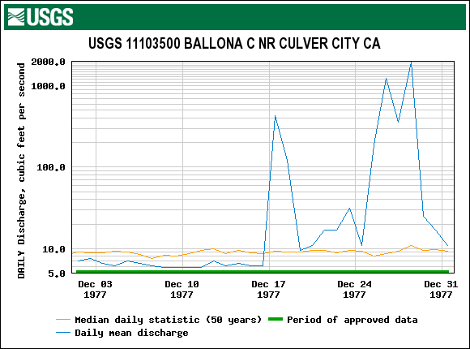
Historical Ballona Creek Discharge
December 1977

Slide 15
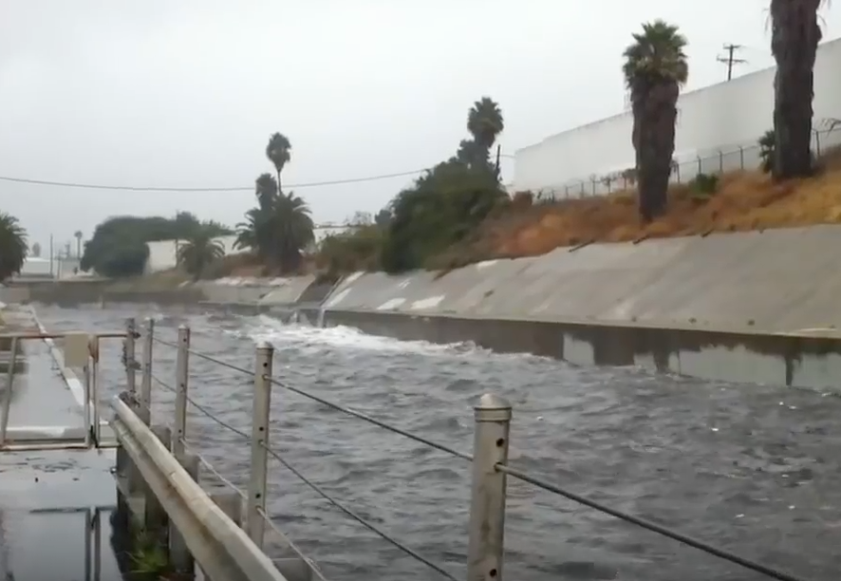
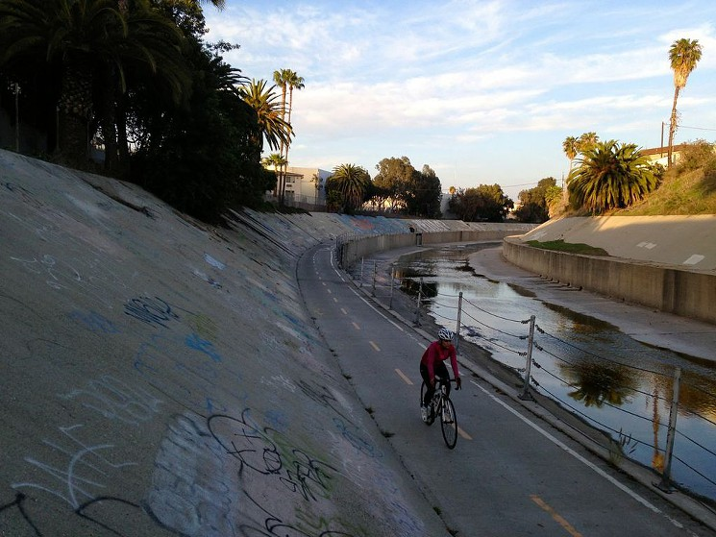
Ballona Creek Discharge Flow
High Discharge Flow
after storm Spring 2012
Low Discharge Flow
No Precipitation

Slide 16
Future Work
National Water Model Enhanced Water Prediction Capability: Hyper-Resolution Modeling for zoomed urban hydrologic processes
Water Quality Assessment: impact of urban runoff as non-point source pollution on wetlands and marine life downstream

Slide 17
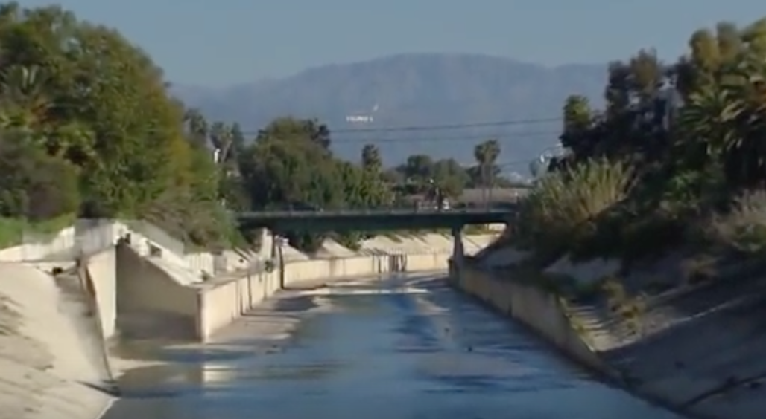
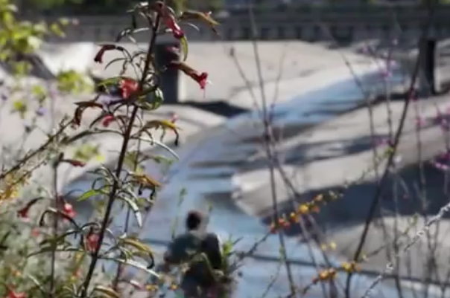
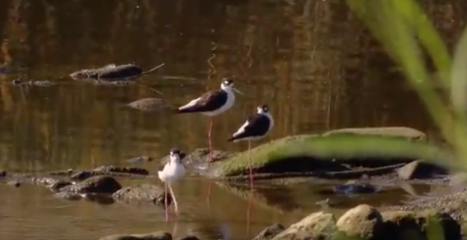
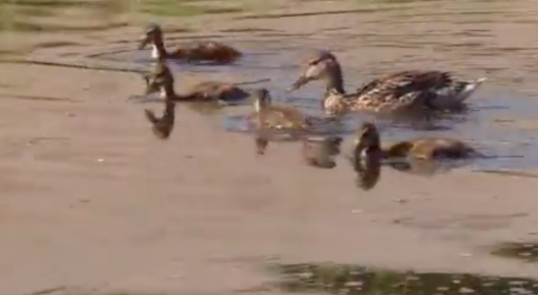
Questions?

Slide 18
References
http://ballonacreek.org/about-the-creek/
https://www.coastal.ca.gov/nps/watercyclefacts.pdf
http://www.lastormwater.org/about-us/about-watersheds/ballona-creek/
http://www.lastormwater.org/about-us/frequently-asked-questions/
ftp://ftp.sccwrp.org/pub/download/DOCUMENTS/TechnicalReports/683_BallonaWaterBalance.pdf
https://www.coastal.ca.gov/nps/Web/cca_pdf/socoastpdf/CCA68BallonaCreek.pdf
https://dpw.lacounty.gov/wmd/NPDES/1994-05_report/Report%20PDF/Section%207%20Ballona%20Creek%20Watershed.pdf
http://www.waterboards.ca.gov/losangeles/water_issues/programs/stormwater/municipal/watershed_management/ballona_creek/Ballona_Creek_EWMP_Presentation.pdf

