Slide 1
California Water Trends
Ellyn weimer
Intro to Arcgis, University of texas at austin
November 29, 2016

Slide 2
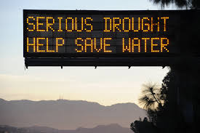
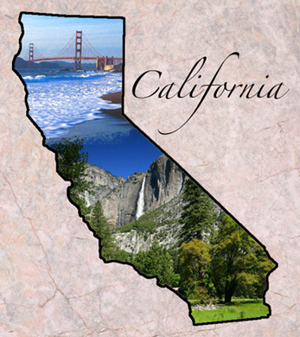
California- Background
Most Populous State in the United States
Today: about 39 million people
Host of a large amount of water intensive agriculture
i.e. Nuts (almonds, walnuts), Fruits (grapes, oranges), and dairy
Heavily hit by drought, especially in recent years (2011-current)
But also hard hit on and off since the early 1900’s.
How does this affect water usage?

Slide 3
Water Trends: Total Water Usage
USGS Water-Use Data
(by county)
Areas of water use include:
-Public
-Domestic
-Industrial
-Thermoelectric
-Mining
-Irrigation
-Livestock

Slide 4
Water Trends: Population

Slide 5
Water Trends: Agriculture

Slide 6
Water Trends: Population v Agriculture
Percent of Total Water Use:
Year | % Agr. (avg) | % Pop (avg)
1990 | 0.64 | 0.22
2000 | 0.65 | 0.21
2010 | 0.6 | 0.39

Slide 7
Future Trends
California wants 25% Urban water use reduction:
Assuming population was only thing changing:
shown with and without 25% urban water use reduction
25% reduction leads to ~2700 Mgal/d less used

Slide 8
Conclusions and Limitations
Hard to predict water trends today when don’t have 2015 water use data, especially water use trends throughout drought from 2011 to current.
Water Availability affects water usage rates
Population and agriculture have large impact on water usage rates, but not the entire story

Slide 9
Questions?

