Slide 1
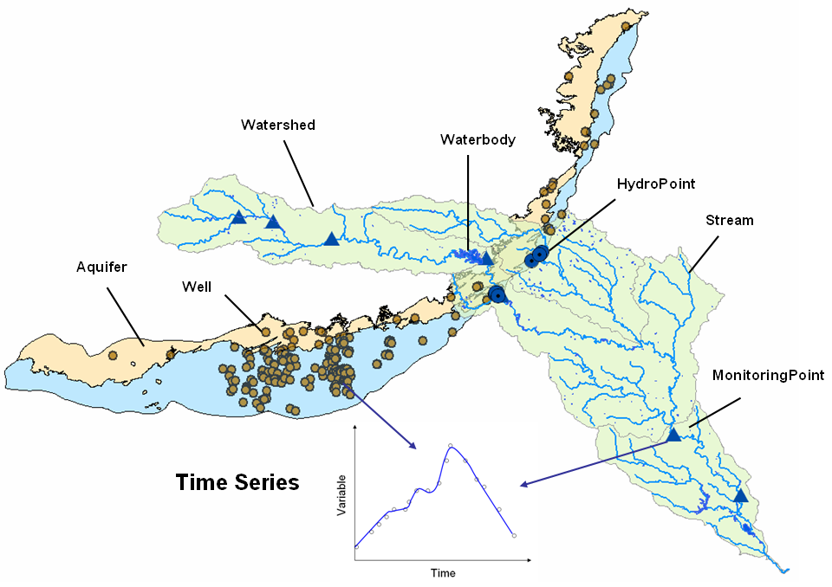
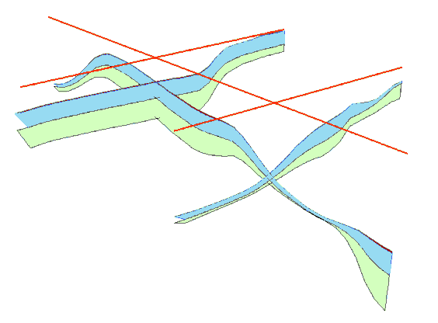
Arc Hydro Groundwater Data Model
GIS in Water Resources - Fall 2016

Slide 2
What To Look For in this Presentation
Ideas on how we think about groundwater features in a GIS context
What kinds of geologic features does the model cover? What does it not cover?
How are relationships used to tie pieces of the data model together

Slide 3
Resources
Groundwater Tools and Data Model
aquaveo.com/archydro-groundwater
Tutorials
aquaveo.com/ahgw-learning
Contact for tool support
support@aquaveo.com
Hydro Resource Center
resources.arcgis.com/en/communities/hydro

Slide 4
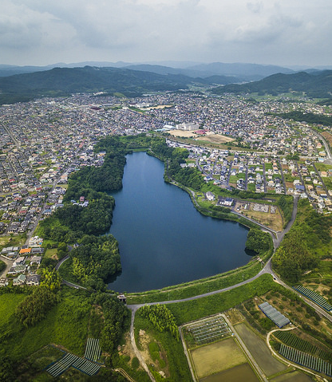


A data model helps you design your database
My_Database
|
Waterbody
- Name
- AreaSqKm
TimeSeries
Water Level
Time
Photo:PhoTones Works #6940 by Takuma Kimura.
Shared under CC BY-SA 2.0. https://creativecommons.org/licenses/by-sa/2.0/legalcode
Notes:
What is this kind of thing (e.g., polygon feature class)? What does it know (attributes)? Who does it know (relationships)?

Slide 5


Why Use a Data Model
Concepts
Tools
Sharing

Slide 6
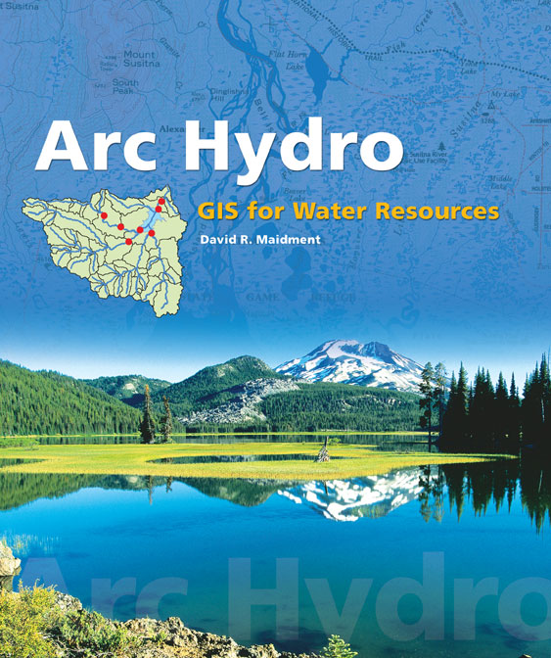
Arc Hydro: GIS for Water Resources
(2002)
A data model for water resources
A toolset for implementation
A framework for linking hydrologic simulation models
Focus on surface water
Free
Notes:
Industrial partners: ESRI, Danish Hydraulic Institute, Camp,Dresser and McKee, Dodson and Associates
Government partners:
Federal: EPA, USGS, Corps of Engineers (Hydrologic Engineering Center)
State: Texas Natural Resource Conservation Commission, Texas Water Development Board
Local: Lower Colorado River Authority, City of Austin, Dept of Watershed Protection
Academic Partners: University of Texas, Brigham Young University, Utah State University

Slide 7
Arc Hydro Describes Surface Water
Drainage
Network
Features
Time Series
Hydrography
Channel

Slide 8
A key concept from Arc Hydro is HydroID
Like Social Security Number for features
Unique in a geodatabase
Used in relationships
Lake
Name = Lake Henry
HydroID = 1001
DamID = 5700
Legend
Dam
Feature Class
Name = Henry Dam
HydroID = 5700
Attribute 1
Attribute 2
…

Slide 9
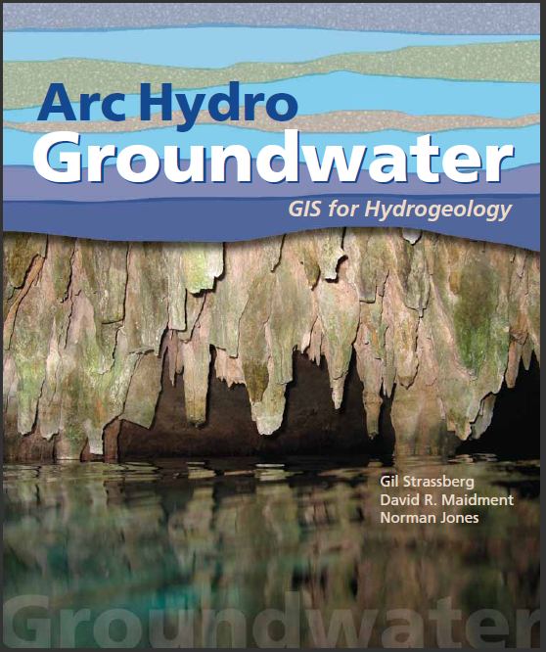
Arc Hydro Groundwater: GIS For Hydrogeology
(2011)
Builds on Arc Hydro
Includes data model and tools
Expands Arc Hydro temporal components
Some tools free, some not

Slide 10
Arc Hydro Groundwater Data Model
http://www.archydrogw.com/File:Archydrogw_overview.JPG

Slide 11
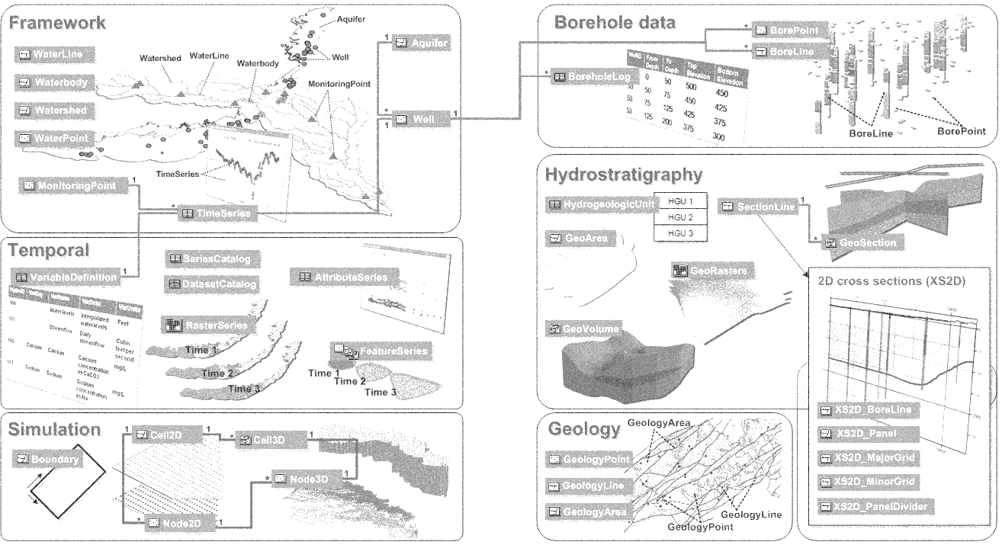
Arc Hydro Groundwater Data Model
Boreholes
Framework
Hydrostratigraphy
Temporal
Cross Sections
Geology
Simulation

Slide 12
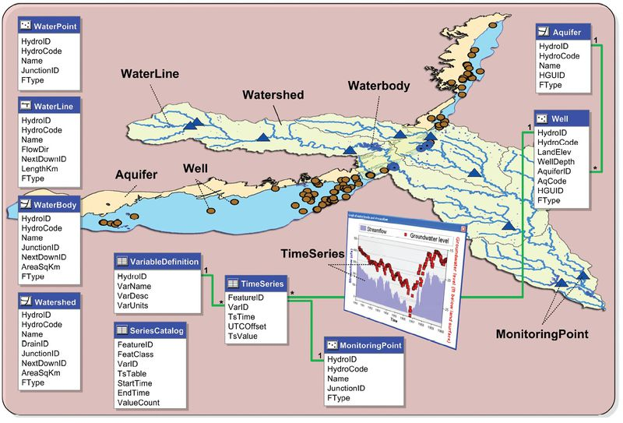
Arc Hydro Framework
Extensible representation of surface water and groundwater
http://www.archydrogw.com/File:Archydrogw_framework.JPG

Slide 13
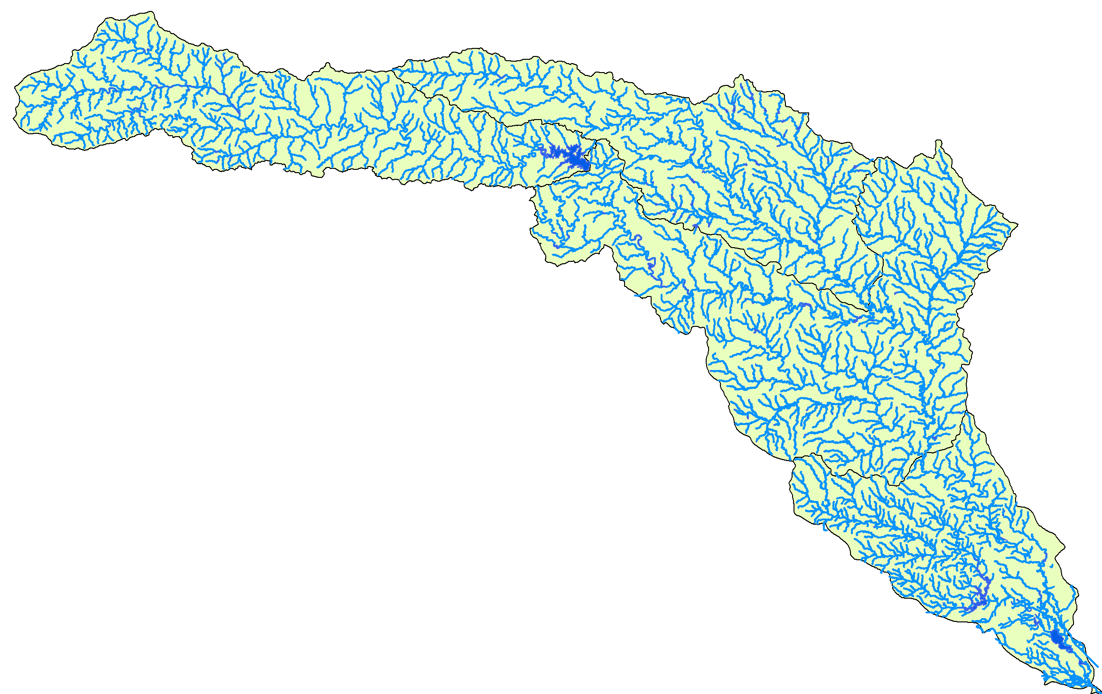
Surface Water Features
WaterLine, WaterBody represent hydrography
Watershed represents drainage areas

Slide 14
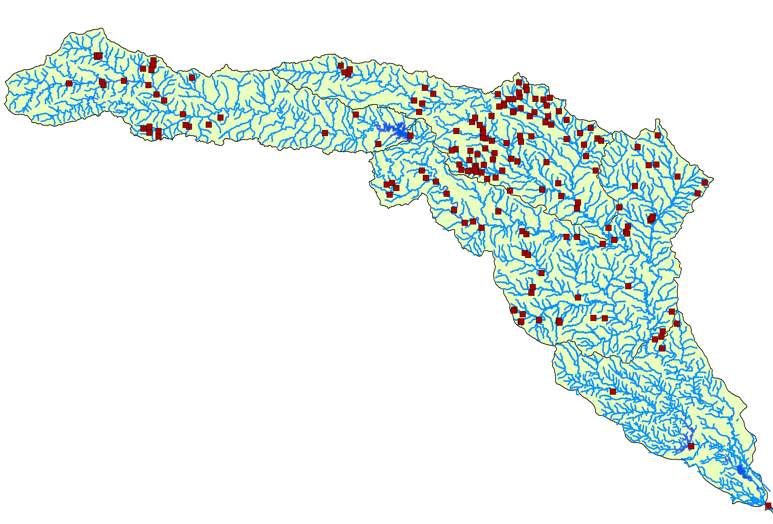
WaterPoint
Structures, dams, springs, diversions, etc.

Slide 15
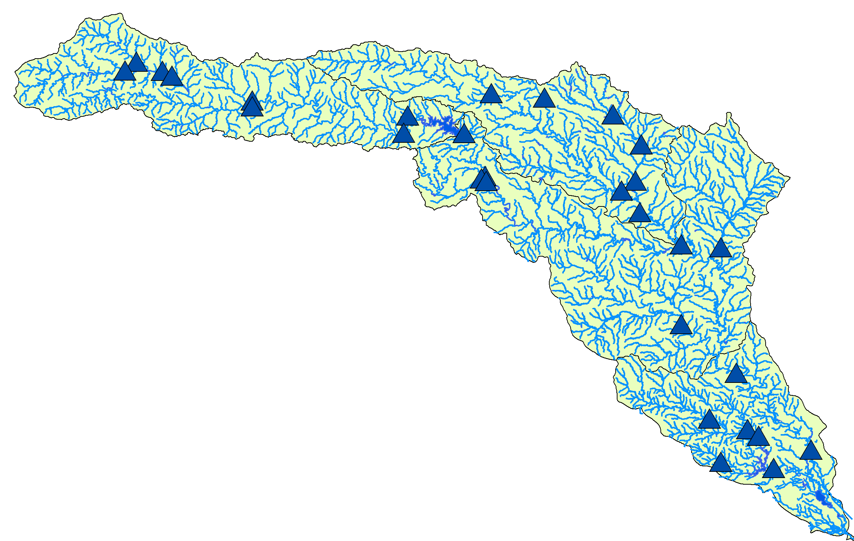
MonitoringPoint
Locations where water is measured

Slide 16
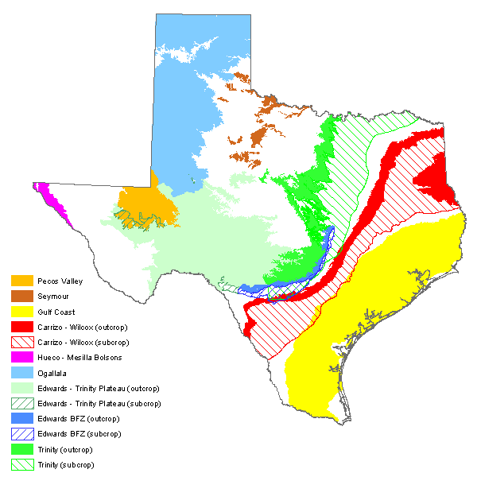
Aquifer
Polygon features of aquifer boundaries
http://www.twdb.texas.gov/groundwater/aquifer/major.asp

Slide 17
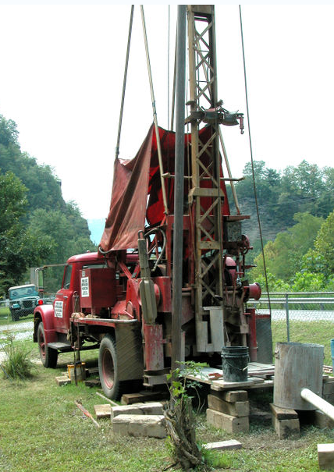
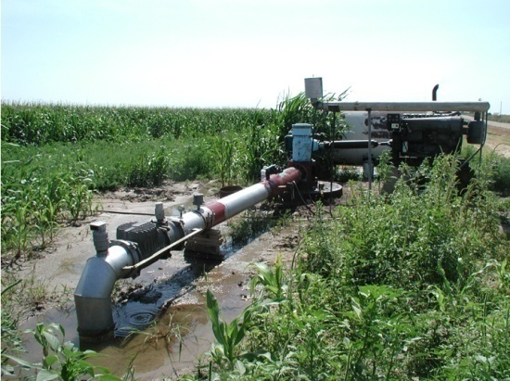
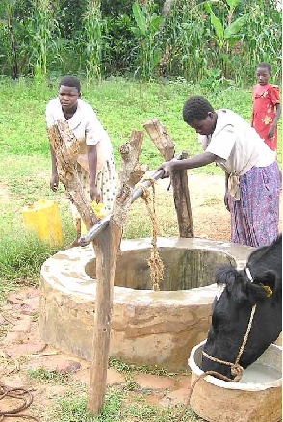
Well
Location where the subsurface has been drilled
Attributes describe depth, use, etc.
Notes:
Photos: unknown

Slide 18
Aquifers are related to Wells
An aquifer can be related to one or more wells (1:M)
Aquifer
Well
1
HydroID
HydroID
HydroCode
HydroCode
Name
LandElev
HGUID
WellDepth
*
FType
AquiferID
AqCode
HGUID
FType

Slide 19
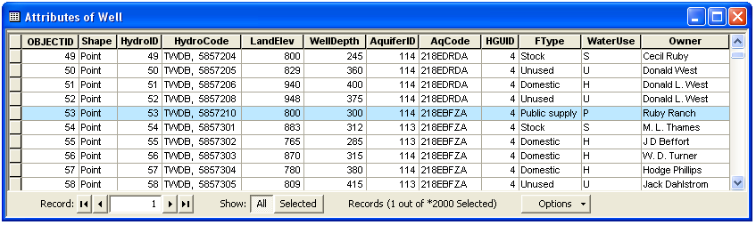
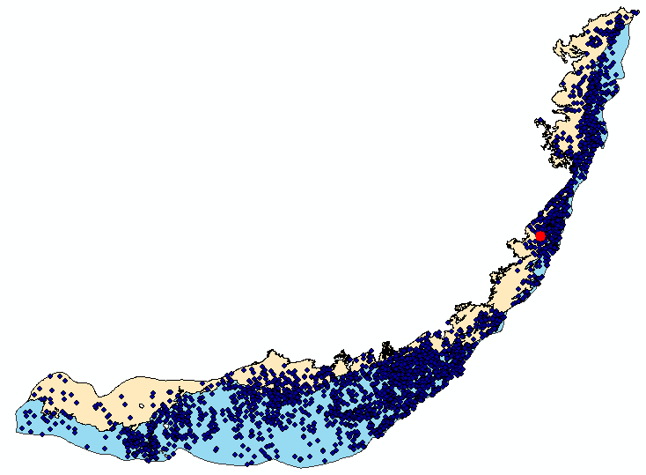
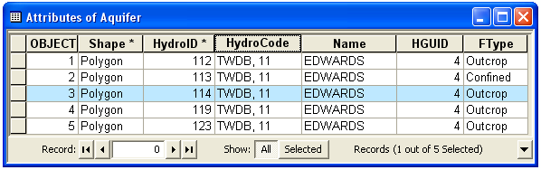
Aquifer and well

Slide 20
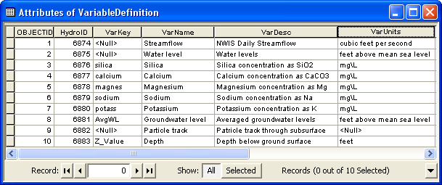
Time Series Variables
VariableDefinition table is a catalog of time varying parameters (e.g., streamflow, water levels, concentrations)
Each variable is indexed with a HydroID

Slide 21
TimeSeries table
Each measurement is indexed by space, time, and type
Space = FeatureID
Time = TsTime
Type = VarID
VariableDefinition
Information about
variables
VarID

Slide 22
Time Series Views
We can slice the data cube to get specific views of the data
Where?
What?
Where and What?
(FeatureID = 2791)
(VarID = 6875)
(FeatureID = 2791 VarID = 6875)
TsTime
TsTime
TsTime
2791
FeatureID
FeatureID
2791
FeatureID
6875
6875
VarID
VarID
VarID

Slide 23
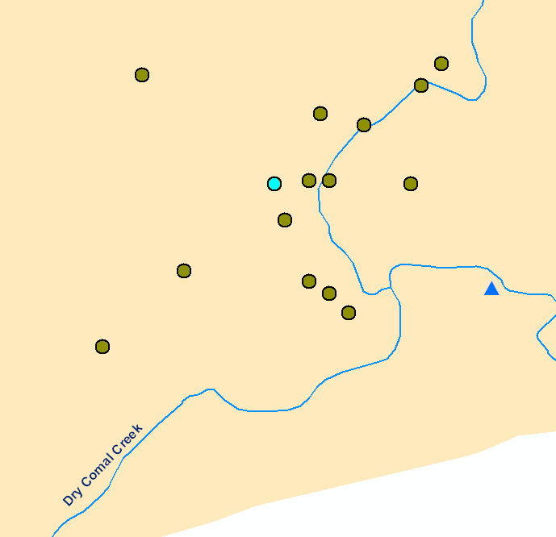
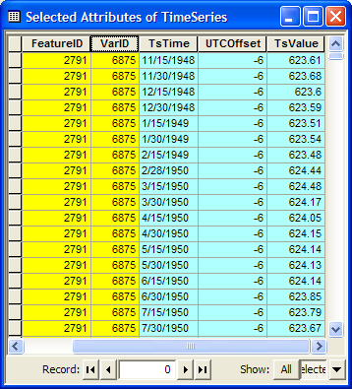
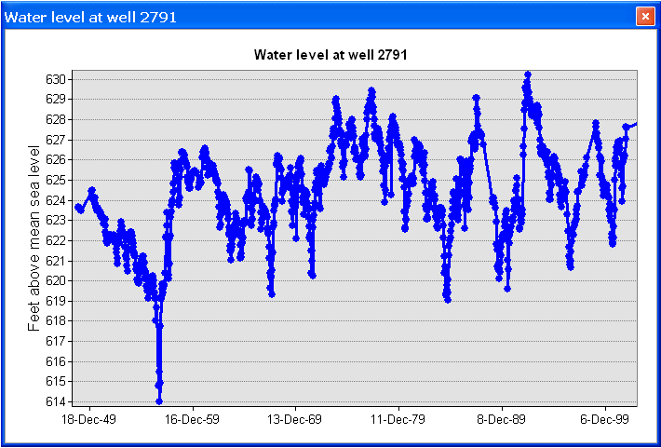
Time Series Views
Well HydroID = 2791
Create a plot of time series related to a feature
Get all the data of VarID 6875 measured at Feature 2791

Slide 24
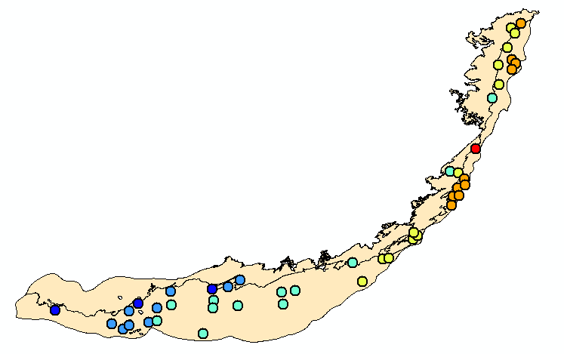
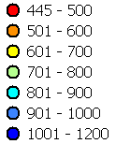
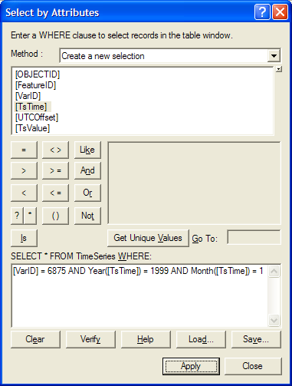
Time Series Views
A type-time view: Get water levels (VarID=6875) for 1/1999
TsTime
Water level in the Edwards Aquifer in 1/1999
1/1991
FeatureID
6875
VarID
Set of layers for different times creates an animation

Slide 25
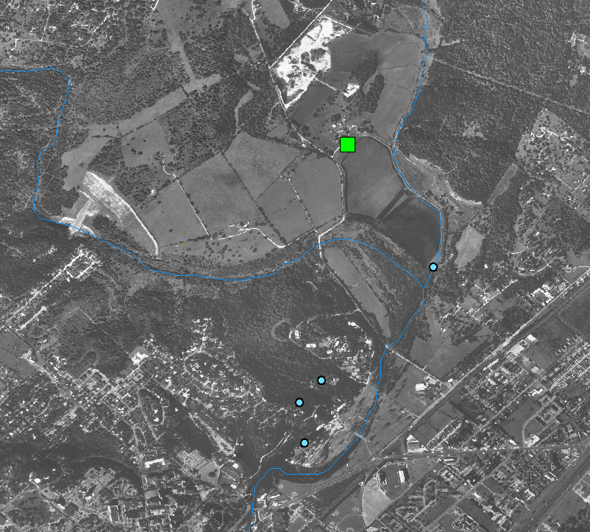
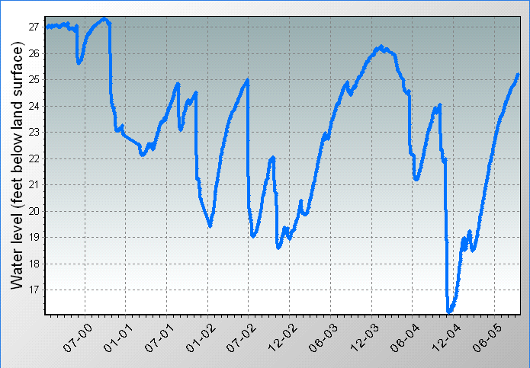
Wells and TimeSeries
Wells are related with time series (e.g., water levels, water quality)
Well
HydroID
Monitoring Well
(
295443097554201
)
TimeSeries
FeatureID
Sink Creek
San Marcos springs
Springs
San Marcos

Slide 26
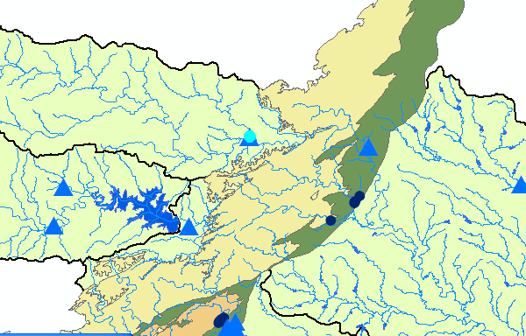
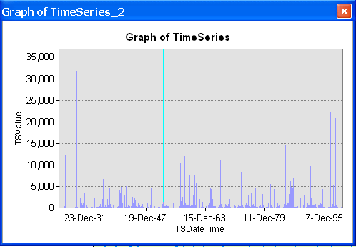
MonitoringPoints and Time Series
Streamflow,
Precipitation,
Etc.

Slide 27
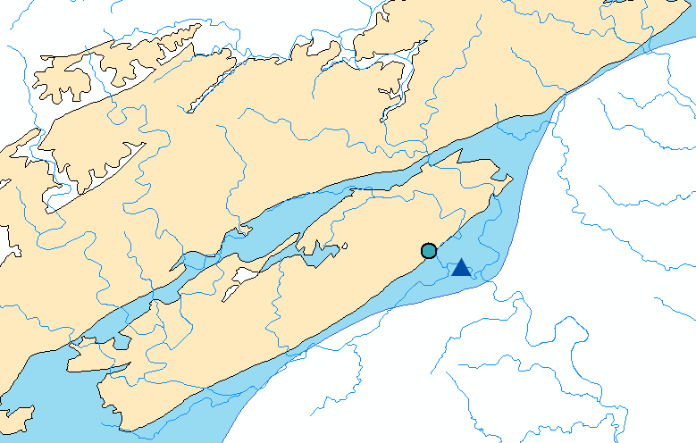
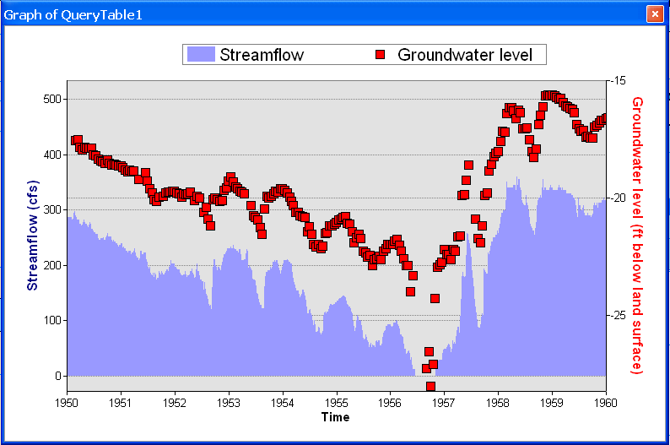
The common framework supports analysis of surface water and groundwater data together
Well in the Edwards Aquifer
Streamflow Gage at Comal Springs

Slide 28
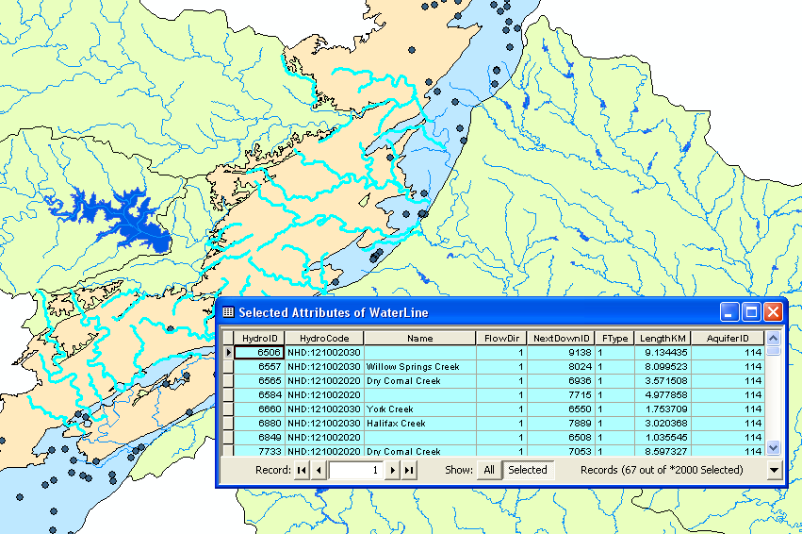
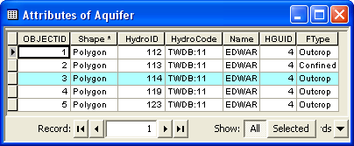
Surface water - groundwater linkage
Relationships between surface water and aquifer enable analysis based on spatial and hydrologic relationships
Streams over the outcrop = recharge features

Slide 29
Arc Hydro Framework - Review
Note the relationships (the lines connecting the boxes)
http://www.archydrogw.com/File:Archydrogw_framework.JPG

Slide 30
Arc Hydro Groundwater Data Model
Boreholes
Framework
Framework
Hydrostratigraphy
Temporal
Cross Sections
Geology
Geology
Simulation

Slide 31
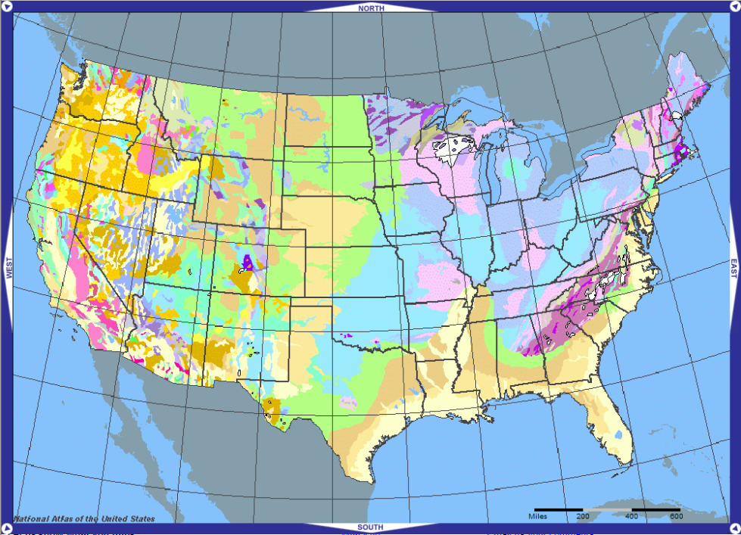
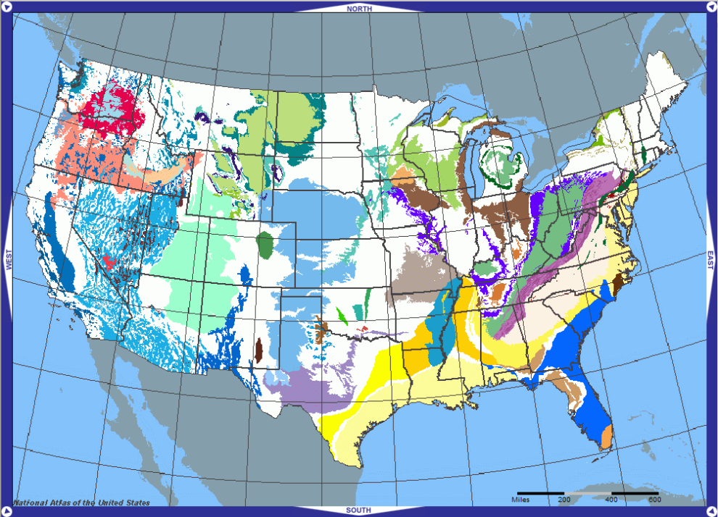
Geologic maps
Are closely tied to geology
Vary in scale (continental, regional, local)
Geology
Aquifers
maps from http://nationalatlas.gov

Slide 32
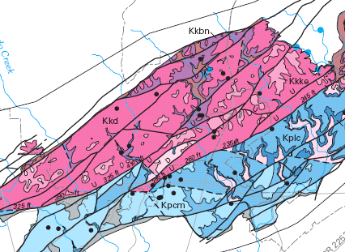
Arc Hydro Geology Component
GeologyPoint: e.g., springs, caves, sinks, observation points
GeologyLine: e.g., faults, contacts
GeologyArea: e.g., outcrops
GeologyLine
GeologyArea
GeologyPoint
A simple data model to support
geologic maps
HydroID
HydroCode
GeoAbbrev
Description
HGUID
HGUCode
FType
GeologyLine
HydroID
HydroCode
GeoAbbrev
Description
HGUID
HGUCode
FType
GeologyArea
HydroID
Map modified from: Geologic map of the Edwards Aquifer recharge zone, south-central Texas. U.S. Geological Survey SIM 2873
HydroCode
GeoAbbrev
Description
HGUID
HGUCode
GeologyPoint
FType

Slide 33
Arc Hydro Groundwater Data Model
Boreholes
Boreholes
Framework
Hydrostratigraphy
Temporal
Cross Sections
Geology
Geology
Simulation

Slide 34
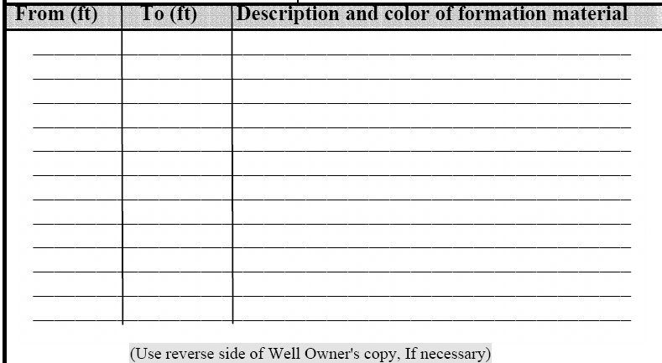

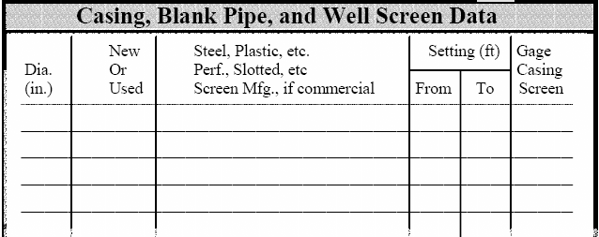
Borehole data
Vertical data (screens, stratigraphy) referenced along the well
From depth (top), To depth (bottom), and Description
well

Slide 35
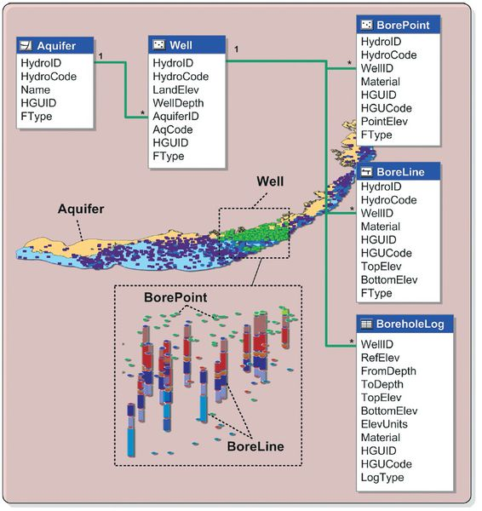
Arc Hydro Borehole Component
Stores borehole data and represents data in 3D
http://www.archydrogw.com/File:Archydrogw_wellsandboreholes.JPG

Slide 36
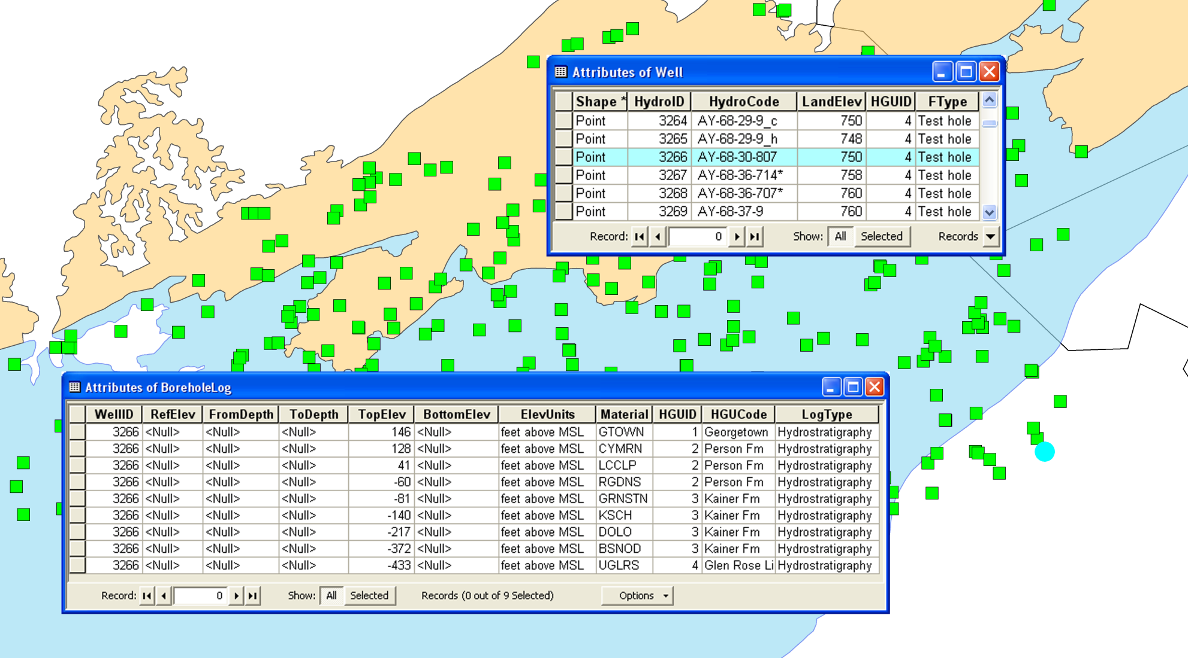
BoreholeLog table
Stores 3D borehole data related with well features
Each row represents a point/interval along a borehole
Data are related to Wells using the WellID attribute
3D geometry is defined by the TopElev and BottomElev attributes

Slide 37
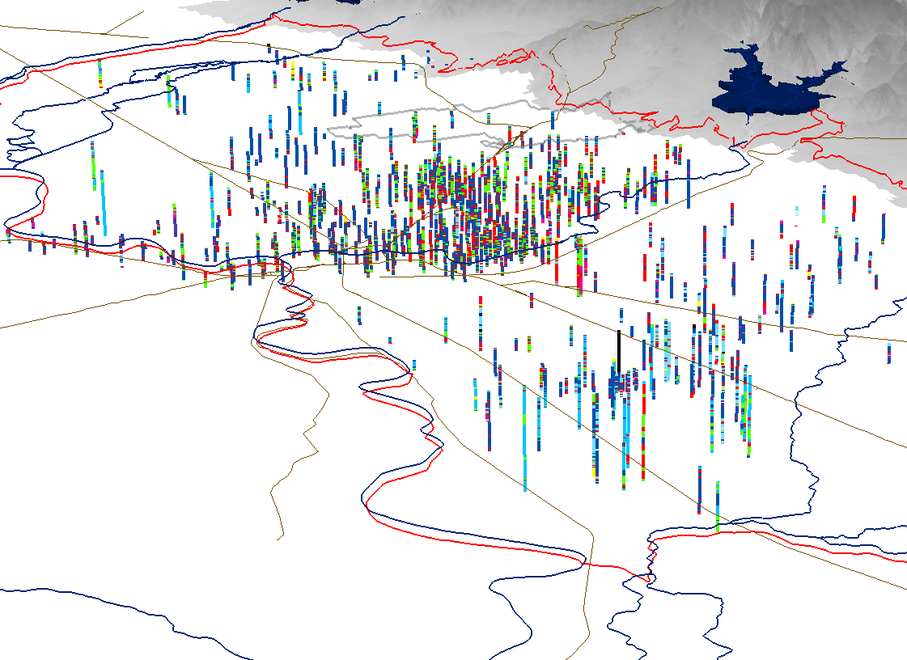
BorePoints and BoreLines
3D features representing data in the BoreholeLog table
BorePoint is a 3D point feature class for representing point locations along a borehole (e.g., geologic contacts, samples)
BoreLine is a 3D line feature class for representing intervals along a borehole

Slide 38
Arc Hydro Groundwater Data Model
Boreholes
Boreholes
Framework
Hydrostratigraphy
Hydrostratigraphy
Temporal
Cross Sections
Geology
Simulation

Slide 39
Hydrogeologic units
“Hydrogeologic unit is any soil or rock unit or zone which by virtue of its hydraulic properties has a distinct influence on the storage or movement of ground water” (USGS glossary of hydrologic terms)
Hydrogeology can be derived by classifying stratigraphic units
Stratigraphic units
Hydrogeologic units
Upper confining unit
Georgetown Fm. (GTOWN)
Georgetown Fm.
Cyclic + Marine member (CYMRN)
Leached + collapsed member (LCCLP)
Pearson Fm.
Regional dense member (RGDNS)
Edwards Aquifer
Grainstone member (GRNSTN)
Kirschberg evaporite member (KSCH)
Kainer Fm.
Dolomitic member (DOLO)
Basal Nodular member (BSNOD)
Upper Glen Rose (UGLRS)

Slide 40
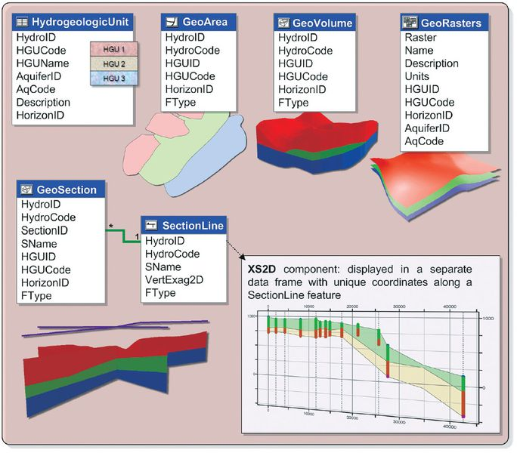
Arc Hydro Hydrostratigraphy
Hydrogeologic units in 2D and 3D
http://www.archydrogw.com/File:Archydrogw_hydrostratigraphy.JPG

Slide 41
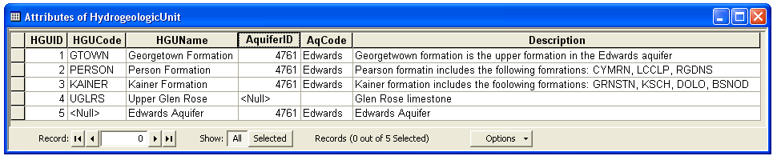
Hydrogeologic unit table
Provides a conceptual description of hydrogeologic units
Units are indexed with an HGUID
Units can be grouped into an aquifer via AquiferID

Slide 42

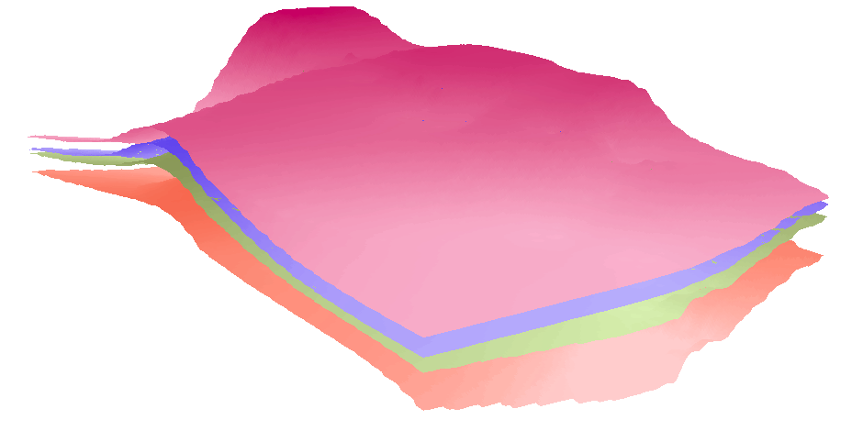
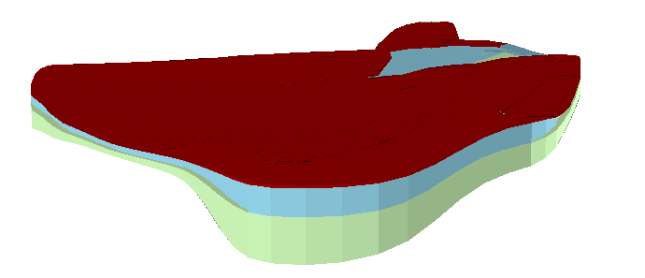
Hydrogeologic unit table
Hydrogeologic units are described with different spatial instances (outcrops, borehole intervals, surfaces, cross sections, and volumes)
HGUID is the key attribute
GeoArea
Polygon
feature class
1
SectionLine
GeoSection
*
PointZ
feature class
HydrogeologicUnit
Multipatch
feature class
Table
HGUID
Conceptual description
GeoRasters
Raster dataset
HGUID
GeoVolume
Spatial description
Multipatch
feature class

Slide 43
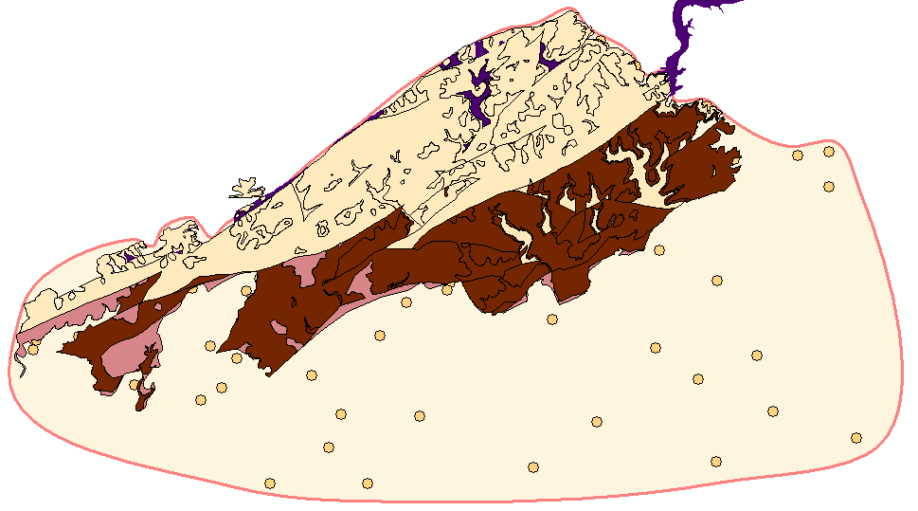

GeoArea (vs GeologyArea)
2D polygons defining boundaries of hydrogeologic units
GeoArea (conceptual/interpolated boundary) ≠ GeologyArea (mapped outcrop)
GeologyArea features represent data from geologic maps
GeologyArea
GeoArea feature representing the Kainer hydrogeologic unit
Data points representing top elevations of the Kainer formation

Slide 44
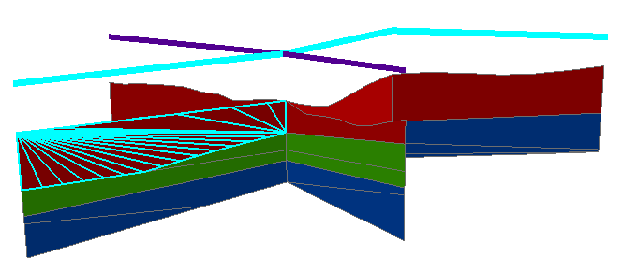
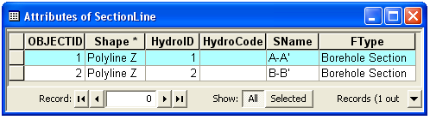
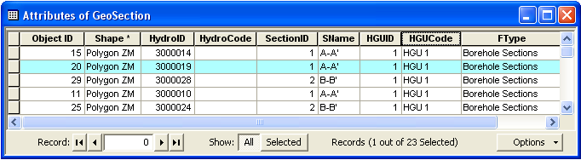
3D Representation of Cross Sections
SectionLine defines the location of the 2D cross section
GeoSection represent 3D sections as 3D features
SectionID of a GeoSection feature relates back to the section line
B
A’
A
B’

Slide 45
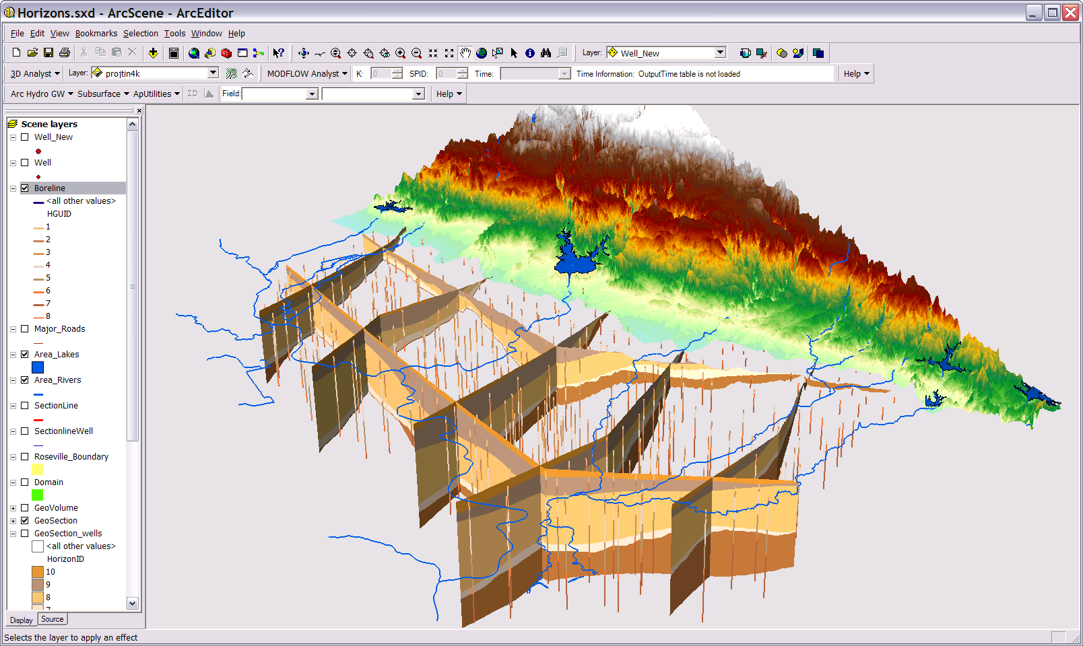
GeoSections

Slide 46
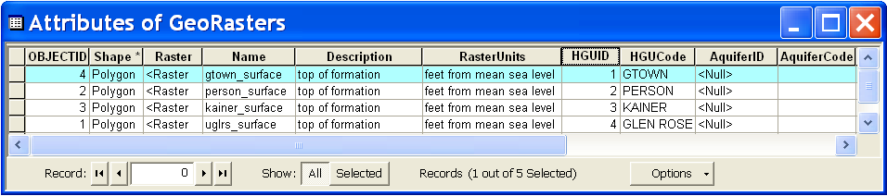


GeoRasters
Raster catalog for storing and indexing raster datasets
Can store top and bottom of formations
Each raster is related with a HGU in the hydrogeologic unit table
Georgetown
Person
Kainer
Glen Rose

Slide 47



GeoRasters
GeoRasters also store hydraulic properties such as transmissivity, conductivity, and specific yield
K (feet/day)
Raster of hydraulic conductivity in the Edwards Aquifer

Slide 48

GeoVolume
Features representing 3D volume objects
Geometry is multipatch

Slide 49
Arc Hydro Groundwater Data Model
Boreholes
Framework
Hydrostratigraphy
Hydrostratigraphy
Temporal
Cross Sections
Cross Sections
Geology
Simulation

Slide 50



Cross sections
Cross sections help us understand local geology
We can sample the subsurface…
Wells
A
A’
Section A-A’
A’
A
Map
…And interpret the rest
Notes:
Cross sections help us visualize / conceptualize / understand the 3D structure of the subsurface.
We can sample strata at wells/boreholes drilled into the subsurface.
We then interpolate between the known points to create a continuous model of subsurface strata.

Slide 51
Cross section coordinates
Cross sections use a (Distance, Elevation) coordinate system
Each system is unique to the cross section…
S
y
Z
x
S
And includes vertical exaggeration…
Notes:
Cross sections have a unique coordinate system.
Data are transformed from X, Y, and Z coordinates to S and Z.
S = length along the section line
Z = vertical elevation – many times exaggerated for better visualization.
Data from nearby wells are projected to the closest point on the cross section.
Subsurface Analyst includes special tools to do these transformations.

Slide 52





GIS datasets
We’d like to create cross sections from GIS datasets
Spatial and attribute relationships tie features together …
Wells
Geologic features
Borehole log
Section lines
Raster surfaces
…Creating the connectivity we need to construct meaningful cross sections
Notes:
We use different GIS datasets:
Wells with related borehole logs
Geologic features – outcrops from geologic maps, faults
Surfaces - DEMs, rasters representing water levels, tops of units, etc.
Section lines
The different datasets need to be managed in a meaningful fashion.
Relationships between feature classes, manage multiple cross sections in a single geodatabase.

Slide 53

XS2D Component
http://www.archydrogw.com/File:Archydrogw_XS2D.JPG

Slide 54


2D Cross Section Editing
Edit cross sections in ArcMap
Borehole data
Outcrop
Salt water interface
Panel divider
Panel

Slide 55

Transform to 3D GeoSection

Slide 56
Arc Hydro Groundwater Data Model
Boreholes
Framework
Hydrostratigraphy
Temporal
Temporal
Cross Sections
Cross Sections
Geology
Simulation

Slide 57

Temporal Component
http://www.archydrogw.com/File:Archydrogw_XS2D.JPG

Slide 58
Types of time varying datasets

Slide 59

Multi-variable time series
(attribute series)
Multiple variables recorded simultaneously at the same location
Example – water quality parameters
Indexed by location (FeatureID) and time (TsTime)
Relationship to the VariableDefinition table is through the VarKey
Variables (VarKey)

Slide 60




Raster Series
Raster datasets indexed by time
Each raster represents a continuous surface describing a variable for a given time
January 1991
January 1992
January 1993

Slide 61



Feature Series
A collection of features indexed by time
Example - particle tracks
Features are indexed by VarID, TsTime, and GroupID
Each group of features creates a track over time

Slide 62
Time Series Catalogs
Like a library’s card catalog, but for time series
Series Catalog
  For a single variable at a single feature
  E.g., a summary of all water level measurements for a well
Dataset Catalog
  For an entire temporal dataset
  E.g., a summary of raster series representing water level across the entire aquifer
Both catalogs include start time, end time, and count

Slide 63



Series Catalog Example
TimeSeries
water depth in a well
SeriesCatalog

Slide 64
Arc Hydro Groundwater Data Model
Boreholes
Framework
Hydrostratigraphy
Temporal
Temporal
Cross Sections
Geology
Simulation
Simulation

Slide 65

Representing simulation models
Georeference model inputs and outputs (in space and time)
Focus on MODFLOW, block centered finite difference grid (nodes are in the center of the cells)
Represent 2D and 3D models
Block-centered finite difference grid

Slide 66

Simulation Component
http://www.archydrogw.com/File:Simulation_Features.png

Slide 67


Boundary
Polygon feature class for representing the extent and orientation of a simulation model

Slide 68
Cell2D and Node
Cell2D: polygon feature class that represents cells or elements associated with a two-dimensional simulation model or a single layer of a three-dimensional model
Node: point feature class used in combination with Cell2D to represent the model’s mesh/grid.
Finite element mesh
Mesh centered finite difference grid
Cell centered finite difference grid

Slide 69

Cell2D and Node for Mapping

Slide 70

Node3D and Cell3D
Node3D - a Z enabled point feature class
Cell3D - Multipatch feature class
Represent three-dimensional cells and Nodes
Used mostly for visualization of 3D models

Slide 71
Arc Hydro Groundwater Data Model
Boreholes
Framework
Hydrostratigraphy
Temporal
Cross Sections
Geology
Simulation
Simulation

Slide 72
Groundwater Tools for GIS

Slide 73

Built-in Tools
Groundwater and Hydrology Toolsets
Time-enabled Layers

Slide 74
Arc Hydro Groundwater Tools
Groundwater Analyst
MODFLOW Analyst
Subsurface Analyst
  3D Features
  2D Cross Sections

Slide 75


Groundwater Analyst
Import and Manage Well Data
Compute Time Series Statistics
Point and Click Graphing Tool

Slide 76


MODFLOW Analyst
Import and Export MODFLOW models
Run MODFLOW from ArcGIS

Slide 77


Subsurface Analyst
3D Features
Create 2D Cross Sections

Slide 78


Subsurface Analyst – 3D
Create and Edit Borehole Data
Create
GeoSections
Create GeoVolumes

Slide 79
Arc Hydro Groundwater Summary Concepts
Arc Hydro helps us represent surface and groundwater systems in GIS
The groundwater data model includes aquifers, wells, hydrogeologic features, time series, and simulation model features
Relationships connect features with geologic data, aquifers, and time series

