Slide 1
Data Sources for GIS in Water Resources by David R. Maidment, and David G. Tarboton
GIS in Water Resources
Fall 2016

Slide 2
Outline
The hierarchical system of watersheds and basins
Where to obtain data and maps
  National/State/Global Data repositories
  Hydrography
  USGS National Water Information System
  Land Cover
  Census
  Elevation
  Soil (Statsgo/Surgo)
  Weather
  Regional data for Texas and Utah

Slide 3
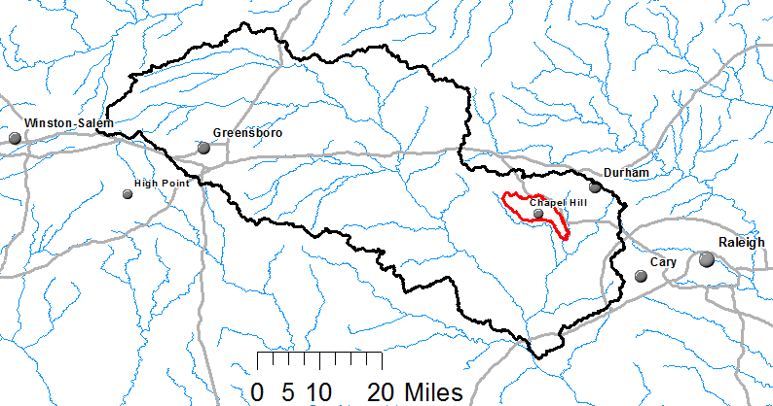
Watershed Hierarchy
Each hydrologic unit is identified by a unique hydrologic unit code (HUC) consisting of two to or more digits based on the levels of classification in the hydrologic unit system.
Digit #
2
4
6
8 HUC
10
12
NHDPlus
HAW HUC 8 03030002
Little Creek HUC 12 030300020603

Slide 4
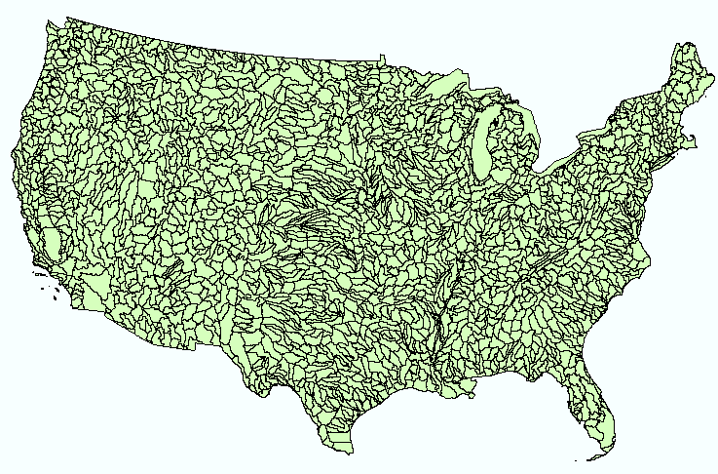
Hydrologic Unit Code Watersheds
~ 2000 HUC 8 for US, about the size of counties

Slide 5
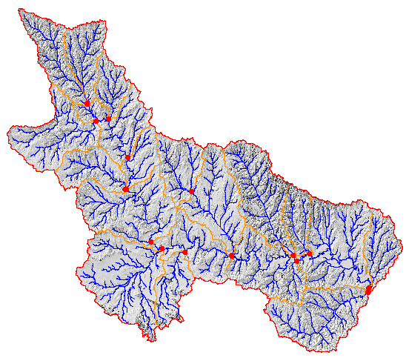
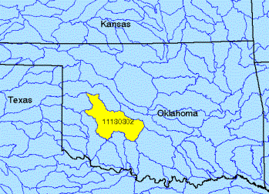
Watershed Boundary Dataset
http://nhd.usgs.gov/wbd.html
National Program by USGS and USDA (NRCS)
Boundaries for 10- and 12- digit watersheds
First cut is by automated delineation from NED
Hand checked and edited
10-digit watersheds

Slide 6
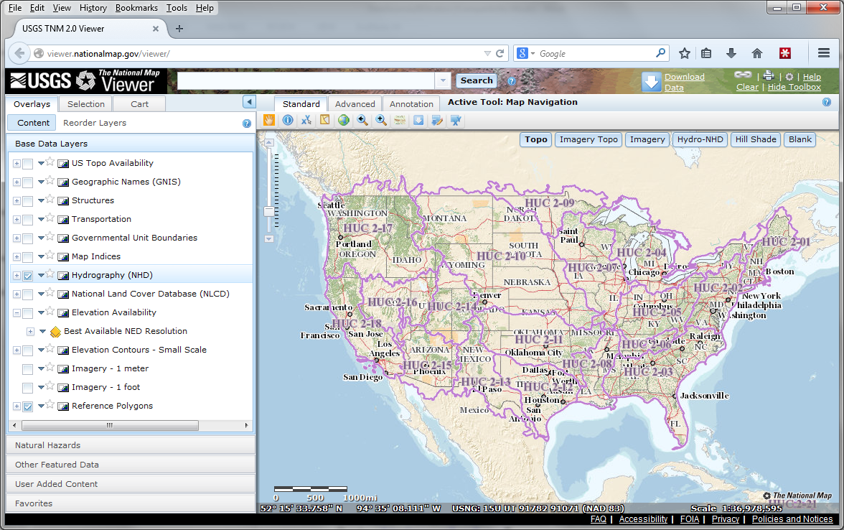
The National Map
http://nationalmap.gov/
A central source for US Government data

Slide 7

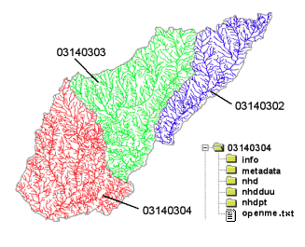
River networks
for 8-digit HUC
watersheds
http://nhd.usgs.gov/

Slide 8
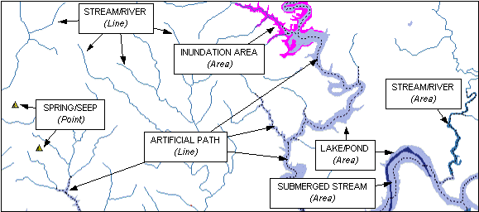

Slide 9
River Reach Codes
Used for river address locations
ReachCode =
12030102000151
ReachCode = 12030102000005
HUC#
Segment#
Location 0.392
on Reach
12030102000005

Slide 10

National Elevation Dataset
http://ned.usgs.gov/
Digital Elevation Model with 1 arc-second (30m), 1/3 arc-second (10m) and some 1/9 arc second (3m) cells
Distributed as part of the National Map
10 billion data
Derived from USGS 1:24,000 quadrangle sheets and at higher resolution from LIDAR
Get the data:
http://nationalmap.gov/viewer.html

Slide 11
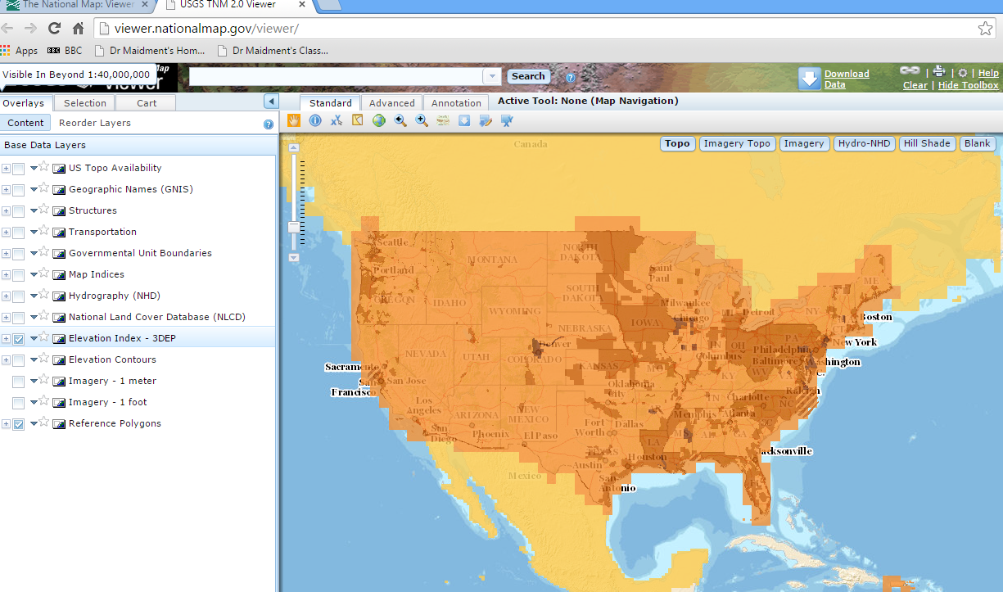
National Elevation Dataset Availability
From http://nationalmap.gov/viewer.html

Slide 12

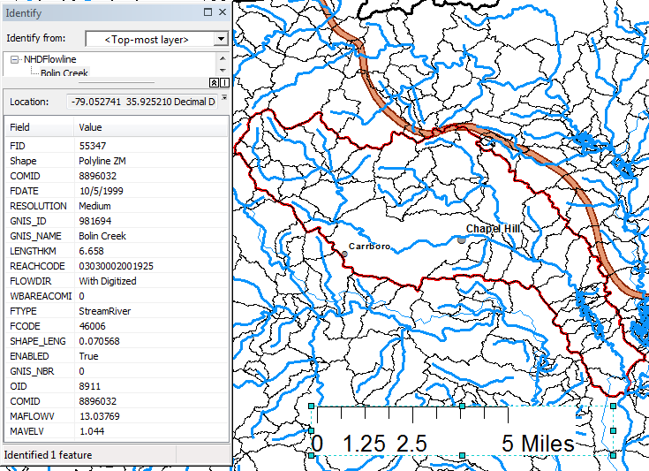
Slope
Elevation
Mean annual flow
  Corresponding velocity
Drainage area
% of upstream drainage area in different land uses
Stream order
http://www.horizon-systems.com/nhdplus/

Slide 13
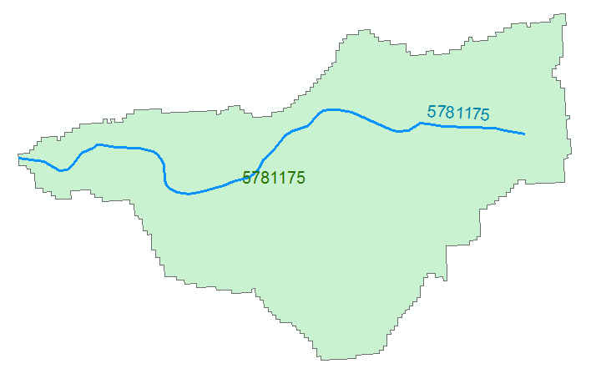
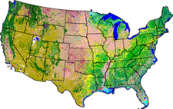
NHDPlus Version 2.1
Foundation for a Geospatial Hydrologic Framework for the United States
NHDPlus
2.7 million reach catchments in US
average area 3 km²
reach length 2 km
Uniquely labelled
National Elevation Dataset
Watershed Boundary Dataset
National Hydrography Dataset
National Land Cover Dataset
http://www.arcgis.com/home/item.html?id=5600cf6b463043ec97b764fb258997be#!

Slide 14
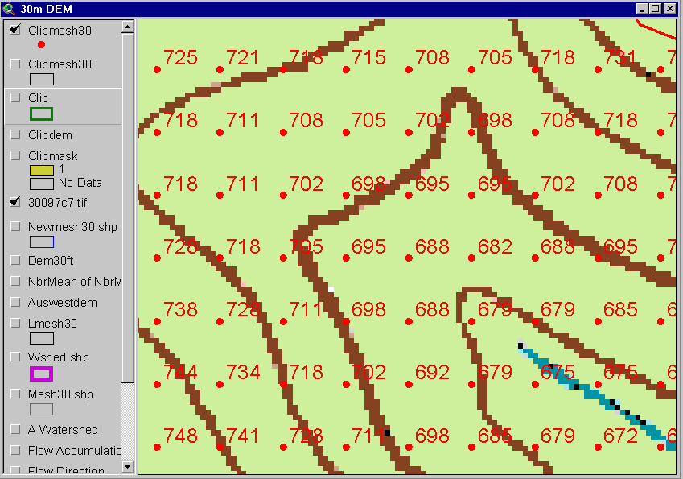
Digital Elevation Model (DEM)
720
720
Contours
740
720
700
680
740
720
700
680

Slide 15
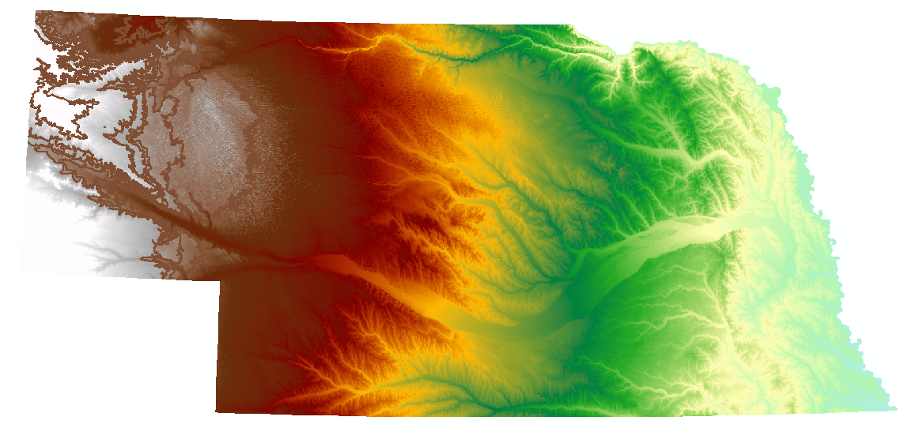
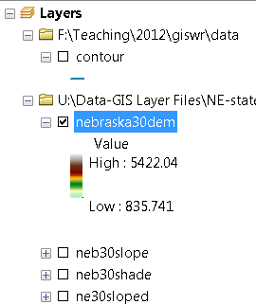
Digital Elevation Model (DEM)-30 meter

Slide 16
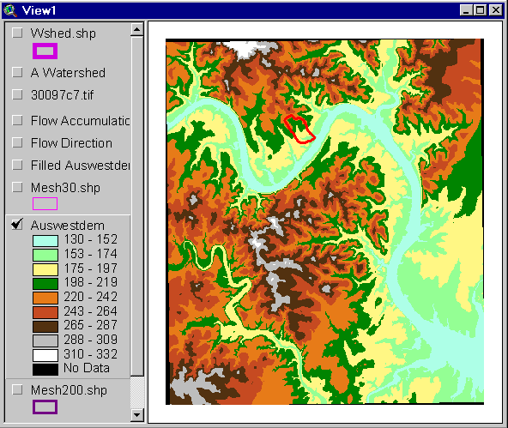
Austin West 30 Meter DEM

Slide 17
Eight Direction Pour Point Model
ArcGIS raster operations involved in watershed delineation are derived from the premise that “water flows downhill, in doing so, will follow the steepest descent
32
64
128
16
1
8
4
2
Water in a given cell flows one or more of eight adjacent cells in the direction of steepest descent (ArcGIS)

Slide 18
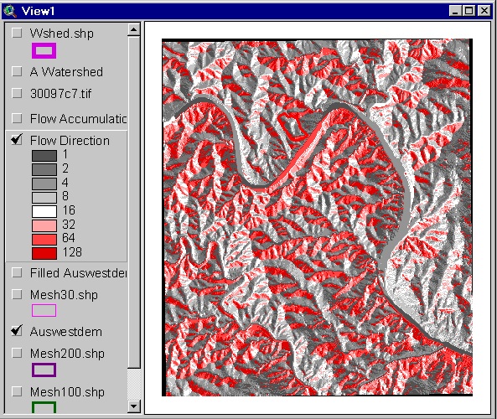
Flow Direction Grid
32
64
128
16
1
8
4
2

Slide 19
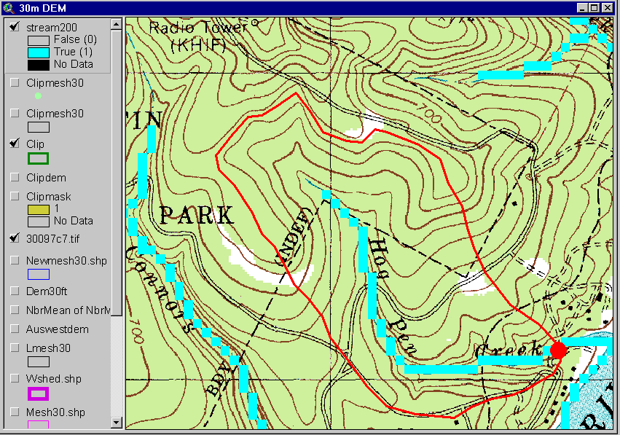
Delineation of Streams and Watersheds on a DEM

Slide 20

https://lta.cr.usgs.gov/SRTM

Slide 21
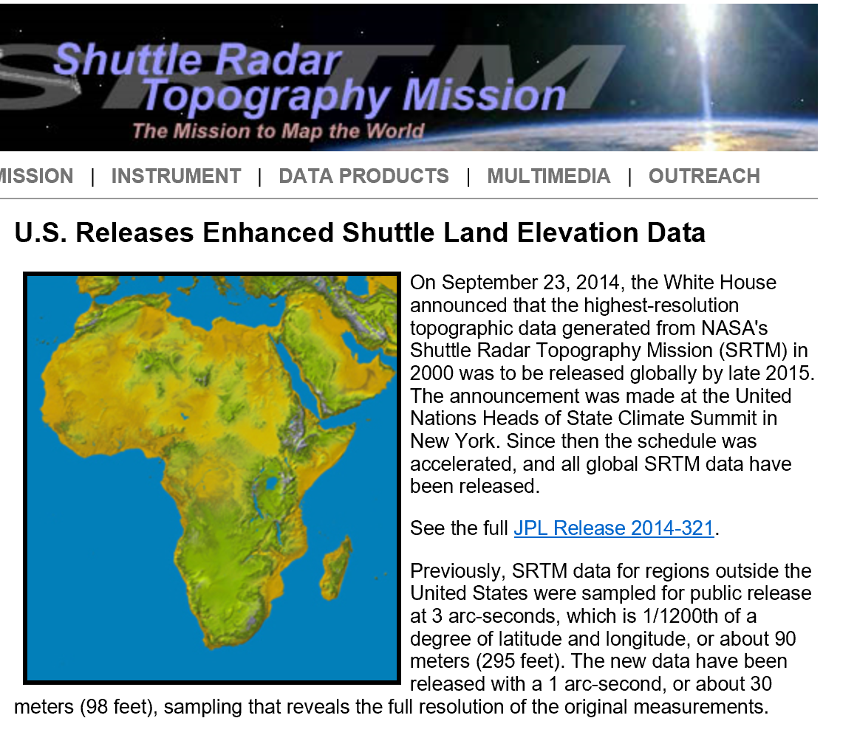
SRTM Topographic Data
http://www2.jpl.nasa.gov/srtm/

Slide 22
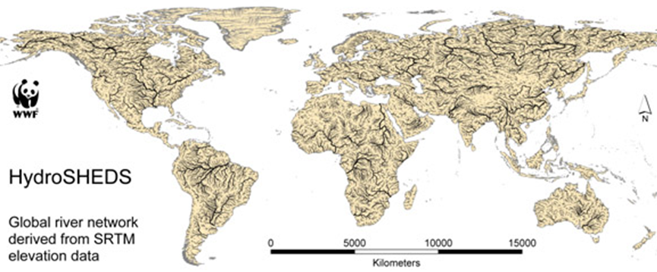
HydroSheds derived from SRTM
http://hydrosheds.cr.usgs.gov/

Slide 23
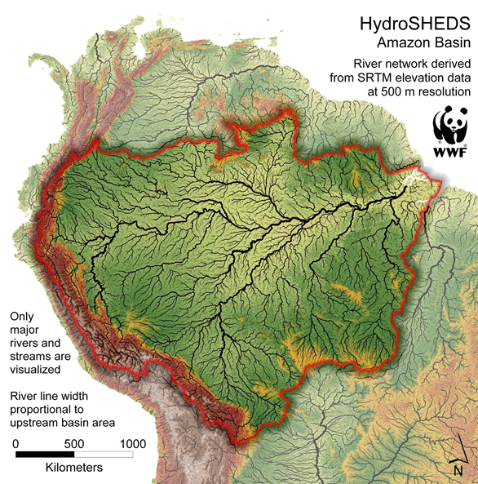

Slide 24
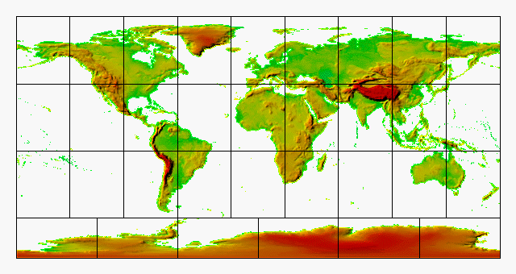
GTOPO30 - 1 km Digital Elevation Model of the Earth
https://lta.cr.usgs.gov/GTOPO30

Slide 25
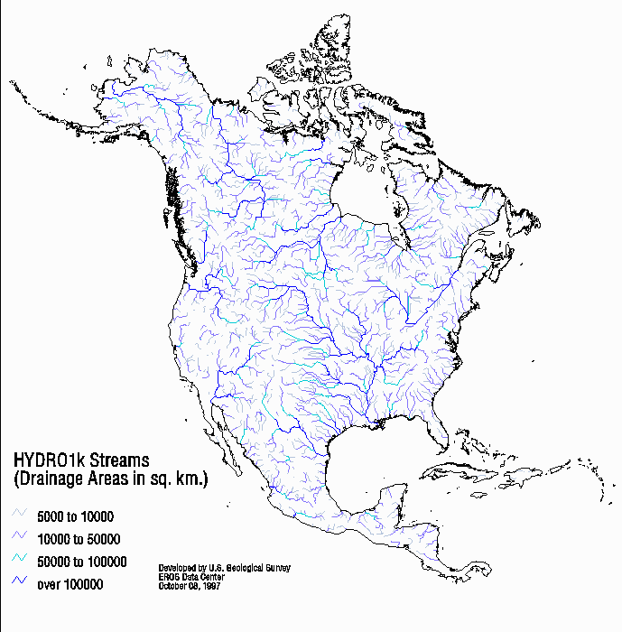
Drainage in North America
Hydro1K is
derived from
GTOPO30
using raster
GIS analysis
https://lta.cr.usgs.gov/HYDRO1K

Slide 26
Soil Data
Natural Resources Conservation Service (NRCS)
State Soil Geographic Database-STATSGO
Soil Survey Geographic Database- SSURGO
http://www.nrcs.usda.gov/wps/portal/nrcs/site/soils/home/
http://websoilsurvey.sc.egov.usda.gov/App/WebSoilSurvey.aspx
https://gdg.sc.egov.usda.gov/

Slide 27

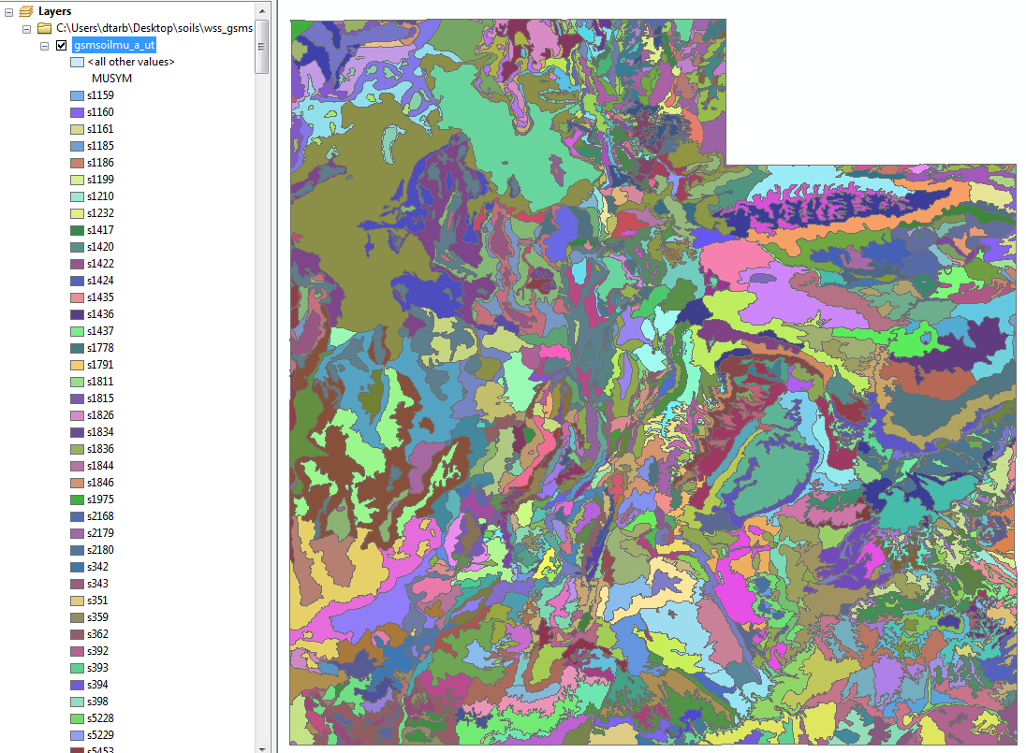
1:250,000 Scale Soil Information
https://gdg.sc.egov.usda.gov/

Slide 28
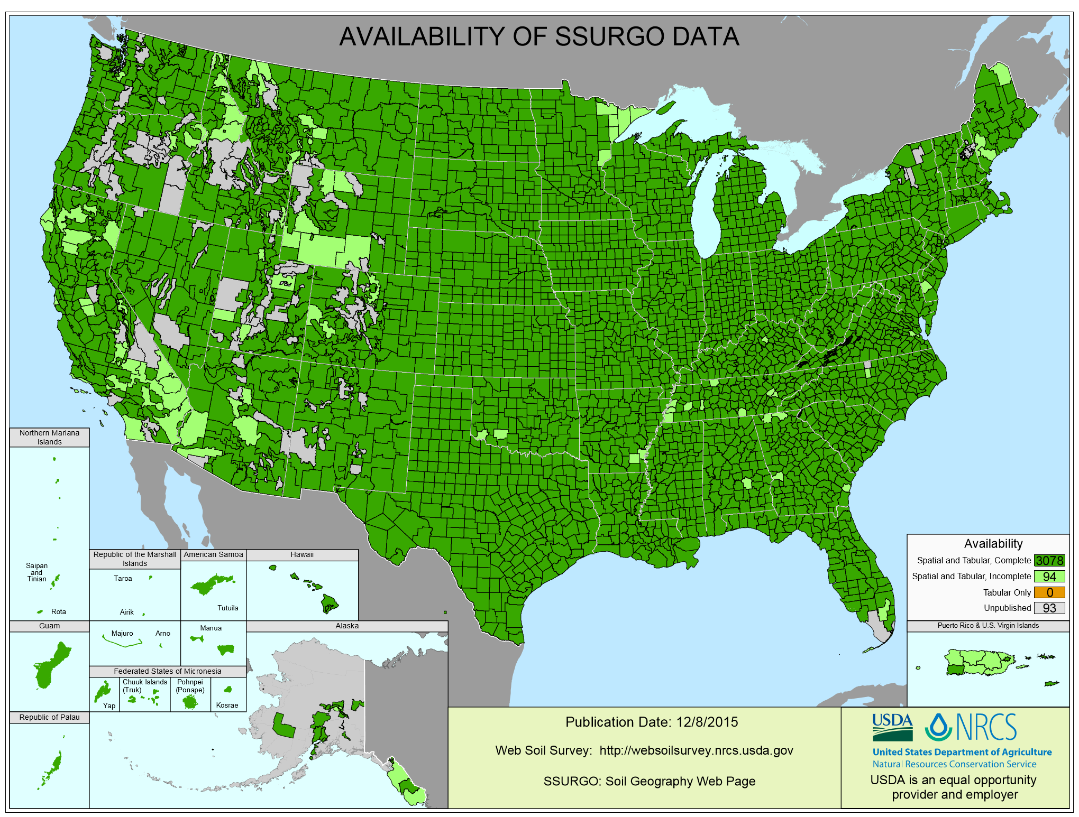
SSURGO:
County Level
Digital Soil Maps
1:24,000 scale
soil information
http://websoilsurvey.nrcs.usda.gov/DataAvailability/SoilDataAvailabilityMap.pdf

Slide 29
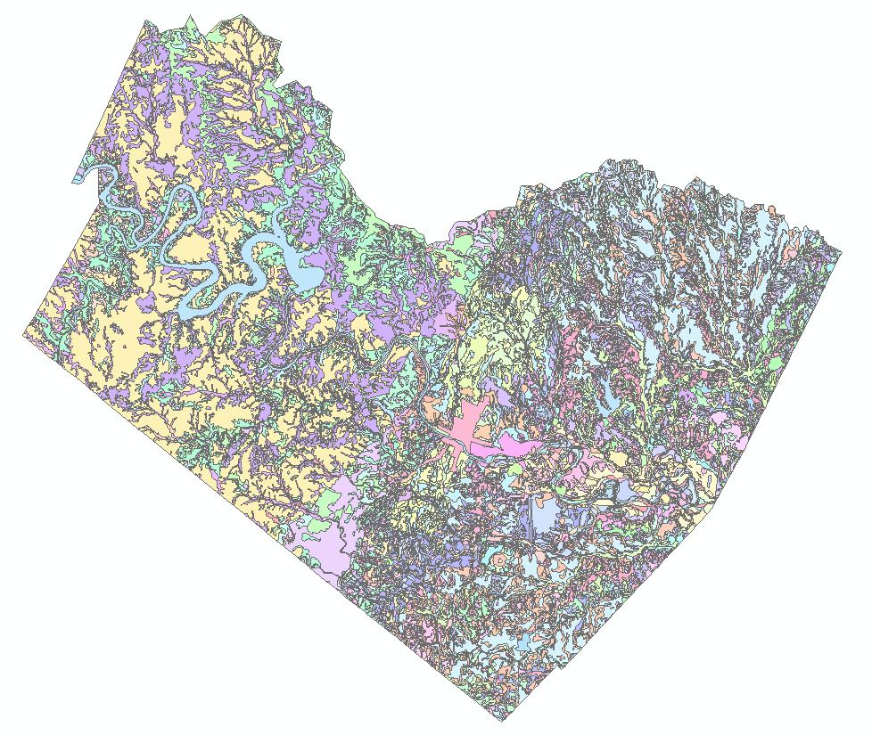
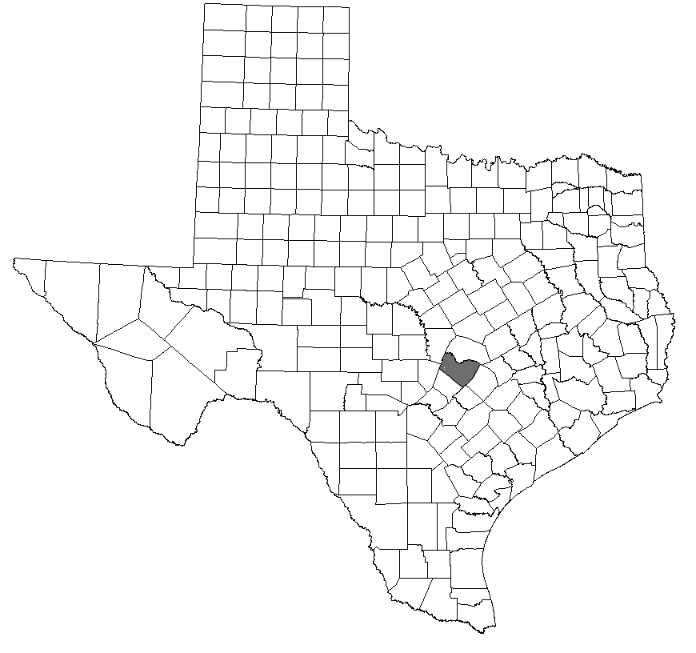
Ssurgo for Travis County
103 soil map units described by 7530 polygons of average area 35.37 ha (87 acres)

Slide 30
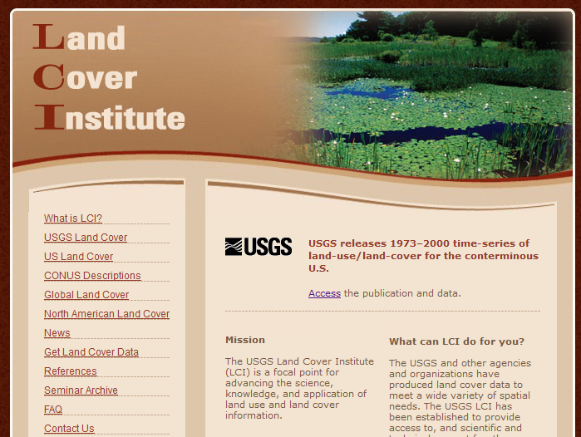
http://landcover.usgs.gov/

Slide 31
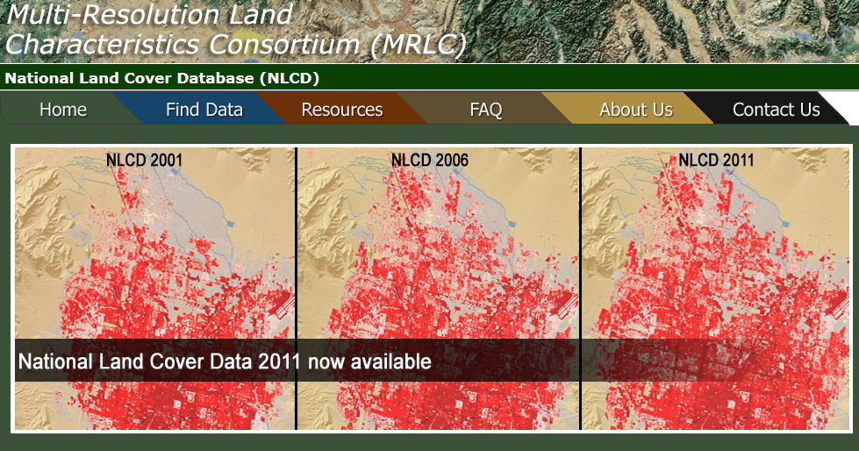
National Land Cover Dataset
1992, 2001, 2006 and 2011
Get the data:
http://www.mrlc.gov/

Slide 32
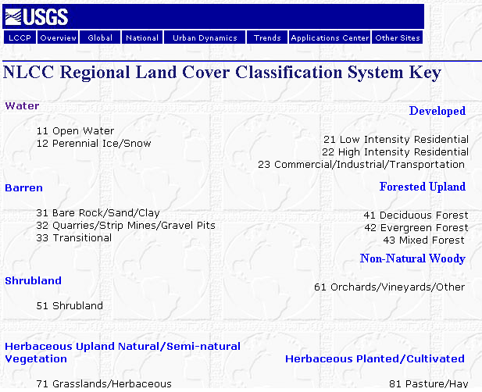

Slide 33
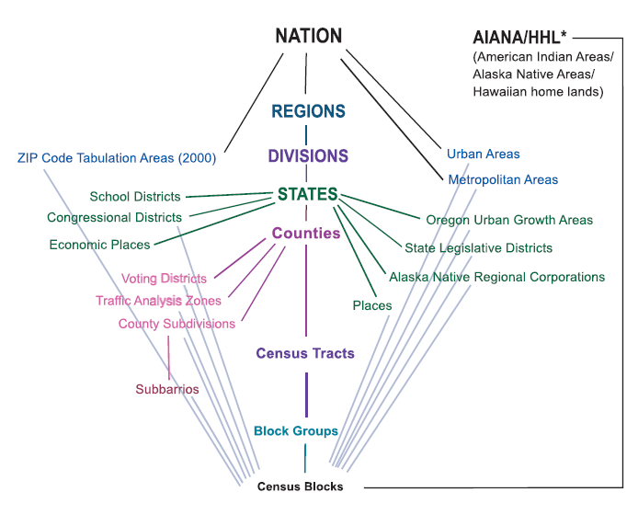
Hierarchy of Census Geographic Entities
http://www.caee.utexas.edu/prof/maidment/giswr2014/Census/AccessingCensusData.pdf
74,000
220,000 (avg 600 households/block grp)
US Population: 316 million
US Households: 133 million
11,000,000
Notes:
This diagram depicts the geographic hierarchy, as a series of nesting relationships, based on the legal, administrative, or areal relationships of the entities. For example, a line joining the lower-level entity “place” and the higher-level entity “state” means that a place cannot cross a state boundary.

Slide 34
American Community Survey
Source of detailed demographic and housing characteristics, including:
  Income
  Language spoken at home
  Educational attainment
  Occupation
  Place of work and journey to work
Data collected annually from approximately 3 million households per year. Approximately 250,000 households per month.
Data collected throughout the year—produces period estimates rather than point estimates.
 | ACS 1-Year Data | ACS 3-Year Data | ACS 5-Year Data
Geographic Areas | 65,000 or more population | 20,000 or more population | All areas, block group or higher

Slide 35
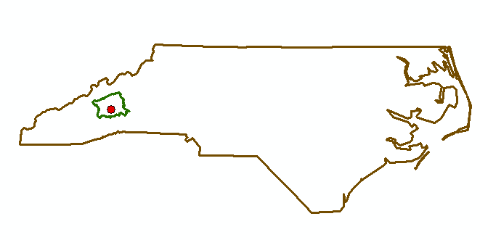
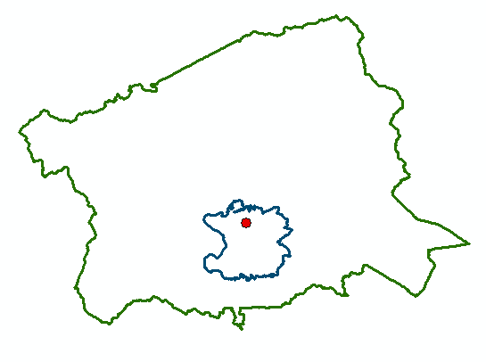
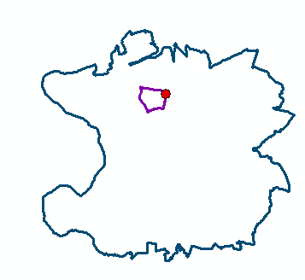
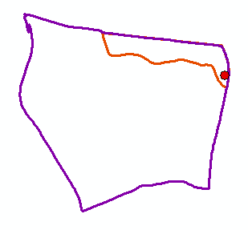
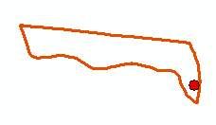
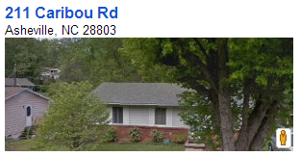
North Carolina
Buncombe County
Zip Code 28803
Census Block Group 370210020004
Scales of
Data Aggregation
Census Block 370210020004000
A single property – 211 Caribou Rd

Slide 36
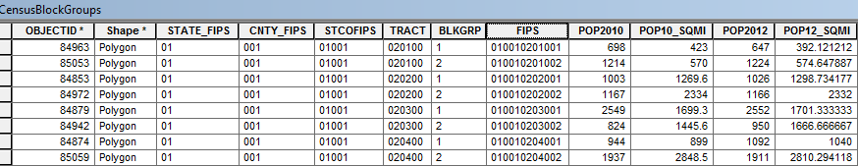
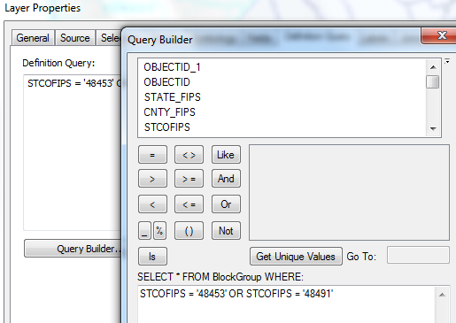
Census Block Groups for the US
http://www.caee.utexas.edu/prof/maidment/giswr2014/census/census.gdb.zip (308MB)
State
County
Tract
Block Group
Definition query to isolate Travis and Williamson Counties

Slide 37
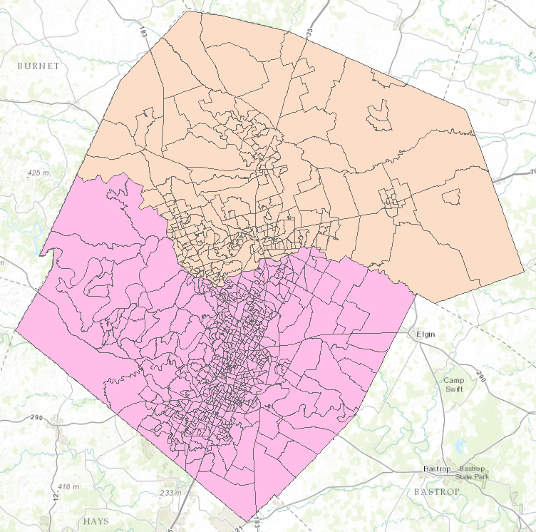

Census Block Groups in Travis and Williamson Counties
Williamson County
Travis County

Slide 38
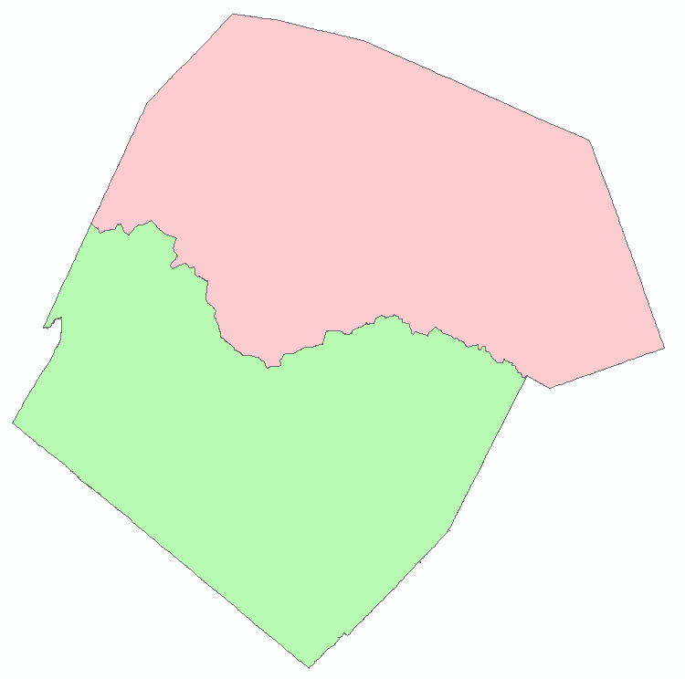
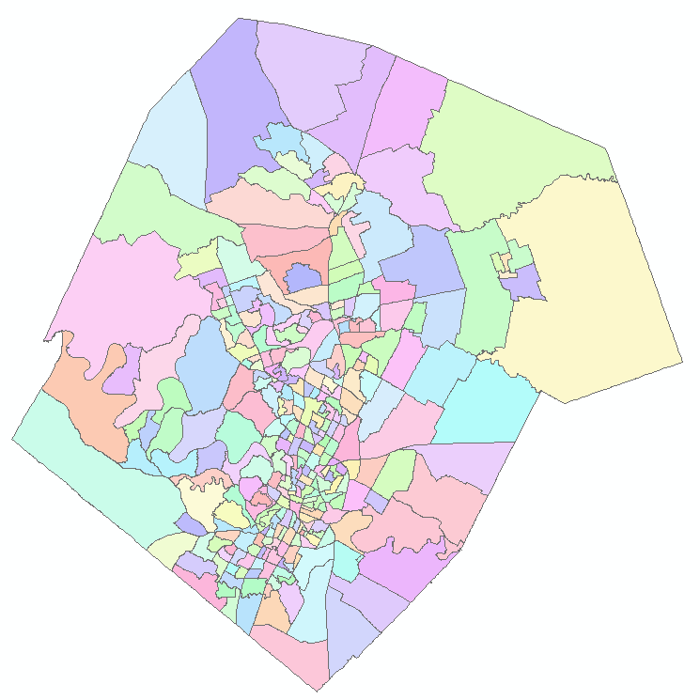
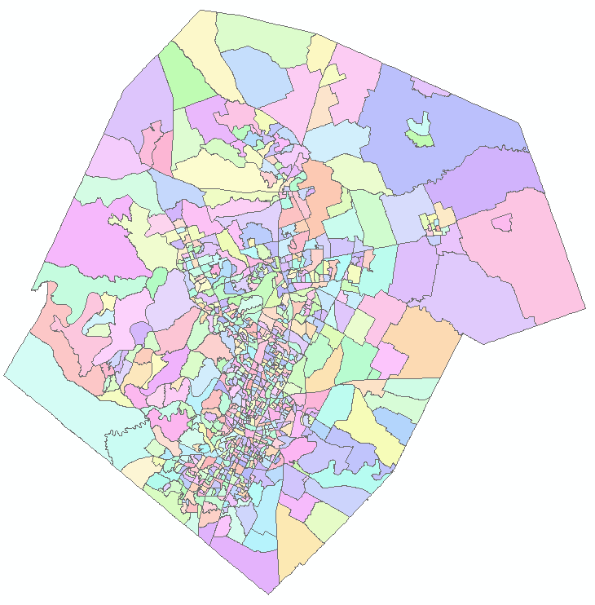
Demographic Analysis
Williamson
Travis
Two Counties
307 Tracts
823 Block Groups

Slide 39
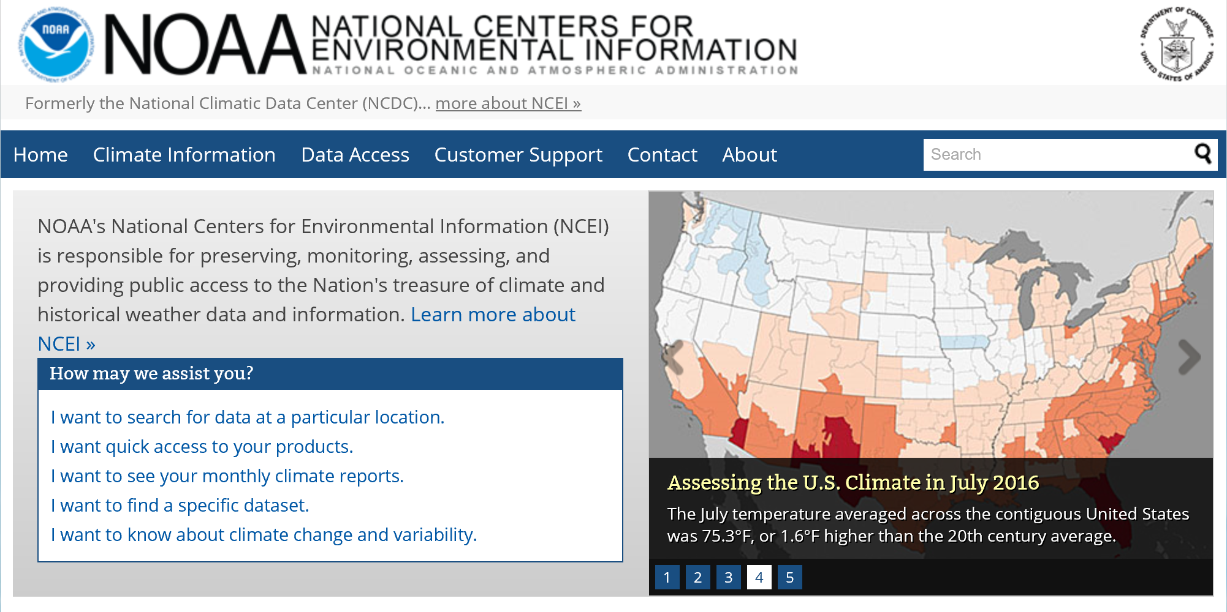
https://www.ncei.noaa.gov/

Slide 40

www.climate.gov

Slide 41

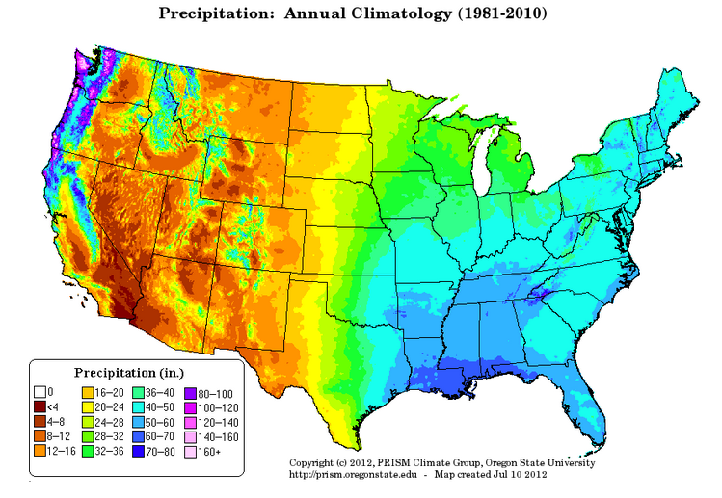
PRISM Mean Annual Precipitation (Oregon State U.)
http://prism.oregonstate.edu/

Slide 42
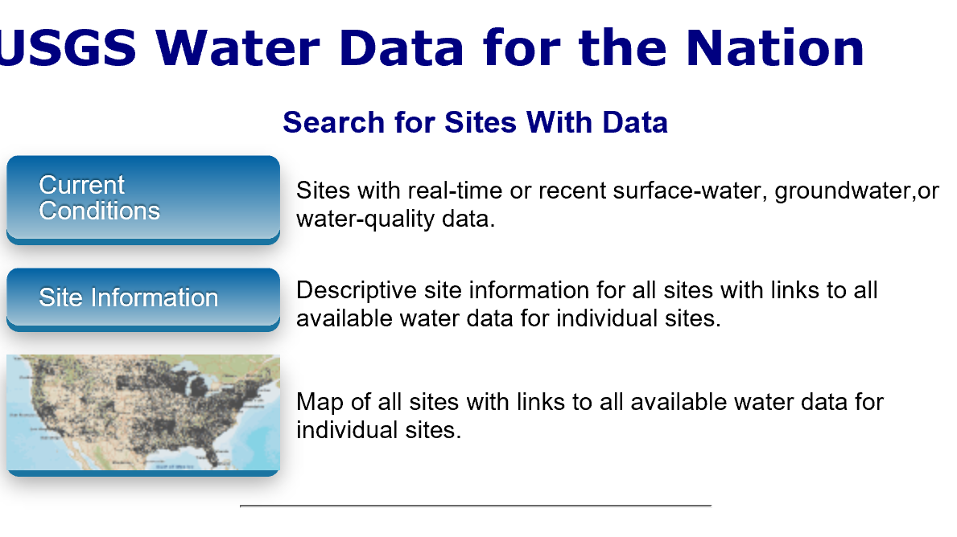
National Water Information System
Web access to USGS water
resources data in real time
http://waterdata.usgs.gov/usa/nwis/

Slide 43
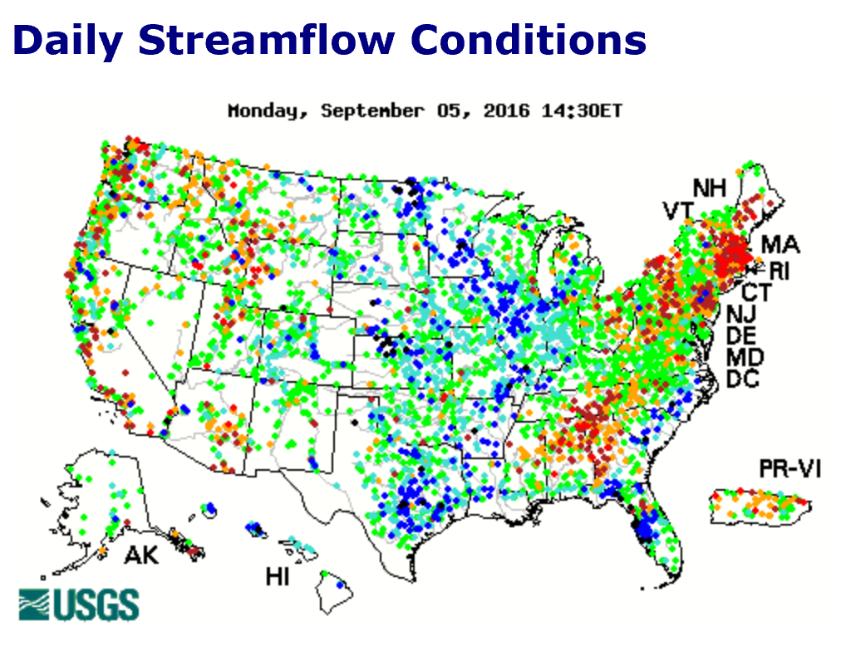
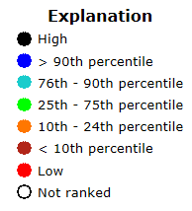
USGS Water Watch
Web access to USGS water resources data in real time
http://waterdata.usgs.gov/nwis/rt

Slide 44
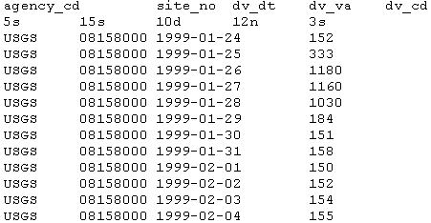
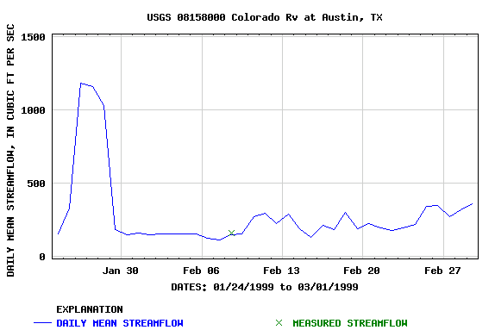
USGS National Water Information System.
http://water.usgs.gov
Real-time and Historic Data
  Streamflow and stage
  Groundwater levels
  Water Quality
  Site information
Tabular or Graphical Format

Slide 45
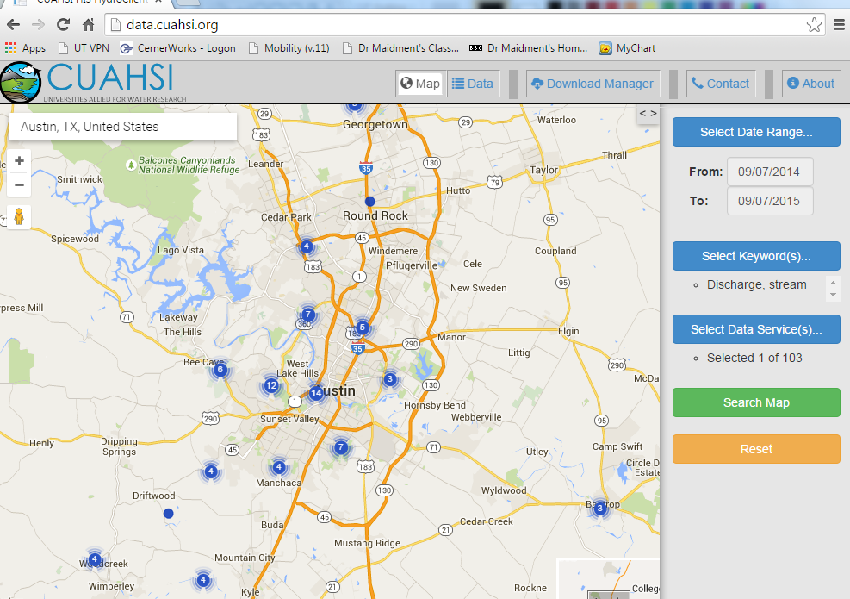
CUAHSI Water Data Services
http://data.cuahsi.org

Slide 46

NOAA National Water Model
http://water.noaa.gov/tools/nwm-image-viewer

Slide 47

HydroShare NWM Apps
http://apps.hydroshare.org

Slide 48



ArcGIS Online: Living Atlas
http://doc.arcgis.com/en/living-atlas/
Land Cover
Elevation
Soils

Slide 49


ArcGIS Online Services
http://landscape1.arcgis.com/arcgis/services/
http://landscape2.arcgis.com/arcgis/services/
http://landscape3.arcgis.com/arcgis/services/
http://elevation.arcgis.com/arcgis/services
http://hydro.arcgis.com/arcgis/services

Slide 50

Ready to Use Services in ArcGIS Pro
http://pro.arcgis.com/en/pro-app/help/projects/connect-to-a-gis-server.htm

Slide 51

Elevation Services
http://elevation.arcgis.com/arcgis/services

Slide 52



Other Dynamic Map Services

Slide 53

http://water.weather.gov/ahps/

Slide 54

http://water.weather.gov/ahps/

Slide 55


http://enviroatlas.epa.gov/enviroatlas/

Slide 56


EnviroAtlas
All data is available for download
Some data is available for download as web service

Slide 57


Texas Natural Resource Information System http://www.tnris.org/

Slide 58

TWDB http://www.twdb.texas.gov/mapping/gisdata.asp

Slide 59


http://www.wcc.nrcs.usda.gov/snotel/

Slide 60

SNOTEL System for Measuring Snow and Supporting Spring Runoff and Water Supply Forecasts

Slide 61

USU Doc Daniels SNOTEL Site

Slide 62


Measuring Snow Water Equivalent

Slide 63

http://www.cbrfc.noaa.gov

Slide 64

CBRFC SNOTEL Ensemble
http://www.cbrfc.noaa.gov/station/sweplot/sweplot.cgi?tglu1

Slide 65

http://gis.utah.gov

Slide 66

Utah GIS Portal Download GIS Data
http://gis.utah.gov/data/

Slide 67

http://geology.utah.gov/maps/gis/index.htm

Slide 68

http://www.wrcc.dri.edu/

Slide 69

Bear River Watershed
http://www.bearriverinfo.org/

Slide 70


MODIS on NASA Worldview
(Shrinking Great Salt Lake)
2012-05-11
2015-08-31
https://earthdata.nasa.gov/labs/worldview/?p=geographic&l=MODIS_Aqua_CorrectedReflectance_TrueColor,MODIS_Terra_CorrectedReflectance_TrueColor,Reference_Features,Coastlines&t=2012-05-11&v=-114.20487628044651,40.12581729563662,-110.51347003044651,42.16048526438662
https://earthdata.nasa.gov/labs/worldview/?p=geographic&l=MODIS_Aqua_CorrectedReflectance_TrueColor,MODIS_Terra_CorrectedReflectance_TrueColor,Reference_Features,Coastlines&t=2015-08-31&v=-114.20487628044651,40.12581729563662,-110.51347003044651,42.16048526438662

Slide 71

Smoke from Fires over W US
MODIS 2015-08-19
https://earthdata.nasa.gov/labs/worldview/?p=geographic&l=MODIS_Aqua_CorrectedReflectance_TrueColor,MODIS_Terra_CorrectedReflectance_TrueColor,Reference_Features,Coastlines&t=2015-08-19&v=-134.01859698357154,33.61092471751162,-104.48734698357154,49.88826846751162

Slide 72
Summary
There are a plethora of data sources available
Knowing what is available is important to scope GIS analyses and projects
GIS is about creating knowledge, telling stories, making decisions – all involve integrating information from multiple sources
The way that data is organized can enhance or inhibit the analyses that can be done
Data dissemination is increasingly becoming service based

