Slide 1
Demography
David R. Maidment
GIS in Water Resources
Fall 2016

Slide 2
Overview of Demographic Data
Michael Ratcliffe
Geography Division
US Census Bureau

Slide 3
Data Tabulation Programs
  Decennial Census of Population and Housing: every 10 years
  Population Estimates and Projections Program: every year
  Small Area Income and Poverty Estimates Program: every year
  American Community Survey: every year
  Economic Census: every 5 years
  Local Employment Dynamics Program: every year
  Census of Governments: every 5 years
  Over 100 Annual, Quarterly or Monthly Surveys, including 13 principal economic indicators
(Political Reapportionment)
(Socioeconomics)

Slide 4
American Community Survey
Source of detailed demographic and housing characteristics, including:
  Income
  Language spoken at home
  Educational attainment
  Occupation
  Place of work and journey to work
Data collected annually from approximately 3 million households per year. Approximately 250,000 households per month.
Data collected throughout the year—produces period estimates rather than point estimates.
 | ACS 1-Year Data | ACS 3-Year Data | ACS 5-Year Data
Geographic Areas | 65,000 or more population | 20,000 or more population | All areas, block group or higher

Slide 5
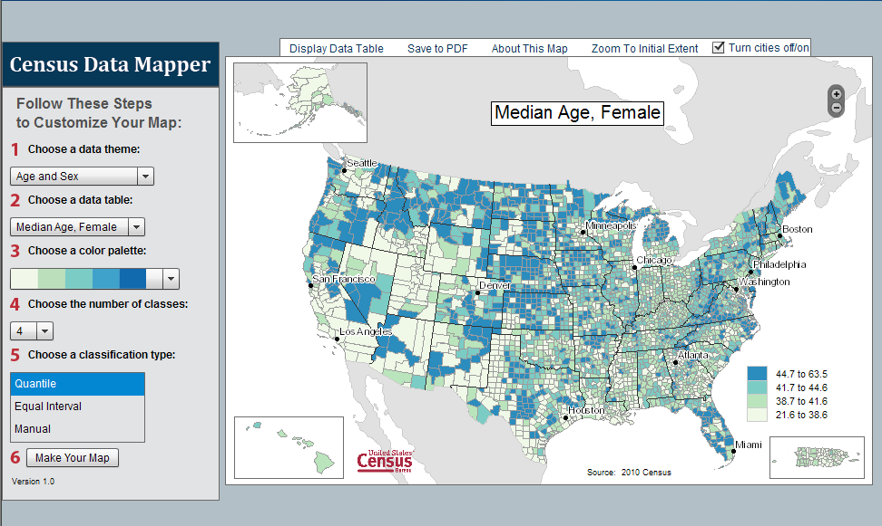
http://tigerweb.geo.census.gov/datamapper/map.html
Notes:
Publically released visualization tool. Allows users to create custom maps that are suitable for inclusion in publications. The Bureau did not previously offer this capability.

Slide 6
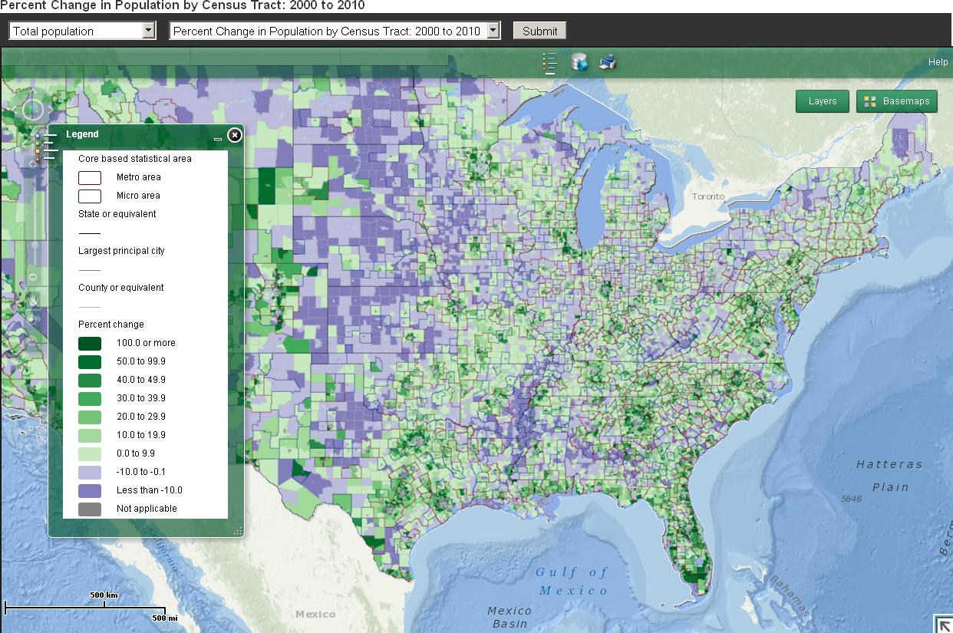
Census Tract Thematic Map Viewer http://www.census.gov/population/metro/data/thematic_maps.html
Notes:
Provides tract-level data to analyze distributions of demographic characteristics within metropolitan and micropolitan statistical areas and counties outside CBSAs.

Slide 7
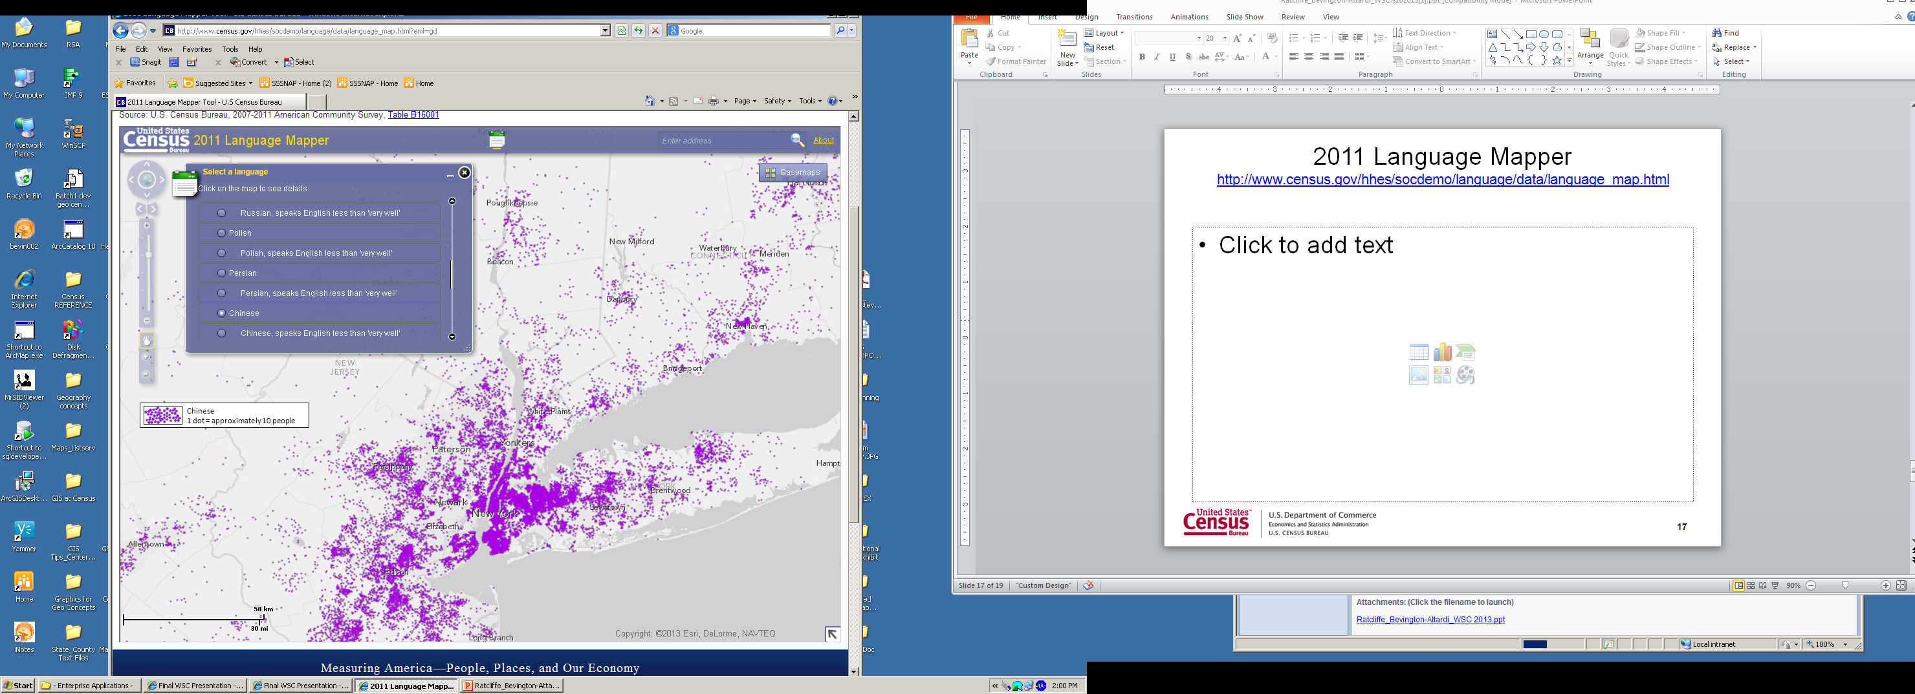
2011 Language Mapper http://www.census.gov/hhes/socdemo/language/data/language_map.html
Notes:
One of the more recent on-line mapping tools to be released in Census Flows Mapper. This tool provides the ability to access and map county-to-county migration flow data from the ACS 5-year dataset.
These data previously were available only via a complex data matrix containing information for each pairing of the nation’s 3,143 counties.
Census Flows Mapper enables the most novice user to view migration data. It also provides experienced migration analysts with an easy means to gain a quick overview of migration trends before diving deeper into the data.

Slide 8
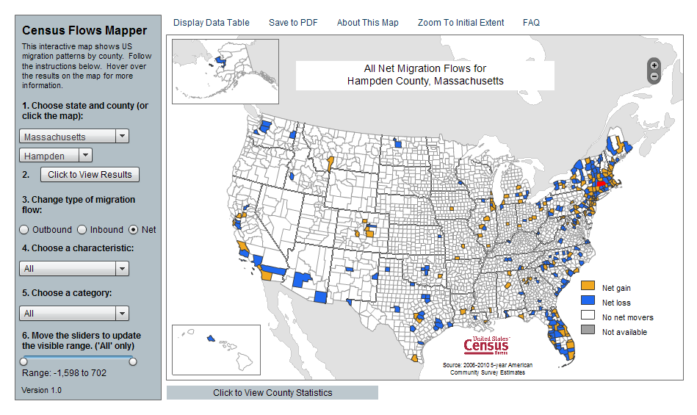
Migration of People
http://flowsmapper.geo.census.gov/flowsmapper/map.html
Notes:
Based on the same technology GEO worked with ECON to develop the Census Flows Mapper which shows county-to-county migration from the American Community Survey 5-year data.

Slide 9
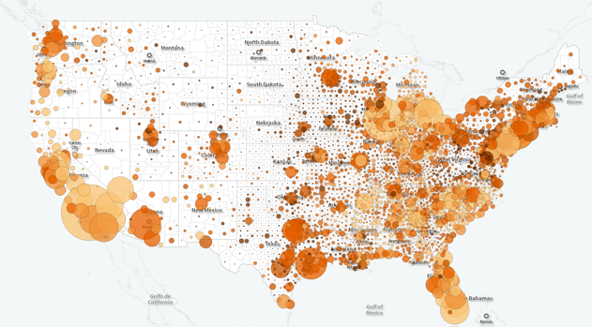
Social Explorer
http://www.socialexplorer.com/

Slide 10
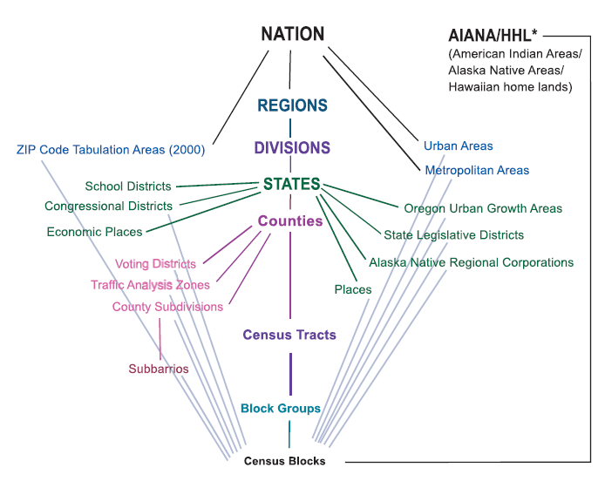
Hierarchy of Census Geographic Entities
74,000
220,000 (avg 600 households/block grp)
US Population: 316 million
US Households: 133 million
11,000,000
Notes:
This diagram depicts the geographic hierarchy, as a series of nesting relationships, based on the legal, administrative, or areal relationships of the entities. For example, a line joining the lower-level entity “place” and the higher-level entity “state” means that a place cannot cross a state boundary.

Slide 11
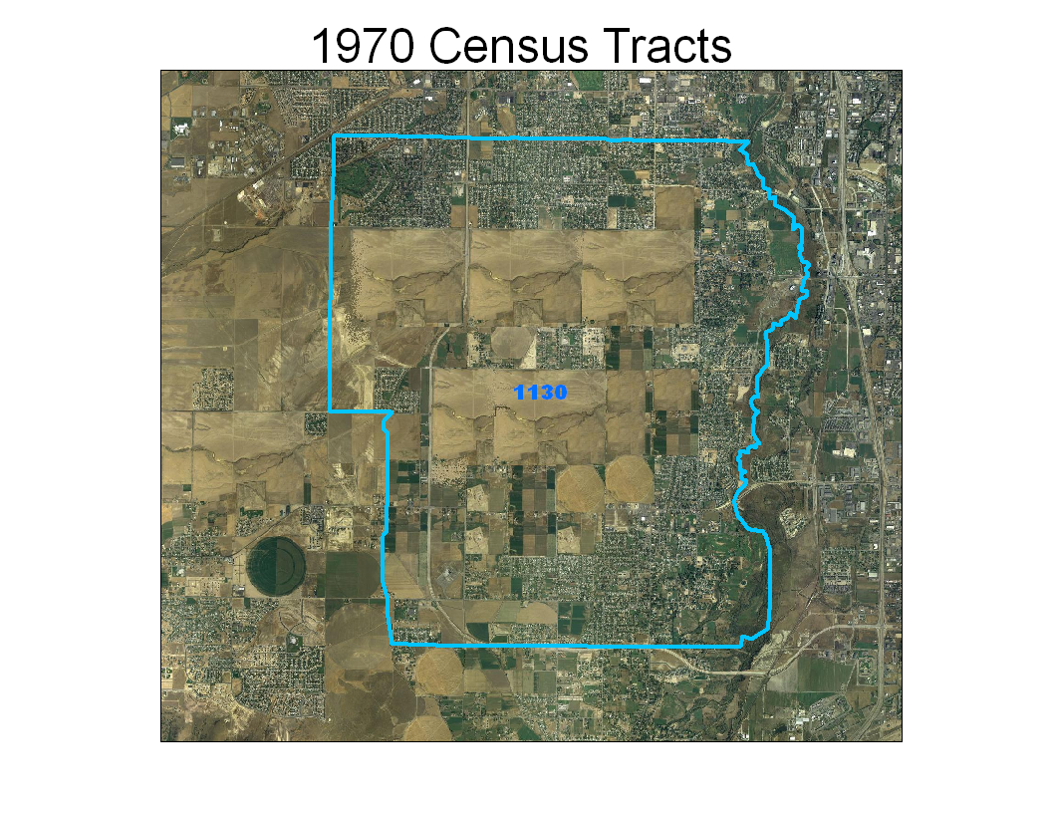
Notes:
The next few slides show an example of an area where population continues to grow and therefore the census tract is split over the decades.
This is the original tract 1130 in South Jordan City, Utah during the 1970 Census

Slide 12
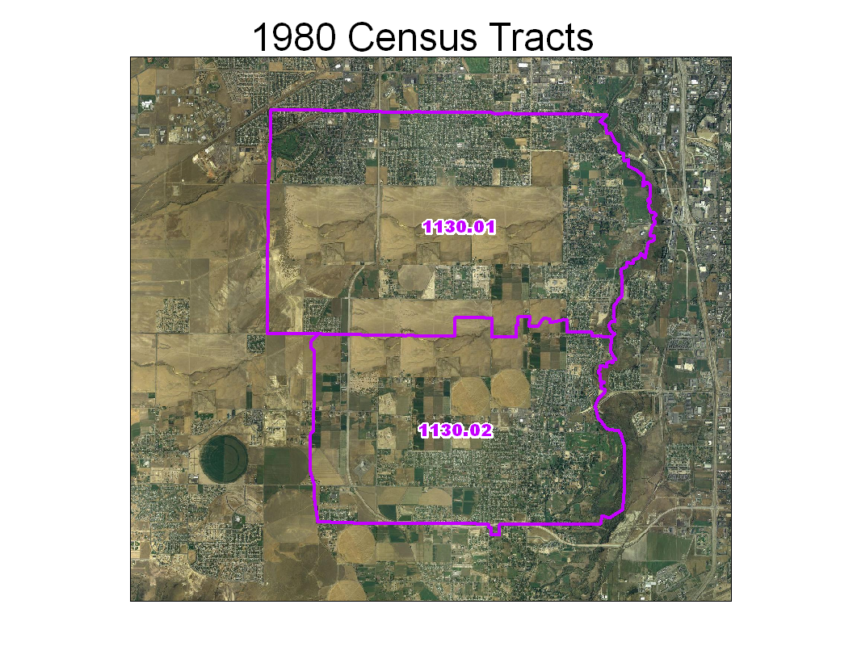
Notes:
For the 1980 Census, enough growth occurred to split the original tract 1130 into two new pieces. Note the tract suffixes .01 and .02.

Slide 13
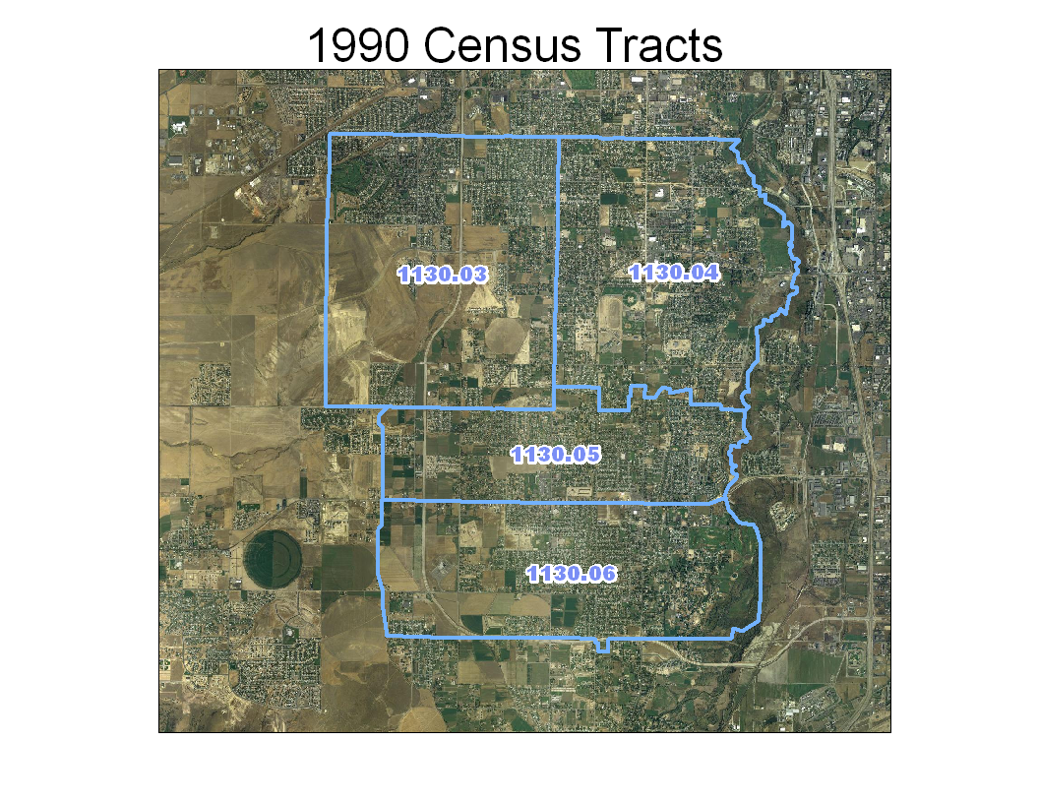
Notes:
For the 1990 Census, growth has again continued at an accelerated pace requiring the two tracts from 1980 to be split further. Notice the original suffixes are no longer used and new ones are provided.

Slide 14
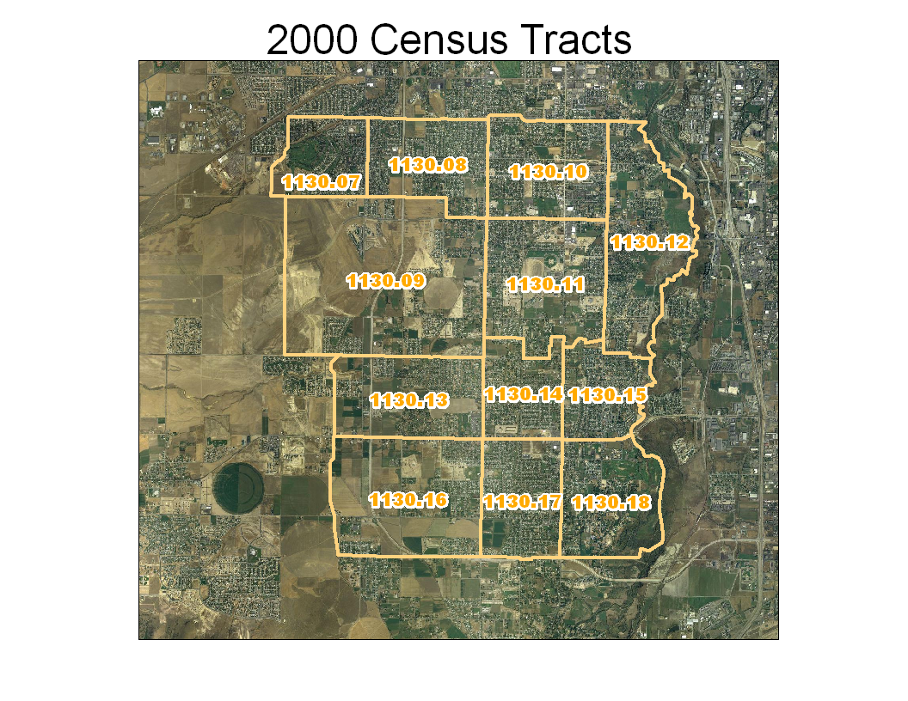
Notes:
Finally in the 2000 Census, the four tracts from 1990 had to be further sub-divided. Once again, the tract suffixes from 1990 are no longer used and new ones are given. You can see that the original outline of tract 1130 still exists, so you can compare the data from 2000 to the same geographic area in 1970.

Slide 15
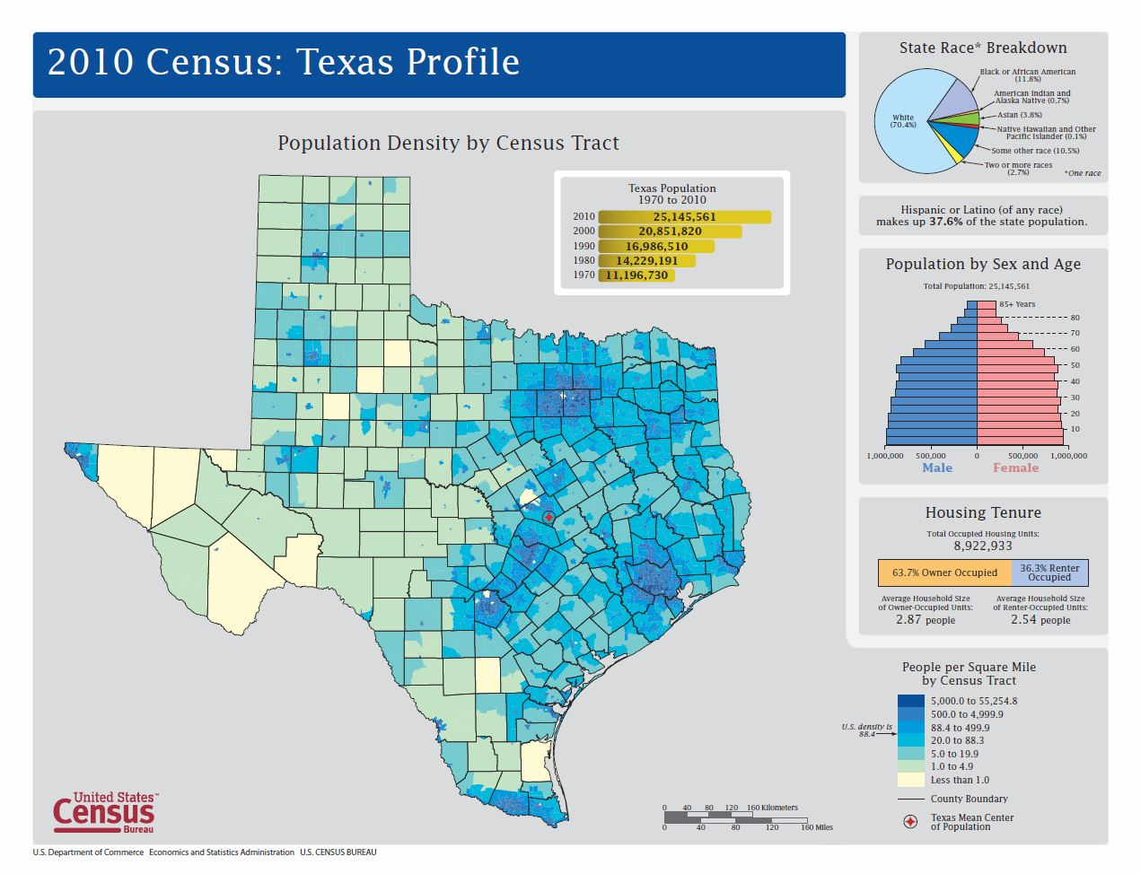
Profile Maps of States
http://www2.census.gov/geo/maps/dc10_thematic/2010_Profile/2010_Profile_Map_Texas.pdf

Slide 16
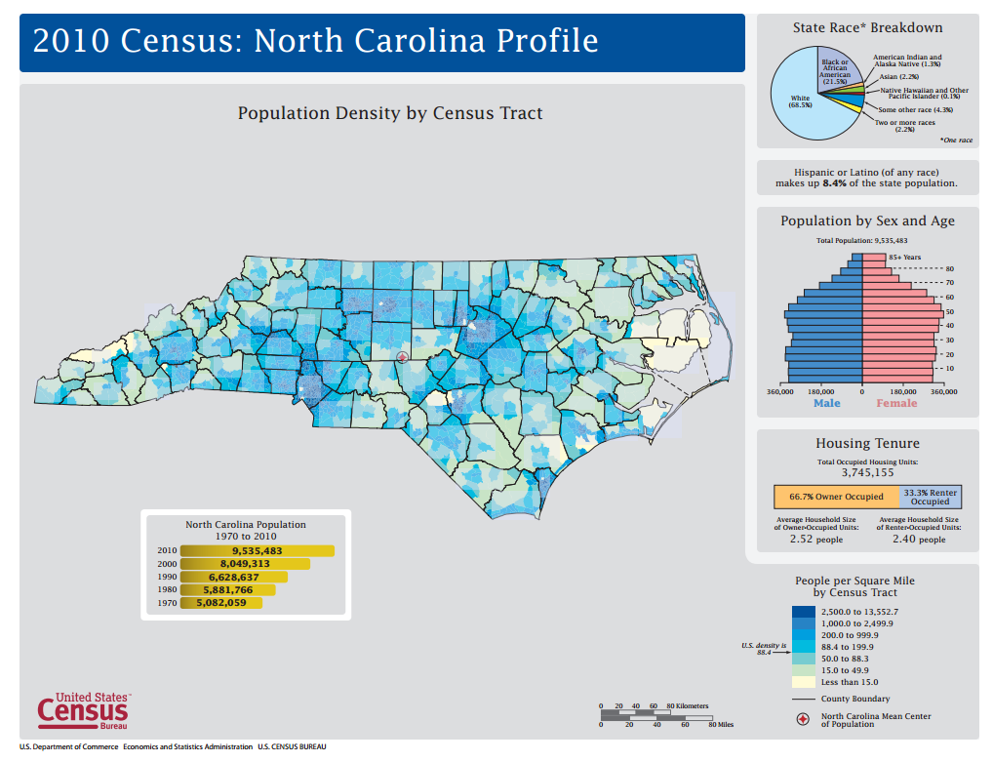
North Carolina Population Profile
http://www2.census.gov/geo/maps/dc10_thematic/2010_Profile/2010_Profile_Map_North_Carolina.pdf

Slide 17
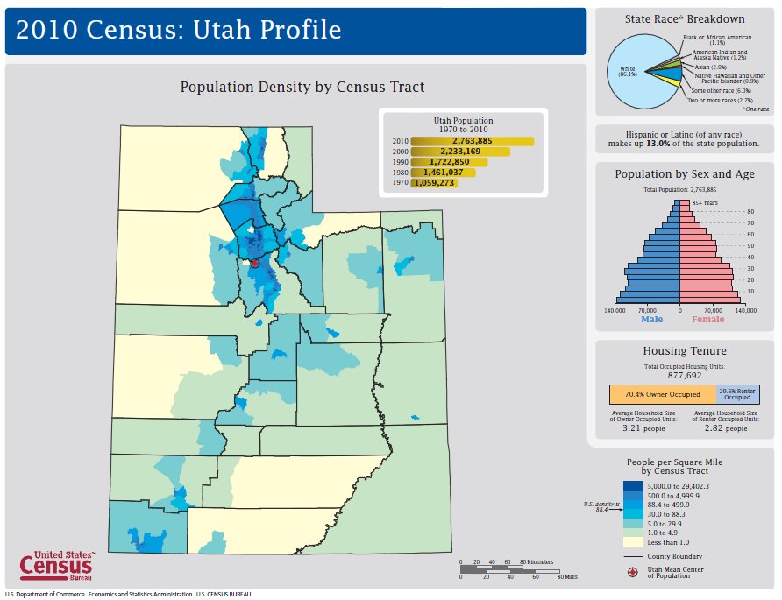
http://www2.census.gov/geo/maps/dc10_thematic/2010_Profile/2010_Profile_Map_Utah.pdf

Slide 18
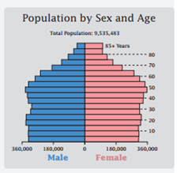
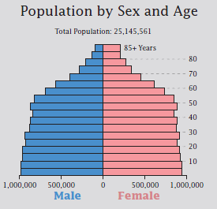
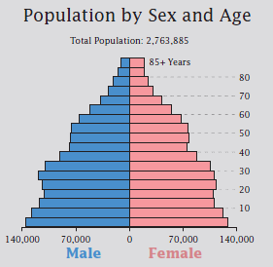
Age Distribution of Population
North Carolina
Texas
Utah

Slide 19
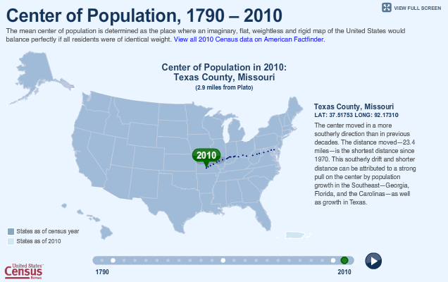
Center of Population of the United States
http://www.census.gov/2010census/data/center-of-population.php

Slide 20
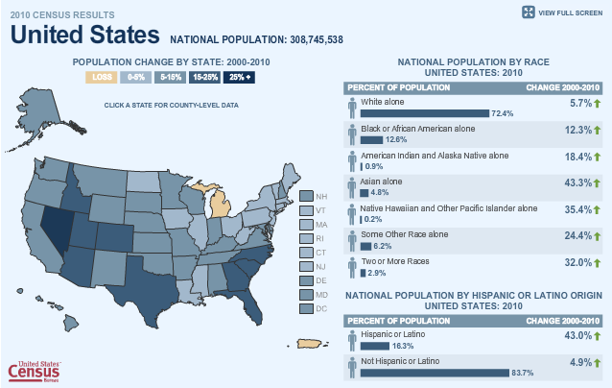
Population Change 2000-2010
http://www.census.gov/2010census/data/

Slide 21
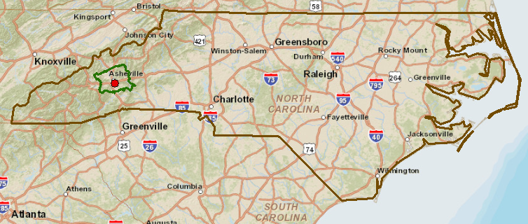
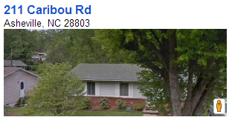
A house in North Carolina

Slide 22
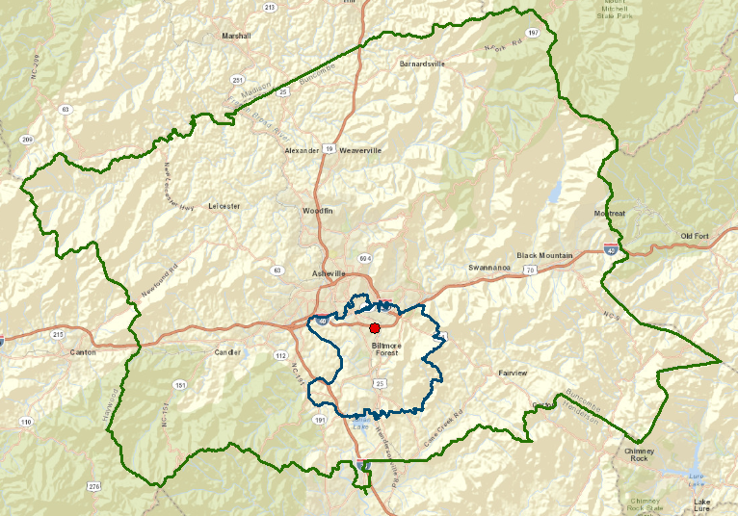
Buncombe County
County boundary
House
Zip code boundary

Slide 23
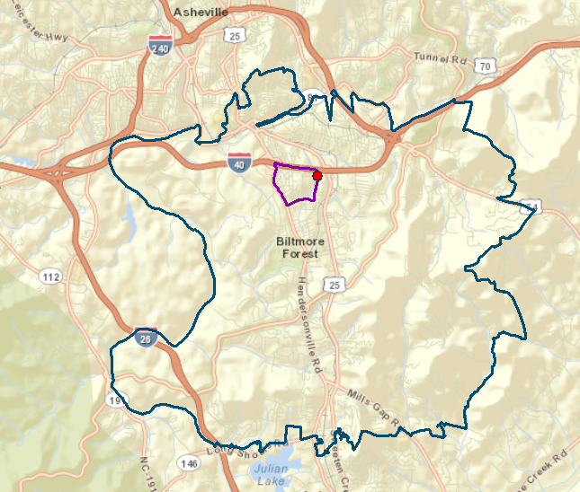
ZipCode 28803
House
Census block group boundary
Zip code boundary

Slide 24
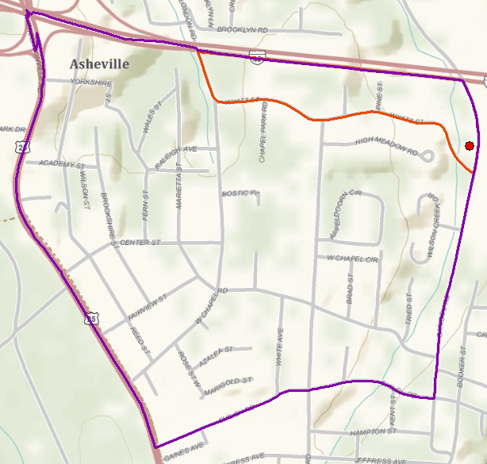
Census Block Group 370210020004
Census block boundary
House
Census block group boundary
This is used for the American Community Survey each year
There are 220,000 census block groups in the United States

Slide 25
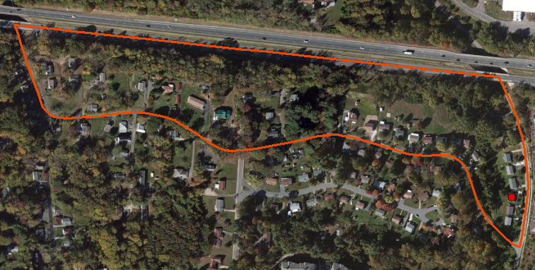
Census Block 370210020004000
211 Caribou Rd
This is used for the Census of Population each 10 years
There are 11,000,000 census blocks in the United States

Slide 26
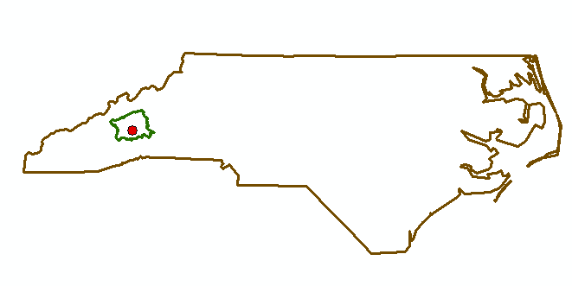
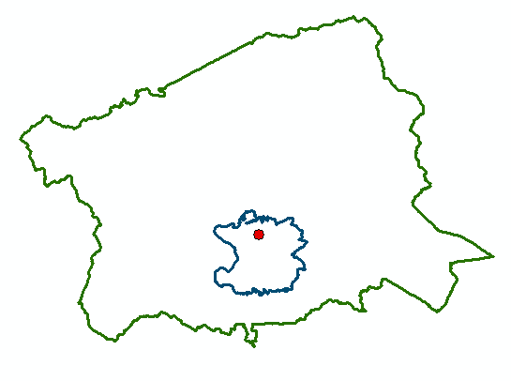
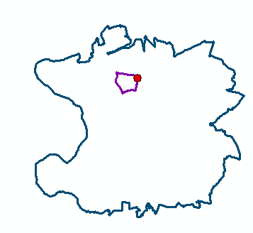
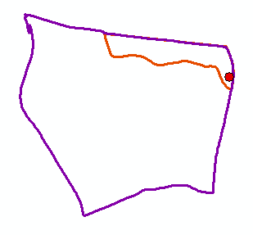
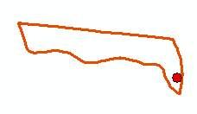
North Carolina
Buncombe County
Zip Code 28803
Census Block Group 370210020004
Scales of
Data Aggregation
Census Block 370210020004000
A single property – 211 Caribou Rd

Slide 27
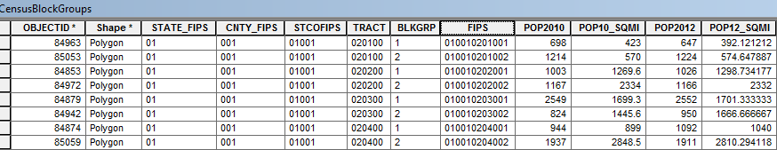
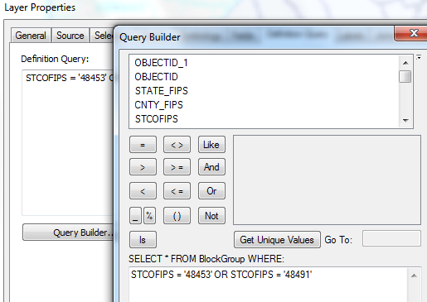
Census Block Groups for the US
http://www.caee.utexas.edu/prof/maidment/giswr2014/census/census.gdb.zip (308MB)
State
County
Tract
Block Group
Definition query to isolate Travis and Williamson Counties

Slide 28
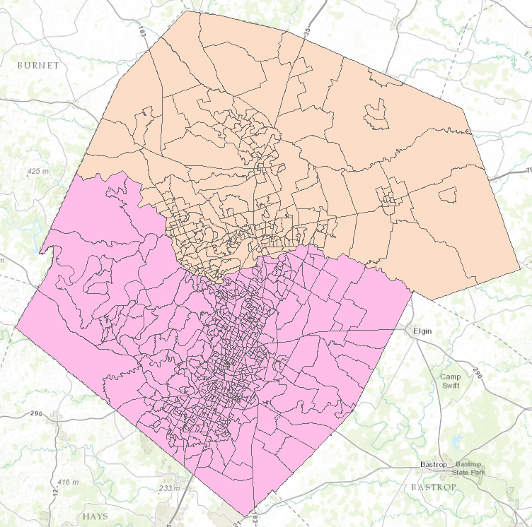

Census Block Groups in Travis and Williamson Counties
Williamson County
Travis County

Slide 29
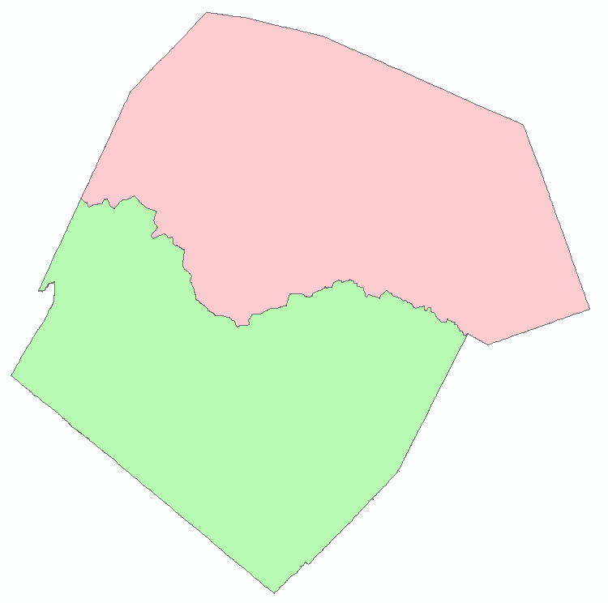
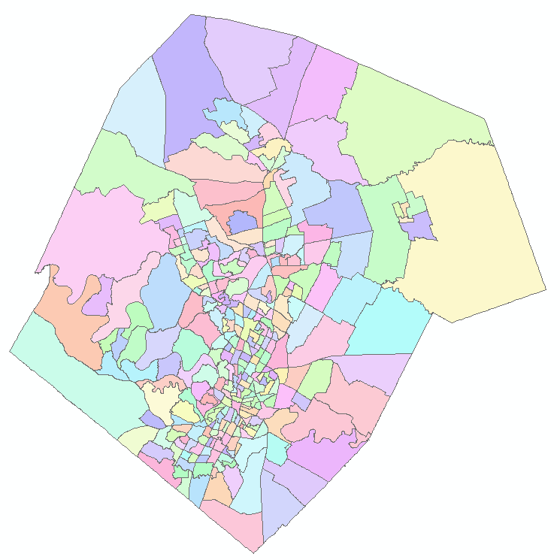
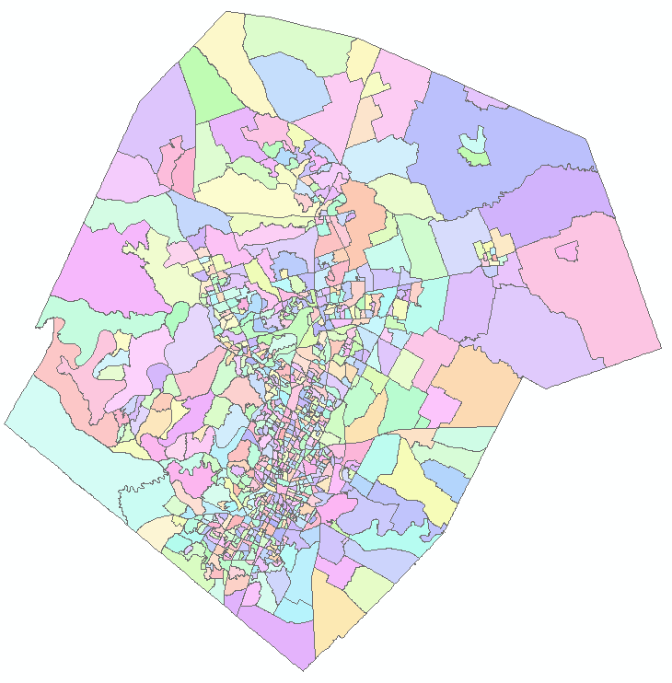
Demographic Analysis
Williamson
Travis
Two Counties
307 Tracts
823 Block Groups

Slide 30

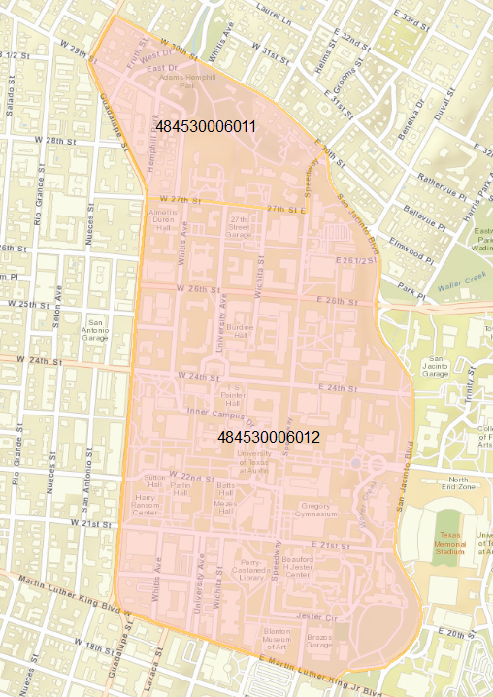
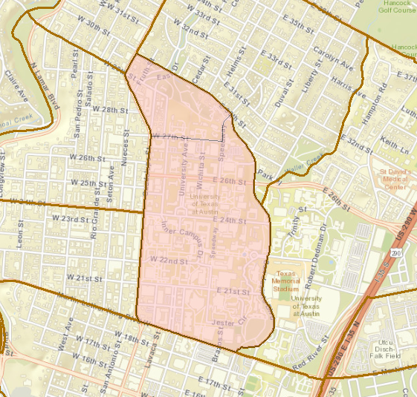
UT Demography
Census Block Groups
UT Campus
48 453 000601

Slide 31
Characteristics of Vulnerable Populations?

Slide 32
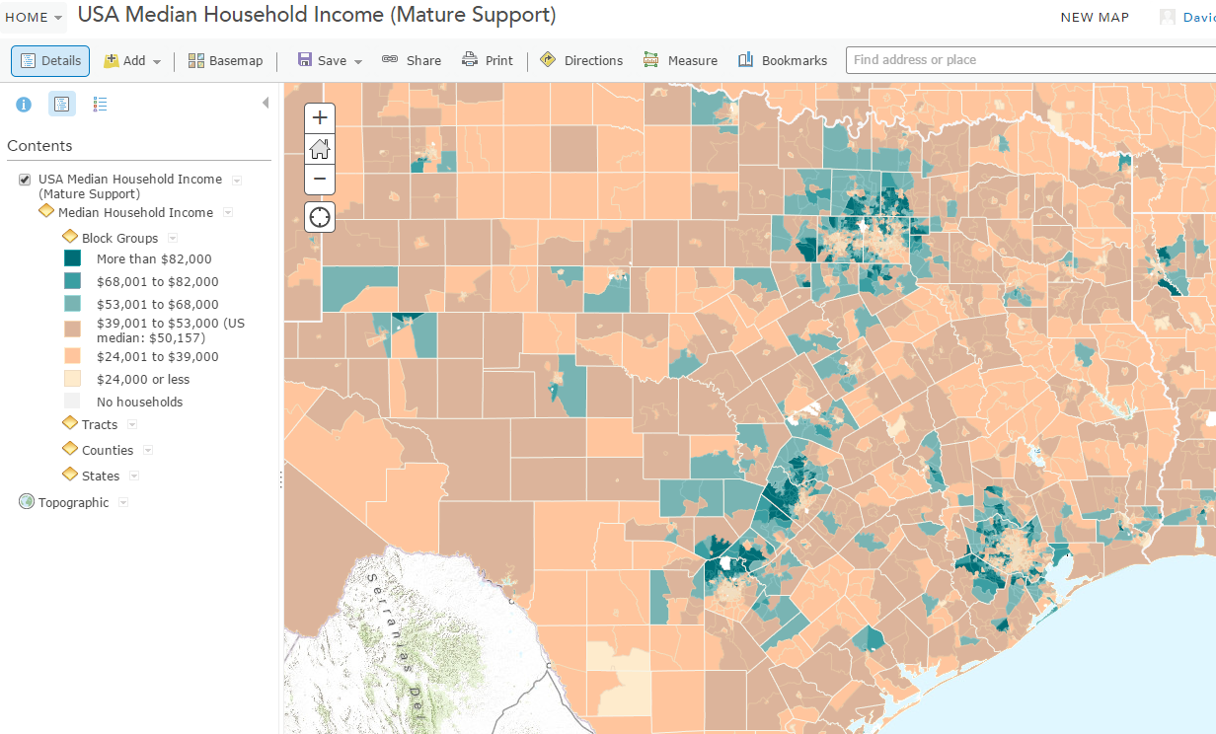
Median Household Income
https://ut-austin.maps.arcgis.com/home/webmap/viewer.html?layers=da76de09076b4959ad005e1dc2c48049

Slide 33
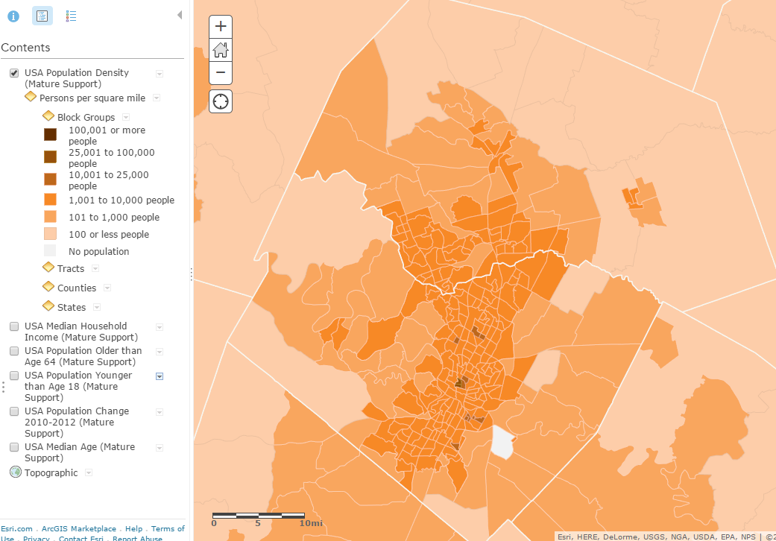
Population Density

Slide 34
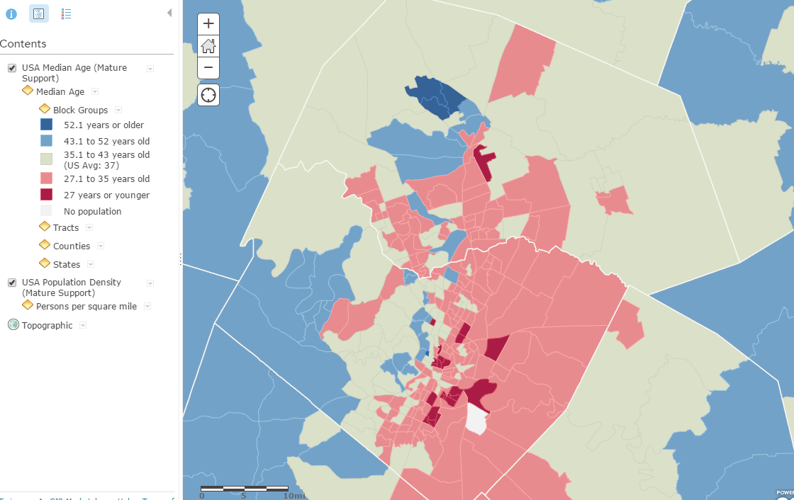
Median Age

Slide 35
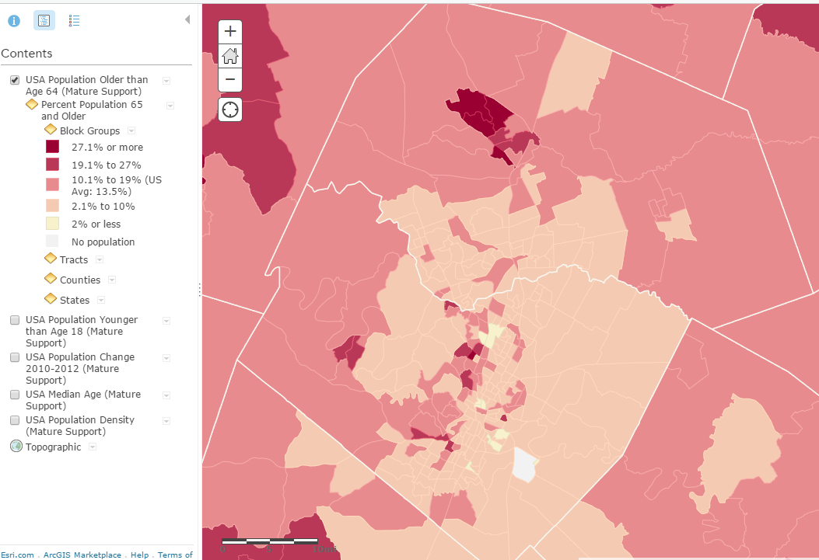
% Population 65 and older

Slide 36
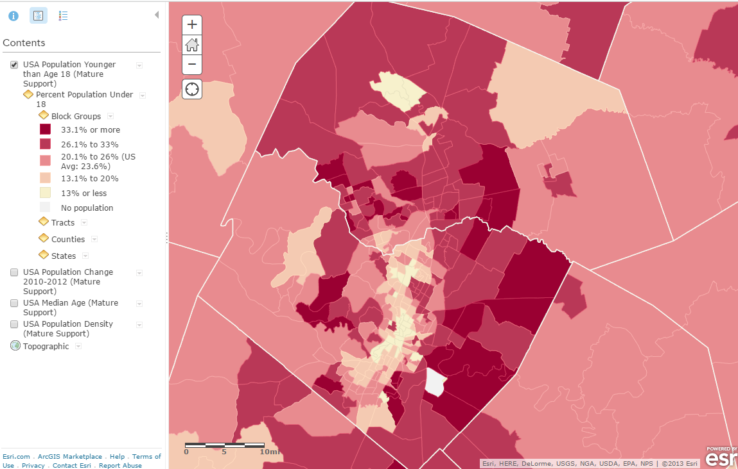
% Population under age 18

Slide 37
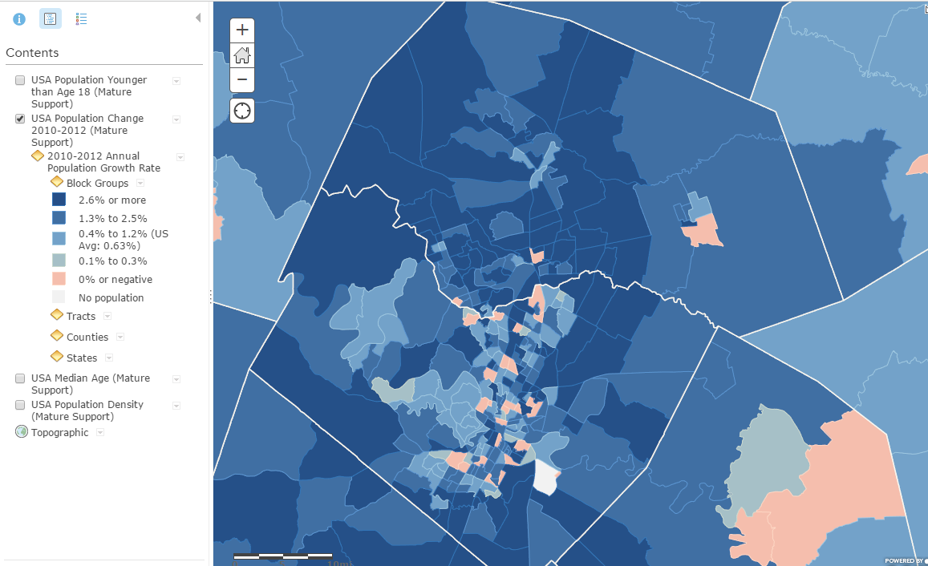
Annual Population Growth Rate

Slide 38
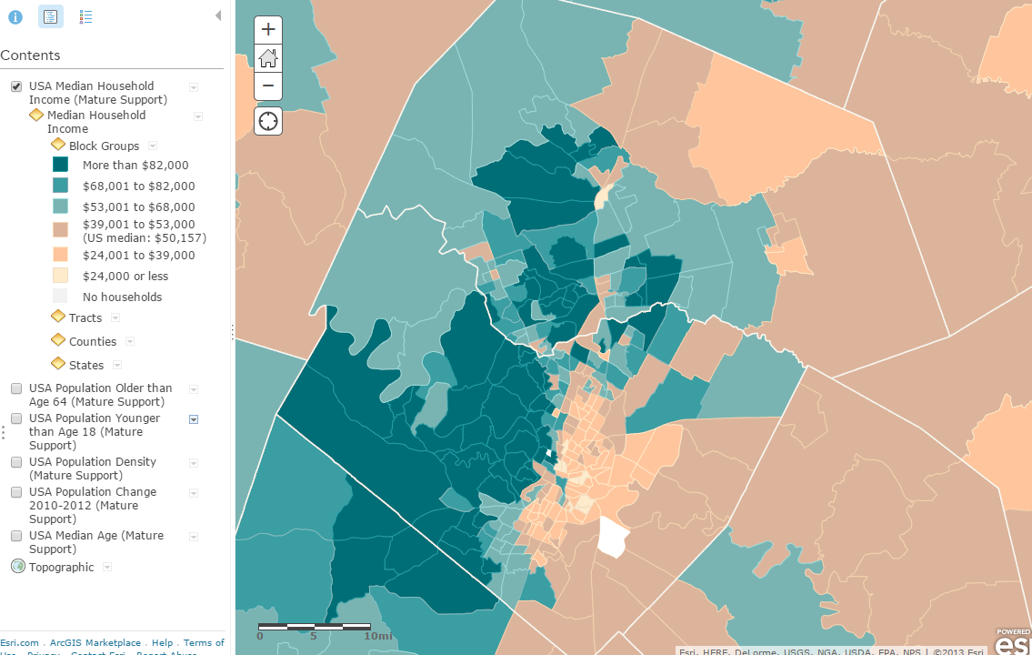
Median Household Income

Slide 39
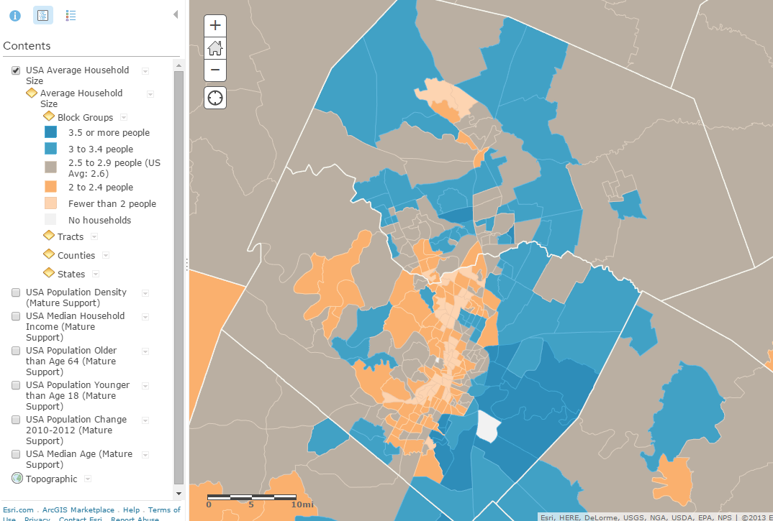
Average Household Size

Slide 40
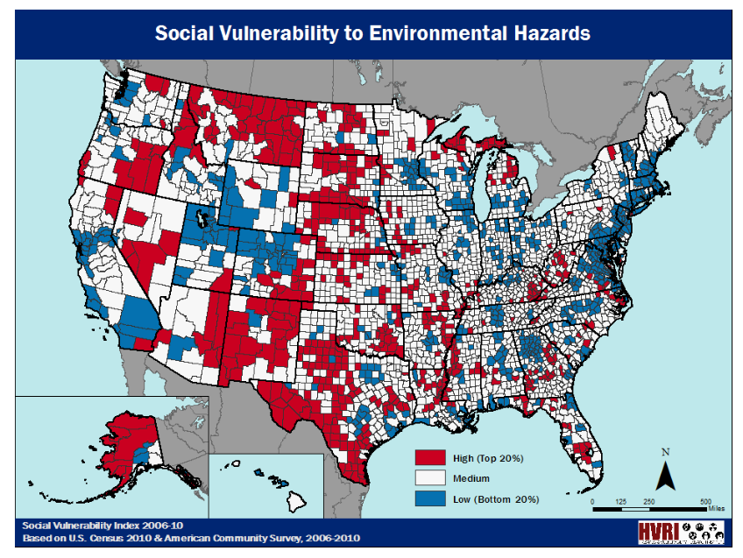
Social Vulnerability Index, Univ. of South Carolina

Slide 41
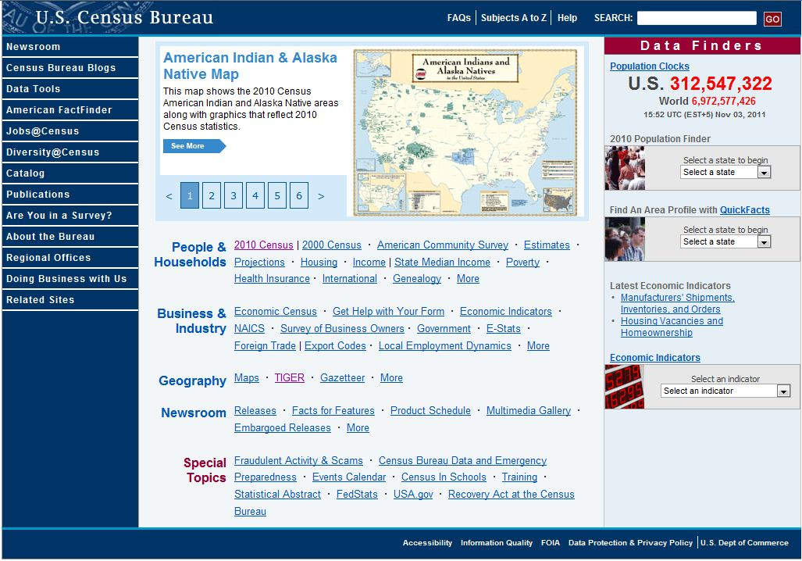
Finding the Right Data
Population, housing, economic & geographic data
Shapefiles prepared for GIS users
http://www.census.gov/

Slide 42

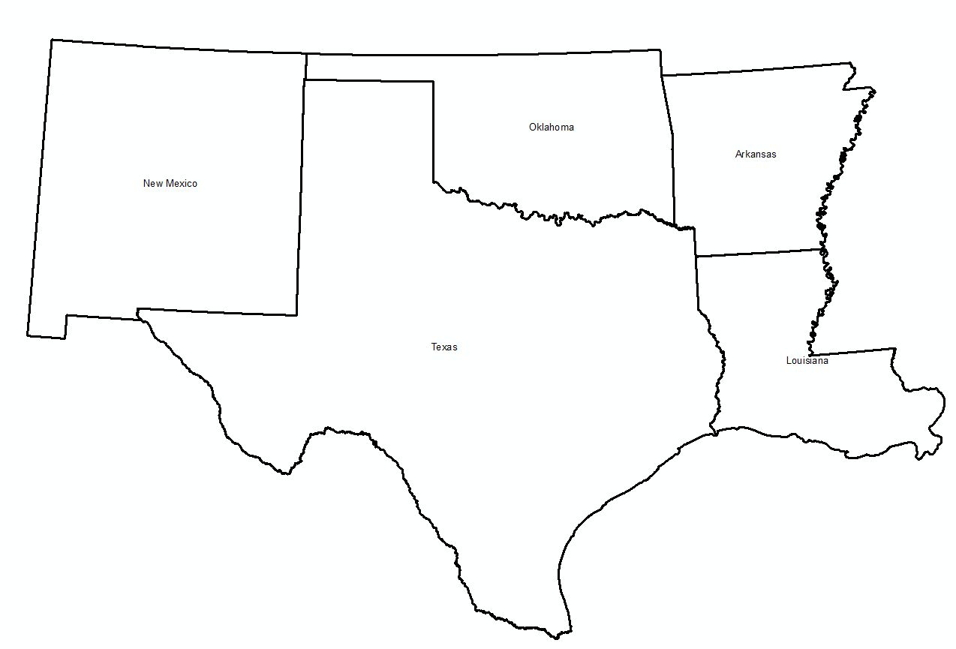
TIGER
Topologically Integrated Geographic Encoding and Referencing System
TIGER is geographic data
  State and county lines
  Updated annually
For census data, American FactFinder (http://factfinder2.census.gov )

Slide 43
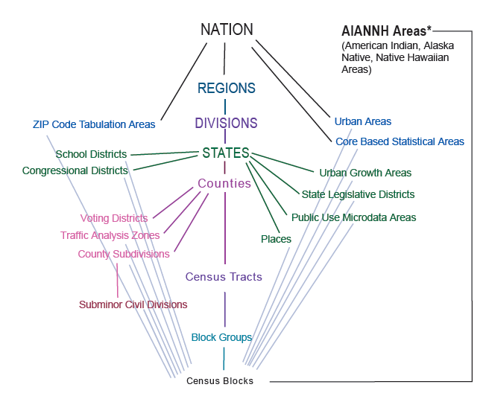
Standard Hierarchy of Census Geographic Entities

Slide 44
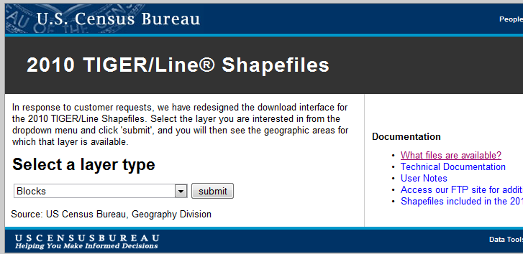
Getting TIGER Shapefiles
http://www.census.gov/cgi-bin/geo/shapefiles2010/main

Slide 45


Selecting Travis County, Texas
Pick a State
Pick a County

Slide 46

Travis County Census Tracts (218)

Slide 47

Travis County Census Blocks (15922)
Average of 73 Blocks per Tract

Slide 48

Census Blocks

Slide 49


A Census Block (38 houses)
Texas
Travis

Slide 50

Census Shapefiles with Population
ftp://ftp2.census.gov/geo/tiger/TIGER2010BLKPOPHU/
http://www.census.gov/geo/www/tiger/tgrshp2010/pophu.html

Slide 51

All the Census Blocks for a State
ftp://ftp2.census.gov/geo/tiger/TIGER2010BLKPOPHU/

Slide 52

Census Blocks for Texas (914,231)

Slide 53



Census Blocks in Travis County

Slide 54


Population and Housing Units

Slide 55


Population and Housing Units in Travis County
Population = 1,024,266
Pop/HU = 2.32
Housing Units = 441,240

Slide 56


Surface and Groundwater Systems

Slide 57

San Marcos Basin
Austin
San Antonio

Slide 58



Clip Function

Slide 59


Population of the San Marcos Basin
Population (2010) = 179,727

Slide 60

Edwards Aquifer

Slide 61


Population Living Over the Edwards Aquifer
Population (2010) = 2,352,709
Small Tracts in High Population Areas
Large Tracts in Low Population Areas

