Slide 1
Height above Nearest Drainage (HAND) Flood Inundation mapping
David Tarboton
Utah State University
dtarb@usu.edu
Acknowledgements: David Maidment, Nazmus Sazib, Xing Zheng, Yan Liu, Shaowen Wang, Ahmet Yildirim

Slide 2
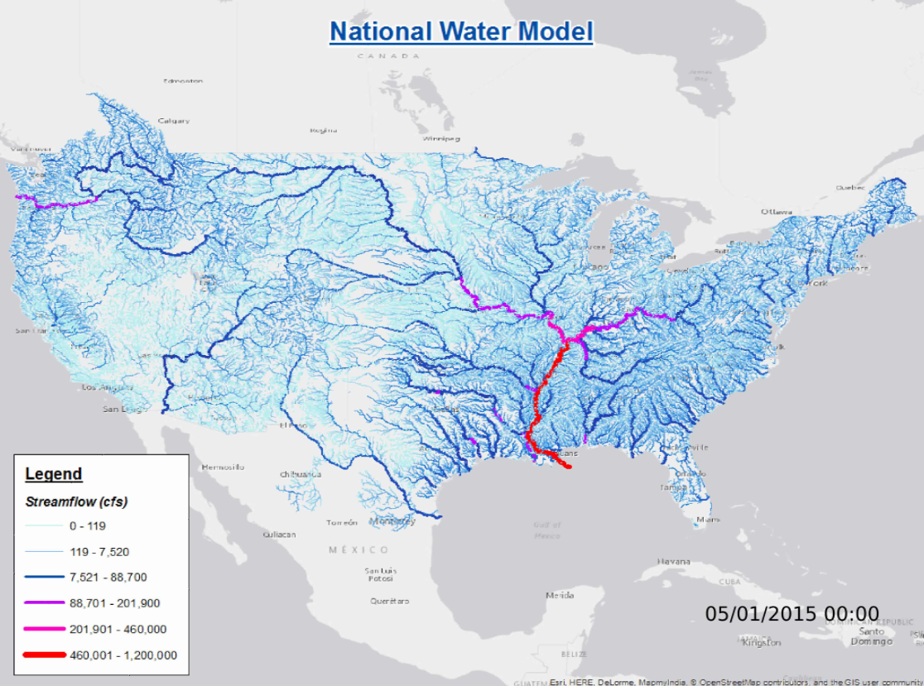
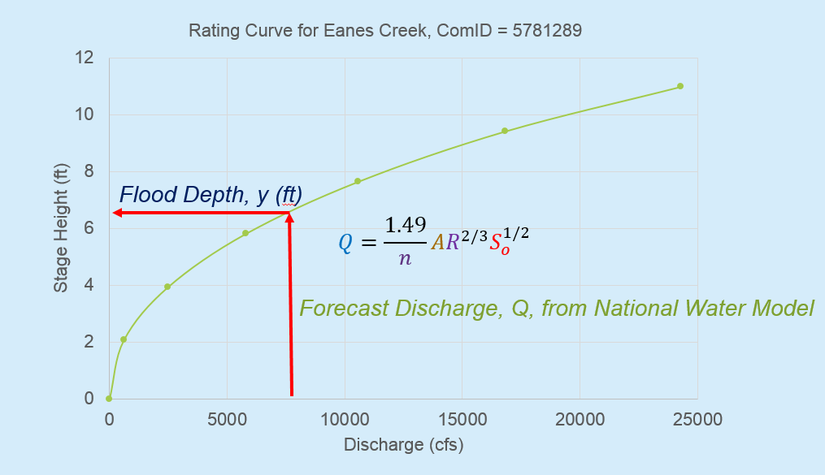
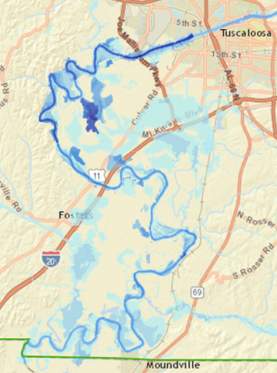
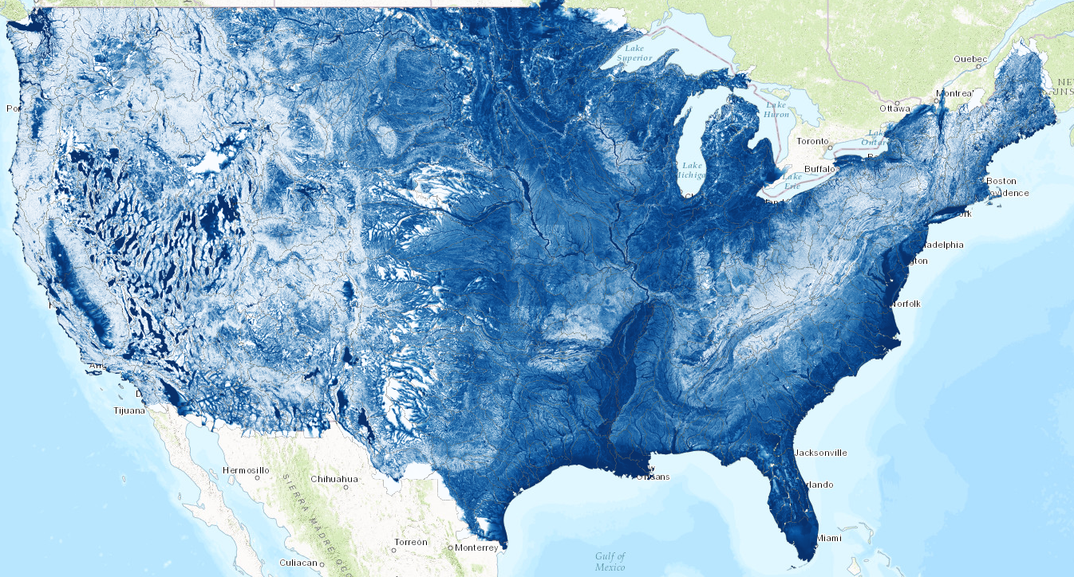
Flood Inundation Mapping
1. Forecast discharge with National Water Model
2. Convert discharge to depth using rating curve
3. Convert depth to inundation using HAND
1
2
3
Slide from David Maidment

Slide 3
Flooding occurs when Water Depth is greater than Height Above Nearest Drainage (HAND)
Address Point
Height Above
Nearest Drainage
(HAND)
Flood Depth
Normal Depth
Stream Bed
May be used to determine flood risk
Slide from David Maidment

Slide 4
Objective
The National Water Model produces flows at reach scale
Need a way to obtain reach level hydraulic properties for inputs to these models
Need a way to map from reach scale stage to flood inundation depth
Exploit high resolution topography and 1:1 relationship between stream reaches (NHD) and their catchments

Slide 5
Mapping Flood Inundation with Height above the nearest drainage (HAND)
Each stream reach has a water depth h_{w} (from a hydraulic model)
Each stream reach has an ID
Each grid cell has the ID of the reach it connects to and the height above the nearest stream h_{s}
Evaluate inundation using h_{w}-h_{s}
    If(h_{w}(id) > h_{s}(id))
      Inundation depth = h_{w}(id) - h_{s}(id)
    Else
      Inundation depth = 0
This is approximate because it neglects many details of the river hydraulics and flow over flood plains. But more detailed approaches often demand hard to obtain and uncertain inputs so this may be a helpful approach to get screening level and real time flood maps

Slide 6
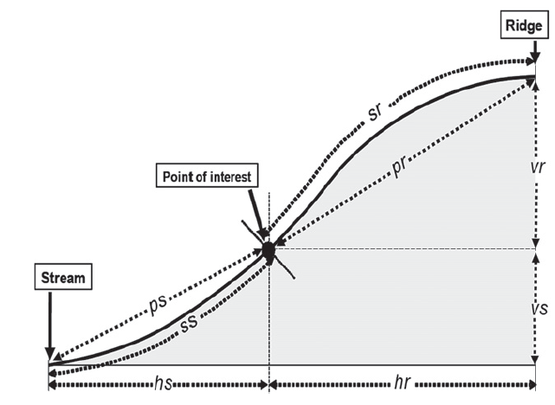
How to calculate the height above the nearest drainage?
TauDEM (http://hydrology.usu.edu/taudem)
Tesfa, T. K., D. G. Tarboton, D. W. Watson, K. A. T. Schreuders, M. E. Baker and R. M. Wallace, (2011), "Extraction of hydrological proximity measures from DEMs using parallel processing," Environmental Modelling & Software, 26(12): 1696-1709, http://dx.doi.org/10.1016/j.envsoft.2011.07.018.
Nobre, A. D., L. A. Cuartas, M. Hodnett, C. D. Rennó, G. Rodrigues, A. Silveira, M. Waterloo and S. Saleska, (2011), "Height Above the Nearest Drainage – a hydrologically relevant new terrain model," Journal of Hydrology, 404(1–2): 13-29, http://dx.doi.org/10.1016/j.jhydrol.2011.03.051.
Nobre, A. D., L. A. Cuartas, M. R. Momo, D. L. Severo, A. Pinheiro and C. A. Nobre, (2015), "HAND contour: a new proxy predictor of inundation extent," Hydrological Processes, http://dx.doi.org/10.1002/hyp.10581.

Slide 7
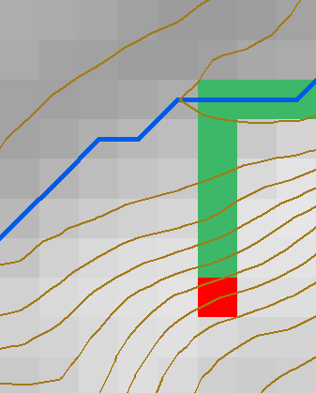
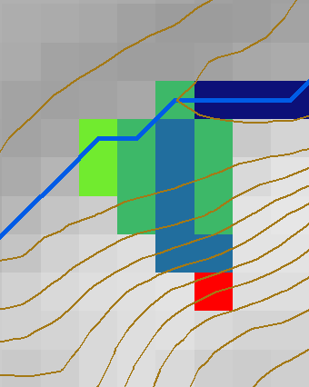
TauDEM Dinfinity Representation of Flow Field
D8
D∞
Tarboton, D. G., (1997), "A New Method for the Determination of Flow Directions and Contributing Areas in Grid Digital Elevation Models," Water Resources Research, 33(2): 309-319.)
http://hydrology.usu.edu/taudem

Slide 8
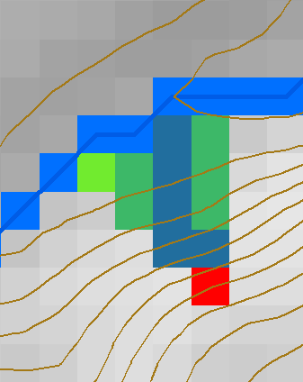
HAND evaluated using TauDEM Dinfinity Vertical Distance Down function
TauDEM Distance Down and Distance Up
Ridge
sr
sr
pr
pr
vr
Point of interest
Stream
ps
ps
ss
vs
ss
D∞
hr
hs
hr
hs
Vertical distance to stream evaluated as weighted average over multiple flow paths. This results in a “smooth” height above nearest stream layer
Tesfa, T. K., D. G. Tarboton, D. W. Watson, K. A. T. Schreuders, M. E. Baker and R. M. Wallace, (2011), "Extraction of hydrological proximity measures from DEMs using parallel processing," Environmental Modelling & Software, 26(12): 1696-1709, http://dx.doi.org/10.1016/j.envsoft.2011.07.018.

Slide 9
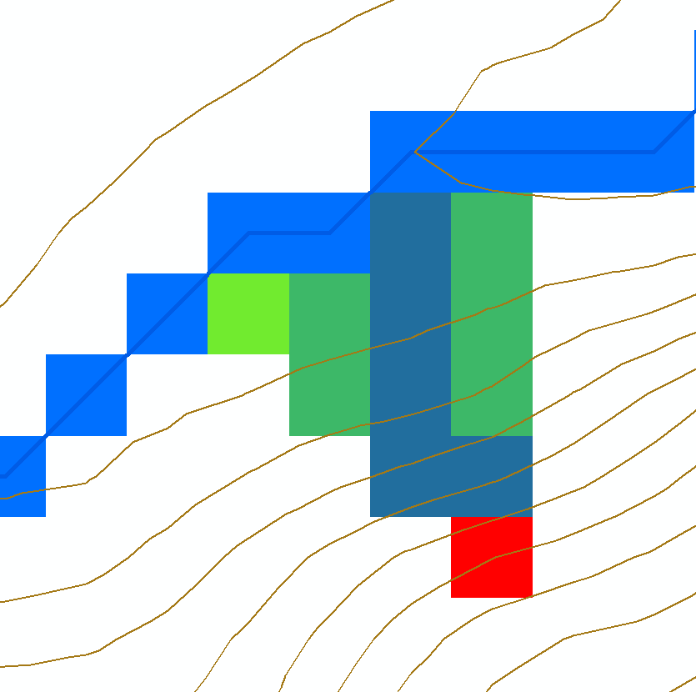
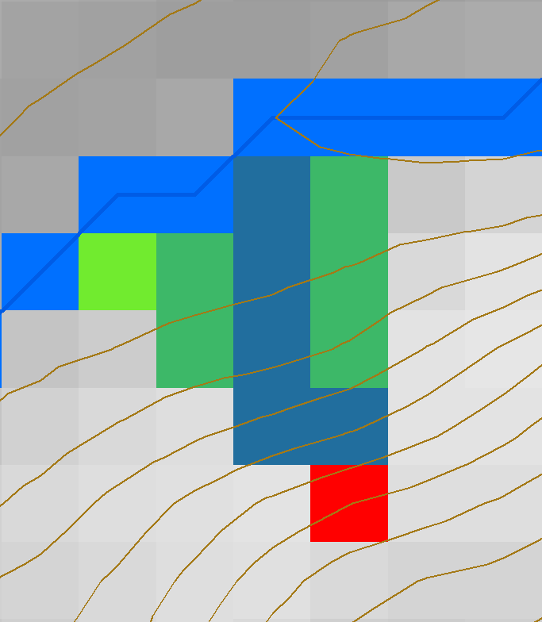





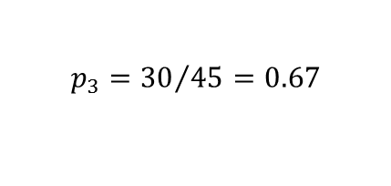
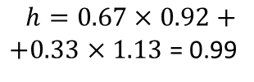

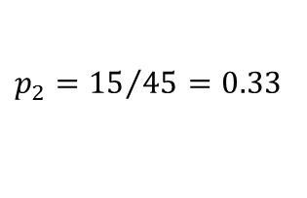
HAND Algorithm
Set h=0 along streams (target input set)
Mark remaining grid cells as “ready” if all down results are available and “not ready” if down results not yet computed
For a “ready” cell find its flow direction and elevation differences to down cells
Calculate h using weighted average
0
0
0
0
0
0
0.99
0
$$z=435.56$$
$$z=435.35$$
$$p_{3}={30}/{45}=0.67$$
$∆_{3}$=$\left(436.48−435.56\right)$=0.92
$p_{2}={15}/{45}=0.33$
$∆_{2}$=$\left(436.48−435.35\right)$=1.13
$$α=1.308 rad= 75°$$
$$z=436.48$$
$$h=0.67×0.92+$$
$+0.33×1.13$ = 0.99

Slide 10






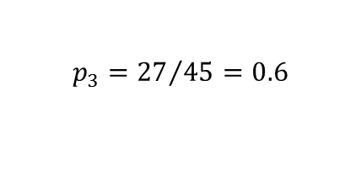

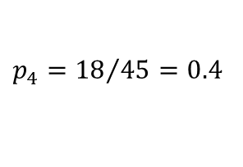

HAND Algorithm Continued
Evaluate up cells when they become “ready”
0
0
0
0
0
0
0.95
0.99
$$z=438.13$$
$$z=437.49$$
$$h=1.88$$
$$h=2.64$$
0
1.88
2.64
$p_{4}={18}/{45}=0.4$
$$p_{3}={27}/{45}=0.6$$
4.88
$$α=1.902 rad= 108°$$
$$z=440.23$$
$∆_{3}$=$\left(440.23−438.13\right)$=2.1
$∆_{4}$=$\left(440.23−437.49\right)$=2.74
$h=0.4×(2.74+1.88)+0.6×(2.1+2.64)$ = 4.88

Slide 11
Result
Elevation z (m)
HAND h (m)
436.01
435.56
0
0
436.44
436.47
436.48
0
0.92
0.99
437.15
437.49
438.13
0.71
1.88
2.64
438.65
439.20
440.22
2.20
3.31
4.68

Slide 12
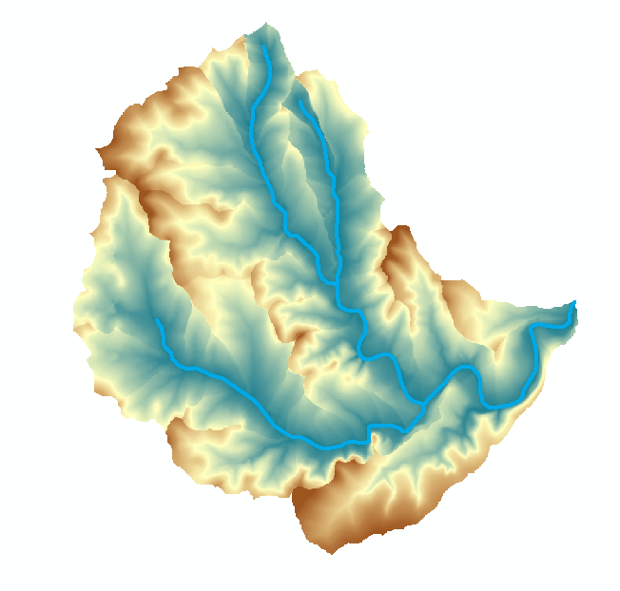

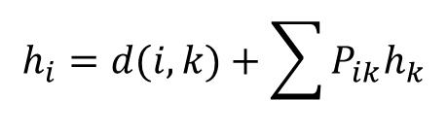

TauDEM model for vertical drop to stream (aka HAND)
$$h_{i}=0 for i on stream raster$$
$$h_{i}=d(i,k)+\sum{P_{ik}h_{k}}$$
i
P_{ik}
P_{ik}
$$d\left(i,k\right)=z_{i}−z_{k} for vertical drop$$
Could use D8 instead of Dinfinity
Could use Euclidean distances
Premised on good elevation model and consistent stream raster
Can be applied separately by catchment
  parallelism
  Incremental refinement of DEM

Slide 13
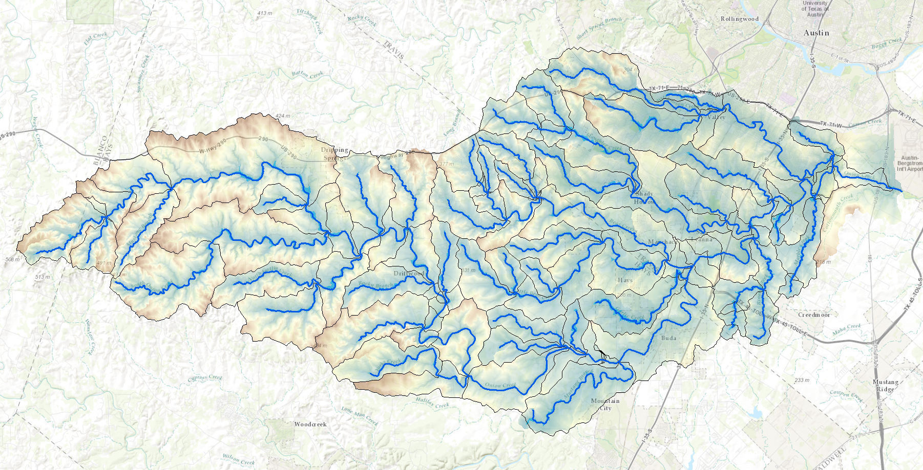
HAND from TauDEM for Onion Creek near Austin Texas
1/3 arc second NED DEM

Slide 14
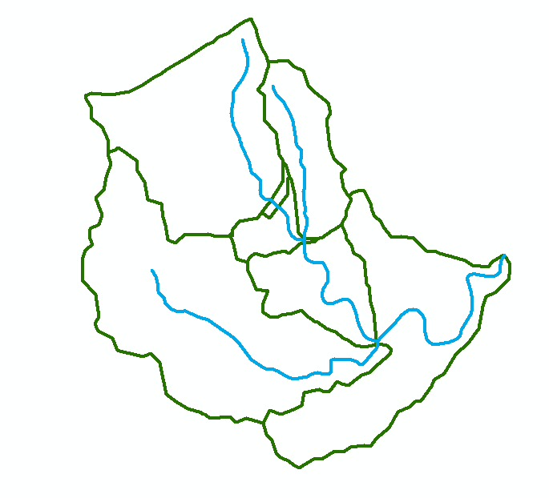
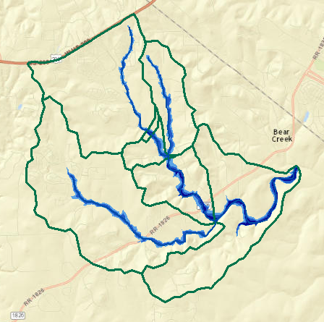
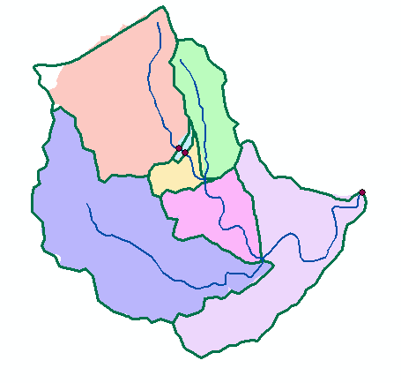
Mapping Flood Extent and Depth by Reach in each Catchment based on depth in each stream
Height above stream
(relative elevation of land surface cell above cell in stream to which it flows)
Flowlines
Reach Scale Flood Depth
Comid | Depth (ft)
5781365 | 8
5781381 | 9
5781405 | 10
5781401 | 15
5781399 | 14
5781383 | 12
5781933 | 11
Catchments
Inundation map

Slide 15
Mapping from height above nearest drainage to flood extent
Reach and Watershed id
Height above nearest drainage raster h_{HAND}
h_{w}(1) = 3.5
      depth = h_{w}(id) - h_{s}(id)
      = 1.5-1 = 0.5
h_{w}(2) = 2.5
h_{w}(3) = 1.5
Notes:
Elevations are filled to that of the pools pour point

Slide 16
From NHD-HAND to Inundation
Inundation Extent
Water Depth Raster
3 | 2 | 3 | 6 | 7 | 13 | 15
6 | 0 | 0 | 0 | 3 | 11 | 17
14 | 7 | 1 | 0 | 4 | 9 | 16
19 | 13 | 4 | 2 | 0 | 4 | 4
17 | 15 | 13 | 4 | 1 | 0 | 0
16 | 16 | 15 | 12 | 7 | 5 | 3
18 | 17 | 19 | 17 | 17 | 11 | 7
2 | 3 | 2
 | 5 | 5 | 5
 |  | 4 | 5 | 1
 |  | 1 | 3 | 5 | 1 | 1
 |  |  | 1 | 4 | 5 | 5
 |  |  |  |  | 0 | 2
h_{HAND}<=H_{stage}
y_{water}=H_{stage}-h_{HAND}
Slide from David Maidment

Slide 17
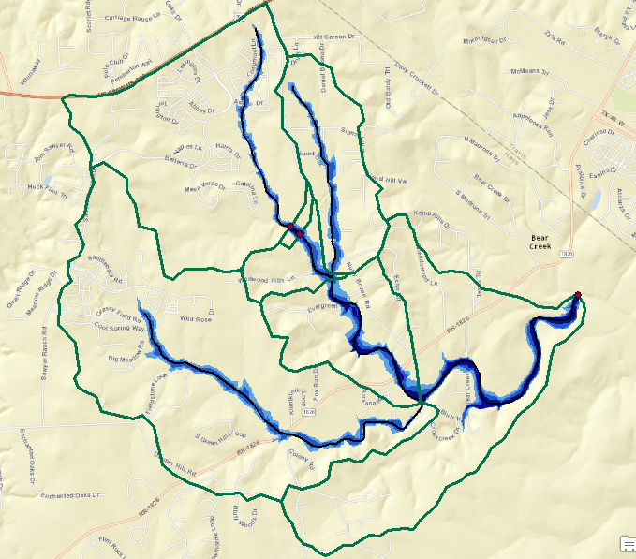
Reach based height above nearest stream flood map example
h_{w}=8 ft
h_{w}=9 ft
h_{w}=11 ft
h_{w}=12 ft
h_{w}=14 ft
h_{w}=10 ft
h_{w}=15 ft

Slide 18
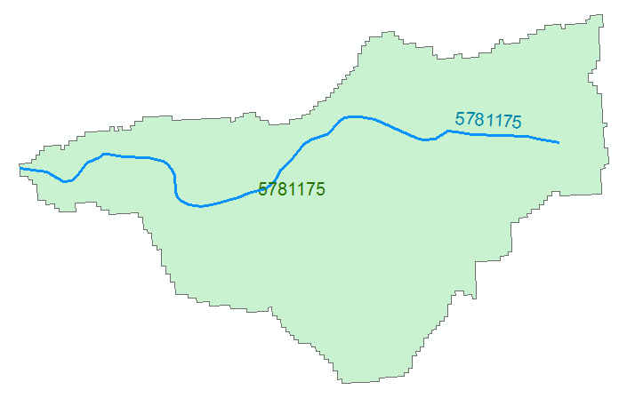


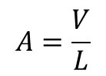


Reach Scale River Hydraulic Properties
Comid | H | A | R | P | T | V | Ab | As
5781175 | 3
5781175 | 4
A table with reach hydraulic parameters as keyed to hydrography
Derived from DEM, LIDAR or HEC RAS cross sections
A_{s}
Surface Area
Wetted Bed Area
L
V
Volume
A_{b}
T
$$A=\frac{V}{L}$$
Cross Section Area
Depth
h
A
P
P$=\frac{Ab}{L}$
Wetted Perimeter
T$=\frac{As}{L}$
Top Width
R$=\frac{A}{P}$
Hydraulic Radius
Slide from David Maidment

Slide 19

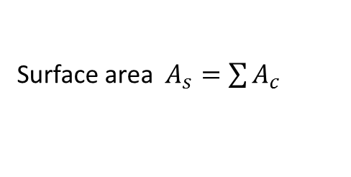

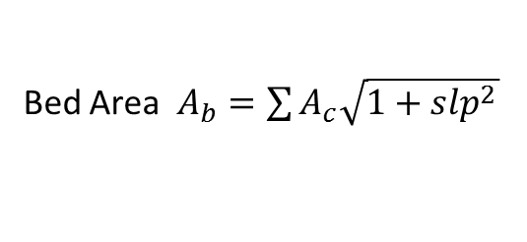
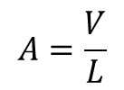
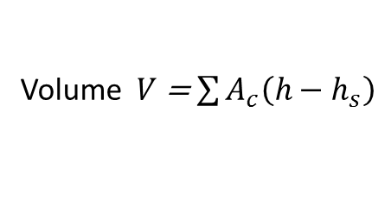


Terrain based derivation of “reach scale” hydraulic properties
For each Catchment
For each height h
Identify cells where h_{s} < h
A_{s}
Surface Area
Single Cell Plan Area $A_{c}$ =dx * dy
Surface area $A_{s}=\sum{A_{c}}$
Bed Area $A_{b}=\sum{A_{c}\sqrt{1+slp^{2}}}$
Wetted Bed Area
L
A_{b}
Approximates each cell as sloping plane
V
Volume
Volume $V$ = $\sum{A_{c}\left(h−h_{s}\right)}$
T
$$A=\frac{V}{L}$$
Cross Section Area
A
P$=\frac{Ab}{L}$
Wetted Perimeter
P
T$=\frac{As}{L}$
Top Width
R$=\frac{A}{P}$
Hydraulic Radius
Based on slide from David Maidment

Slide 20


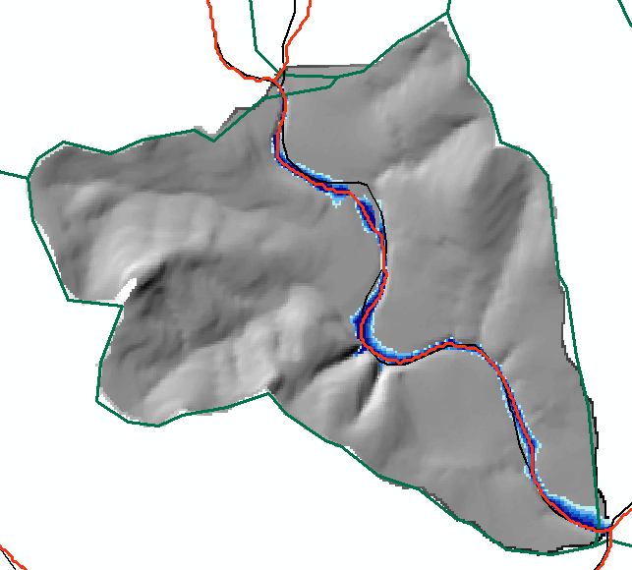
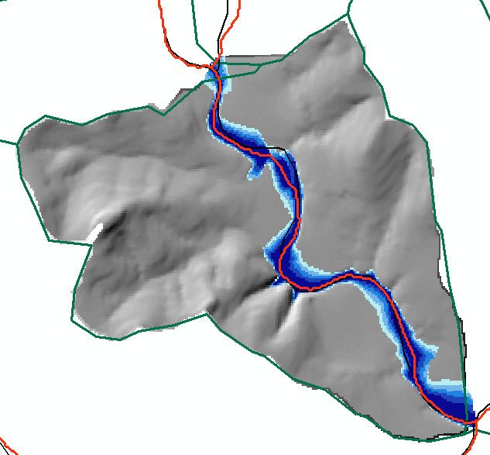
Reach Hydraulic Properties Example
1 m inundation
3 m inundation
Height (m) | A_{s} (m²) | Vol (m³) | A_{b} | L (m) | A=V/L (m²) | P=A_{b}/L (m) | T=A_{s}/L (m) | R=A/P (m)
1 | 129878 | 79466 | 129948 | 2975 | 26.7 | 43.7 | 43.7 | 0.612
3 | 319877 | 530378 | 320414 | 2975 | 178.3 | 107.7 | 107.5 | 1.655

Slide 21
Terrain Approximated Reach Average Hydraulic Properties
Hydraulic Radius
Wetted Perimeter
Cross-sectional Area
Top Width
Need for input to reach scale hydraulic model

Slide 22
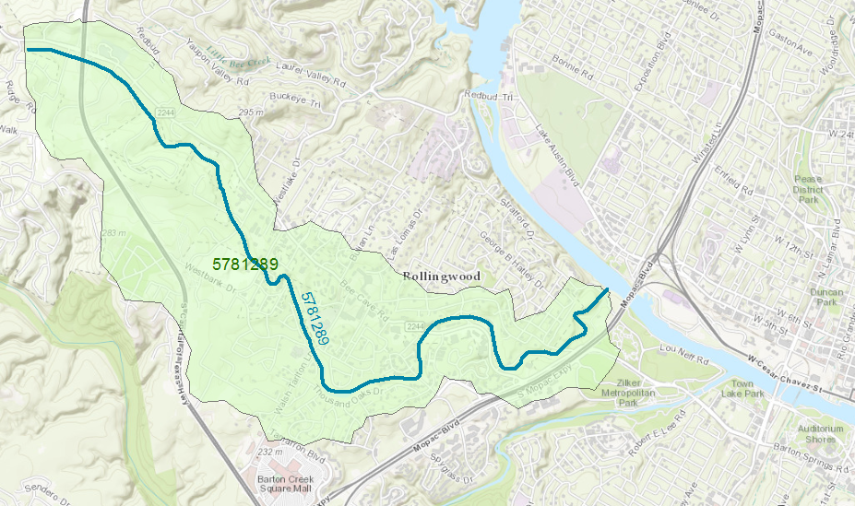
Reach Catchment 5781289
Eanes Creek, Rollingwood, Texas
Drainage area = 3.13 mi²
Reach Length = 4.3 miles
Slide from David Maidment

Slide 23
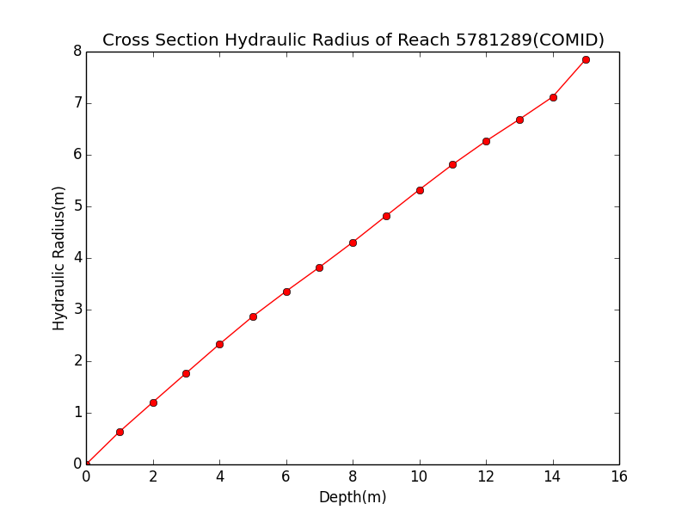
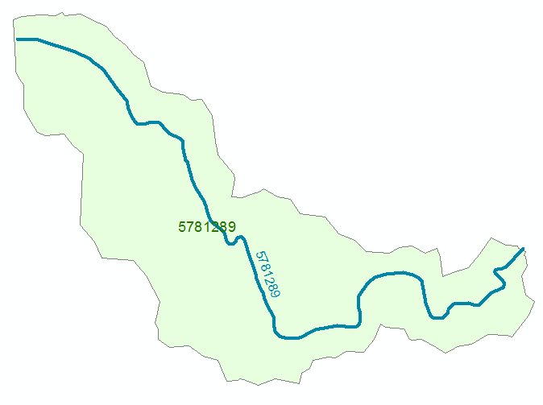
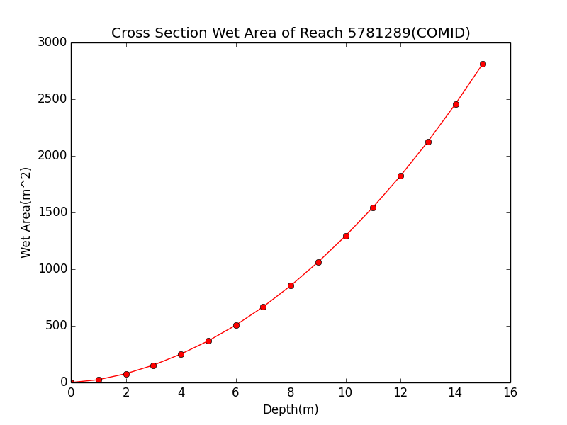
Discharge Computation
Hydraulic Radius, R
Flood Discharge, Q (cfs)
$$Q=\frac{1.49}{n}AR^{2/3}S_{o}^{1/2}$$
Flood Depth, h (ft)
Cross section Area, A
n = 0.035 Manning roughness of channel
S_{o} = 0.0163 Bed slope
Slide from David Maidment

Slide 24
Rating Curve for Eanes Creek
Flood Depth, y (ft)
$$Q=\frac{1.49}{n}AR^{2/3}S_{o}^{1/2}$$
Forecast Discharge, Q, from National Water Model
Slide from David Maidment

Slide 25
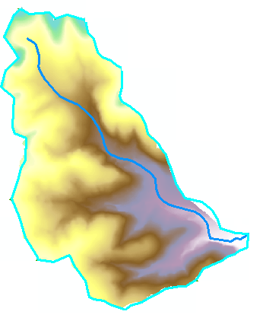
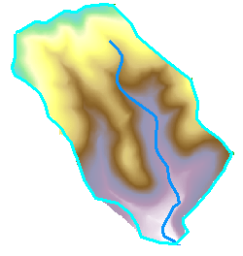
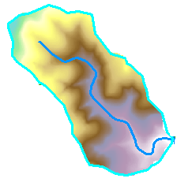
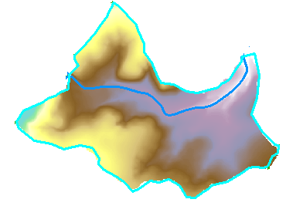
Decompose computation by catchments or River Corridor
Parallel computation
High resolution in some areas
Incremental improvement

Slide 26
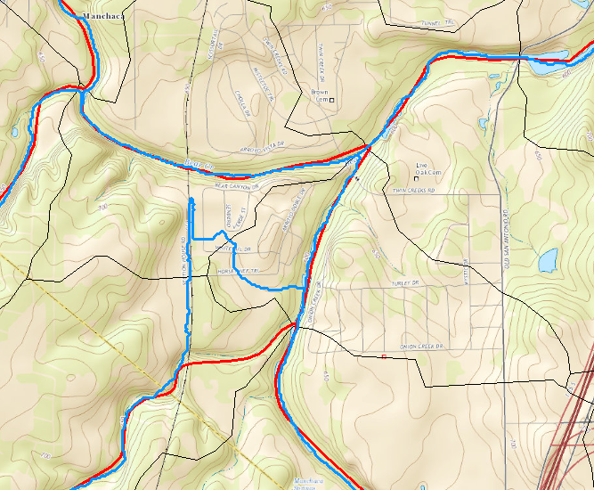
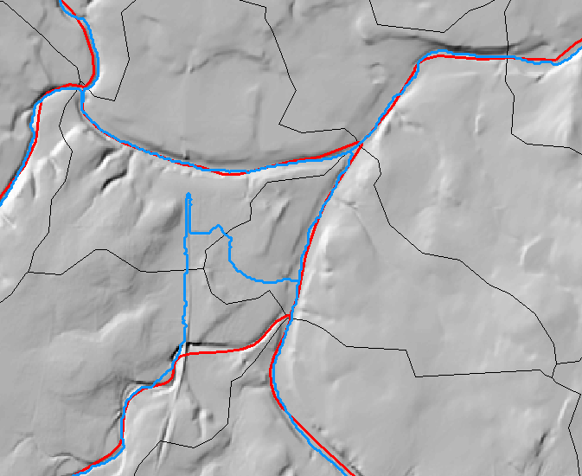

DEM Flowlines challenged by road barriers
Need for hydrography conditioned DEM

Slide 27
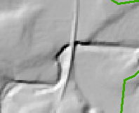
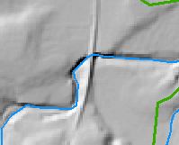
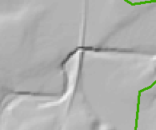
Obstacle Removal using NHD HR
48 | 48 | 49 | 48 | 47
48 | 46 | 50 | 46 | 45
47 | 45 | 51 | 43 | 39
44 | 40 | 51 | 47 | 47
41 | 45 | 52 | 48 | 48
48 | 48 | 49 | 48 | 47
48 | 46 | 50 | 46 | 45
47 | 45 | 51 | 43 | 39
44 | 40 | 51 | 47 | 47
41 | 45 | 52 | 48 | 48
48 | 48 | 49 | 48 | 47
48 | 46 | 50 | 46 | 45
47 | 45 | 40 | 40 | 39
44 | 40 | 51 | 47 | 47
41 | 45 | 52 | 48 | 48
Obstacles, like this railroad that are present in DEM are removed tracing down NHD HR streams ensuring that elevation never increases along a stream.

Slide 28
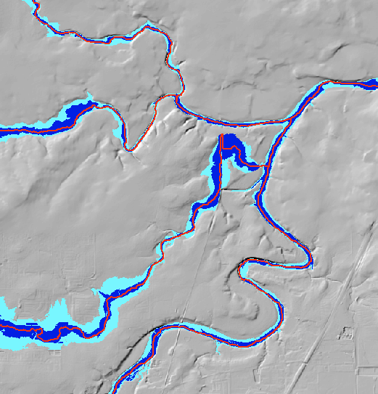
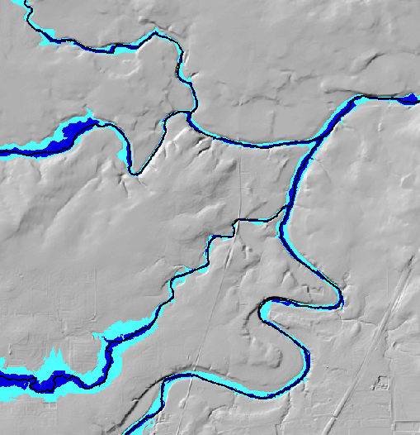
Effect of obstacle removal
Before
After
HAND inundation based on raw 10 m NED DEM
Hand inundation for 10 m NED DEM with obstacles removed using NHD HR

Slide 29
Complete HAND Workflow
USGS 3DEP 10m DEM
NHD HR Flowline
1:24000
NHDPlus Flowline
1:100000
Obstacle Removal
Pit Removal
Channel Head Extraction
D∞ Flow Direction
D8 Flow Direction
Rasterization
D8 Flow Accumulation
Channel Head Weight Grid
Stream Definition by Threshold
D∞ Flow Direction
Raster
D∞ Distance Down
(Vertical Average)
Stream Raster
HAND Raster
Catchment Features
Flood Inundation Mapping

Slide 30
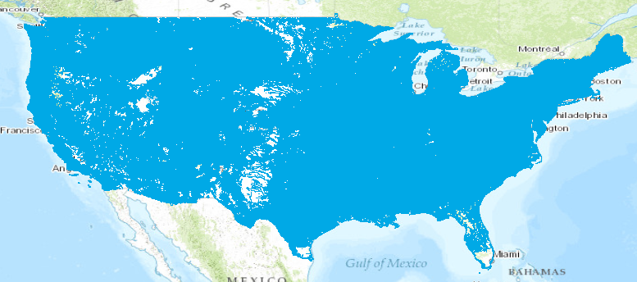
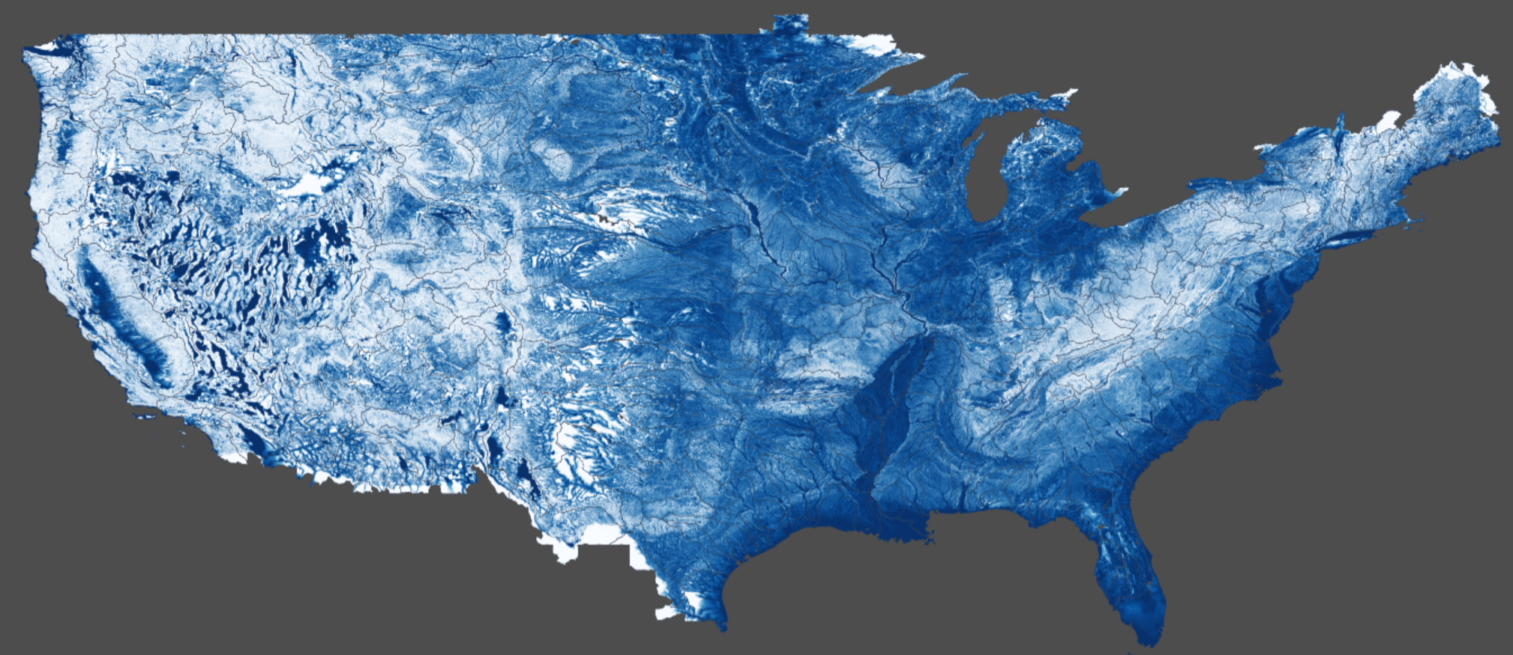
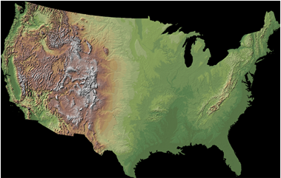

Continental-Scale HAND layer evaluated on ROGER supercomputer at NCSA
Catchments and Flowlines
Height Above Nearest
Drainage (HAND)
(relative elevation of land
surface cell above cell in
stream to which it flows)
Digital Elevation Model
Slide from David Maidment

Slide 31
Conclusions
The height above nearest stream approach suggested as way to rapidly approximate real time flood inundation
Includes an approach to approximate reach scale hydraulic properties
DEM topography should represent river bed elevations to maximal extent possible
Research ways to align and reconcile elevation and hydrography (present obstacle removal approach not ideal)
Investigate incorporating high resolution (e.g. LIDAR) data in areas where accuracy is critical

