Slide 1
Water Information Sharing and HydroShare
HydroShare: Advancing Hydrology through Collaborative Data and Model Sharing
David Tarboton, Ray Idaszak, Jeffery Horsburgh, Dan Ames, Jon Goodall, Larry Band, Venkatesh Merwade, Alva Couch, Rick Hooper, David Maidment, Pabitra Dash, Michael Stealey, Hong Yi, Tian Gan, Tony Castronova, Brian Miles, Zhiyu Li, Mohamed Morsy, Shaowen Wang, Yan Liu
USU, RENCI, BYU, UNC, UVA, CUAHSI, Tufts, Texas, Purdue, Caktus, NCSA
http://www.hydroshare.org
ACI-1148453
ACI-1148090
2012-2017

Slide 2
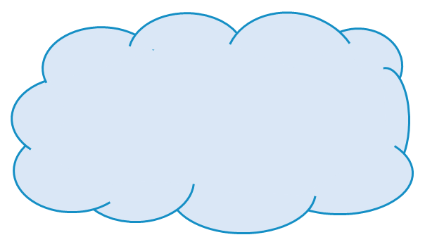
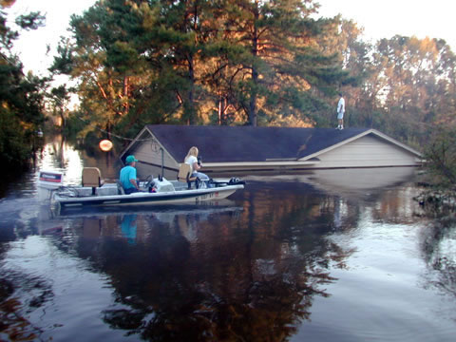
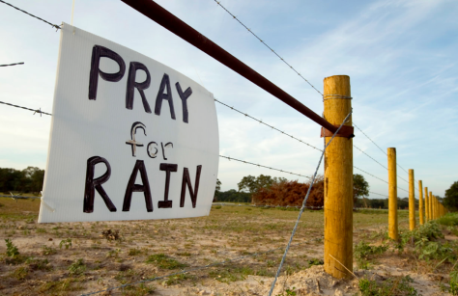
Motivation: Hydrologic research is a team sport
Advancing Hydrologic Understanding
requires integration of information from multiple sources
is data and computationally intensive
requires collaboration and working as a team/community
Analysis
Data
Models
Grand challenge (NRC 2001): Better hydrologic forecasting that quantifies effects and consequences of land surface change on hydrologic processes and conditions
Predicting and protecting against Floods and Droughts

Slide 3
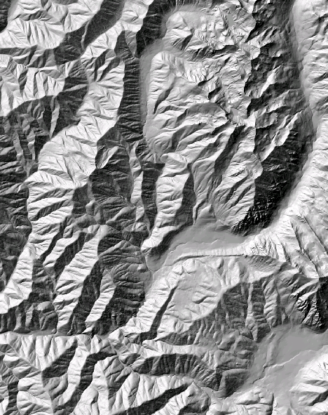
The challenge of large data sizes Digital Elevation Model (DEM) resolution
e.g. 50,000 km²
Watershed
1980’s DMA 90 m
10² cells/km²
27 MB
1990’s USGS DEM 30 m
10³ cells/km²
240 MB
2000’s NED 10 m
10⁴ cells/km²
2 GB
2010’s LIDAR ~1 m
10⁶ cells/km²
200 GB
A factor 10,000 increase in 30 years

Slide 4
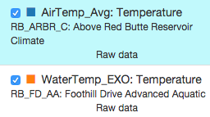
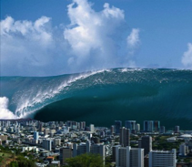
The Data Deluge
One week = 672 observations
One day = 96 observations
One month = 2880 observations
One year = 35,040 observations
So far (~1.5 years) = 55,000+ observations
Times 14 Aquatic Sites with ~26 Variables
Times 14 Climate Sites with ~74 Variables
Plus different versions of the data (raw versus checked) = 43,400,000+ observations
You need some infrastructure to manage and share the data.
From Jeff Horsburgh
Notes:
So, let’s talk about the volume of data being generated in the network.

Slide 5
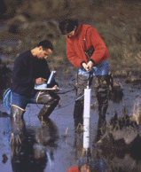
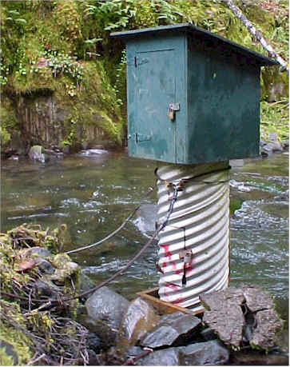
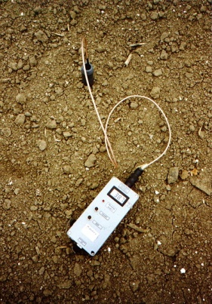
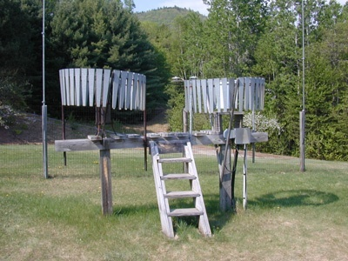
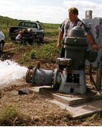
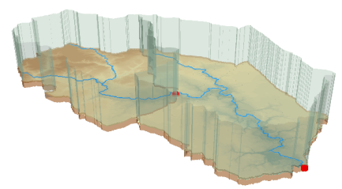
The challenge of data heterogeneity
Water quality
Water quantity
From dispersed federal agencies
From investigators collected for different purposes
Different formats
Points
Lines
Polygons
Fields
Time Series
Rainfall and Meteorology
Soil water
Groundwater
The way that data is stored can enhance or inhibit the analysis that can be done
We need ways to organize the data we work with
Data models
GIS

Slide 6
The way that data is organized can enhance or inhibit the analysis that can be done
I have your information right here …
Picture from: http://initsspace.com/

Slide 7
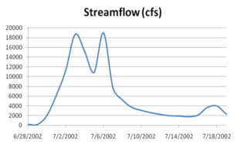
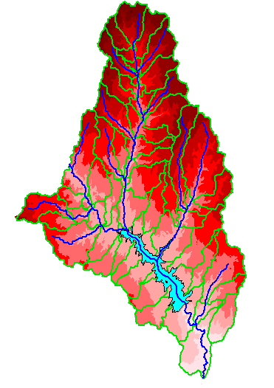
Hydrologic Science
It is as important to represent hydrologic environments precisely with
data as it is to represent hydrologic processes with equations
Physical laws and principles
(Mass, momentum, energy, chemistry)
Hydrologic Process Science
(Equations, simulation models, prediction)
Hydrologic conditions
(Fluxes, flows, concentrations)
Hydrologic Information Science
(Observations, data models, visualization
Hydrologic environment
(Physical earth)
From David Maidment

Slide 8
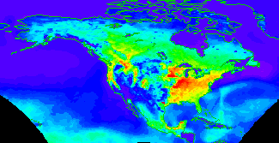
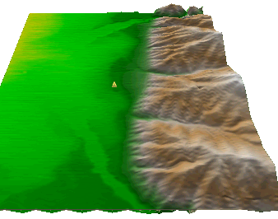
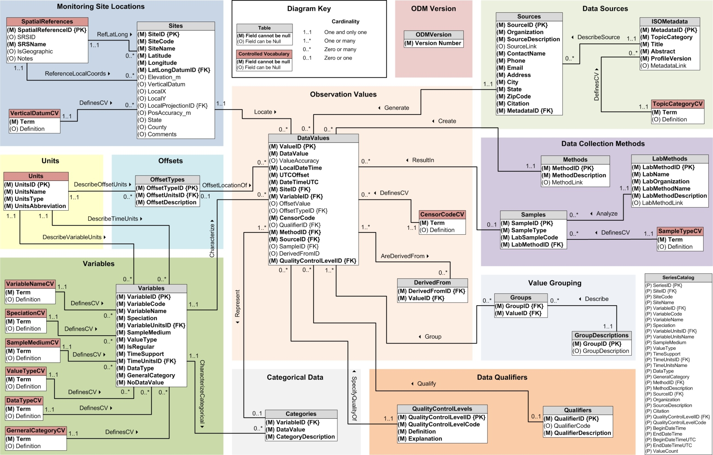
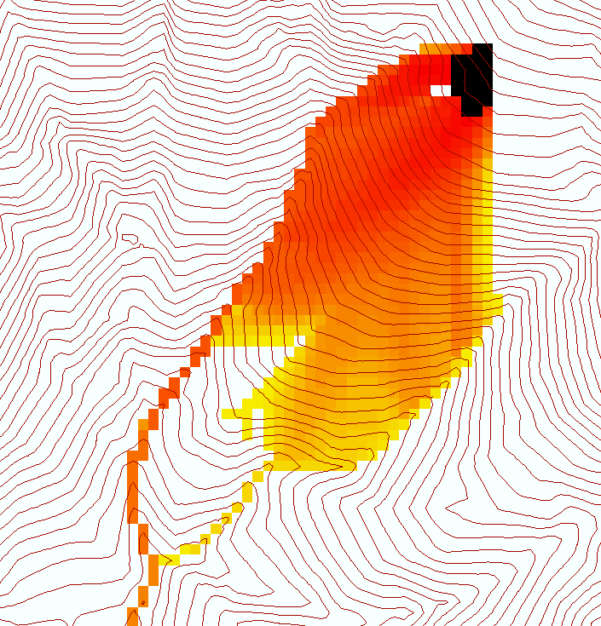
Data models organize the diversity of natural systems
NetCDF (Unidata) - A model for Continuous Space-Time data
ArcHydro – A model for Discrete Space-Time Data
Time, TSDateTime
Time, T
Coordinate
dimensions
{X}
TSValue
D
Space, FeatureID
Space, L
CUAHSI Observations Data Model: What are the basic attributes to be associated with each single data value and how can these best be organized?
Variables, TSTypeID
Variables, V
Variable dimensions
{Y}
Terrain Flow Data Model used to enrich the information content of a digital elevation model

Slide 9
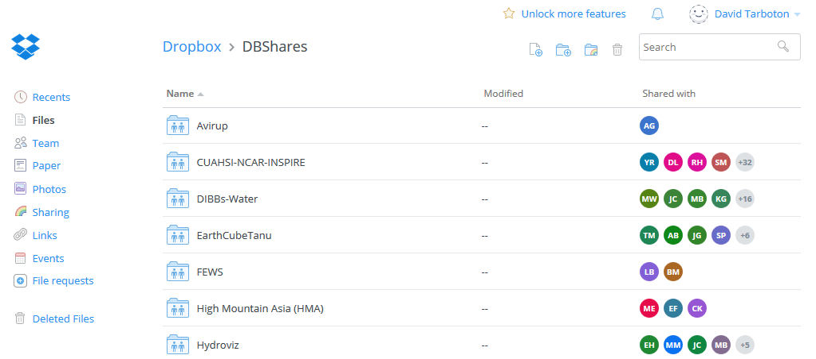
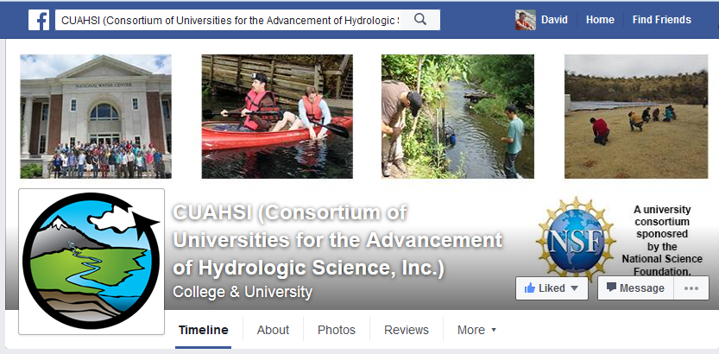
How do people share other content now
YouTube
Facebook
Instagram
Drop Box
Google Drive
ArcGIS Online
Hydrologic data ?
From Jeff Horsburgh

Slide 10
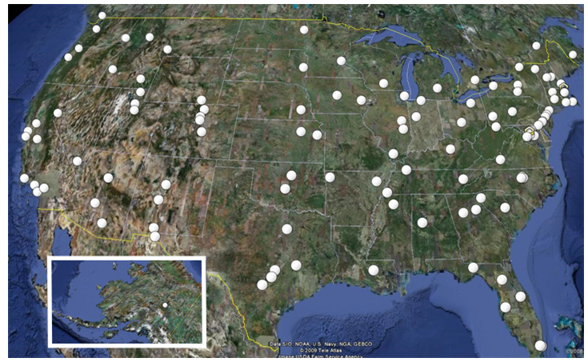
CUAHSI
Consortium of Universities for the Advancement of Hydrologic Science, Inc.
111 US University members
7 affiliate members
19 International affiliate members
An organization representing more than one hundred United States universities, receives support from the National Science Foundation to develop infrastructure and services for the advancement of hydrologic science and education in the U.S.

Slide 11
What is HIS?
HIS = Hydrologic Information System
The CUAHSI* Hydrologic Information System (HIS) provides web services, tools, standards and procedures that enhance access to more and better data for hydrologic analysis.
http://his.cuahsi.org
Notes:
HIS helps you discover and access hydrologic data.

Slide 12
Major Challenges Addressed by CUAHSI HIS
How do I find and access hydrologic observations for use in my work?
How can I store, manage, and share hydrologic observations in a way that makes my life easier and in a way that others could use them?

Slide 13
Finding Information on the Internet
Catalogs
Catalog
Publish/Register
Find
Access
Server
Desktop
Servers
Desktops, Clients, Browsers

Slide 14
CUAHSI Hydrologic Information System
HydroCatalog
Data Discovery and Integration
Metadata Services
WaterML, Other OGC Standards
Search Services
HydroServer
HydroDesktop
Data Publication
Data Services
Data Analysis and Synthesis
Information Model and Community Support Infrastructure

Slide 15
What are the basic attributes to be associated with each single data value and how can these best be organized?
DateTime
Interval (support)
“When”
Time, T
t
A data value
v_{i} (s,t)
Variable
Method
Quality Control Level
Sample Medium
Value Type
Data Type
Source/Organization
“Where”
Location
Feature of interest
Latitude
Longitude
Site identifiers
s
Space, S
V_{i}
“What”
Variables, V
Units
Accuracy
Censoring
Qualifying comments

Slide 16
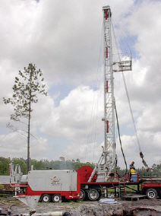
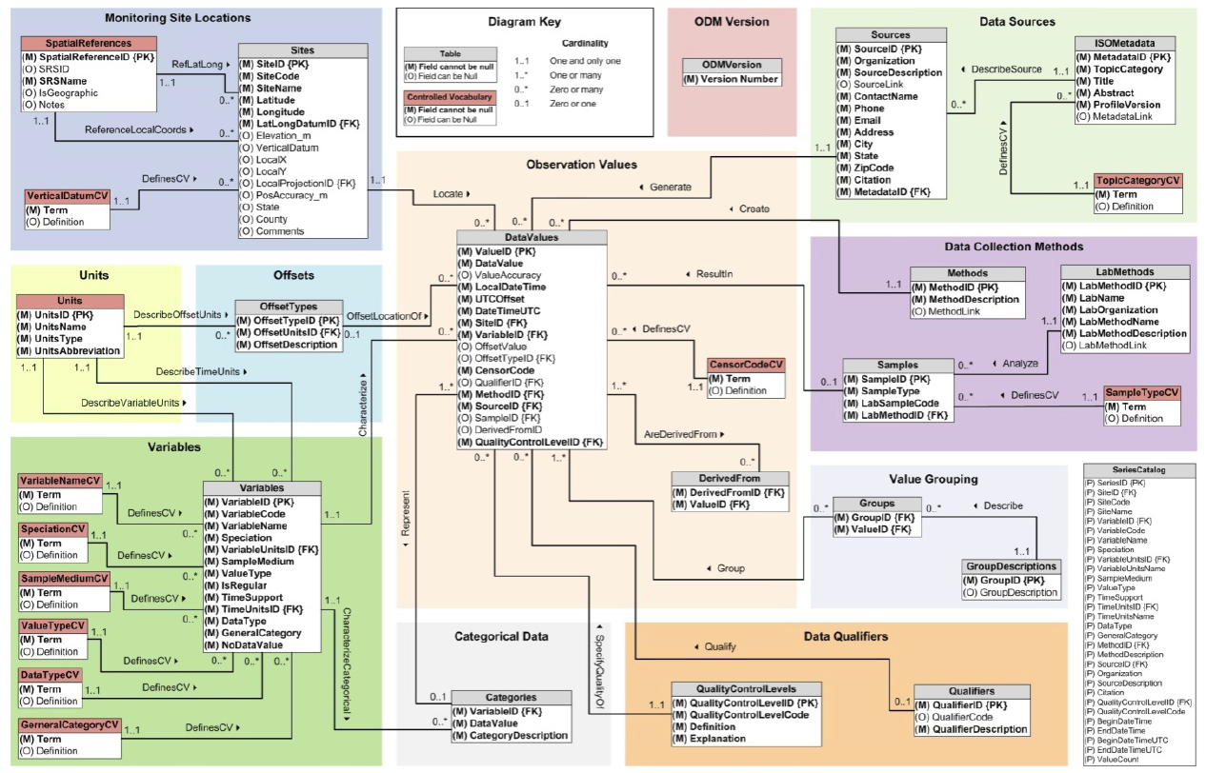
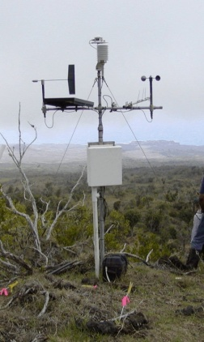
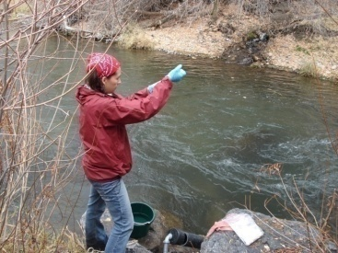
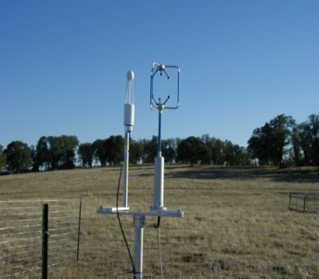
Observations Data Model (ODM)
Streamflow
Groundwater
levels
Precipitation
& Climate
Soil
moisture
data
Water Quality
Flux tower data
A relational data model at the single observation level
Metadata for unambiguous interpretation
Traceable heritage from raw measurements to usable information
Promote syntactic and semantic consistency
Cross dimension retrieval and analysis
Horsburgh, J. S., D. G. Tarboton, D. R. Maidment, and I. Zaslavsky (2008), A relational model for environmental and water resources data, Water Resources Research, 44, W05406, doi:10.1029/2007WR006392.

Slide 17
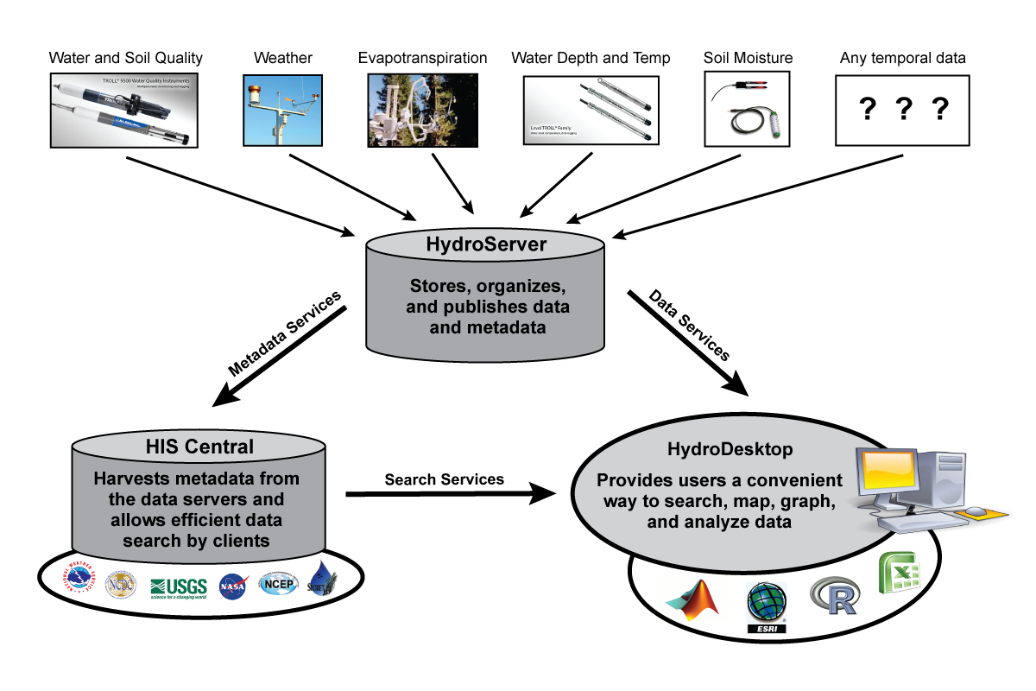
CUAHSI HIS Enabling Water Data Discovery
From Jeff Horsburgh

Slide 18
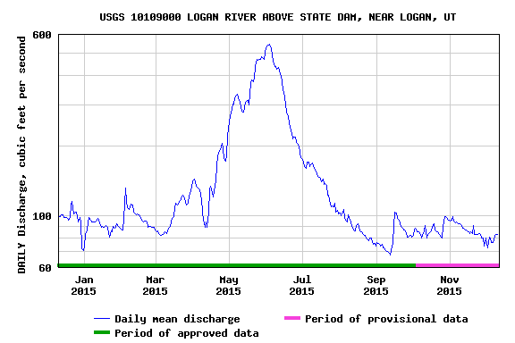
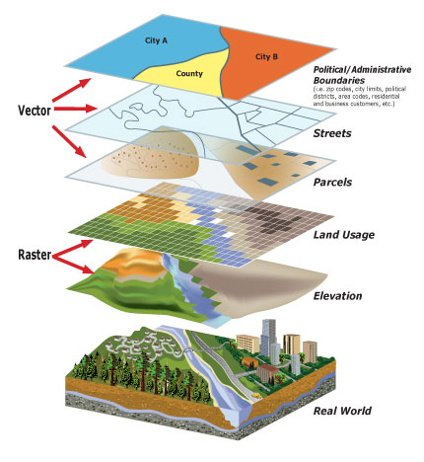
Data and models used by hydrologists are diverse…
Time series
Geographic rasters
Geographic features
Multidimensional space/time
Model programs
Model instances
…
http://www.usgs.gov
http://www.unidata.ucar.edu
http://www.esri.com
From Jeff Horsburgh
Notes:
But, the data we use are diverse, and we don’t currently have a lot of options for sharing models or model instances. We’ve nailed time series down, but we still don’t have great cyberinfrastructure embraced by our community that supports the broad spectrum of data and models we use.

Slide 19
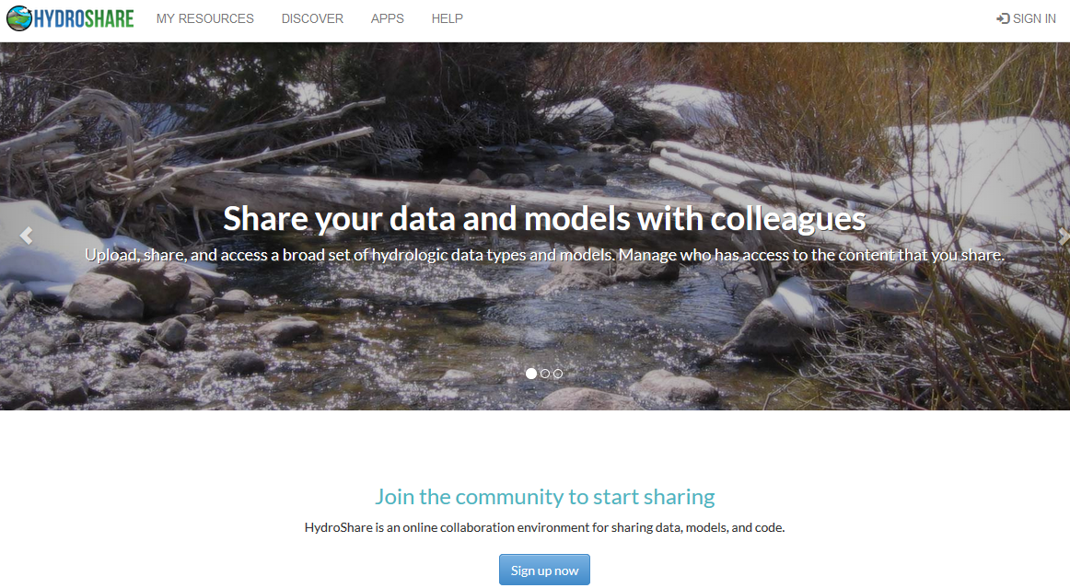
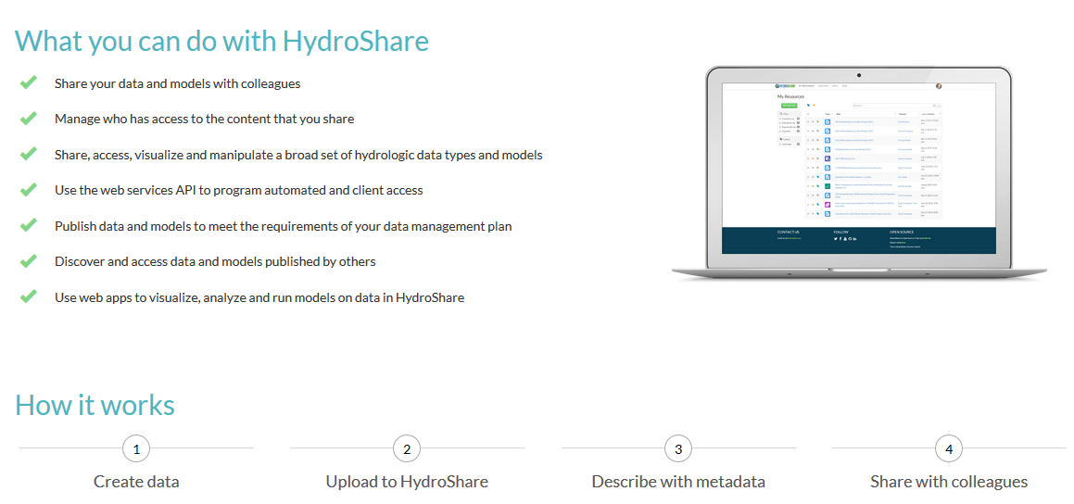
HydroShare is a collaborative environment for data sharing, analysis and modeling
Share your data and models with colleagues
Manage who has access to the content that you share
Share, access, visualize and manipulate a broad set of hydrologic data types
Sharing and execution of models
Access to and use of high performance computing
Publication of data and models with a DOI
Our goal is to make sharing of hydrologic data and models as easy as sharing videos on YouTube or shopping on Amazon.

Slide 20
HydroShare is a system for sharing Hydrologic Resources and Collaborating
Files and sets of files structured to represent a hydrologic process, model, or element in the hydrologic environment
Standard data models enhance interoperability and support functionality “hydro value added”
Tools (Web apps) that act on resources to visualize, modify and create new resources
Encode standard/best practices
Access control and sharing model
Resource exploration
Actions on Resources
Django website
Hydro-Share Apps
iRODS “Network File System”
Resource storage

Slide 21
Definition of Data
In OMB Circular A-110 research data is defined as “recorded factual material commonly accepted in the scientific community as necessary to validate research findings, but not any of the following: preliminary analyses, drafts of scientific papers, plans for future research, peer reviews, or communications with colleagues.”
Validating research findings may involve
Observations and measurements
Models, code and scripts
Simulation results
HydroShare resources need to accommodate all these types of “data”

Slide 22
In HydroShare you can now
Share your data and models with colleagues
Manage who has access to the content that you share
Share, access, visualize and manipulate a broad set of hydrologic data types and models
Use the web services API to program automated and client access
Publish data and models to meet the requirements of your data management plan and receive a citable digital object identifier (DOI)
Discover and access data and models published by others
Use web apps to visualize, analyze and run models on data in HydroShare
Demo

Slide 23
How HydroShare Works
Organize and annotate your content
Manage access
Web software to operate on content you have access to (Apps)
Extensibility
Django website
API
HydroShare Apps
Resource exploration
Actions on Resources
OAuth
API
API
Anyone can set up a server/app platform (software service) to operate on HydroShare resources through iRODS and API
Distributed file storage
iRODS “Network File System”
SWATShare (Hubzero)
CyberGIS
Unidata - THREDDS, Hyrax
Landlab ?
Parallels the paradigm for how PC’s are used
HydroShare
Data Store
CyberGIS
Data Store

Slide 24
HydroShare Functionality
Sharing and publication of data (DOI)
Social discovery and added value
Model sharing
Model input data preparation
Model execution
Visualization and analysis (best of practice tools)
Collaboration, Reproducibility, Credit, Transparency
Clearing your desk!
Server/Cloud Computation
Platform independence
Big data
Reproducibility
Reduce needs for software installation and configuration

Slide 25
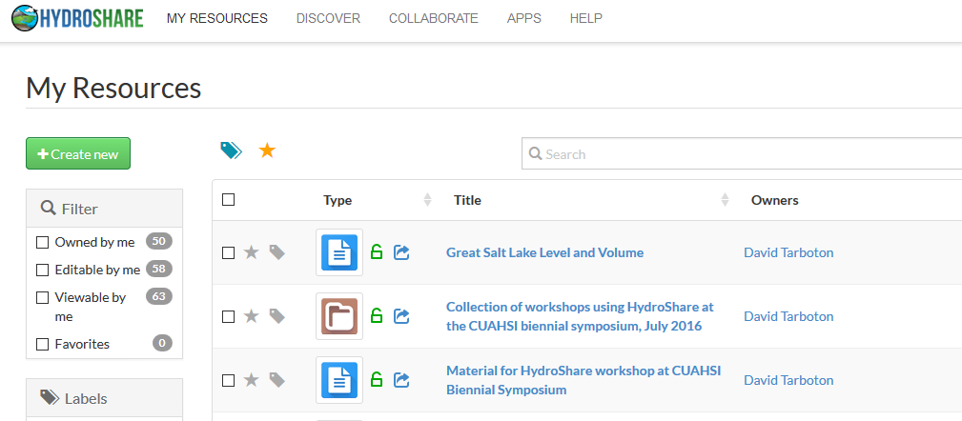
Collaborative data sharing
Add content to HydroShare to share with your colleagues or formally publish to document result reproducibility

Slide 26
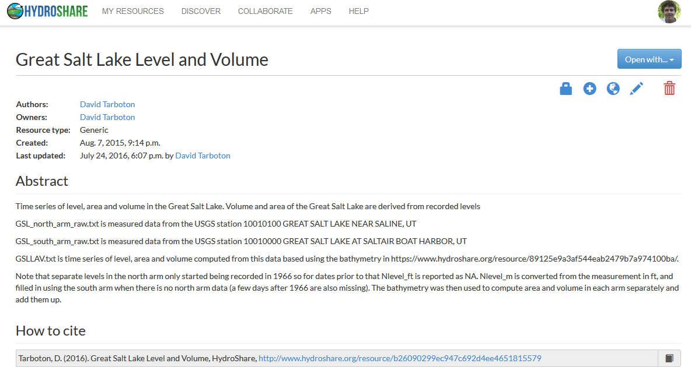
Resources (data and models) in HydroShare are objects of collaboration (social objects)
For each resource you can
Manage who has access
To edit
To view
Comment or rate
Get unique identifier
Describe with metadata
Organize into collections
Formally publish
Version
Open with compatible web app

Slide 27
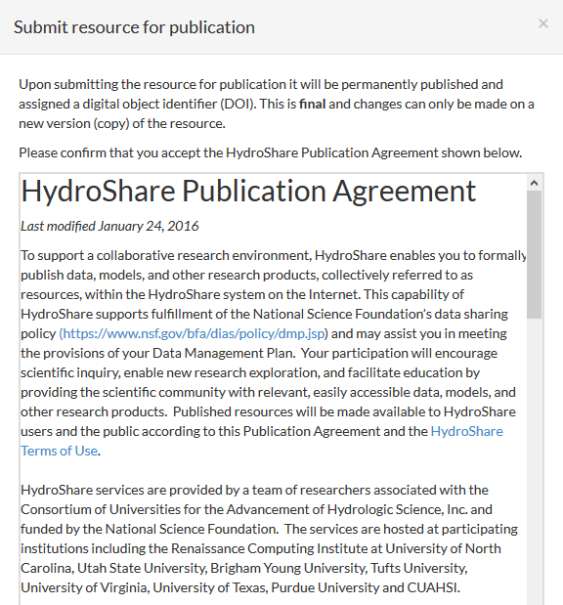
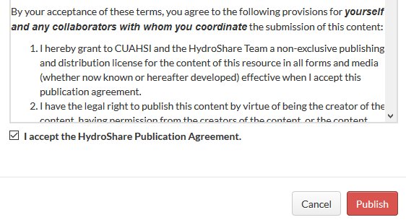
Formal data publication
Resources formally published receive a citable digital object identifier (DOI) and are made immutable to changes
...

Slide 28
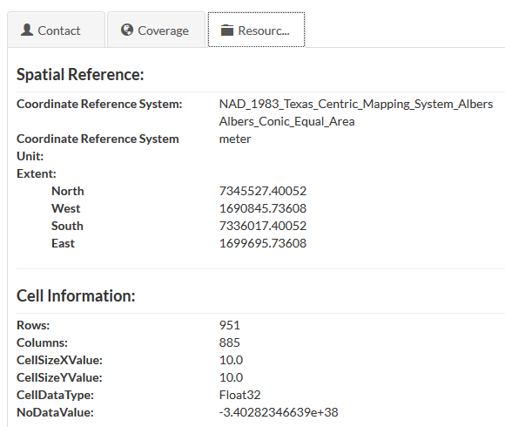
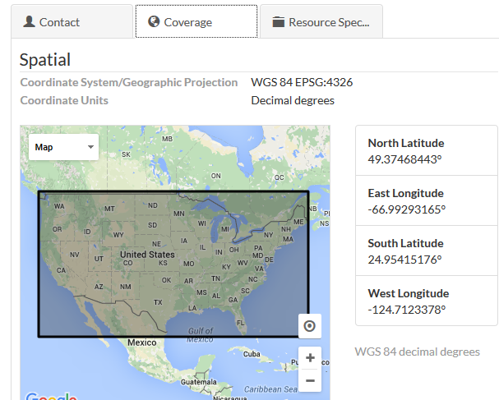
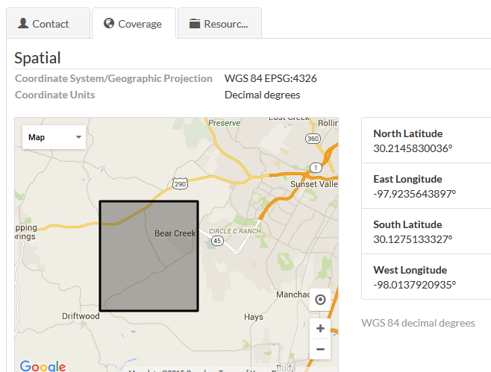
Automatic and natural metadata gathering eases some of the pain of metadata entry
For geographic raster WGS 84 Coverage information automatically harvested from GeoTIFF coordinate system information
For multidimensional netCDF data with CF convention metadata the HydroShare RDM metadata can be fully and automatically completed

Slide 29
Access Control Model
Capabilities given to users
Owners can perform all operations on a resource and set whether a resource is Public, Discoverable, or Private and Shareable. A resource may have multiple owners
Editors can edit resource metadata and add and delete resource content files. If the resource is Shareable editors can extend editing or viewing access to other users.
Viewers can view resource metadata and download resource content files. If the resource is Shareable viewers can use manage access to extend viewing access to other users.
Resource access settings
Public: Content visible to all users
Discoverable: Only metadata is visible to all users
Published: Public and immutable with citable digital object identifier (DOI) assigned
Private: Content (and metadata) only visible to users and members of groups that have had access specifically enabled
Shareable: Users with edit or view permission can extend this permission to other users or groups

Slide 30
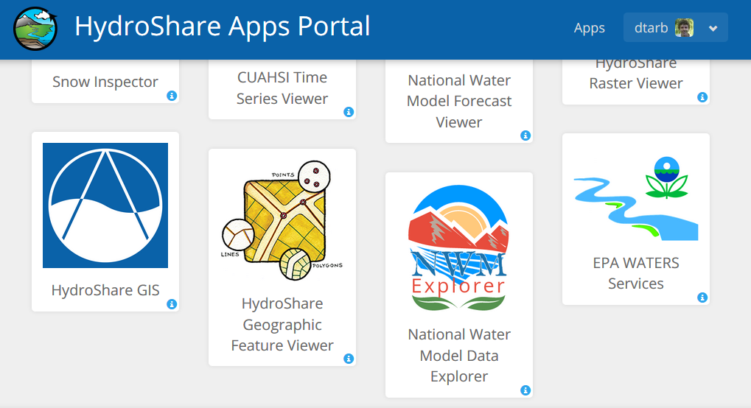
Apps act on resources to support web based visualization and analysis http://apps.hydroshare.org

Slide 31
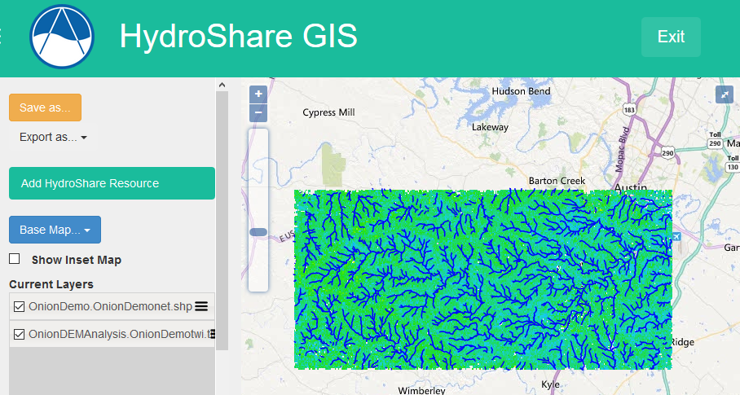

Slide 32
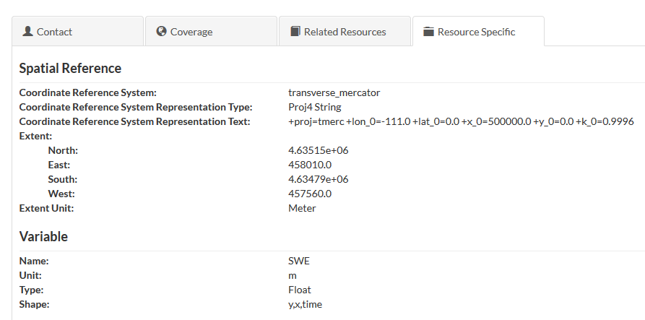
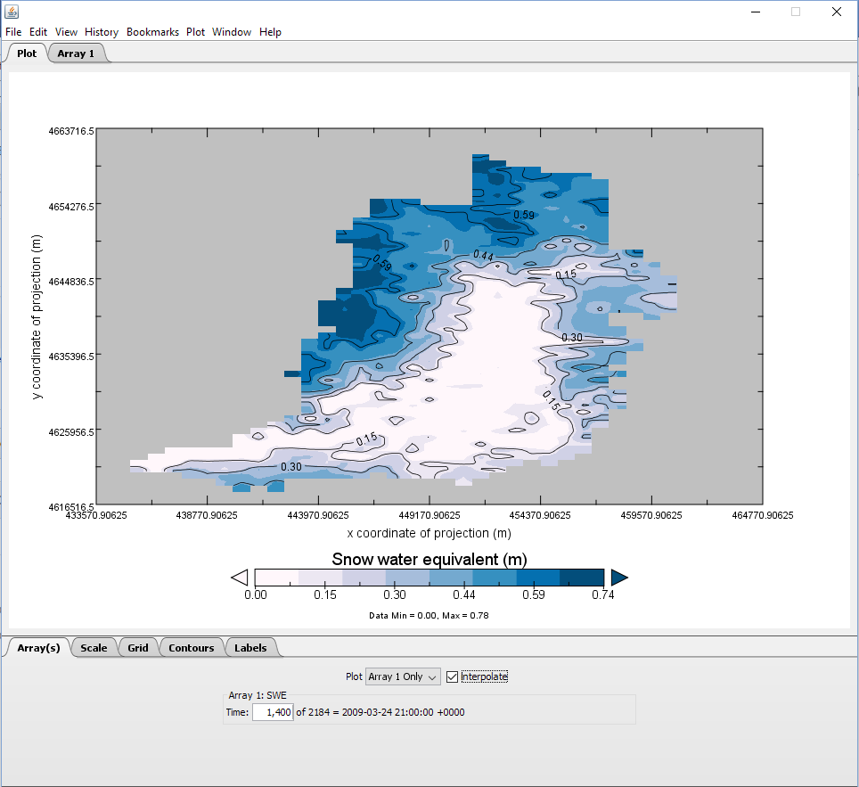
Hyrax OPeNDAP Server for public Multidimensional resources in netCDF format
Snapshot in time in visualized in Panoply

Slide 33
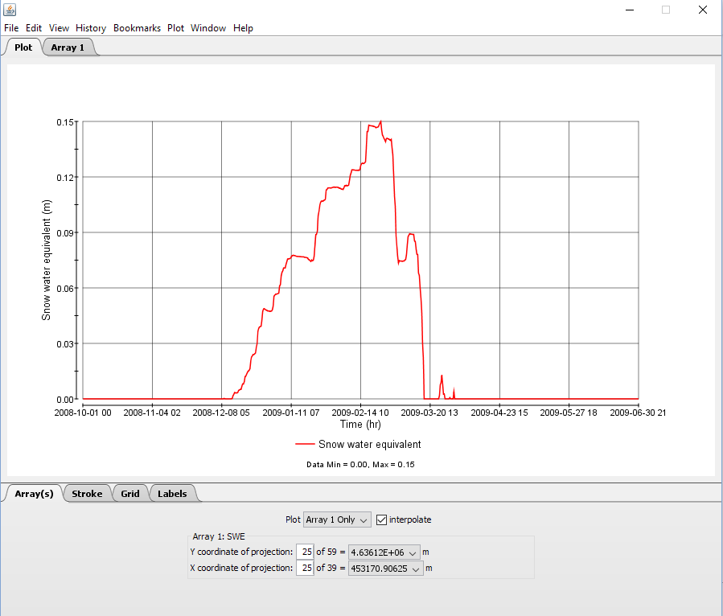
Single Cell Time Slice from multidimensional netCDF file visualized in Panoply

Slide 34
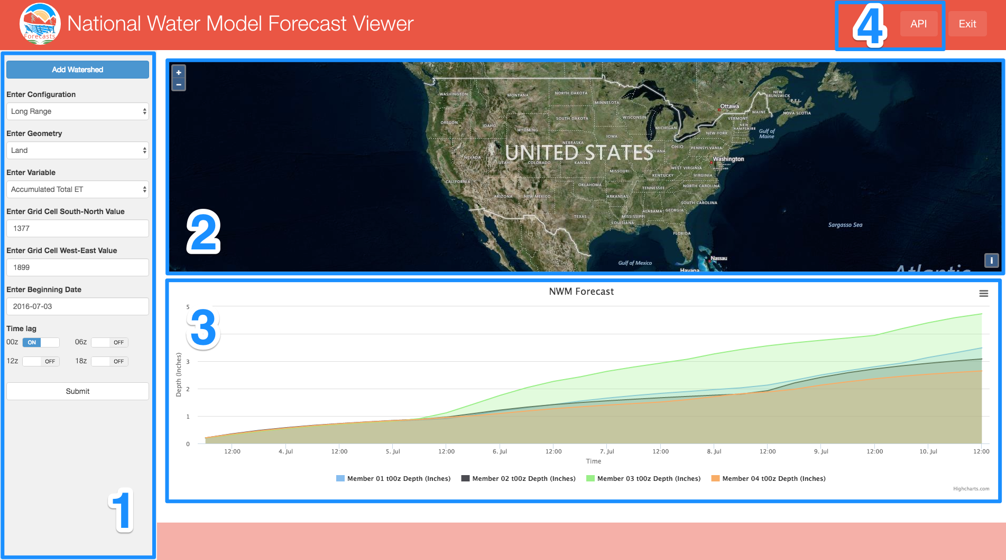
NWM Forecast Viewer App
Provides visualization of the channel, reservoir, and land type forecasts for the four different configurations of the NWM.
Enhancing access to community data products
From Michael Souffront and Jim Nelson
Notes:
A form to specify forecast parameters.
A map for data selection based on location.
A graph area to display the forecasts.
An API to access data programmatically.

Slide 35
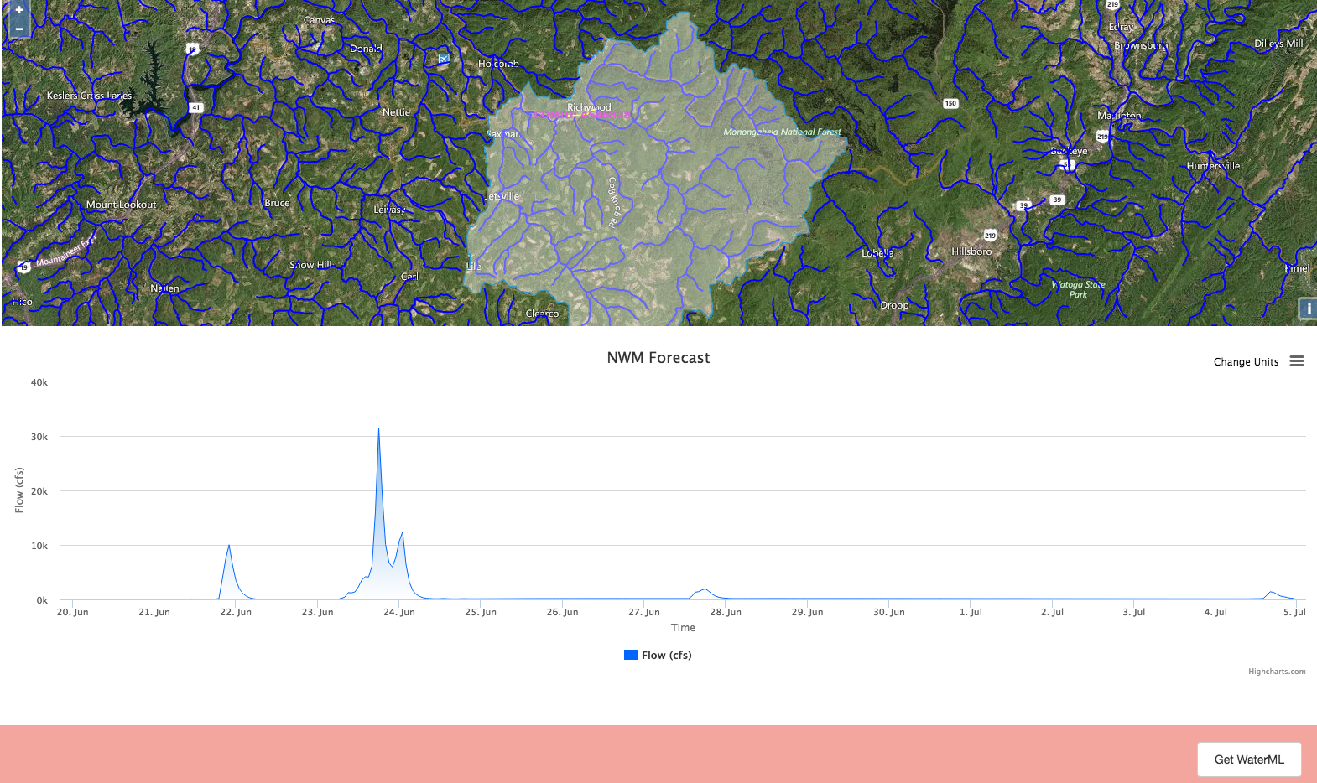
From Michael Souffront and Jim Nelson
Notes:
A form to specify forecast parameters.
A map for data selection based on location.
A graph area to display the forecasts.
An API to access data programmatically.

Slide 36
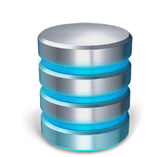
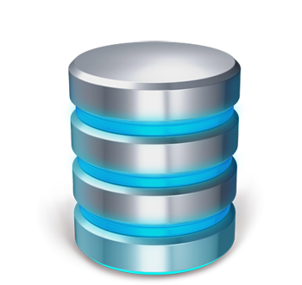
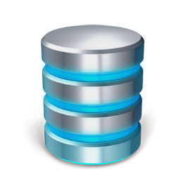
National Water Model Community Data Access Architecture
Community of users, developers, contributors and hydrologic science researchers
Tethys NWM Apps
website
CyberGIS Apps
iRODS Federated “Network File System” Data Storage
2-3 TB/day
Outputs dropped from distribution when older than 24-48 Hours
50 TB Rolling NWM Data Store
National HAND Layer
50 TB HydroShare Resource Data Store
Selective retention

Slide 37
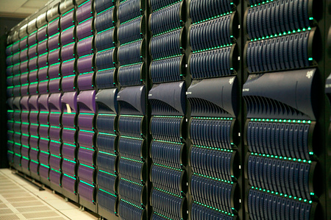
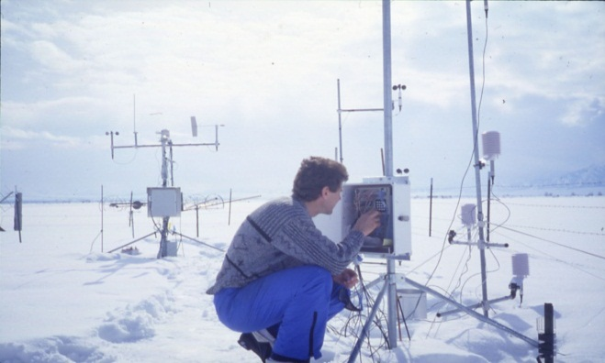
A digital divide
Do you have the access or know how to take advantage of advanced computing capability?
Hydrologic Experimentation and Modeling
Data Intensive High Performance Computing
#!/bin/bash
vi
chmod
#PBS -l nodes=4:ppn=8
grep
awk
mpiexec
Need Gateway Data and Software Services

Slide 38
Can we deliver Hydrologic Research and Analysis functionality as a service over the web?
Data Sources
Server
Functions and Tools
Software as a Service
Users
The trend towards network/cloud computing
Based on slide from Norm Jones

Slide 39
TauDEM in CyberGIS
http://gateway.cigi.illinois.edu/
Analysis submitted
Analysis running
Results data created
Results Ready

Slide 40
Summary
A new, web-based system for advancing model and data sharing
Access multiple types of hydrologic data using standards compliant data formats and interfaces
Flexible discovery functionality
Model sharing and execution
Facilitate and ease access to use of high performance computing
Social media and collaboration functionality
Links to other data and modeling systems
Enable more rapid advances in hydrologic understanding through collaborative data sharing, analysis and modeling

Slide 41
References
Couch, A., D. Tarboton, R. Idaszak, J. Horsburgh, H. Yi and M. Stealey, (2015), "A Flexible File Sharing Mechanism for iRODS," iRODS User Group Meeting, Chapel Hill, iRODS Consortium, 61-68, http://irods.org/wp-content/uploads/2015/09/UMG2015_P.pdf
Heard, J., D. Tarboton, R. Idaszak, J. Horsburgh, D. Ames, A. Bedig, A. M. Castronova, A. Couch, P. Dash, C. Frisby, T. Gan, J. Goodall, S. Jackson, S. Livingston, D. Maidment, N. Martin, B. Miles, S. Mills, J. Sadler, D. Valentine and L. Zhao, (2014), "An Architectural Overview of Hydroshare, A Next-Generation Hydrologic Information System," 11th International Conference on Hydroinformatics, HIC 2014, New York City, USA, Paper 311, http://academicworks.cuny.edu/cc_conf_hic/311/.
Horsburgh, J. S., M. M. Morsy, A. M. Castronova, J. L. Goodall, T. Gan, H. Yi, M. J. Stealey and D. G. Tarboton, (2015), "Hydroshare: Sharing Diverse Environmental Data Types and Models as Social Objects with Application to the Hydrology Domain," JAWRA Journal of the American Water Resources Association, http://dx.doi.org/10.1111/1752-1688.12363, http://www.neng.usu.edu/cee/faculty/dtarb/Horsburgh_etal_HydroShareRDM_AuthorVersion.pdf.
Merwade, V., C. Song, L. Zhao. S. Zhe and M. A. Rajib, SWATShare – A portal for sharing, publishing, and running SWAT models using XSEDE resources, Proceedings of the 2013 SWAT Users Conference and Workshops, July 2013, Toulouse, France. http://swat.tamu.edu/media/114650/2013-swat-conference-proceedings-secured.pdf
Rajib, M. A., V. Merwade, I. L. Kim, S. Zhe, L. Zhao and C. Song, (2014), "SWATShare – A Web-Portal For Hydrology Research And Education Using Soil Water And Assessment Tool," 11th International Conference on Hydroinformatics, New York City, USA, Paper 463, http://academicworks.cuny.edu/cc_conf_hic/463.
Tarboton, D. G., R. Idaszak, J. S. Horsburgh, J. Heard, D. Ames, J. L. Goodall, L. Band, V. Merwade, A. Couch, J. Arrigo, R. Hooper, D. Valentine and D. Maidment, (2014a), "HydroShare: Advancing Collaboration through Hydrologic Data and Model Sharing," in D. P. Ames, N. W. T. Quinn and A. E. Rizzoli (eds), Proceedings of the 7th International Congress on Environmental Modelling and Software, San Diego, California, USA, International Environmental Modelling and Software Society (iEMSs), ISBN: 978-88-9035-744-2, http://www.iemss.org/sites/iemss2014/papers/iemss2014_submission_243.pdf.
Tarboton, D. G., R. Idaszak, J. S. Horsburgh, J. Heard, D. Ames, J. L. Goodall, L. E. Band, V. Merwade, A. Couch, J. Arrigo, R. Hooper, D. Valentine and D. Maidment, (2014), "A Resource Centric Approach for Advancing Collaboration Through Hydrologic Data and Model Sharing," 11th International Conference on Hydroinformatics, HIC 2014, New York City, USA, Paper 314, http://academicworks.cuny.edu/cc_conf_hic/314/.
Tarboton, D. G., R. Idaszak, J. S. Horsburgh, D. Ames, J. L. Goodall, L. E. Band, V. Merwade, A. Couch, R. Hooper, D. Valentine, D. Maidment, P. Dash, M. Stealey, H. Yi, T. Gan, T. Castronova, B. Miles, S. Livingston, C. Frisby (2015), "HydroShare: Advancing Hydrology through Collaborative Data and Model Sharing," iRODS User Group Meeting, Chapel Hill, https://irods.org/wp-content/uploads/2015/06/Tarboton-HydroShare.pdf.
http://www.hydroshare.org
ACI-1148453
ACI-1148090
2012-2017
Notes:
The HydroShare project is part of a broad effort in CUAHSI in the area of Hydrologic Information Systems. We have a team of developers and domain scientists from eight universities working on HydroShare. This is part of the even broader focus in NSF on data management, Cyberinfrastructure and sustainable software.

Slide 42
Thanks to the HydroShare and CyberGIS teams!
USU
RENCI/UNC
CUAHSI
BYU
Tufts
UVA
Texas
Purdue
SDSC
Caktus
CyberGIS/NCSA
http://www.hydroshare.org
ACI-1148453
ACI-1148090
2012-2017
Notes:
The HydroShare project is part of a broad effort in CUAHSI in the area of Hydrologic Information Systems. We have a team of developers and domain scientists from eight universities working on HydroShare. This is part of the even broader focus in NSF on data management, Cyberinfrastructure and sustainable software.

