Slide 1
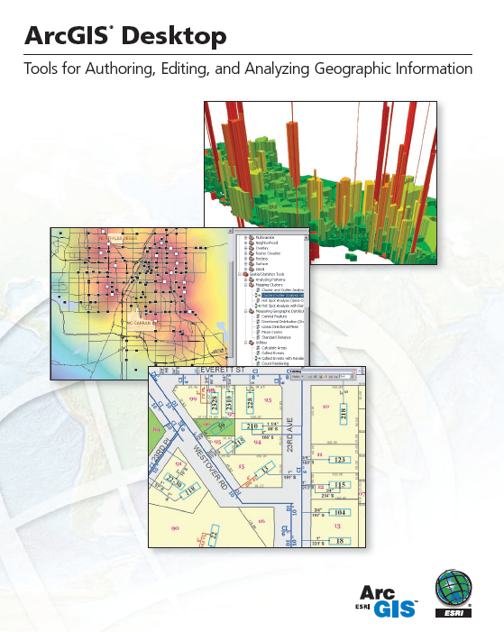
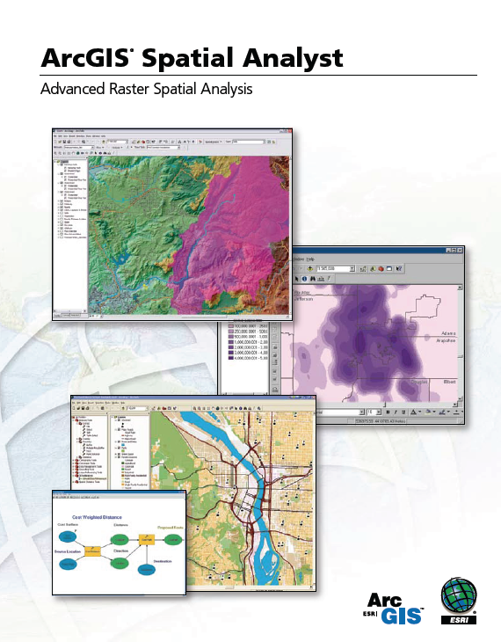
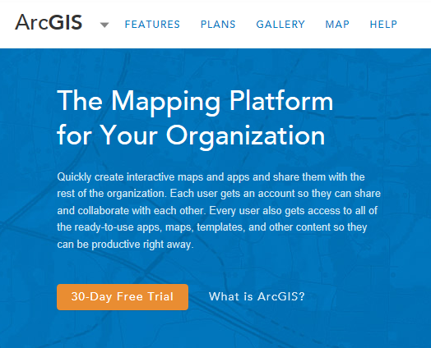
Introduction to ArcGIS Software

Slide 2
Reference Material
Watch some sessions of the 2016 ESRI User Conference http://video.esri.com/series/265/2016-esri-user-conference-plenary
Take a look through the ArcGIS Imagery book http://learn.arcgis.com/en/arcgis-imagery-book/

Slide 3
Introduction to GIS Software
Conceptual framework of ArcGIS
How data are stored in ArcGIS
ArcGIS Desktop
Extensions of ArcGIS – spatial analyst, 3D analyst
ArcGIS Online

Slide 4
Introduction to GIS Software
Conceptual framework of ArcGIS
How data are stored in ArcGIS
ArcGIS Desktop
Extensions of ArcGIS – spatial analyst, 3D analyst
ArcGIS Online

Slide 5
Jack Dangermond, President, ESRI
Article from NY Times:
http://www.nytimes.com/2011/07/10/business/esris-chief-on-tending-his-plants-and-his-company.html?_r=2

Slide 6
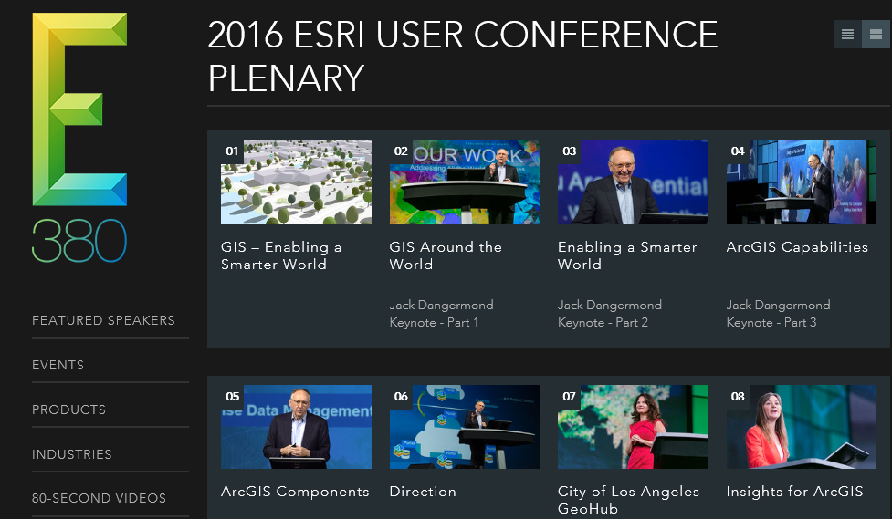
Videos from Plenary Session of ESRI User Conference
http://video.esri.com/series/265/2016-esri-user-conference-plenary

Slide 7
Online Book about Image Analysis in ArcGIS
http://learn.arcgis.com/en/arcgis-imagery-book/

Slide 8
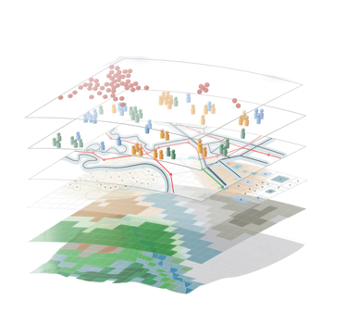
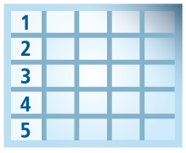
Geospatial Systems Are Helping Us Understand
Understanding
Sharing and Collaboration
Knowledge
Information
Integration
Mapping
Data
. . . Helping Us Make Better Decisions

Slide 9
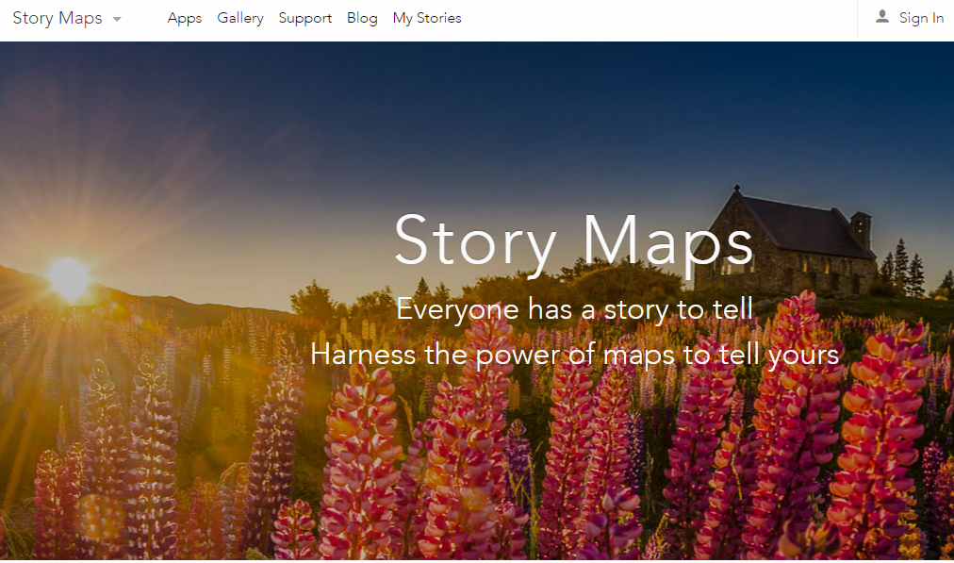
Story Maps
http://storymaps.arcgis.com
“Sound of Music”
http://arcg.is/1FT9CRJ

Slide 10
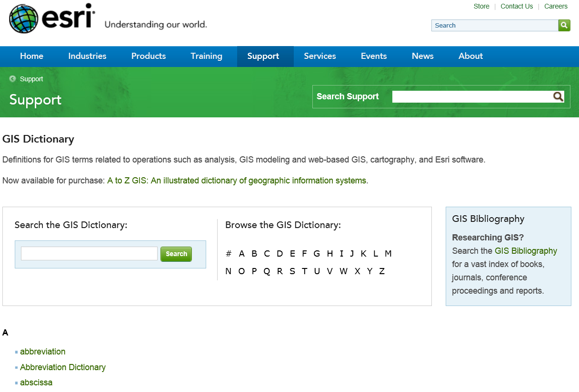
GIS Dictionary
http://support.esri.com/en/knowledgebase/Gisdictionary/browse

Slide 11
Introduction to GIS Software
Conceptual framework of ArcGIS
How data are stored in ArcGIS
ArcGIS Desktop
Extensions of ArcGIS – spatial analyst, 3D analyst
ArcGIS Online

Slide 12
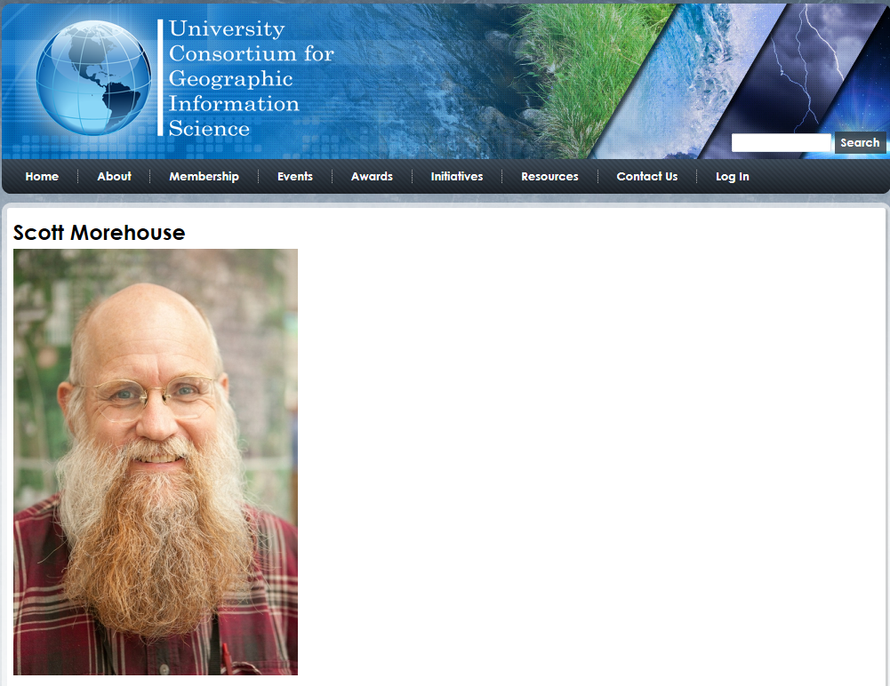
http://ucgis.org/ucgis-fellow/scott-morehouse
Made a Fellow of UCGIS in 2014
“All geographic information systems are built using formal models that describe how things are located in space. A formal model is an abstract and well-defined system of concepts. A geographic data model defines the vocabulary for describing and reasoning about the things that are located on the earth. Geographic data models serve as the foundation on which all geographic information systems are built.”
Scott Morehouse, Preface to “Modeling our World”, First Edition. He is the chief software engineer at ESRI

Slide 13
ESRI GIS Development
Arc/Info (coverage model)
Versions 1-7 from 1980 – 1999
Arc Macro Language (AML)
ArcGIS (geodatabase model)
Version 8.0, …, 10.4.1 from 2000 – Python scripting
ArcView (shapefile model)
Versions 1-3 from 1994 – 1999
Avenue scripting language

Slide 14
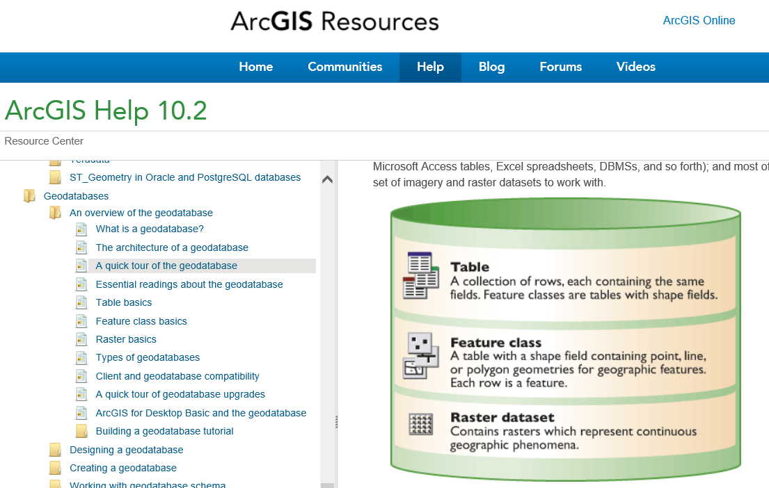
Geodatabase
https://desktop.arcgis.com/en/arcmap/latest/manage-data/geodatabases/what-is-a-geodatabase.htm

Slide 15
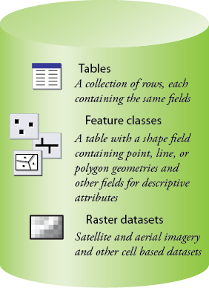
Common Geospatial Information Types
Image: Michael Zeiler, ESRI

Slide 16
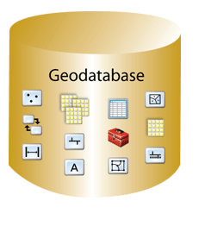
Geodatabase – a store for all types of geospatial information

Slide 17
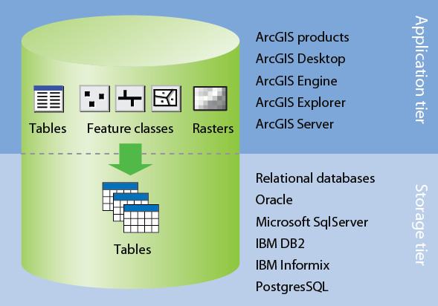
Application and Storage Tiers
Image: Michael Zeiler, ESRI

Slide 18
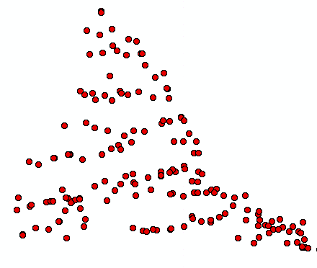
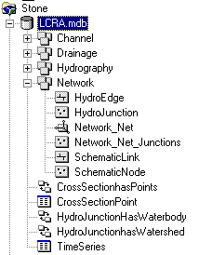
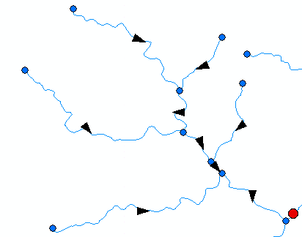
ArcGIS Geodatabase
Workspace
Geodatabase
Feature Dataset
Feature Class
Geometric
Network
Relationship
Object Class

Slide 19
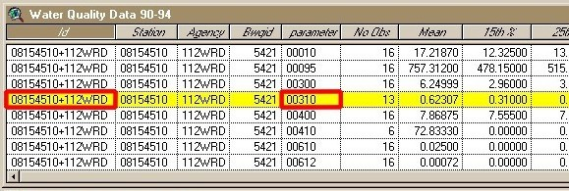
Object Class
An object class is a collection of objects in tabular format that have the same behavior and the same attributes.
An object class is a table that has a unique identifier (ObjectID)
for each record

Slide 20
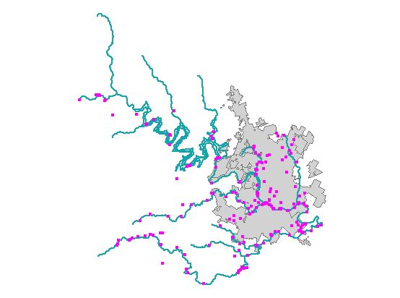
Feature Class
A feature class is a collection of geographic objects in tabular format that have the same behavior and the same attributes.
Feature Class = Object class + spatial coordinates

Slide 21
Relationship
A relationship is an association or link between two objects in a database.
A relationship can exist between spatial objects (features in feature classes), non-spatial objects (objects in object classes), or between spatial and non-spatial objects.

Slide 22
Relationship
Relationship between non-spatial objects
Water
Quality
Data
Water
Quality
Parameters

Slide 23
Relationship
Relationship between spatial and non-spatial objects
Water quality data
(non-spatial)
Measurement station
(spatial)

Slide 24
Introduction to GIS Software
Conceptual framework of ArcGIS
How data are stored in ArcGIS
ArcGIS Desktop
Extensions of ArcGIS – spatial analyst, 3D analyst
ArcGIS Online

Slide 25
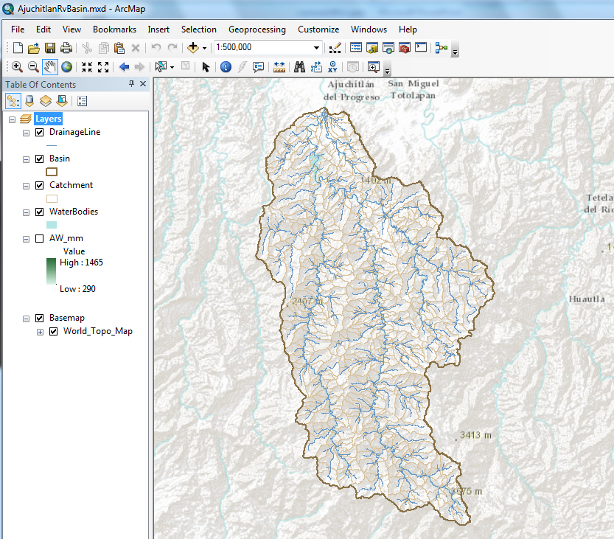
ArcMap – primary work interface
http://desktop.arcgis.com/en/arcmap/latest/map/main/mapping-and-visualization-in-arcgis-for-desktop.htm

Slide 26
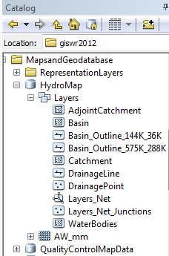
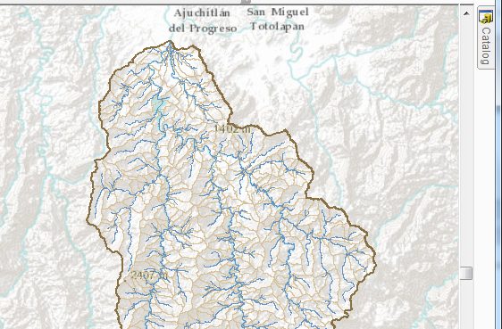
Arc Catalog – view the geodatabase
https://desktop.arcgis.com/en/arcmap/latest/map/working-with-arcmap/what-is-the-catalog-window-.htm

Slide 27
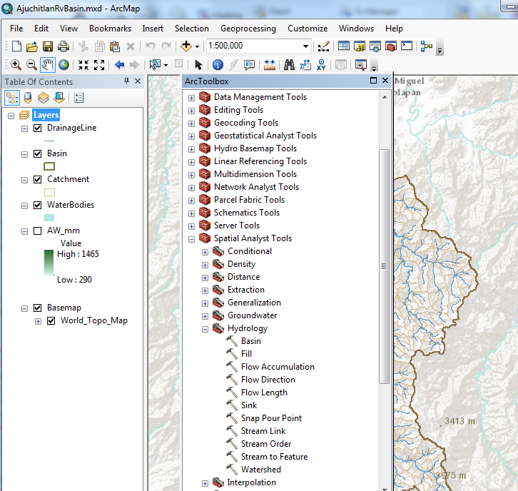
ArcToolbox – processing functions
https://desktop.arcgis.com/en/arcmap/latest/tools/main/a-quick-tour-of-geoprocessing-tool-references.htm

Slide 28
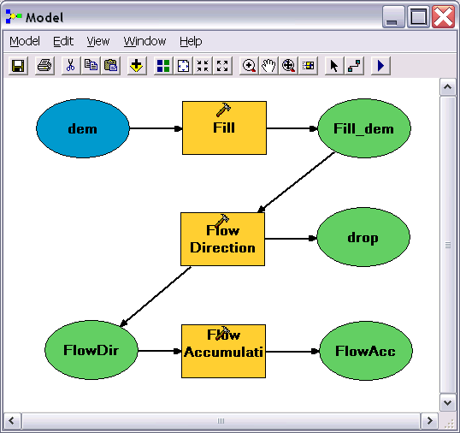
Geo-Processing
Toolbox tools linked together using the model builder to automate data processing

Slide 29
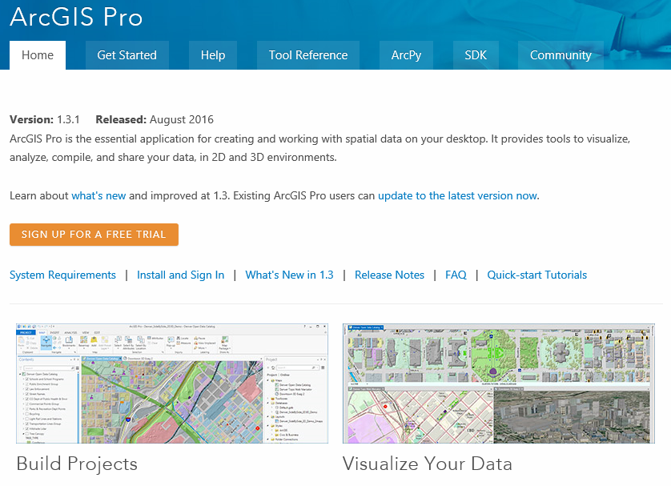
ArcGIS Pro
https://pro.arcgis.com/en/pro-app/
New Interface for ArcGIS for 64-bit computing

Slide 30
Introduction to GIS Software
Conceptual framework of ArcGIS
How data are stored in ArcGIS
ArcGIS Desktop
Extensions of ArcGIS – spatial analyst, 3D analyst
ArcGIS Online

Slide 31
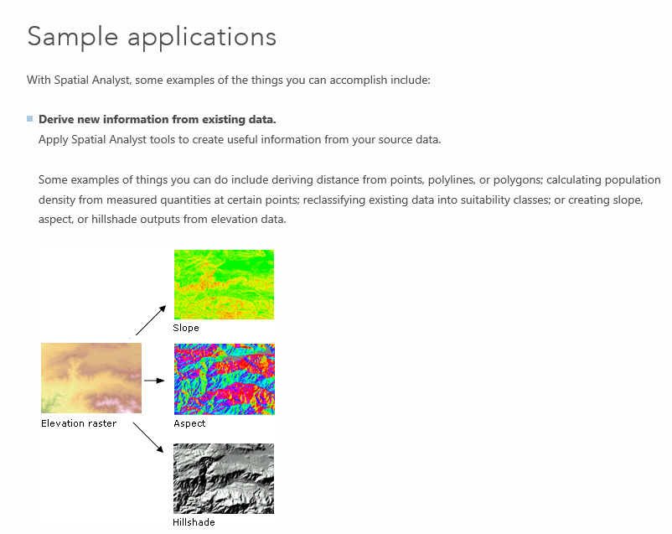
Spatial Analyst
https://desktop.arcgis.com/en/arcmap/latest/extensions/spatial-analyst/what-is-the-spatial-analyst-extension.htm

Slide 32
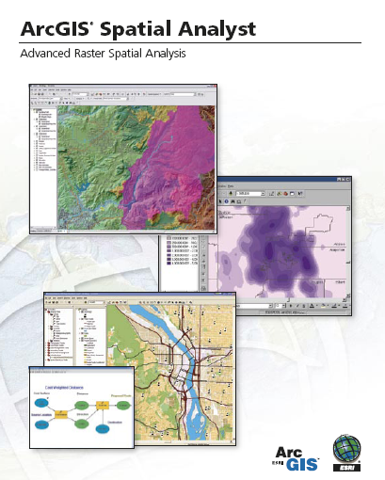
Spatial Analyst
Analysis of land surface terrain as a grid
Key means of defining drainage areas and connectivity to stream network

Slide 33
Grid Datasets
Cellular-based data structure composed of square cells of equal size arranged in rows and columns.
The grid cell size and extension (number of rows and columns), as well as the value at each cell have to be stored as part of the grid definition.
Number of columns
Cell size
Number of rows

Slide 34
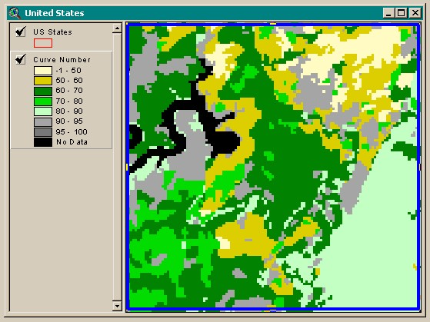
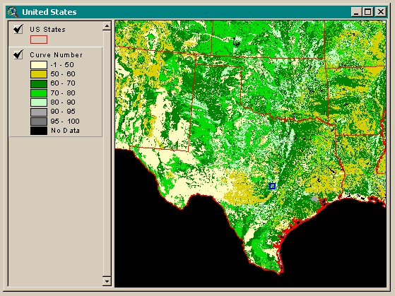
Grid Datasets
Grid datasets

Slide 35
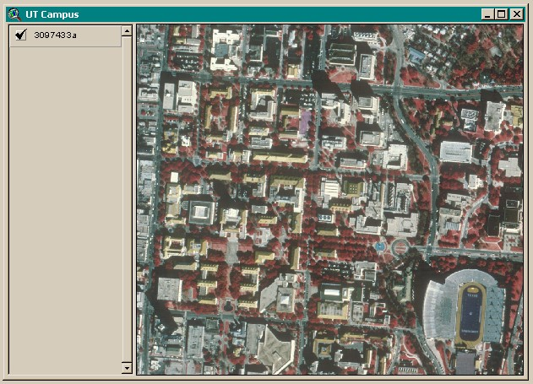
Image Datasets
Digital Orthophotos and satellite imagery
Image datasets

Slide 36
3-D Analyst
Analysis of land surface terrain as triangulated irregular network (TIN)
Visualization in 3-D using Arc Scene
Stream channel of Pecan Bayou, TX

Slide 37
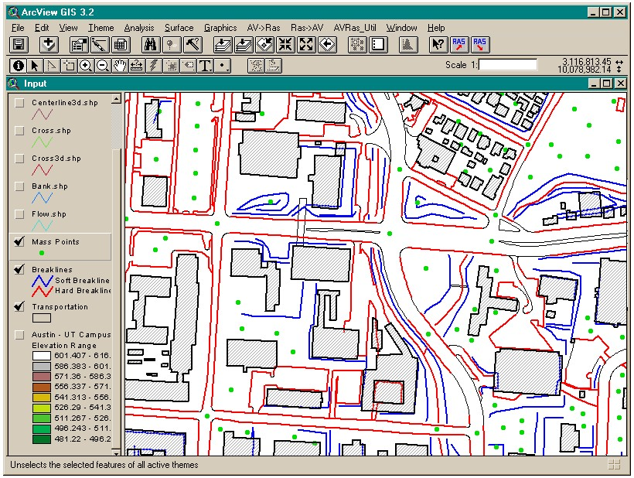
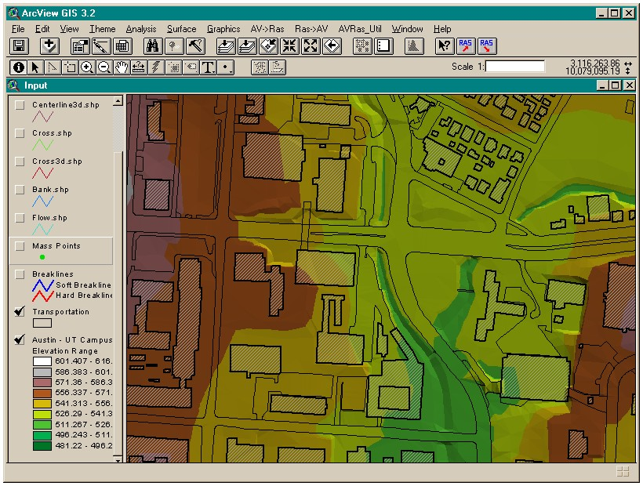
TIN Datasets
TIN datasets
Points and breaklines from which a TIN is constructed.

Slide 38
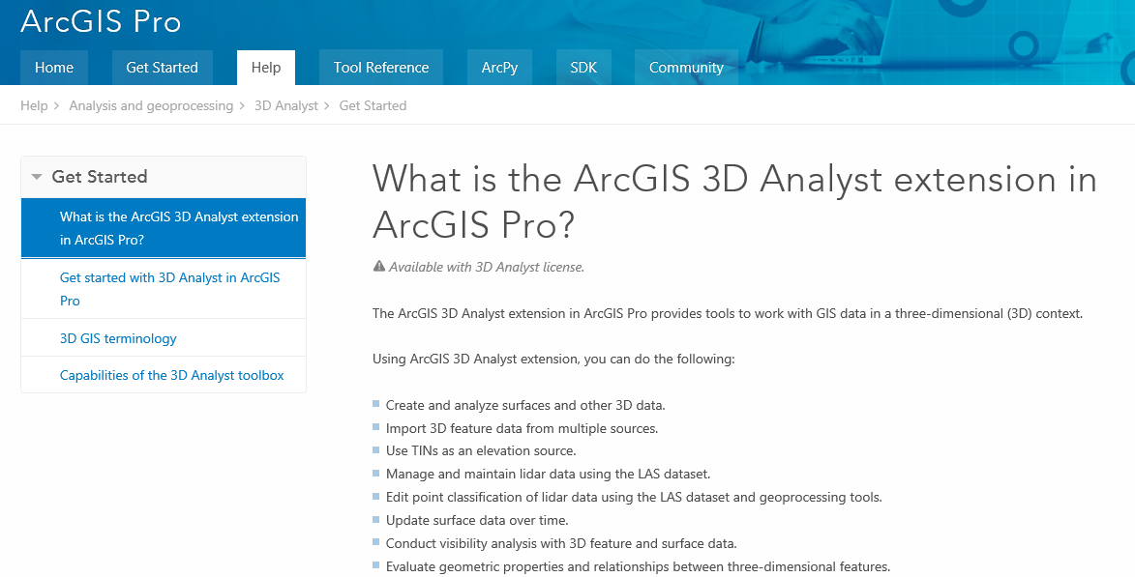
3D Analyst and ArcScene
https://pro.arcgis.com/en/pro-app/help/analysis/3d-analyst/what-is-the-3d-analyst-extension-.htm

Slide 39
Introduction to GIS Software
Conceptual framework of ArcGIS
How data are stored in ArcGIS
ArcGIS Desktop
Extensions of ArcGIS – spatial analyst, 3D analyst
ArcGIS Online

Slide 40
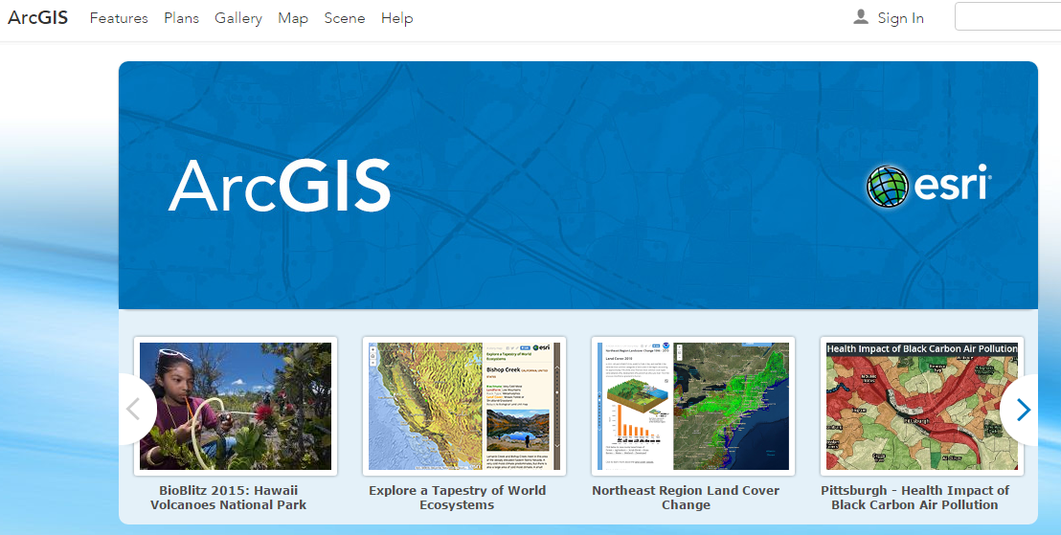
ArcGIS Online
Mapping on the web

Slide 41
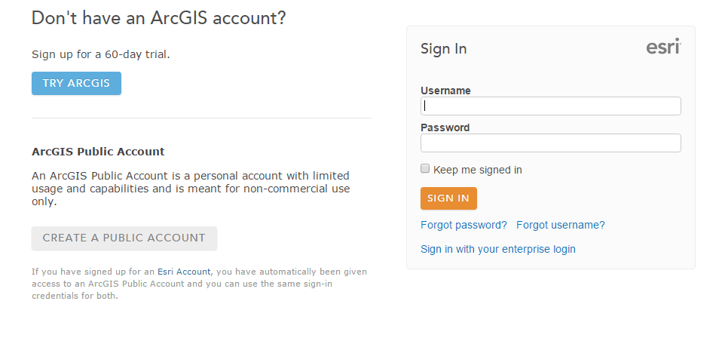
Sign In to Organizational Account associated with your institution
Use of services is paid for with “credits”

Slide 42
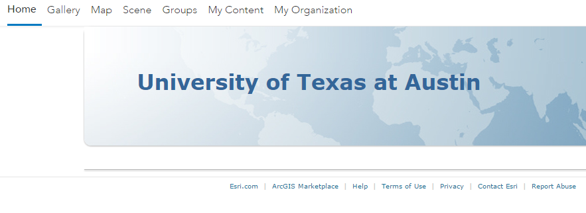
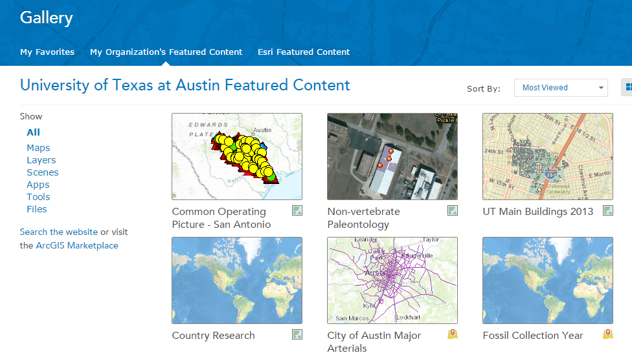
UT Austin Organizational Account
Resources – my content, groups, organization, public

Slide 43
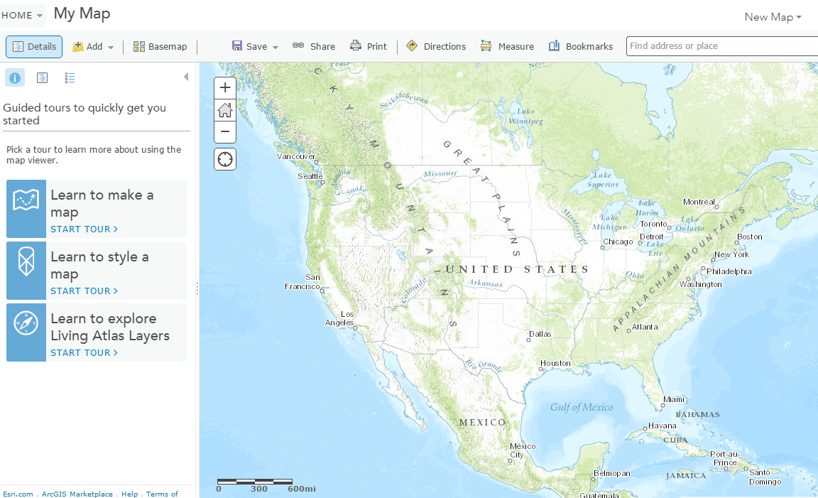
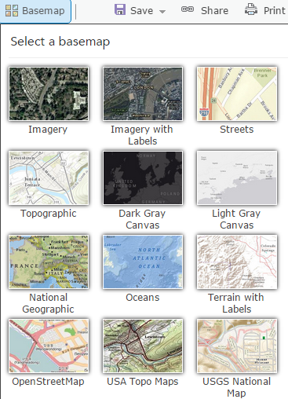
Make a Map Select a base map and add things to it

Slide 44
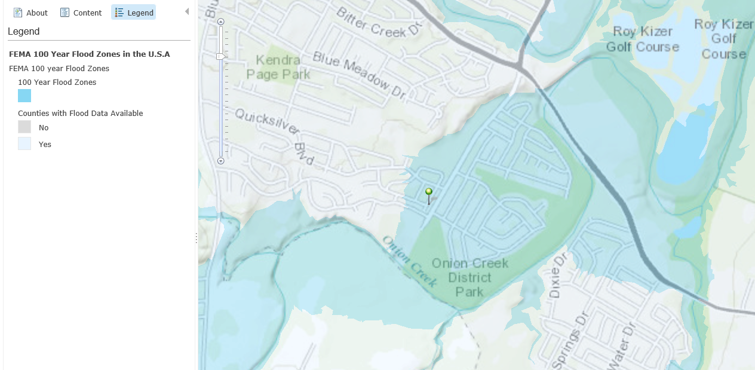
A home in a FEMA flood hazard zone

Slide 45
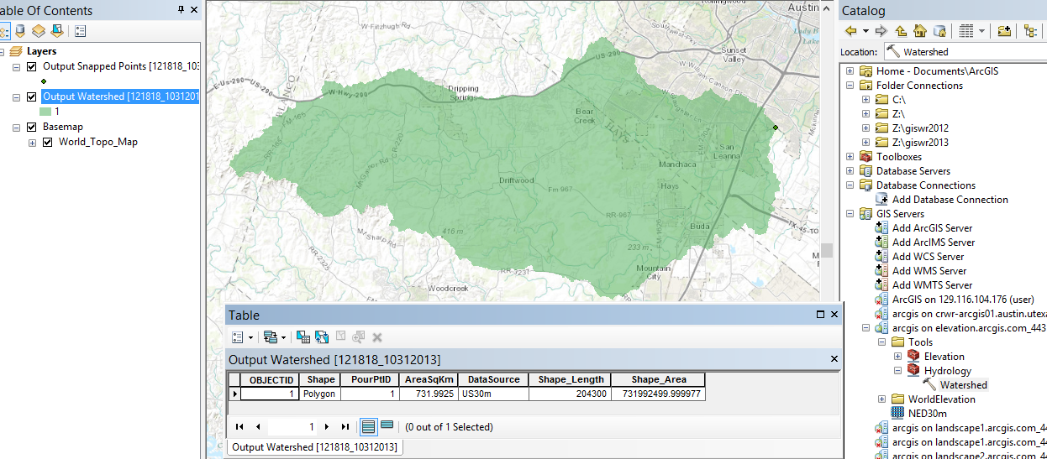
Using web services to delineate the drainage area above home
Drainage area = 732 km², or 282 miles²

Slide 46
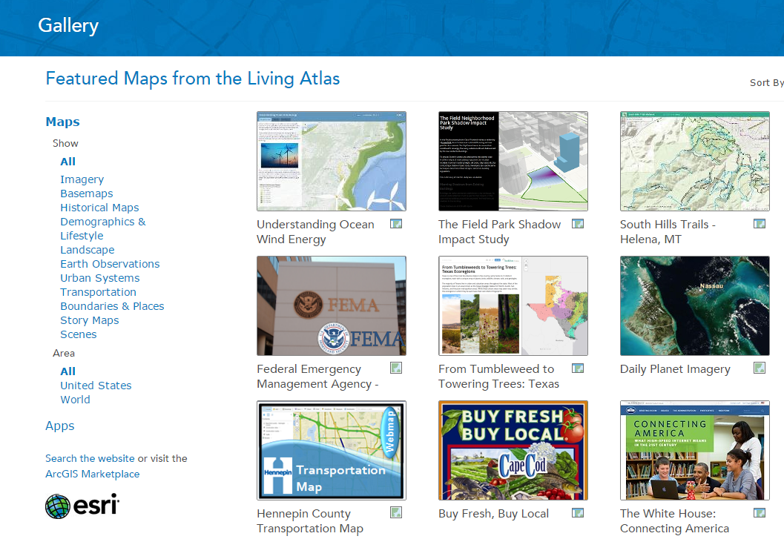
Living Atlas
http://www.arcgis.com/home/gallery.html

Slide 47
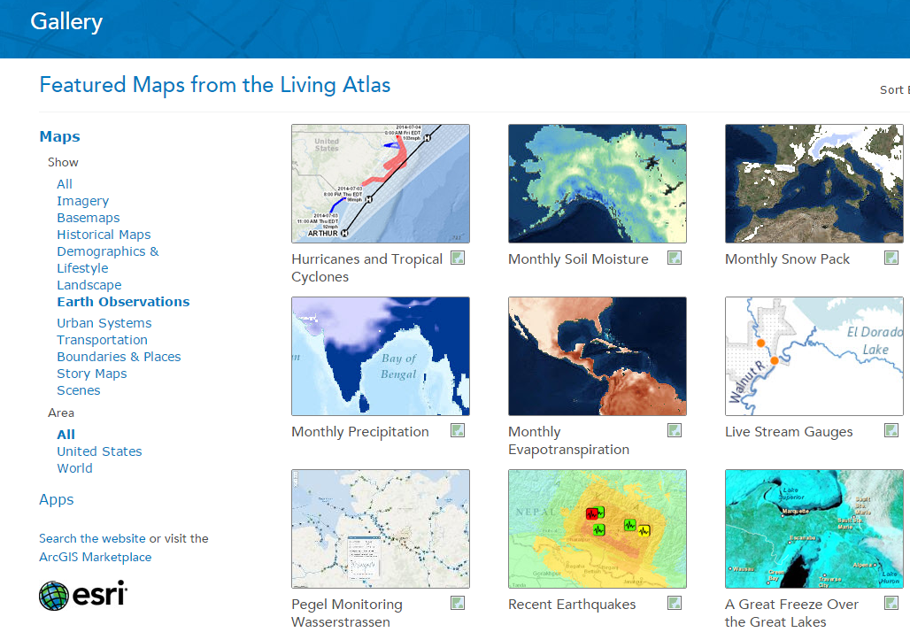
Earth Observations

