Slide 1
GIS in Water Resources
Midterm Review 2016

Slide 2

Geographic Data Model
“All geographic information systems are built using formal models that describe how things are located in space. A formal model is an abstract and well-defined system of concepts. A geographic data model defines the vocabulary for describing and reasoning about the things that are located on the earth. Geographic data models serve as the foundation on which all geographic information systems are built.”
Scott Morehouse, Preface to “Modeling our World”, First Edition. He is the chief software engineer at ESRI
Or, more simply: the way that data is organized can enhance or inhibit the analysis that can be done

Slide 3
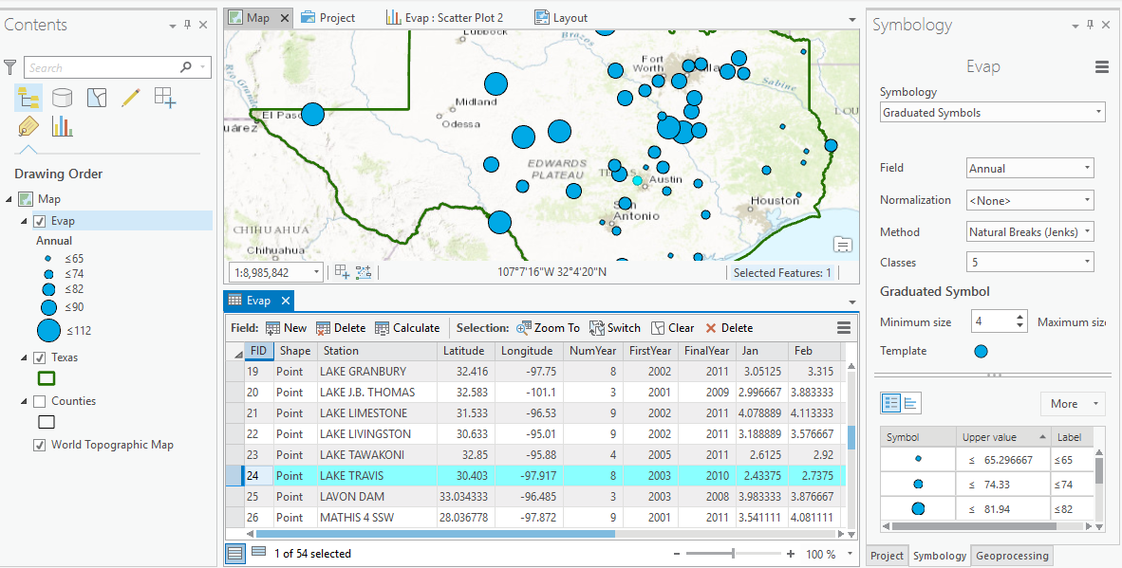
GIS: Map Features and Tabular Records

Slide 4
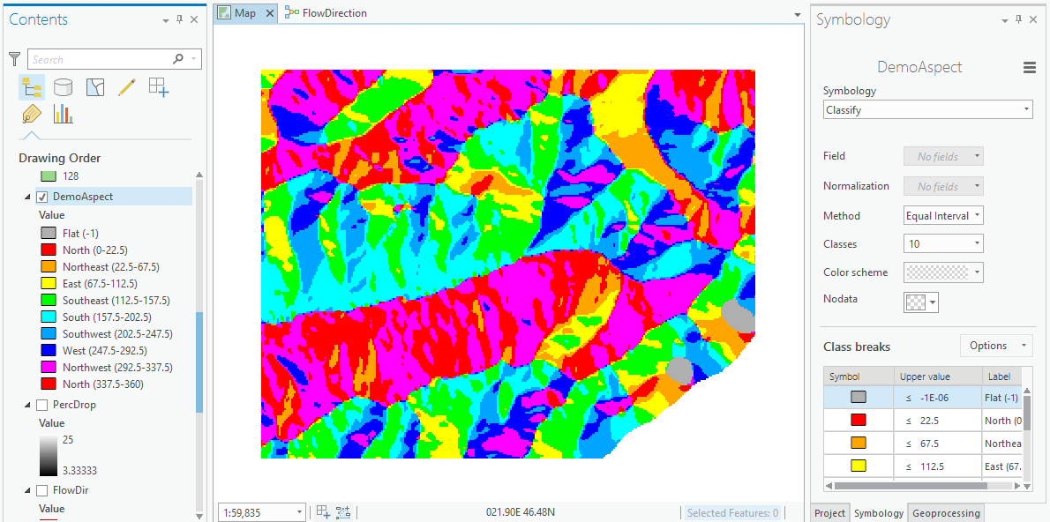
Visualization and Map Symbology

Slide 5
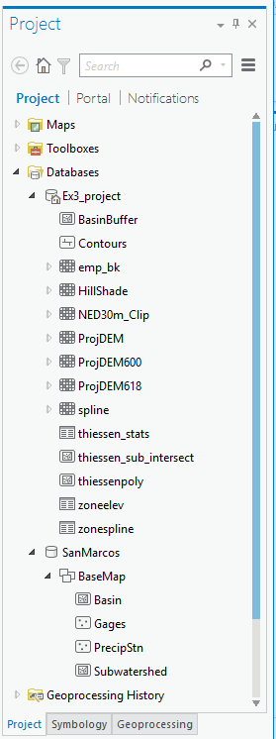
Databases and their components
Geodatabase
Raster
Table
Feature Dataset
Feature Class

Slide 6
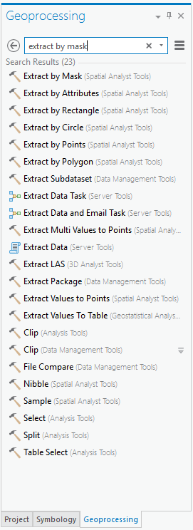
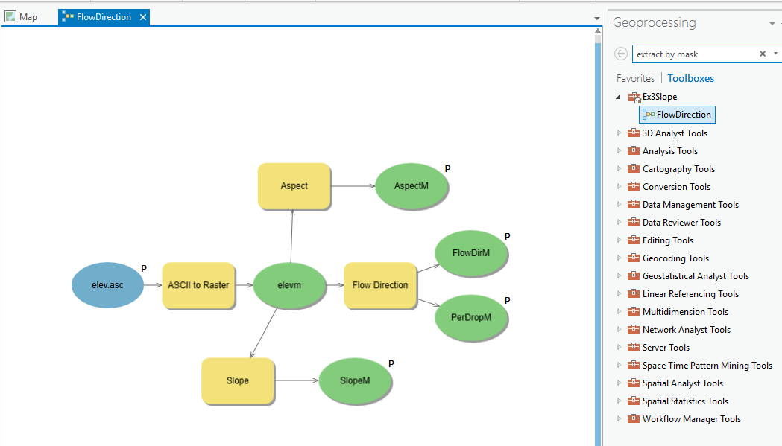
Analysis using Geoprocessing
Tools and Toolboxes
Model Builder for executing Workflows

Slide 7
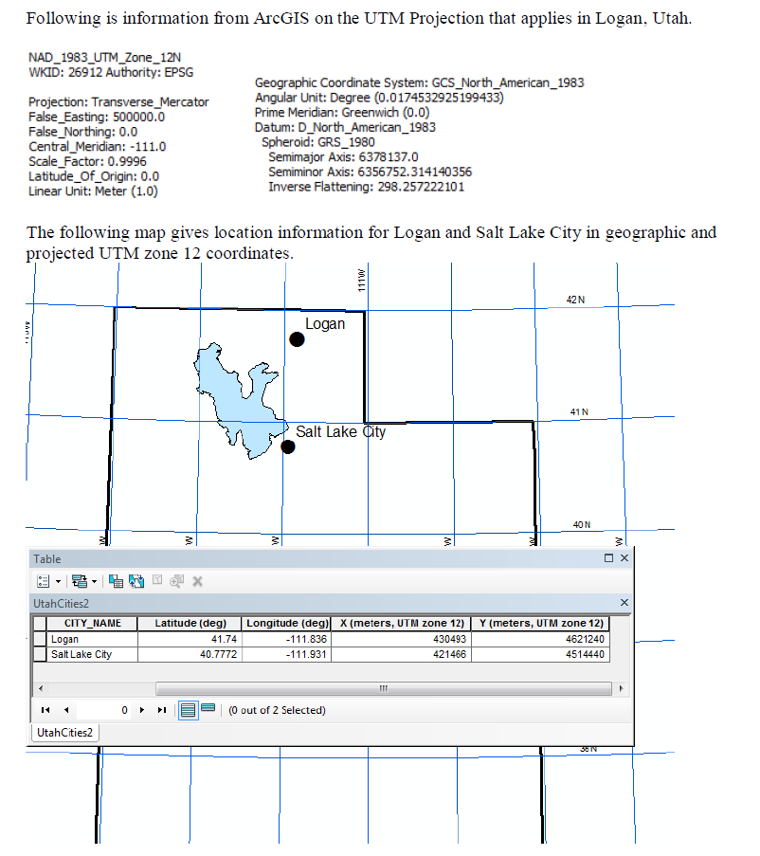
2014 Midterm Questions
What earth datum is used?
What map projection is used?
Draw and label on the map the Central Meridian for the UTM projection. What is its X-coordinate value in meters?
Calculate perpendicular distance in Km between Salt Lake City and the Central Meridian.
Calculate the distance (Km) from Logan to Salt Lake City based on the projected coordinate system.

Slide 8
Map Projection Concepts
The spatial reference of a dataset comprises datum, projection and coordinate system.
For consistent analysis the spatial reference of data sets should be the same.
ArcGIS does projection on the fly so can display data with different spatial references properly if they are properly specified.
ArcGIS terminology
  Define projection. Specify the projection for some data without changing the data.
  Project. Change the data from one projection to another.

Slide 9
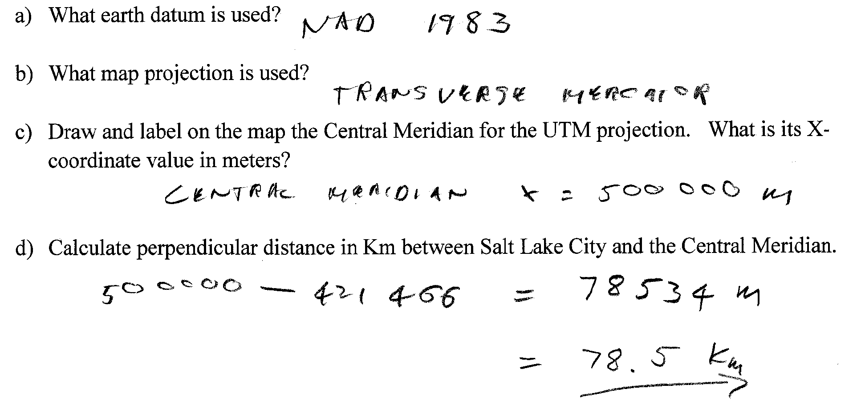
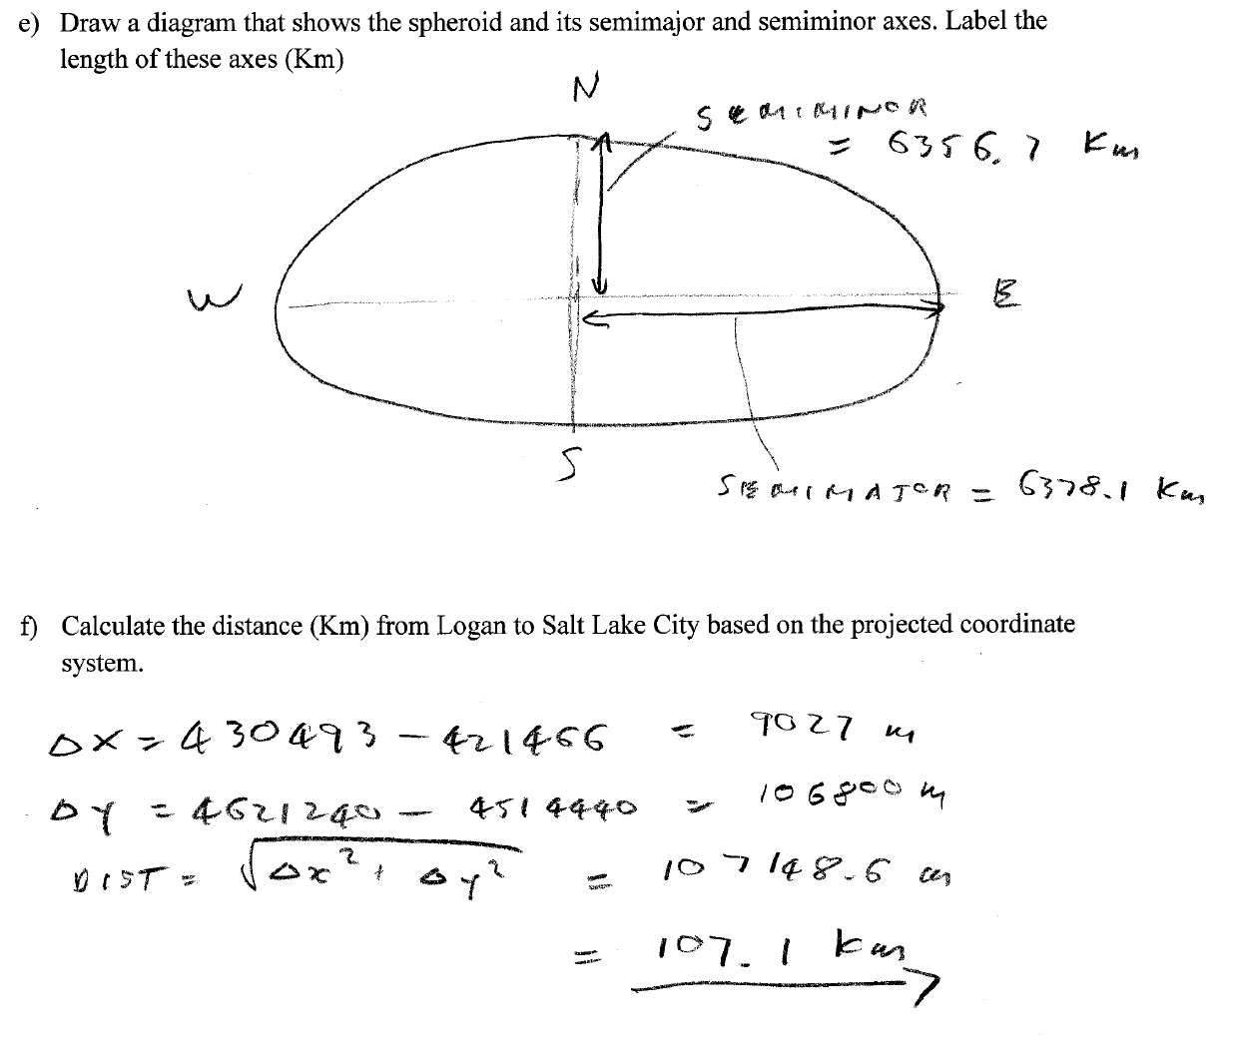

Slide 10
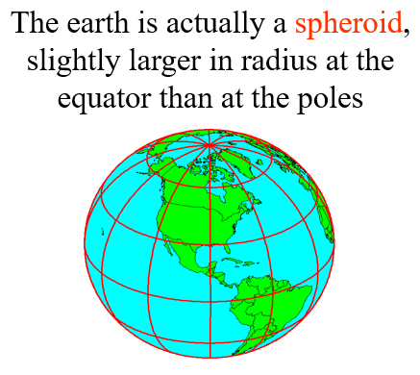
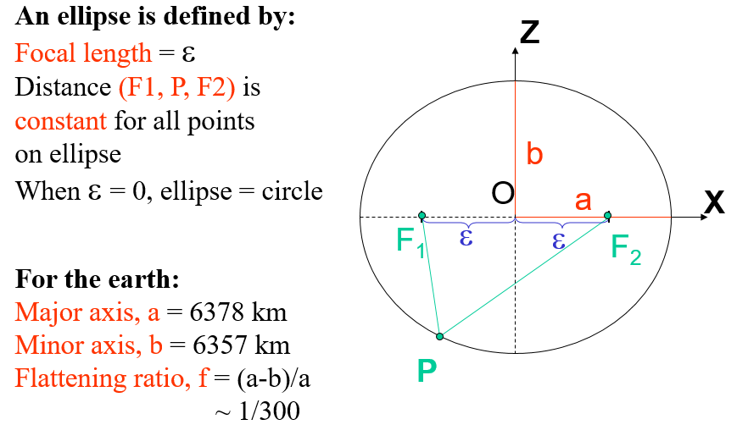

Slide 11
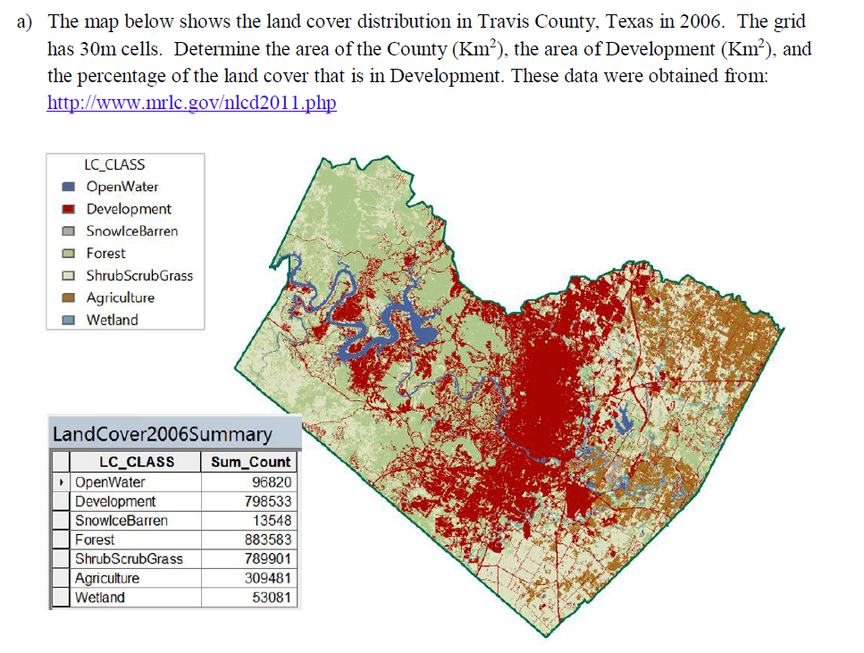
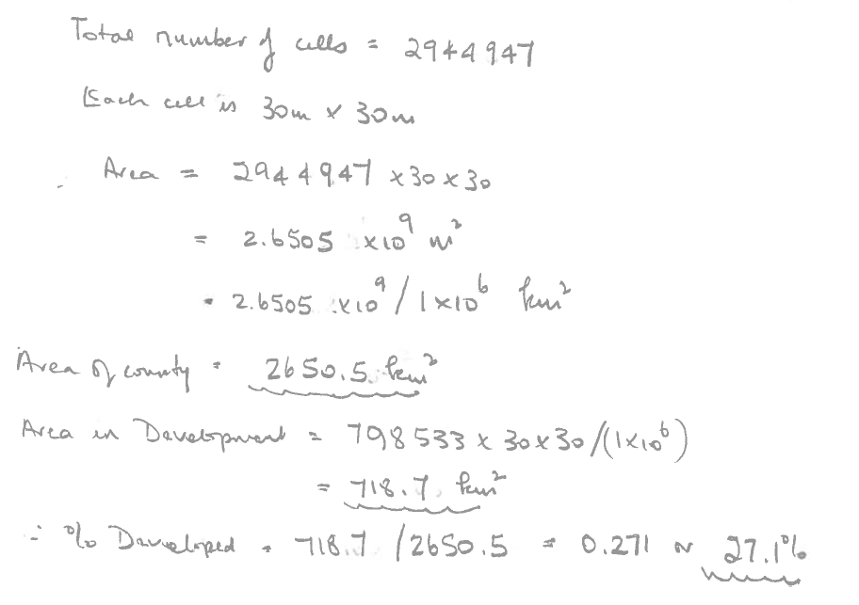

Slide 12
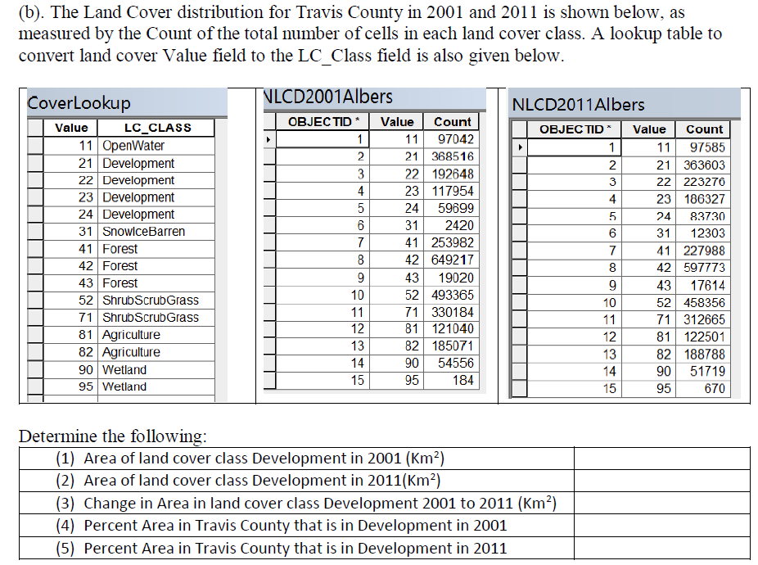
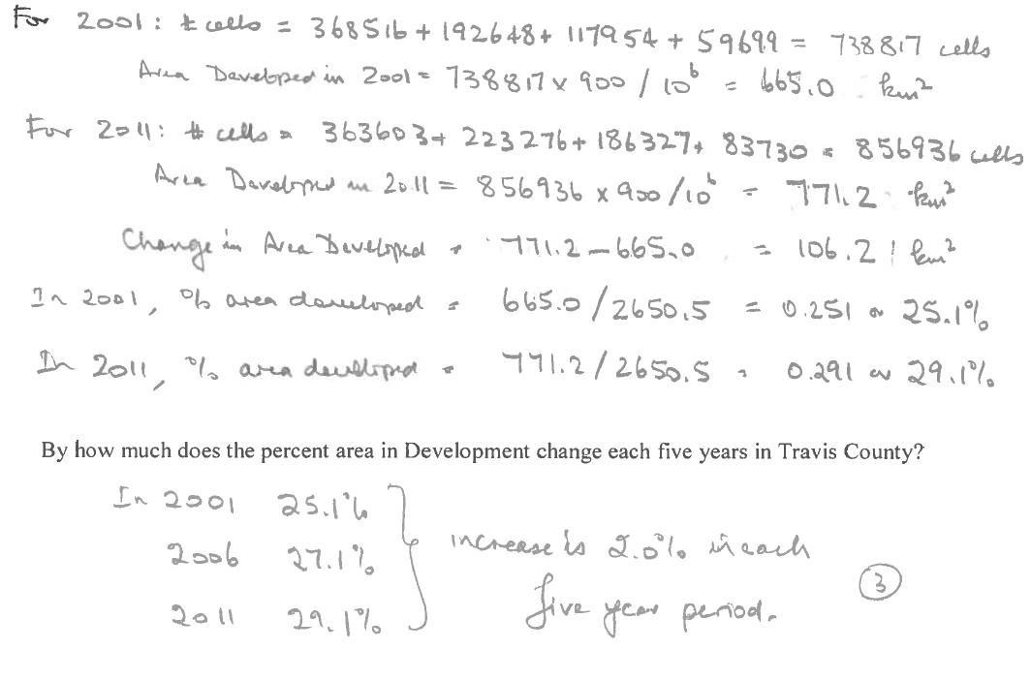
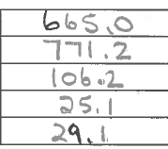

Slide 13
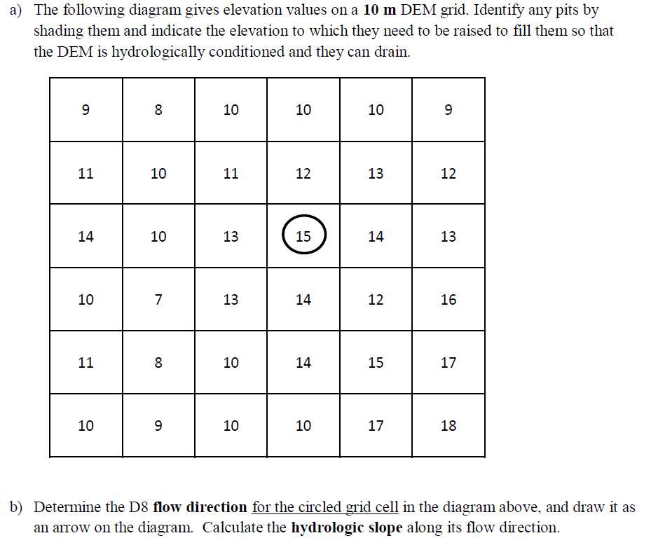

Slide 14
Pit Filling
Original DEM
Pits Filled
Pits
Pour Points
Grid cells or zones completely surrounded by higher terrain
The lowest grid cell adjacent to a pit
Notes:
Elevations are filled to that of the pools pour point

Slide 15
Hydrologic Slope
- Direction of Steepest Descent
30
30
80
74
63
80
74
63
69
67
56
69
67
56
60
52
48
60
52
48
Slope:

Slide 16
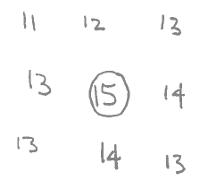
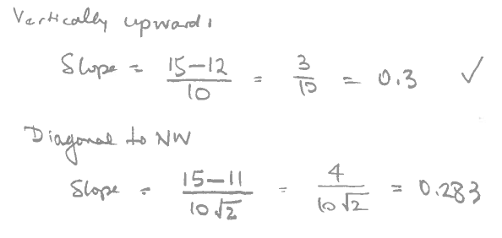

13
9
9

Slide 17
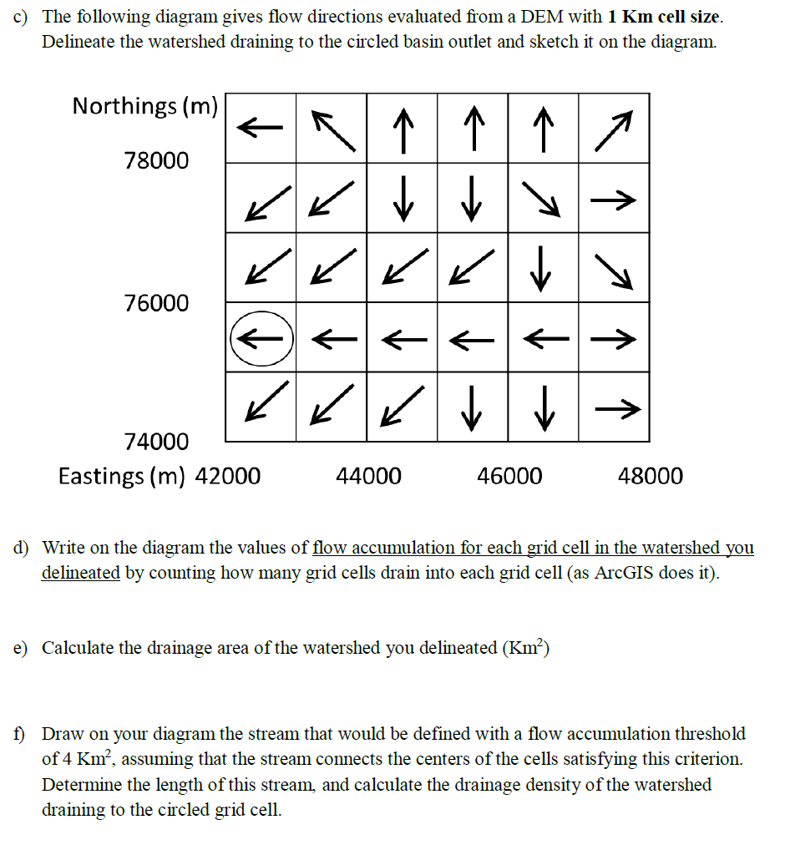

Slide 18
Flow Accumulation Grid.
Area draining in to a grid cell
0
0
0
0
0
0
0
0
0
0
0
2
2
2
0
0
2
2
2
0
0
0
10
0
1
0
0
1
0
10
1
0
0
14
0
1
0
0
0
14
0
4
1
19
1
0
4
1
1
19
ArcHydro Page 72

Slide 19
Stream Network for 10 cell Threshold Drainage Area
Flow Accumulation
> 10 Cell Threshold
0
0
0
0
0
0
0
0
0
0
0
2
2
2
0
0
2
2
2
0
0
0
10
0
1
0
0
1
0
10
1
0
0
14
0
1
0
0
0
14
0
4
1
19
1
0
4
1
1
19

Slide 20
Watershed Draining to Outlet
Watershed mapped as all grid cells that drain to an outlet
Streams mapped as grid cells with flow accumulation greater than a threshold

Slide 21
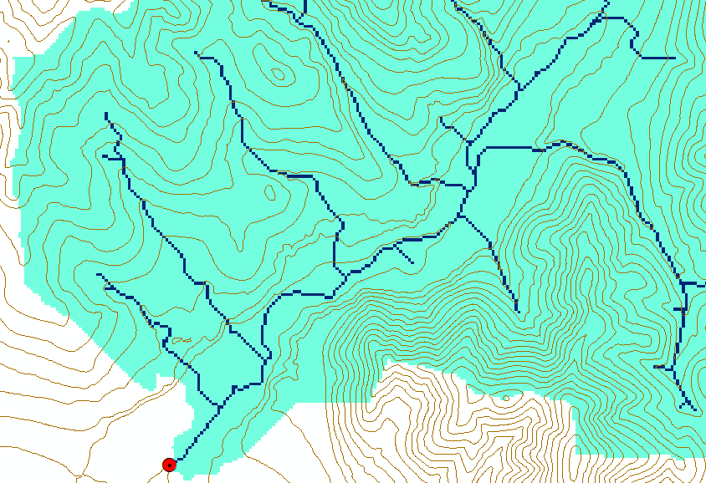
Watershed and Stream Grids
Watershed mapped as all grid cells that drain to an outlet
Streams mapped as grid cells with flow accumulation greater than a threshold

Slide 22
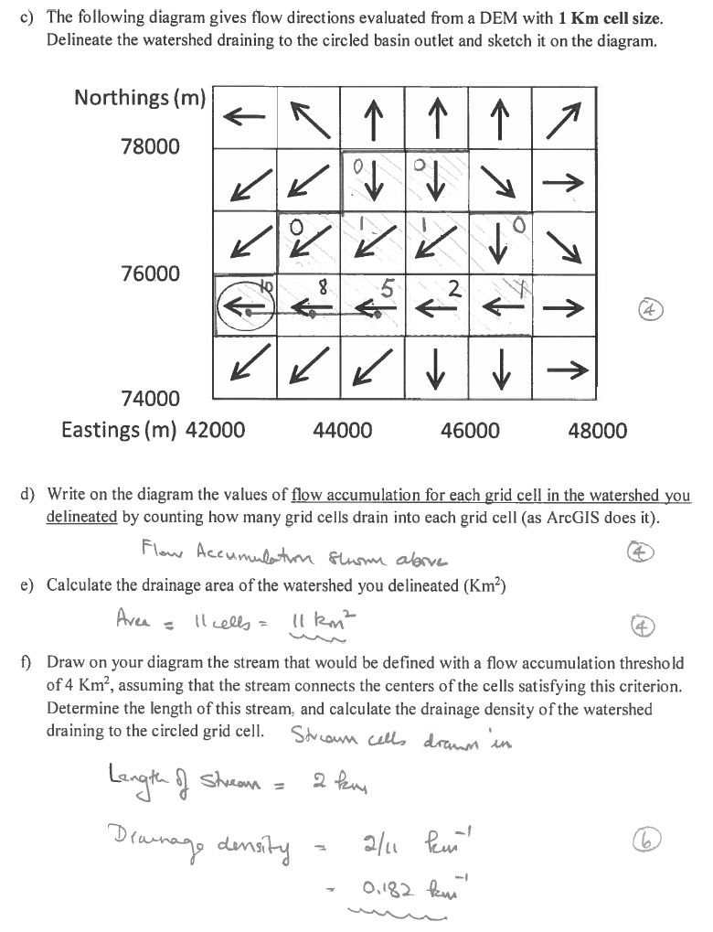

Slide 23
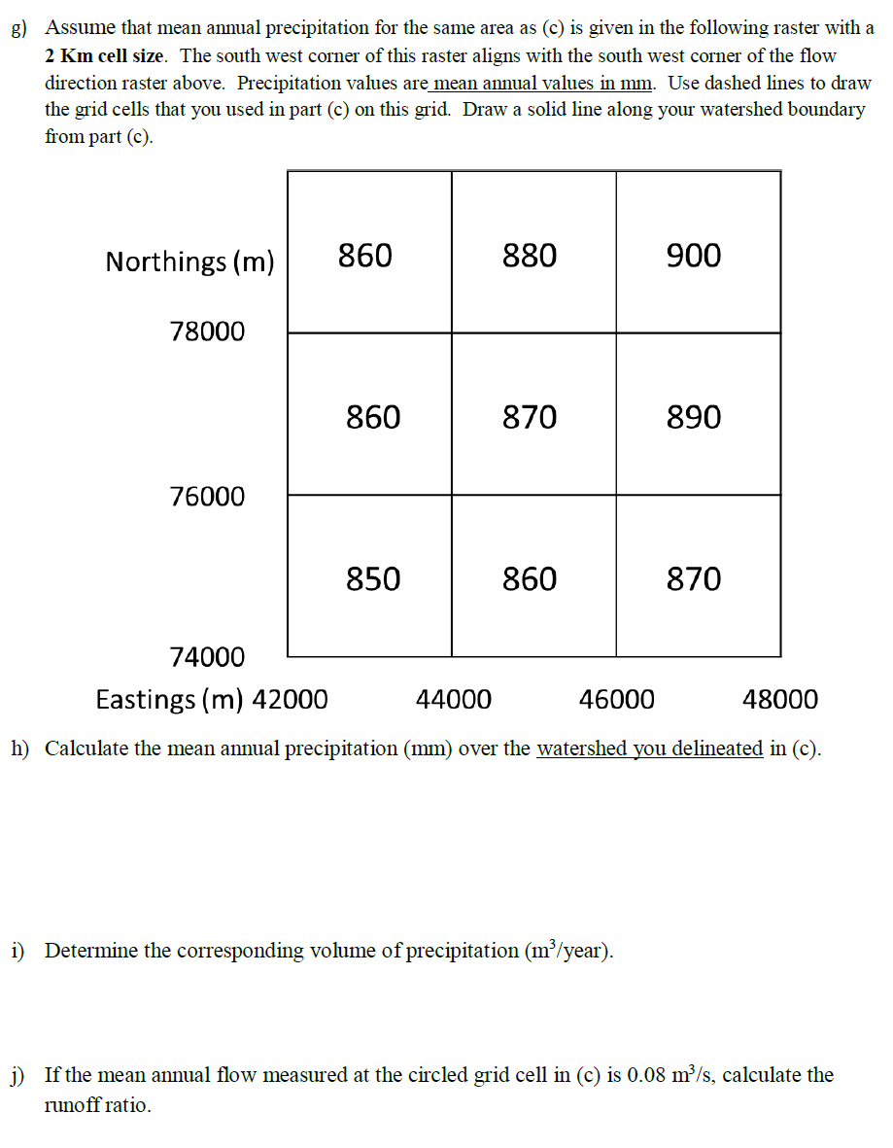

Slide 24
Raster calculation and resampling
Resampling or interpolation (and reprojection) of inputs to target extent, cell size, and projection within region defined by analysis mask
+
=
Analysis mask
Analysis cell size
Analysis extent

Slide 25
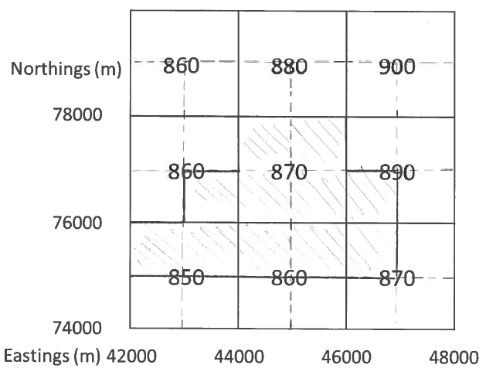
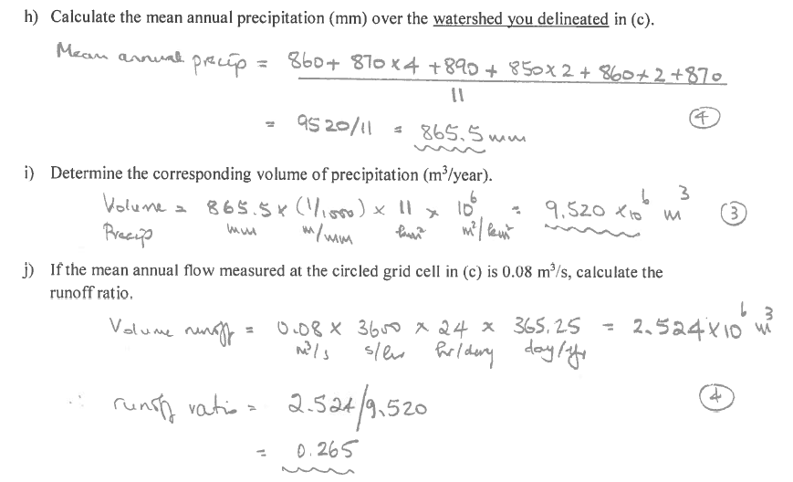

Slide 26
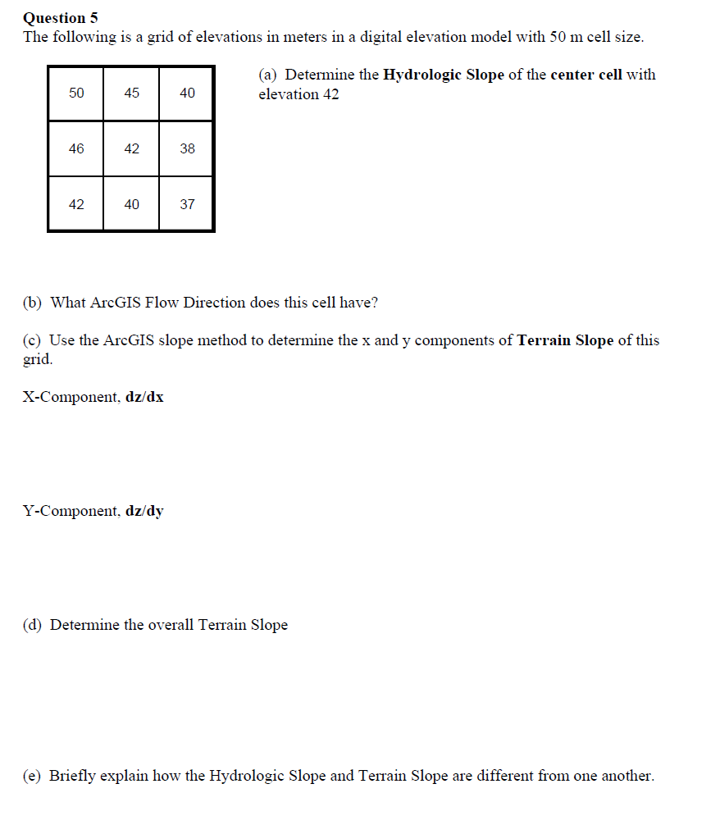
2012 Midterm Question

Slide 27

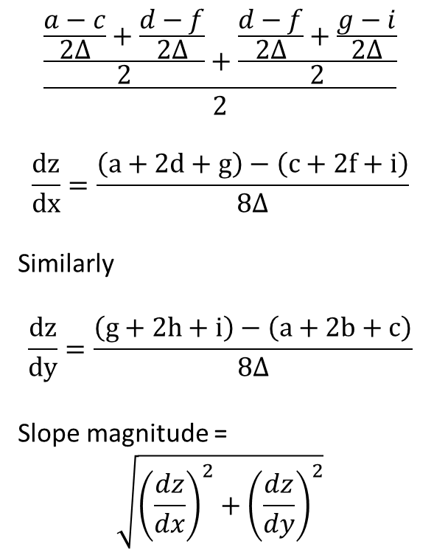


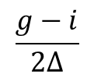
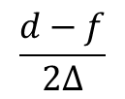
ArcGIS “Slope” tool
y
a
b
c
$$\frac{\frac{\frac{a−c}{2∆}+\frac{d−f}{2∆}}{2}+\frac{\frac{d−f}{2∆}+\frac{g−i}{2∆}}{2}}{2}$$
$$\frac{dz}{dx}=\frac{\left(a+2d+g\right)−\left(c+2f+i\right)}{8∆}$$
Similarly
$$\frac{dz}{dy}=\frac{\left(g+2h+i\right)−\left(a+2b+c\right)}{8∆}$$
Slope magnitude =
$$\sqrt{{\left(\frac{dz}{dx}\right)}^{2}+{\left(\frac{dz}{dy}\right)}^{2}}$$
d
e
f
g
h
i
x
$$\frac{a−c}{2∆}$$
$$\frac{d−f}{2∆}$$
c
$$\frac{g−i}{2∆}$$
$$∆$$
b
f
a
e
i
d
h
g
$$2∆$$
x
y

Slide 28








ArcGIS Aspect – the steepest downslope direction
$$Δy=$$
$$Δx=$$
$$Δx$$
Use atan2 to resolve ambiguity in atan direction
$$Δy$$
$$α$$
$$−Δx$$
$$−Δy$$
$$α+{180}^{o}$$

Slide 29
Example
30
a
b
c
80
74
63
d
e
f
145.2º
69
67
56
g
h
i
60
52
48

Slide 30
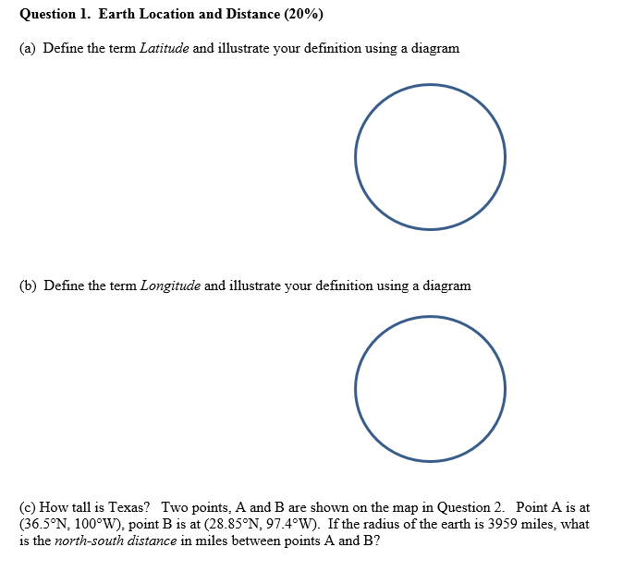
2014 Midterm Questions

Slide 31
Definition of Latitude, φ
m
S
p
O
n
φ
q
r
(1) Take a point S on the surface of the ellipsoid and define there the tangent plane, mn
(2) Define the line pq through S and normal to the
tangent plane
(3) Angle pqr which this line makes with the equatorial
plane is the latitude φ, of point S

Slide 32
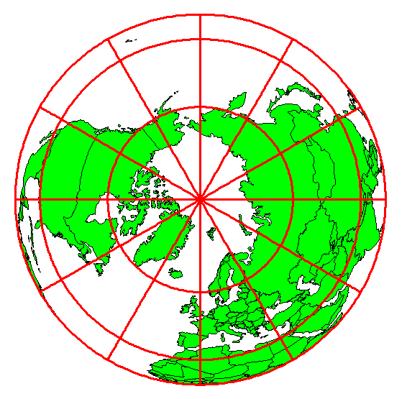
Definition of Longitude, λ
λ = the angle between a cutting plane on the prime meridian
and the cutting plane on the meridian through the point, P
180°E, W
-150°
150°
-120°
120°
90°W
(-90 °)
90°E
(+90 °)
-60°
P
λ
-60°
-30°
30°
0°E, W

Slide 33
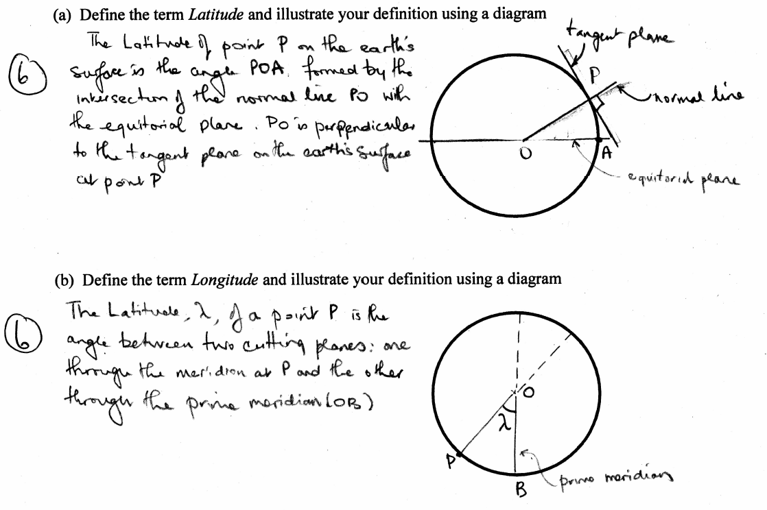

Slide 34
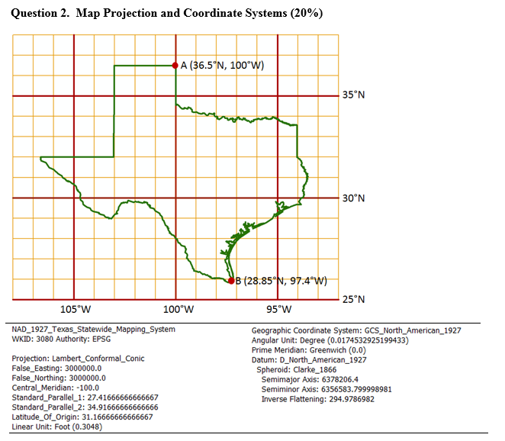
A map of Texas and a set of map projection parameters for the state are given above.
(a) Please draw and label on the map: the central meridian, the latitude of origin, and the two standard parallels.
(b) Give the numerical values (in degrees and minutes) for (ϕ₀, λ₀):
(c) Give the numerical values for (X₀, Y₀):
(d) What earth datum is used?
(e) What spheroid is used?
(f) What map projection is used?
(g) What are the distance units in the coordinate system?

Slide 35

Length on Meridians and Parallels
(Lat, Long) = (φ, λ)
Length on a Meridian:
AB = R_{e} Δφ
(same for all latitudes)
R
Δλ
D
30 N
R
C
R_{e}
Δφ
B
0 N
R_{e}
Length on a Parallel:
CD = R Δλ = R_{e} Δλ Cos φ
(varies with latitude)
A

Slide 36
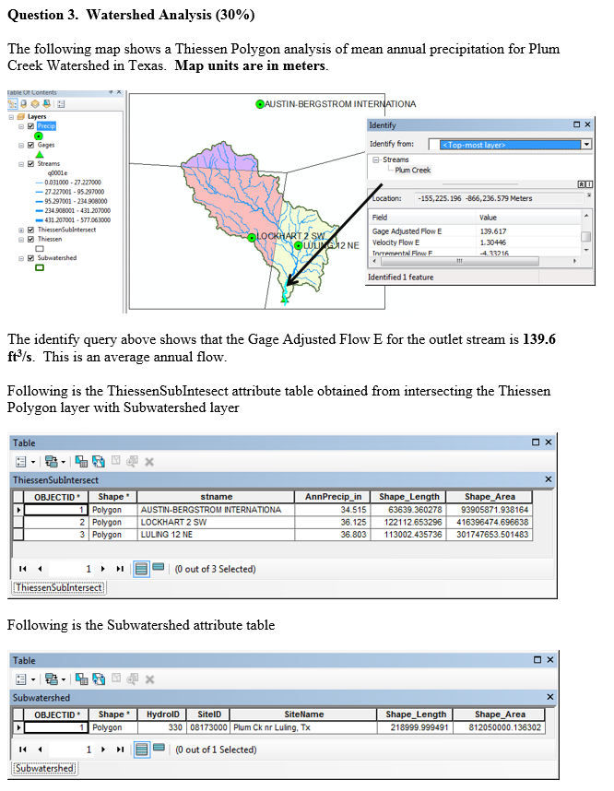
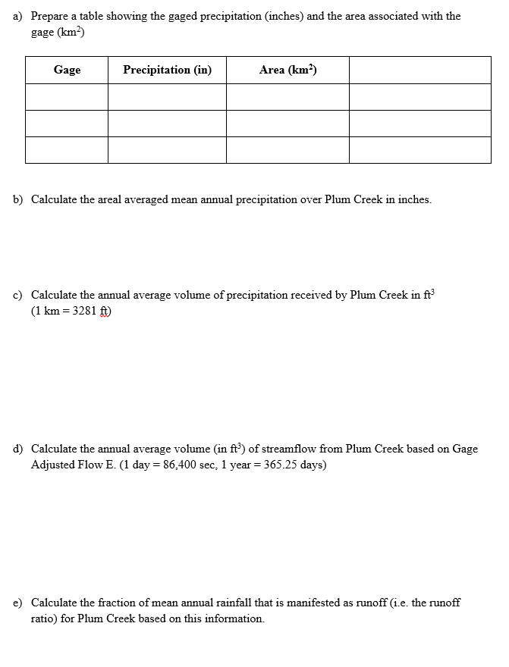

Slide 37
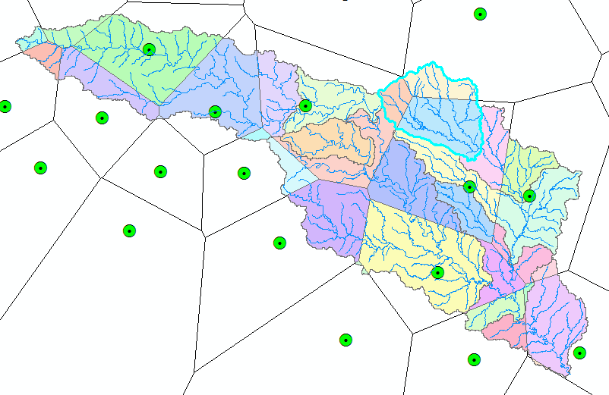
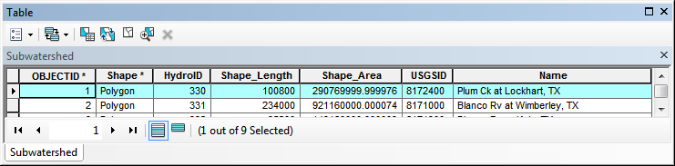
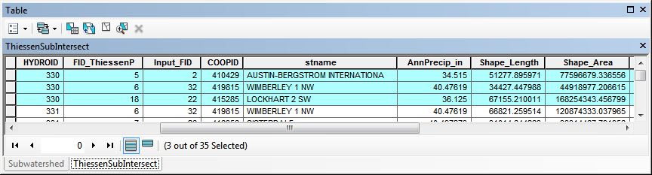
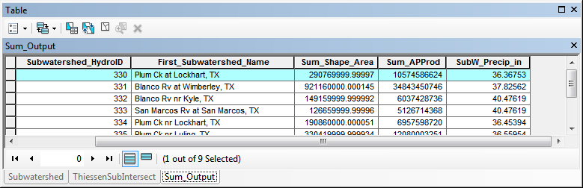
Subwatershed Precipitation by Thiessen Polygons
Thiessen Polygons
Intersect with Subwatersheds
Evaluate A*P Product
Summarize by subwatershed
$$P_{i}=\frac{\sum_{k}{A_{ik}P_{k}}}{\sum_{k}{A_{ik}}}$$

Slide 38
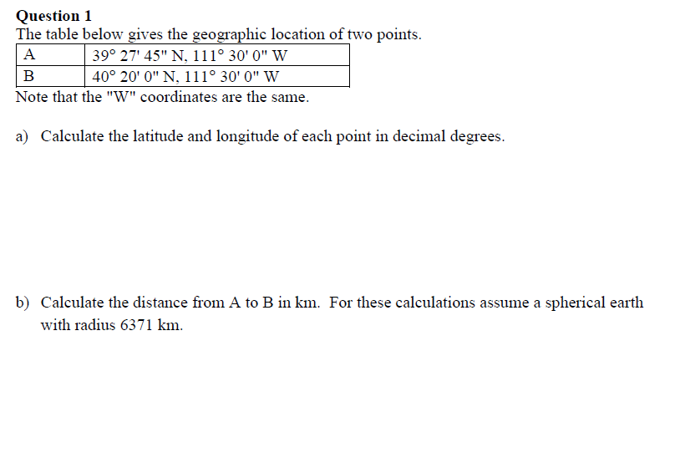
2013 Midterm Questions

Slide 39
Length on Meridians and Parallels
(Lat, Long) = (φ, λ)
Length on a Meridian:
AB = R_{e} Δφ
(same for all latitudes)
R
Δλ
D
30 N
R
C
R_{e}
Δφ
B
0 N
R_{e}
Length on a Parallel:
CD = R Δλ = R_{e} Δλ Cos φ
(varies with latitude)
A

Slide 40
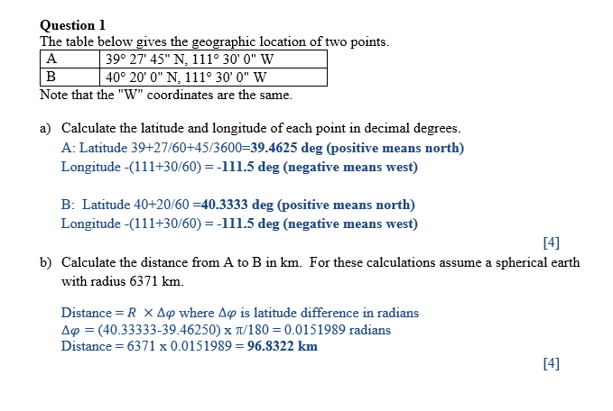

Slide 41
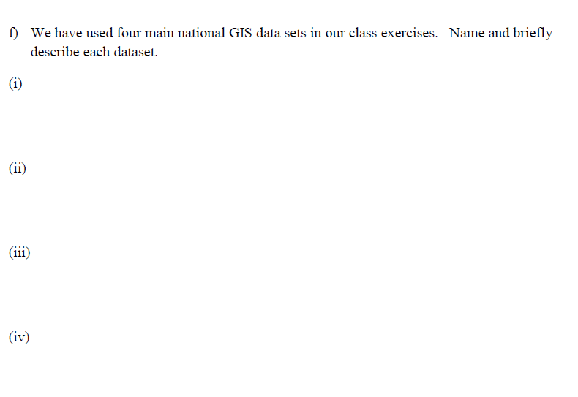

Slide 42
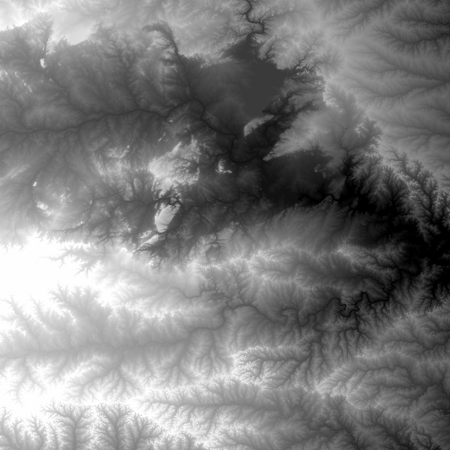
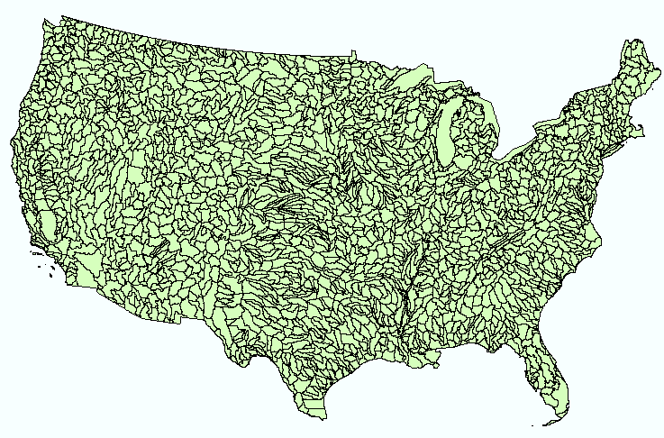
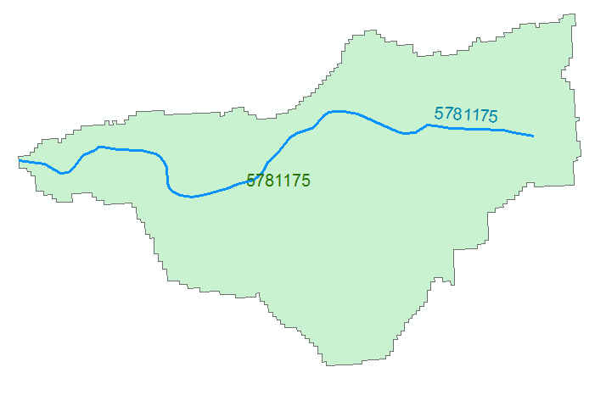
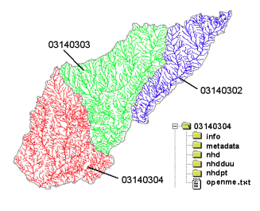
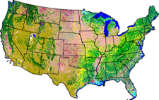
NHDPlus Version 2.1
Foundation for a Geospatial Hydrologic Framework for the United States
NHDPlus
2.7 million reach catchments in US
average area 3 km²
reach length 2 km
Uniquely labelled
National Elevation Dataset
Watershed Boundary Dataset
National Hydrography Dataset
National Land Cover Dataset

Slide 43
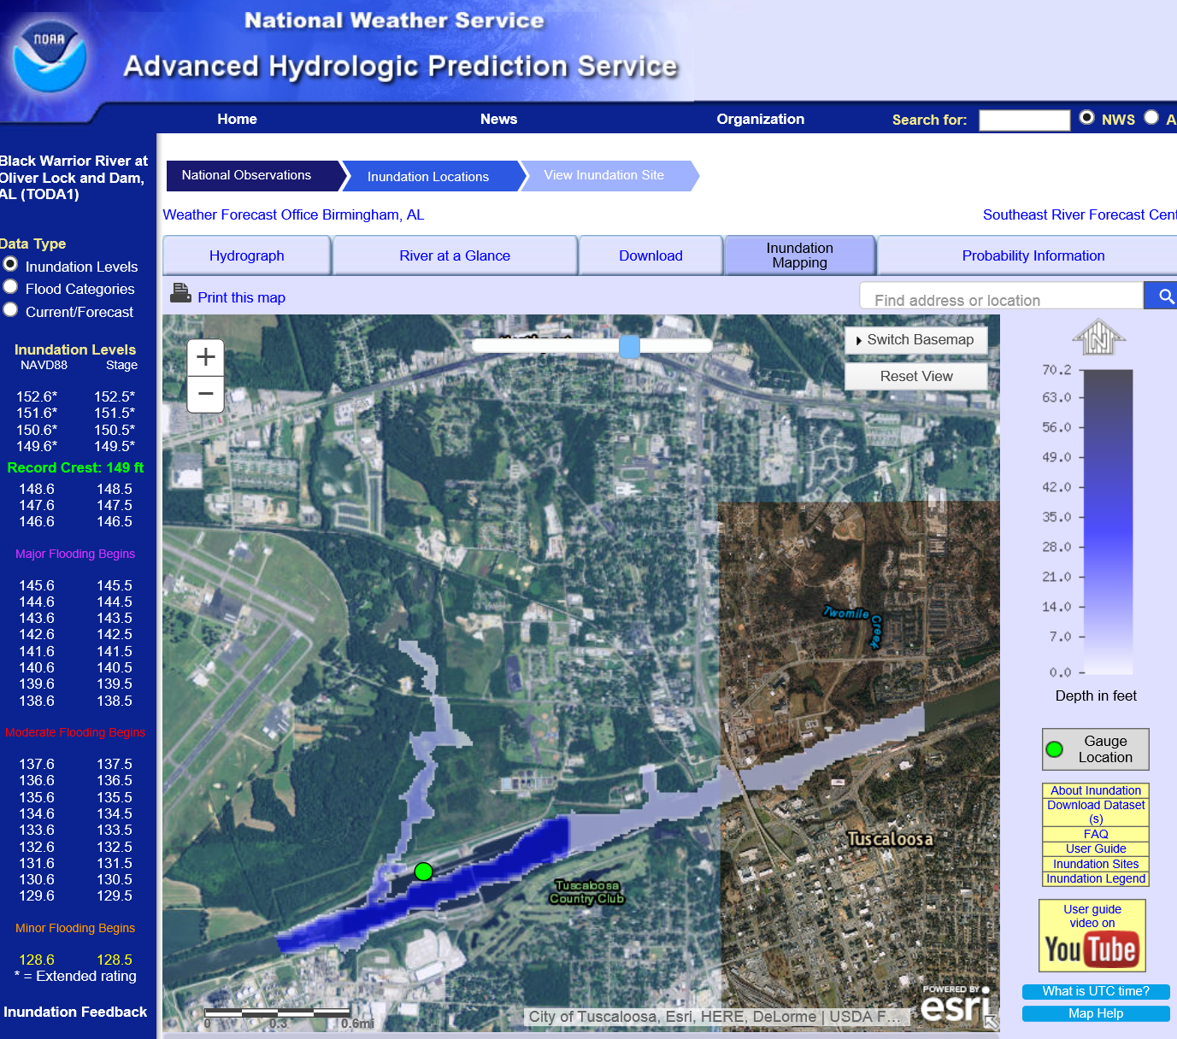
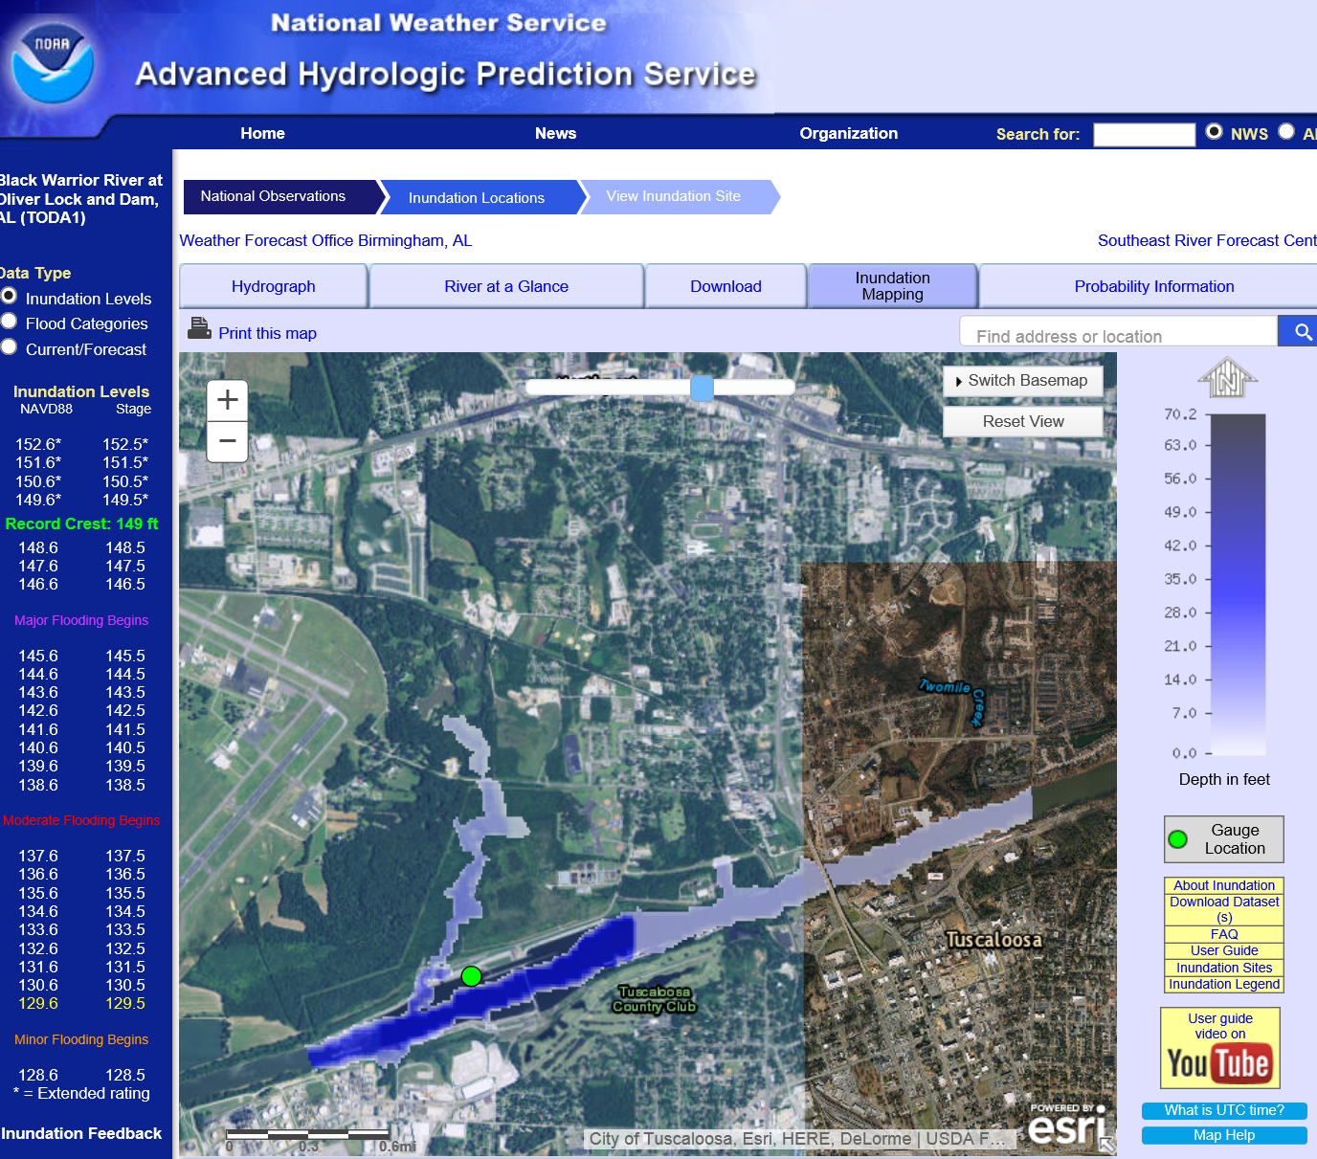
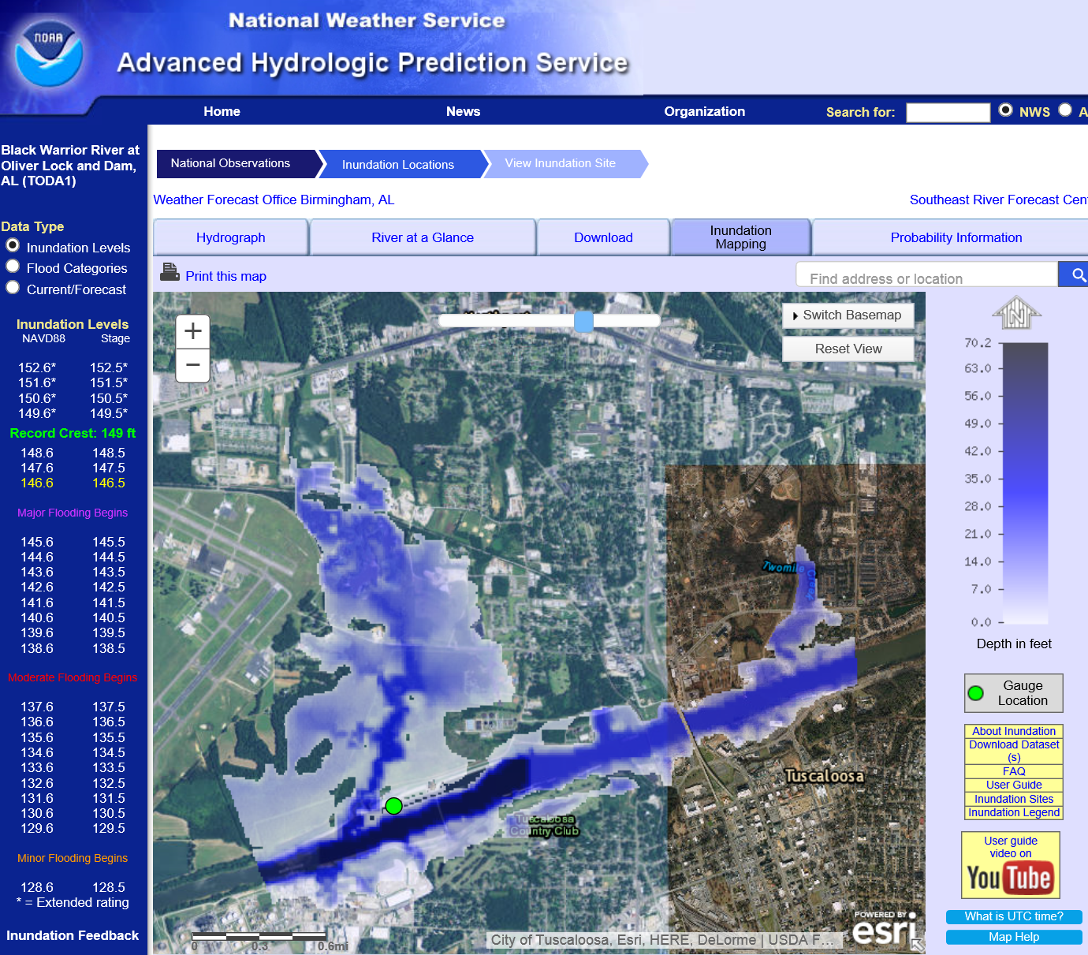
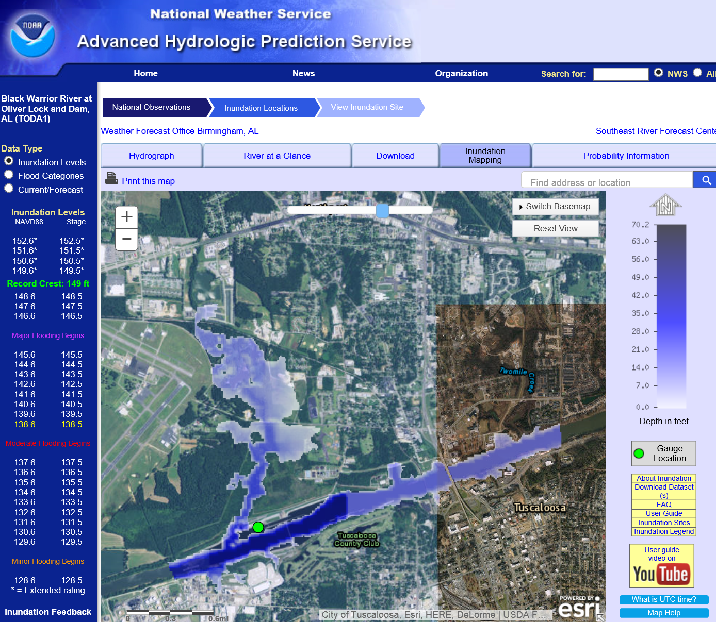
Real-Time Flood Inundation Mapping
Black Warrior River
at Oliver Lock and Dam
Flooding
Major
Moderate
Minor

Slide 44




Flood Inundation Mapping – NHDPlus-HAND Method
Water surface elevation
h = z + y
y
NHDPlus
h
z
Geodetic datum
Catchments and Flowlines
Height Above Nearest
Drainage (HAND)
(relative elevation of land
surface cell above cell in
NHDPlus stream to which it flows)
Inundation map
Height above
drainage < 15 ft)
Digital Elevation Model

Slide 45

Height above Nearest Drainage (HAND) evaluated using TauDEM Dinfinity Vertical Distance Down function
TauDEM Distance Down and Distance Up
Ridge
sr
sr
pr
pr
vr
Point of interest
Stream
ps
ps
ss
vs
ss
D∞
hr
hs
hr
hs
Vertical distance to stream evaluated as weighted average over multiple flow paths. This results in a “smooth” height above nearest stream layer
You should be able to interpret DEM elevations to be able to identify the height above the nearest stream and area of inundation

