Slide 1
Extending ArcGIS using programming
David Tarboton

Slide 2
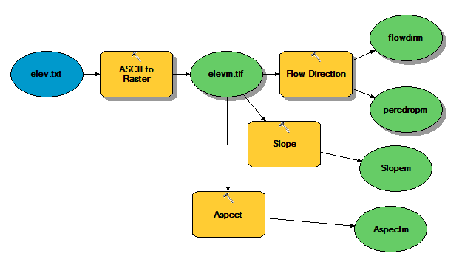
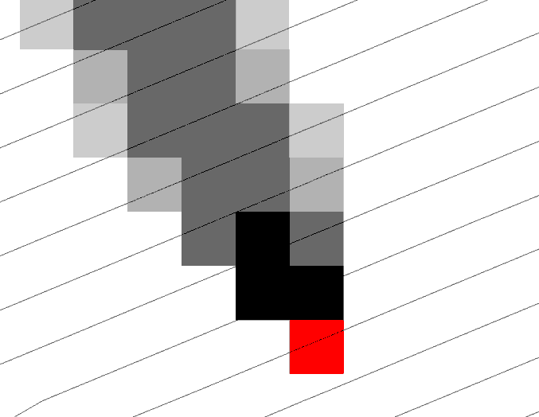
Why Programming
Automation of repetitive tasks (workflows)
Implementation of functionality not available (programming new behavior)

Slide 3
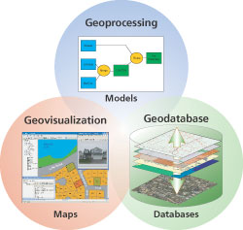
Three Views of GIS
Geodatabase view: Structured data sets that represent geographic information in terms of a generic GIS data model.
Geovisualization view: A GIS is a set of intelligent maps and other views that shows features and feature relationships on the earth's surface. "Windows into the database" to support queries, analysis, and editing of the information.
Geoprocessing view: Information transformation tools that derive new geographic data sets from existing data sets.
adapted from www.esri.com

Slide 4
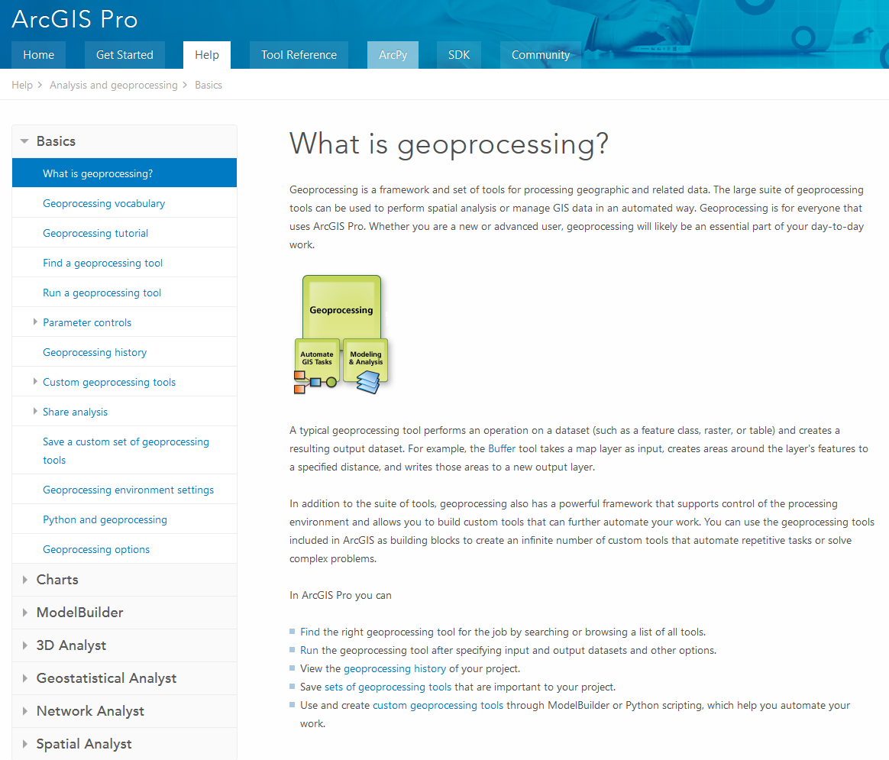
ArcGIS Pro Geoprocessing Help
http://pro.arcgis.com/en/pro-app/help/analysis/geoprocessing/basics/what-is-geoprocessing-.htm

Slide 5
ArcGIS programming options
Model builder
Python scripting environment
ArcObjects library (for system language like C++, .Net)
AML
Open standard data formats that anyone can use in programs (e.g. shapefiles, geoTIFF, netCDF)

Slide 6
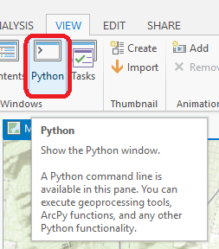
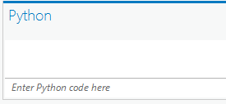
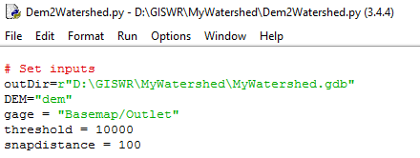

Python Environments
Python Window built into ArcGIS Pro
  http://pro.arcgis.com/en/pro-app/arcpy/get-started/python-window.htm
Idle: Simple editor that is part of Python
PyCharm: Powerful professional development environment, https://www.jetbrains.com/pycharm/

Slide 7
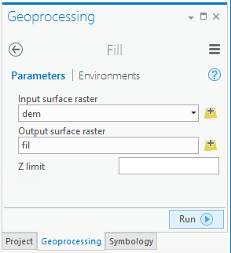
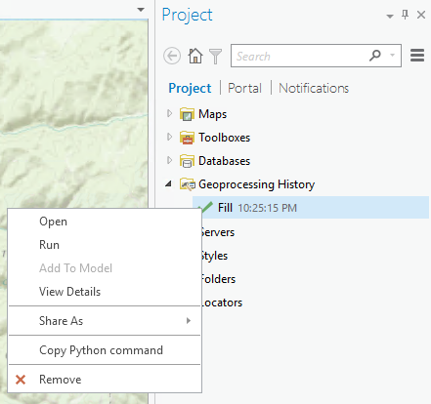
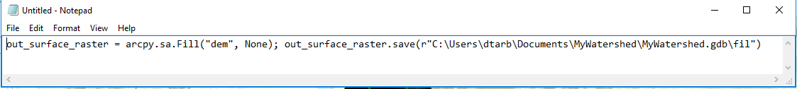
Each Geoprocessing tool has it’s own Python Command

Slide 8
Demo
Python code from Geoprocessing History
Use of Python Window
Python code from online help
Sequencing code into a script
Editing and running with Idle

Slide 9
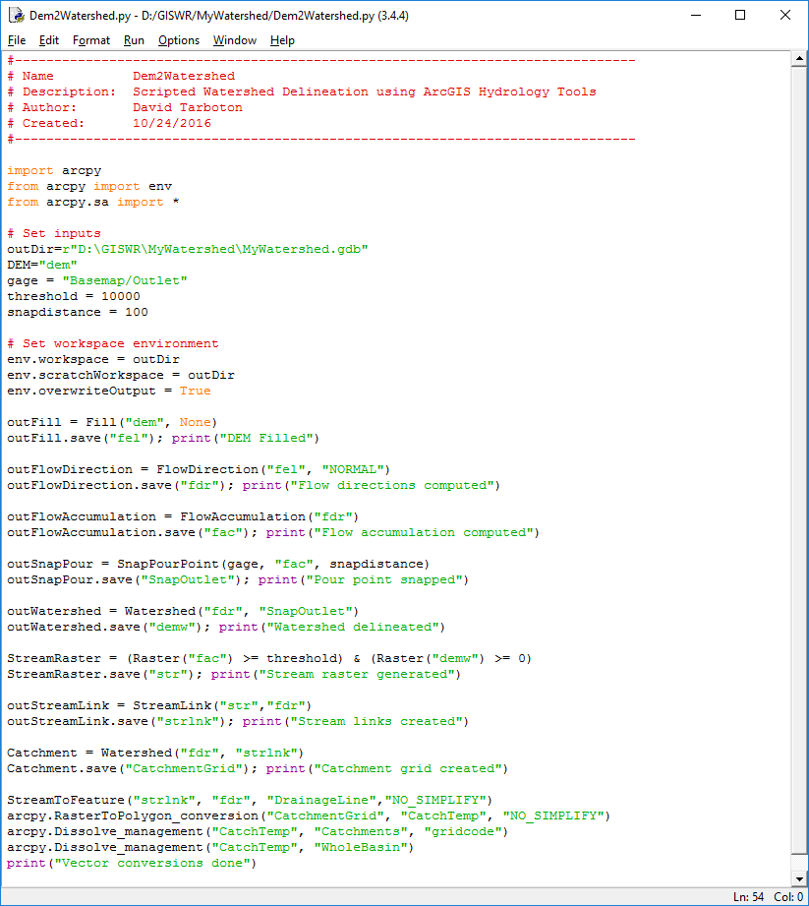
Example – Watershed delineation using Python
(Steps from Exercise 4)
Set Inputs
  DEM
  Outlet
  Threshold
Set workspace
Fill
Flow Direction
Flow Acumulation
Snap Outlet
Watershed
Stream Raster
Stream Link
Catchment
Vector Conversion
1
2
3
4
5
6
7
8
9
10
11

Slide 10
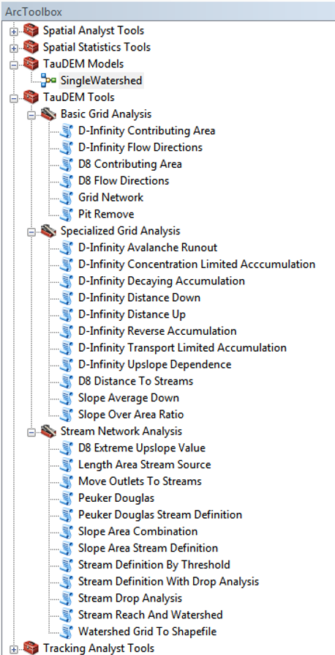
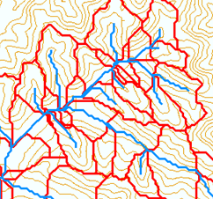
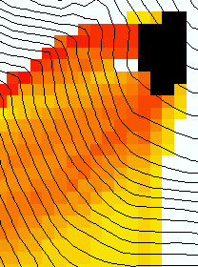
TauDEM
Stream and watershed delineation
Multiple flow direction flow field
Calculation of flow based derivative surfaces
MPI Parallel Implementation for speed up and large problems
Open source platform independent C++ command line executables for each function
Deployed as an ArcGIS Toolbox with python scripts that drive command line executables
http://hydrology.usu.edu/taudem/

Slide 11
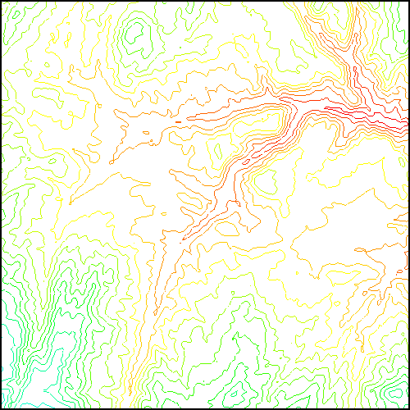
TauDEM Parallel Approach
MPI, distributed memory paradigm
Row oriented slices
Each process includes one buffer row on either side
Each process does not change buffer row
Improved runtime efficiency
Capability to run larger problems

Slide 12
Some Algorithm Details
Pit Removal: Planchon Fill Algorithm
Initialization
1st Pass
2nd Pass
Planchon, O., and F. Darboux (2001), A fast, simple and versatile algorithm to fill the depressions of digital elevation models, Catena(46), 159-176.

Slide 13
Parallel Scheme
Communicate
Initialize( Z,F) Do for all grid cells i if Z(i) > n F(i) ← Z(i) Else F(i) ← n i on stack for next pass endfor Send( topRow, rank-1 ) Send( bottomRow, rank+1 ) Recv( rowBelow, rank+1 ) Recv( rowAbove, rank-1 ) Until F is not modified
Z denotes the original elevation.
F denotes the pit filled elevation.
n denotes lowest neighboring elevation
i denotes the cell being evaluated
Iterate only over stack of changeable cells

Slide 14
Pseudocode for Recursive Flow Accumulation
Global P, w, A, Δ FlowAccumulation(i) for all k neighbors of i if P_{ki}>0 FlowAccumulation(k) next k return
P_{ki}

Slide 15
Generalization to Flow Algebra
Replace
P_{ki}
P_{ki}
P_{ki}
i
by general function

Slide 16
Parallelization of Flow Algebra
1. Dependency grid
2. Flow algebra function
Executed by every process with grid flow field P, grid dependencies D initialized to 0 and an empty queue Q. FindDependencies(P,Q,D) for all i for all k neighbors of i if P_{ki}>0 D(i)=D(i)+1 if D(i)=0 add i to Q next
Executed by every process with D and Q initialized from FindDependencies. FlowAlgebra(P,Q,D,θ,γ) while Q isn’t empty get i from Q θ_{i} = FA(γ_{i}, P_{ki}, θ_{k}, γ_{k}) for each downslope neighbor n of i if P_{in}>0 D(n)=D(n)-1 if D(n)=0 add n to Q next n end while swap process buffers and repeat

Slide 17
Parallelization of Contributing Area/Flow Algebra
1. Dependency grid
and so on until completion
resulting in new D=0 cells on queue
Queue’s empty so exchange border info.
Decrease cross partition dependency
Executed by every process with grid flow field P, grid dependencies D initialized to 0 and an empty queue Q. FindDependencies(P,Q,D) for all i for all k neighbors of i if P_{ki}>0 D(i)=D(i)+1 if D(i)=0 add i to Q next
A=1
A=1
A=1
A=1
A=1
A=1
A=1
A=1
D=0
A=1
A=1
A=1
A=1
D=0
D=0
A=1
A=1
A=1
D=0
D=0
A=1
D=0
A=1
A=1
A=1
A=1
A=1
A=1.5
A=1.5
A=3
D=0
A=1.5
A=1.5
D=1
D=0
D=1
D=0
D=0
A=3
D=0
D=3
D=2
D=1
D=0
D=0
D=1
D=1
A=1.5
D=1
A=1.5
A=3
A=3
A=1.5
A=1.5
2. Flow algebra function
B=-2
B=-1
Executed by every process with D and Q initialized from FindDependencies. FlowAlgebra(P,Q,D,θ,γ) while Q isn’t empty get i from Q θ_{i} = FA(γ_{i}, P_{ki}, θ_{k}, γ_{k}) for each downslope neighbor n of i if P_{in}>0 D(n)=D(n)-1 if D(n)=0 add n to Q next n end while swap process buffers and repeat
B=-2
B=-1
A=1
A=1
D=2
D=2
D=1
A=1
D=1
A=1
D=0
A=1
A=1
D=2
D=2
D=2
D=2
D=2
D=1
D=1
D=1
D=1
A=1
D=1
A=1
A=5.5
D=0
A=2.5
D=0
A=1
A=1
D=1
D=1
D=1
A=1
D=1
A=1
D=0
D=0
A=1
D=1
D=1
D=3
D=2
D=1
D=1
D=1
D=1
D=1
A=1
D=1
A=1
D=1
A=6
A=3.5
D=1

Slide 18
Programming
C++ Command Line Executables that use MPI
Use GDAL/OGR library to read and write datasets in open standard formats for exchange with other programs
ArcGIS Python Script Tools
Python validation code to provide file name defaults
Shared as ArcGIS Toolbox
Any computer
Requires ArcGIS

Slide 19
Q based block of code to evaluate any “flow algebra expression”
while(!que.empty())
{
//Takes next node with no contributing neighbors
temp = que.front(); que.pop();
i = temp.x; j = temp.y;
// FLOW ALGEBRA EXPRESSION EVALUATION
if(flowData->isInPartition(i,j)){
float areares=0.; // initialize the result
for(k=1; k<=8; k++) { // For each neighbor
in = i+d1[k]; jn = j+d2[k]; flowData->getData(in,jn, angle);
p = prop(angle, (k+4)%8);
if(p>0.){
if(areadinf->isNodata(in,jn))con=true;
else{
areares=areares+p*areadinf->getData(in,jn,tempFloat);
}
}
}
}
// Local inputs
areares=areares+dx;
if(con && contcheck==1)
areadinf->setToNodata(i,j);
else
areadinf->setData(i,j,areares);
// END FLOW ALGEBRA EXPRESSION EVALUATION
}
C++

Slide 20
Maintaining to do Q and partition sharing
C++
while(!finished) { //Loop within partition
while(!que.empty())
{ .... // FLOW ALGEBRA EXPRESSION EVALUATION
}
// Decrement neighbor dependence of downslope cell
flowData->getData(i, j, angle);
for(k=1; k<=8; k++) {
p = prop(angle, k);
if(p>0.0) {
in = i+d1[k]; jn = j+d2[k];
//Decrement the number of contributing neighbors in neighbor
neighbor->addToData(in,jn,(short)-1);
//Check if neighbor needs to be added to que
if(flowData->isInPartition(in,jn) && neighbor->getData(in, jn, tempShort) == 0 ){
temp.x=in; temp.y=jn;
que.push(temp);
}
}
}
}
//Pass information across partitions
areadinf->share();
neighbor->addBorders();

Slide 21
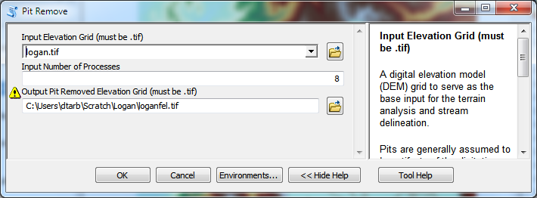
Python Script to Call Command Line
mpiexec –n 8 pitremove –z Logan.tif –fel Loganfel.tif

Slide 22
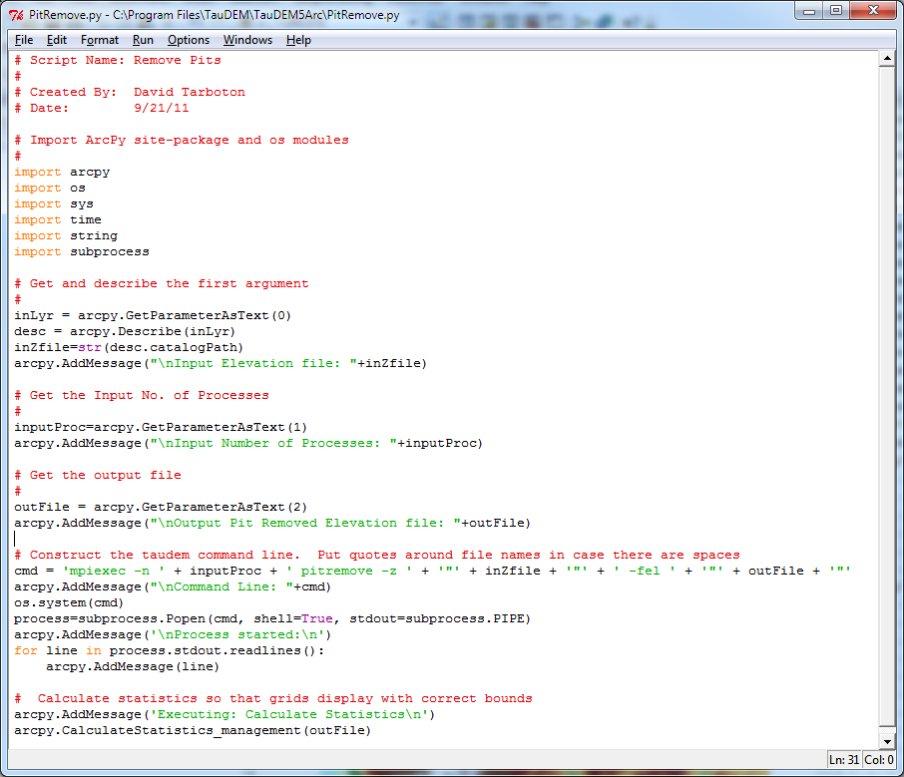
PitRemove
Python

Slide 23
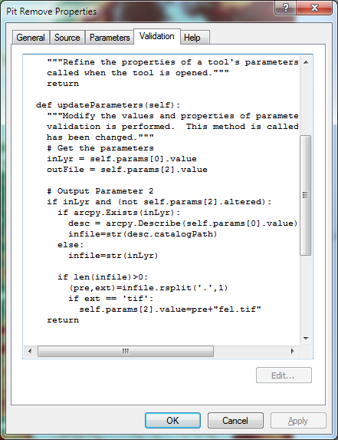
Validation code to add default file names
Python

Slide 24
Summary
GIS and Water Resources analysis capabilities are readily extensible with programming
to do something new
to repeat something needed frequently
Model builder provides visual programming and helps learn ArcGIS python commands
Python – cross platform, powerful and easy to use is a good programming language to start with (when your time is valuable)
Compiled language programming for developers (C++) to achieve optimal efficiency (when the computers time is valuable)

