Slide 1
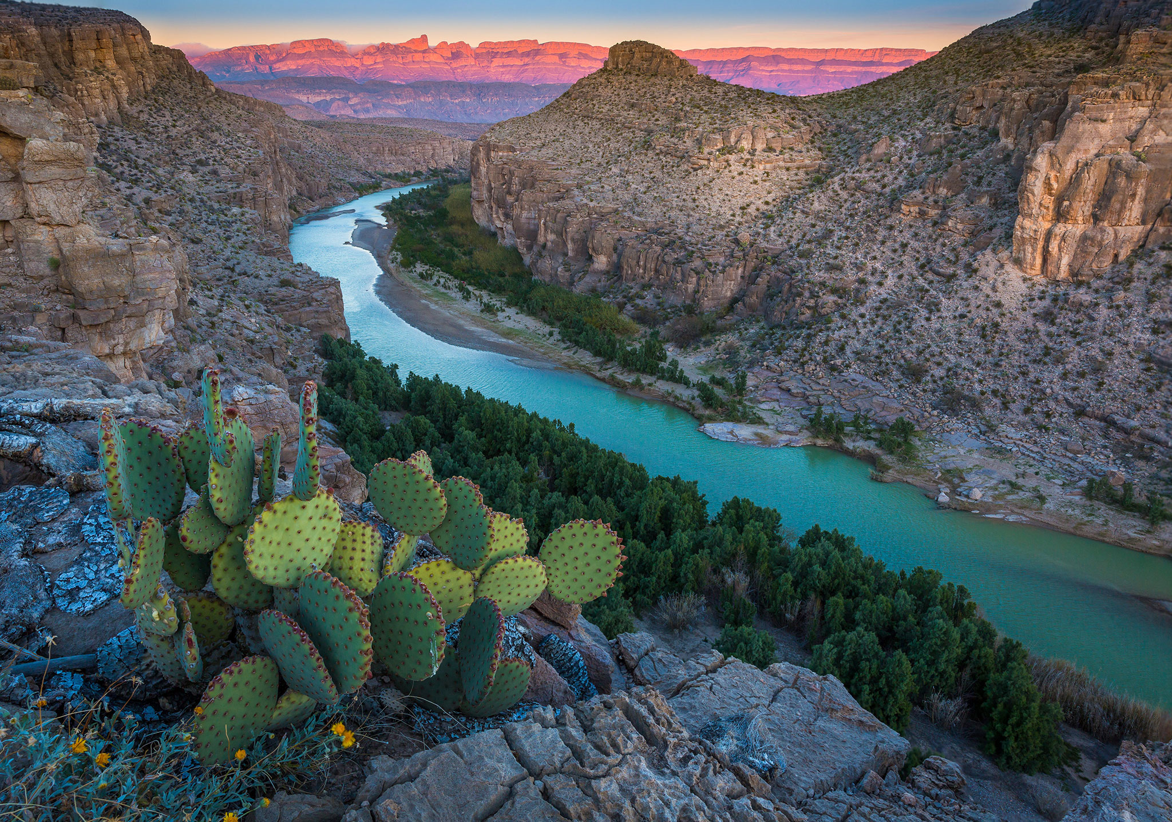
Assessing Basin-wide Water
Availability to Meet Treaty Obligations:
Rio Conchos, Mexico
Jake T. Ward
Fall 2017

Slide 2
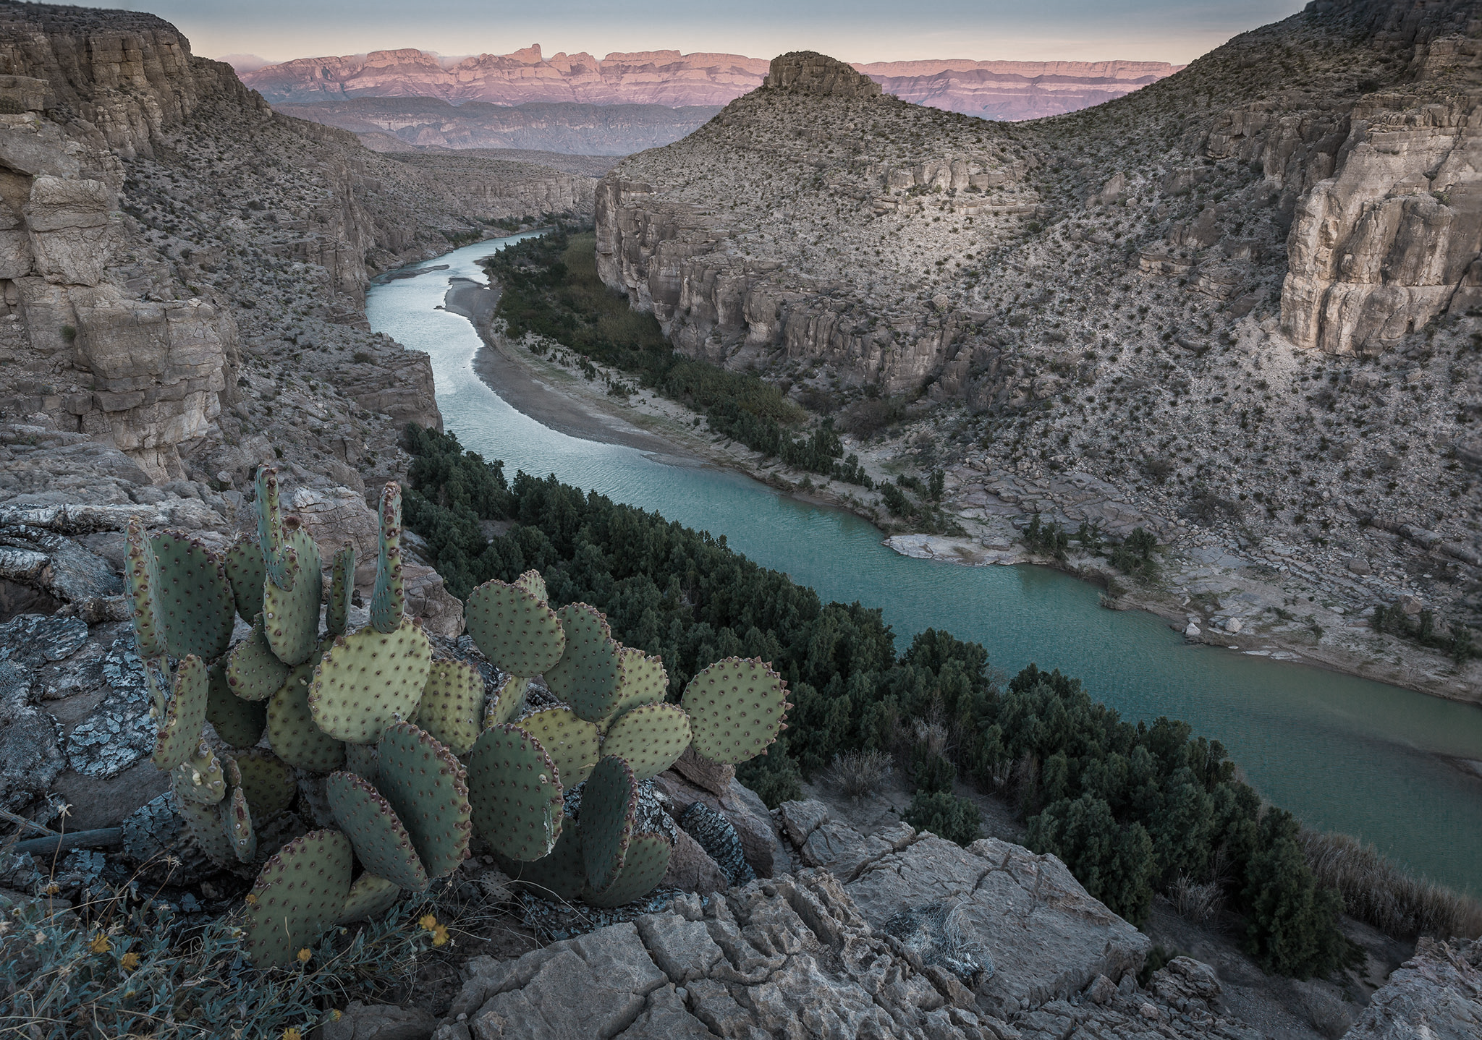
Project Motivation
Cross-disciplinary study: linking international policy to hydrological sciences/engineering
Mexico has treaty arrangements with U.S. to deliver water to Lower Rio Grande from Rio Conchos
Regional surface and groundwater water availability assessments are limited
Future Use: Engage stakeholders through visual platform
Jake T. Ward
Fall 2017

Slide 3
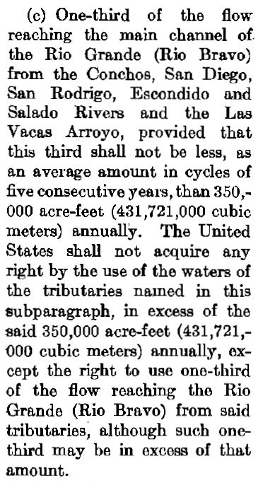
Background:Treaty of 1944
Mexico-U.S. treaties extending back to 1848
Development on Lower Rio Grande and need for shared water use on Colorado River results in Treaty of 1944
Article 4:
to Mexico
2/3 of Rio Conchos Flow
to United States
1/3 of Rio Conchos Flow
(350,000 AF/Yr)
Renames Int’l Management Institution, IBWC
Mexico accrues “water debts”
Jake T. Ward
Fall 2017
Notes:
Up to 1.5 million AF in 2002

Slide 4
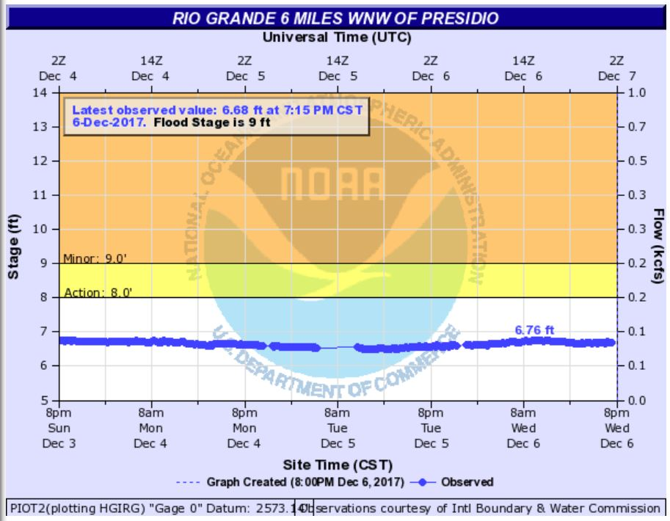
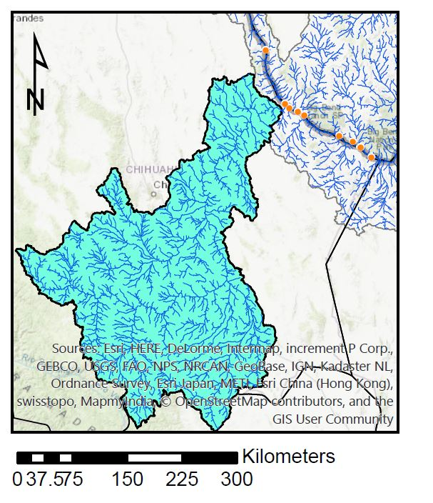
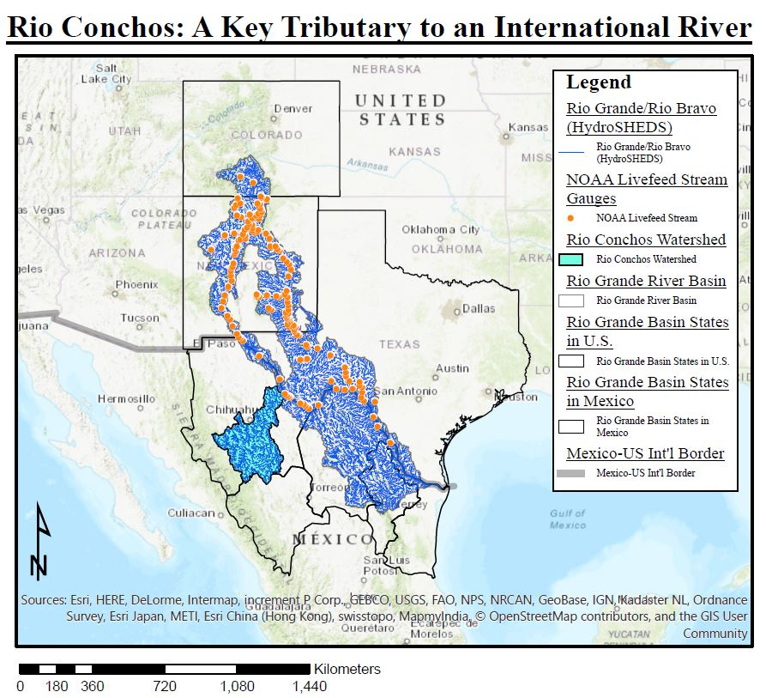
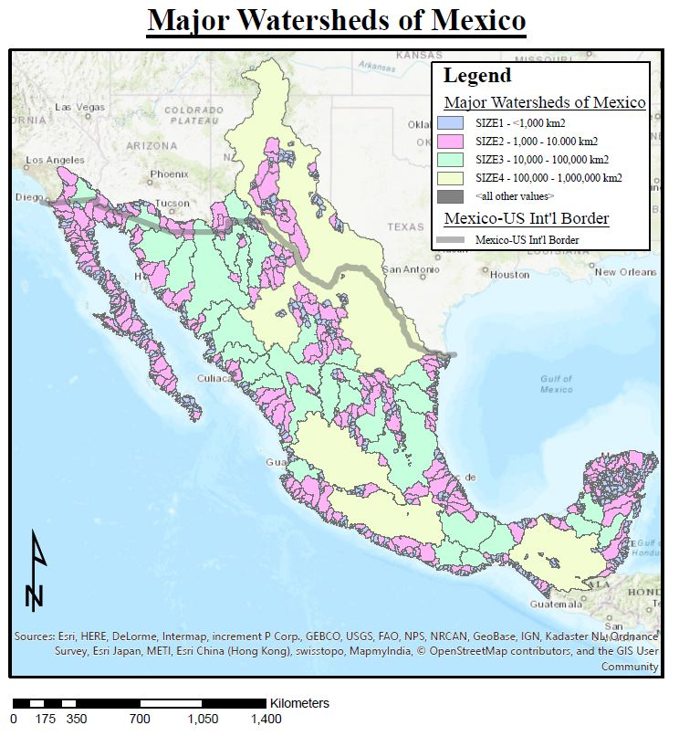
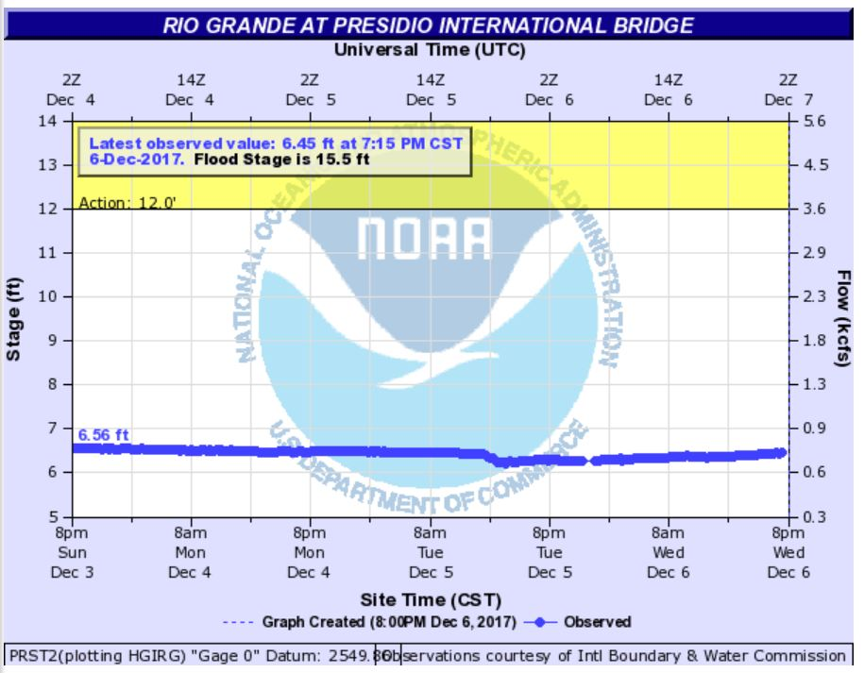
Regional
Context
Jake T. Ward
Fall 2017
Notes:
Chihuahua
Durango
Coahuila
Nuevo Leon
Tamaulipas
560 km
68,000 km2
Average 850 cfs

Slide 5
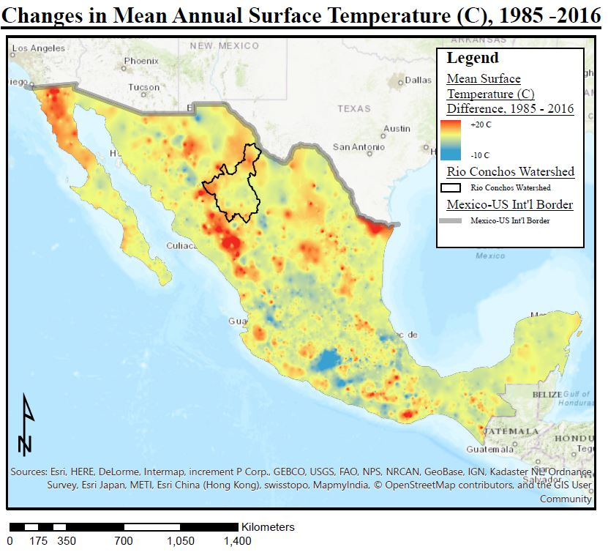
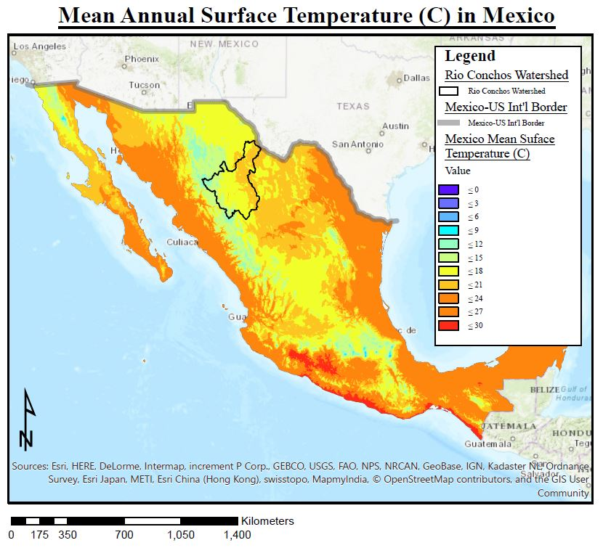
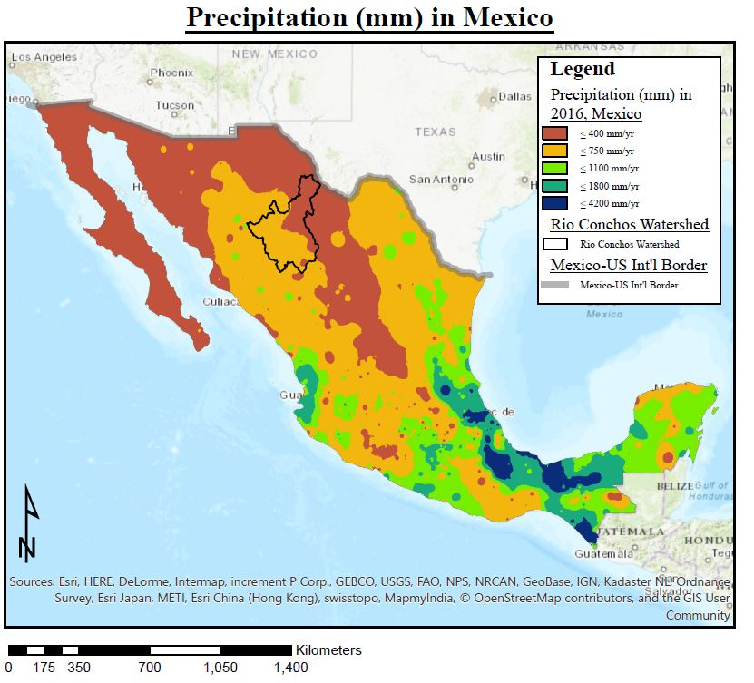
Regional
Climate
Jake T. Ward
Fall 2017
Notes:
Mean Surface Temp 15-20C
2 + C

Slide 6
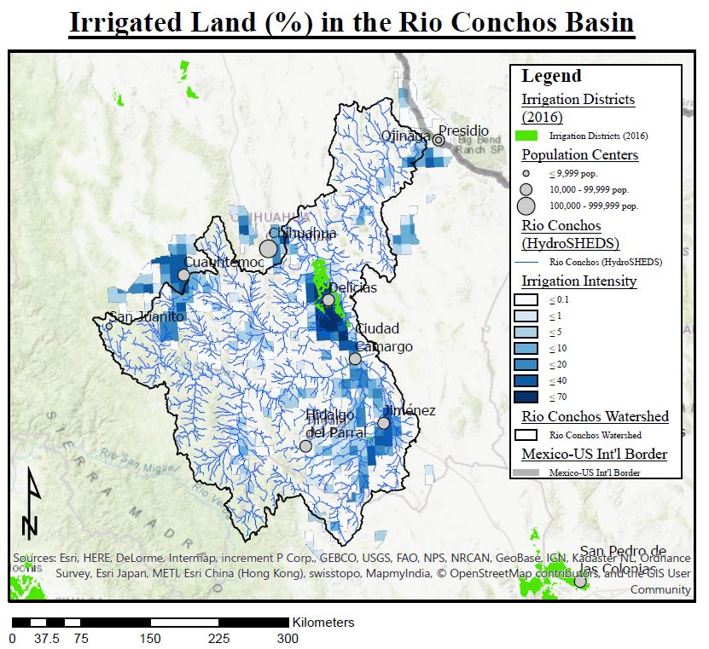
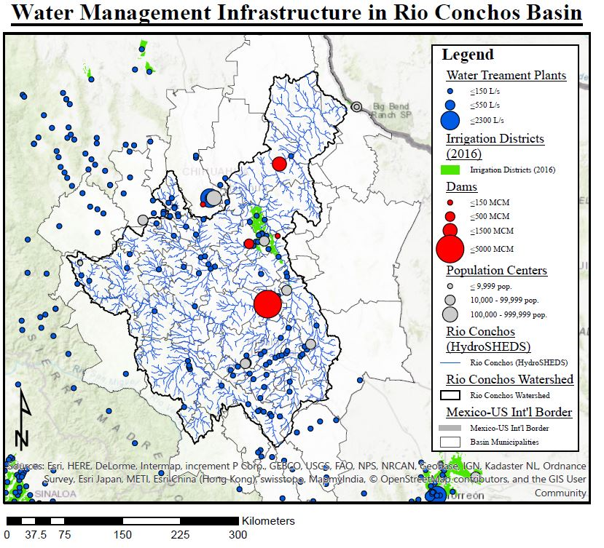
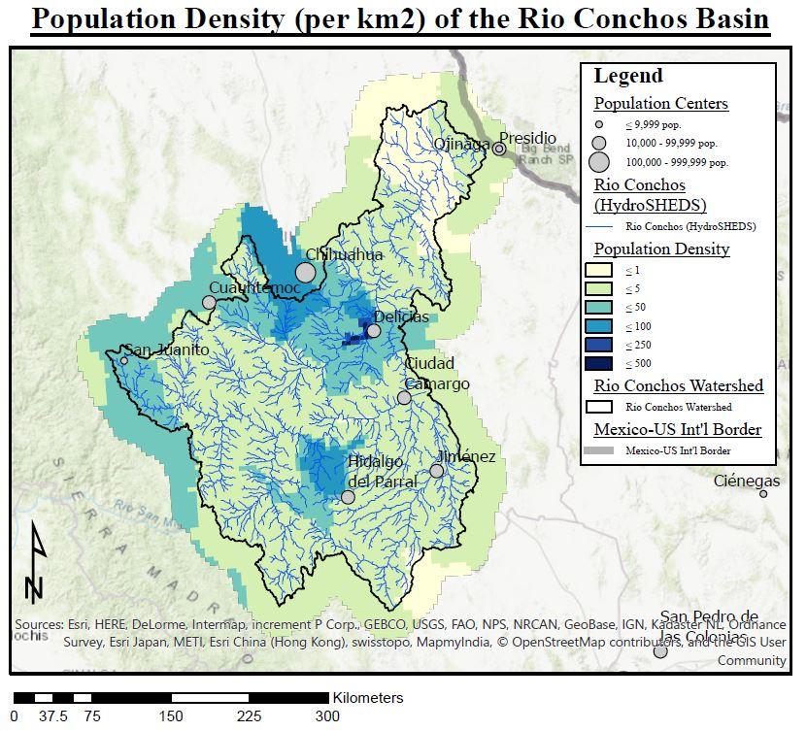
Rio Concho
Institutional
Setting
Jake T. Ward
Fall 2017
Notes:
Who are the regional (basin-wide) institutional players that will facilitate management
800,000 + in Chihuahua MX

Slide 7
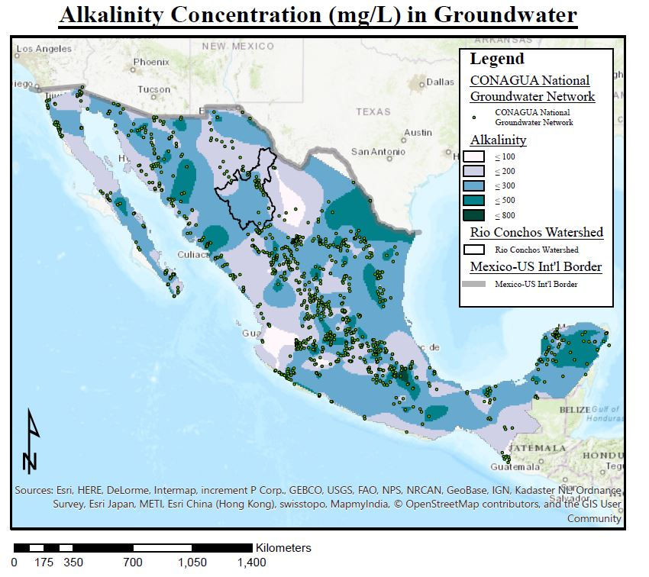
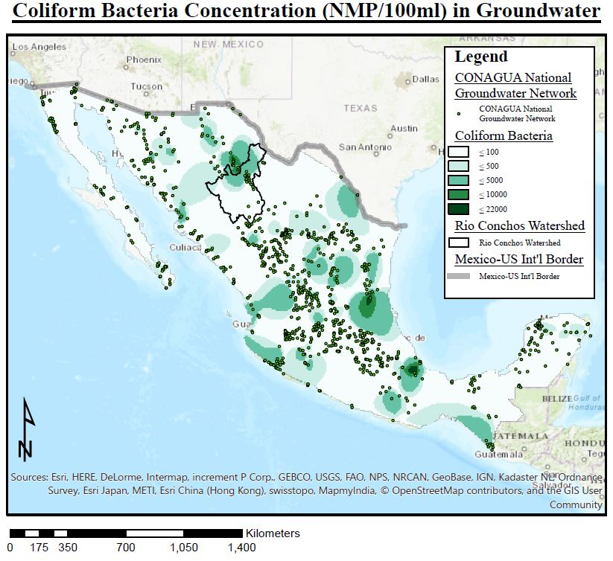
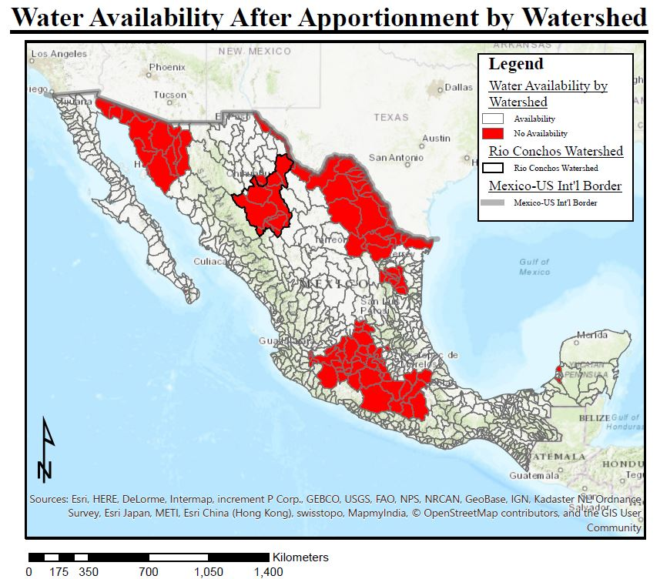
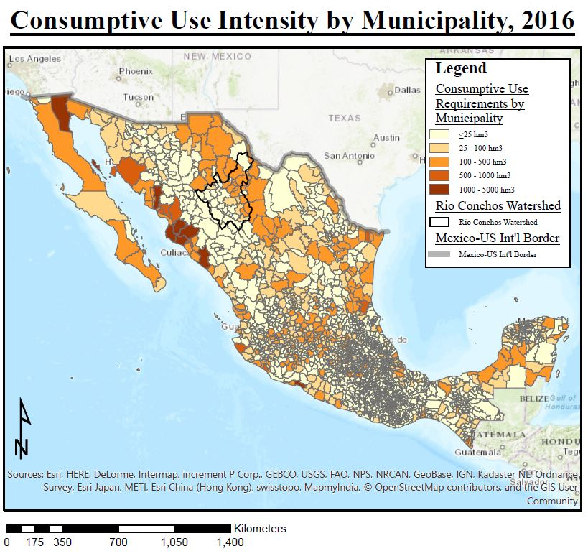
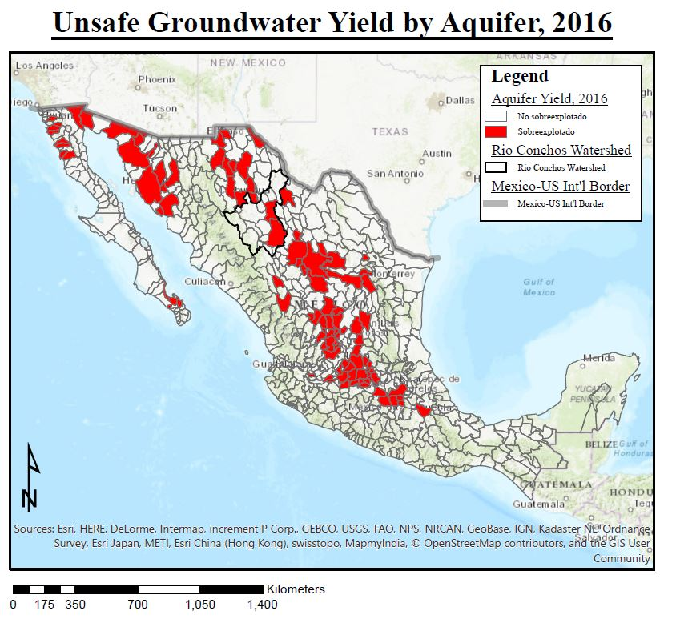
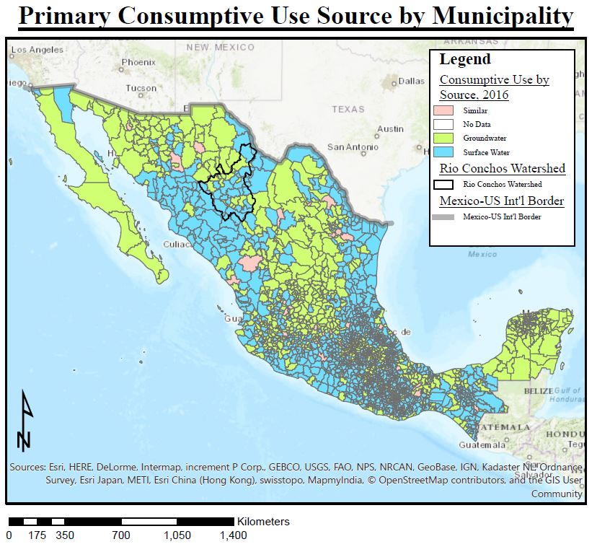
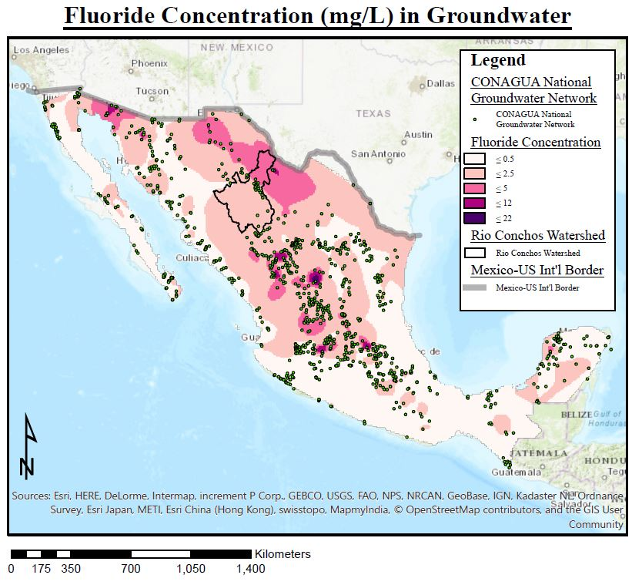
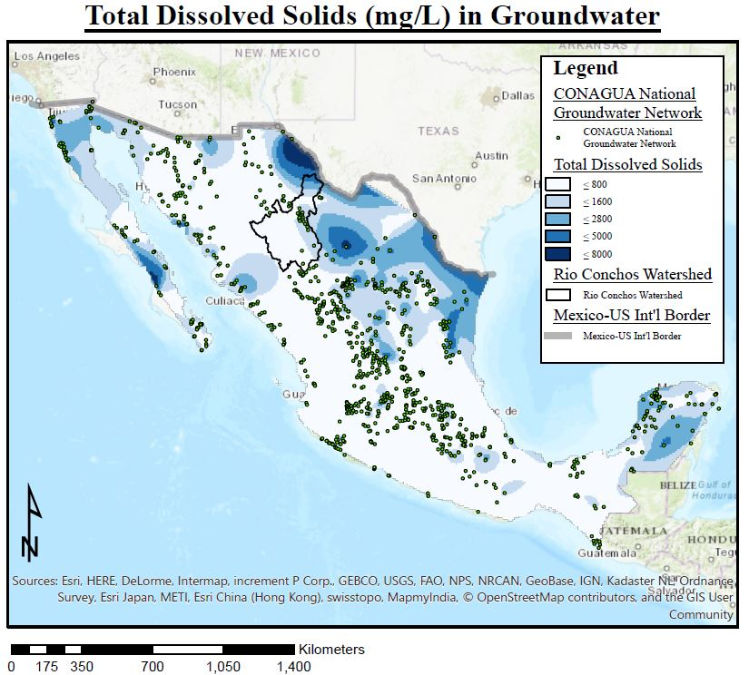
Surface
Water or Groundwater?
Jake T. Ward
Fall 2017
Notes:
Centralized Water Management

Slide 8
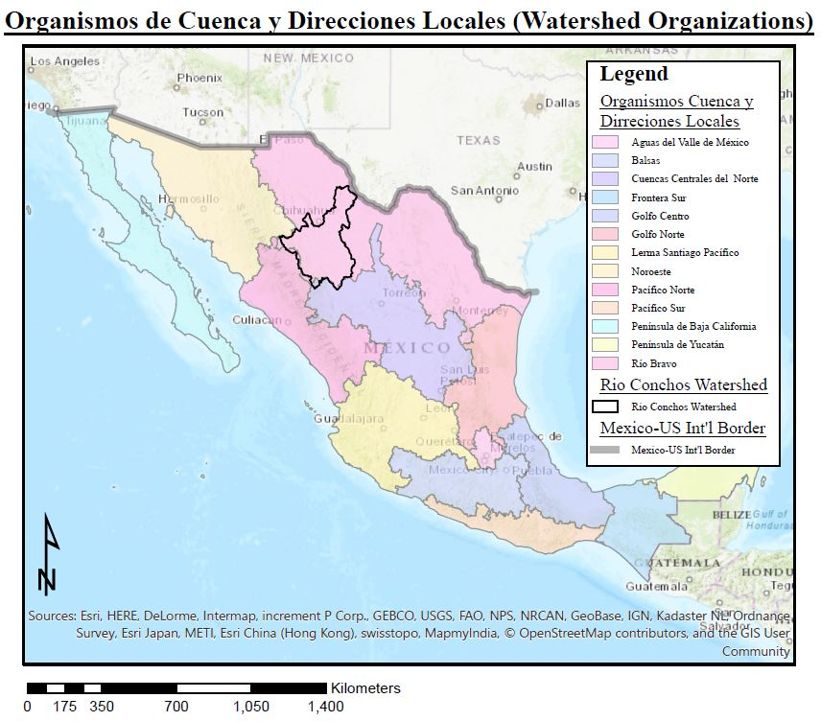
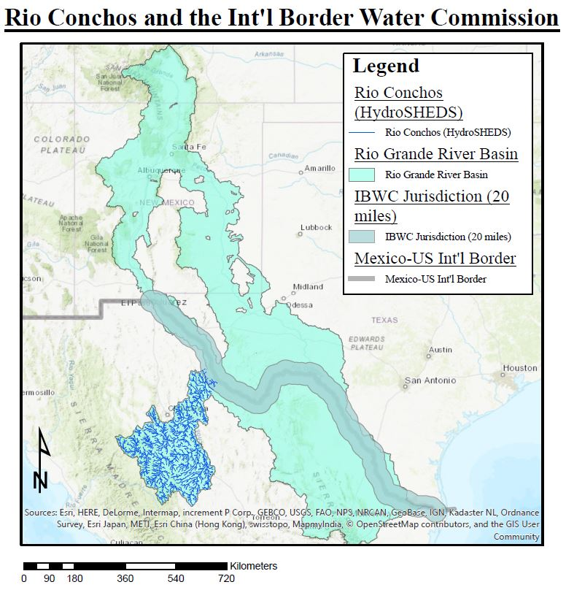
Sustainable Water Management
to Meet Int’l Obligations
Jake T. Ward
Fall 2017
Notes:
Who are the regional (basin-wide) institutional players that will facilitate management
800,000 + in Chihuahua MX

Slide 9
Questions?
Jake T. Ward
Fall 2017

