Slide 1
November 2016
Flooding in Manayunk Neighborhood of Philadelphia
Sam Brodfuehrer
Graduate Research Assistant, The University of Texas at Austin

Slide 2
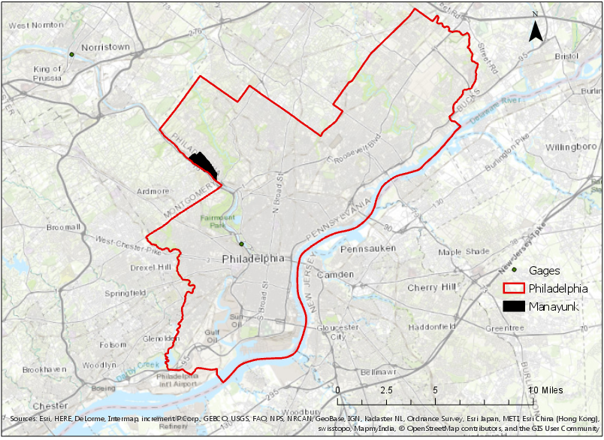
Philadelphia Geography

Slide 3
Manayunk

Slide 4
Manayunk Floods
Three Major Floods
Hurricane Floyd, 1999
Hurricane Irene, 2011
Flash Flood 2014

Slide 5
Manayunk Brewery

Slide 6
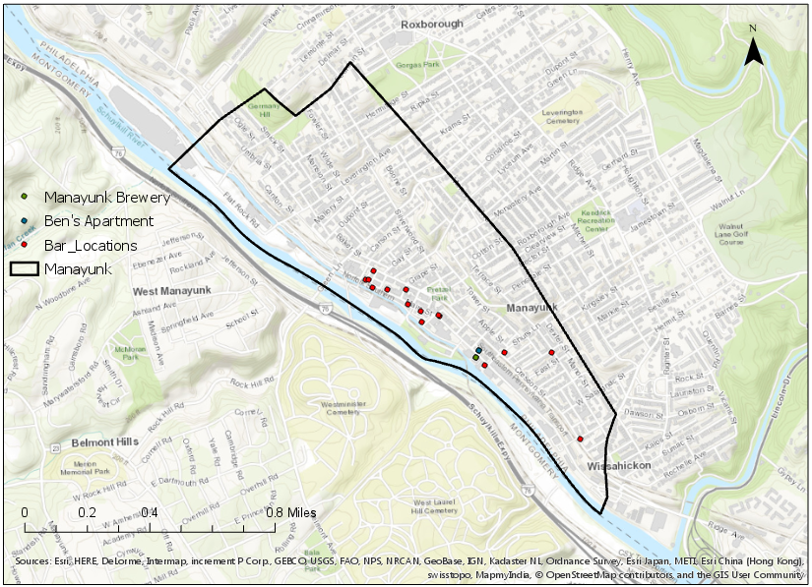
Map of Manayunk

Slide 7
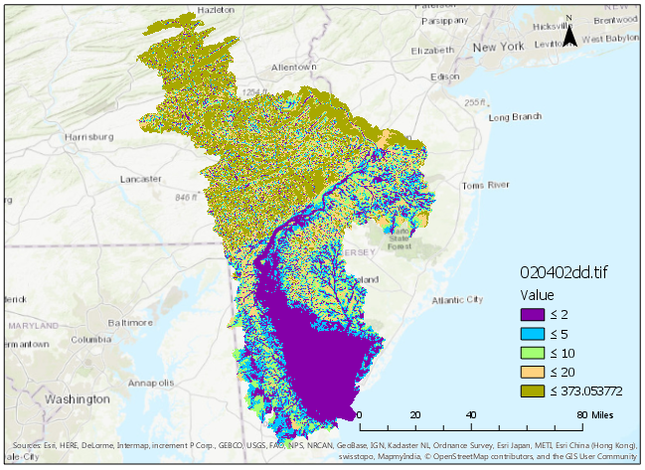
HAND Raster: HUC 020402

Slide 8
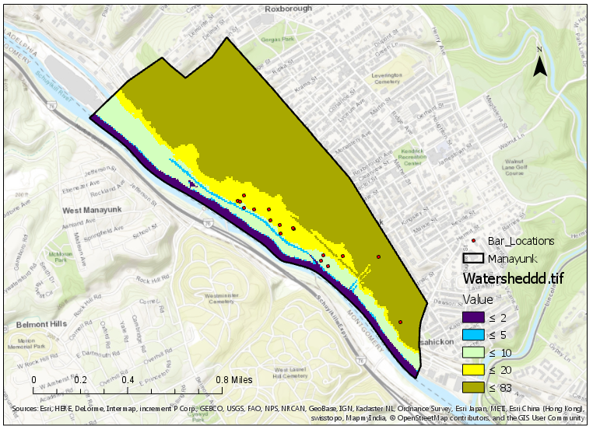
HAND Raster: Manayunk

Slide 9
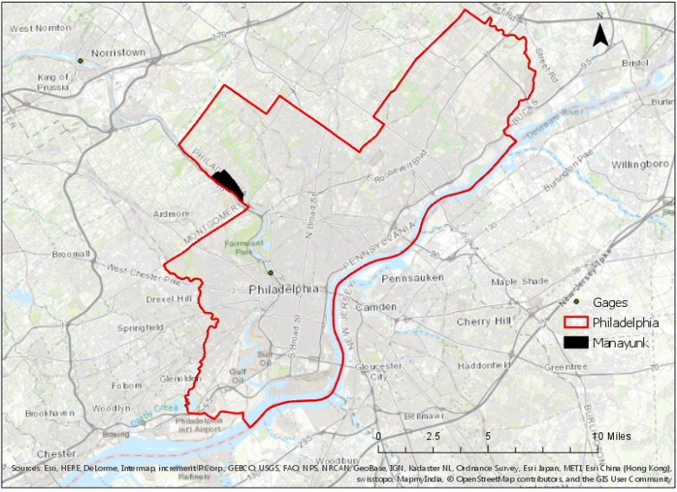
Rating Curve for Schuylkill River

Slide 10
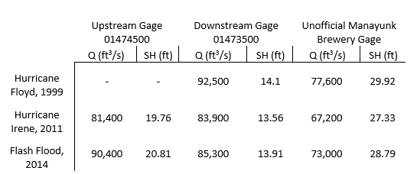
Gage Data

Slide 11
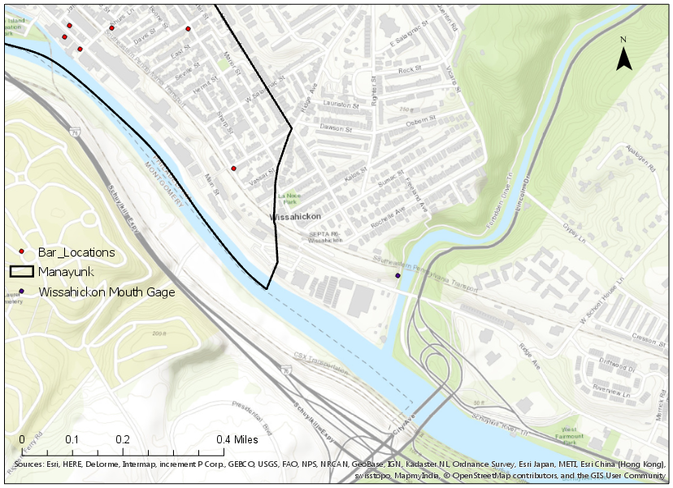
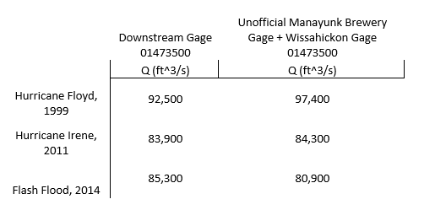
Gage Data Continued

Slide 12
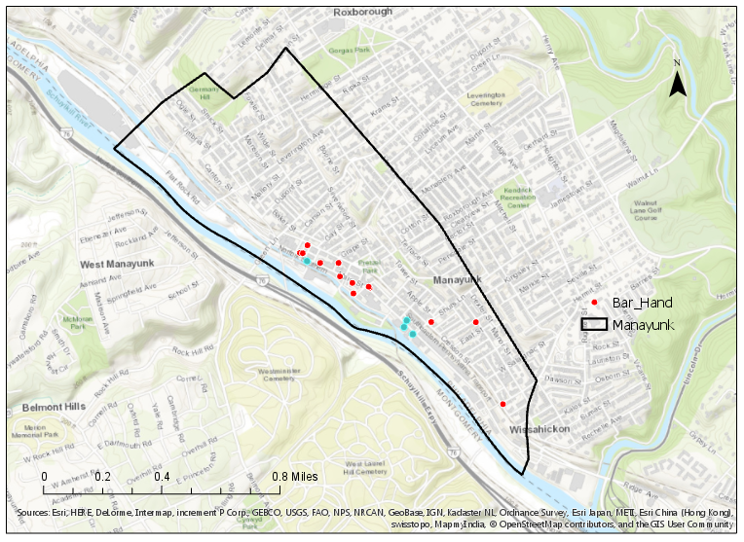
Bars Flooded during Major Floods
4 locations flooded
Flooding concentrated
around Manayunk
Brewery

Slide 13
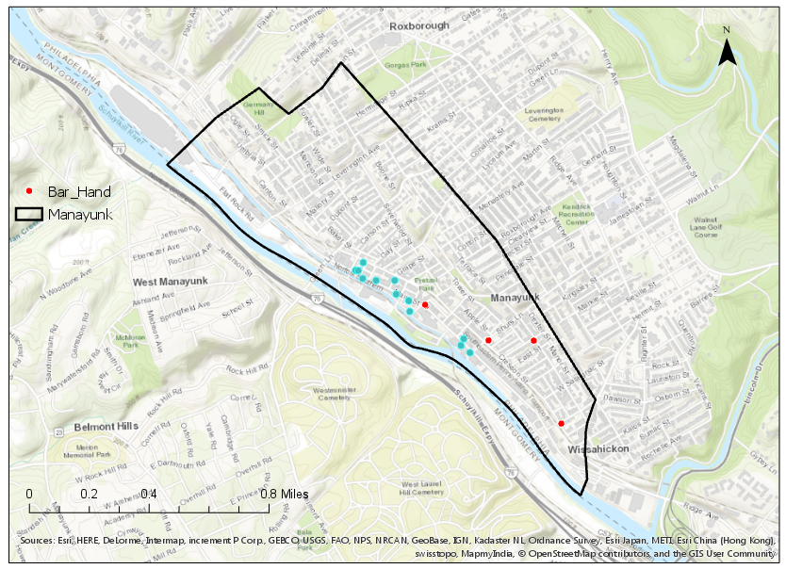
Bars Flooded at 42.5 ft Stage Height
12 locations flooded
Flooding all along
Main Street

Slide 14
Conclusions
Flooding is concentrated around Manayunk Brewery (including Ben’s Apartment)
Based on HAND and unofficial gage, significant flooding occurs around 25 ft stage height
Rating curve was able to calculate reasonable discharge flows

Slide 15
Questions?

