Slide 1
Long-Term Human Impact on a Neotropical Watershed in the Belize-Guatemala Transboundary Area:
Assessing relationship between humanization of landscape and flood potential
LEILA DONN | DEPT. OF GEOGRAPHY AND THE ENVIRONMENT

Slide 2
Research Overview
Human-environment interactions in tropical watersheds are poorly understood
Understanding human influence on floodplains can help make predictions for the future
By 2050, over half the world’s population will live in the tropics (Roberts et al. 2017)
Belize River Valley offers a 4ky + record of human-environment interaction
Conceptually model linkages between climate change, human activity, flood regimes, settlement patterns
Notes:
Tropical watersheds are poorly understood
By 2050 half of world’s population will live in tropics
Long histories of human use
Belize River Valley has long record of humanization, from Maya Archaic to present
Currently active agricultural area
We need to understand our impacts over time
Thesis
Conceptual model of river valley formation and influence of human v. natural drivers
To get at these questions need to understand linkages between climate, geomorphology, flood regimes, and human activity through time
Beginning with 3-mile stretch of river with known archaeological sites
Using GIS and LiDAR, fieldwork, labwork
Methods from geography, geoscience and geoarchaeology
Will include flood regimes
Inform flood management systems and resource use today

Slide 3
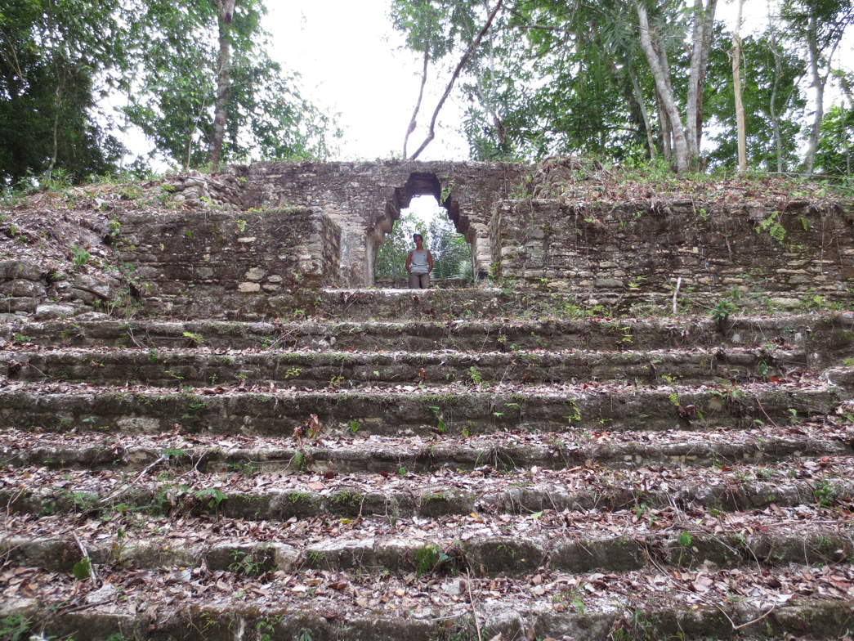
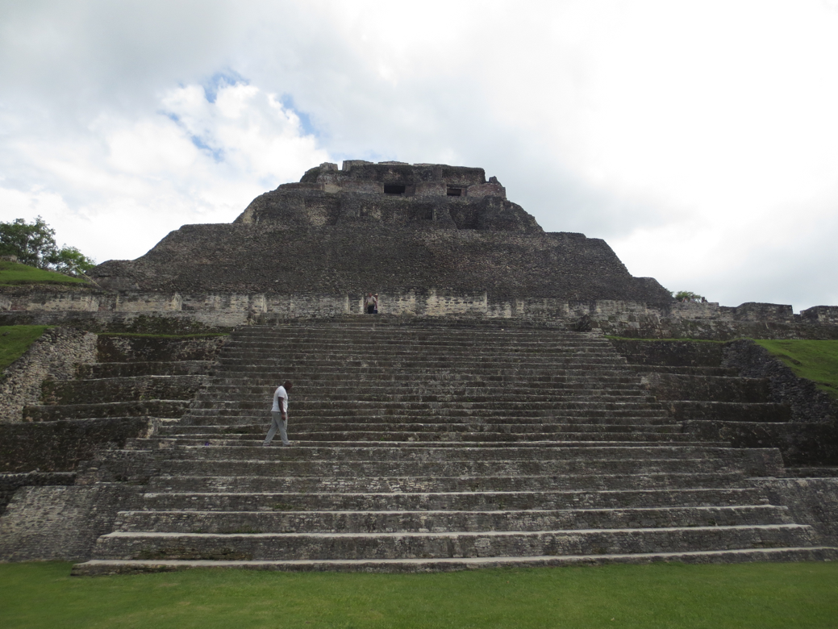
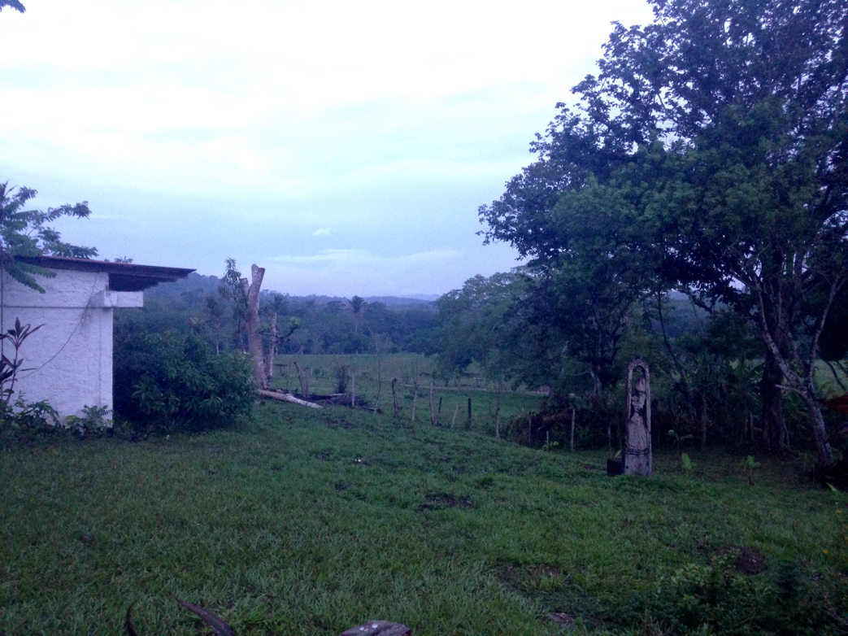
Study Site
Notes:
Spring 2017 used LiDAR (acquired by UTSA) to conduct preliminary study of geomorphology
First mapped valley geomorphology and areas of probable sediment aggradation with stratigraphic exposures, near to Maya sites
Summer 2017 I opportunistically sampled and described accessible exposures
Field characterization included Munsell, profile description, magnetic susceptibility (ID buried soils, fire)
Shipped to UT Austin for lab analysis

Slide 4
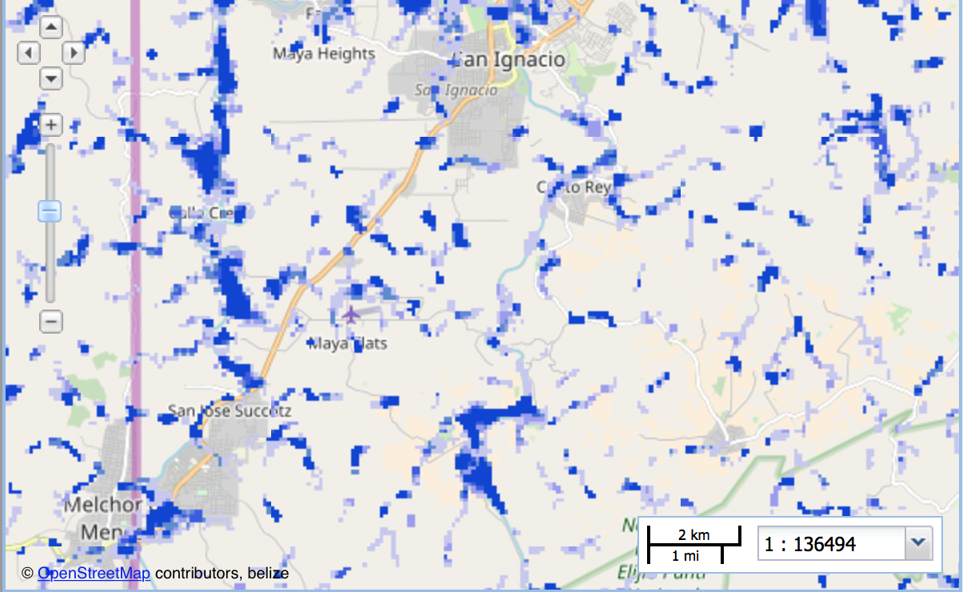
FLOOD MAPPING
HAND inundation maps for modern floodplain
Based on LiDAR and ground-truthed flood deposits
Then, expand study area based on maps
Generate paleoflood map
Notes:
I’ll use LiDAR imagery, ground-truthed flood deposit locations + ArcGIS to create flood potential maps
First will map modern river system
Then will build flood potential maps using HAND method
Provide insight into landscape formation through aggradation and/or erosion
Will correlated with presence of Maya sites
Will help differentiate between human v. natural flood drivers through relationship between landesque capital, known flood sediment, and mapped probability of inundation
Basis for larger study, including flood map for paleofloodplain 4 meters below current floodplain
Master’s phase will help create more targeted sampling plan
Focus on areas with excellent, long-term flood records
Compare range of humanized profiles

Slide 5
Step 1: Stream Delineation
Currently available online
Notes:
Not great stuff available online. Working on it, but running into lots of little problems.

Slide 6
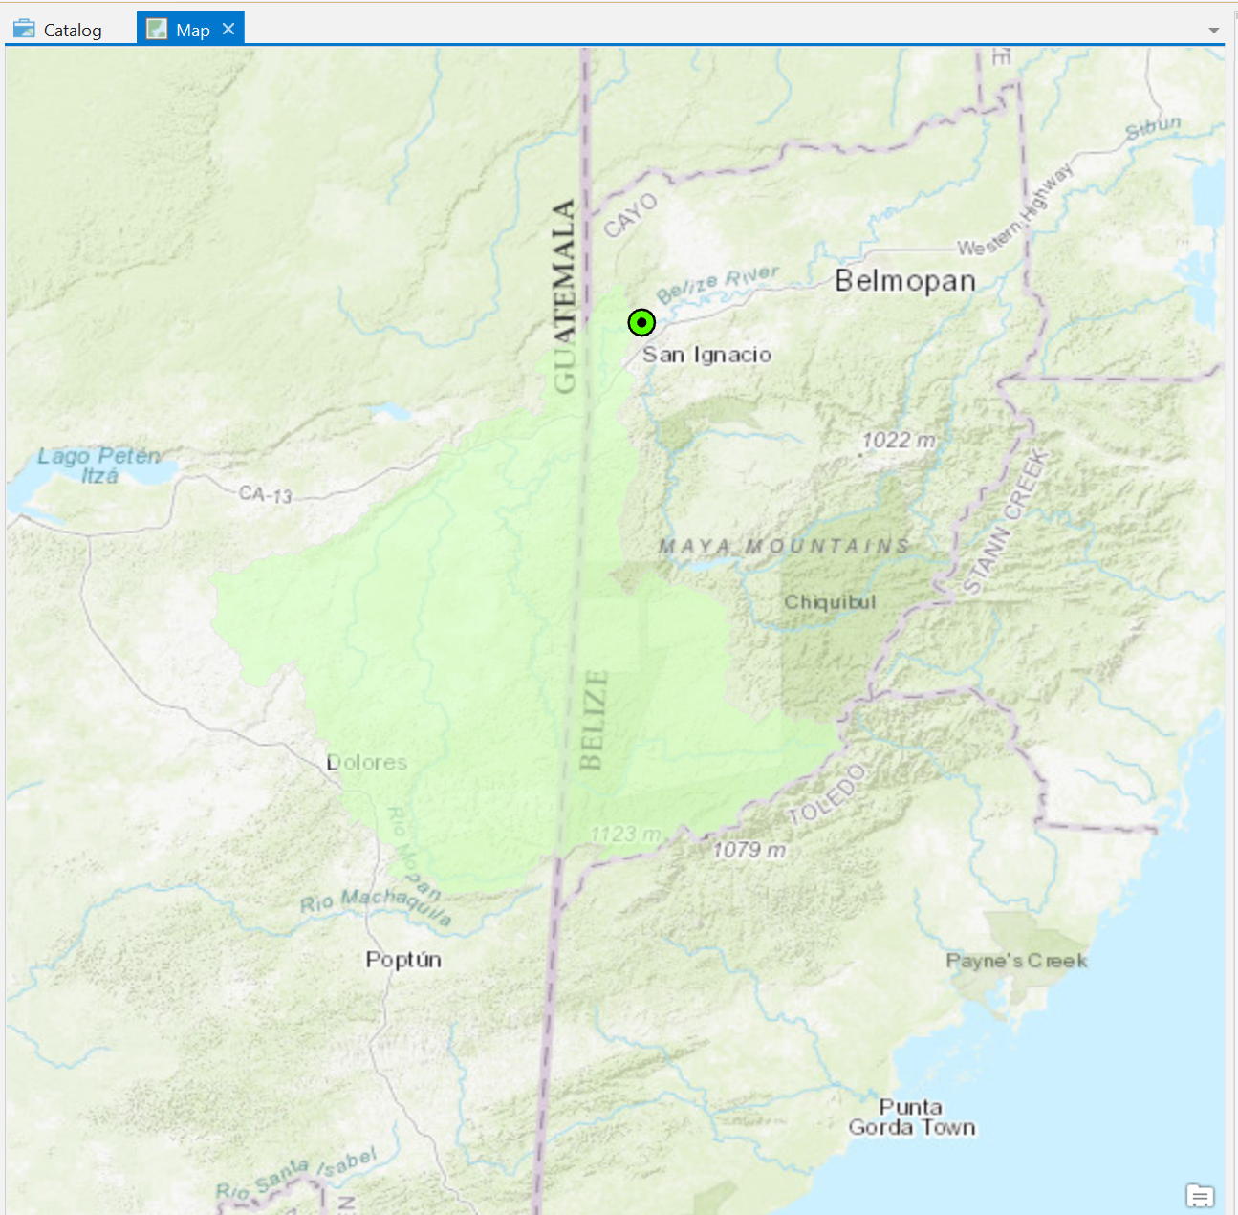
Watershed Generation

Slide 7
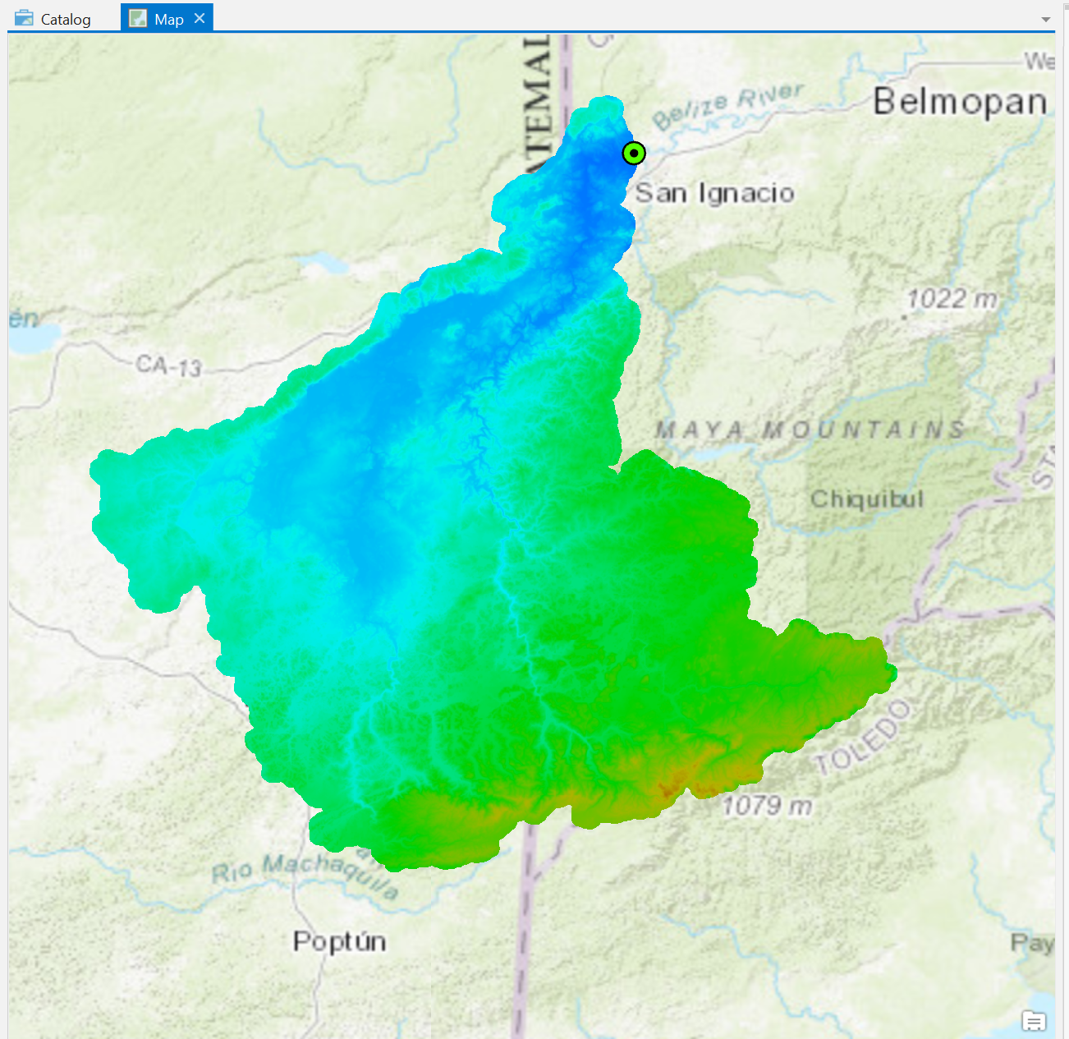
SRTM DEM from HydroSHEDS
Notes:
Shuttle Radar Topography Mission

Slide 8
Stream Network

Slide 9
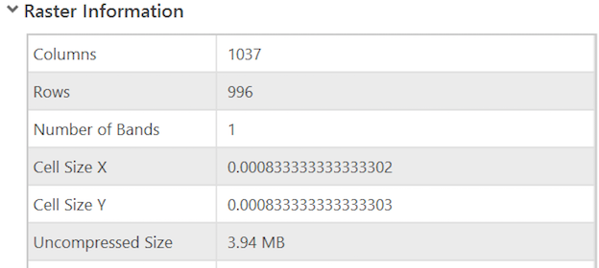
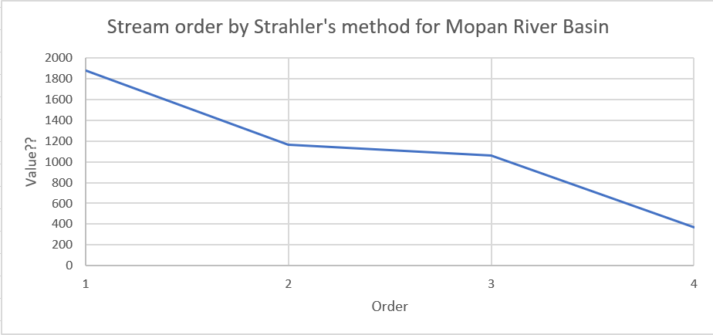
Stream Order
??
Notes:
Interested in assessing morphometrics to get at relationships between sinuosity, rate of meander migration and humanization of landscape.

Slide 10
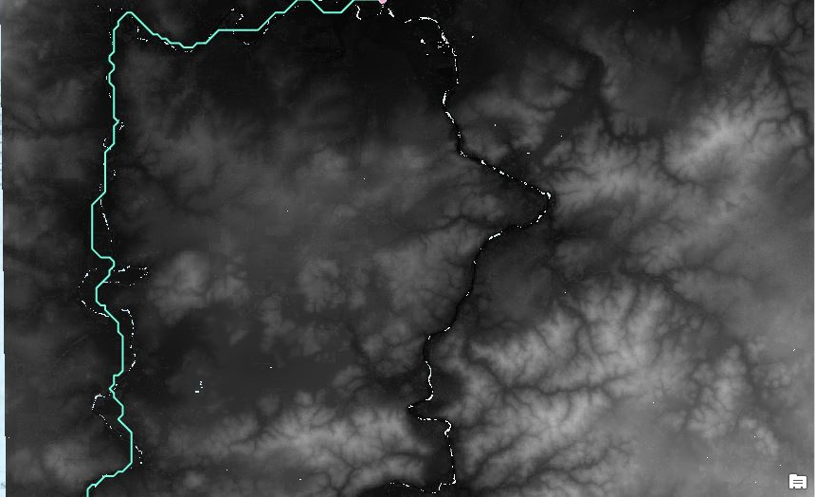
Begin HAND with LiDAR DEM
Not perfect
Notes:
Hmmm the rivers don’t match exactly.

Slide 11
Currently…
Start Flag? Field with value of 1.
Notes:
Need to get through this…

Slide 12
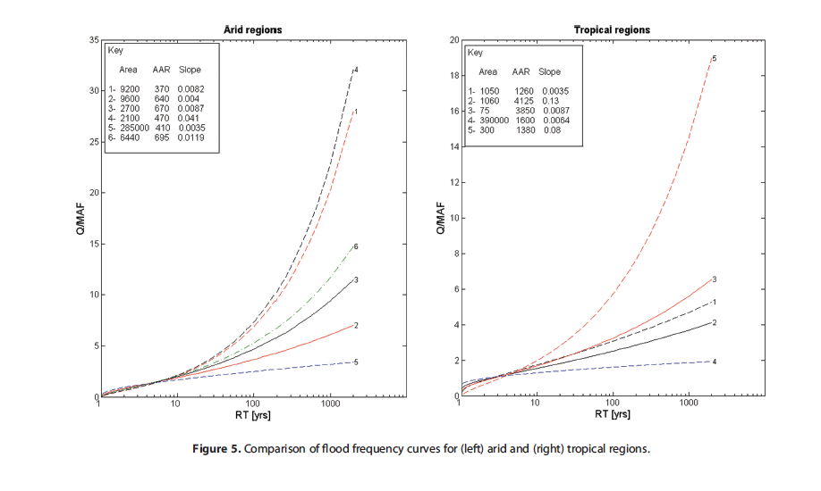
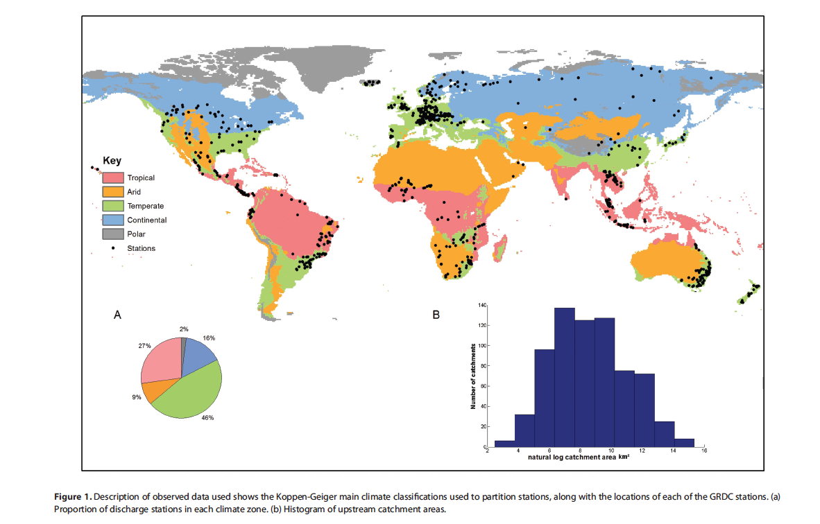
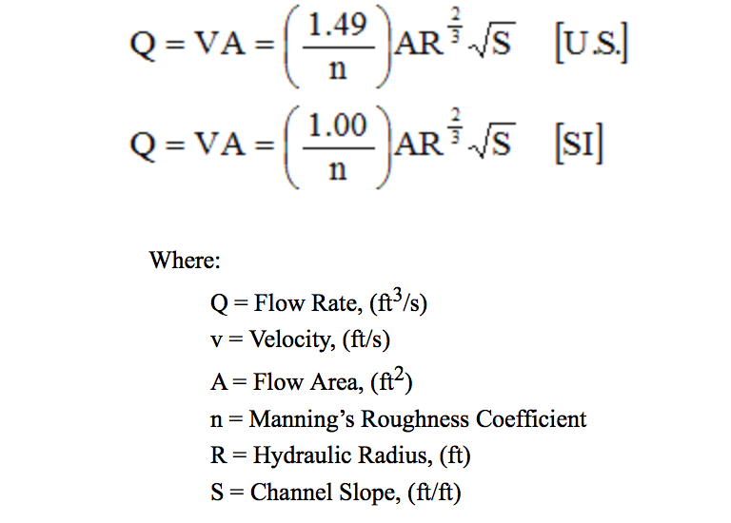
Next: Determine channel hydraulic characteristics
Width
Upstream flow accumulating at each width measured
Interpolate all width values
Estimate river depth based on RFFA
Smith et al. 2014
Manning’s Equation
Notes:
AAR is average annual rainfall

Slide 13
Future problem: Delineation of Belize River Watershed
Notes:
This will be part of expanding my flood mapping to the Belize River Valley watershed: dissertation

Slide 14
Conclusion
Human-environment interactions drive landscape change
Flooding affects much of the world
Rivers add value to the landscape, and contribute to tourism
leiladonn@utexas.edu
Notes:
It’s important to understand how human-environment interactions drive landscape change as an analogy to how we may be changing our landscape.
This includes alterations to flooding recurrence caused by changes to erosion and sedimentation patterns.
This is particularly important in the tropics, which are under increasing environmental stress due to larger populations and changing climate.
Finally, rivers are beautiful. We love to see them.
They add value to our landscapes – both those that we call home and those that we choose to visit. They can be economic drivers through tourism, and certainly are in the Belize River Valley.
And so it’s important that we know how we may be changing them over time.

