Slide 1
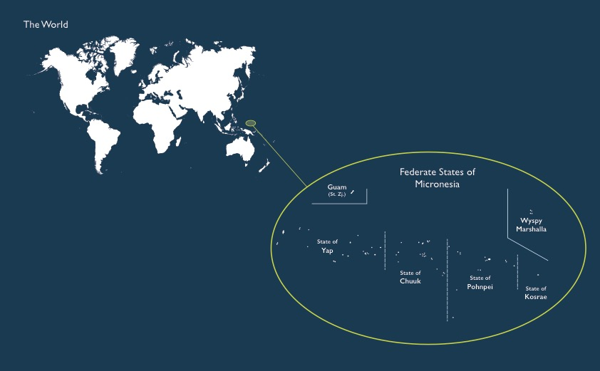
Water, Water, Everywhere:
Freshwater Distribution and Water Quality in the Federated States of Micronesia
Rachel Weinheimer
14 November 2017

Slide 2
1,000,000 square miles of ocean
271 square miles of land
14th largest Exclusive Economic Zone
105,000 people

Slide 3
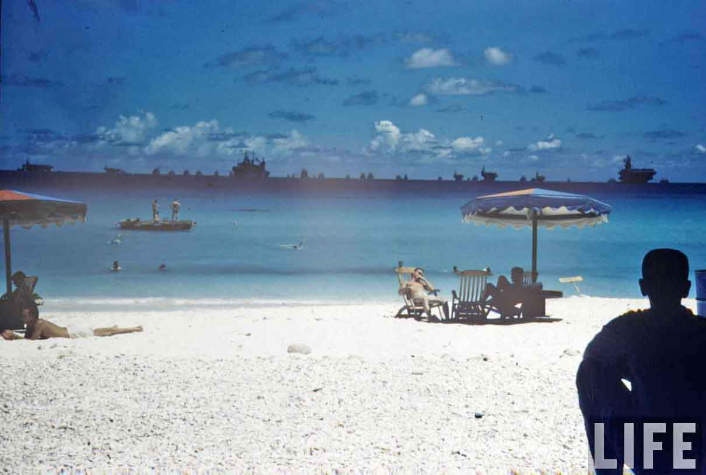
Why do we care?
Security Policy
U.S. has full military control over waters
Aid Policy
Compact of Free Association - $3.5 billion to FSM and RMI from 2003-2023
U.S. is legally obligated to respond to disasters
Aid dependency and sustainability
Migration Policy
Islanders increasingly immigrating to U.S. and main islands $30 million per year in Compact Impact funding

Slide 4
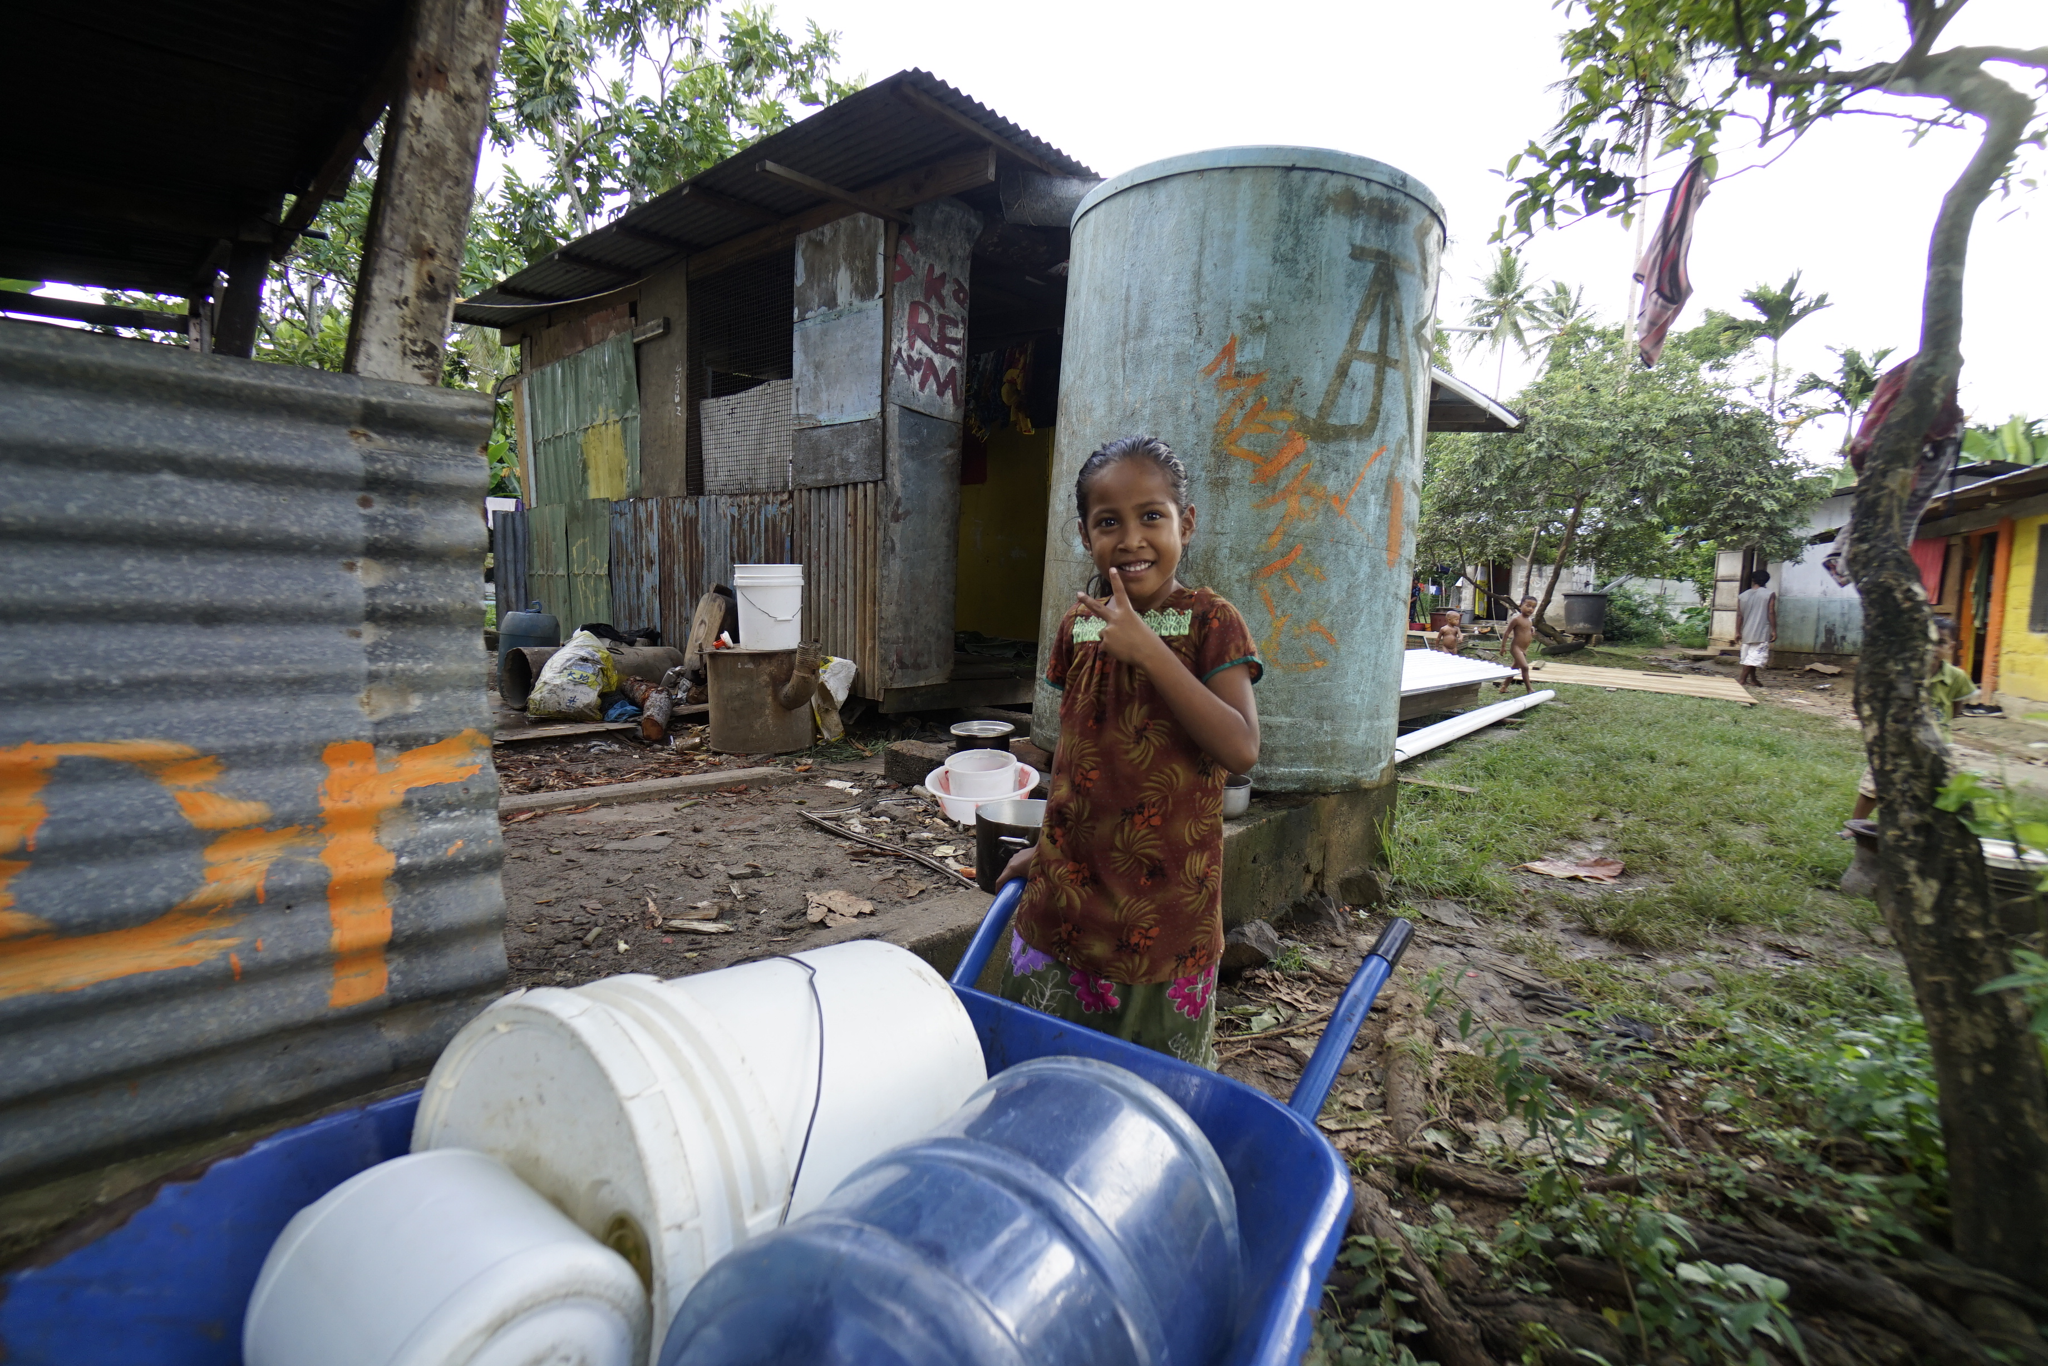
How much water do Micronesians use and where do they get it?
UN minimum provisions 20L/day
FSM from 10L/day – 1136L/day
Rainwater Catchment
Only source on outer islands
Primary source on main islands
38% of families boiled water prior to use
60% of catchments unsanitary

Slide 5
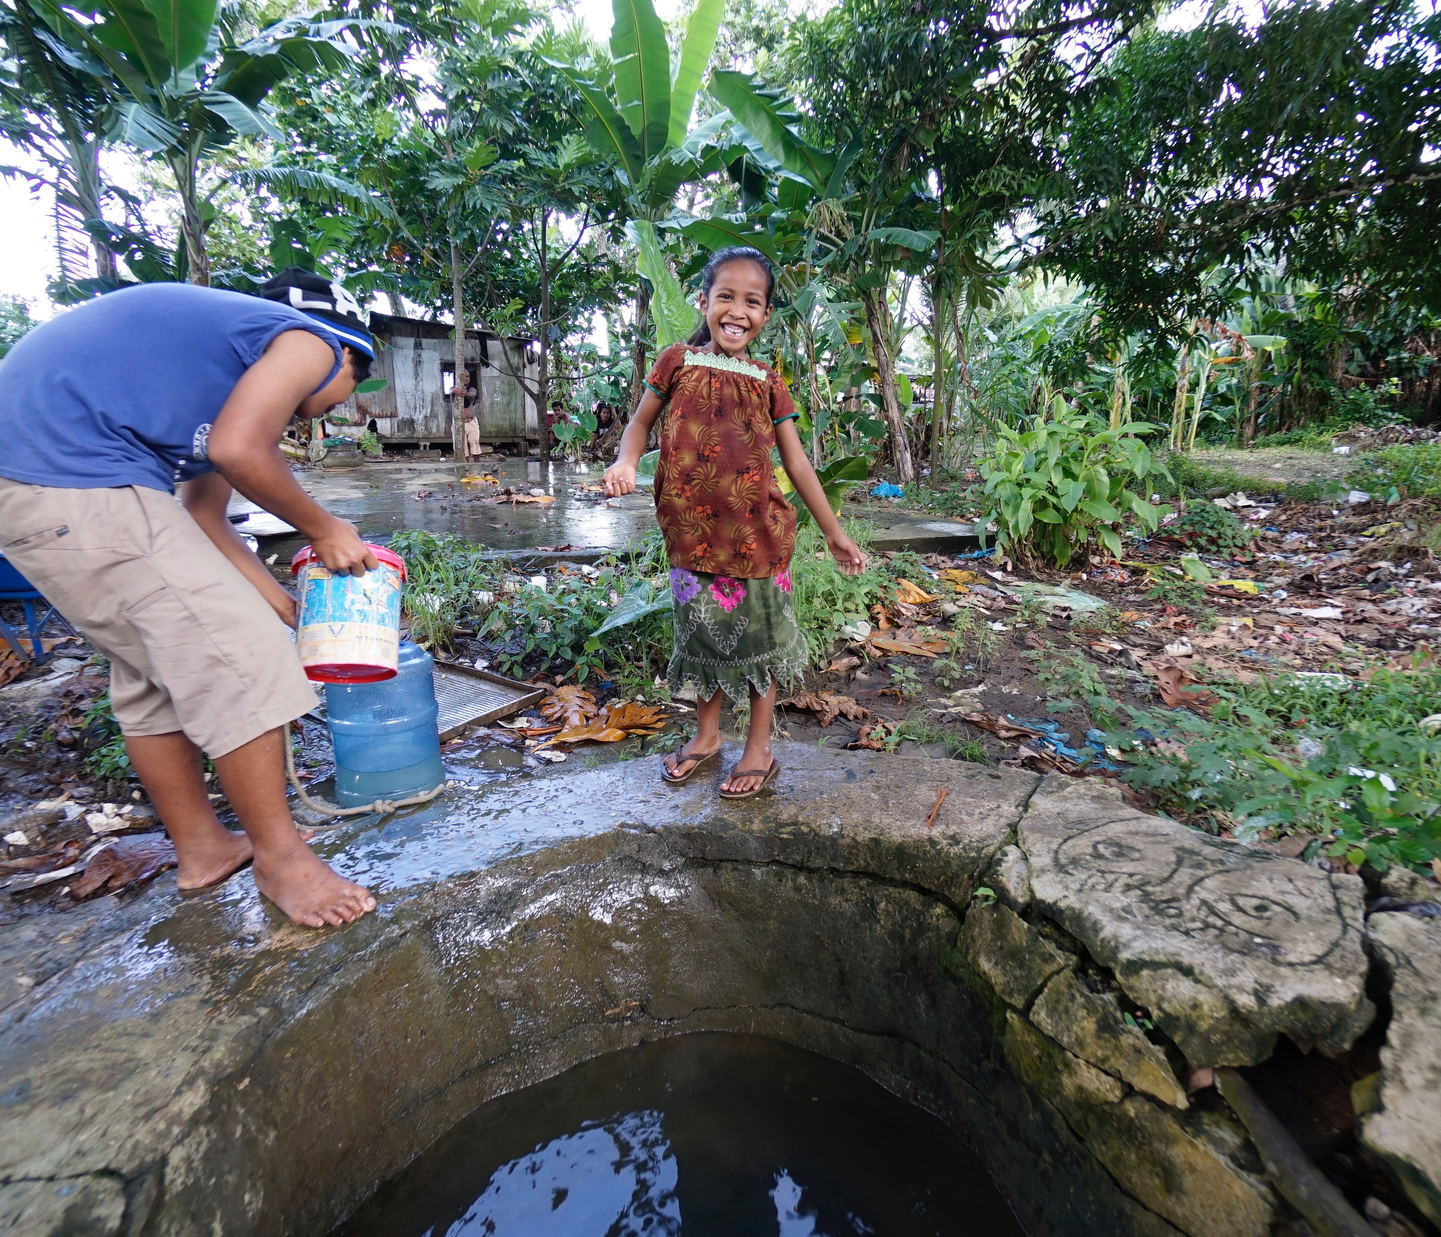
Groundwater and Wells
WWII infrastructure
Frequently brackish or contaminated
  Amoebic dysentery
  Cholera (outbreak in 2000)
  Hepatitis
  Typhoid
  E. Coli
Fluctuates with tides
Groundwater lens floats on top of ocean water
Shallow

Slide 6
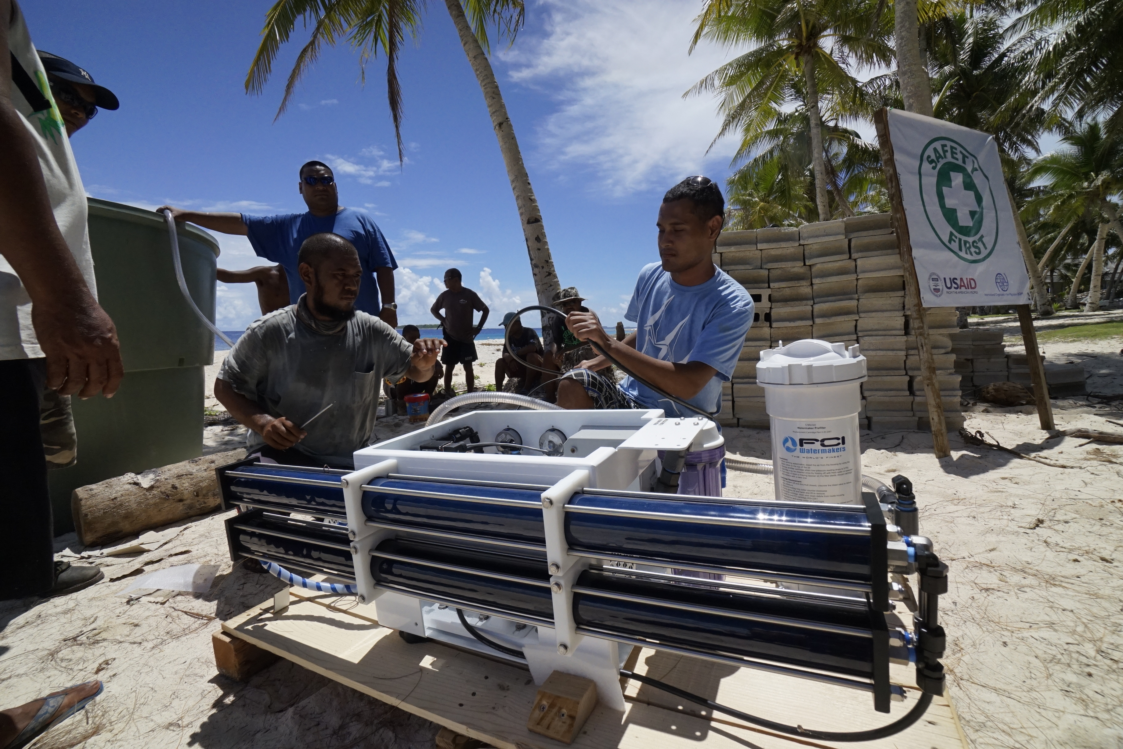
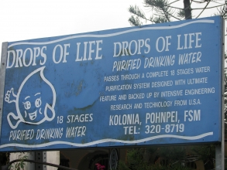
Expensive Alternatives
90% of Micronesians do not pay for water

Slide 7
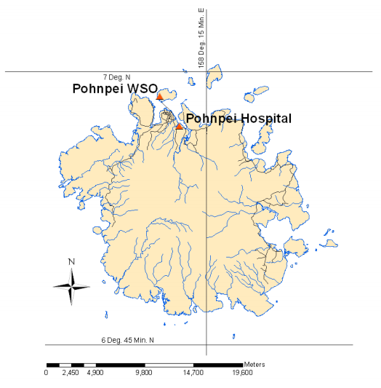
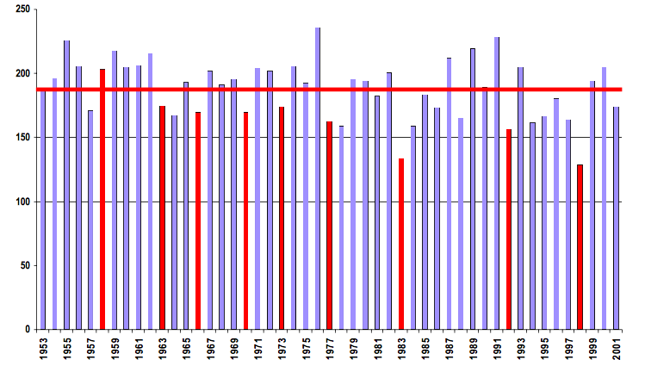
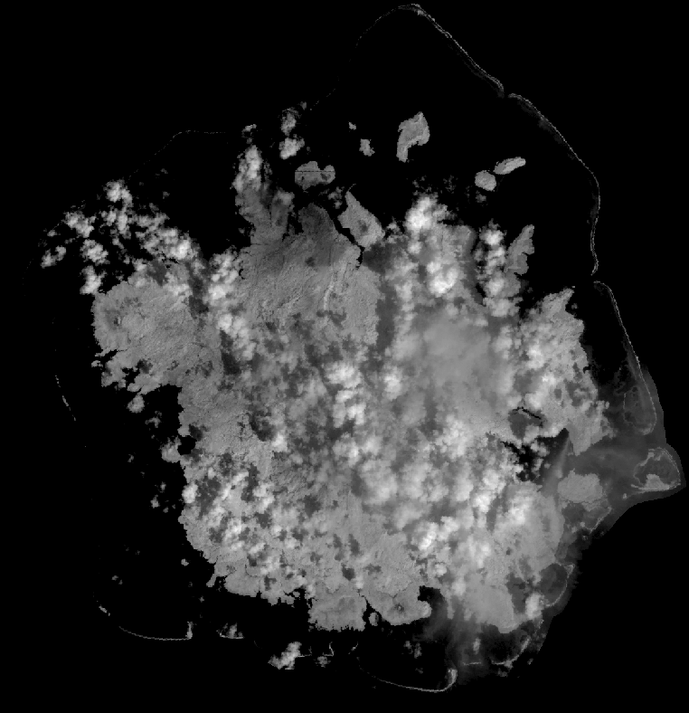
Pohnpei Stream Network
Pohnpei State Annual Rainfall
El-Niño Effects
Pohnpei From Space
Austin – 35 inches per year
Logan – 19 inches per year

Slide 8
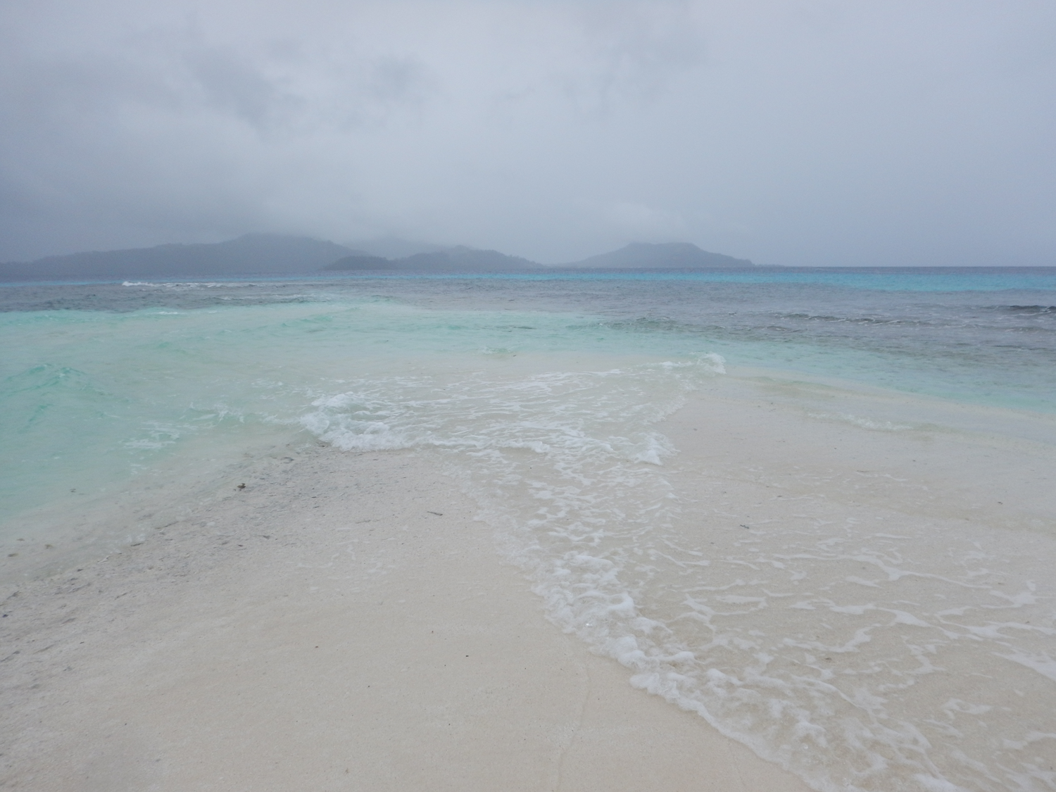
Going Forward
Analysis of each state’s main island – surface water and rainfall against population
Landsat 7 imagery
LiDAR exists, but is still classified
Policy implications on migration and aid
Troubleshooting
.inp files created for Environmental Protection Agency EPANET software
Thanks. Questions?

