Slide 1
Holocene Jökulhlaups along the Hvítá River and Gullfoss, Iceland
Greta Wells
14 November 2017
Notes:
*Hvita = Kvit-au

Slide 2
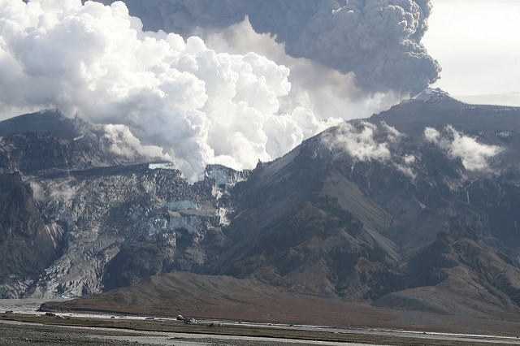
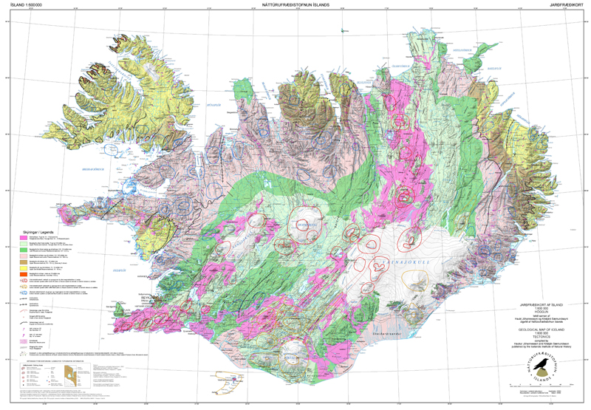
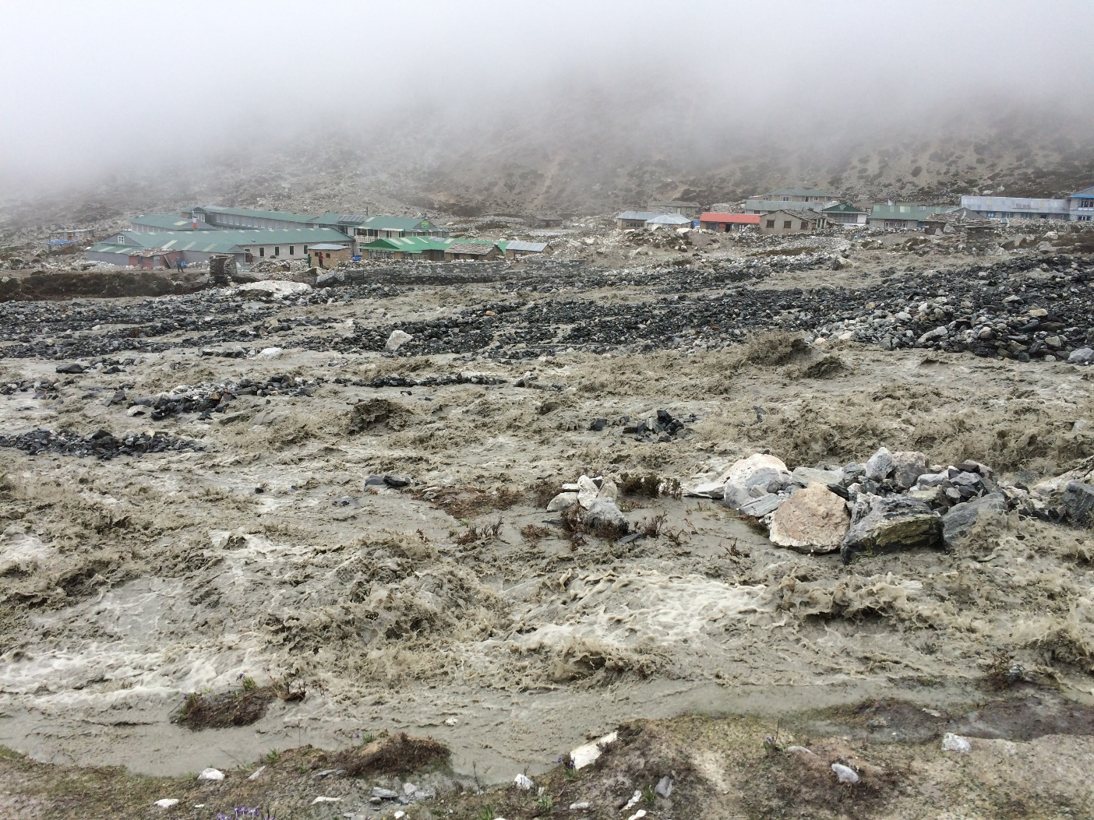
Icelandic Jökulhlaups
Jökull + laup (“glacier leap”)
Glacial lake outburst floods (GLOFs)
Generated in two ways:
1) Geothermal and volcanic activity generates meltwater, which accumulates in subglacial lakes
2) Ice-dammed proglacial lake
http://www.jokulhlaup.org.uk
Jóhannesson and Sæmundsson (2009)
Notes:
Keep in mind, Eyjafjallajokull (2010) jokulhlaup didn’t exceed peak discharge of 15,000 m³ s⁻¹

Slide 3
Most research is on volcanogenic jökulhlaups from southern ice caps...
Any floods from Langjökull or Hofsjökull?
Series of floods drained glacial lake Kjölur ~9500 BP over a period of 100-200 years
Maximum peak discharge = ~2—3 x 10⁵ m³ s⁻¹
Maximum lake volume = ~25—30 km³
Tómasson (1993)
Notes:
5 ice caps- 10% is ice-covered
Active arm of MAR, plus plenty of geothermal activity (hot springs, steam vents, mud pots, geothermally-altered clay in a rainbow of colors), BUT no Holocene eruptions beneath L or H
Most research has been on jokulhlaups from southern ice caps (volcanically active, frequent floods)… BUT have there been any jokulhlaups draining from Langjokull or Hofsjokull?

Slide 4
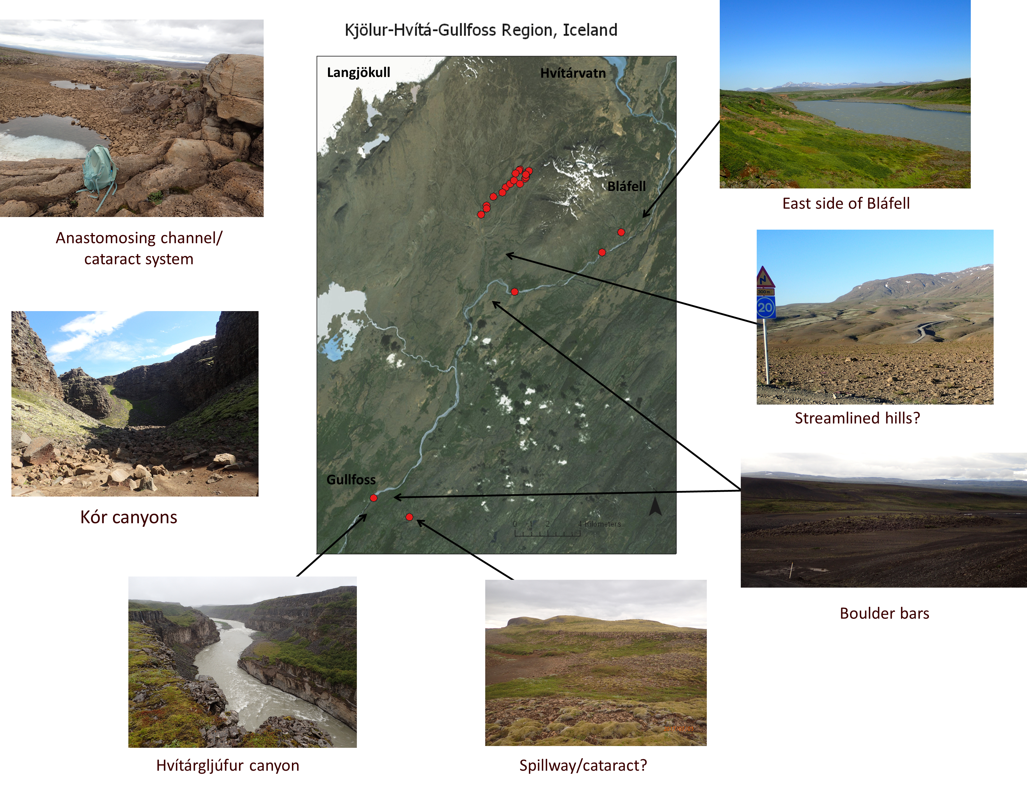
Research Objectives
Build on Tómasson’s research to reconstruct a Holocene timeline of the Kjölur jökulhlaups
Timing
Routing
Magnitude
Frequency
Notes:
*Note: articles are still being translated! This is (obviously) a key (and missing) piece to the puzzle.
Try to fill in research gaps
How can you figure out number of flood events?

Slide 5
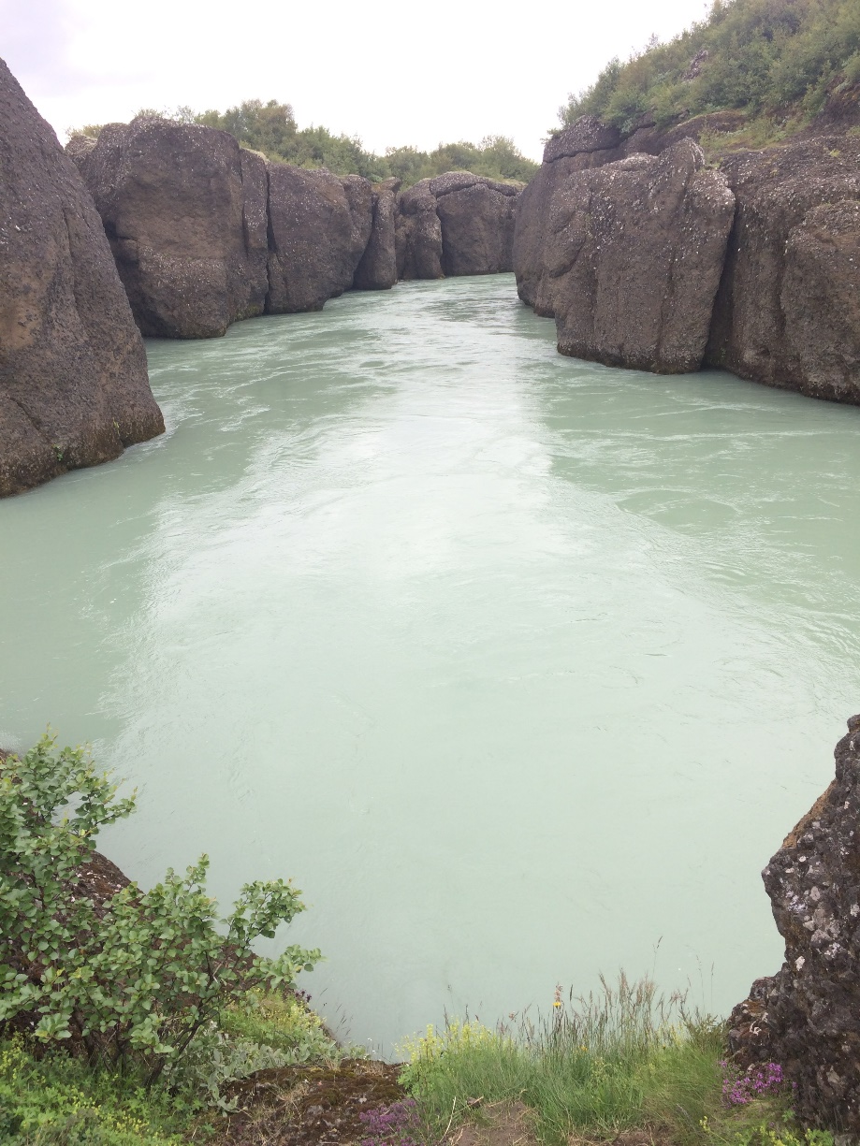
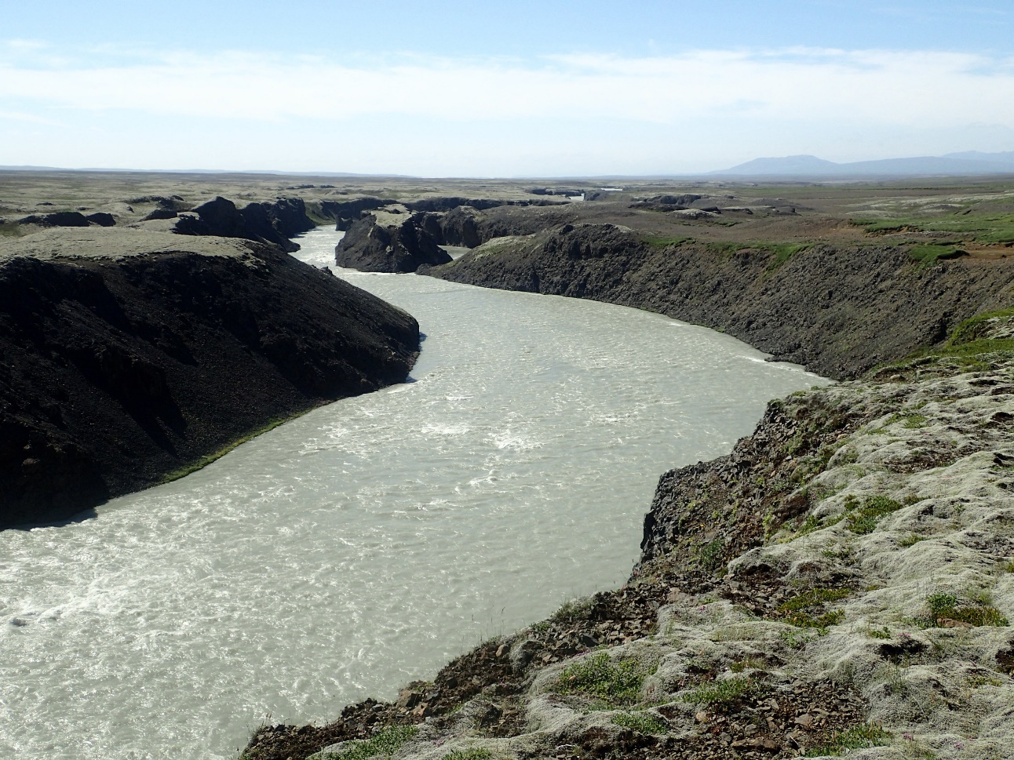
Hvítá River Watershed
“White River”
Hvítá (185 km) and Sog (22 km) join to form Ölfusá (25 km)
Hvítá- Ölfusá drainage basin = 6190 km² (Pagneux et al., 2010)
Periodic winter ice jams
Popular rafting destination
Ice-jam flood in 2001 (Pagneux, 2011)

Slide 6
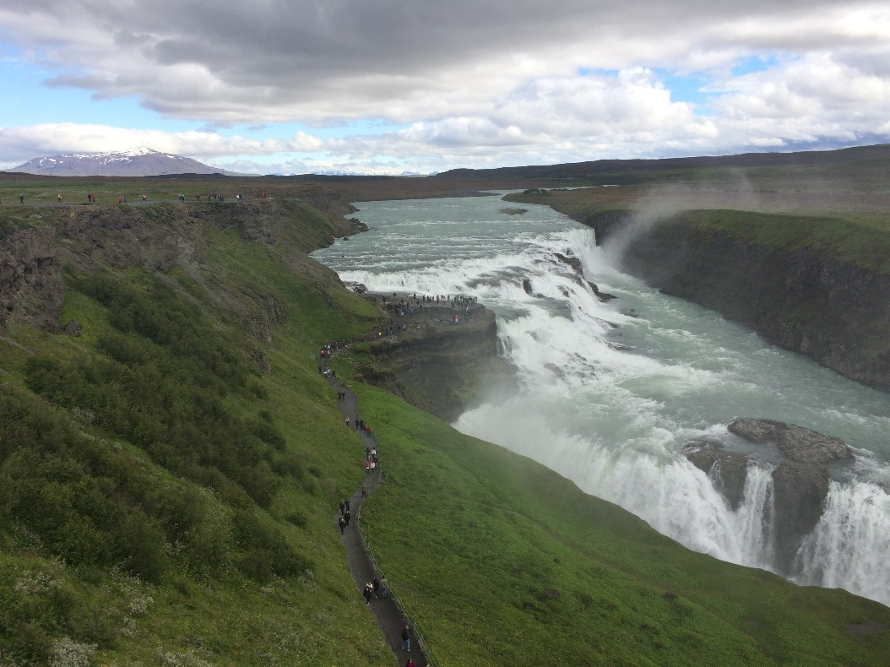
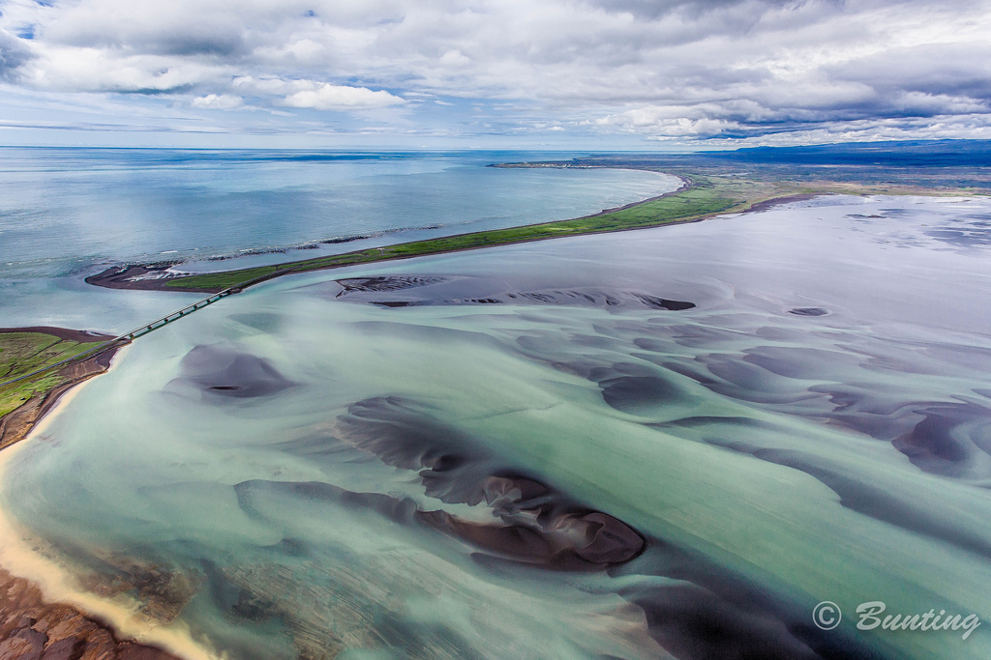
Langjökull
Hvítárvatn
Hvítá
Gullfoss
Sog
Ölfusá

Slide 7
Objectives
Map the Hvítá drainage basin
Drainage area
Stream discharge
Flow direction/watershed delineation
HAND calculations → estimate flood routes and inundation area for different peak discharges
Compare modeled inundation area with geomorphologic field observations
E.g. Do erosional landforms occur in zones of greater flow velocity or topographic constriction?

Slide 8
Data Sets
Landmælingar Íslands (National Land Survey of Iceland)
DEM
Hydrology
Glaciers
Streams/rivers
Ponds/lakes
Drainage canals/ditches
Gaging station data?

Slide 9
Hydrology
yfirbordsvatn = water surfaces
skurður, veitugöng = canal/ditch, tunnel
jökull = glacier
stöðuvatn, tjörn = lake, pond
á ekki við = not applicable
á, lækur = brook).

Slide 10
DEM + hydrology

Slide 11
Join “surface water” (polygon) to “drainage features” (line) to create one feature class

Slide 12
Geoprocessing: Flow Direction

Slide 13
Geoprocessing: Watershed

Slide 14
Next Steps
Delineate drainage basin
Calculate drainage basin area
Look for gaging station datasets → need stream discharge values
Calculate HAND to map flood inundation
Compare flood maps to geomorphologic field evidence

Slide 15
Questions?

