Slide 1
Reported Flood Inundation due to Hurricane Harvey in Houston, TX
Isha Deo
November 21, 2017
Notes:
I think this picture serves as an introduction to the severity of the flooding problem in Houston during and after Hurricane Harvey. Although generally susceptible to flooding, Houston’s experience during Harvey were catastrophic and alarming. It is critical that a repeat event can not be prevented immediately, engineers, city planners, and emergency management need tools to understand the complicated processes causing such damage.

Slide 2
Specific Issues during Harvey
Fluvial inundation: flooding caused by channels overtopping their banks during/after a storm event
Pluvial inundation: flooding in local depressions caused directly by rainfall
Established floodplain maps model flood-danger zones using fluvial inundation
Most of the flooding during Harvey was pluvial – the fluvial predictions were inaccurate and caused “safe” areas to flood
In the recovery phase, there is a lack of comprehensive information about which neighborhoods/streets experienced pluvial flooding
Notes:
Typical floodplain maps consider only fluvial flooding i.e. when a channel overtops its banks into the floodplain
Pluvial vs fluvial flooding

Slide 3
Crowd-Sourced Flood Inundation Metrics
Although official inundation data is not readily available on a broad spatial and temporal scale, data collected from social media and existing city response systems can serve as proxy data to gain a broad understanding
Data is collected from two sources
Official City of Houston 311 Flooding Reports from 8/24/2017 - 9/7/2017
Citizen-led Facebook group for rescue requests

Slide 4
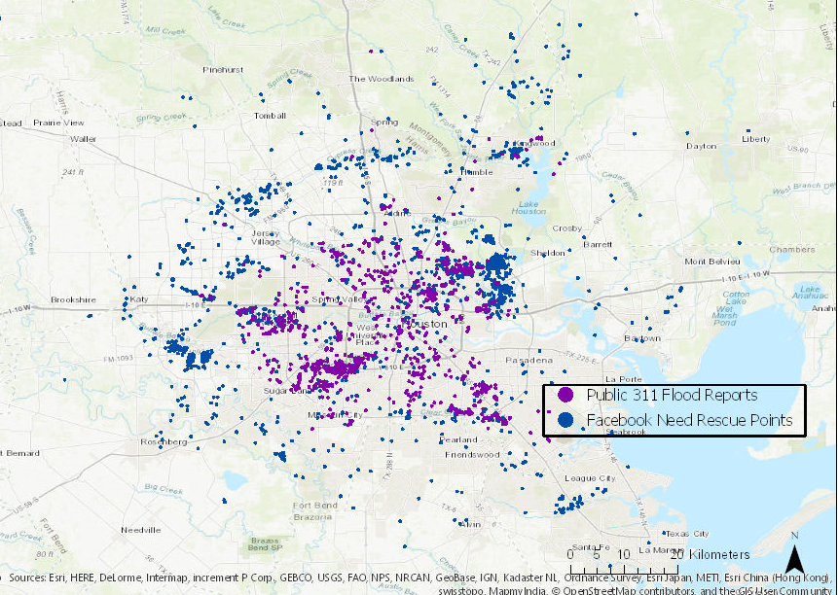
Crowd-Sourced Flood Inundation Metrics
The combined data represent about 5300 Facebook rescue requests and 1300 Houston 311 calls
All the Houston 311 call data is time-stamped, while most of the Facebook data is time stamped
Together, these data provide a picture of flooded residential areas on a broad spatial and temporal scale

Slide 5
Facebook Rescue Request Data
Google Form
Google Sheet
Google MyMaps App
Victims gave basic information, asking for help
Compilation of request information
Plotted requests on a map so able citizens conduct rescues

Slide 6
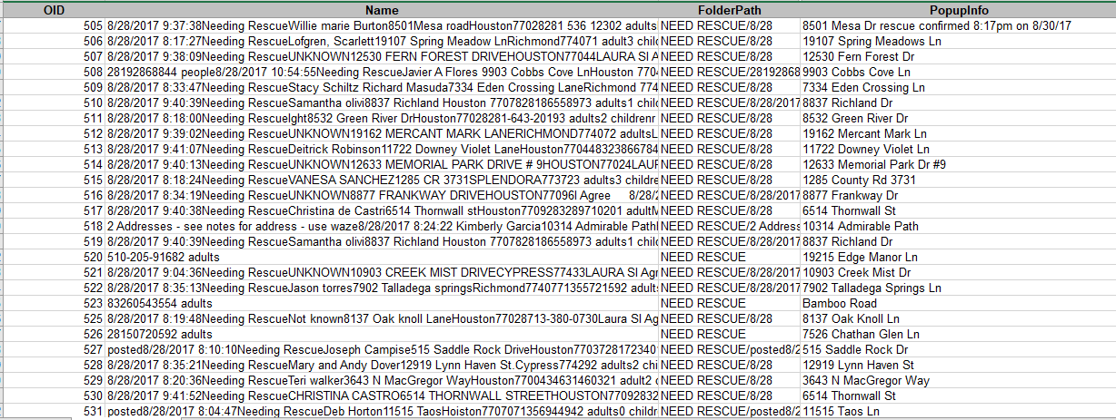
Facebook Rescue Request Data
Spreadsheet was manually edited and updated and requires manual sorting of data

Slide 7
CoH 311 Flood Reports
Point density analysis to identify areas of severe inundation
These areas can be visually and quantitatively compared to other parameters such as:
Official flood hazard maps
Transportation networks
Stormwater drainage networks
Land use

Slide 8
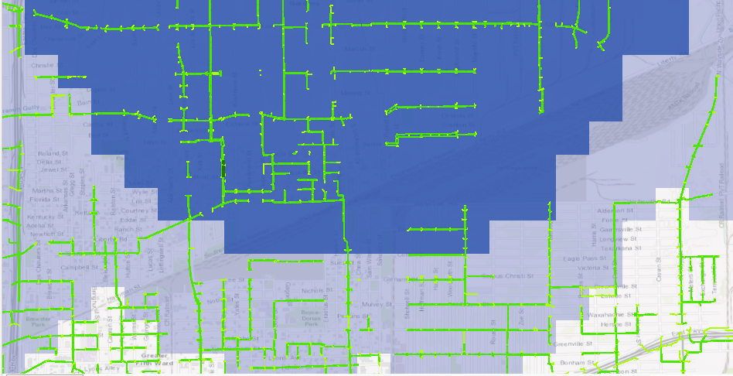
CoH 311 Flood Reports – Stormwater Network
Comparison to stormwater network in Houston
Picture is zoomed in because stormwater network cannot be seen at wide extent
Unsure about how to quantify such a complicated network system

Slide 9
CoH 311 Flood Reports – Floodplain Map
Visual comparison to official floodplain maps
Areas reporting flooding lay outside the official floodplain

Slide 10
Future Plans
Use time slider function to create a visual trend of storm progression and reported flooding
Attempts have failed thus far
Manually sort Facebook rescue request data
Combine 311 and Facebook data, in order to analyze together
Point density
Time slider
Notes:
Typical floodplain maps consider only fluvial flooding i.e. when a channel overtops its banks into the floodplain
Pluvial vs fluvial flooding

Slide 11
In the public eye…

Slide 12
References
311 Flood Report Data: City of Houston Open Data Portal
http://cohgis-mycity.opendata.arcgis.com/datasets/public-311-location
Facebook group: Hurricane Harvey 2017 - Together We Will Make It; TOGETHER WE WILL REBUILD https://www.facebook.com/groups/1982997775271266/
MyMaps application for rescue calls: https://www.google.com/maps/d/u/0/viewer?mid=1qmepB5HrFSthl1DyK7lG9slEabY&ll=29.69095 0934799677%2C-95.29091127744147&z=11
Public Utility Data (Stormwater): MyCityHouston on ArcGIS Online Portal
http://www.arcgis.com/home/item.html?id=ace9cbd6e03e48998cc51f295ba4af72
Floodplain for Harris County (2012): ArcGIS Online Portal
http://www.arcgis.com/home/item.html?id=f9b77bef062645a79ad6dab00ae6fa87
Notes:
Typical floodplain maps consider only fluvial flooding i.e. when a channel overtops its banks into the floodplain
Pluvial vs fluvial flooding

