Slide 1
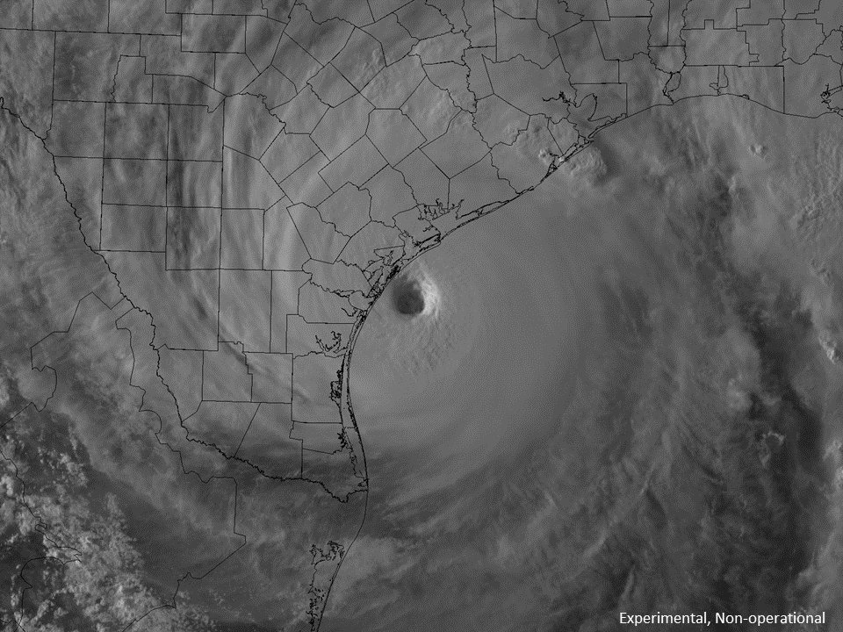
Hurricane Harvey:
Precipitation and Flood Analysis in the Lake Houston Area
Indu Venu Sabaraya

Slide 2
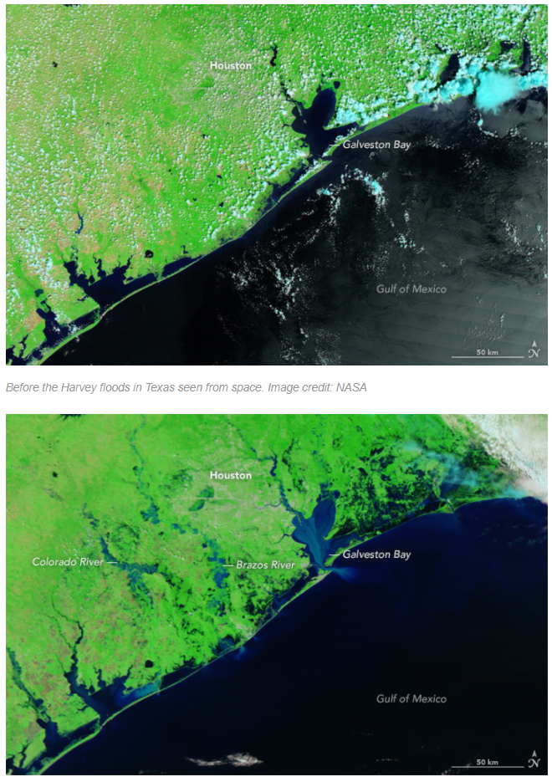
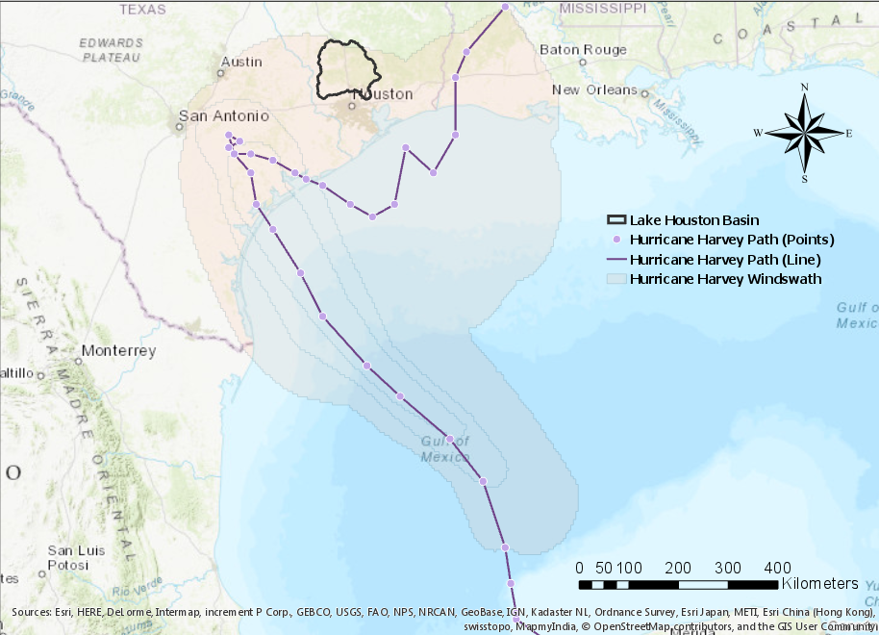
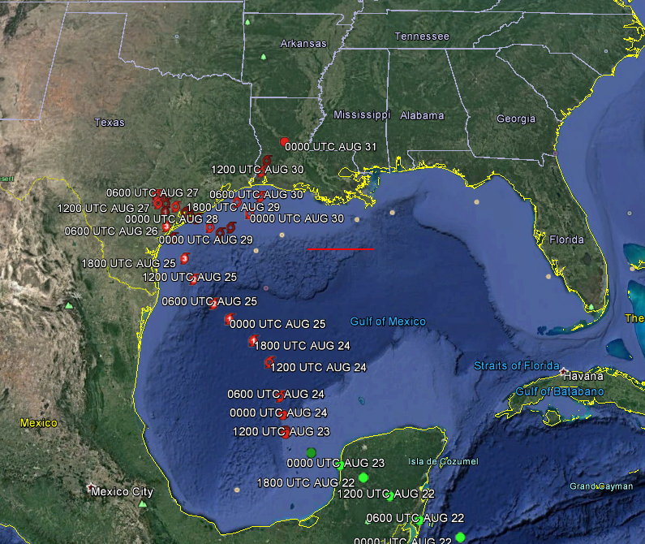
Hurricane Harvey: Quick Facts
NHC, Google Earth
NHC, ArcGIS Pro
Notes:
Fewer than a dozen storms in the past century have reached land in the region as a Category 4 hurricane or higher.
Houston area – 800 miles of bayous and creeks
Several bayous, flood channels and rivers around the city were well above the top of the water bank as of 4 p.m. CT Aug 28
In this slide, I have some information about Hurricane Harvey. The map in the center is the data from National Hurricane Center displayed on Google Earth. I also utilized the shapefiles from NHC to use in ArcGIS Pro to compare where my area of interest would be as compared to the hurricane path.
The next set of images are from NASA, where we can see the Gulf Coast area before and after the hurricane. Several blue-er regions have opened up in the second image showing areas that are inundated or expanded streams and channels.

Slide 3
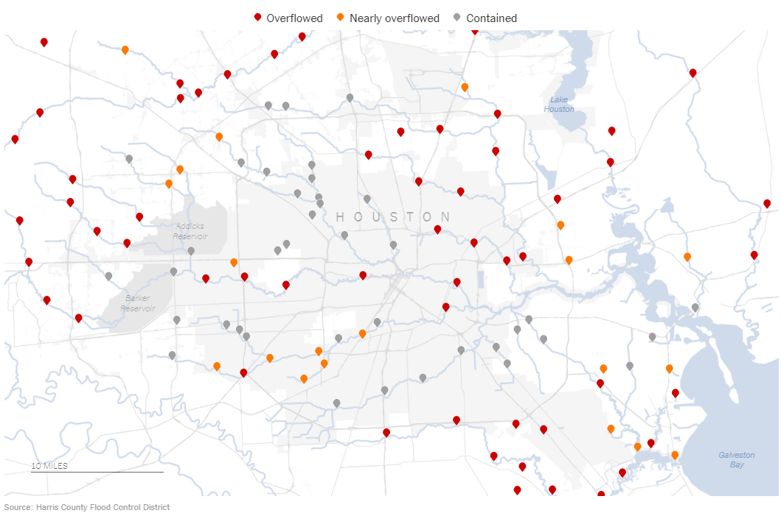
Notable Issues
Overflows from water channels
NY Times: https://www.nytimes.com/interactive/2017/08/28/us/houston-maps-hurricane-harvey.html
Notes:
Some notable issues in the Houston Metropolitan region included overflowing water channels. This map from NYT shows several locations where water channels overflowed (in red)

Slide 4
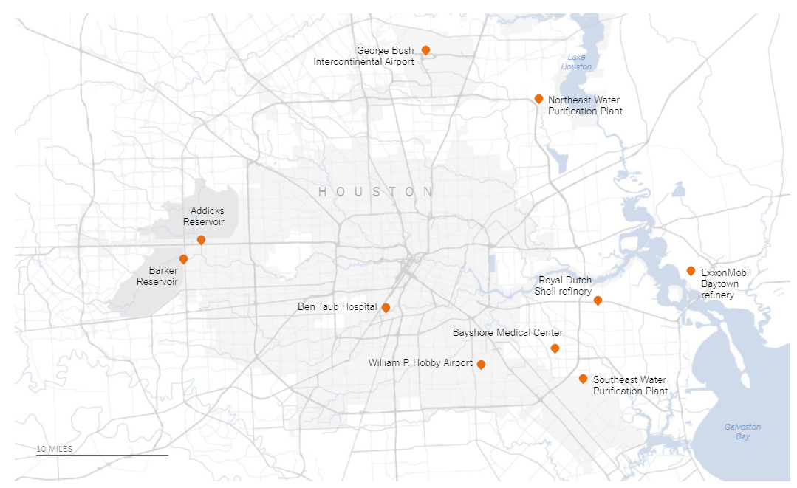
Notable Issues
NYT: Mayor Sylvester Turner said that Houston’s Northeast Water Purification Plant was completely submerged as of 6 p.m. Sunday
Infrastructure shutdowns
NY Times: https://www.nytimes.com/interactive/2017/08/28/us/houston-maps-hurricane-harvey.html
Notes:
Other notable issues included infrastructure shutdowns. The map from NYT here shows locations where infrastructure shutdowns occurred. The Northeast Water Puridication plant (shown in box) had completely submerged by Aug 27 evening.
Water plants not functioning
Mayor Sylvester Turner said that Houston’s Northeast Water Purification Plant was completely submerged as of 6 p.m. Sunday and that the Southeast Water Purification Plant was operating at 5 percent production.

Slide 5
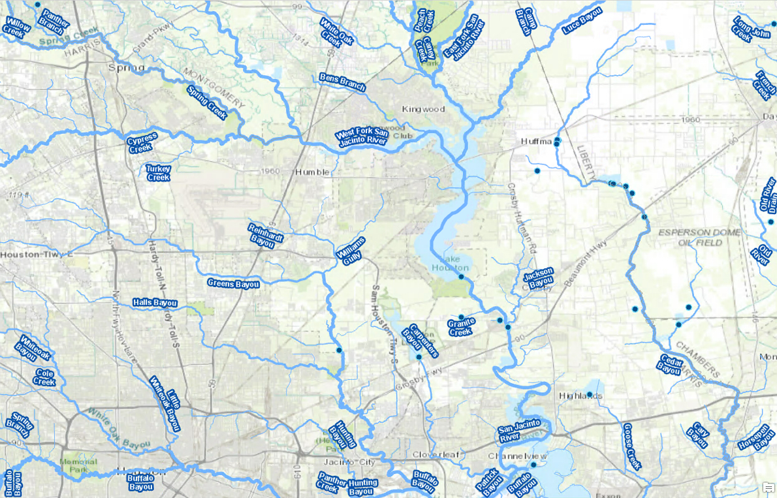
Area of Interest

Slide 6
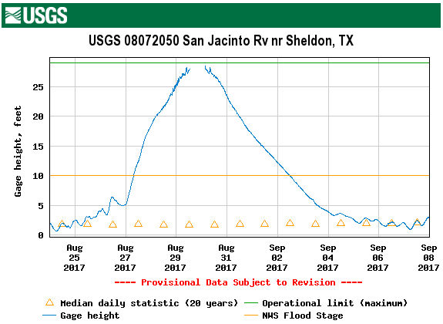
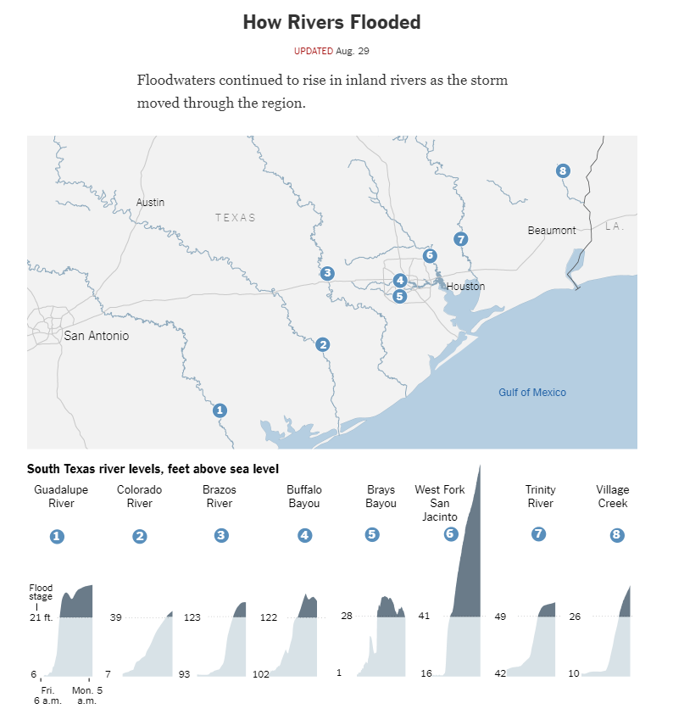
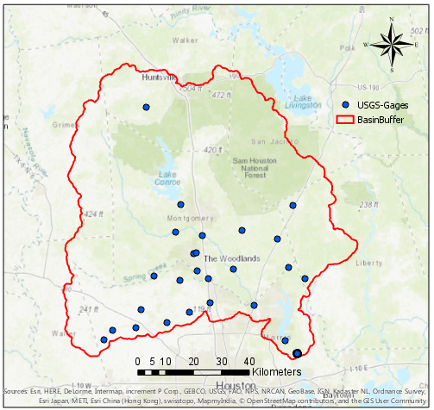
Area of Interest: Lake Houston Area
USGS Stream Gages
NY Times
Notes:
I will briefly explain why I chose this region. An article from NYT looked at water levels above sea levels for several of the water networks in the path of Hurricane Harvey. One of them stands out poignantly. WestFork San Jac river levels rose very sharply between 25th and 28th of August.
To look at the data more in detail, I downloaded USGS stream gages for the region and looked at a Stream Site downstream of Lake Houston and obtained the gage height data during the hurricane event. The graph here shows the changes in the gage height over Aug 25 to Sep 08. At the peak flow, it even exceeded the operational limit, where the sensors cannot make data available or reliable.
Counties: Liberty grimes harris waller walker Montgomery sanjac
In particular, it is important for forecasters and emergency and water managers to know the approximate stage where streamflow and water-level data will no longer be valid or available as a result of the stage sensing system reaching its minimum or maximum operational limit.

Slide 7
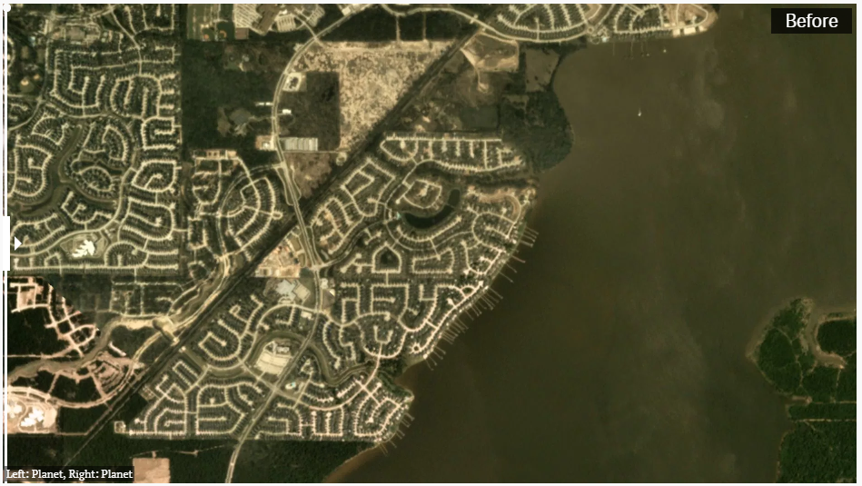
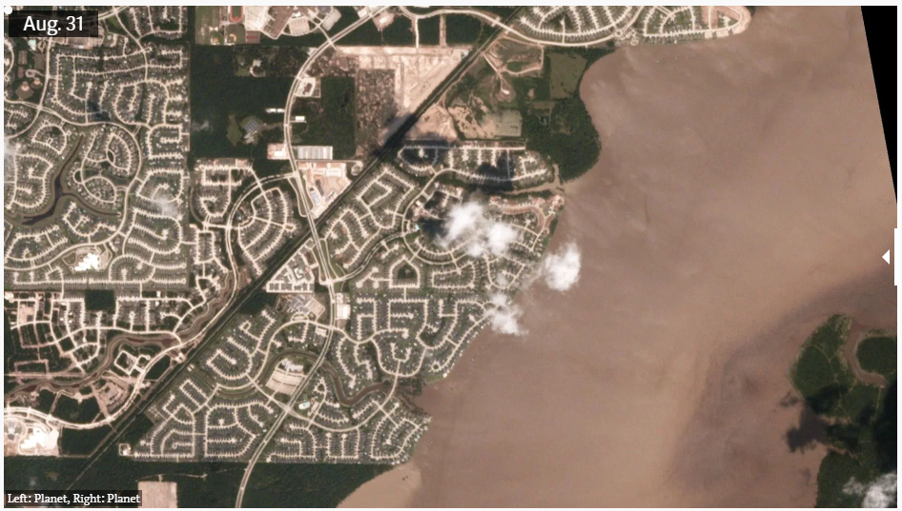
Before
After
Lake Houston
https://qz.com/1068571/incredible-before-and-after-images-of-houston-neighborhoods-hit-by-hurricane-harvey/
Notes:
I also looked at some aerial differences in the region. Lake Houston areas do not show a huge difference. I thought I could attribute this to the equalization by the lake.
http://disasterresponse.maps.arcgis.com/apps/StorytellingSwipe/index.html?appid=c62112f6ba834227978d8f1cf2b6f5af

Slide 8
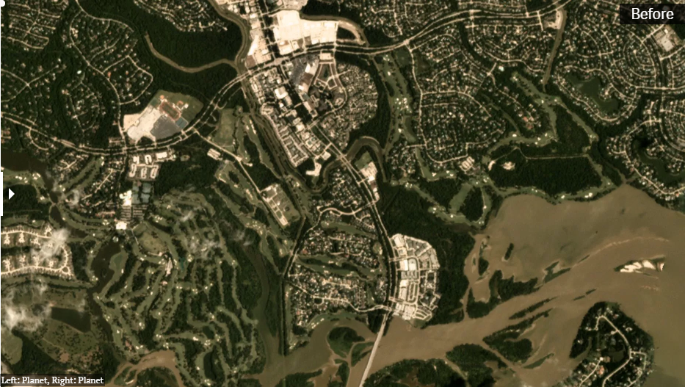
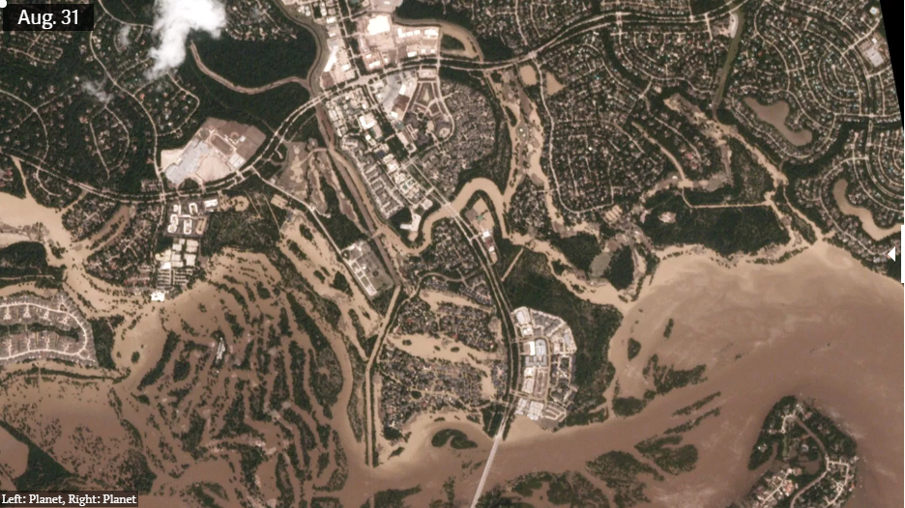
Before
After
Kingwood
https://qz.com/1068571/incredible-before-and-after-images-of-houston-neighborhoods-hit-by-hurricane-harvey/
Notes:
http://disasterresponse.maps.arcgis.com/apps/StorytellingSwipe/index.html?appid=c62112f6ba834227978d8f1cf2b6f5af

Slide 9
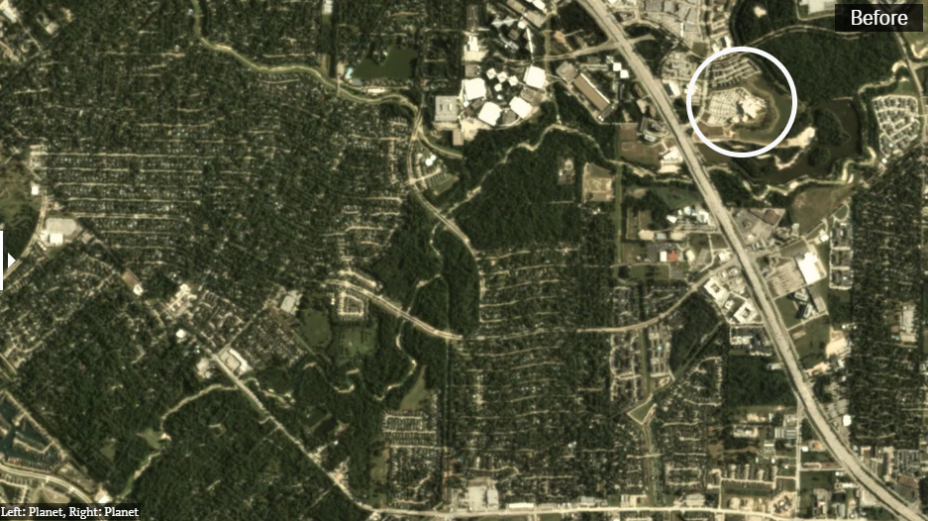
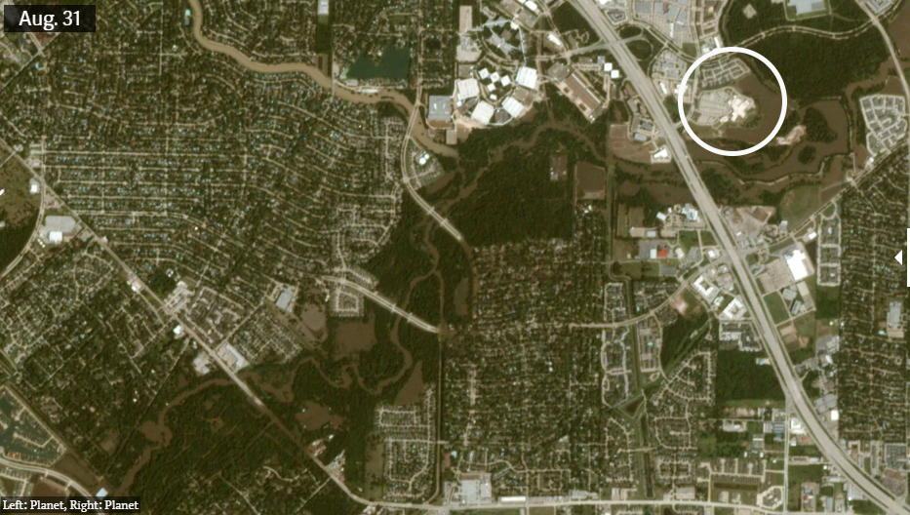
Before
After
Cypress Creek
https://qz.com/1068571/incredible-before-and-after-images-of-houston-neighborhoods-hit-by-hurricane-harvey/
Notes:
http://disasterresponse.maps.arcgis.com/apps/StorytellingSwipe/index.html?appid=c62112f6ba834227978d8f1cf2b6f5af

Slide 10
Objectives
Delineate a basin with interesting characteristics to study and describe its features
Map the rainfall occurred during the hurricane event
Assess water quality changes in the area
Attempt to map the flood inundation in the basin
Notes:
My overall objective for the term project, as a complete outsider to hydrology or GIS, was to be able to learn about visualization of real world data.
The specific objectives were to create a basin based on the real world characteristics.
Map,visualize and take a quantitative look at the rainfall from hurricane over the delineated region.
Assess water quality changes in this region.
And if time and skills permit, attempt to map the flood inundation in the basin.

Slide 11
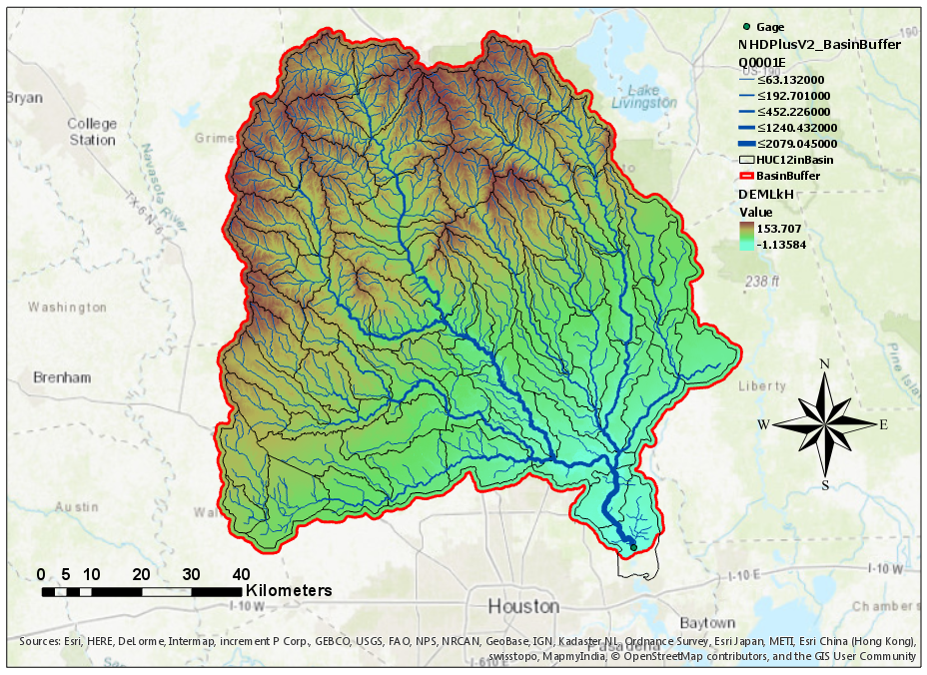
Watershed Draining to Stream Gage & Extracting DEM
Parameter | Value
Basin Area (km²) | 7911.52
Date | 24 Aug – 02 Sept, 2017
Counties within basin | 7
Notes:
Using some learning exercises from class, a watershed draining to a point was delineated and the DEM for this region was extracted in ArcGIS pro. This area is generally pretty flat. The soil type is predominantly clayey which makes for some risky flooding situations. Some details about the region are presented in the table on the left.
7437 without buffer

Slide 12
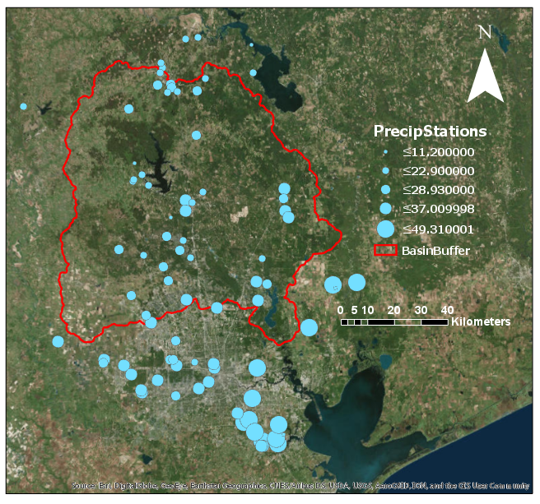
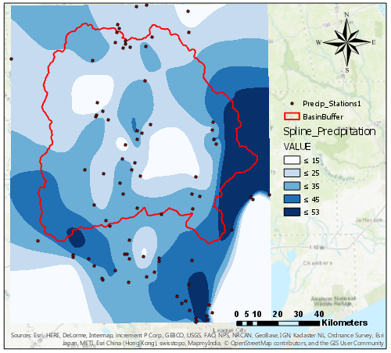
Rainfall During Harvey: Spline and Thiessen
HUC 10 Name | 10-Day Area Weighted Precipitation (in)
West Fork San Jacinto River | 25.30
West Fork San Jacinto River-Conroe Lake | 19.33
Caney Creek-Lake Creek | 18.58
Crystal Creek-West Fork San Jacinto River | 22.83
Frontal Lake Houston | 30.55
Little Cypress Creek-Cypress Creek | 28.42
Walnut Creek-Spring Creek | 24.84
Peach Creek-Caney Creek | 22.06
Tarkington Bayou-Luce Bayou | 31.96
Winters Bayou-East Fork San Jacinto River | 24.37
East Fork San Jacinto River-Frontal Lake Houston | 27.23
Buffalo Bayou-San Jacinto River | 40.23
Up to 10-day cumulative precipitation data, GHCN-Daily, NOAA
Notes:
Precipitation data over 10 days was collected from NOAA and visualized with the software. A map with graduated symbols are shown on the map on the left. Spline interpolation was conducted to get a visual similar to the ones seen in the news. A caveat here was that some sites only collected data for 2-4 of the 10 days that I requested. So some of the lower precipitation regions actually could have a higher number and I need to adjust that later on.
I also tried to use the Thiessen method to obtain zonal statistics for the HUC10 subwatersheds in the region to see an area weighted precipitation. This included some regions outside my basin since I did not want my data to get skewed at the boundaries. At the end of the presentation I have the data for the Texas Gulf region as well.

Slide 13
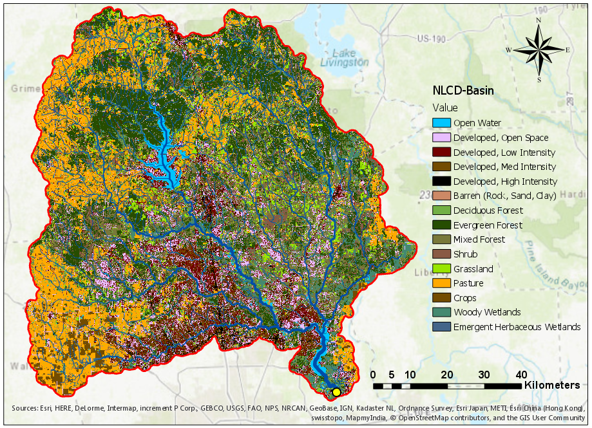
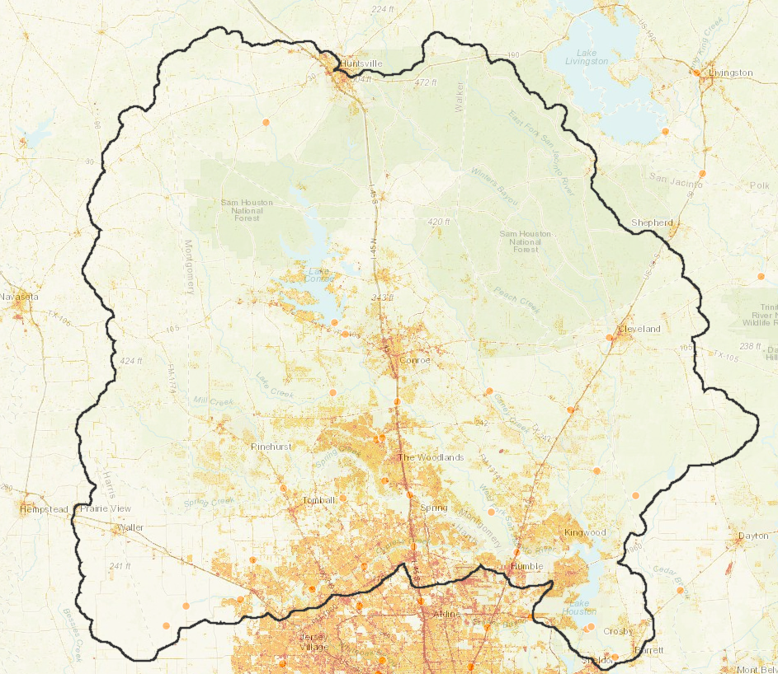
Effects of development:
Development and Impervious Surfaces near Water Bodies
USA NLCD Land Cover 2011
USA NLCD Impervious Surface 2011
Notes:
To understand how the problems can get compounded in a storm event, I looked at the land cover data using National Land Cover Dataset 2011. The different land uses are presented in the legends. The ones I find interesting are the red, brown and black legend keys – where low medium and high intensity developments have occurred. A lot of these are clustered around the streams, which makes sense..
To see how much they contribute to the imperviousness of the surface – NLCD Impervious Surfaces Dataset 2011 was also used.. This very closely mirrors the development areas and the highway systems.
So during such a high impact event like Harvey, the water flowing downstream from mainly ranches and pastures and agricultural areas towards the city is largely facing more and more impervious areas. If the water quality during such an event is bad, then it may make the downstream areas vulnerable to harmful water, which is standing around now.

Slide 14
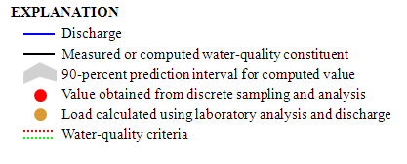
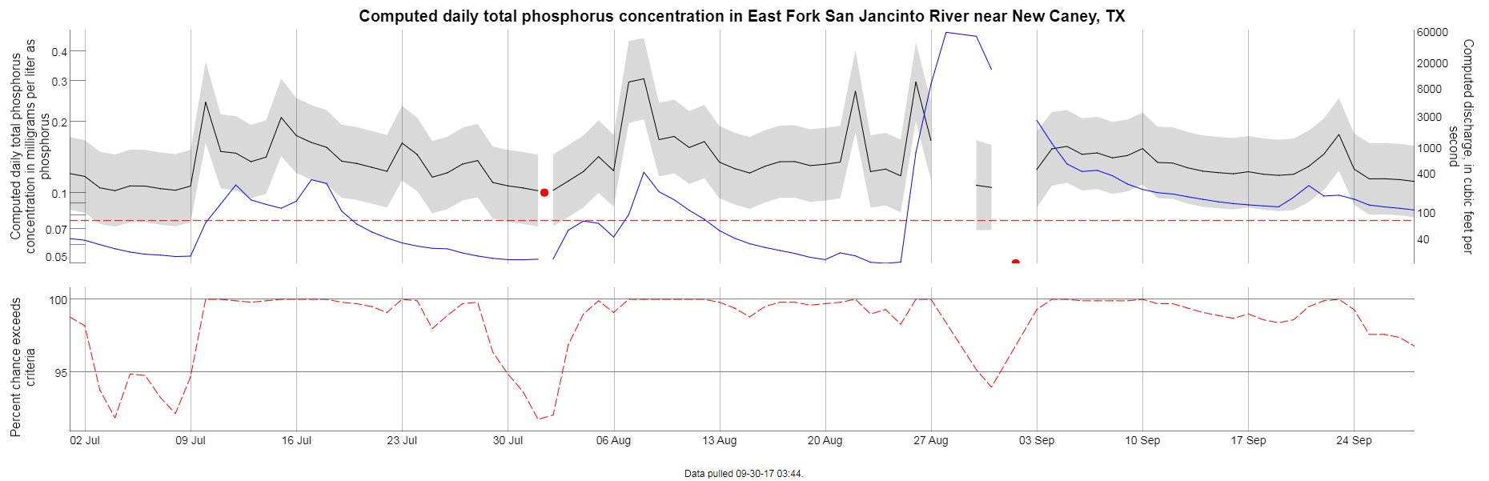
Water Quality Indices: USGS
https://nrtwq.usgs.gov/explore/dyplot?site_no=08070200&pcode=00665&period=ytd_q3&timestep=dv&modelhistory=

Slide 15
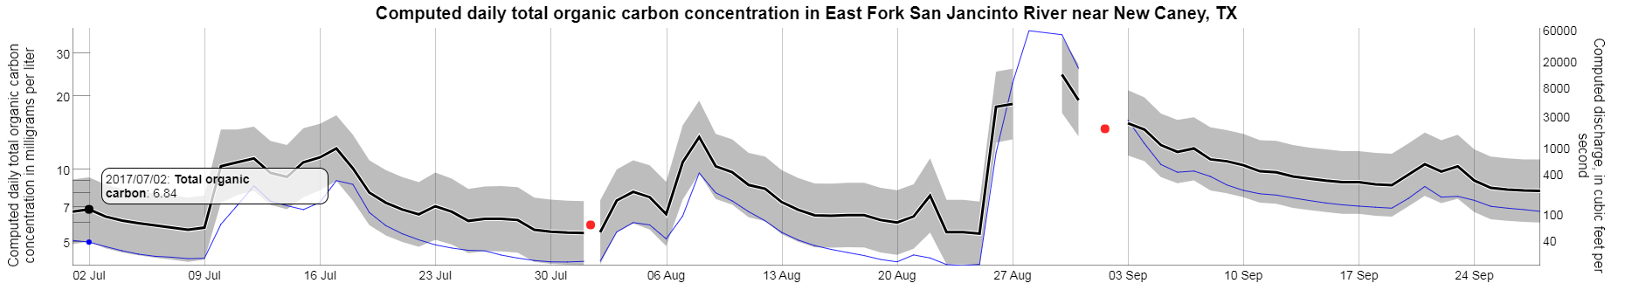
Water Quality Indices - USGS
https://nrtwq.usgs.gov/explore/plot?site_no=08070200&pcode=00631&period=ytd_q3&timestep=uv&modelhistory=

Slide 16
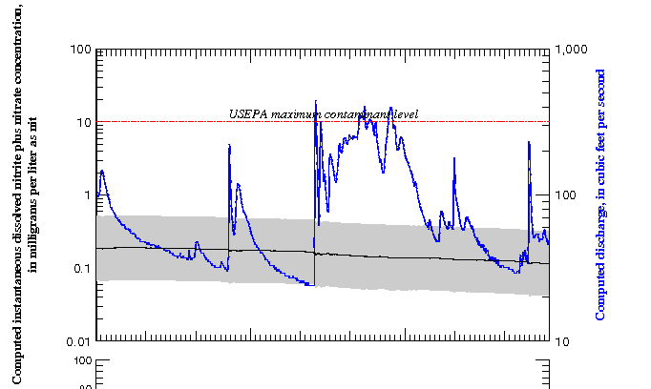
Water Quality Indices - USGS
https://nrtwq.usgs.gov/explore/plot?site_no=08070200&pcode=00631&period=ytd_q3&timestep=uv&modelhistory=

Slide 17
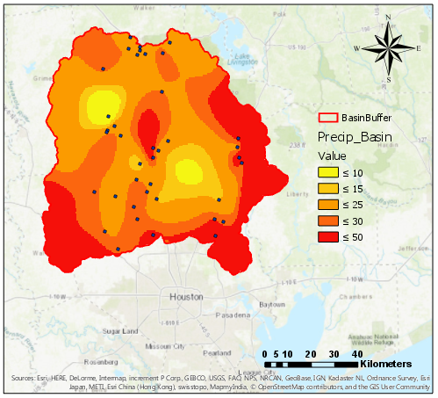
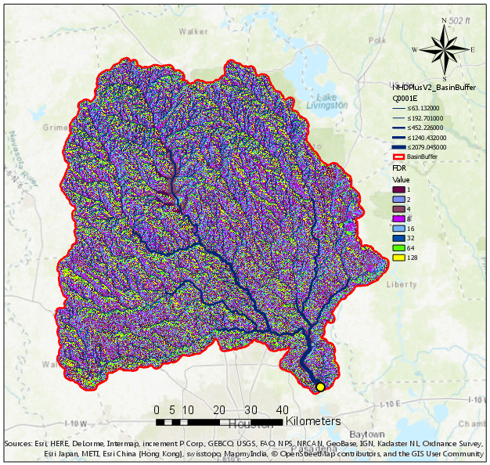
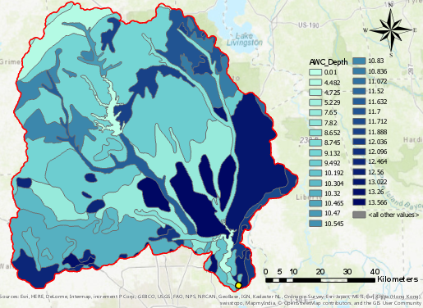
From Rainfall, Slopes and Available Water Capacity: Runoff
Rainfall
Flow Direction
STATSGO
Notes:
These data could be more meaningful when put together with other data sets. When we put together the rainfall, slopes and soil properties, we can use some methods to obtain the rainfall runoffs, which could be useful to pinpoint origins of runoff and have a good idea for a future storm event. I may attempt this if I can pick the brains of some hydrology folks first.

Slide 18
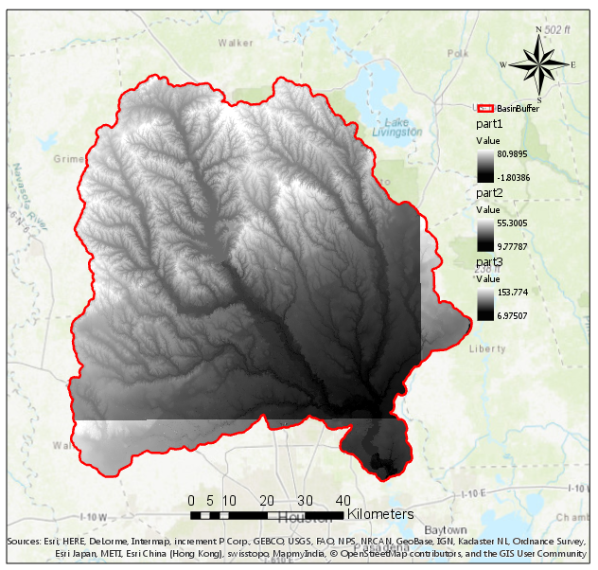
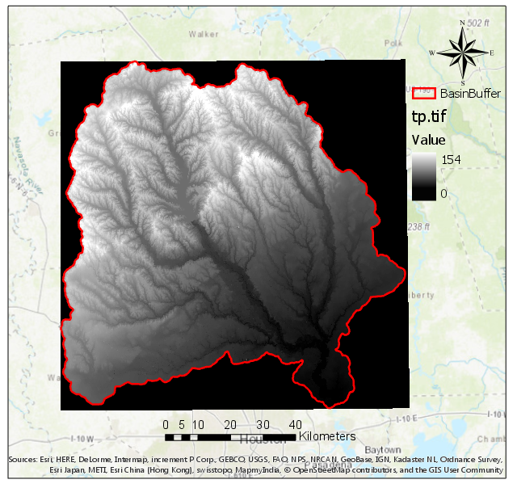
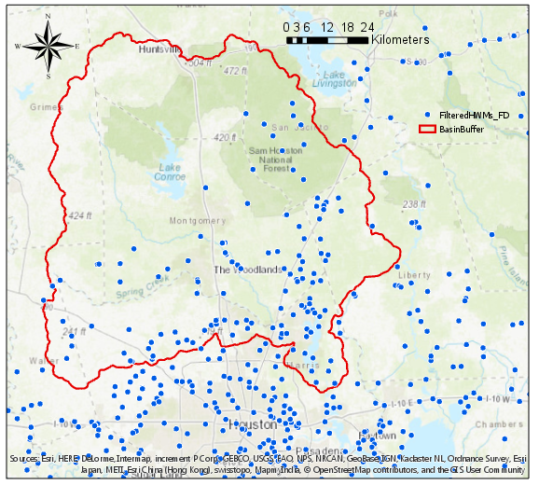
HAND Analysis: Current work
Mosaic to New Raster
Error in moving from
Feature to Raster
NED 1/3 arc second
Validation
USGS
High-Water Mark Data
Notes:
I also attempted to start the HAND mapping for this really large basin. I tried it with the 30 m NED the TAUDEM CyberGIS did not show anything. I made a tif from a mosaic of the 1/3 arc sec NED and tried to work through the HAND exercise but there are some grid errors that have currently brought me to a standstill.
If the HAND mapping could be done and subsequent rating curve data can be compared to the the high water mark data obtained from USGS to validate the mapping.

Slide 19
Progress and Future Work
Delineate a basin with interesting characteristics to study and describe its features
Map the rainfall occurred during the hurricane event
Assess water quality changes in the area
Attempt to map the flood inundation in the basin

Slide 20
Plan of Work
1. Work towards a better visualization of the water quality data
2. Work towards the inundation mapping to find out regions that would be affected by bad water quality

Slide 21
References
US Department of Commerce; NOAA; National Weather Service. Major Hurricane Harvey - August 25-29, 2017 http://www.weather.gov/crp/hurricane_harvey (accessed Sep 21, 2017).
Weather Prediction Center. Storm Summary Method http://www.wpc.ncep.noaa.gov/discussions/nfdscc1.html (accessed Sep 19, 2017).
Almukhtar, S.; Bloch, M.; Carlsen, A.; Fessenden, F.; Griggs, T.; Lai, K. K. R.; Park, H.; Pearce, A.; White, J.; Yourish, K. Mapping the Devastation of Harvey in Houston https://www.nytimes.com/interactive/2017/08/28/us/houston-maps-hurricane-harvey.html?_r=0 (accessed Sep 19, 2017).
Stuckey, A. Raw sewage spilled in Houston area after wastewater plants damaged by Harvey http://www.chron.com/news/houston-texas/article/Nearly-a-dozen-wastewater-treatment-facilities-12209605.php (accessed Sep 21, 2017).

Slide 22
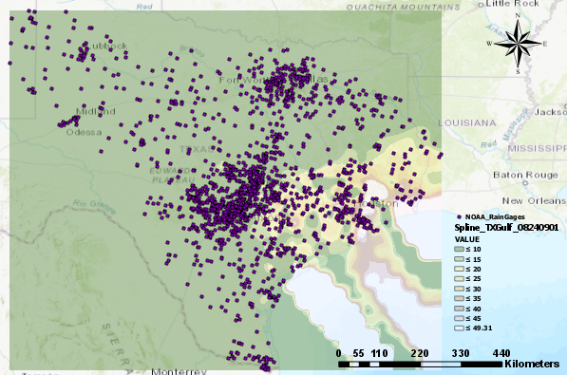
Thank You
Questions?
Comments?

