Slide 1

Analyzing the relationship between latitudinal position & stream discharge in glacial-fed river systems.
By Kevin Strybos
Dr. Maidment’s Fall, 2017 WR Course

Slide 2
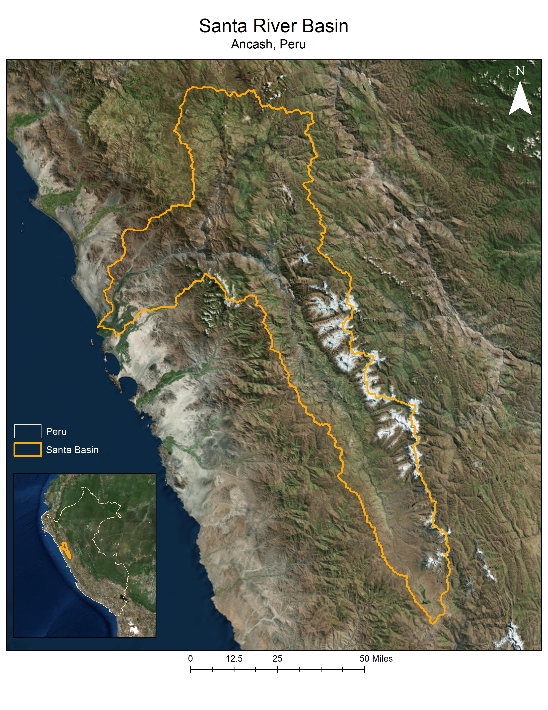
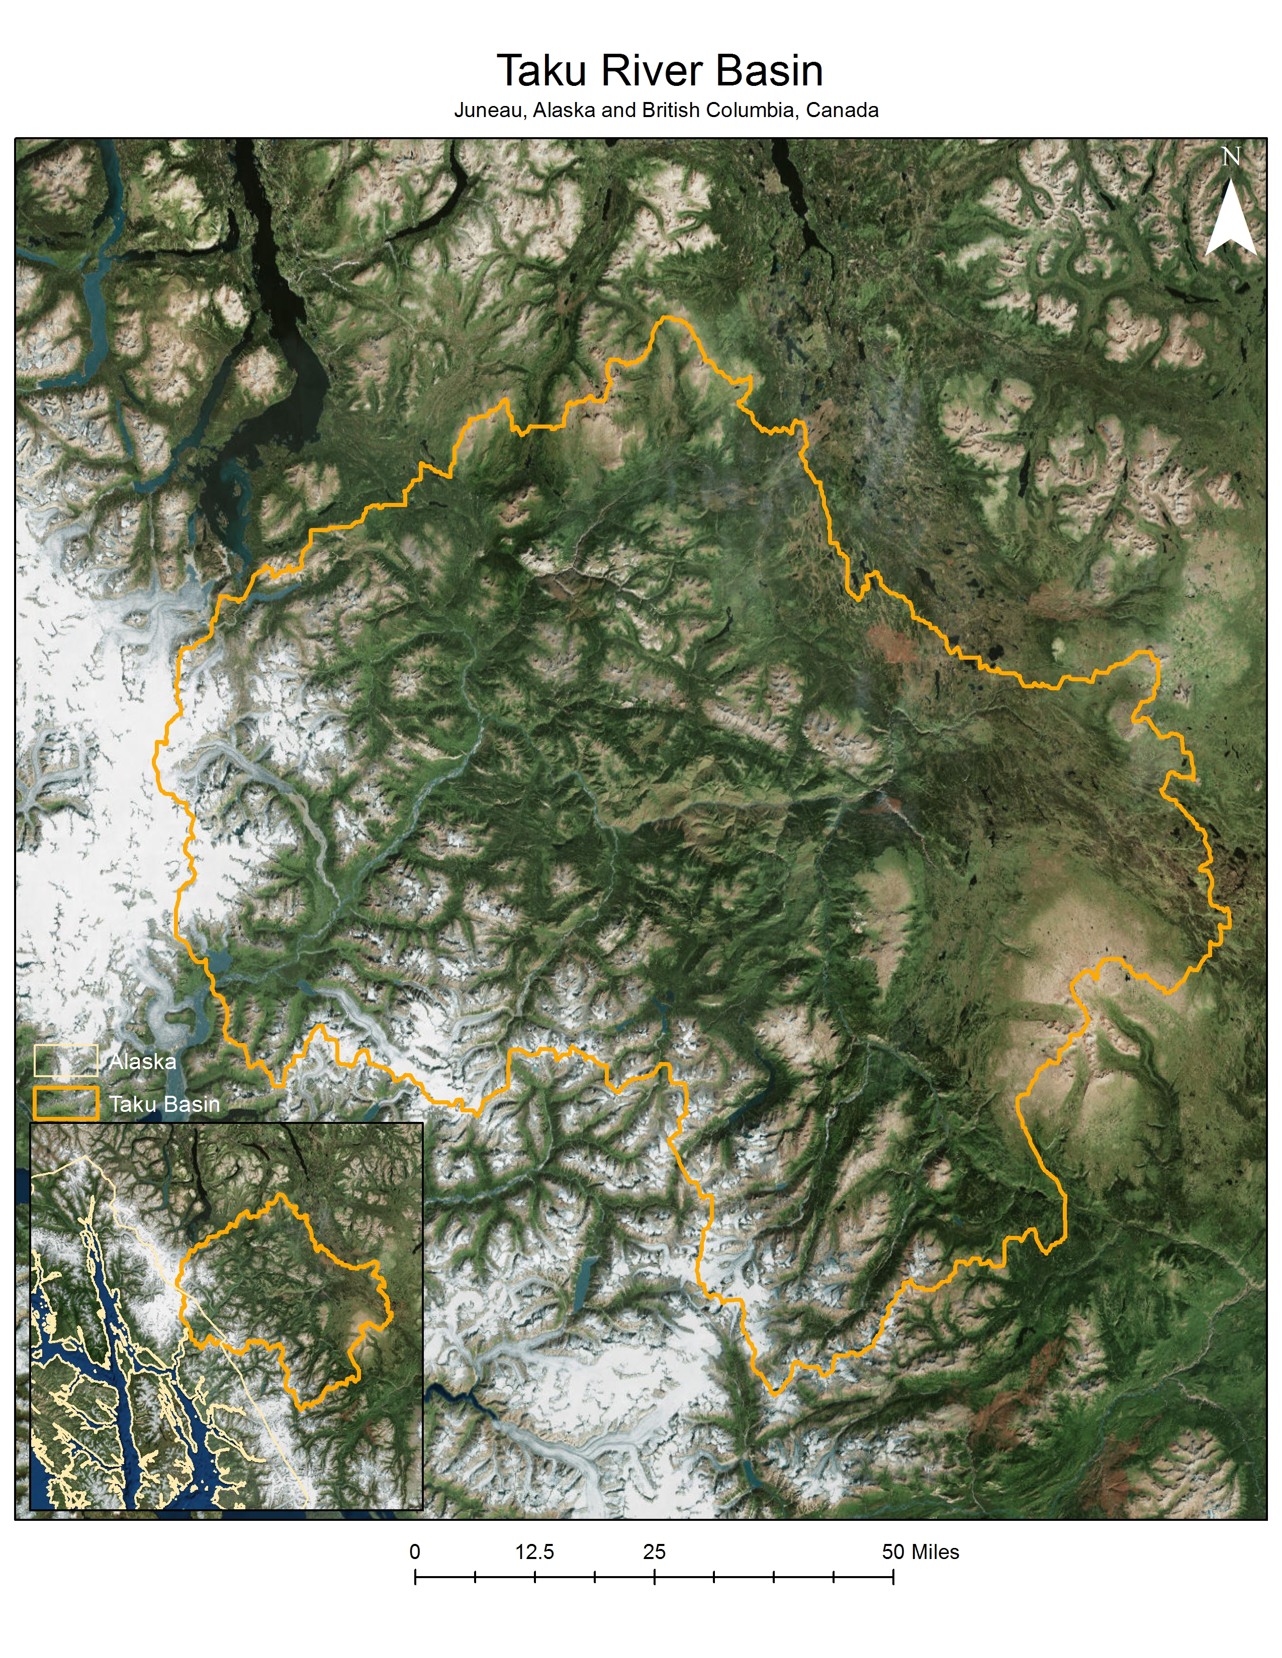
Focus areas
High elevation
Low latitude
(9.5261° S)
Low elevation
High latitude
(58.3019° N)

Slide 3
Background and history
Santa River Basin
Located in Ancash, Peru
Relies heavily on glacial runoff during dry season. (~40% streamflow comes from glacial runoff during dry season)
1.4 million people depend on water coming from glaciers in the Santa.
World’s highest tropical mountain range and the largest glaciated area in the tropics.
Glaciers are rapidly melting
Taku River Basin
Runs from British Columbia, Canada to the capital of Juneau in southeast Alaska.
Depending on the time of the year, the Juneau area only receives ~6 hours of sunlight or darkness.
32,800 people rely on the Taku River for various resources.
~35% of Alaska’s overall runoff is provided by glacial melt during the warmer months
Taku Glacier was one of the only advancing glaciers in Alaska until recently (2005) where it came to a halt and may begin receding.

Slide 4

What causes variation in stream discharge?
Although all of these are important factors to consider, my project is mostly focused on climate with respect to incoming solar radiation throughout the year
*Pie chart not representative of actual proportion for each variable*

Slide 5
Methods
Data collection
  DEMs (ASTER GDEM Version 2), stream data (USGS & Dr. Baraer of University of Quebec), and glacier shapefiles from GLIMS
Delineated river basins, streams and catchments
  Mostly just visualizing the river basin—not a significant part of my data analysis.
Clipped the DEM by the glacier shapefiles and applied the Area Solar Radiation tool on the output glacier DEM.
  Significantly decrease processing time of the ASR tool.
  12 outputs created, which provide incoming solar radiation values for each month of the year.
Ran the Zonal Statistics tool to find the average incoming solar radiation hitting glaciers for each month of the year.
  These values were then compared to the monthly stream discharge data to identify any sort of relationships.

Slide 6
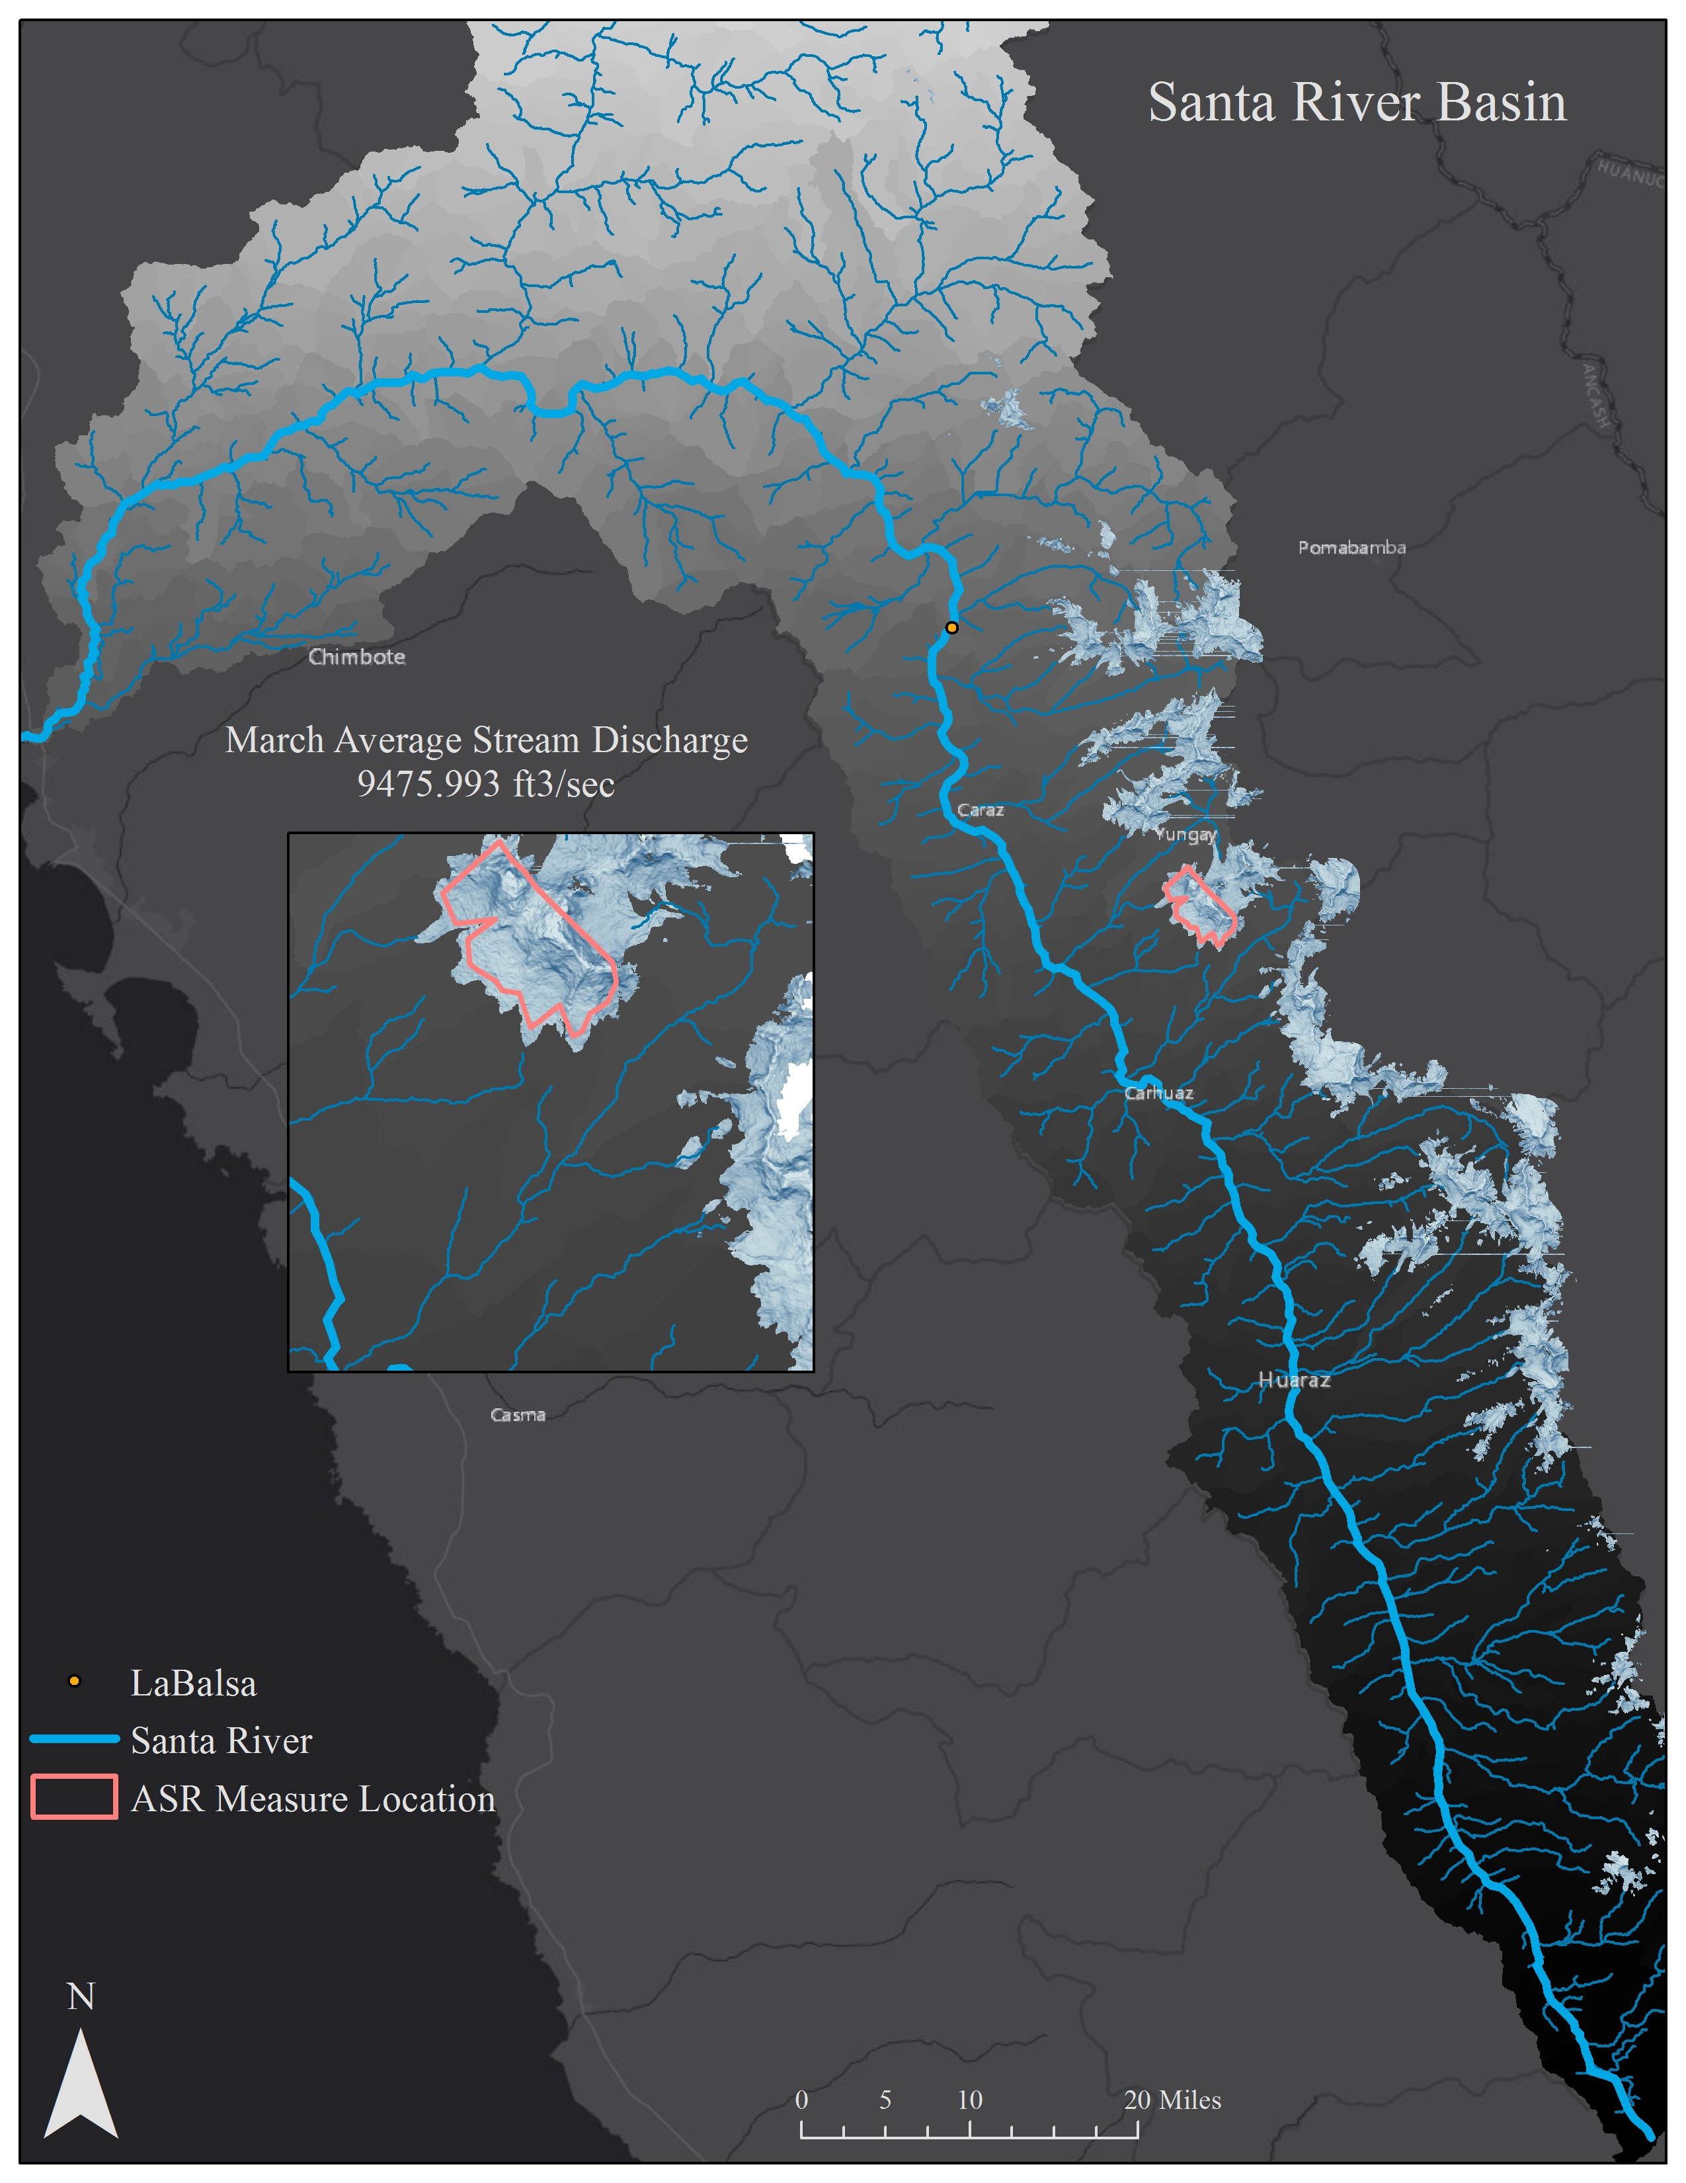
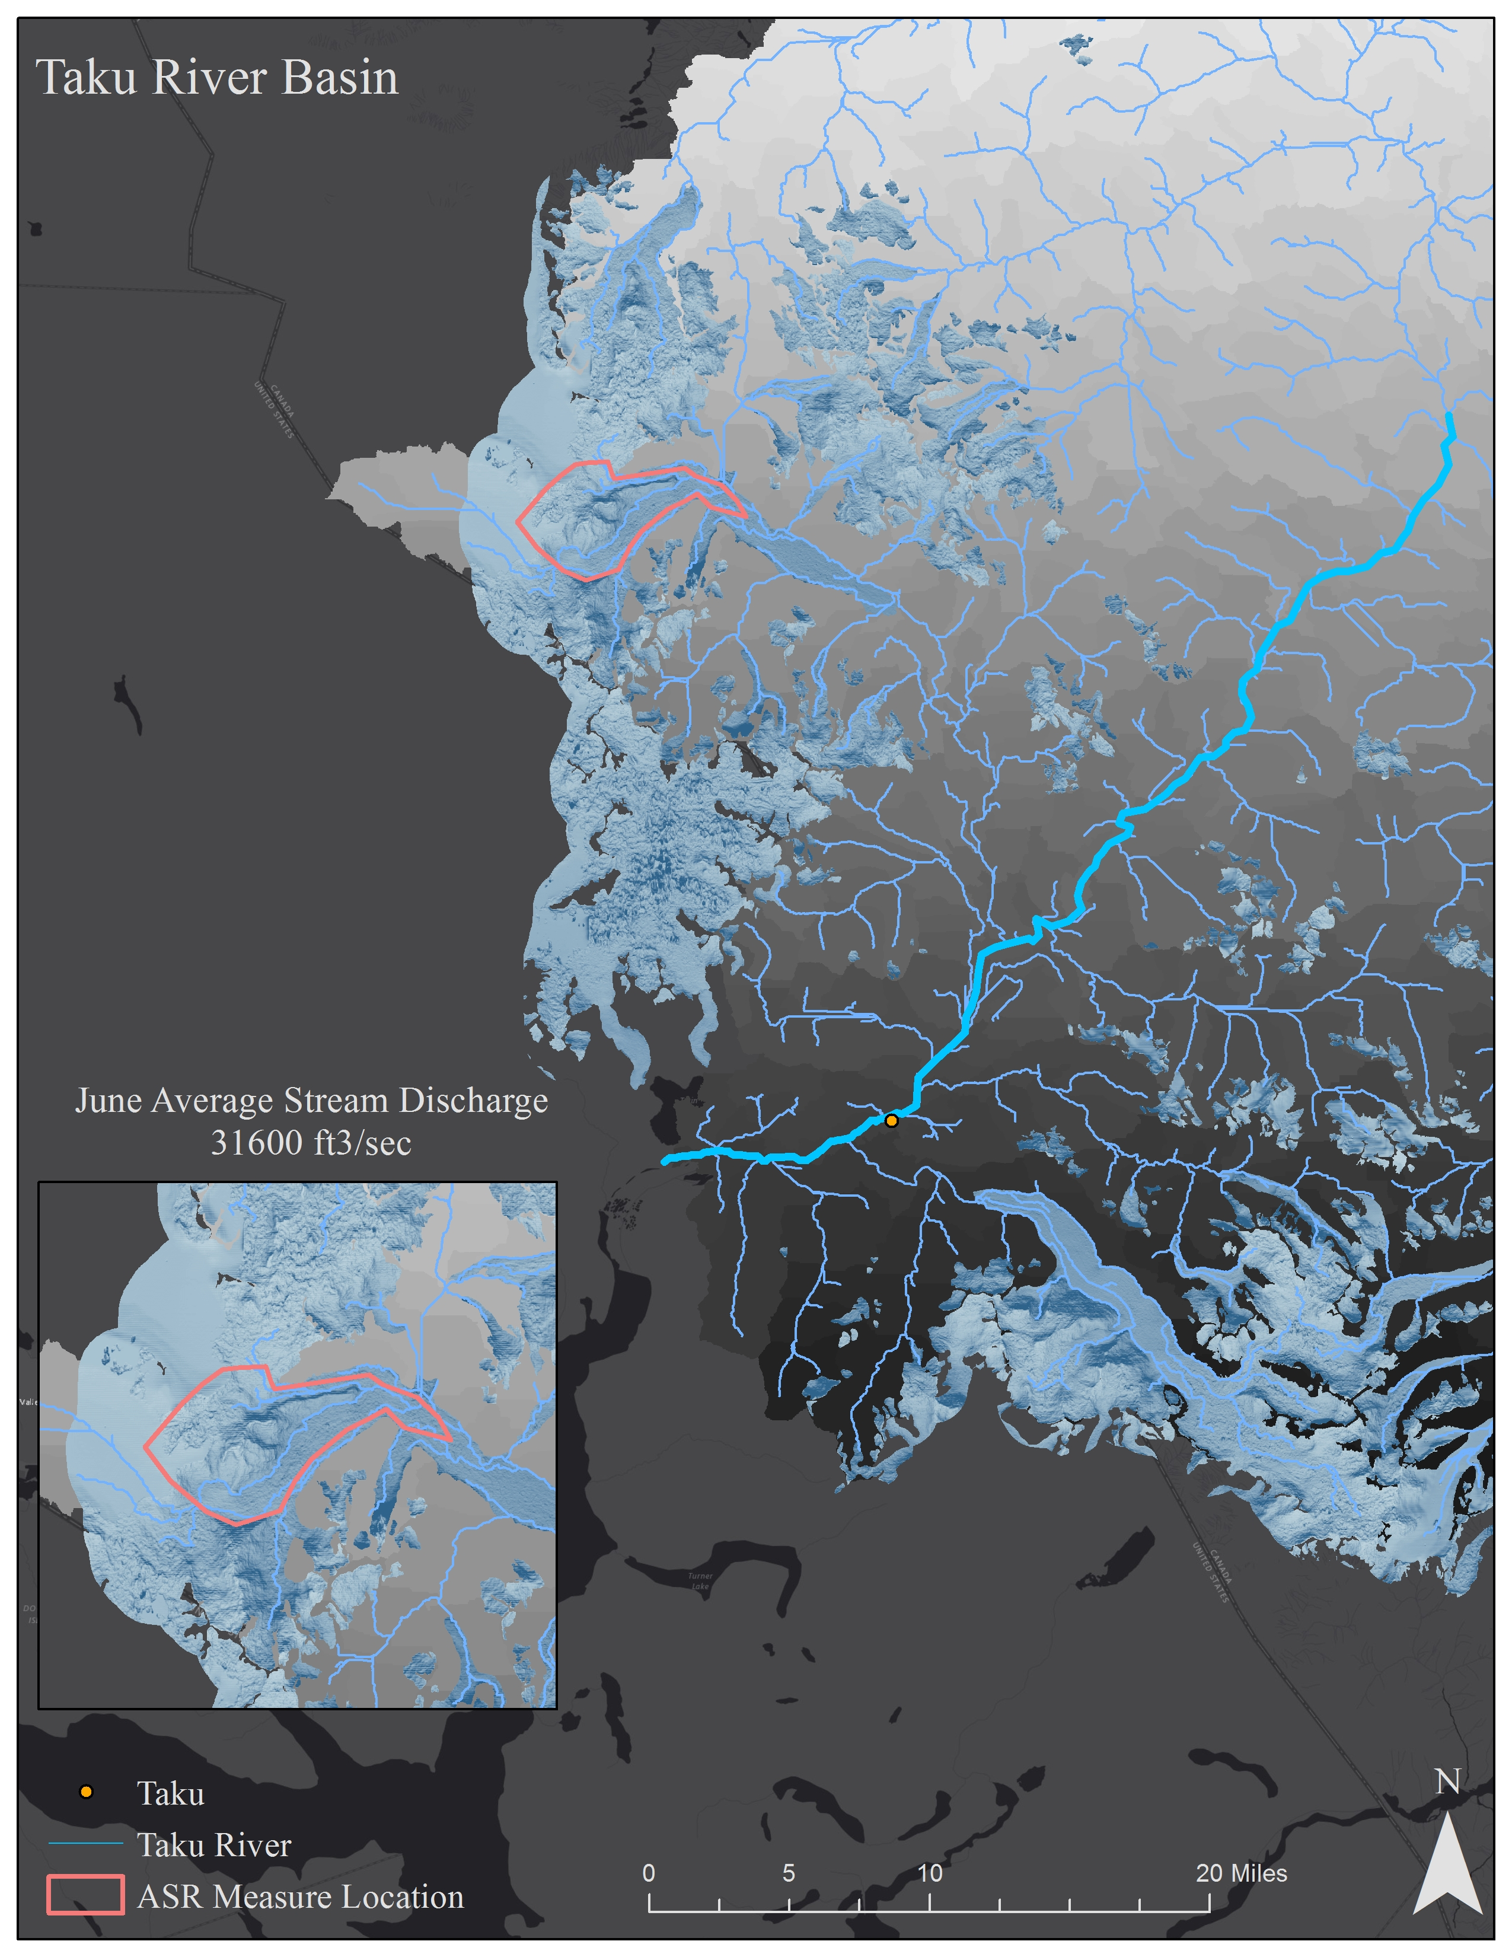
ASTER GDEM is a product of METI and NASA.

Slide 7
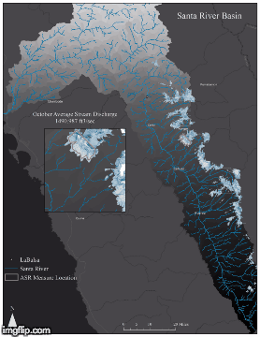
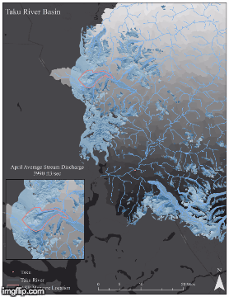
Results

Slide 8
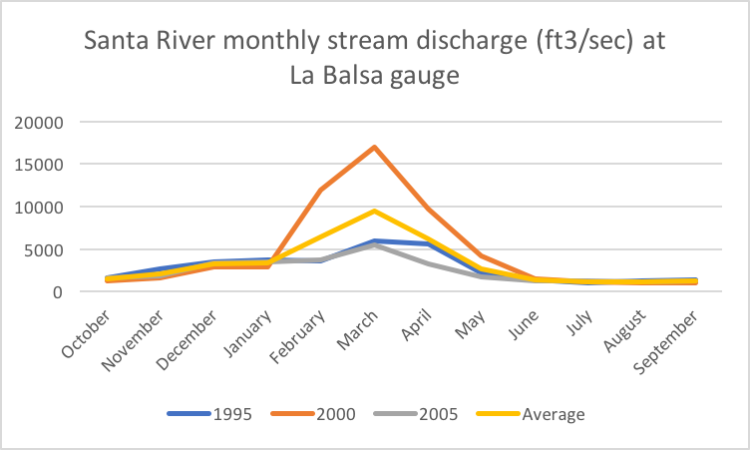
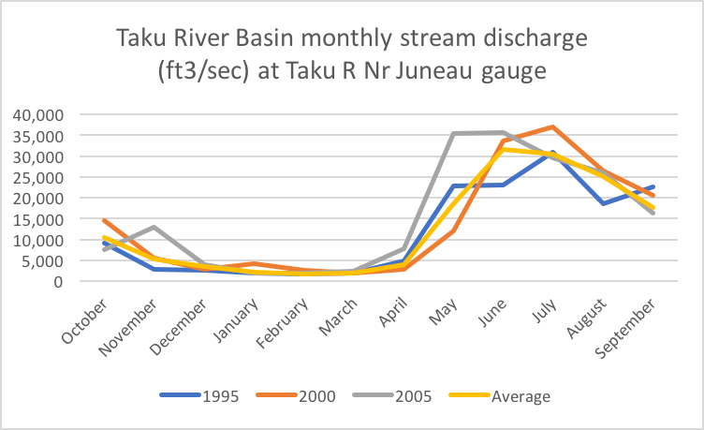
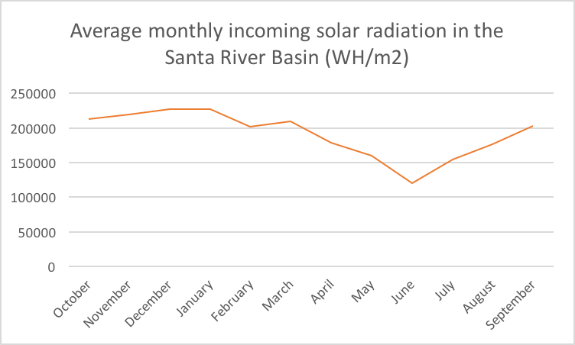
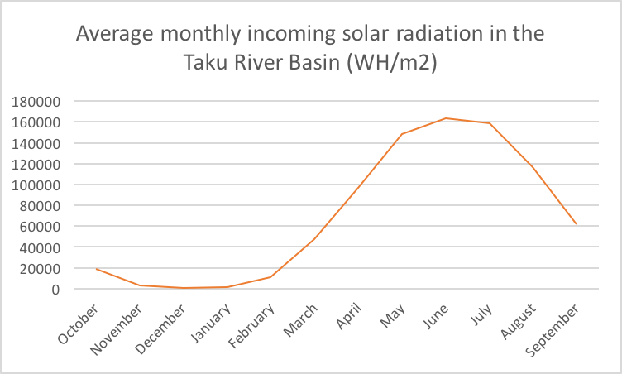

Slide 9
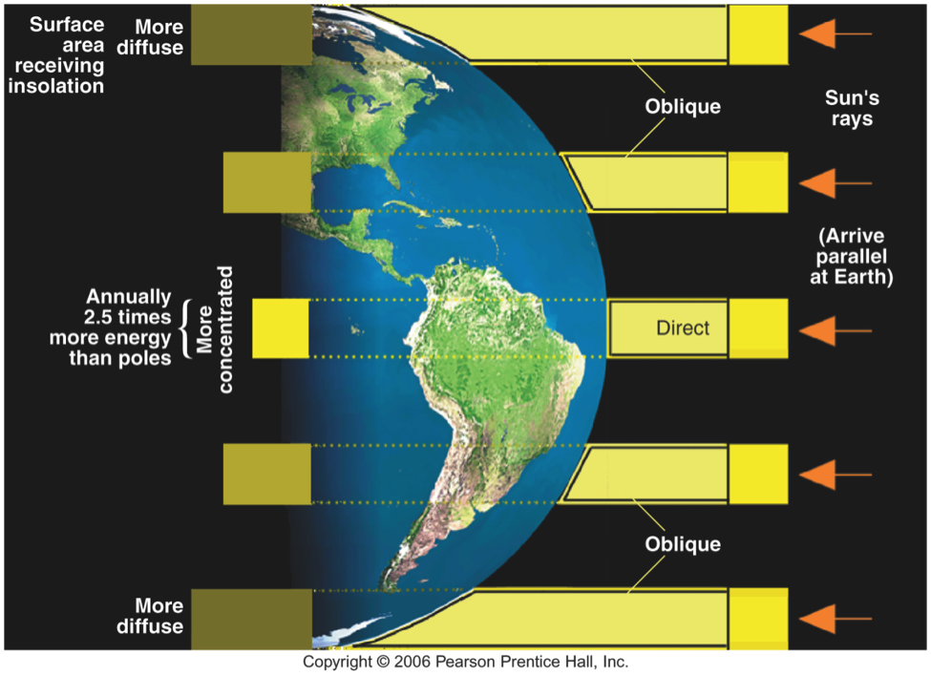
Interpretation of results
Alaska
Although the Santa River Basin doesn’t see high variation in incoming solar radiation throughout the year due to its close proximity to the equator, it does have high seasonality in stream discharge.
  Seasonality in precipitation values and other variables may have a more significant direct impact than incoming solar radiation on stream discharge variation.
  The Taku River Basin has a more obvious relationship between stream discharge and incoming solar radiation due to the extreme seasonality of sunlight and temperatures in Alaska.
  Runoff from glaciers is almost completely restricted to the warmer months since there is little to no sunlight to melt it during winter months.
Peru

Slide 10
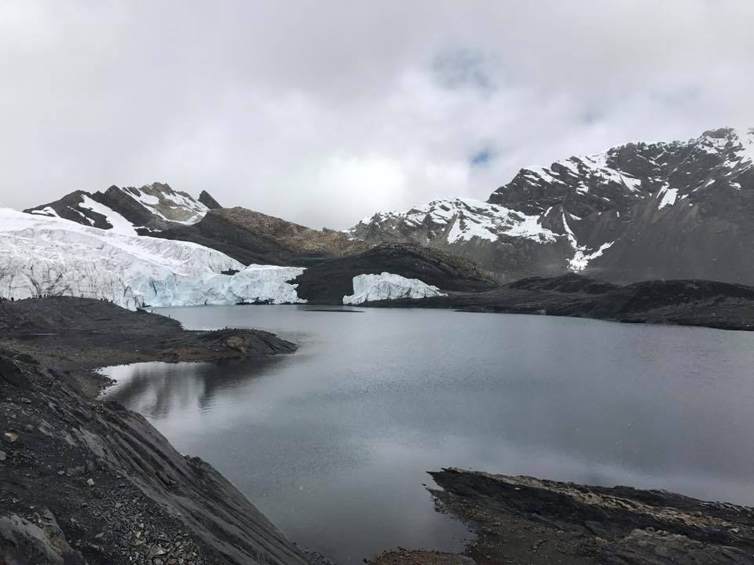
Conclusion
Incoming solar radiation shows a positive correlation with stream discharge, especially in regions further from the equator.
Further studies should incorporate data on precipitation and groundwater measurements.
  This will help better understand the relationship of glacial runoff to stream discharge.
Pastoruri Glacier in Peru

Slide 11
References
Baraer, Michel, et al. “Glacier recession and water resources in Peru’s Cordillera Blanca.” Journal of Glaciology , vol. 58, no. 207, 28 Nov. 2011, pp. 134–150.
NASA LP DAAC, 2015, ASTER Level 1 Precision Terrain Corrected Registered At-Sensor Radiance. Version 2. NASA EOSDIS Land Processes DAAC, USGS Earth Resources Observation and Science (EROS) Center, Sioux Falls, South Dakota (https://lpdaac.usgs.gov), accessed September, 2017, at https://asterweb.jpl.nasa.gov/gdem.asp.
Raup, Bruce H. “GLIMS: Global Land Ice Measurements from Space.” GLIMS: Global Land Ice Measurements from Space, www.glims.org/.

