Slide 1
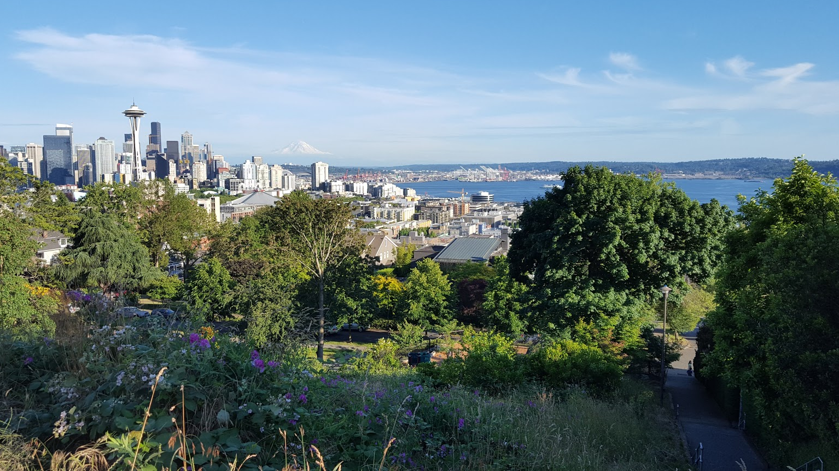
Combined Sewer Overflows in Seattle, WA
GIS in Water Resources
Lisa Thompson
11/21/2017

Slide 2
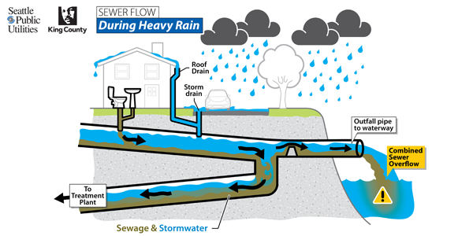
What are combined sewer overflows (CSOs)?
Relief points in older systems that carry sewage and stormwater in the same pipe.
When heavy rains fill the pipes, CSOs release sewage and stormwater directly into rivers, lakes, or Puget Sound.
Annually, more than 300 sewage overflows discharges millions of gallons of raw sewage and stormwater into Seattle’s waterways creating health and environmental risks.
http://kingcounty.gov/services/environment/wastewater/cso.aspx

Slide 3
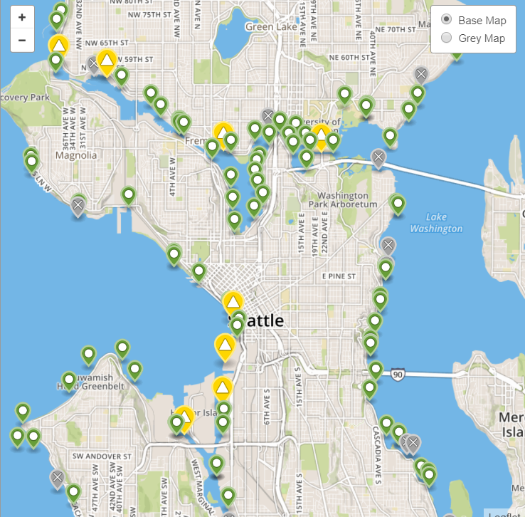
King County/Seattle
Regulatory Requirements
Almost 860 municipalities across the U.S. have combined sewer systems.
  Regulated through the National Pollutant Discharge Elimination System (NPDES) permit program.
Seattle is required to reduce overflows to an average of no more than one overflow per outfall per year.
Actions Seattle is taking:
  Reducing CSOs through operation and maintenance
  Maximizing flow to treatment plants
  Notifying the public
  Monitoring CSO outfalls
  Executing capital improvement projects
King County is required to control all of its CSOs by 2030.
Main method to reduce CSOs is to store stormwater during heavy rainstorms and slowly release it to the treatment plant.
http://www.kingcounty.gov/services/environment/wastewater/cso-status.aspx

Slide 4
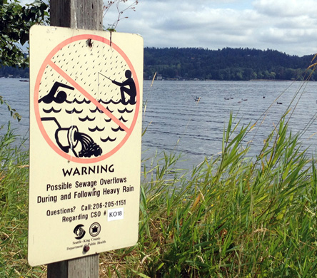
Project
Objectives
Use GIS to determine a method of prioritizing CSO improvements.
  Create catchment areas associated to specific CSO locations
  Relate precipitation in a catchment with the volume of the overflow
  Create maps with volumes and frequencies of overflows at a subset of CSOs
http://www.kingcounty.gov/services/environment/wastewater/cso-status.aspx

Slide 5
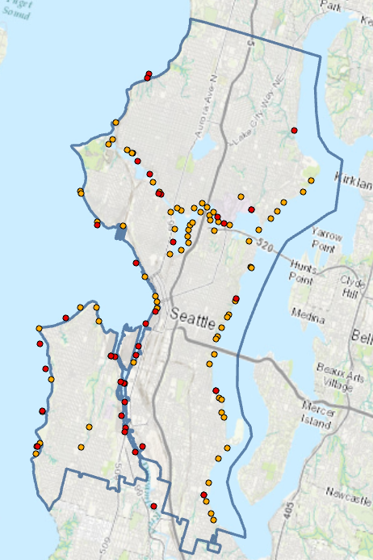
Map of CSOs in Seattle
Managed by King County (red) and the City of Seattle (orange)
  King County – 38 outfalls
  City of Seattle – about 90 outfalls
King County manages CSOs that serve areas greater than 1000 acres
  Focus on the larger CSOs
Outfall locations extracted from NPDES permits for King County (WA0029181) and Seattle (WA0031682)

Slide 6
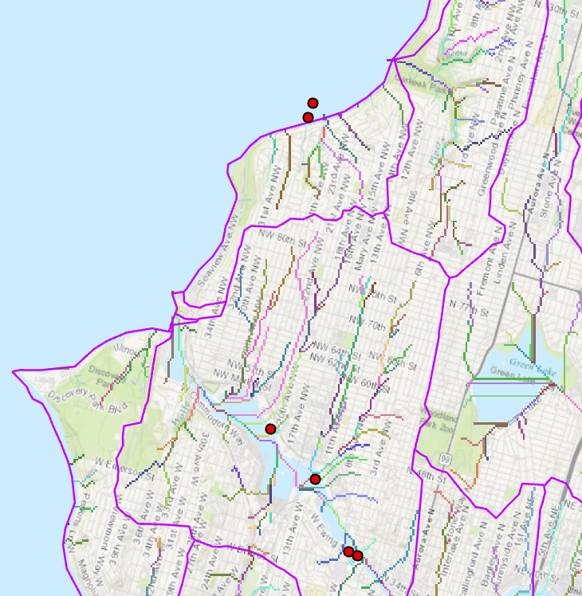
Data Compilation and Analysis
Data Sources
  NED 30-meter DEM
  NHDPlus Catchment Boundaries
  Washington Department of Ecology Permit and Reporting Information System (PARIS)
    NPDES Permit
    CSO Outfall locations
    Discharge data
Analysis
  Map Outfalls
  Flow Direction, Flow Accumulation, Stream Delineation
Stream delineation at a 100 cell threshold

Slide 7
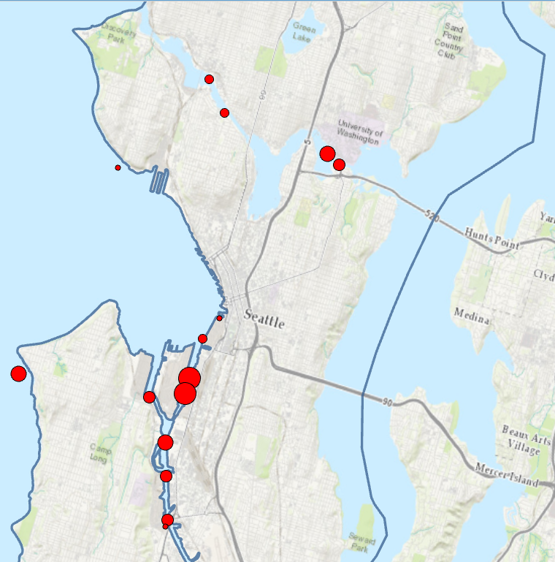
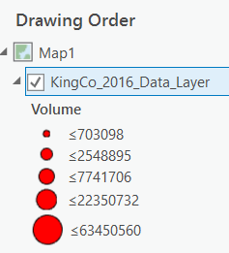
October 13, 2016 Rain Event
Over the month of October:
  10.1 inches of rain
  56 untreated overflow events
  321 million gallons discharged
October 13, 2016:
  2.9 inches of rain
  15 untreated overflow events
  157 million gallons discharged
Untreated discharge volumes from the October 13, 2016 rain event.

Slide 8
Next Steps
Create catchment areas that relate to specific outfalls.
Interpolate rain gage data and relate it to overflow volumes to predict when a sewer overflow may occur.
Create maps with the volumes and frequencies of overflows at a subset of CSOs.
Look at water quality data to determine if there is a correlation to sewer overflows.

Slide 9
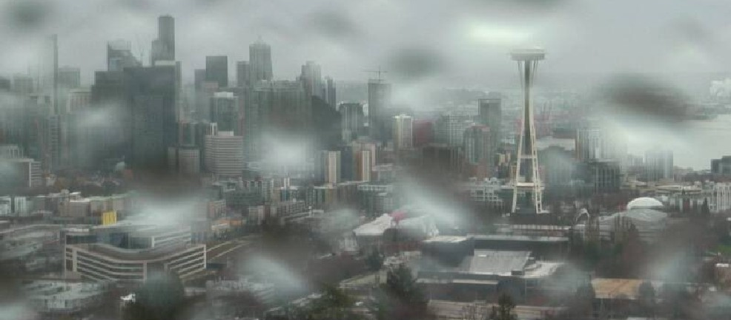
Questions?
http://komonews.com
http://www.kingcounty.gov
http://www.seattle.gov

