Slide 1
Vegetation coverage and change in the Wax Lake Delta
Kyle Wright
Environmental & Water Resources Engineering
Masters Student / NSF Research Fellow
Passalacqua Group

Slide 2
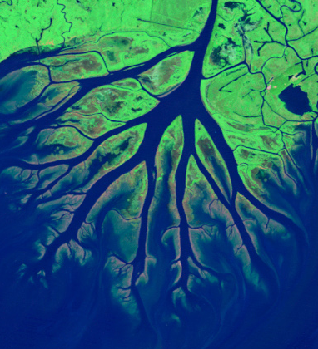
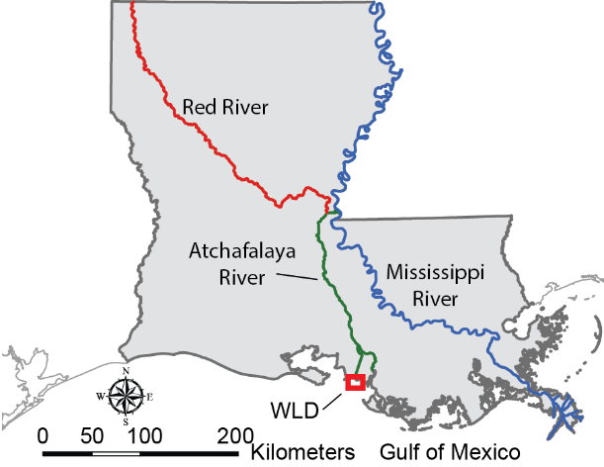
The importance of connectivity in river deltas
23% - 54% of channel flow is lost to interdistributary islands
N
[Hiatt & Passalacqua, 2015, 2017; Shaw et al., 2016]

Slide 3
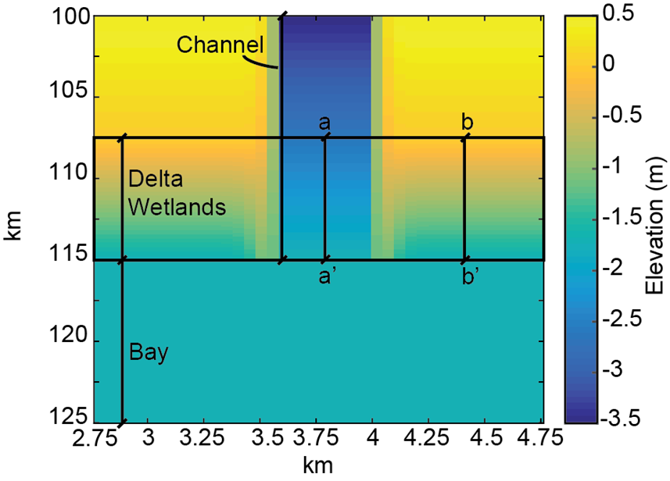
Island vegetation controls degree of connectivity
Confined Flow
More vegetative roughness in islands
In hydrodynamic models, vegetation often treated as uniform (or ignored)
[Hiatt & Passalacqua, 2017]

Slide 4
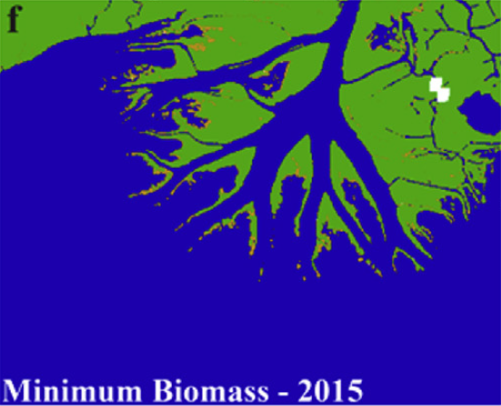
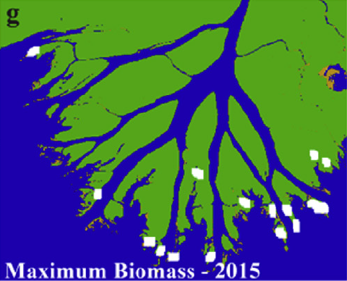
Vegetation far from homogeneous
[Olliver & Edmonds, 2017]

Slide 5
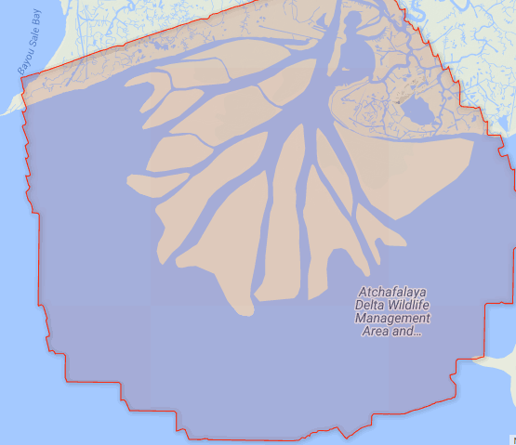
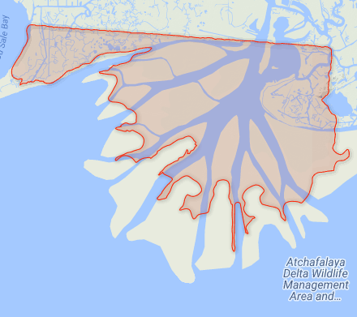
Methods & Data Sources:
2009
Data from two Lidar campaigns available on OpenTopography
Jan 14th, 2009 (NCALM)
228.87 km²
1.69 pts/m²
Feb 13th-14th, 2013 (UT JSG)
30.98 km²
14.27 pts/m²
Used in Wagner et al., 2016 to look at elevation change
2013

Slide 6
2009

Slide 7
2013

Slide 8
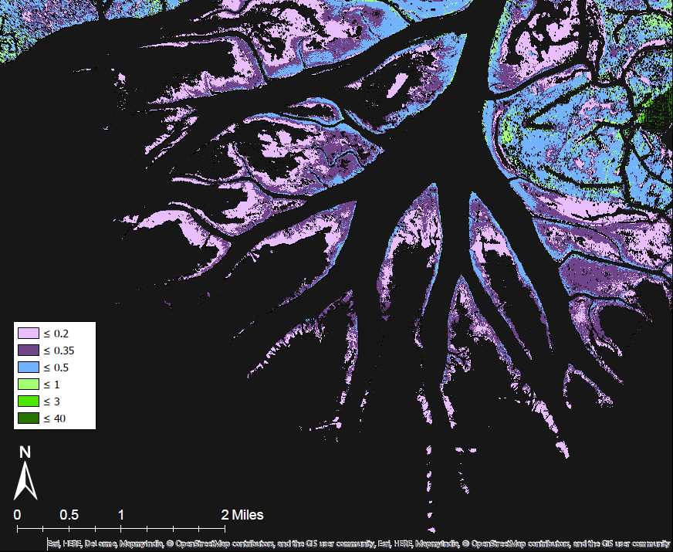
Ground elevations (post-cleaning)
2009
2013

Slide 9
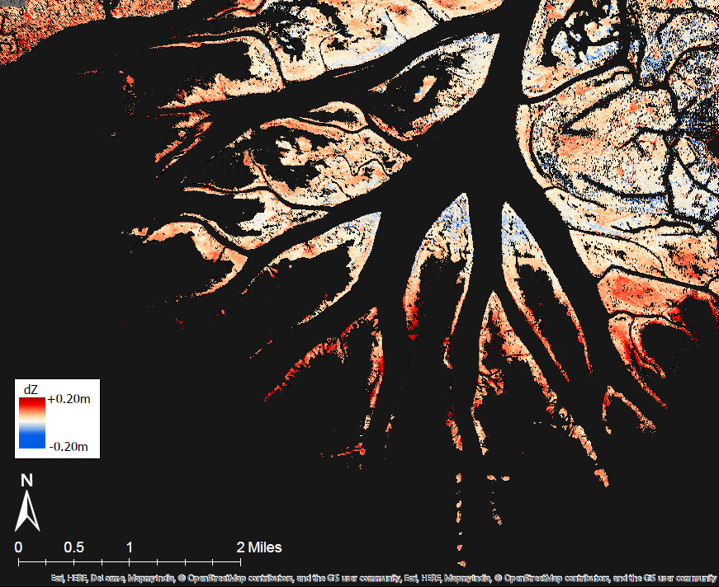
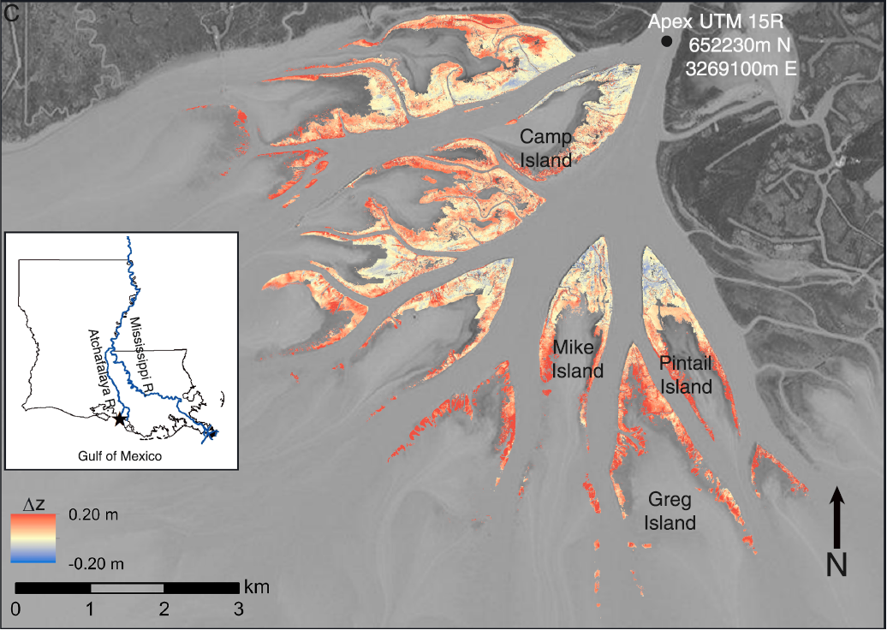
Elevation Change
2013 – 2009
[Wagner et al., 2017]

Slide 10
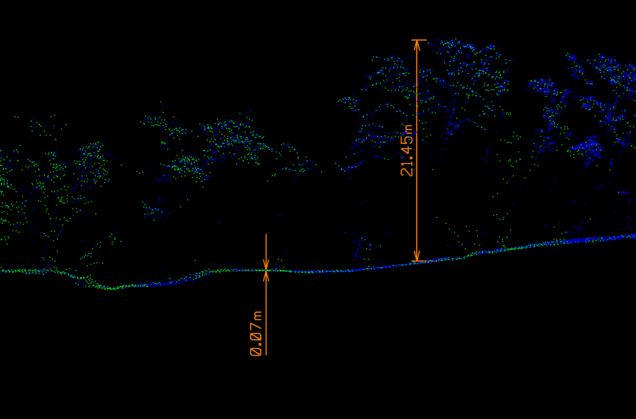
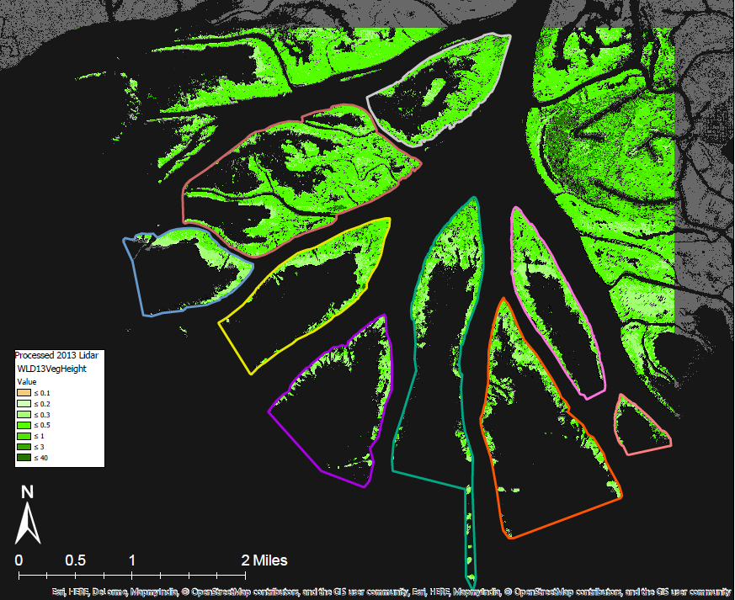
(Surface – Ground) ∝ Vegetation
2009
2013
[Image Source: OpenTopography]

Slide 12
Questions?
[Image credit: Phillip Russo]

