Slide 1
Indirect changes in fish assemblages due to increases in arctic river discharge
Cody Dawson
28 November 2017
Marine Science

Slide 2
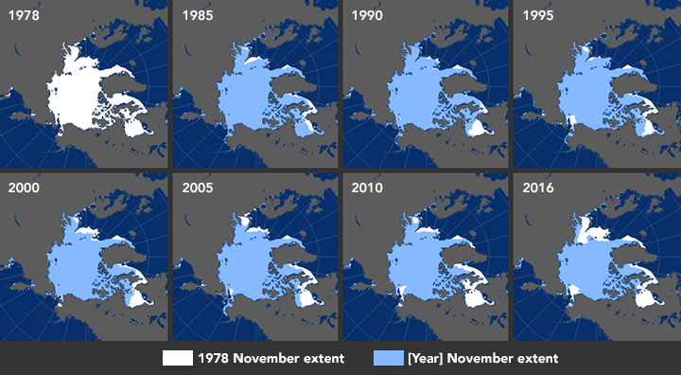
The Arctic Is Being Impacted By Climate Change
NASA

Slide 3
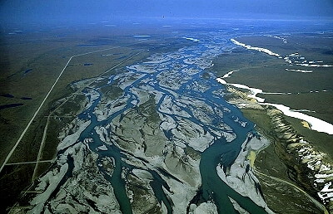
Arctic River Discharge Has Increased
Sagavanirktok River
Eurasian rivers most heavily impacted (Peterson et al 2002)
North American rivers seeing more pronounced effects recently (McClelland et al. 2014)
Combination of pluvial and glacial water sources

Slide 4
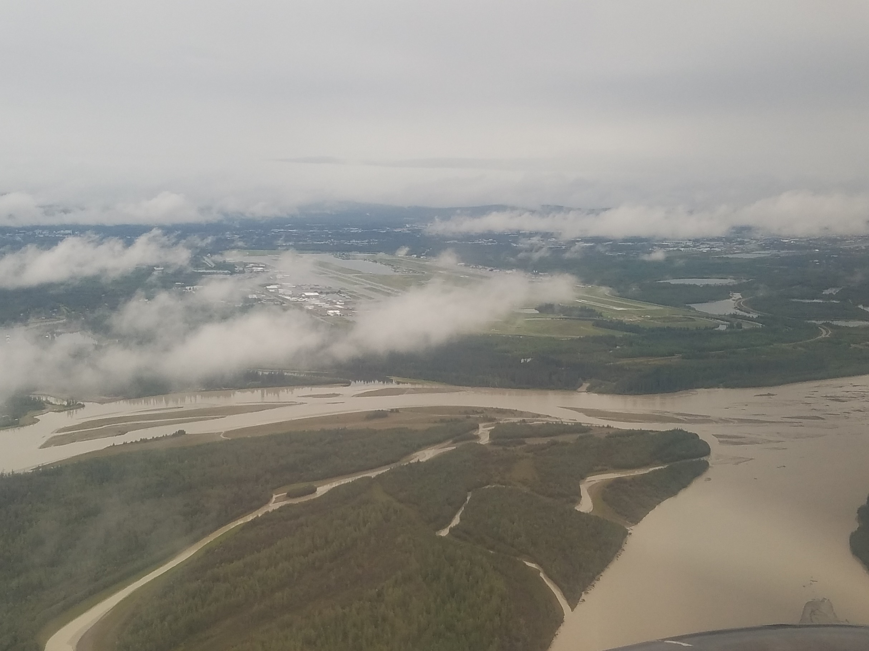
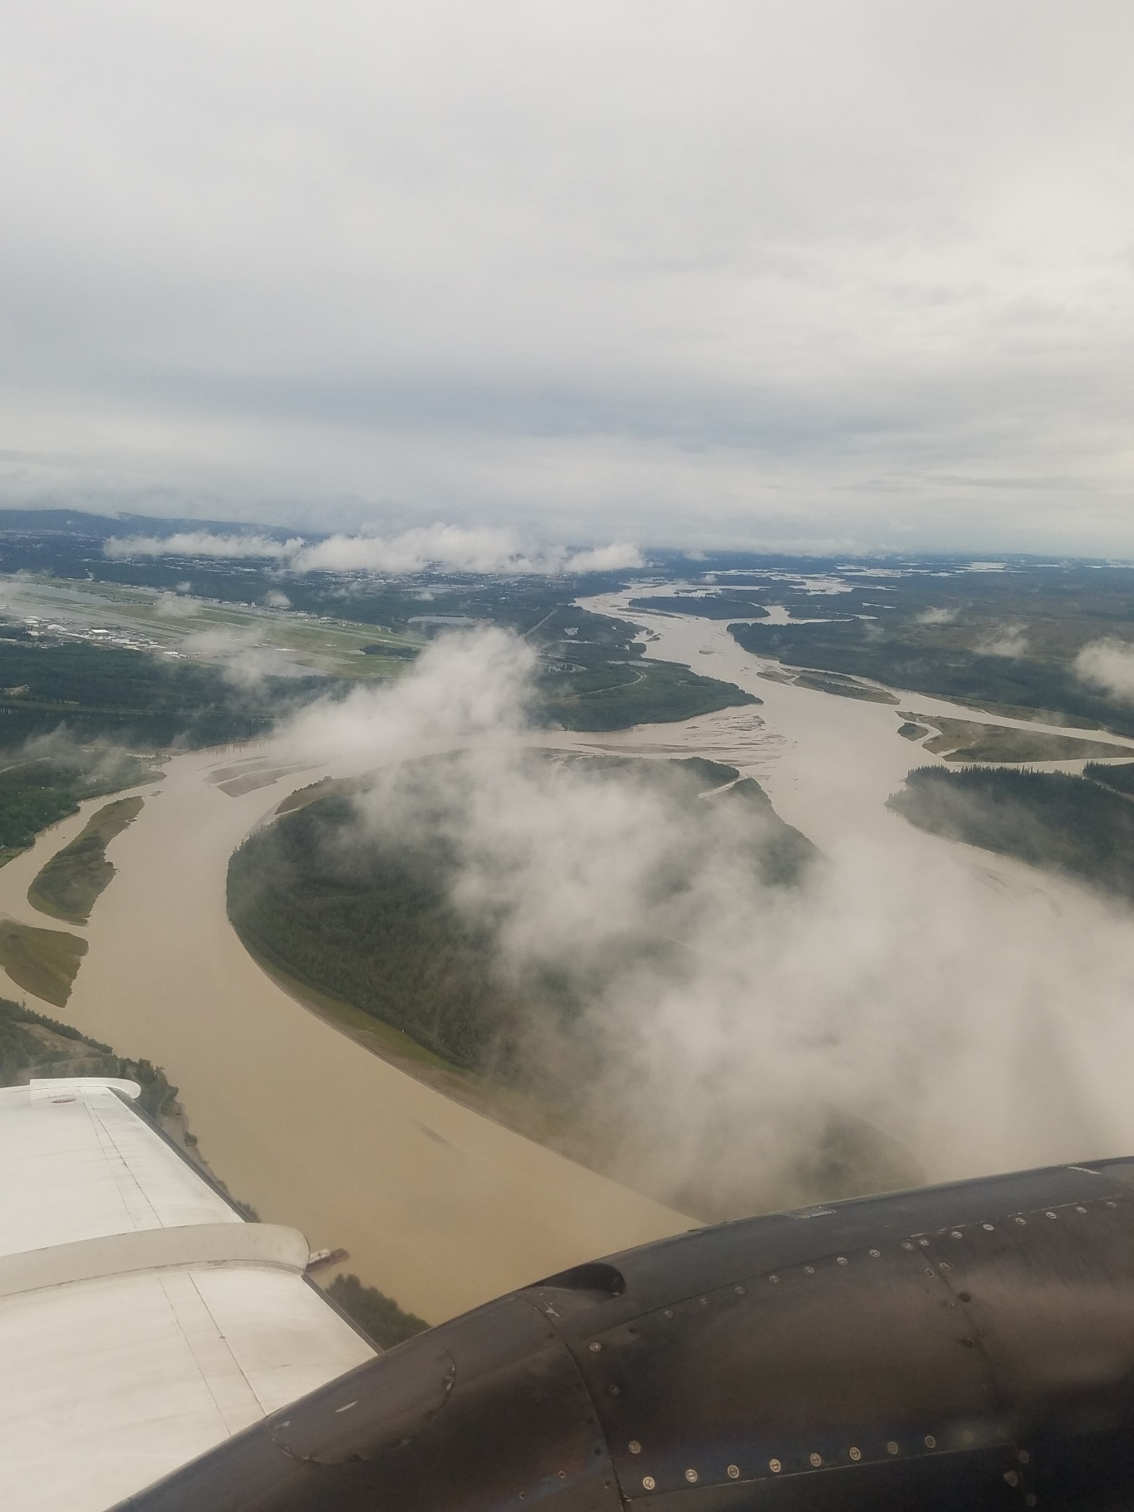
Arctic River Discharge Has Increased

Slide 5
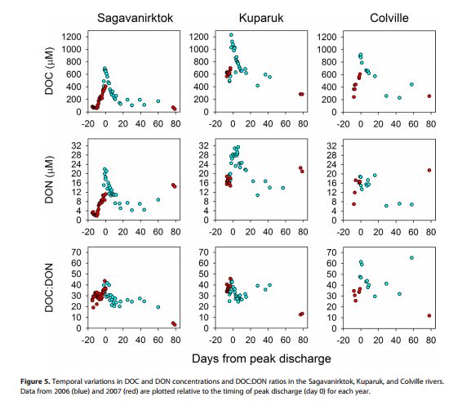
Increased River Discharge Could Switch Trophic Balance
Brings organic and inorganic nutrients to coastal zone
Some areas have seen doubling in phytoplankton productivity (Wikner & Andersson 2012)
McClelland et al. 2014

Slide 6
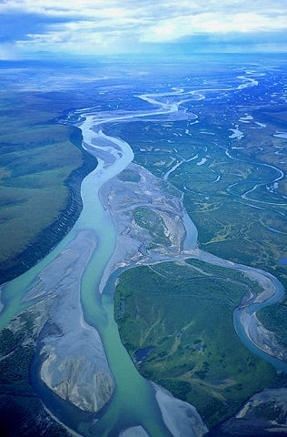
Objectives
Delineate Sag, Lower Colville, and Kuparuk watersheds
Identify streams and major rivers in watersheds
Identify streams containing known anadromous fish populations
Calculate accurate river discharge to locate areas of coastal nutrient loading
Colville River

Slide 7
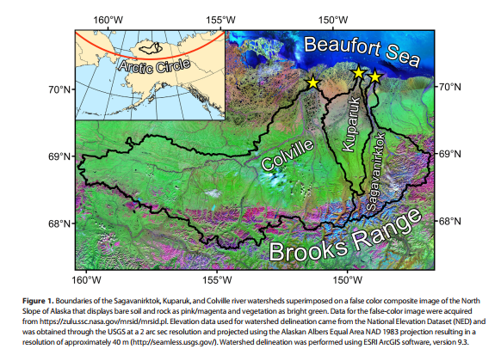
McClelland et al. 2014

Slide 8
Discharge from USGS gages in 2016

Slide 9
Discharge from USGS gages in 2016

Slide 10
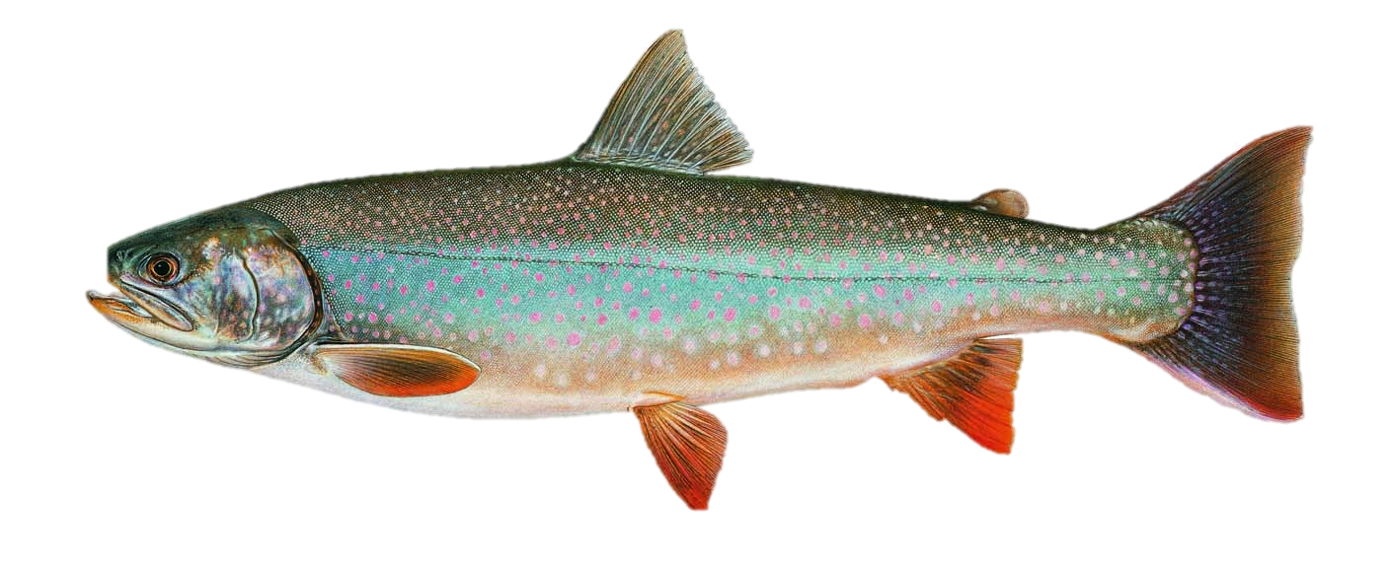
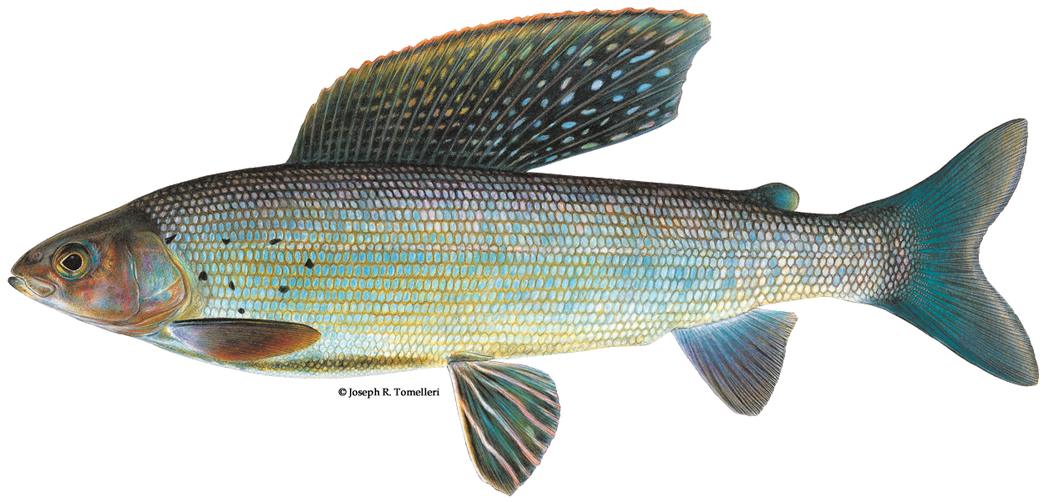
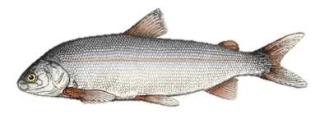
What’s Left
This Project:
Find more resolute DEM for discharge
Identify stream outlets with potential for nutrient loading
Future Endeavors:
Add catch data from summer sampling
Try and develop model using GIS to predict where fish might move to (Joy & Death 2004)
Dolly Varden
Broad Whitefish
Arctic Grayling

Slide 11
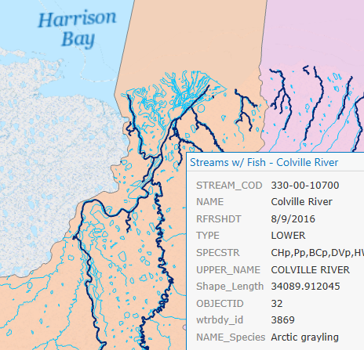
Story map?

Slide 12
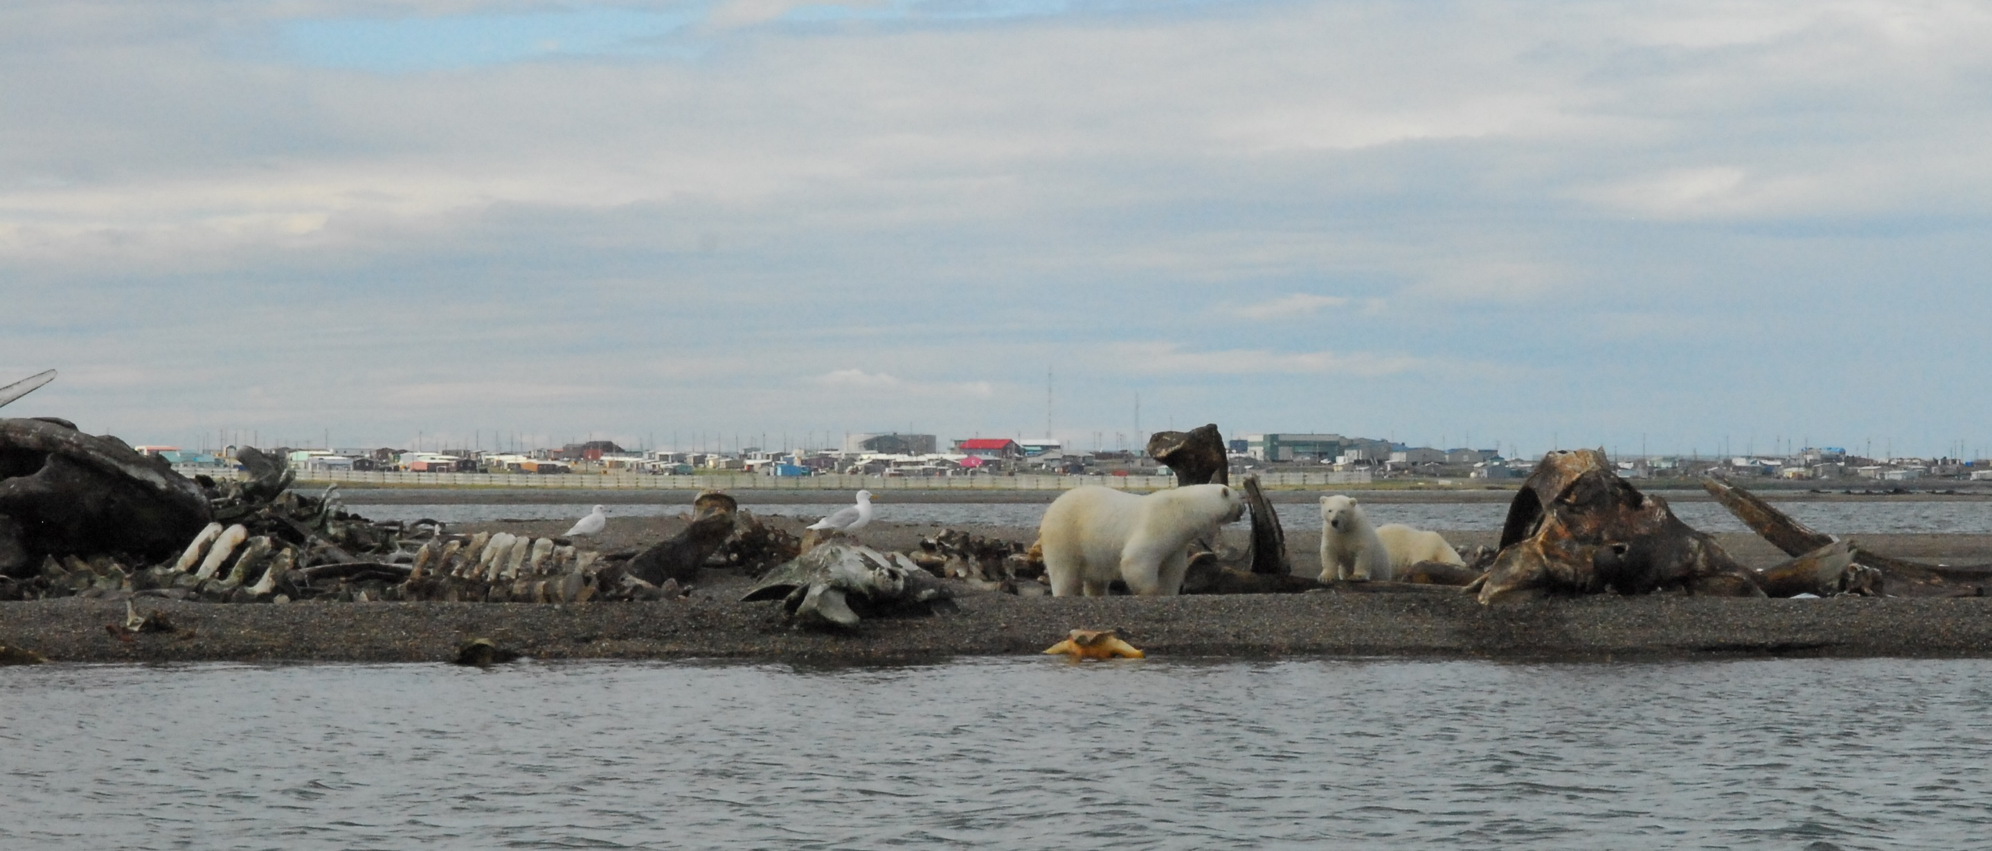
Questions?

