Slide 1
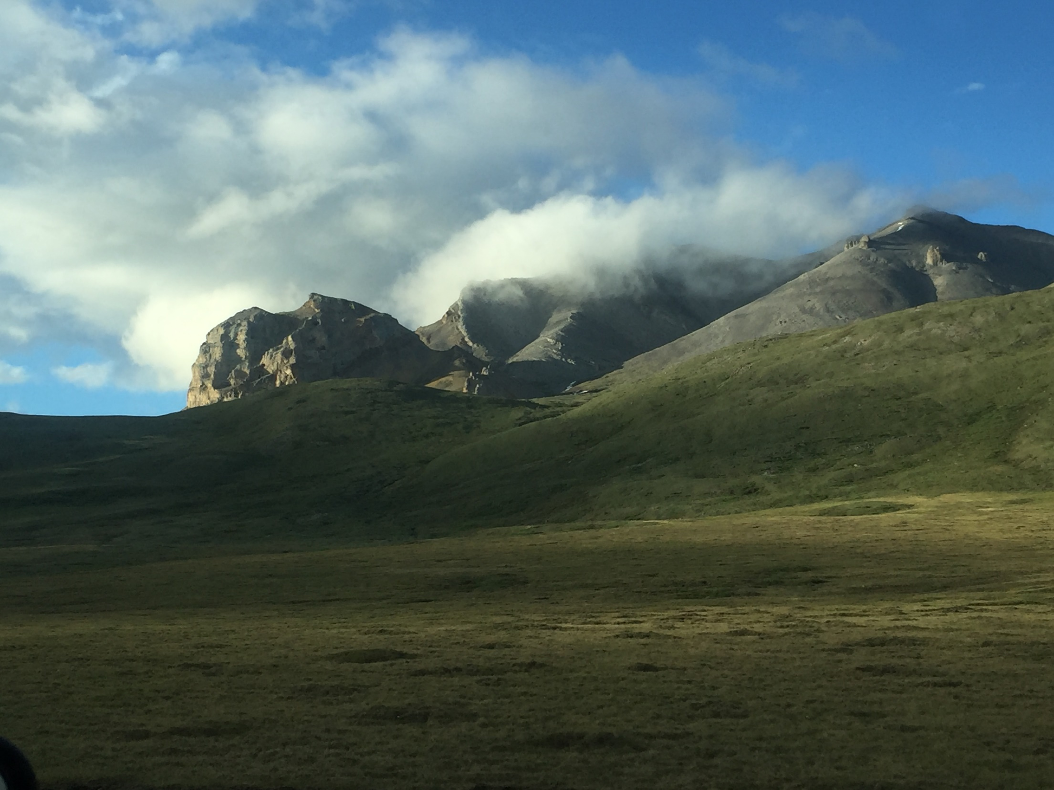
Determining Subsurface Discharge to Streams in an Arctic Basin
Kindra Nicholaides
Jackson School of Geosciences

Slide 2
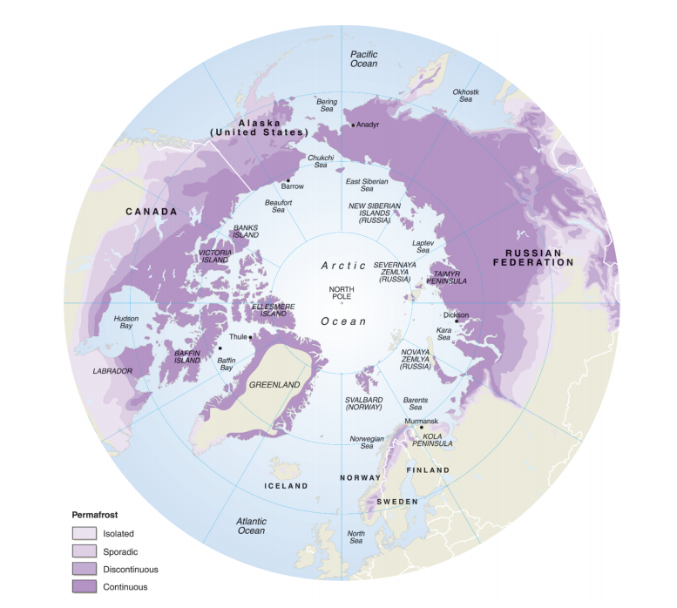
Climate Change
Arctic Permafrost Map:
16% of landmass
~50% of world’s soil organic carbon
Keeling Curve
Brown et al. 1998

Slide 3
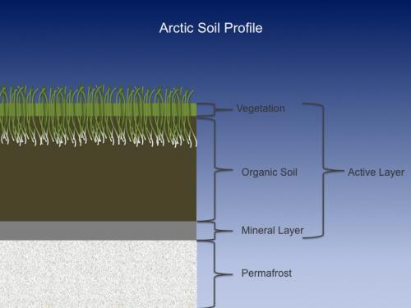
Active Layer
Shallow groundwater aquifer
Thaws in the summer, freezes in the winter
Objective
Use ArcGIS to determine flow rate through the active layer and determine discharge into surface water.
www.polartrec.com

Slide 4
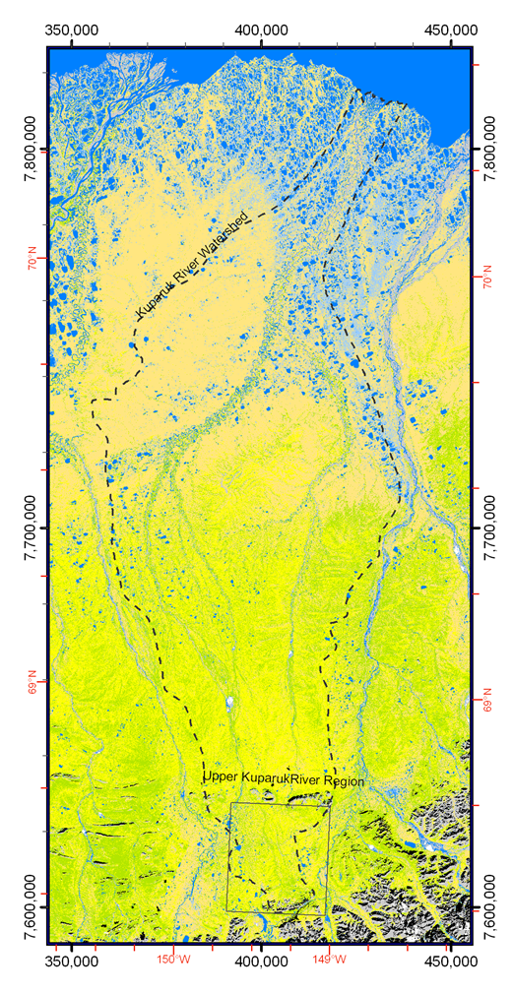
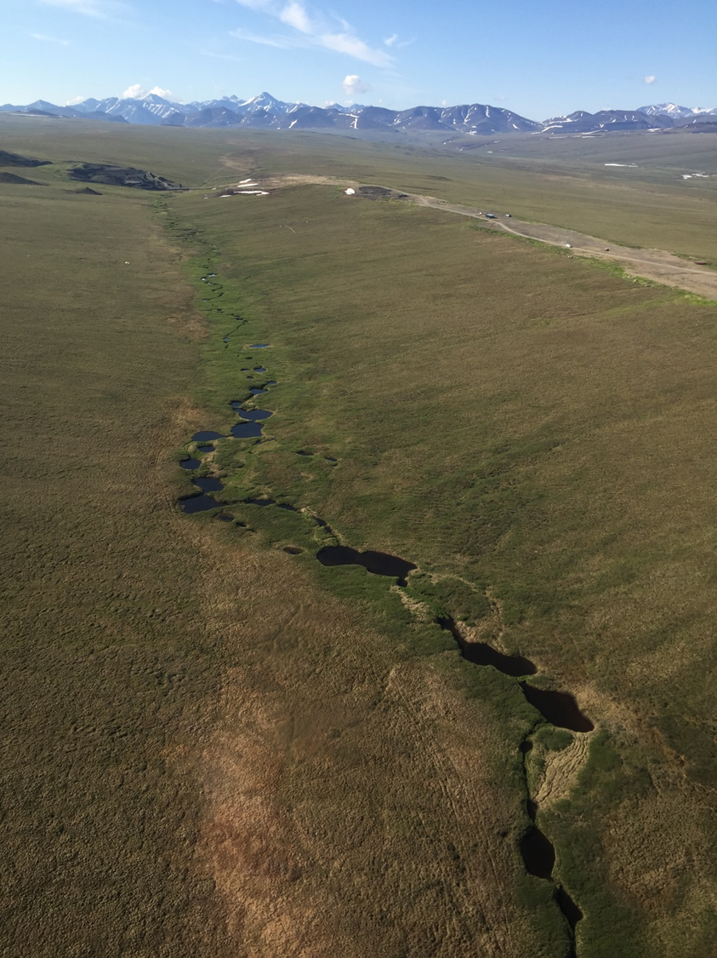
Study Site: Imnavait Creek, North Slope of Alaska 68.616°N, 149.318°W
11 August 2015
80 piezometers installed on hillslope normal to stream
Measurements:
Depth to ice table
Depth to water table
GPS coordinates of wells
Distance to Stream
Cores extracted and soil taken to lab to find:
Hydraulic conductivity
Porosity
Wetting/drying curves
www.ArcticAtlas.org
LTER site

Slide 5
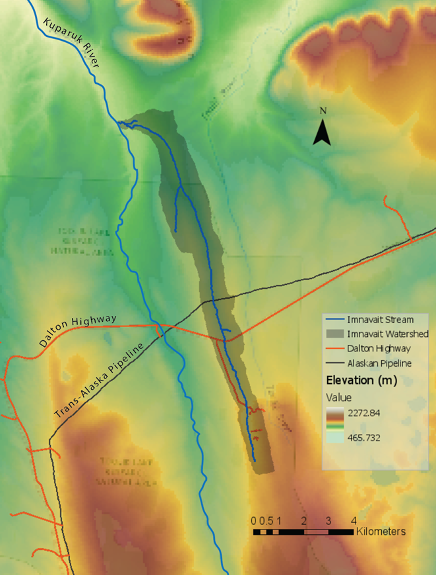
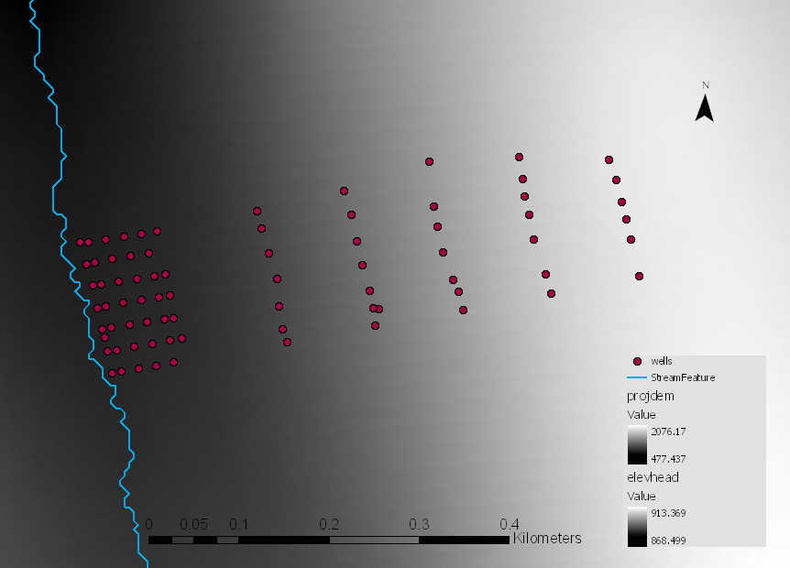
DEM processing
5m resolution DEM from Polar Geospatial Center at University of Michigan
Imported XY data for wells
Delineated watershed and stream

Slide 6
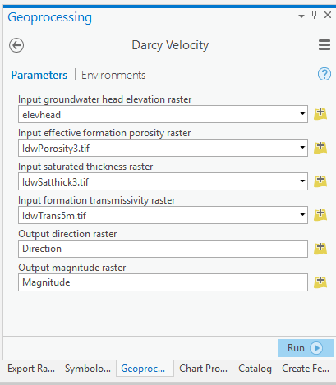
Darcy Velocity tool
Based on Darcy’s Law:
$q=\frac{Q}{A}=−K ∇h$
K= hydraulic conductivity
h = hydraulic head
Q = discharge
A = cross sectional area
Seepage velocity :
$v=\frac{q}{n}=\frac{−T∇h}{bn}$
T = transmissivity
b = saturated thickness
n = porosity

Slide 7
Interpolation
Porosity
Transmissivity
Saturated Thickness
Inverse distance weighting to create hillslope rasters:
Porosity
Transmissivity
Saturated Thickness
DEM - Depth to water Raster = Hydraulic head

Slide 8
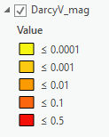
Result of Darcy tool and some Raster Calculations
Output of Darcy Velocity
( $v=\frac{Q}{An}=\frac{−T∇h}{bn}$ )
X
Porosity
X
Area
=
Discharge, Q (cm3/day)
Zonal Statistics:
Sum all cells where stream intersects
Final Answer = 1325 cm3/day

Slide 9
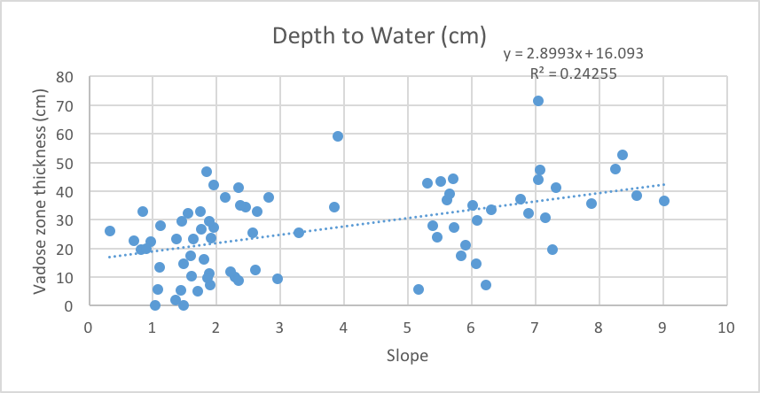
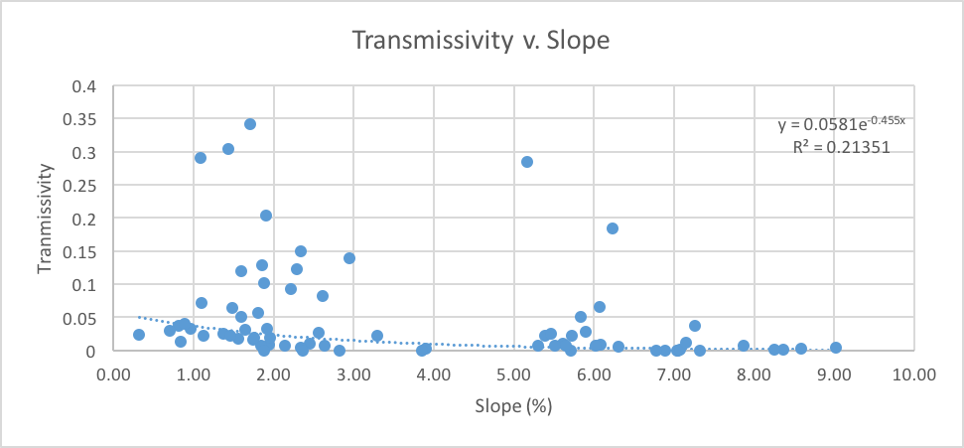
Next Steps
Upscale to entire Imnavait Basin
Interpolate values based on slope raster
Compare to Hydrograph to see if discharge is reasonable

Slide 10
Questions?

