Slide 1
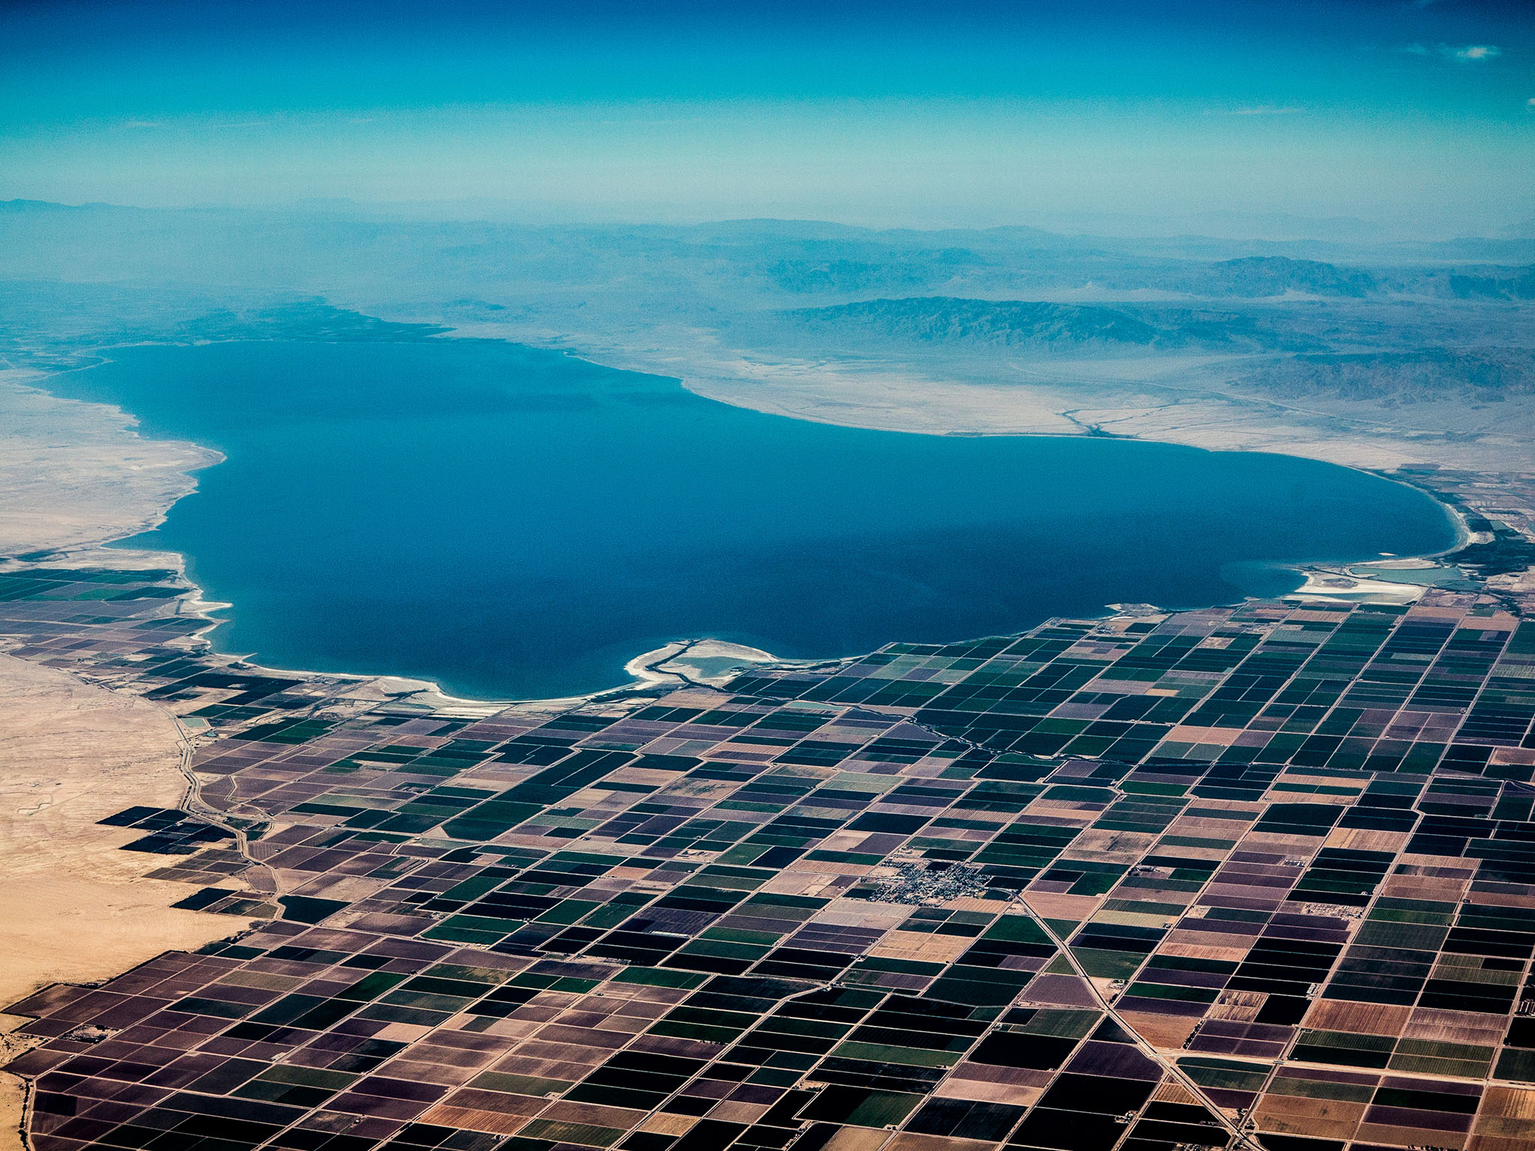
The Shrinking Salton Sea
Madison Rasmus
GIS in Water Resources
November 28, 2017

Slide 2
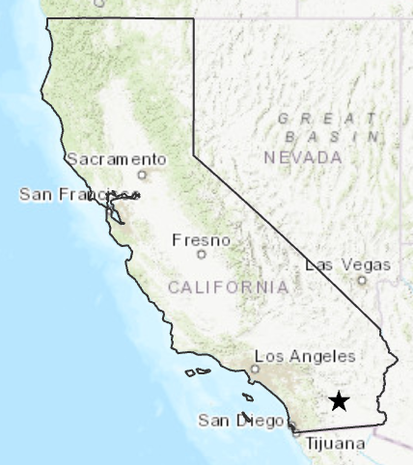
Background
Location: lowest portion of the desert valley in Imperial and Riverside Counties (Salton Basin)
Salton Sea as we know today was formed in 1905 via a Colorado River canal breach
  18 months of continual flooding between 1905-1907
California’s largest lake
  Surface area: 343 mi²
  110 miles of shoreline
  Average depth: 29 feet

Slide 3
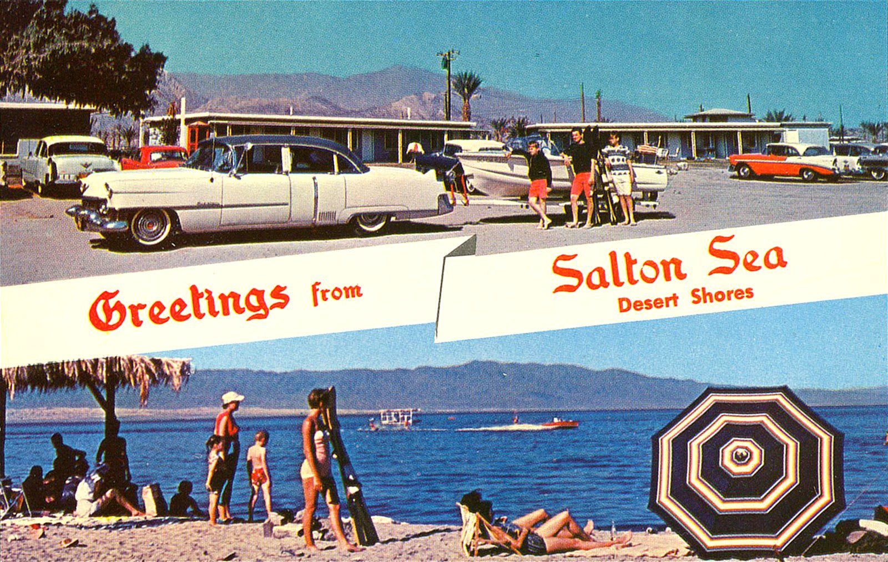
History
The Salton Basin formed in prehistoric times via mountain uplift and sediment transport from the Colorado River
It was assumed the Salton Sea would dry up as it had done in the past but a consistent supply of agricultural runoff from kept the sea at a consistent size
  Designated as an official farm drainage reservoir in 1924 by the Federal Government
Thrived as a prominent fishery and vacation spot up until the 1980s
  Fish supplied by the US Fish & Wildlife Department
  California’s most visited State Park up until the mid 1980s

Slide 4
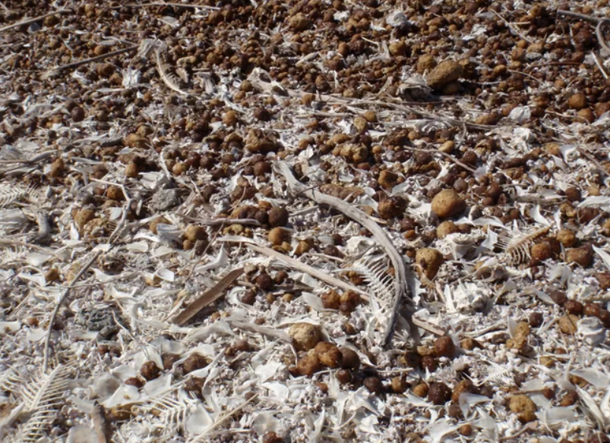
Current Environmental Concerns
Rising salinity
  Currently estimated to be 50 times saltier than the Pacific Ocean
  Salton Sea fed by agricultural runoff with incredibly high levels of salt, pesticides, selenium and other harmful chemicals
  Attempts to regulate inflow quality have been largely unsuccessful
Reduced inflows
  Inflows ≠ evaporative losses
  Sea is shrinking and exposing toxic lake bed
Ecosystem disruptions
Source: LiveScience

Slide 5
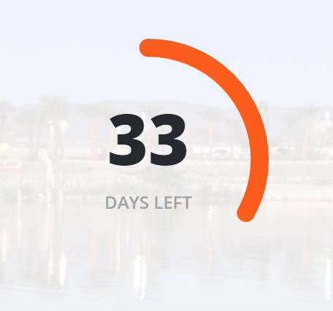
Quantification Settlement Agreement (QSA)
Established in 2003 between the Imperial Irrigation District, San Diego County Water Authority, and Metropolitan Water District
Transfers more water Colorado River water to San Diego, Orange, and Los Angeles Counties to accommodate rising municipal demand
Farmers in the Imperial Valley have financial incentives to reduce agricultural water use
Imperial Irrigation District required to provide makeup water to the Salton Sea until the end of this year
Source: Salton Sea Authority

Slide 6
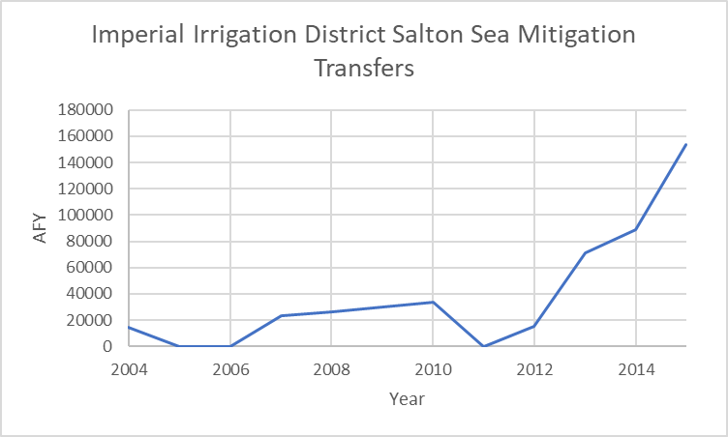
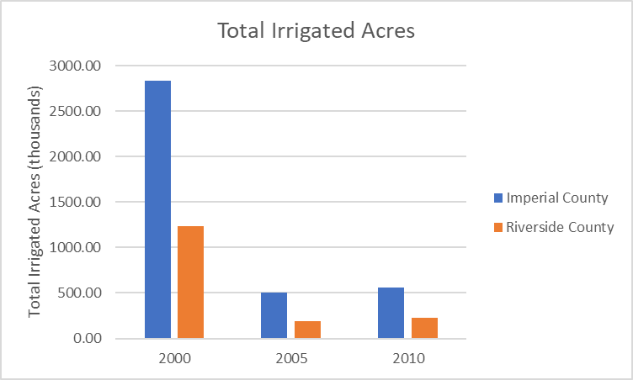
QSA Data
Source: Imperial Irrigation District
Source: USGS

Slide 7
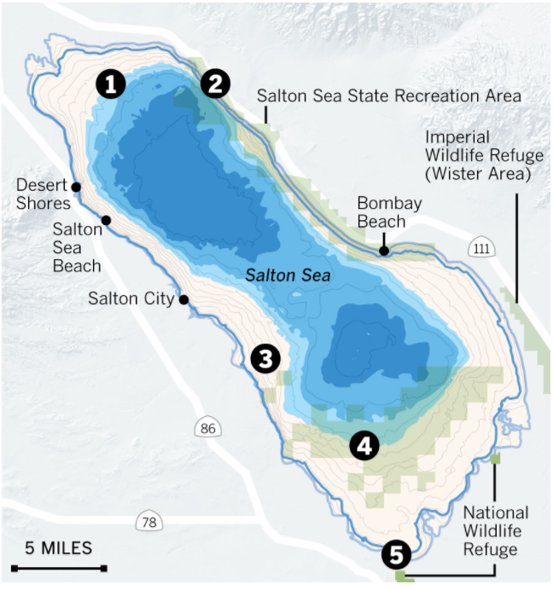
Salton Sea, 2033
Source: LA Times

Slide 8
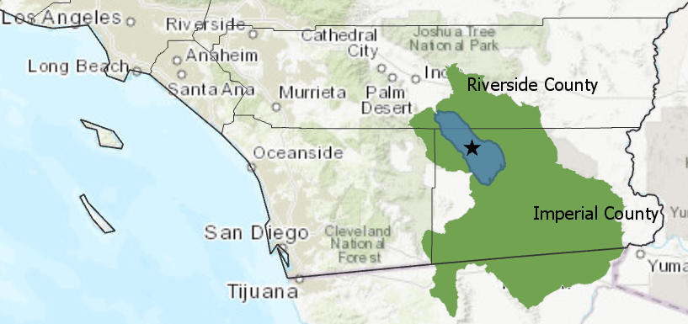
GIS Analysis
HUC8 Watershed generated with NHDPlus dataset
Over 5000 mi² extending primarily into Riverside and Imperial County

Slide 9
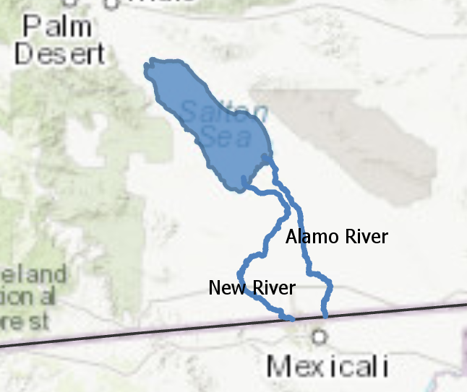
GIS Analysis
Flowlines generated NHDPlus dataset
New River and Alamo River – main sources of agricultural inflow to the Sea

Slide 10
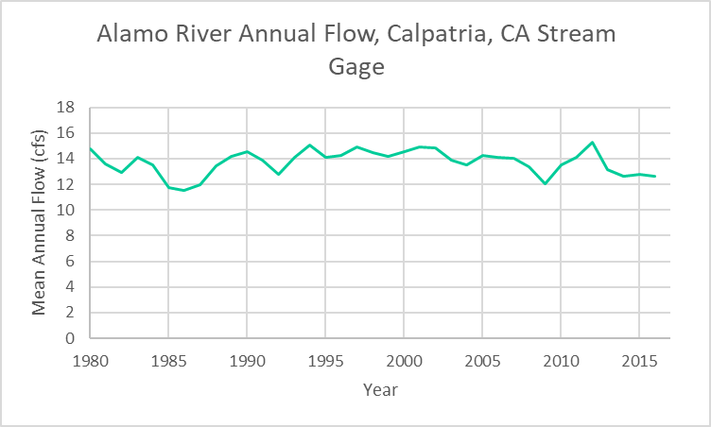
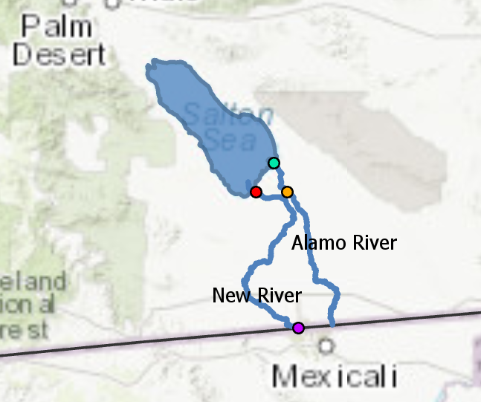
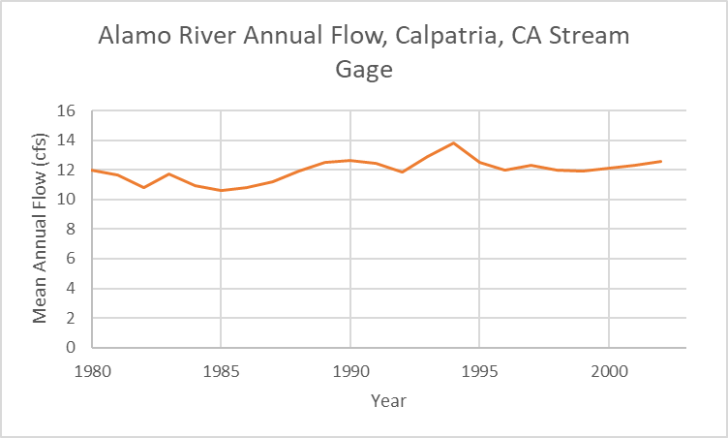
USGS Stream Gauge Data

Slide 11
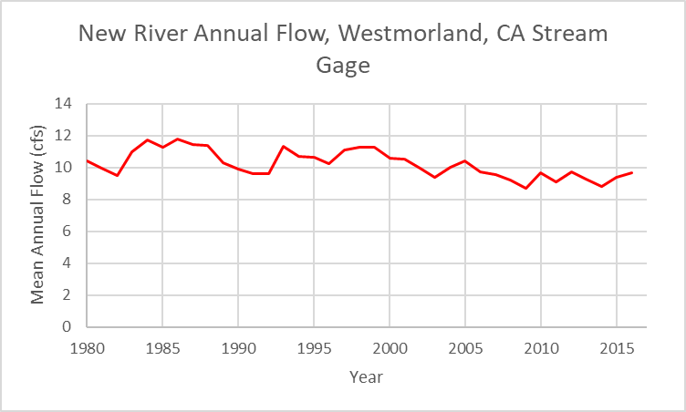
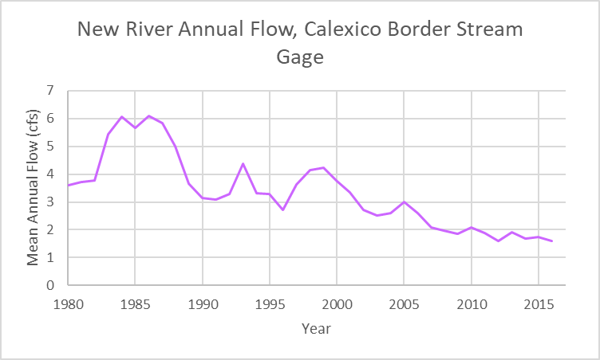
USGS Stream Gauge Data

Slide 12
Next Steps
Extrapolate effects on the Salton Sea after IID makeup water stops at the end of this year
Look into current municipal uses in San Diego, Orange, and LA Counties

Slide 13
References
Salton Sea Authority
  http://saltonseaauthority.org
USGS Stream Data
  https://waterdata.usgs.gov/nwis/rt
USGS Water Use Data
  https://water.usgs.gov/watuse/data/index.html
Imperial Irrigation District QSA Annual Reports
  http://www.iid.com/water/library/qsa-water-transfer/qsa-annual-reports

Slide 14
Questions?

