Slide 1
HOW TO AVOID GETTING TRAPPED IN YOUR CAR DURING A FLOOD:
Virginia Beach edition
Presented by: Raj Shah
GIS in Water Resources Fall 2017

Slide 2
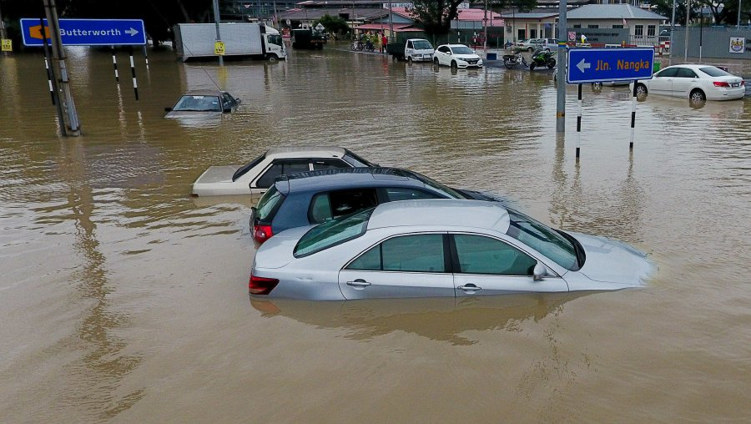

Slide 3
Virginia Beach
Largest population of any VA City: 452,745 (2015)
Year-round tourist attraction
While hurricanes and tropical storms more frequently hit Florida, Gulf Coast, etc., upper Atlantic coast still vulnerable- Hurricane Sandy
Relatively auto-dependent
  Light Rail to Norfolk and Rapid Bus Routes but only 2%
  of the population uses public transit to commute

Slide 4
Goals
Observe spatial extent identified in VB’s Disaster Plan/Emergency Management
Perform “Reverse Suitability Analysis” in ArcGIS Pro to identify vulnerable areas using additional variables
Compare and contrast results with Disaster Plan
End-Product: Identification of areas/roads to implement measures like
permeable pavement, bioretention curb extensions, sidewalk planters

Slide 5
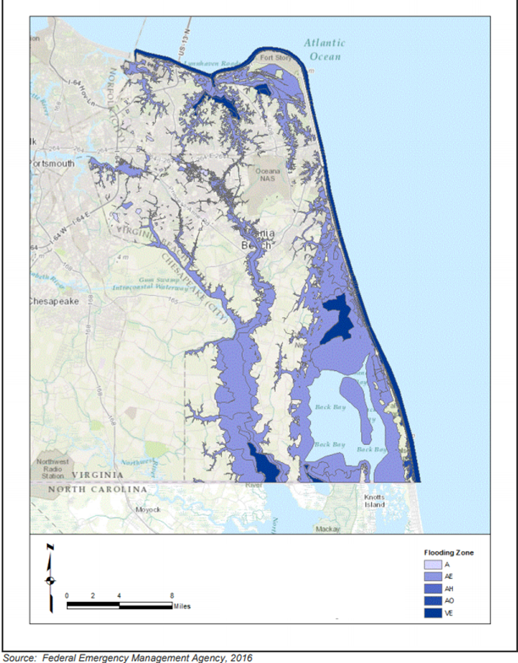
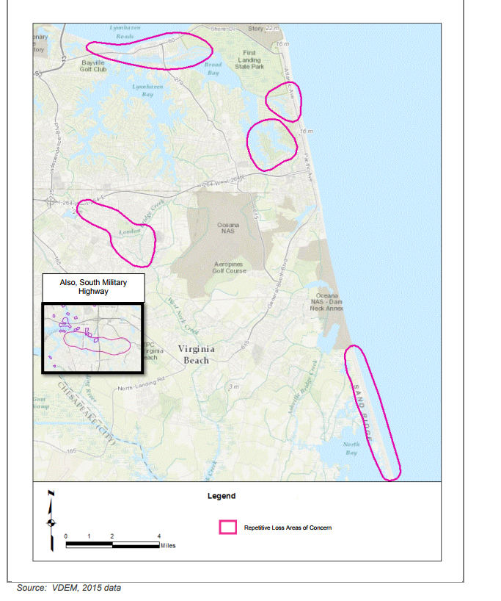
Hampton Roads Region Disaster Planning

Slide 6
Methods
Chose 100-year Floodplain, Arterial Roads with high Annual Average Daily Traffic measures, high population density areas, elevation (DEM, converted to slope) as variables
Used Euclidean distance to place 500ft buffers and convert variables to raster data → reclassify function for rankings → raster calculator with variables weighted → reclassify function → raster to polygon → select by attributes where gridcode was lowest (1,2) for most vulnerable areas

Slide 8
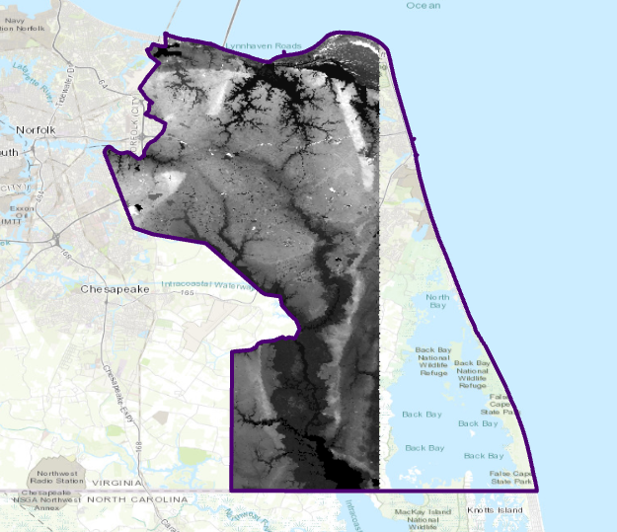
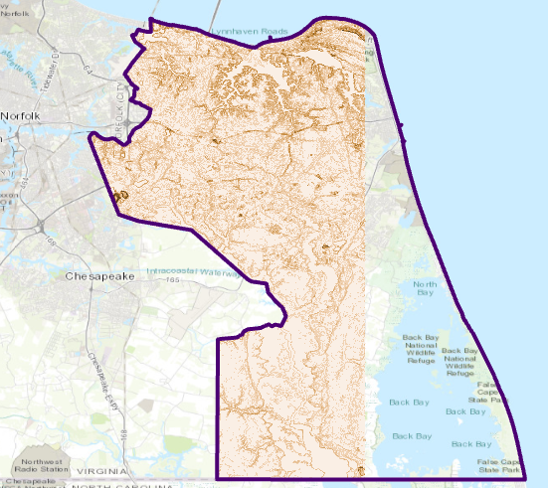
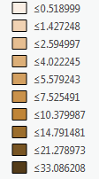

Slide 9
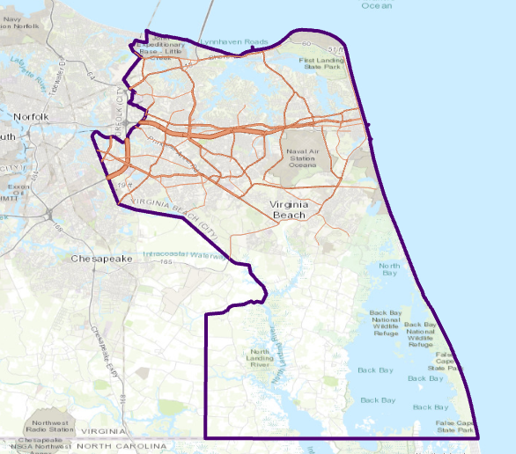
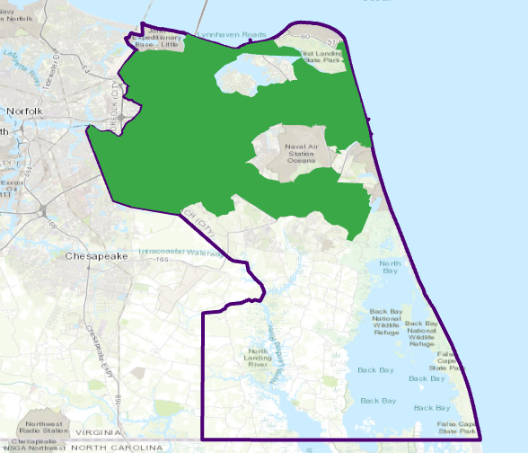

Slide 10
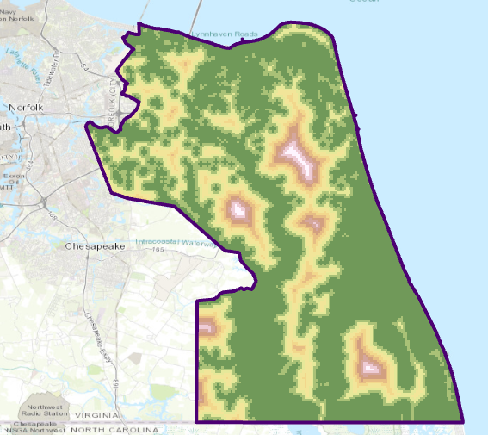
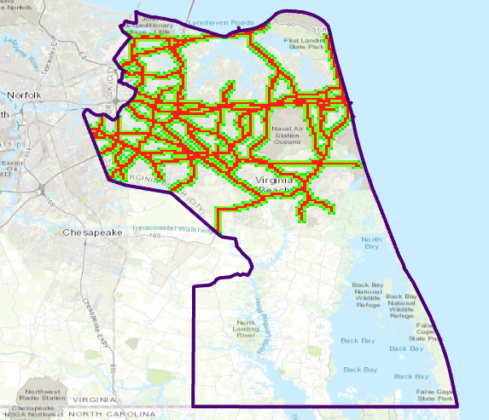
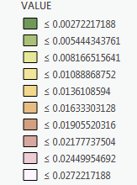
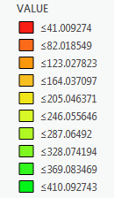

Slide 11
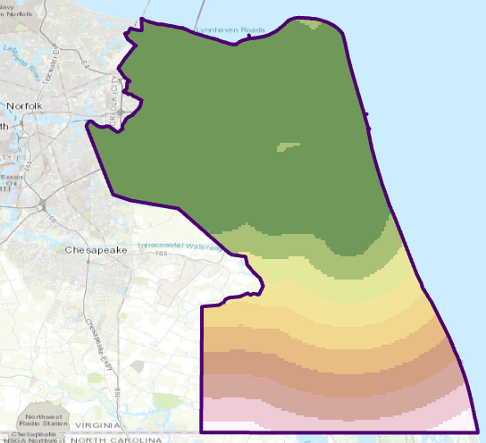
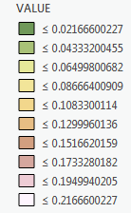

Slide 12
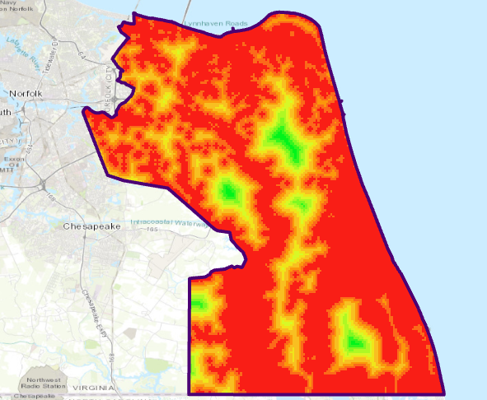
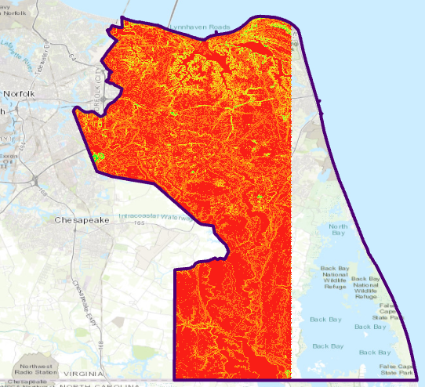



Slide 13
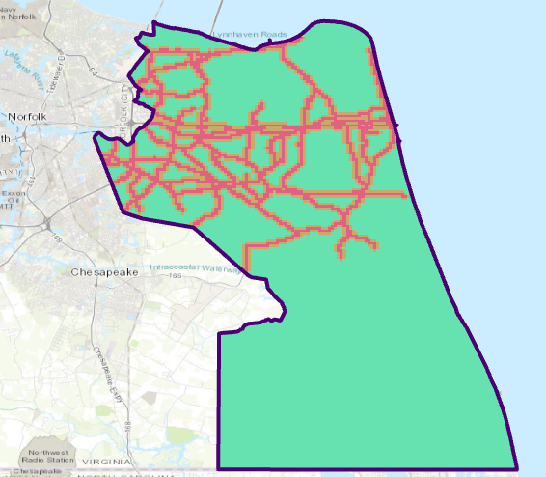
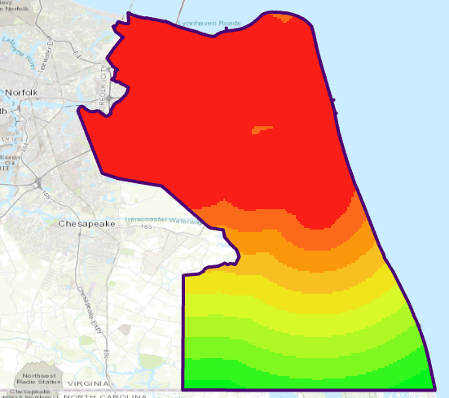



Slide 14
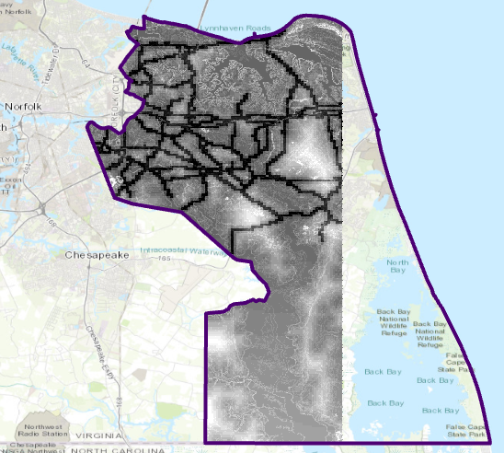
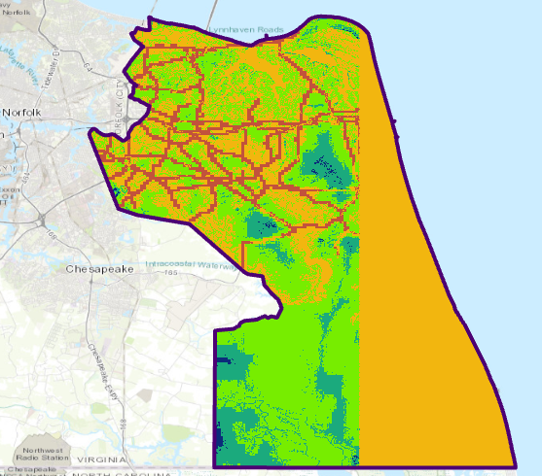



Slide 15
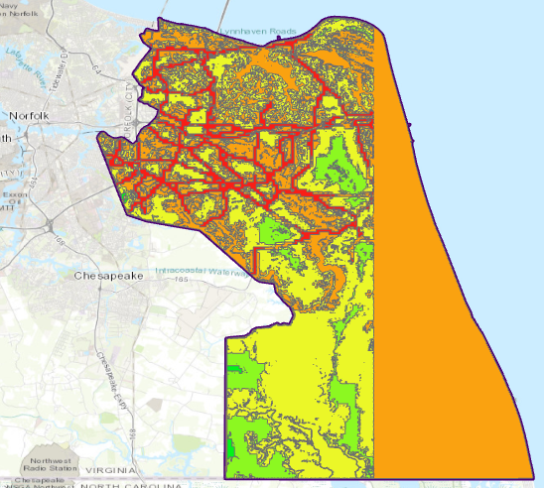
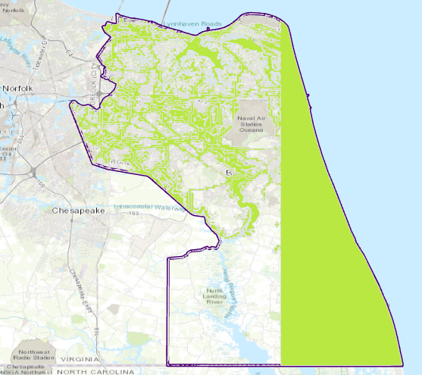



Slide 16
Comparison
Overlaps with floodplain except for areas of higher elevation and roads
Major Roads: I-64, I-264, VA-165, VA-225, US-135, General Booth Blvd, Indian River Road, Independence Blvd, Virginia Beach Road
While floodplain is present in SE part of the city, roads have less daily traffic and population density per sq. mi. in each tract is low

Slide 17
Limitations/Room for improvement
Vertical heterogeneity- could not find stream data without null values for City of VB
DEM doesn’t cover the coastline- use contours instead?
Could not use uniform cell size for Euclidean distance function
Moving forward, might also be useful to intersect vulnerable areas with public transit infrastructure- BRT/LRT/regular bus lines

Slide 18
Questions/comments/alternative data source suggestions?
https://www.vbgov.com/government/departments/emergency-management/Documents/4-%20Hazard%20Identification%20and%20Analysis.pdf
https://www.vbgov.com/government/departments/emergency-management/Documents/5-%20Vulnerability%20Assessment.pdf
https://www.epa.gov/sites/production/files/2015-10/documents/gi_munichandbook_green_streets_0.pdf

